Slide 1
Internet of Things
LPWAN: Low Power Wide Area Network

Slide 2
Main Categories of Low Power Networks
Short-range low power networks
Long-range low power networks
Former (also called last 100 meters of connectivity) represent a large fraction of the potential number of things, e.g. 6LoWPAN, RFID) NFC) and BLE)
  6LoWPAN is a key part of the IoT
Later (called as low-power wide area networks (LPWAN)) are designed and used for long-range communications at low-power consumption and low data rate e.g. SigFox, long-range wide area network (LoRaWAN), narrow-band IoT (NB-IoT)
Both 6LoWPAN and LPWAN play a crucial role in the IoT world where each network type has its unique characteristics and applications.

Slide 3
LoRa [Long Range]
LoRa is short form for Long Range
LoRa is a radio frequency-based communication protocol
  used to transfer data over large distances (to be specific over hundreds of kilometers) by consuming very little power.
Low power and Long Range: These two properties make LoRa special
It uses license-free radio frequency bands like 433 MHz, 868 MHz, 915 MHz, and 923 MHz based on the location where we are using it.

Slide 4
LoRa [Long Range]
A lot of LoRa modules can be used to transmit and receive data using LoRa
They can work in either point-to-point mode or in the broadcast mode as well
  But the data will only remain within those LoRa nodes and the network consisting of those nodes.
If we want to get data somewhere outside of the network, we can't do that by just using LoRa alone.
That's where we need LoRaWAN.
In LoRaWAN we connect the LoRa technology with any other technology such as Wi-Fi, etc through a Gateway.
This enhances the capability of LoRa in loT.

Slide 5
LoRa: Advantages
Long Range: LoRa devices can transmit signals over distances from 1km — 10km.
Low Power: LoRa end nodes wake up only at a fixed time, which can extend battery life. End node batteries can last for 5-10 years.
Security:
  Data encryption using AES128 between end nodes and network servers/
  Data encryption using AES128 at the application level.
Low Cost: Work in free frequencies and no upfront licensing cost to use the technology.
Easy Deployment: Simple network architecture and easy to deploy.

Slide 6
LoRa: Disadvantages
Not for large data transmission.
Not for continuous monitoring.
Wake up only at a fixed time, so you can’t communicate with end nodes at any time.
The transmission rate is slow and easy to get interference because of using free frequencies.

Slide 7
LoRaWAN
Whenever we need to transmit data outside a network between LoRa modules or on any device other than a LoRa module
  then we need a LoRaWAN with a LoRaWAN Gateway in it
Simply we connect our LoRa network with the Internet or any other technology by using a LoRaWAN Gateway.
LoRaWAN: a short form of LoRa based Wide Area Network.

Slide 8
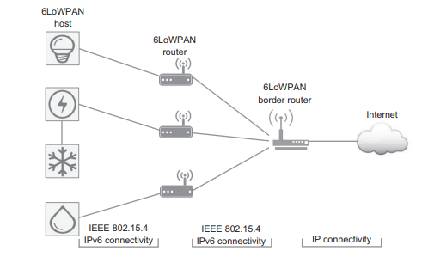
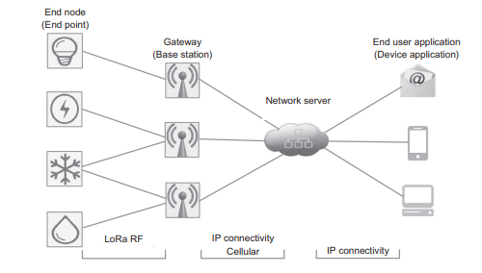
Architecture: 6LoWPAN vs LoRaWAN

Slide 9
Architecture: 6LoWPAN vs LoRaWAN
The main differences in term of network architecture
distance between end nodes and intermediate nodes
  10 –100 m [6LoWPAN]: many nodes have to be distributed to cover a small area (i.e. high node density).
  5–50 km [LoRaWAN]: a small number of base stations can cover a whole city
topology
  In 6LoWPAN networks, host node can communicate with other host nodes directly.
  LoRaWAN and SigFox, end nodes can communicate only with gateways and they cannot send packets directly to other end nodes

Slide 10
Architecture: 6LoWPAN vs LoRaWAN
The main differences in term of network architecture
Visibility
  An IP node in other networks can communicate directly with a 6LoWPAN node as it has a unique IPv6 address
  IP nodes cannot communicate with LPWAN end nodes directly.
Mobility
  6LoWPAN protocol stack does not support mobility
  LoRaWAN supports mobility

Slide 11
LoRaWAN
LoRaWAN network architecture: deployed in a star-of-stars topology
gateways relay messages between end-devices and a central network server.
The gateways are connected to the network server via standard IP connections and act as a transparent bridge,
The wireless communication takes advantage of the Long Range characteristics of the LoRa physical layer, allowing a single-hop link between end-device and one or many gateways.
All modes are capable of bi-directional communication,

Slide 12
LoRaWAN: Security
LoRaWAN specification defines two layers of cryptography:
A unique 128-bit Network Session Key shared between the end-device and network server.
A unique 128-bit Application Session Key (AppSKey) shared end-to-end at the application level.
AES algorithms are used to provide authentication and integrity of packets to the network server and end-to-end encryption to the application server.

Slide 13
LoRaWAN: Physical Layer
LoRa (physical layer): a chirp spectrum modulation technique for long-range, low data rate and low-power wireless communications
A chirp is a sinusoidal signal whose frequency increases or decreases over time.
The main features of LoRa RF are
low-cost,
low energy consumption,
secure bidirectional communications and
long range where a single gateway has a coverage of hundreds of square kilometers

Slide 14
LoRaWAN and 6LoWPAN: Physical Layer parameters
Parameter | 6LoWPAN | LoRaWAN
Frequency band | 2400–2483.5 MHz (worldwide) 902–929 MHz (North America) 868–868.6 MHz (Europe) | 902–928 MHz (North America) 863–870 MHz and 434 MHz (Europe) 779–787 MHz (China)
Max data rate | 250 kbps for 2.4 GHz band 40 kbps for 915 MHz band 20 kbps for 868.3 MHz band | 980 bps–21.9 kbps for 915 band 250–50 kbps for 868 MHz band and 780 MHz band
Transmission range | 10–100 m | 5–15 km
Battery life time | 1-2 years | Less than 0 years

Slide 15
LoRaWAN: MACs Layer
LoRaWAN is the MAC protocol for LoRa nodes and it is an open standard maintained by LoRa Alliance.
LoRaWAN MAC protocol uses a simple ALOHA protocol as a channel access mechanism
LoRaWAN offers fully bidirectional symmetrical and secure links between end nodes and gateways.
LoRaWAN defines three types of devices: Class A, Class B and Class C
LoRaWAN MAC protocol supports a payload ranging from 19 bytes to 250 bytes with protocol overhead ranging from 12 bytes to 28 bytes depending on regional specifications

Slide 16
LoRaWAN: Upper layers
As yet, LoRaWAN network does not support IPv6
  Thus It does not have an adaptation layer as in 6LoWPAN architectures.
  The constraints of LPWAN networks are more demanding than 6LoWPAN networks (e.g. very low payload length and very low data rate)
However, working is in process for LoRaWAN IPv6 adaption layer specification (by LoRa Alliance*)
  TS010-1.0.0 is latest specification document
*https://lora-alliance.org/

Slide 17
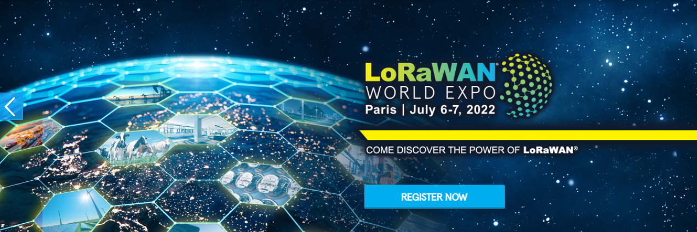
LoRa Alliance
It is an open, non-profit association with the mission to support and promote the global adoption of the LoRaWAN standard
  the leading LPWAN.
*https://lora-alliance.org/

Slide 18
LoRaWAN IPv6 adaption layer specification
How to use Static Context and Header Compression (SCHC), defined in [RFC8724, RFC9011],
  as an adaptation layer to enable LoRaWAN end-devices to use IPv6-based stacks over LoRaWAN.
Worst-case LoRaWAN application payload sizes are too small to transport IPv6 headers, let alone additional upper layer headers or application payload.
Furthermore, LoRaWAN does not natively provide fragmentation and reassembly.
An adaptation layer is therefore required to enable IPv6-based applications over a LoRaWAN Layer 2 medium

Slide 19
LoRaWAN IPv6 adaption layer specification
SCHC provides header compression and decompression as well as optional fragmentation and reassembly between the application layer of an end-device and its corresponding application northbound of the Application Server.
SCHC was designed to be efficient over mediums with Maximum Transmission Units (MTU) on the order of 10s-100s of bytes and is able to cope with widely asymmetric, or even unidirectional, connectivity.
Using a SCHC adaptation layer, a LoRaWAN link can deliver the 1280-byte MTU required by IPv6 and therefore can transport IPv6 and upper layer headers and payloads.

Slide 20
LoRaWAN IPv6 adaption layer specification
How to use Static Context and Header Compression (SCHC), defined in [RFC8724, RFC9011],
  as an adaptation layer to enable LoRaWAN end-devices to use IPv6-based stacks over LoRaWAN.
Worst-case LoRaWAN application payload sizes are too small to transport IPv6 headers, let alone additional upper layer headers or application payload.
Furthermore, LoRaWAN does not natively provide fragmentation and reassembly.
An adaptation layer is therefore required to enable IPv6-based applications over a LoRaWAN Layer 2 medium

Slide 21
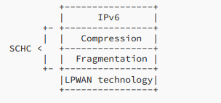
SCHC as an adaption layer for IPv6 over LoRaWAN
SCHC can be characterized as an adaptation layer between an upper layer (i.e., IPv6) and an underlying layer (i.e, an LPWAN technology).
SCHC comprises two sublayers
  the Compression sublayer and
  the Fragmentation sublayer

Slide 22
SCHC as an adaption layer for IPv6 over LoRaWAN
Before an upper layer packet (e.g., an IPv6 packet) is transmitted to the underlying layer,
  header compression is first attempted.
The resulting packet is called a "SCHC Packet", whether or not any compression is performed.
The optional SCHC fragmentation be applied to the SCHC Packet (If needed by the underlying layer).
The inverse operations take place at the receiver.

Slide 23
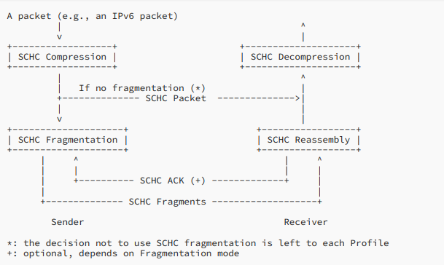
SCHC operation

Slide 24
LoRaWAN: Device Classes
Class A device is allowed to transmit at any time, randomly selecting a communication channel.
Class B devices implement all the functionalities of Class A devices but also schedule periodic listen windows.
Class C devices implement all the functionalities of Class A devices but keep their receiver open whenever they are not transmitting.

