Slide 1




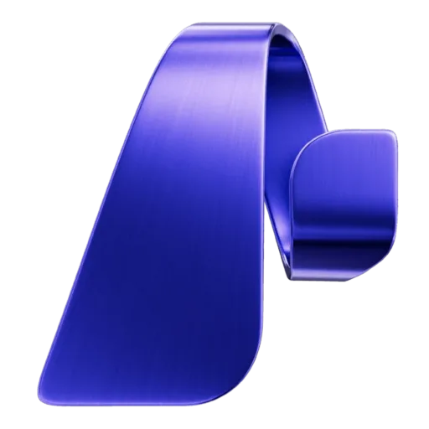

MICROSOFT & CCI INNOVATION CHALLENGE FOR VIRGINIA
SCuBA Compliance Copilot
Turning CISA's SCuBA baselines and ScubaGear assessments into validated OSCAL:
with an AI layer that cannot invent a compliance fact.
8
100%
26
OSCAL documents
Eval accuracy
False findings eliminated
Contributors: Saleha Muzammil (UVA), Mughees Ur Rehman (Virginia Tech)
Notes:
Opening. We took the SCuBA/OSCAL challenge. Three numbers to remember: eight validated OSCAL documents, 100% eval accuracy, and 26 false findings that existing approaches produce and we eliminate.

Slide 2
THE PROBLEM
Compliance stops where the scanner ends
CISA's ScubaGear grades Microsoft 365 tenants against SCuBA baselines, but outputs human-readable reports: not machine-readable compliance evidence.
So everything downstream is still done by hand:
• System Security Plans: written in Word
CISA Binding Operational Directive
These baselines are not optional best practice.
They are legally mandatory for federal civilian agencies and the de facto standard for universities, school divisions, and local governments running the same Microsoft 365 estate.
• Plans of Action & Milestones: tracked in spreadsheets
• NIST 800-53 Mappings: assembled by hand for ATO packages
• Auditor Inquiries: answered by manually re-reading reports
An organisation without a dedicated GRC team needs weeks to get from “we ran the scanner” to “we have an auditable package.”
Notes:
The gap is not detection — CISA solved that. The gap is everything after detection. And BOD 25-01 makes it mandatory, so this work is not optional.

Slide 3
OUR GOAL
From “we ran the scanner” to an auditable package
Take any Virginia public body from a ScubaGear run to a validated, auditor-ready OSCAL package in minutes, not weeks.
Every compliance fact traceable to CISA's or VITA's own published data
AI that explains, prioritises and answers questions, but can never invent a fact
Three success criteria we set before writing code
All eight OSCAL models, including the three CISA left TODO, passing NIST validation.
Complete
Every NIST 800-53 mapping matches CISA's own crosswalk, proven by a CI test, never guessed by a model.
Faithful
Agents read only validated documents through tools; every claim cites the exact node it came from.
Grounded
Notes:
Our goal was not another scanner. It was to close the gap after detection: take any Virginia public body from a ScubaGear run to an auditor-ready package in minutes. We set three success criteria up front: complete, faithful to CISA, and grounded AI. Everything that follows is measured against them.

Slide 4
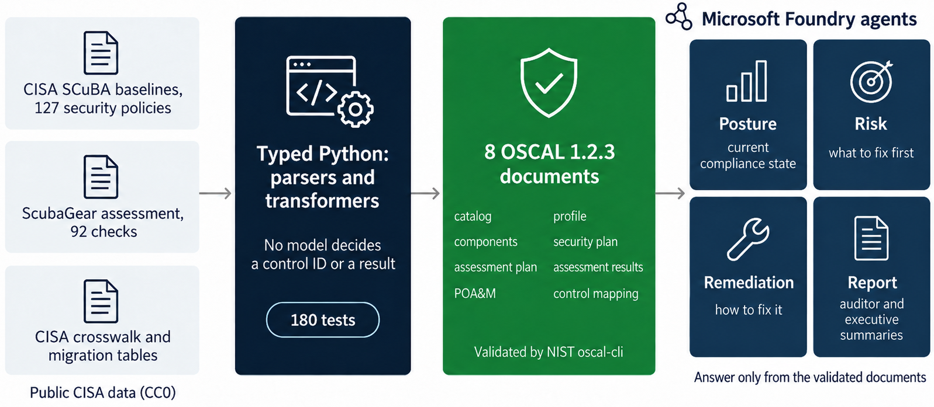
ARCHITECTURE
Deterministic core with AI on top.
How do you know the model didn't invent that number? It couldn't have. Every figure comes from a pure function over a document that passed the NIST validator, and that function has tests.
Notes:
The single most important decision: parsing and OSCAL generation are plain typed Python. AI is layered on top where judgement helps, and is structurally prevented from touching the facts.

Slide 5
RESULT #1 · PERFORMANCE
The complete OSCAL chain: eight documents, all valid
✓
catalog
127 SCuBA policies, rationale, guidance, MITRE ATT&CK
✓
profile
the controls this assessment covered
✓
component-definition
the M365 services under assessment
CISA TODO
✓
system-security-plan
the tenant and its in-scope controls
CISA TODO
✓
assessment-plan
the procedure ScubaGear performs
✓
assessment-results
92 observations · 83 findings · 26 risks
✓
plan-of-action-and-milestones
26 prioritised items with deadlines
CISA TODO
✓
mapping-collection
SCuBA → NIST 800-53, with provenance
CISA TODO = A model CISA marked unfinished in their own abandoned oscal-exploration branch. We completed all three.
8/8
Valid
NIST JSON Schema & Metaschema Validation
8/8 pass NIST JSON Schema
7/8 also pass NIST's own oscal-cli 3.2.0 with full Metaschema constraints.
Notes:
Three of these — component-definition, SSP and POA&M — are the ones CISA marked TODO. Passing JSON Schema is necessary but not sufficient; Metaschema enforces cardinality and cross-reference resolution too.

Slide 6
RESULT #2 · INNOVATION
Mappings provably faithful to CISA
CISA already publishes the authoritative SCuBA → NIST 800-53 crosswalk.
Asking a model to guess what CISA has already stated is not innovation: it is a correctness regression.
71
+18
89/92
3
direct crosswalk entries
resolved via CISA's
migration table
Deterministic: 97%
zero AI guessing
reported as unmapped:
never inferred
The CI test that proves it
Our build fails if any emitted mapping diverges from CISA's CSV
read independently of our own parser, so a parser bug cannot make the test agree with itself. It also pins a case published third-party tooling gets wrong:
MS.AAD.1.1v1 → CM-7 (least functionality) not IA-2(1) (an MFA control)
Emitted as an OSCAL 1.2 mapping-collection: where provenance, confidence-score and matching-rationale are native fields, so the distinction lives in the standard rather than a convention we invented.
Notes:
This is the difference between a tool you can audit and one you have to trust. 97% deterministic from CISA's own published data; the remaining 3 are reported as unmapped — never inferred by a model.

Slide 7
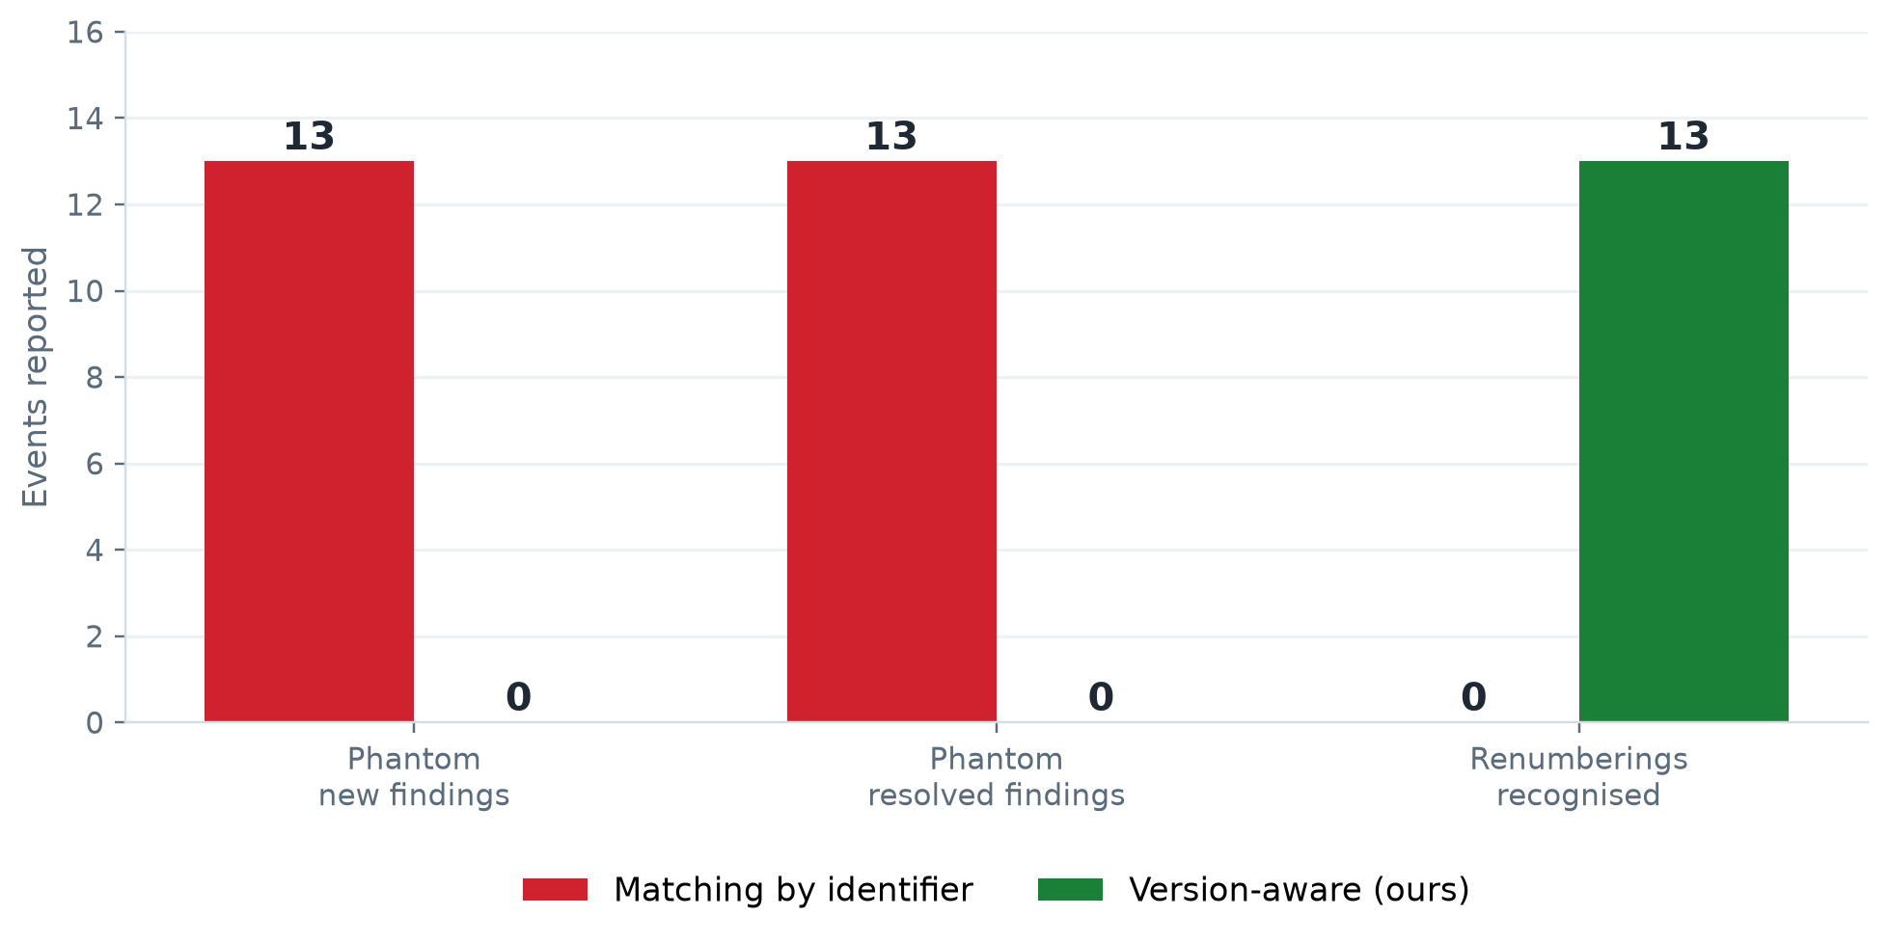
RESULT #3 · INNOVATION
Drift that survives a baseline version change
SCuBA policy IDs are versioned, and CISA revises them. B
Between two runs, MS.DEFENDER.* became MS.SECURITYSUITE.*. A tool matching on identifier reports each renumbered policy twice, once vanished, once new.
26
fabricated events from a single baseline renumbering
What actually changed
✓ 3 genuine improvements
✕ 1 genuine regression
⟳ 13 renumberings, correctly absorbed
Impact on Compliance Metrics:
This corrupts exactly the numbers a compliance report is built onhow many findings opened, how many closed, whether posture improved. CISA publishes the fix themselves: we consume it.
Notes:
This is a real technical insight, not a feature list item. Every drift tool we found compares run-to-run by ID and would get this wrong.

Slide 8
RESULT #4 · INNOVATION
Two questions the compliance number hides
find_in_page “Is the number even real?”
security “What can still happen to us?”
Policies can be omitted from the report by editing a config file, which removes them from the denominator.
CISA maps each policy to the MITRE ATT&CK techniques it mitigates. A technique is uncovered when every mapped policy is failing.
4
policies suppressed, all mandatory SHALL
6
uncovered
15
degraded
32
covered
2
exemptions expired but still active
+0.9
percentage points added to the score
Every exemption becomes an OSCAL risk an auditor can query.
Three low-severity findings are the last remaining mitigation for two techniques each.
A POA&M says what is non-compliant. Neither question can be answered from the scanner's own report.
Notes:
Two audits of the compliance number itself. Left: exemptions are the denominator nobody checks, and we make them OSCAL risks with a status. Right: ranking by attack coverage genuinely disagrees with ranking by SHALL/SHOULD.

Slide 9
BUILT FOR THE COMMONWEALTH
What a SCuBA failure means in Virginia
SCuBA is federal guidance.
Virginia public bodies every public college, university and school division are governed by SEC530, VITA's Information Security Standard, which adopts NIST 800-53 and uses its control identifiers directly.
SCuBA policy
→
CISA crosswalk
→
NIST 800-53
→
VITA SEC530
An exact join on identifiers published by CISA and VITA. No model is involved anywhere in this chain.
fact_check
grid_on
balance
23 of 26
1,189
3
failures are also
Commonwealth obligations
SEC530 controls parsed
from VITA's own spreadsheet
federal only — Virginia
withdrew the control
Where the two governments differ
Three failures map only to SC-7(10), which the Commonwealth has withdrawn — “not applicable to COV”.
They remain federal obligations and carry no SEC530 duty.
We also surface who Virginia says owns each control, from SEC530's own IMPLEMENTED BY column.
Notes:
The contest is for Virginia, and this is the slide that earns that. A Virginia institution otherwise works this out by hand, per finding, per standard.

Slide 10
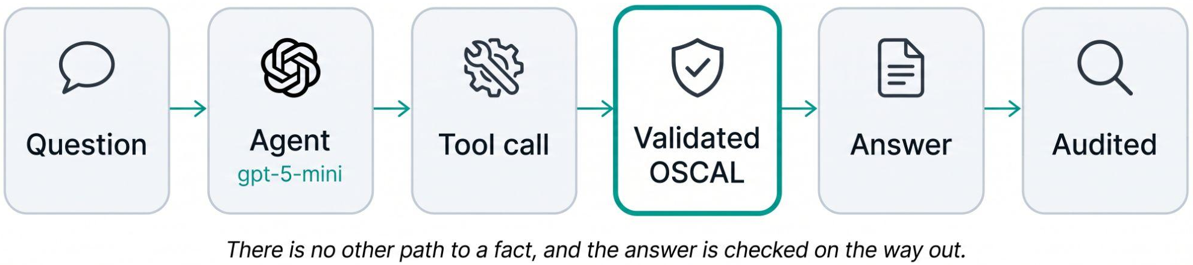
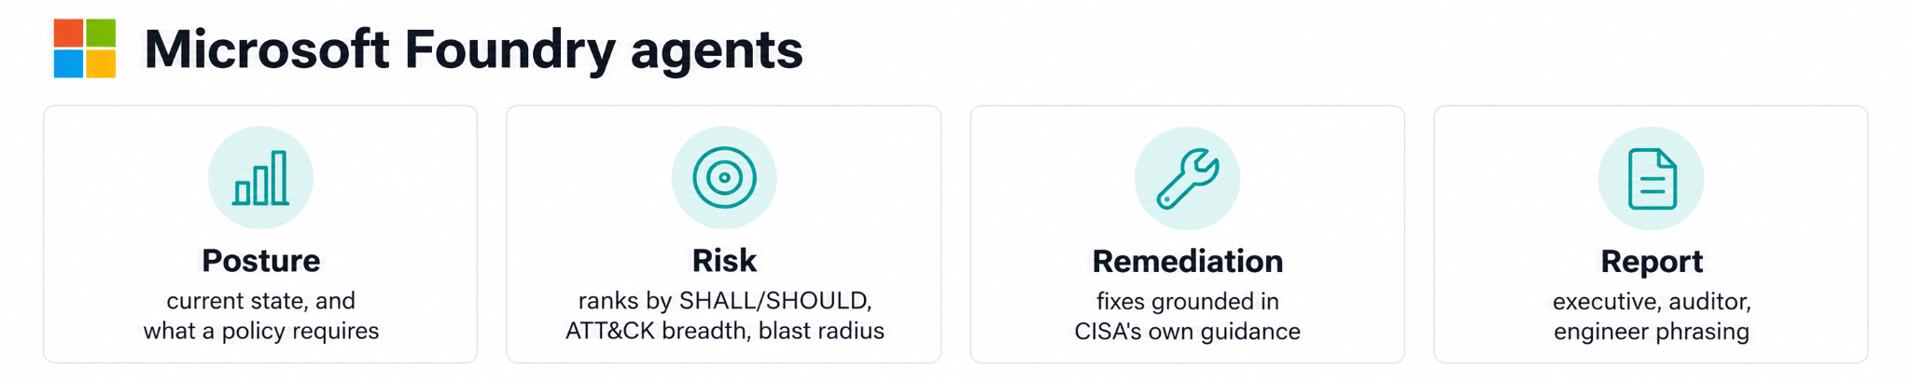
MICROSOFT FOUNDRY
An AI layer that cannot fabricate
Guardrails that are mechanisms, not promises
Every claim is checked against the evidence: policy IDs, NIST controls, ATT&CK techniques, OSCAL UUIDs
Each citation resolves to the exact node in the validated document
Unknown policy IDs return an error, never a plausible control
Uploaded scans are untrusted: instruction-like text is neutralised first
Notes:
Four specialists share one grounding rule. The guardrails are architectural: agents have no access to data, only to tools that read validated documents.

Slide 11
MEASURED, NOT ASSERTED
We tested our architecture against the obvious one
Same 15 questions, Same model, Same grader.
The only variable: one arm gets tools over validated OSCAL, the other gets the raw scanner output dumped into context.
GROUNDED
UNGROUNDED
Pass rate
100%
80%
Answers asserting facts never given to it
0
2
Security identifiers invented from memory
0
6
The pass rate is not the story. Fabrication is.
The scanner file contains no NIST control IDs and no MITRE technique IDs, those come from CISA's baselines, which we integrate.
Asked anyway, the ungrounded model did not decline.
  It asserted six identifiers from memory, and named T1110.003 “Credential Stuffing” when MITRE and CISA both say “Password Spraying”.
Our agents asserted zero facts they were not given, enforced by a test that fails the build if it ever changes.
Notes:
This is the beat that converts restraint into measured superiority. We are not claiming the model is dangerous - we are showing what the obvious implementation actually does, with the same model and the same questions.

Slide 12
ECONOMIC VALUE & SOCIETAL IMPACT
Measured, not asserted
We separate what we measured from what we assumed, and expose every assumption.
MEASURED: counted from the artifacts
ASSUMED: Adjustable by the reader
26
POA&M items with severity + deadline
20 min
to hand-author one POA&M item
91
SSP implemented-requirements
10 min
per SSP requirement
89
NIST 800-53 mappings resolved
6 min
per NIST mapping lookup
26
phantom drift findings avoided
$62.11/h
BLS Virginia analyst wage x1.3 loaded
20–69 h
$1.6k–$5.5k
$0.62
manual effort replaced
per assessment cycle
analyst time value
per assessment cycle
cost to run
per month, all Azure
Roughly a 5,000x return.
Across Virginia's 326 public institutions on the quarterly cycle SEC530 already requires: 26,000–90,000 analyst hours a year returned to actual security work.
Notes:
We give a band, not a number, and every assumption is a slider in the app. Judges do not have to accept our inputs - they can change them. The measured column needs no assumption at all.

Slide 13
FEASIBILITY
This is running today, not a prototype sketch
✓
Real data
CISA's published ScubaGear assessment: a genuine redacted run, CC0 licensed. Any tenant's own ScubaResults file runs the same parser, transformers and validator, there is no separate demo path.
✓
Real validation
NIST oscal-cli in CI. The build fails if any document stops validating.
✓
Real deployment
Microsoft Foundry project in eastus2, gpt-5-mini, keyless auth. Provisioned and answering.
✓
Reproducible
From a clean clone: Install, then two commands, generate and validate, reproduce every artifact byte-for-byte, fully offline. Every document carries the SHA-256 of each input inside its own metadata, so an artifact can be tied back to the exact scan that produced it.
!
Honest about limits
oscal-cli has no mapping command yet, so that document is JSON-Schema validated only. We report cli:n/a rather than implying more.
Notes:
Feasibility is demonstrated rather than argued. Everything on this slide can be checked from the repository in a few minutes.

Slide 14
KEY LEARNINGS
What building it taught us
1
Grounding beats prompting
Same model, same 15 questions: giving it tools over validated OSCAL took accuracy from 80% to 100% and invented identifiers from 6 to 0. Architecture did what no prompt could.
2
Look it up, don't generate it
CISA's own crosswalk resolved 89 of 92 mappings deterministically. Keeping the model for judgement, not lookup, is what made the output auditable.
3
Schema-valid isn't enough
JSON Schema checks structure only. NIST's Metaschema also enforces cardinality and cross-references, so we made oscal-cli a CI gate.
4
IDs drift, meaning doesn't
One baseline renumbering produced 26 phantom findings. Consuming CISA's migration table turned drift into something a report can trust.
5
Research before building
CISA's abandoned oscal-exploration branch showed us exactly where the gap was, and what not to rebuild.
Notes:
Five things we'd tell the next team. The big one: grounding is an architectural decision, not a prompt. Same model, same questions, and the tool-grounded version stopped fabricating entirely. And wherever an authority has already published the answer, look it up rather than generate it.

Slide 15
CISA built the scanner. We built everything after it.
A complete, validated OSCAL chain for Microsoft 365 mappings that is provably faithful to CISA’s own crosswalk, with drift that survives a baseline version change and exemptions an auditor can query.
An AI layer that cannot invent a compliance fact, with every finding for a Commonwealth institution also traced to SEC530.
8
89/92
26
100%
OSCAL documents
NIST-validated
mappings deterministic
no AI guessing
false findings
eliminated
evaluation
accuracy
GitHub: https://github.com/saleha-muzammil/microsoft-sec
Notes:
Close on the framing that makes the contribution legible: CISA built detection, we built the compliance layer that turns detection into an auditable package.

Slide 16


Thankyou
Saleha Muzammil
University of Virginia
Mughees Ur Rehman
Virginia Tech

