Slide 1

Solving Sudoku Puzzles with GA
Evolutionary algorithm course final project presentation
Saleh Afzoon
1-february-2020
Notes:
Download more minimal templates here: https://crmrkt.com/GK9Dwa

Slide 2

Paper description
Authors:
Rory Douglas
Published year:
2014
Publisher:
University of Derby

Slide 3
Paper Methodology
Paper methodology came in bellow sections:
Representation
Fitness Function
Crossover
Mutation
Parent selection and Survivor Selection

Slide 4
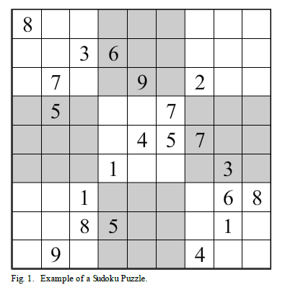

Representation
Chromosomes consist of 81 byte values. These are split into 9 sets of 9 byte values to represent 3x3 sub-grids.

Slide 5
Fitness Function
The fitness function in this algorithm simply checks whether the rows and columns have duplicates and increments a cost value for every time there is a duplicate. Squares are not checked as by design they will always be valid. Fitness will be measured between 0 and 1, with 1 being ideal fitness.

Slide 6
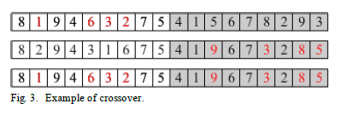
Crossover
Crossover operation has been explained vaguely as bellow:
Crossover is performed by selected a 3x3 sub grid
from either of the parent chromosomes based
on the crossover rate.

Slide 7
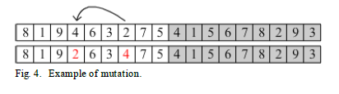
Mutation
Mutation operation also has been explained vaguely as bellow
and problem is that doesn't mentioned that mutation perform
for each block or just for one block.
Mutation is performed by swapping
two byte values within a 3x3 sub-grid.

Slide 8
Parent and survivor selection
Tournament selection as parent selection mechanism.
Elitism 80% for survivor selection

Slide 9
Paper Conclusions
The algorithm developed in this paper was able to solve simple Sudoku puzzles, however it is fairly safe to say it does not excel at solving Sudoku. Two major problems with the algorithm are :
the size of the search space
the fitness calculation.

Slide 10
Implementation
Notes:
Download more minimal templates here: https://crmrkt.com/GK9Dwa

Slide 11
Fitness Implementation
For Implement fitness function we present two way :
Count duplication of number in row and column as for occur n>1 we add n-1 to fitness of chromosome.
Or another way as beside doing the first way ,for each absent number in row or column we add 1 to fitness

Slide 12
Proof accurate of fitness
Output of algorithm for this initial chromosome.
5 | 4 | 5 | 4 | 1 | 7 | 5 | 2 | 7
9 | 5 | 2 | 1 | 9 | 4 | 7 | 3 | 4
8 | 7 | 7 | 9 | 2 | 2 | 1 | 8 | 6
8 | 2 | 9 | 7 | 8 | 4 | 2 | 6 | 5
2 | 5 | 7 | 8 | 9 | 6 | 8 | 5 | 1
5 | 4 | 7 | 2 | 2 | 9 | 3 | 7 | 8
7 | 1 | 7 | 5 | 7 | 3 | 4 | 3 | 3
6 | 3 | 5 | 5 | 6 | 7 | 2 | 8 | 1
1 | 9 | 4 | 5 | 9 | 9 | 1 | 9 | 5

Slide 13
Proof accurate of fitness in rows
5 | 4 | 5 | 4 | 1 | 7 | 5 | 2 | 7
4 duplication + 4 absence = 8
8 | 2 | 9 | 7 | 8 | 4 | 2 | 6 | 5
2 duplication + 2 absence = 4
7 | 1 | 7 | 5 | 7 | 3 | 4 | 3 | 3
4 duplication + 4 absence = 8
9 | 5 | 2 | 1 | 9 | 4 | 7 | 3 | 4
2 duplication + 2 absence = 4
fitness calculation per row
(rows are not in order in sudoku)
2 | 5 | 7 | 8 | 9 | 6 | 8 | 5 | 1
2 duplication + 2 absence = 4
6 | 3 | 5 | 5 | 6 | 7 | 2 | 8 | 1
2 duplication + absence = 4
8 | 7 | 7 | 9 | 2 | 2 | 1 | 8 | 6
3 duplication + 3 absence = 6
5 | 4 | 7 | 2 | 2 | 9 | 3 | 7 | 8
2 duplication + 2 absence = 4
1 | 9 | 4 | 5 | 9 | 9 | 1 | 9 | 5
5 duplication + 5 absence = 10

Slide 14
Proof accurate of fitness in columns
5
9
8
8
2
5
7
6
1
4
5
7
2
5
4
1
3
9
5
2
7
9
7
7
7
5
4
4
1
9
7
8
2
5
5
5
1
9
2
8
9
2
7
6
9
7
4
2
4
6
9
3
7
9
5
7
1
2
8
3
4
2
1
2
3
8
6
5
7
3
8
9
7
4
6
5
1
8
3
1
5
4
4
8
4
6
6
4
4
4
fitness calculation per column
(duplication + absence)

Slide 15
Fitness calculation
As paper mentioned fitness value must be in (0,1].
For achieving that we determine worst and best solution as boundary.
And by using expression: 1- (fitness/144) final fitness achieve.
Worst case is a puzzle with same value for every cell :
Worst Fitness = 144 -> 1-(144/144) = 0
Best case is a sudoku answer :
Best Fitness = 0 -> 1-(0/144) = 1

Slide 16
Mutation Implementation
For Implement mutation function we present two way :
Swap mutation inside each sub-grid(block) of chromosome.
Randomly choose one block of chromosome to perform swap mutation inside.

Slide 17
Mutation Implementation 1
[[8, 4, 2, 9, 1, 2, 9, 8, 7],[9, 3, 4, 1, 4, 8, 9, 3, 2], [5, 2, 1, 7, 3, 4, 8, 8, 2],
[8, 2, 9, 3, 2, 9, 5, 5, 8], [7, 8, 2, 8, 9, 6, 2, 4, 9], [9, 7, 5, 4, 1, 9, 3, 7, 8],
[6, 1, 4, 6, 3, 5, 2, 9, 4], [5, 1, 3, 7, 9, 7, 2, 9, 5], [4, 7, 7, 2, 8, 1, 6, 7, 4]] fitness: 92
block index: 2 first_index: 5 second_index: 2
[[8, 4, 2, 9, 1, 2, 9, 8, 7], [9, 3, 4, 1, 4, 8, 9, 3, 2],[5, 2, 4, 7, 3, 1, 8, 8, 2],
[8, 2, 9, 3, 2, 9, 5, 5, 8], [7, 8, 2, 8, 9, 6, 2, 4, 9], [9, 7, 5, 4, 1, 9, 3, 7, 8],
[6, 1, 4, 6, 3, 5, 2, 9, 4], [5, 1, 3, 7, 9, 7, 2, 9, 5], [4, 7, 7, 2, 8, 1, 6, 7, 4]] fitness: 92

Slide 18
Mutation Implementation 2
[[8, 4, 2, 9, 1, 2, 9, 8, 7],[9, 3, 4, 1, 4, 8, 9, 3, 2], [5, 2, 1, 7, 3, 4, 8, 8, 2],
[8, 2, 9, 3, 2, 9, 5, 5, 8], [7, 8, 2, 8, 9, 6, 2, 4, 9], [9, 7, 5, 4, 1, 9, 3, 7, 8],
[6, 1, 4, 6, 3, 5, 2, 9, 4], [5, 1, 3, 7, 9, 7, 2, 9, 5], [4, 7, 7, 2, 8, 1, 6, 7, 4]] fitness: 92
block index: 0 first_index: 0 second_index: 7 block index: 1 first_index: 8 second_index: 7 block index: 2 first_index: 0 second_index: 5
block index: 3 first_index: 5 second_index: 0 block index: 4 first_index: 2 second_index: 3 block index: 5 first_index: 2 second_index: 6
block index: 6 first_index: 2 second_index: 6 block index: 7 first_index: 4 second_index: 7 block index: 8 first_index: 2 second_index: 1
[[8, 4, 2, 9, 1, 2, 9, 8, 7], [9, 3, 4, 1, 4, 8, 9, 2, 3],[1, 2, 4, 7, 3, 5, 8, 8, 2],
[9, 2, 9, 3, 2, 8, 5, 5, 8], [7, 8, 8, 2, 9, 6, 2, 4, 9], [9, 7, 3, 4, 1, 9, 5, 7, 8],
[6, 1, 2, 6, 3, 5, 4, 9, 4], [5, 1, 3, 7, 9, 7, 2, 9, 5], [4, 7, 7, 2, 8, 1, 6, 7, 4]] fitness: 92

Slide 19
Crossover Implementation
Crossover function take two parents from population and create two children by uniform method.

Slide 20

Results
Max generation = 4000
10 times run
 | Min fit | Max fit | Mean fit | Median fit | Found
Easy #1 | 0.8125 | 0.8402777777777778 | 0.8270833333333334 | 0.8263888888888888 | no
Easy #2 | 0.8055555555555556 | 0.8194444444444444 | 0.8118055555555556 | 0.8125 | no
Easy #3 | 0.8125 | 0.8402777777777778 | 0.8243055555555557 | 0.8229166666666666 | no
Easy #4 | 0.7986111111111112 | 0.8263888888888888 | 0.8083333333333333 | 0.8055555555555556 | no
Easy #5 | 0.8055555555555556 | 0.8263888888888888 | 0.8138888888888889 | 0.8125 | no
Easy #6 | 0.7916666666666666 | 0.8333333333333334 | 0.8083333333333332 | 0.8055555555555556 | no

Slide 21
Results
Max generation = 4000
10 times run
 | Min fit | Max fit | Mean fit | Median fit | Found
Hard #1 | 0.7777777777777778 | 0.8055555555555556 | 0.7930555555555555 | 0.7916666666666666 | no
Hard #2 | 0.7638888888888888 | 0.7986111111111112 | 0.7798611111111111 | 0.7777777777777778 | no
 | Min fit | Max fit | Mean fit | Median fit | Found
Medium #1 | 0.7777777777777778 | 0.8125 | 0.7944444444444445 | 0.7916666666666666 | no
Medium #2 | 0.8055555555555556 | 0.8194444444444444 | 0.8104166666666666 | 0.8090277777777778 | no

Slide 22
Results
What about another configuration
Population Size | 500
Tournament Size | 5
Mutation Rate | 20%
Crossover Rate | 100%
Elitism | 20%
Max generation = 50
Xover = uniform
 | Min fit | Max fit | Mean fit | Median fit | Found
Easy #1 | 0.7986111111111112 | 0.8263888888888888 | 0.8076388888888889 | 0.8055555555555556 | no
Xover = orderOne
 | Min fit | Max fit | Mean fit | Median fit | Found
Easy #1 | 0.7916666666666666 | 0.8333333333333334 | 0.8090277777777777 | 0.8055555555555556 | no

Slide 23
Results
What about changing fitness function
Population Size | 500
Tournament Size | 3
Mutation Rate | 10%
Crossover Rate | 50%
Elitism | 80%
Row and column duplication
 | Min fit | Max fit | Mean fit | Median fit | Found
Easy #1 | 0.7986111111111112 | 0.8263888888888888 | 0.8083333333333333 | 0.8055555555555556 | no
Row and column and sub-grid duplication
 | Min fit | Max fit | Mean fit | Median fit | Found
Easy #1 | 0.8240740740740741 | 0.8518518518518519 | 0.8342592592592594 | 0.8333333333333334 | no

Slide 24
Results
What about changing mutation
Population Size | 500
Tournament Size | 3
Mutation Rate | 10%
Crossover Rate | 50%
Elitism | 80%
Multi mutation per block
 | Min fit | Max fit | Mean fit | Median fit | Found
Easy #1 | 0.7986111111111112 | 0.8263888888888888 | 0.8083333333333333 | 0.8055555555555556 | no
Single mutation
 | Min fit | Max fit | Mean fit | Median fit | Found
Easy #1 | 0.7777777777777778 | 0.8125 | 0.7965277777777777 | 0.7986111111111112 | no

Slide 25
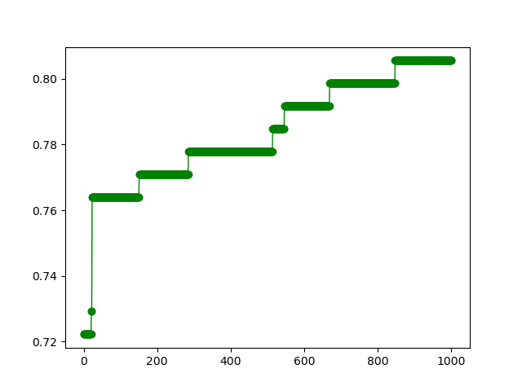
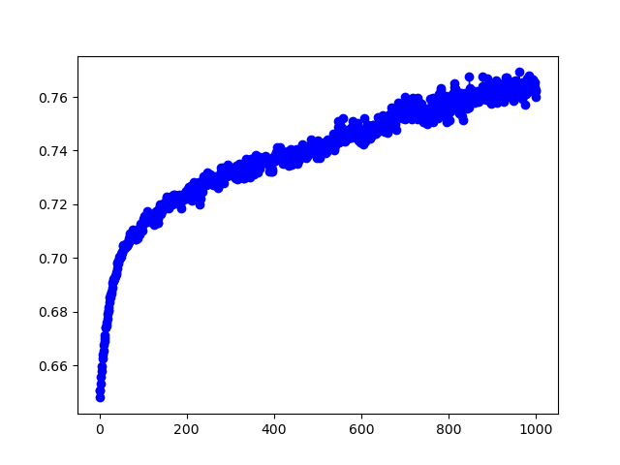
Checking GA learning
Best fitness per generation
Average fitness per generation

Slide 26
Conclusion
As paper itself mentioned method has two major problem as size of search area and fitness function
Cause of ambiguity in method explanation, I think I missed something. but it’s obvious that problem need maybe diversity preserving and somehow get out from local optima.
More complex fitness function gave better answer.

Slide 27


