Slide 1


AlShihr-Mukalla General Information Services
Provider - Application

Slide 2
Introduction
The application serves as a user-friendly and consolidated platform that provides citizens with accurate and up-to-date information about various government and private units and their services. It eliminates the need for time-consuming visits or phone calls, as users can easily access detailed information about required documents, procedures, and schedules through the application. The key benefit is centralizing information from different units into a single interface, allowing efficient search based on keywords, categories, or location. The application aims to empower citizens, improve transparency, and enhance their experience when interacting with government and private services. The developers collaborated closely with government units to ensure reliable and regularly updated information. Through continuous improvement and user feedback, the goal is to make the application an indispensable tool for citizens seeking information and services.

Slide 3
Problem Statement
The application aims to address the complexities and inefficiencies faced by citizens when accessing information and services from government units. Currently, there is a lack of centralized platforms that provide comprehensive details about these units, resulting in confusion, wasted time, and frustration. The application seeks to provide a user-friendly and consolidated platform that offers accurate and up-to-date information about government units, including required documents and service details with specific dates and times. By eliminating the need for physical visits or phone calls, the application simplifies the process and enables citizens to quickly find the necessary information they need.

Slide 4
Project Objectives
01
03
02
04
Develop a mobile application that used to provide citizens with comprehensive details about the services that provided by providers such as passports and immigration, hospitals, schools, etc.
Create a user-friendly interface that allows users to to easily access and search for specific provider or services.
05
Allow users to rate the services in the application.
Implement a robust database to store and manage accurate information about each provider.
Collaborate closely with providers to ensure the accuracy and reliability of the information provided in the application.

Slide 5
Project Scope
The scope of the application encompasses providing citizens with detailed information about the providers. The primary focus is on facilitating inquiries and accessing information about the services provided by these providers for citizens who live in mukalla and AlShihr.

Slide 6
Related Works

Slide 7
Yemen Guide
our application
Yemen guide
city-based search feature
Service providers are responsible for adding services to the application.
The application facilitates a quick and efficient process for services providers to add services.
The information provided for each service is ensured to be accurate and reliable.
state-based search feature
Users have the capability to contribute by adding services and events to the application.
The process of adding services may experience delays as each service undergoes a review by official personnel of the application before being approved.
There may be instances where the information provided for each service lacks sufficient accuracy.

Slide 8
Atlas Al-Sharq Marketing Directory
our application
Atlas
city-based search feature
The information provided for each service is ensured to be accurate and reliable.
The application offers a sleek and modern interface design, providing users with a contemporary user experience.
Users have the ability to rate the services provided in the application.
state-based search feature
There is a noticeable absence of information regarding services in certain areas, such as Hadramaut and Al-Mahra.
The application's interface is outdated and lacks a modern design, impacting the user experience negatively.
The application sends notifications for new service is added, but unfortunately, there is no option to disable these notifications in the settings.

Slide 9
our application advantage
1- Comprehensive: covers government, private, hotels, hospitals, etc.
2- Up-to-date: regularly refreshed information.
3- Direct: partnered with governments entities for reliable information.
4- Depth: detailed information on each service , including opening hours, contact
5- details, required documents, booking options, fees
6- Local focus: provides dedicated sections for major cities and districts within
provinces

Slide 10
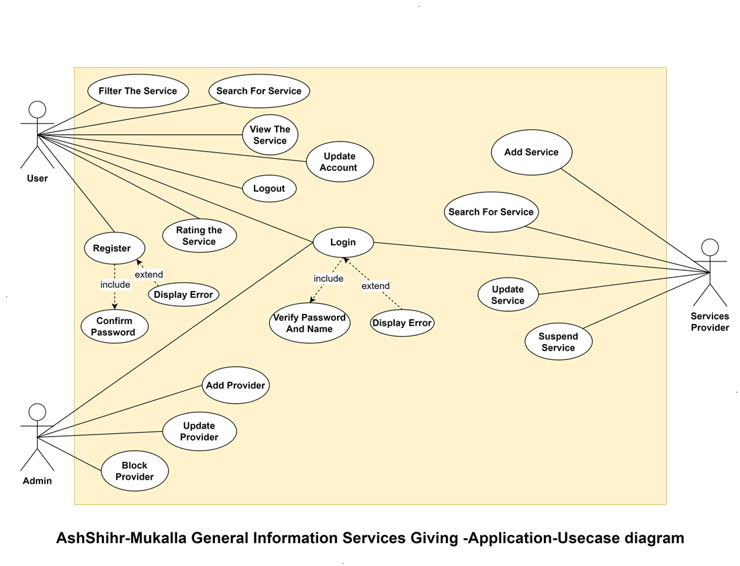
Use case

Slide 11
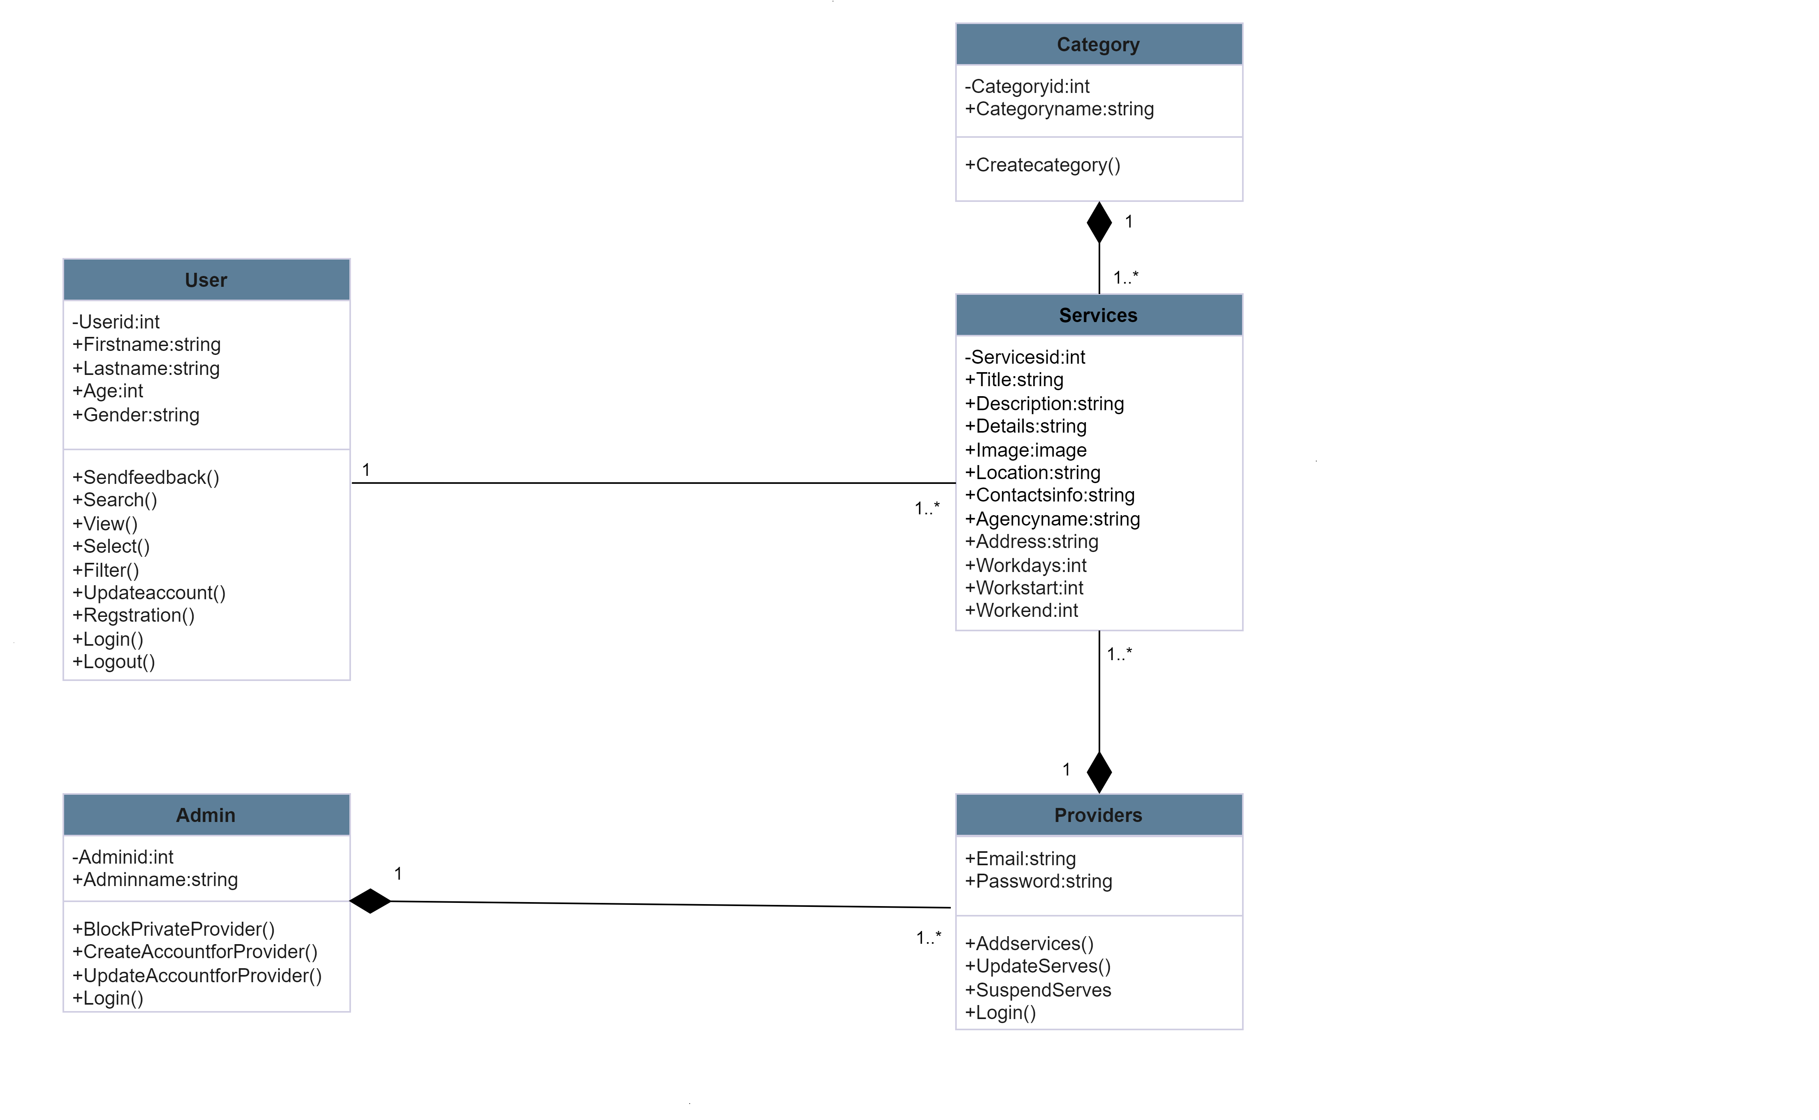
Class diagram

Slide 12
Database digram

Slide 13
Entity relationship

Slide 14
Reference
[1] H. T. R. Freddy, W. Achmad, and M. S. Nasution, “The Effectivity Of Public Services Based On Smart Goverment In Bukit Raya Distric Pekanbaru City,” J. Gov., vol. 7, no. 1, pp. 239–259, 2022.
[2] J. Trischler and J. Westman Trischler, “Design for experience–a public service design approach in the age of digitalization,” Public Manag. Rev., vol. 24, no. 8, pp. 1251–1270, 2022.
[3] E. Dong, H. Du, and L. Gardner, “An interactive web-based dashboard to track COVID-19 in real time,” Lancet Infect. Dis., vol. 20, no. 5, pp. 533–534, 2020.
[4] Platform . (2017, July 26). دليل اليمن [Android application]. Retrieved from https://play.google.com/store/apps/details?id=com.wneet.yemendirectory.
[5] Developer Hisham. (2023, August 7). دليل اطلس الشرق التسويقي [Android application]. Retrieved from https://play.google.com/store/apps/details?id=com.client.guide.atlas.east

