Slide 1
Game theory, different insight
Elyas Tavoosi, Saleh Bahrami
Bahman 1402

Slide 2
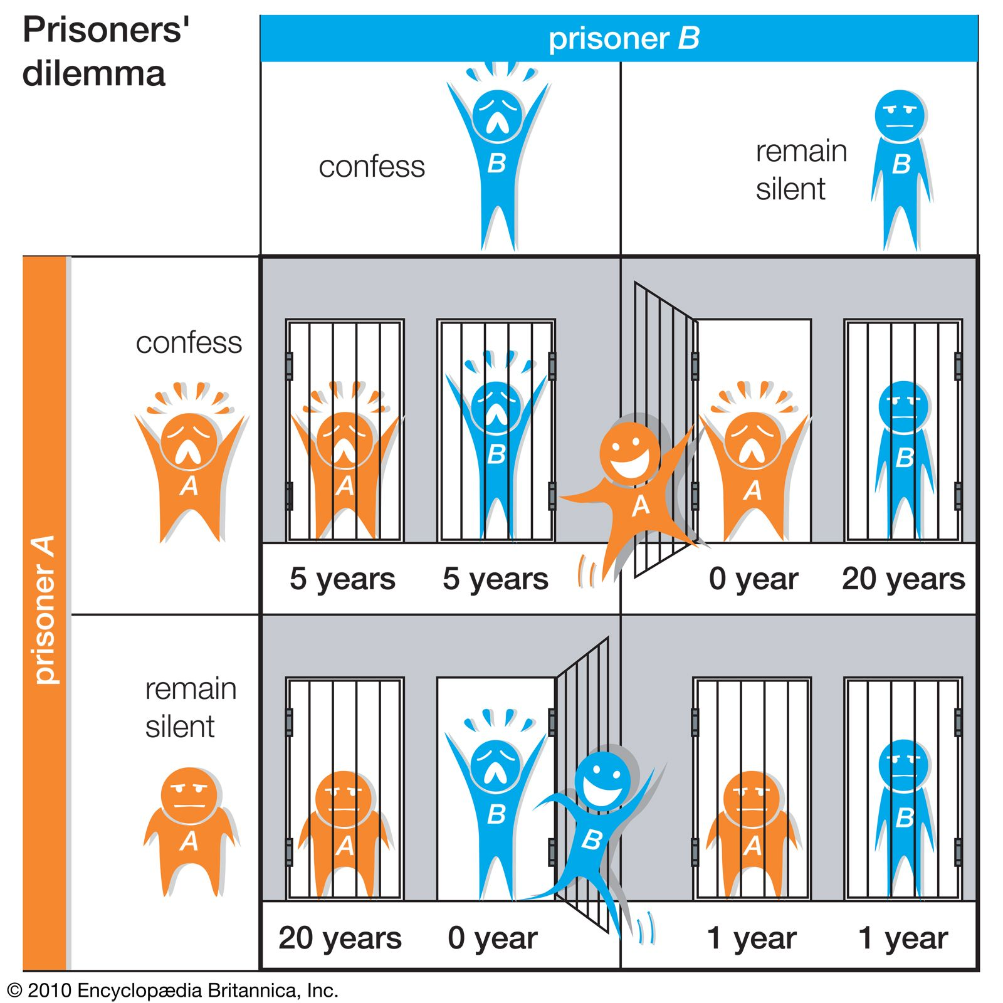
Normal form

Slide 3
Nash Eq, mix and pure.
There is fundamental ambiguity in my mind about strategies.
when dominant strategy exist?
Safety first is the case? (ex. Chiken game)
Minimax?
Should we focus on average reward? Variance is not the case? Concavity of utility

Slide 4
RL and game theory
RL is a game between you and environment
Environment strategy ~ distribution→ pure strategy is good enough
Mix Nash Eq exist → adaptive strategy canceled with randomness
Decision making under uncertainty

Slide 5
Repeated game

Slide 6
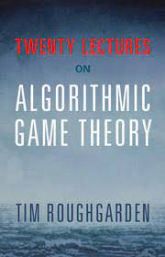
Mechanism design (auctions, others)

Slide 7
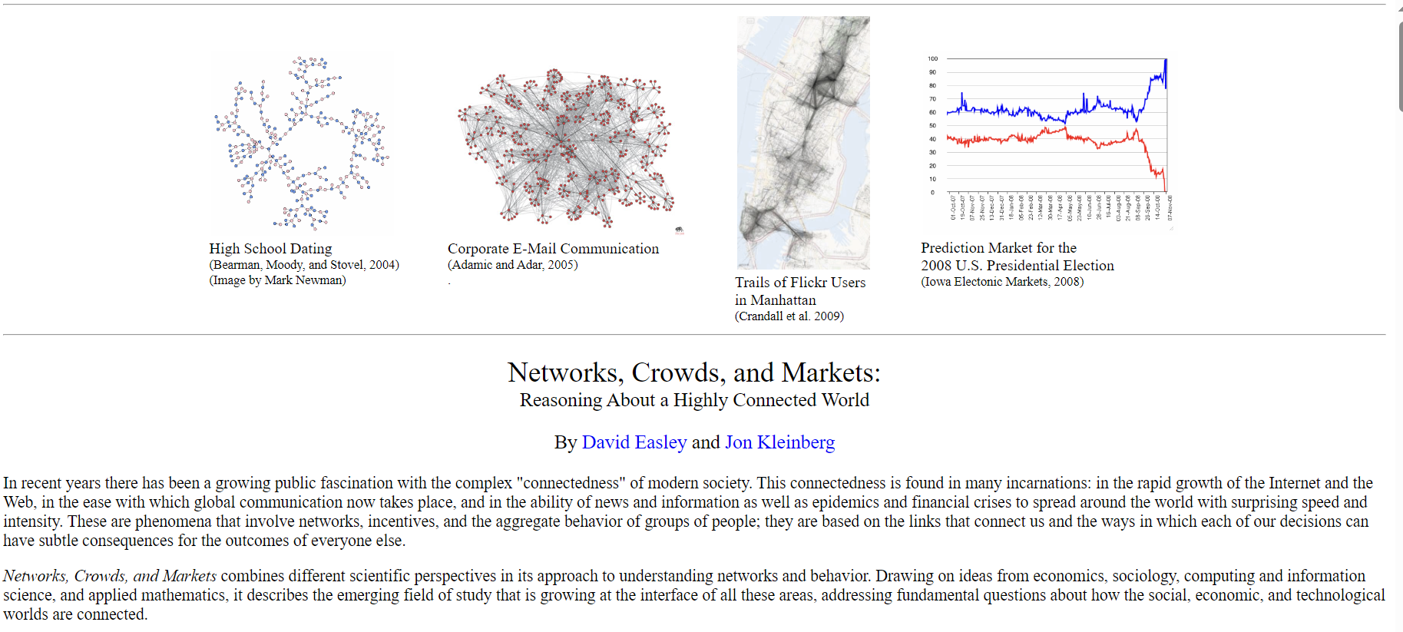
Network game (game theory, GNN, graphs)

Slide 8
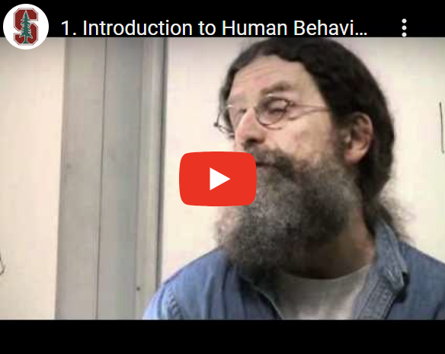
Unexpected applications
Game between Unconscious agents:
Genomes, Forces, Structures, Idea, statics.

Slide 9
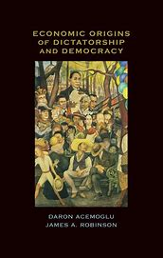
Origins of democracy

Slide 10
Game theory lab
2/3 average converge to 28%
Compare Auctions (1st price/2nd price) data. Ex. Variance of them.
May be need studies about (statistic, economic, network science etc.)

Slide 11
Outputs
Drafts include:
lecture notes, slides, literature review about novel aspects
Research and Experiments
interrelated topics: ex. computational social science
Applied models (??? – target market?)
Academic: TA, RA (long run: ???)
Business analytic techniques developments and broading knowledge about other related things: like economy, combinatorial optimization, AI etc. try to merge them etc.

Slide 12
RECAP
STRATEGY (DOMINANT, )
EQUILIBRIUM

Slide 13
THANKS!
GIT:https://github.com/salehbahrami256/game_theory/

