Slide 1


CSE431
ASSIGNMENT 02
Group: 07

Slide 2
1
Koushik Barmon Sourav
2
Md Iftid Ashrafee
Group Members
3
Mahazabin Khan Dolna
4
Rakibul Alam Nahin
5
Abrar Saleheen
6
Samia Haque

Slide 3
1
INTRODUCTION
2
GNN
CONTENTS
3
TEXT GNN
4
Table
5
Multi-Label Text Classification Using Attention-based GNN
6
SHORT TEXT & CONCLUSION

Slide 4
INTRODUCTION
Text classification is one of the fundamental problems in Natural Language Processing (NLP)
This paper reviews the most recent state-of-the-art graph-based text classification
Compared to the other categories, graphs can capture more complex interactions among the tokens in the text.
Due to its great power in modeling non-Euclidean, graphs have become ubiquitous in the NLP domain

Slide 5
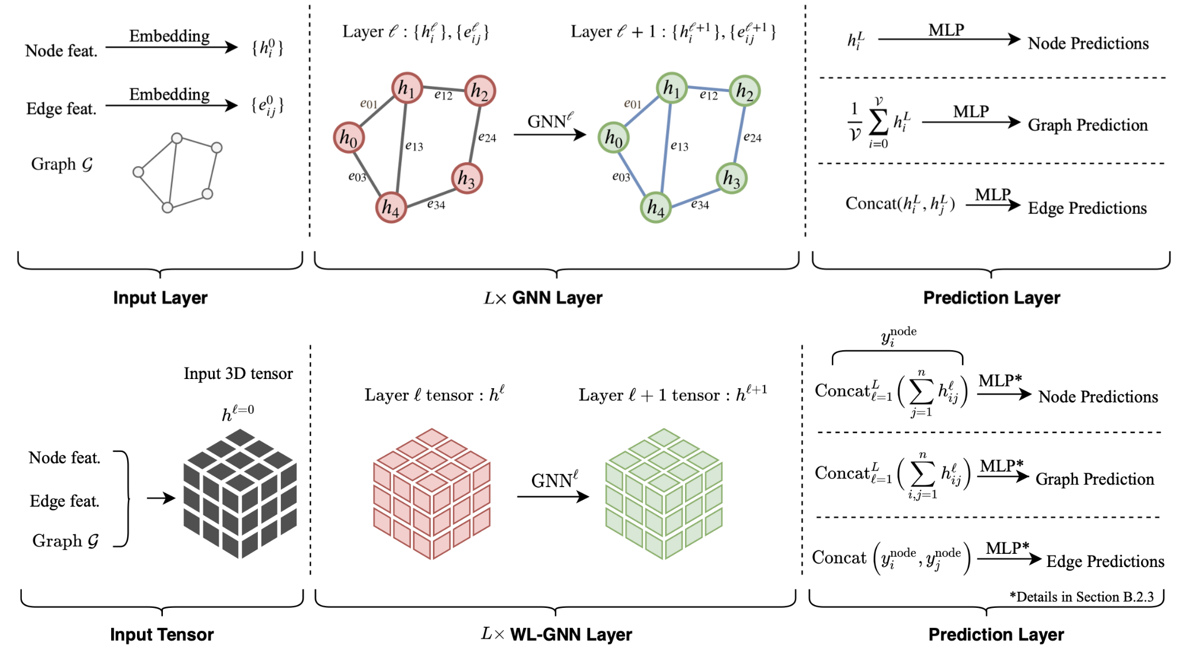
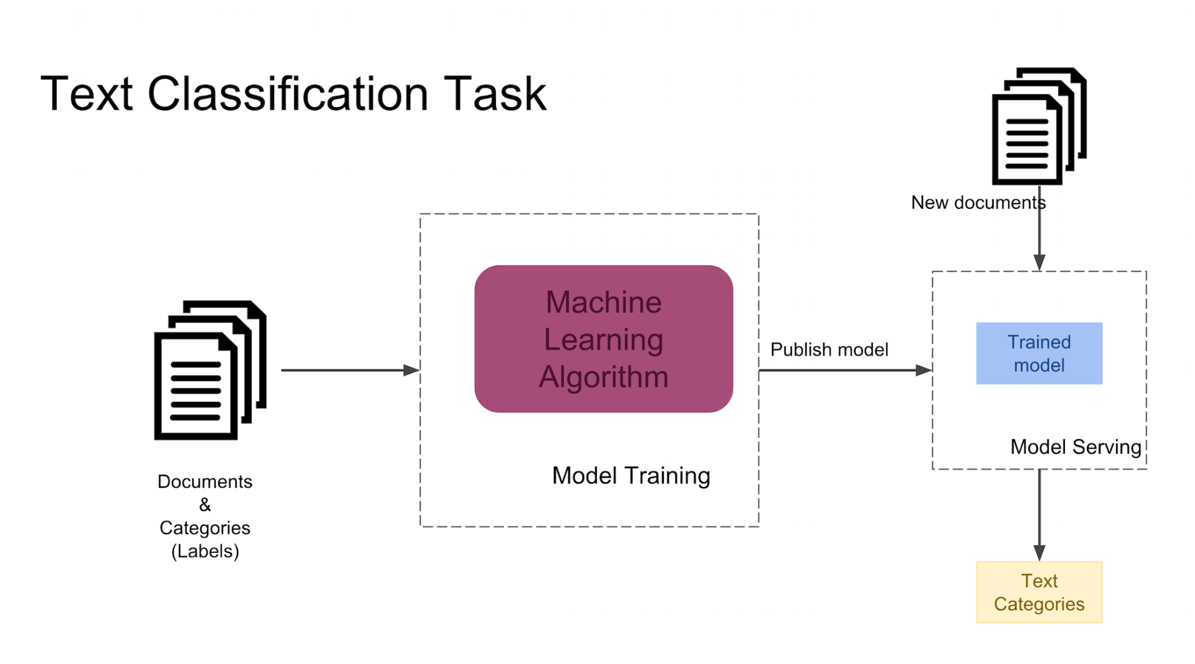
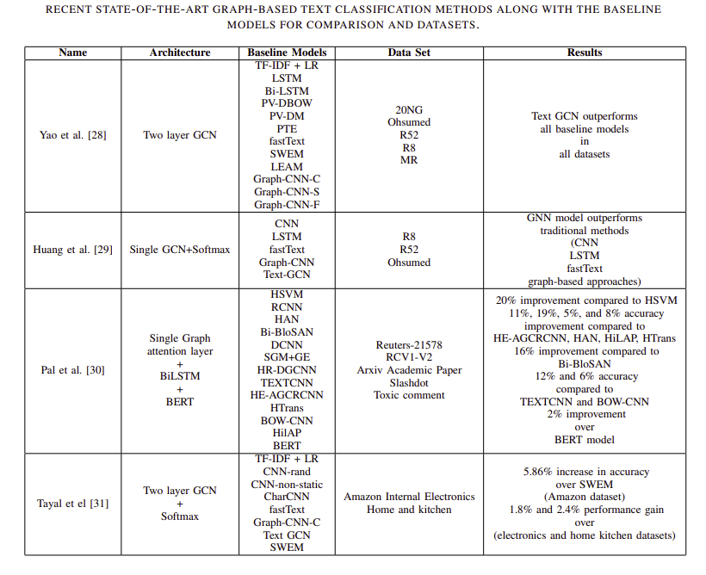

Slide 6
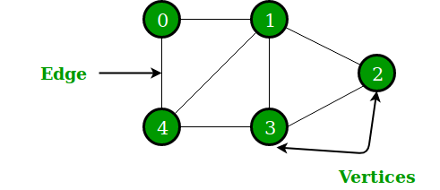
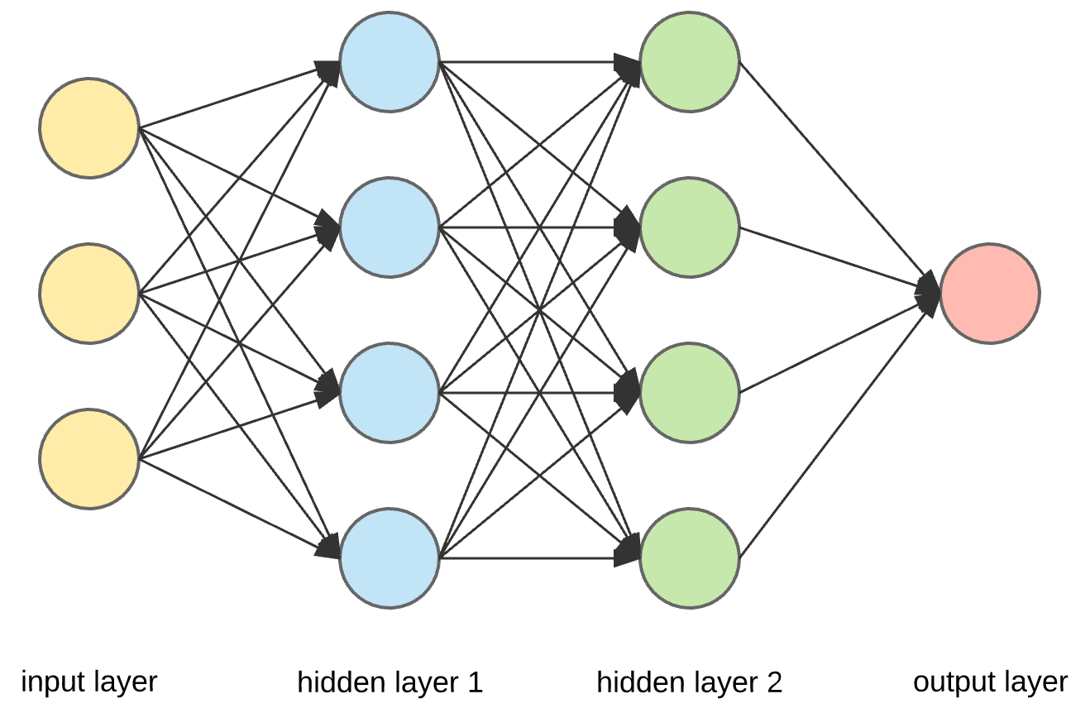
Graph Neural Network
Graph
Neural Network

Slide 7
GNNs are neural networks that can be directly applied to graphs
GNNs can do what Convolutional Neural Networks (CNNs) failed to do.
GNNs are heavily used in various NLP task like text classification, machine translation etc.

Slide 8
Text GCN
Employed a heterogeneous text graph.
The number of nodes is determined by the number of documents.
The prepared graph is fed into a two-layer GCN.

Slide 9



The Text GCN was compared with the following state-of-the-art architectures:
Convolutional Neural Network (CNN)
Long Short Term Memory (LSTM)
Bi-directional LSTM (Bi-LSTM)
Paragraph Vector Model(PV-DBOW - PV-DM)
predictive text embedding (PTE)
FastText
Simple Word Embedding Models (SWEM)
Label Embedding Attentive Models

Slide 10
1
Uses Text as node and learnable edges as passable parameter connected to only
adjacent nodes
Text Level GNN For Text Classification
More efficient model than traditional models
2

Slide 11
1
Solve Multiclass Label Text Classification(MLTC) problems
Multi-Label Text Classification Using Attention-based GNN (MAGNET)
Embedding vectors as node features, adjacency nodes as learnable parameter.
Importance of adjacent labels
2
3
Shows significant improvement than known classifications.

Slide 12
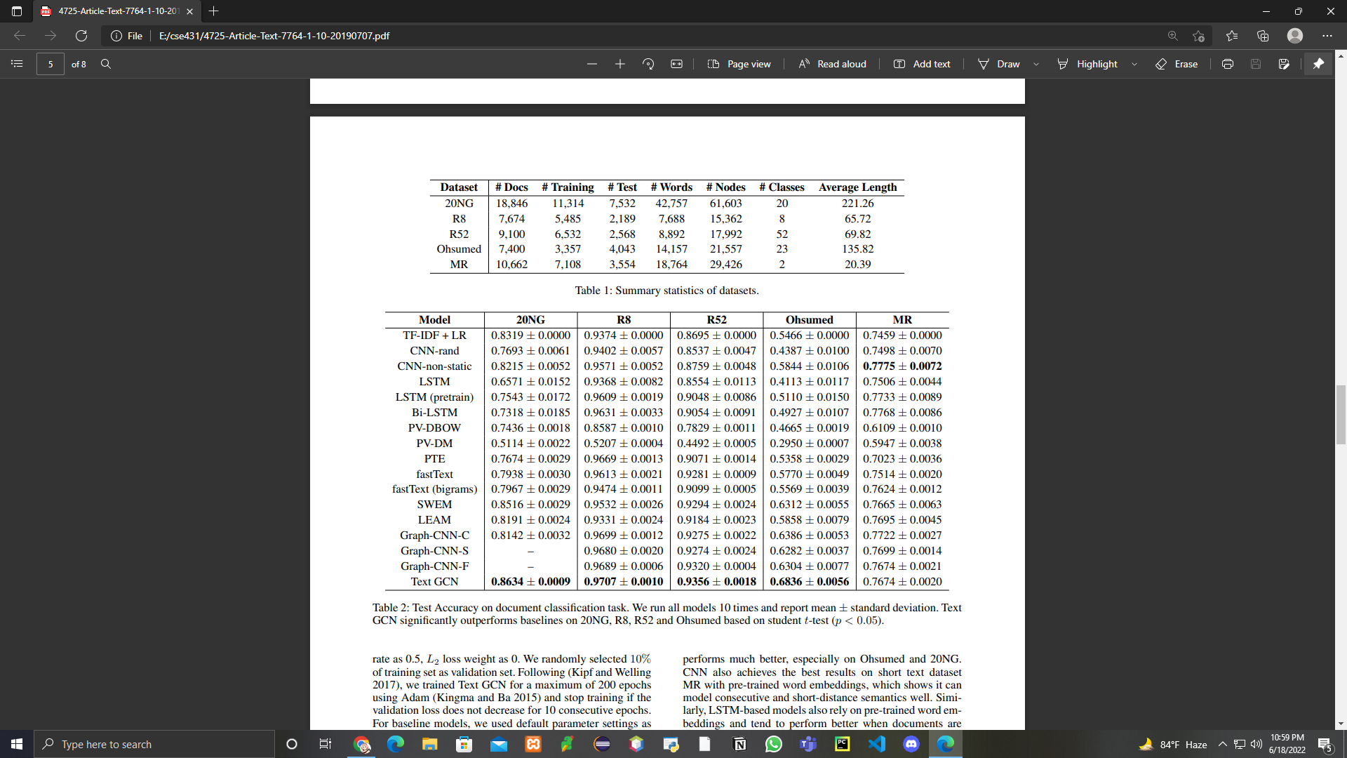

Slide 13
From the experimental results,
Discussion
1
The proposed Text GCN can achieve strong text classification results and learn predictive document and word embeddings.
2
Major limitation of this study is that the GCN model is inherently transductive.
3
Text GCN Could not quickly generate
embeddings .

Slide 14
1
In this research, we suggest a novel text classification method termed as Text Graph Convolutional Networks.
Conclusion
2
A simple two-layer Text GCN demonstrates promising results by outperforming numerous state-of-theart methods on multiple benchmark datasets.
3
Our method also learns predictive word and document embeddings automatically

