Slide 1
Intruder Detection System Using Arduino Uno R3
Name: Saleh Ibne Omar ID: 2017000000040 | Name: MD Jabir Hussain Shuvo ID: 2018000000129 | Name: Morjina Akter ID: 2018000000102

Slide 2
Introduction
An embedded system
Detects unwanted objects
Turns on alerts when intrusion occurs
Protects expensive items
Guards restricted areas

Slide 3
Working Mechanism
An ultrasonic rotating sonar sensor
Emits ultrasonic waves to detect objects
Detects intrusion within 30cm range
Turns on a warning sound
Turns on a warning light

Slide 4
Equipment Used
Arduino Uno R3
Servo motor (SG90)
Ultrasonic sonar sensor (HC-SR04)
Temperature and humidity sensor (DHT11)
Active buzzer
Red LED
1/4W resistor
Breadboard
Jumper wires

Slide 5
Purpose of the Equipment Used
Arduino Uno R3
Works as the mainboard of the system
Servo motor
Helps to rotate sonar sensor
Ultrasonic Sonar sensor
Is used to detect object by emitting ultrasonic wave
Temperature and Humidity sensor
Reads the current temperature of the environment to calculate exact velocity of the ultrasonic wave

Slide 6
Purpose of the Equipment Used
Active buzzer and Red LED
Is used to turn on a warning sound and light when intrusion happens
1/4W resistor
To protect the LED light from fusing
Breadboard and Jumper wires
To keep all the equipment connected to the Arduino board

Slide 7
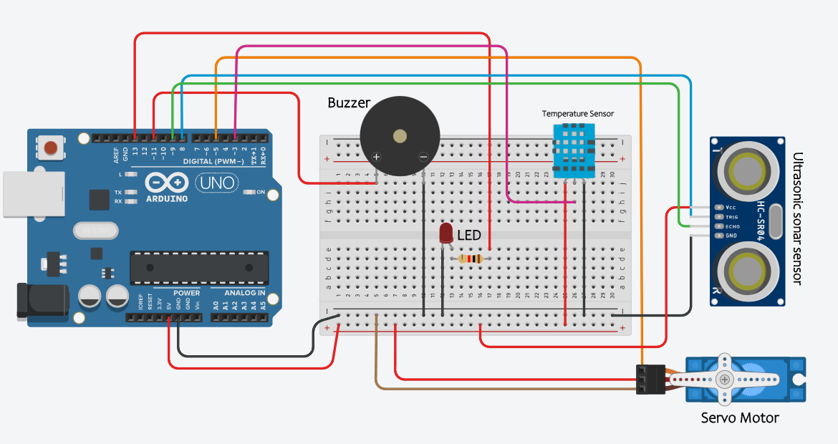
Circuit Diagram

Slide 8
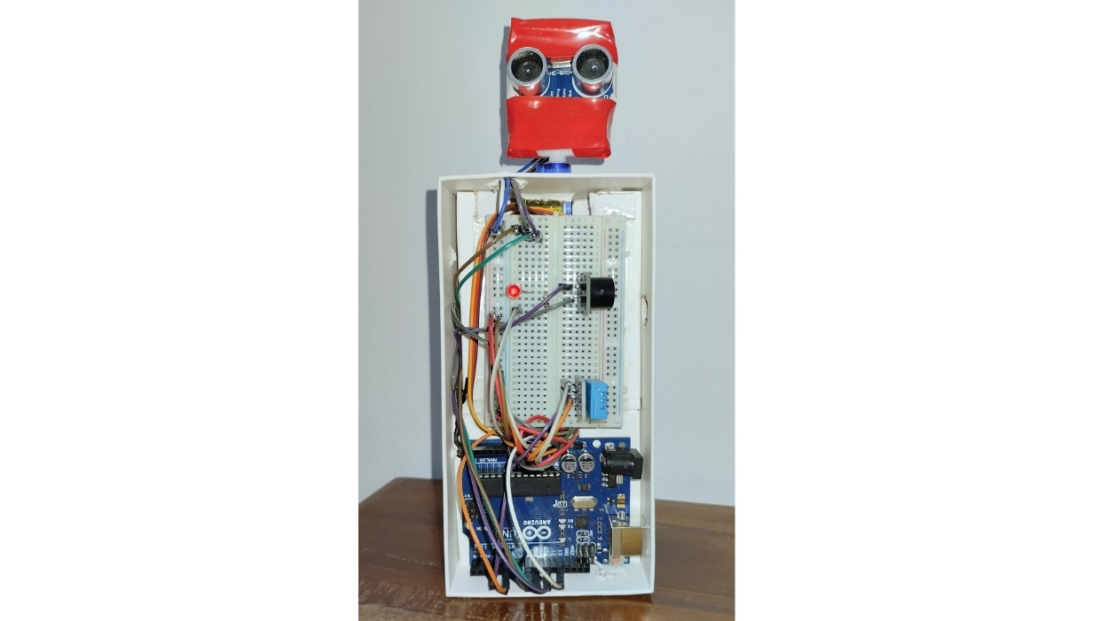
The Intruder Detection System

Slide 9
Source Code
Source code link
https://github.com/salehibneomar/seu-embedded-sys-lab/blob/main/intruder-detection-system.ino

Slide 10
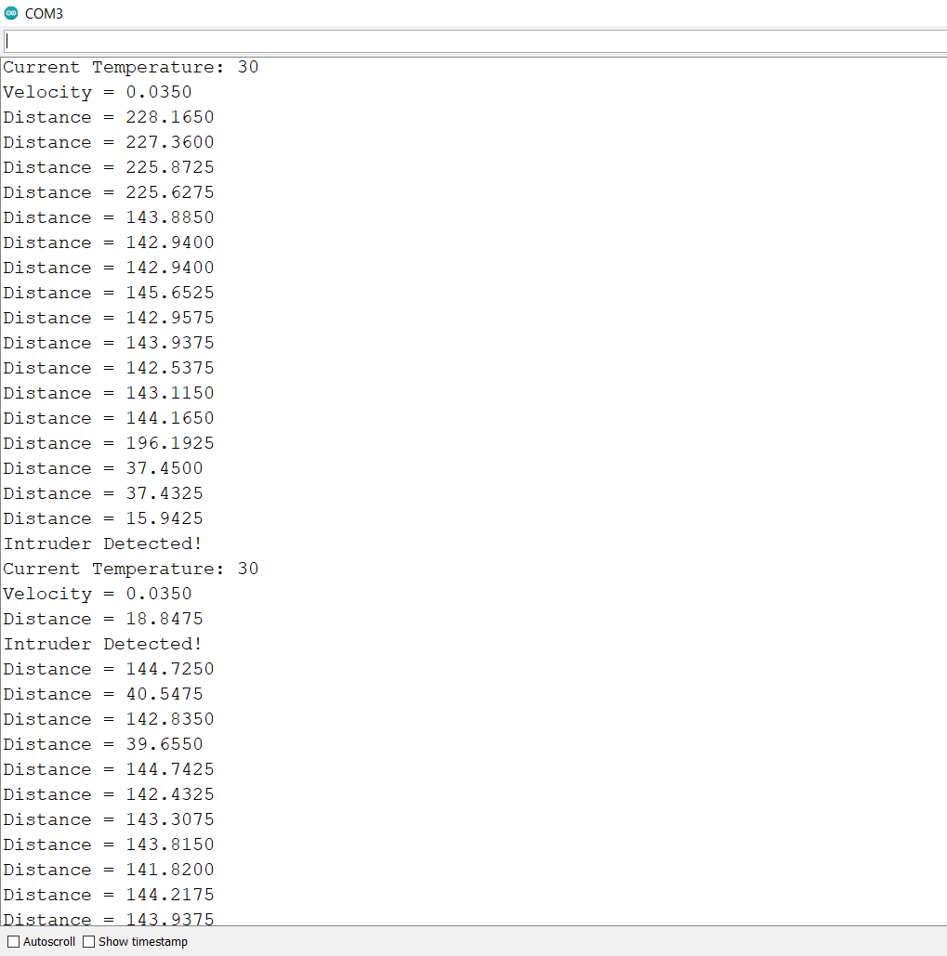
Serial Monitor Output

Slide 11
Applications
Intruder detection
Radar system
Security system

Slide 12
Limitations
Servo motor cannot rotate 360 degrees
Cannot detect objects moving at a high speed
Range of the sonar sensor is only 2cm to 400cm
To solve slow servo rotation the number of distance measurement operations were reduced
Has a delay of 500ms for every repetition of the actual operation

Slide 13
References
Source code
https://github.com/salehibneomar/seu-embedded-sys-lab/blob/main/intruder-detection-system.ino
Circuit Diagram
https://github.com/salehibneomar/seu-embedded-sys-lab/blob/main/intruder-detection-system.ino

Slide 14
Thank you for watching this slideshow presentation!

