Slide 1
Air Quality Measurement Device
Project Presentation
Group-1 (C183085, C183061, C183077, C183056)

Slide 2
The things we’ll know after this presentation
Description
Hardware we used
Software we used
Simulation (Using Proteus)
Working principle
How we worked

Slide 3
Description
Growing urbanization and no. of Industrial towns make it a requirement to have a close concern of the environment. Hard to keep monitoring continuously certain sites such as industries, busy traffic signals, villages prone to soil erosion & high ammonia concentration etc.
Air quality monitoring is the process of assessment of pollutants present in atmosphere by their quantity and types as per air quality standards. Air quality monitoring helps us to take action based on pollutants present in atmosphere to improve air quality
The air quality sensor developed by our group senses various gasses but mainly carbon dioxide (CO2) in the environment in PPM (parts per million).
The main aim of this project is to develop a device which can monitor PPM in air in real time.
The air monitoring device developed in this project is based on Arduino Uno. The sensor used for monitoring the air pollution is MQ-135 gas sensor. The Arduino board connects with the sensor using analog pins.

Slide 4
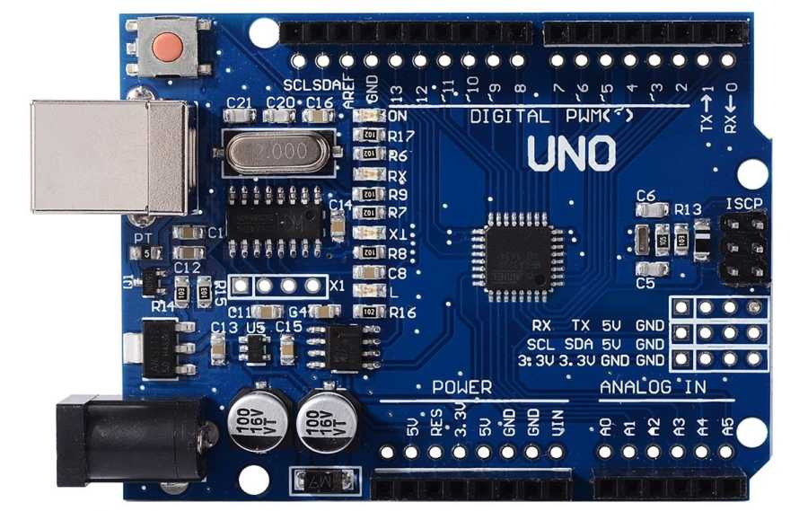
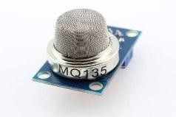
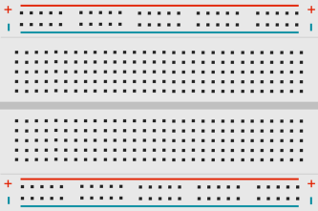
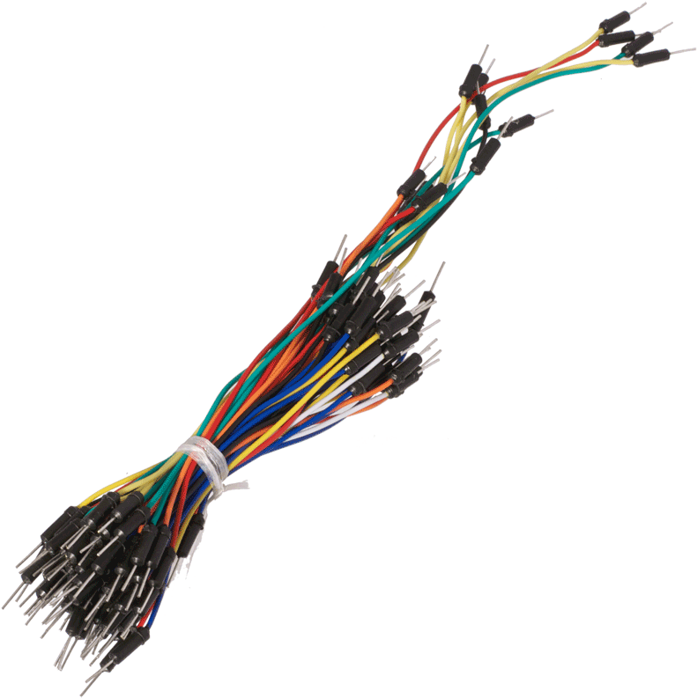
Hardware we used
Arduino Uno
MQ135 gas sensor
Breadboard
Jumper wires
Potentiometer 10k
Resistors 220 ohm

Slide 5
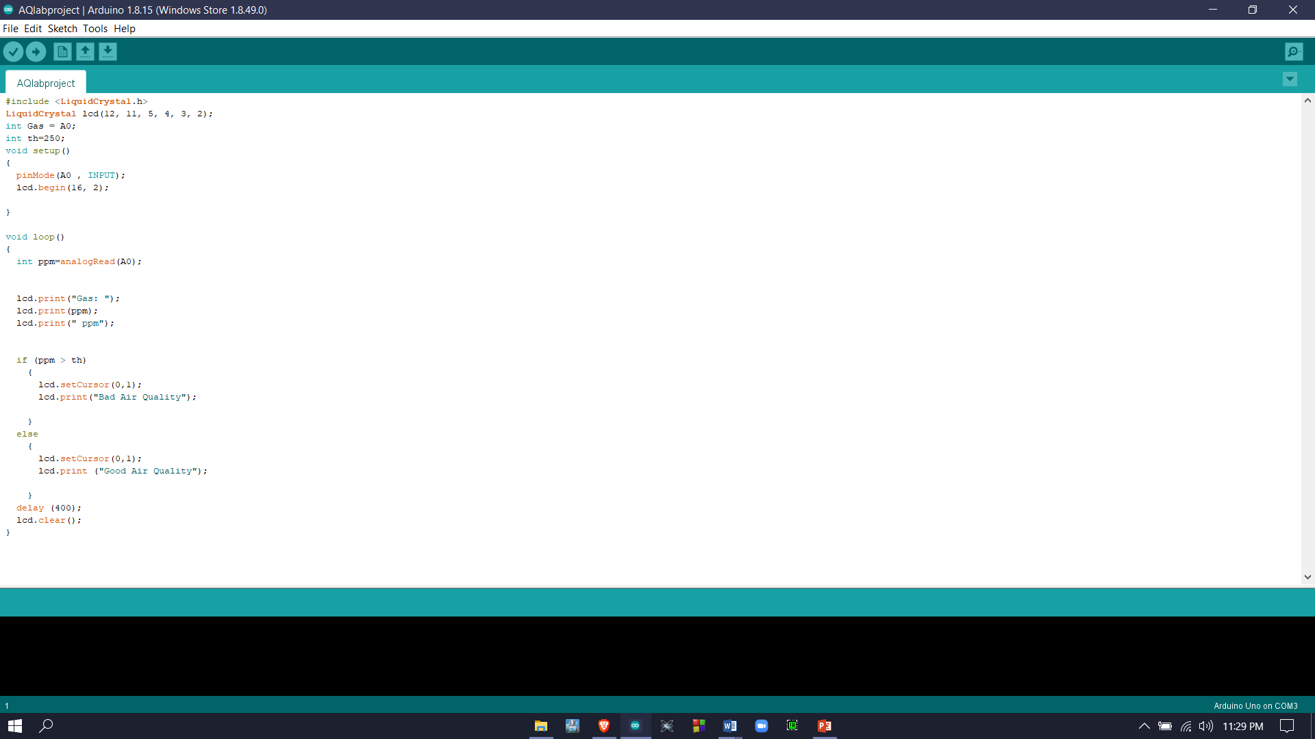
Software we used
Arduino IDE
To Program Arduino Uno we need IDE. Arduino IDE contains a text editor for writing code, a message area, a text console, a toolbar with buttons for common functions and a series of menus. It connects to the Arduino hardware to upload programs and communicate with them.
Our code

Slide 6
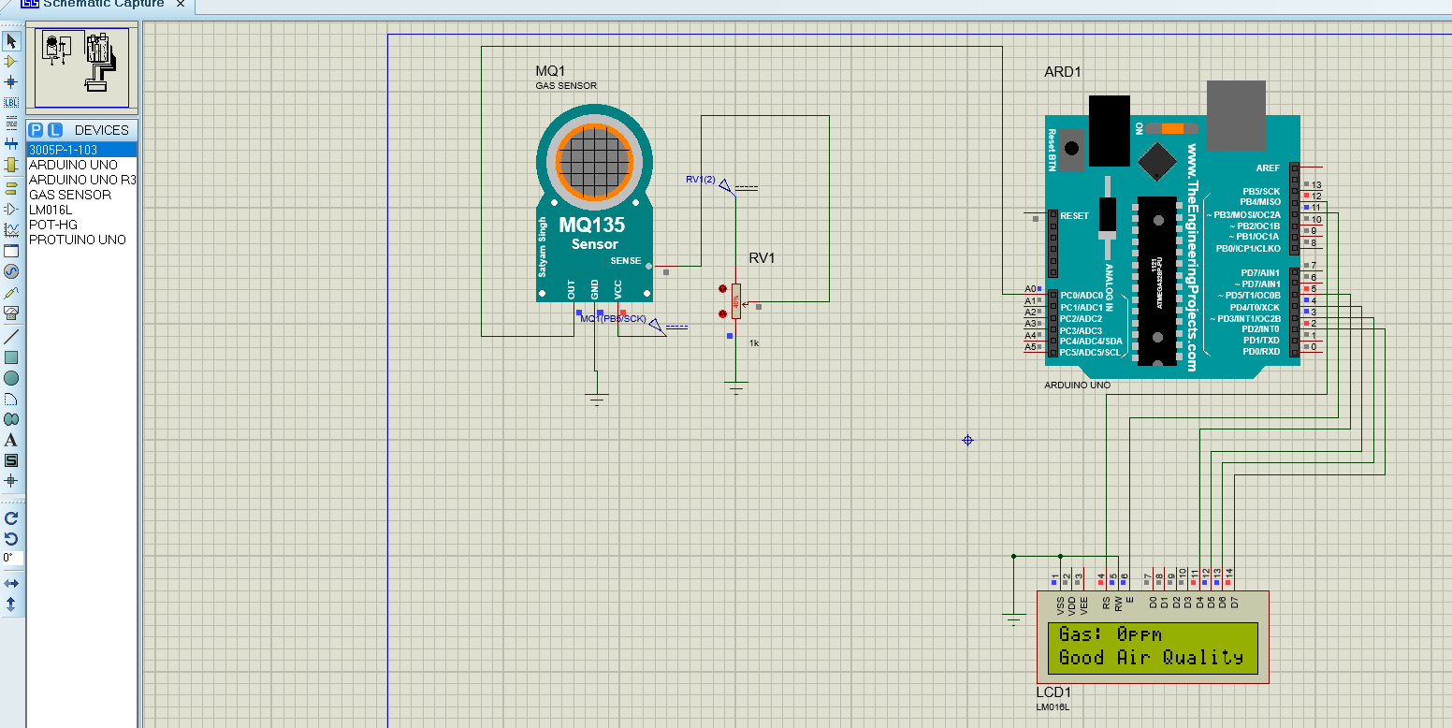
Simulation (Using Proteus)

Slide 7
Working Principle
As the device is powered, the Arduino board loads the required libraries.
The analog voltage sensed at the pin A0 of the Arduino is converted to a digital value by using the in-built ADC channel of the Arduino.
The Arduino board has 10-bit ADC channels, so the digitized value ranges from 0 to 1023. The digitized value can be assumed proportional to the concentration of gases in PPM.
The VCC and Ground terminals of the MQ-135 sensor are connected to the common VCC and Ground. The Analog Output pin of the sensor is connected to the A0 pin of the Arduino.
The code is uploaded on the board using the USB drive and then run. The output is observed on the LCD directly in PPM unit.

Slide 8
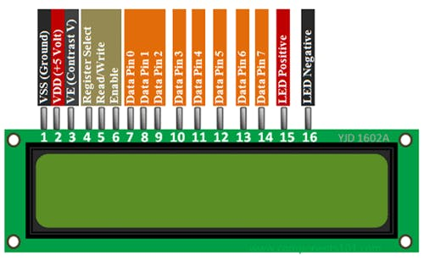
How we worked
The 16X2 LCD display is used to monitor the sensor values read by the Arduino board from MQ-135. It is interfaced with the Arduino Uno by connecting its data pins D4 to D7 with pins 5 down to 2 of the controller respectively. The RS and E pins of the LCD are connected to pins 12 and 11 of the controller respectively. The RW pin of the LCD module is connected to the ground. VDD pin is connected to 5v voltage source and V0 is connected to the middle pin of potentiometer. A pin is connected to the 5v through 220 ohm resistor and K to ground.

Slide 9
How we worked
The other two pins of potentiometer connected to the common 5v source slot of breadboard and common ground. The potentiometer will control the contrast of the LCD.
The MQ-135 sensor’s Vcc pin connects to the common 5v source slot, GND pin connects to the common ground slot and A0 pin connects to the analog A0 pin of the Arduino.
Lastly, after coding in LAPTOP at Arduino IDE, we uploaded the code to the Arduino plugging it by a D type cable. It took 30-60 minutes to warm up the MQ-135 sensor and get the correct Gas measurement in PPM. We used different types of environment and experiments on ourselves to see the results of our device and It was successfully detecting CO2, Alcohol, Smoke, Naphthalene.

Slide 10

THE END

