Slide 1
Giza Real Estate Market Analysis
Interactive dashboard and ML Models

Slide 2
01
02
Table of contents
03
04
Data & Scenario
Dashboard
Understanding the dataset used in the analysis and the project scenario
Generating insights from excel interactive dashboard
Clustering
Regression
Using K-means Clustering to better understand our clients
Using Multiple regression to predict prices and compare between salesmen and marketing campaigns

Slide 3
01
Data & Scenario

Slide 4
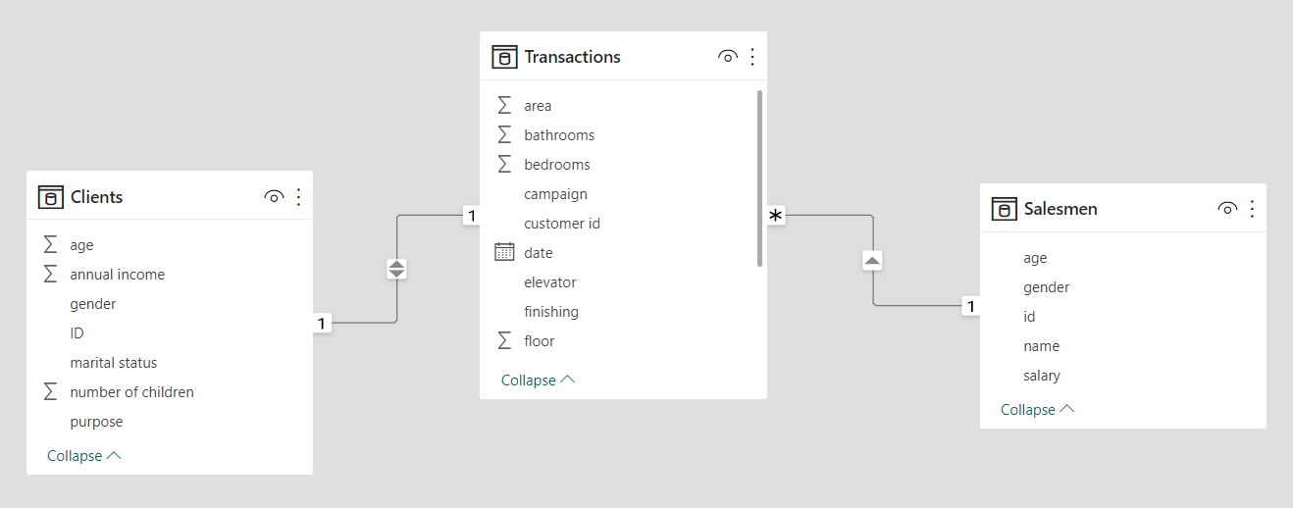
This dataset is dummy data created using Excel Functions like: RandBetween() and IFS() Functions.
The dataset contains 3 tables: Transactions, Clients and Salesmen.
Transactions table contains records of 999 Sales transactions done between jan-2021 and Dec-2022 in 3 Cities: Zayed, Hadayek El-Ahram and October, the table contains 14 columns.
The Clients table contains information about the 999 Clients who bought the apartments in the 2 years window, the table contains 7 columns.
Salesmen Table contains information about the company’s sales team which consists of 3 Salesmen, the table contains 5 columns.

Slide 5
Scenario
Smsar is a Real estate marketing company operating in Giza especially in 3 main cities: Zayed, October and Hadayek El-Ahram.
the company would like to know the following:
the evolution of the prices in the 3 cities over the 2 years and what are the factors affecting the apartments prices.
Who is the best salesman in the sales team in terms of getting the best profit percentage of price?
Is campaign Y significantly better than campaign X in generating profit?
What are the characteristics of the clients to optimize the marketing strategy?

Slide 6
02
Dashboard

Slide 7
Interactive Dashboard

Slide 8
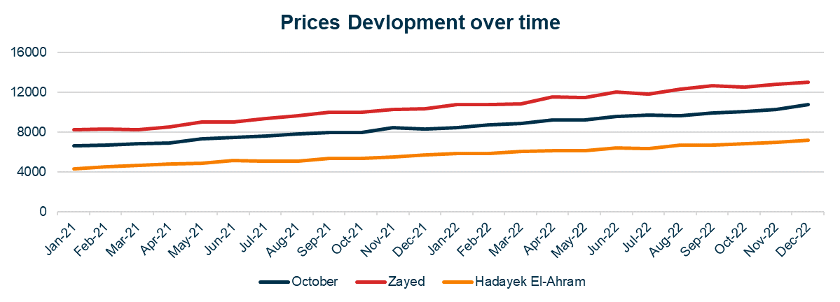
Line Chart
We can see that over the 2 years Zayed had the highest prices followed by October then Hadayek El-Ahram, with an upward trend in all 3 cities.

Slide 9
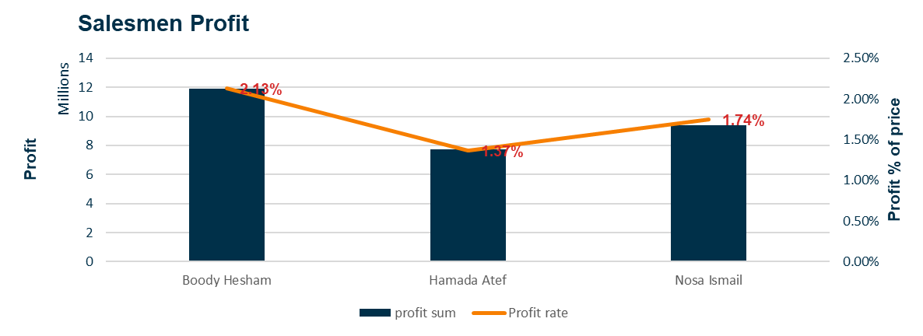
Combo Chart
From the combo chart we can see that boody Hesham generated the highest profit to price ratio by 2.13% and generated the highest amount of profit by almost 12 million EGP over the 2 years.
The acceptable profit to price ratio ranges between 1% and 2.5% so we can see that all the 3 salesmen had an acceptable ratio.

Slide 10
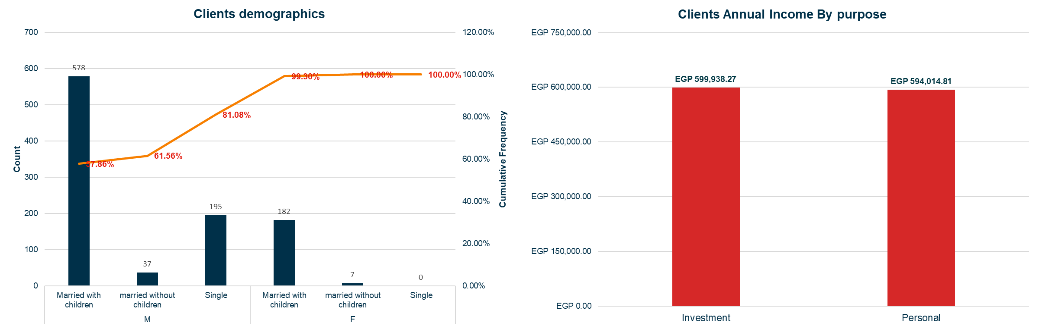
Clients Stats
We can see from the combo chart that more than 80% of our clients are Male clients and more than 75% of all clients are married with children so these are the most 2 important characteristics of our clients.
The annual income of clients who bought apartments as investment is very close to the annual income for those who bought apartments for personal usage, however the clients who bought apartments for personal usage almost double the number of the clients who bought apartments as investment.

Slide 11
03
Clustering

Slide 12
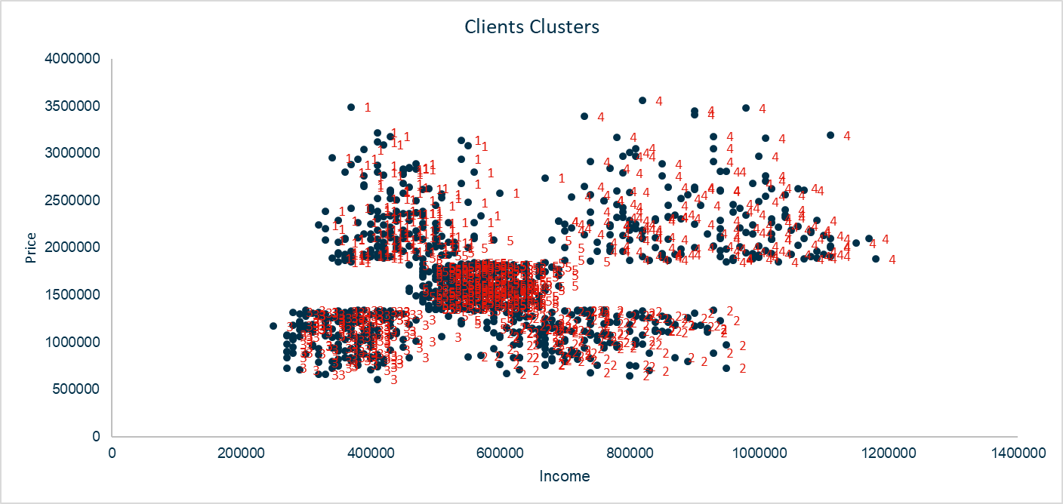
Using the K-means Clustering method we find out that there’re 5 clusters of clients in terms of Apartments prices and Annual Income.
The middle cluster is the standard clients who make relatively average annual income and paid relatively average prices for the apartments.
The top 2 clusters are the clients who paid relatively high prices, the 2 clusters in the right are relatively high-income clusters in contrary to the 2 left clusters.
The 2 right clusters are the 2 best client's groups to target since they make relatively high annual income so they can be potential customers for new deals especially The right bottom cluster who are most likely buying apartments as an investment since they make high annual income and bought relatively cheap apartments.

Slide 13
04
Regression

Slide 14
Regression analysis Objectives
1. Understanding the factors affecting apartments prices.
2. Analyzing the sales team performance.
3. Comparing the X and Y marketing Campaigns.

Slide 15
After running the regression model for the first time all the tested factors were significantly affecting the apartments prices except the floor number and the number of bathrooms, so we run the regression model again after removing the 2 insignificant variables.
Prices regression analysis

Slide 16
Prices regression analysis
The model
We can see from the R square and Adj. R square results that our model fits about 77.5% of our prices data.
And from the F-stat and Significance F we can see that our model as a whole is statistically significant.

Slide 17
Prices regression analysis
The Coeffecients
The coefficients results tells us the following:
The area, number of bedrooms, absence of elevator, finishing and location are all factors that affect the price of the apartments in our dataset.
Zayed is the most expensive location followed by October then Hadayek El-Ahram, these results support our findings from the dashboard.
The unfinished apartments are the cheapest apartments as expected, however the semi-finished and finished apartments aren’t statistically significant (according to the 95% confidence intervals).

Slide 18
Sales Team
101: Hamada Atef
Male, 25 Years, 9000 EGP Monthly salary.
102: Nosa Ismail
Male, 23 Years, 7000 EGP Monthly salary.
103: Boody Hesham
Male, 31 Years, 15000 EGP Monthly salary.

Slide 19
We can see from the regression results that Salesman 103 (Boody Hesham) gets more profit rate than Nosa ismail and Hamada Atef, these results support our findings from the dashboard.
We can also see that although salesman 101 (Hamada Atef) gets less profit rate than salesman 102 (Nosa Ismail) he gets paid more, this requires the company to review the team salaries.
Analysing sales team performance

Slide 20
From the same Regression Model, we can conclude that the campaign type doesn’t affect the profitability, so we accept the Null Hypothesis which means that campaign X and Y aren’t significantly different in terms of profitability, and they don’t affect the profit rate.
A\B testing the marketing campaigns

Slide 21
Conclusions
over the 2 years period Zayed had the highest prices followed by October then Hadayek El-Ahram and the prices of the apartments in the 3 cities are expected to increase in the coming years.
The area, number of bedrooms, absence of an elevator, finishing level and location are all factors that affect the price of the apartments.
The unfinished apartments are the cheapest apartments however, there’s not enough proof that the semi-finished apartments are cheaper than the finished apartments in all cases.
All of our sales team members did a great work over the 2 years but the company should revise the salaries of salesman 101 and 102.
Campaign X and Y aren’t different in terms of profitability so the company should only run one campaign.
The most 2 important factors in the clients demographics is the marital status and the gender, we can achieve almost 80% of our results by simply focusing on Clients who are married and have children and the Male Clients.
Clients with more than 600,000 EGP annual Income are the Most important target for our company, especially those who bought apartments with less than 1,500,000 EGP or More than 2,500,000 EGP.

