Slide 1
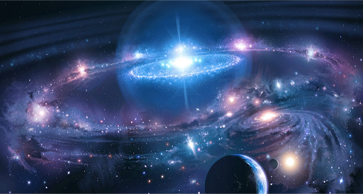

Slide 2


Basic programming Session1: Algorithm & Flowchart
CS1401-2
2
Notes:
2

Slide 3
Assessment
10% Continuous attendance at class.
20% Home Work.
My e-mail address: Salehnasab@sbmu.ac.ir
70% Written final exam.

Slide 4
Decimal (base 10)
The most common system for number representation is the decimal. Everybody is using it. It’s so common than most people must believe that is the only one. It’s used in finances, engineering and biology, almost everywhere we see and use numbers.
As the name is saying the decimal number system is using 10 symbols/characters. In Latin language 10 is “decem” so decimal might be linked to the Latin word.
Decimal Symbols
0 | 1 | 2 | 3 | 4 | 5 | 6 | 7 | 8 | 9

Slide 5
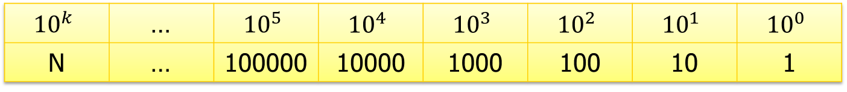
Decimal (base 10)
As you can see there are 10 symbols from 0 to 9. With these symbols we can construct all the numbers in the decimal system.
All the numbers in the decimal system can be constructed by using the above mentioned symbols (0 … 9) multiplied with the power of 10. The power of ten gives us ones, tens, hundreds, thousands and so on.
$${10}^{k}$$ | … | $${10}^{5}$$ | $${10}^{4}$$ | $${10}^{3}$$ | $${10}^{2}$$ | $${10}^{1}$$ | $${10}^{0}$$
N | … | 100000 | 10000 | 1000 | 100 | 10 | 1

Slide 6
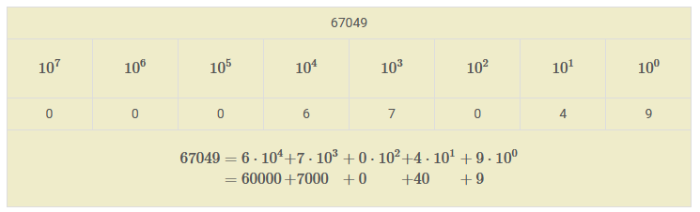
Decimal (base 10) - example
The example below breaks down the decimal number 67049 into powers of 10 multiplied with numbers between 0 and 9. This is just to show that any number in the decimal system can be decomposed into a sum of terms made of from the product of the power of 10 and the symbols 0 … 9.

Slide 7
Binary (base 2)
Another number representation system is the binary one. As the name suggests and by analogy with the decimal system we can say that the binary system is using only 2 symbols/characters:
In the binary representation we only use 0 (zeros) and 1 (ones) to represent numbers.
Binary Symbols
0 | 1

Slide 8
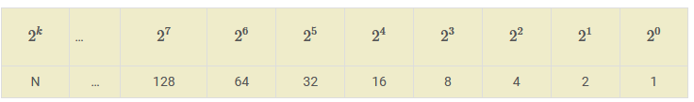
Binary (base 2)
All the decimal numbers we can think of can be represented into binary symbols. We do this by using a sum between terms of the power of 2 multiplied with 0 or 1.

Slide 9
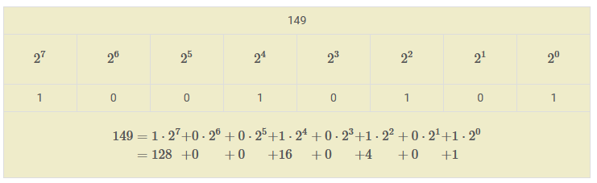
Binary (base 2)
As example we’ll use the number 149 (decimal representation) and transform it into binary representation. We could use any number but if it’s too big it would end up into a long string of zeros and ones.

Slide 10
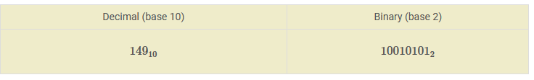

Binary (base 2)
As you can see the decimal number 149 is represented in binary system by a series of zeros and ones (10010101). Usually to distinguish between a decimal or binary number we must specify the base to which we are referring to. The base is described as a subscript after the last character of the number
Example:
By specifying the base of the number we eliminate the probability of confusion, because the same representation (e.g. 11) can mean different things for different bases.

Slide 11
Why algorithm and flowchart?
Software Engineer uses various programming languages to create programs.
Before writing a program, first needs to find a procedure for solving the problem.
The program written without proper pre-planning has higher chances of errors.
Algorithm and flowchart are the powerful tools for learning programming.
Notes:
مهندس نرم افزار برای ایجاد برنامه ها از زبان های برنامه نویسی مختلف استفاده می کند.
قبل از نوشتن یک برنامه، ابتدا باید یک روش برای حل مشکل پیدا کرد.
برنامه بدون پیش برنامه ریزی مناسب شانس خطای بیشتری دارد.
الگوریتم و فلوچارت ابزارهای قدرتمندی برای یادگیری برنامه نویسی هستند.

Slide 12
Why algorithm and flowchart?
An algorithm is a step-by-step analysis of the process, while a flowchart explains the steps of a program in a graphical way.
Algorithm and flowcharts helps to clarify all the steps for solving the problem.
Notes:
الگوریتم و فلوچارت برای واضح بودن همه گام های حل مساله کمک می کنند

Slide 13
Why algorithm and flowchart?
For beginners, it is always recommended to first write algorithm and draw flowchart for solving a problem and then only write the program.
The algorithm can vary from person to person to solve a particular problem.

Slide 14
Algorithm: history & definition
The word “algorithm” relates to the name of the mathematician Al-khowarizmi, which means a procedure or a technique.
An algorithm is a sequence of steps to solve a particular problem or algorithm is an ordered set of unambiguous steps that produces a result and terminates in a finite time.

Slide 15
The characteristics of algorithm
Input: An algorithm may or may not require input.
Output: Each algorithm is expected to produce at least one result.
Definiteness: Each instruction must be clear and unambiguous.
Finiteness: If the instructions of an algorithm are executed, the algorithm should terminate after finite number of steps.

Slide 16
The control structures of algorithm & flowchart
The algorithm and flowchart include following three types of control structures.
Sequence
Branching (Selection)
Loop (Repetition)

Slide 17
The control structures of algorithm & flowchart
Sequence: In the sequence structure, statements are placed one after the other and the execution takes place starting from up to down.

Slide 18
The control structures of algorithm & flowchart
Branching (Selection): In branch control, there is a condition and according to a condition, a decision of either TRUE or FALSE is achieved. In the case of TRUE, one of the two branches is explored; but in the case of FALSE condition, the other alternative is taken. Generally, the ‘IF-THEN’ is used to represent branch control.

Slide 19
The control structures of algorithm & flowchart
Loop (Repetition): The Loop or Repetition allows a statement(s) to be executed repeatedly based on certain loop condition e.g. WHILE, FOR loops.

Slide 20
Advantages of algorithm
It is a step-wise representation of a solution to a given problem, which makes it easy to understand.
An algorithm uses a definite procedure.
It is not dependent on any programming language, so it is easy to understand for anyone even without programming knowledge.
Every step in an algorithm has its own logical sequence so it is easy to debug.
Notes:
یک نمایش گام به گام از یک راه حل برای یک مشکل خاص است که به راحتی قابل درک است.
یک الگوریتم از یک روش قطعی و روشن استفاده می کند.

Slide 21
How to write algorithms
Step 1 Define your algorithms input: Many algorithms take in data to be processed.
Step 2 Define the variables: Algorithm's variables allow you to use it for more than one place. We should use meaningful variable name.
Step 3 Outline the algorithm's operations: Use input variable for computation purpose.
Step 4 Output the results of your algorithm's operations
Notes:
گام 1 : بسیاری از الگوریتم ها داده ها را پردازش می کنند.
گام2 :متغیرهای الگوریتم اجازه می دهد تا از آن برای بیش از یک مکان استفاده کنید. ما باید از نام متغیر معنی دار استفاده کنیم.
گام3 طرح کلی عملیات الگوریتم:

Slide 22
How to calculate the area of the rectangle?
Step 1 Define your algorithms input: Input may be the rectangle height and rectangle width.
Step 2 Define the variables: We can define two variables for rectangle height and rectangle width as HEIGHT and WIDTH.
Step 3 Outline the algorithm's operations: to find area of rectangle multiply the HEIGHT and WIDTH variable and store the value in new variable (say) AREA.
Step 4 Output the results of your algorithm's operations: If the input variables described a rectangle with a HEIGHT of 2 and a WIDTH of 3, the algorithm would output the value of 6.

Slide 23
Flowchart: : history & definition
The first design of flowchart goes back to 1945 which was designed by John Von Neumann.
Unlike an algorithm, Flowchart uses different symbols to design a solution to a problem.
It is another commonly used programming tool.
Flowchart is diagrammatic /graphical representation of sequence of steps to solve a problem.

Slide 24
Advantages of flowchart
Flowchart is an excellent way of showing the logic of a program.
Easy and efficient to analyze problem using flowchart.
During program development cycle, the flowchart makes program development process easier.
The flowchart makes program or system maintenance easier.
To convert the flowchart into any programming language code is easy.

Slide 25
Flowchart standard symbols
Oval used to represent start and end of flowchart.
Parallelogram Used for input and output operation
Rectangle Used for arithmetic operations and data-manipulations

Slide 26
Flowchart standard symbols
Diamond: Decision making. Used to represent the operation in which there are two/three alternatives, true and false etc.
Arrows: Flow line used to indicate the flow of logic by connecting symbols.

Slide 27
Flowchart standard symbols

Slide 28
Assignment Symbol
Assignment Symbol (← or =) is used to assign value to the variable.
e.g. to assign value 5 to the variable HEIGHT, statement is
HEIGHT ← 5
or
HEIGHT = 5
The symbol ‘=’ is used in most of the programming language as an assignment symbol.
The statement C = A + B means that add the value stored in variable A and variable B then assign/store the value in variable C.

Slide 29
Mathematical Operators

Slide 30
Relational Operators

Slide 31
Logical Operators

Slide 32
Selection control Statements

Slide 33
Loop control Statements

Slide 34
GO TO statement
GO TO statement also called unconditional transfer of control statement is used to transfer control of execution to another step/statement.
e.g. the statement GOTO n will transfer control to step/statement n.

Slide 35
Algorithm & Flowchart to find the sum of two numbers
Algorithm
Step-1 Start
Step-2 Input first numbers say A
Step-3 Input second number say B
Step-4 SUM = A + B
Step-5 Display SUM
Step-6 Stop

Slide 36
Algorithm & Flowchart to find the sum of two numbers
Algorithm
Step-1 Start
Step-2 Input two numbers say A & B
Step-3 SUM = A + B
Step-4 Display SUM
Step-5 Stop

Slide 37
Algorithm & Flowchart to convert temperature from Fahrenheit to Celsius
C : temperature in Celsius
F : temperature Fahrenheit
Algorithm
Step-1 Start
Step-2 Input temperature in Fahrenheit say F
Step-3 C = 5.0/9.0 (F - 32 )
Step-4 Display Temperature in Celsius C
Step-5 Stop

Slide 38
Algorithm & Flowchart to find Area and Perimeter of Square
L : Side Length of Square
AREA : Area of Square
PERIMETER : Perimeter of Square
Algorithm
Step-1 Start
Step-2 Input Side Length of Square say L
Step-3 Area = L x L
Step-4 PERIMETER = 4 x L
Step-5 Display AREA, PERIMETER
Step-6 Stop

Slide 39
Algorithm & Flowchart to find Area and Perimeter of Rectangle
L : Length of Rectangle
B : Breadth of Rectangle
AREA : Area of Rectangle
PERIMETER : Perimeter of Rectangle
Algorithm
Step-1 Start
Step-2 Input Side Length & Breadth say L, B
Step-3 Area = L x B
Step-4 PERIMETER = 2 x ( L + B)
Step-5 Display AREA, PERIMETER
Step-6 Stop

Slide 40
Algorithm & Flowchart to find the smallest of two numbers
Algorithm
Step-1 Start
Step-2 Input two numbers say
NUM1,NUM2
Step-3 IF NUM1 < NUM2 THEN
print smallest is NUM1
ELSE
print smallest is NUM2
ENDIF
Step-4 Stop

Slide 41
Algorithm & Flowchart to find the largest of two numbers
Algorithm
Step-1 Start
Step-2 Input two numbers say
NUM1,NUM2
Step-3 IF NUM1 > NUM2 THEN
print largest is NUM1
ELSE
print largest is NUM2
ENDIF
Step-4 Stop

Slide 42
Algorithm & Flowchart to find Even number between 1 to 50
Algorithm
Step-1 Start
Step-2 I = 1
Step-3 IF (I >50) THEN
GO TO Step-7
ENDIF
Step-4 IF ( (I % 2) =0) THEN
Display I
ENDIF
Step-5 I = I + 1
Step-6 GO TO Step-3
Step-7 Stop

Slide 43
Algorithm & Flowchart to find sum of series 1+2+3+…..+N
Algorithm
Step-1 Start
Step-2 Input Value of N
Step-3 I = 1, SUM=0
Step-4 IF (I >N) THEN
GO TO Step-8
ENDIF
Step-5 SUM = SUM + I
Step-6 I = I + 1
Step-7 Go to step-4
Step-8 Display value of SUM
Step-9 Stop

Slide 44
Algorithm & Flowchart to find if a number is prime or not
Algorithm
Step-1 Start
Step-2 Input NUM
Step-3 R=SQRT(NUM)
Step-4 I=2
Step-5 IF ( I > R) THEN
Write NUM is Prime Number
Stop
ENDIF
Step 6 IF ( NUM % I ==0) THEN
Write NUM is Not Prime
Stop
ENDIF
Step-7 I = I + 1
Step-8 Go to Step-5

Slide 45
Algorithm & Flowchart to find Factorial of number n ( n!=1x2x3x…n)
Algorithm
Step-1 Start
Step-2 Read number N
Step-3 FACT=1 CTRL=1
Step-4 WHILE (CTRL <= N)
DO
FACT=FACT* CTRL
CTRL=CTRL+1
DONE
Step-5 Display FACT
Step-6 Stop

Slide 46
The first homework
Algorithm & Flowchart to Swap Two Numbers using Temporary Variable
Algorithm & Flowchart to Swap Two Numbers without using temporary variable
Algorithm & Flowchart to find Area and Perimeter of Circle.
Algorithm & Flowchart to find Odd numbers between 1 to n where n is a positive Integer
Algorithm & Flowchart to find GCD and LCM of two numbers

Slide 47
Thank for your Attention
Any Question?

