Slide 1


Slide 2


Basic programming Session4: Python Control Structures (Decisions)
CS1401-2
2
Notes:
2

Slide 3
Python Control Structures (Decisions)
In this session you will be able to:
Write Python scripts to solve problems and manage the flow of control through it.
Frame decision constructs to conditionally execute statements.

Slide 4
Getting Started with Programs
A program is a sequence of statements that are executed in a sequential fashion in order to take in some input, process it as required and produce desired output.
Sometimes, we would need to alter the flow of control through the program. We have decision constructs that help evaluate a condition and decide the path through which control should flow in the program.
Sometimes we might need to repeat a set of statements multiple times, and loops can help implement this flow of control.

Slide 5
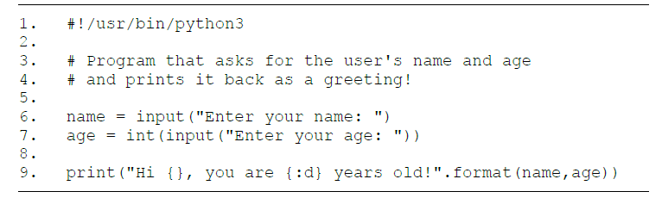
Getting Started with Programs
Let us start with a program that asks the user to enter his/her name and age and prints it back in the form of a greeting.
In line 9, the “:d” format is being applied on age to print it in decimal (though that is the default for an int anyway and would have printed the same as a string too).

Slide 6
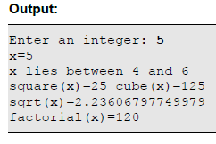
Getting Started with Programs
Let us now write a program that performs some basic operations on integers like:
Finding it's previous and next integer
Finding it's square and cube
Finding it's square root and factorial
import math
x = int(input("Enter an integer: "))
print("x={}".format(x));
print("x lies between {} and {}".format(x-1,x+1))
print("square(x)={} cube(x)={}".format(x**2,pow(x,3)))
print("sqrt(x)={}".format(math.sqrt(x)))
print("factorial(x)={}".format(math.factorial(x)))

Slide 7
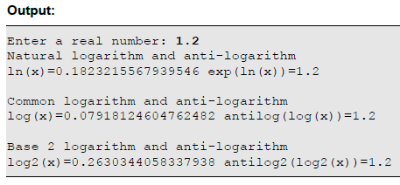
Getting Started with Programs
The next program will deal with logarithms and anti-logarithms
# Logarithms and anti-logarithms
import math
x = float(input("Enter a real number: "))
print("Natural logarithm and anti-logarithm")
print("ln(x)={} exp(ln(x))={}".format(math.log(x), math.exp(math.log(x))))
print("\nCommon logarithm and anti-logarithm")
print("log(x)={} antilog(log(x))={}".format(math.log10(x), pow(10,math.log10(x))))
print("\nBase 2 logarithm and anti-logarithm")
print("log2(x)={} antilog2(log2(x))={}".format(math.log(x,2), pow(2,math.log(x,2))))
The log() function gives the natural logarithm by default, and exp() is the
natural anti-logarithm

Slide 8
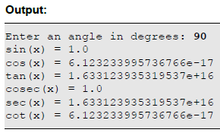
Getting Started with Programs
The next program deals with trigonometry:
# Trigonometry demo
import math
angle = float(input("Enter an angle in degrees: "))
angle = math.radians(angle) # Conversion from degrees to radians
print("sin(x) =",math.sin(angle))
print("cos(x) =",math.cos(angle))
print("tan(x) =",math.tan(angle))
print("cosec(x) =",1/math.sin(angle))
print("sec(x) =",1/math.cos(angle))
print("cot(x) =",1/math.tan(angle))

Slide 9
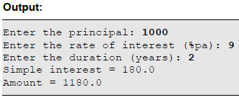
Getting Started with Programs
Problem: Write a program to print the simple interest and amount, given the principal, the rate of interest (in percentage per annum) and the time (in years).
# Program to find the simple interest and amount
p = float(input("Enter the principal: "))
r = float(input("Enter the rate of interest (%pa): "))
t = float(input("Enter the duration (years): "))
si = (p*t*r)/100
amount = p + si
print("Simple interest={}",si)
print("Amount={}",amount)

Slide 10
Decisions
One of the fundamental control flow statements any programming language provides is the support for decisions – to conditionally execute a piece of code. Python provides the if Statement to implement decisions. Like most other programming languages, this has many forms – each of which will be discussed in the following sections.

Slide 11
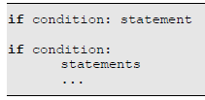
Decisions
The if Statement
The simple if Statement conditionally executes a statement or a block of statements. It's syntax is shown below:
The statements inside the if block are identified by their indentation! To keep things simple, for now we'll use a single tab character per level of indentation.
In the first form shown above, if the condition evaluates to True, the following statement is executed. If the condition evaluates to False, that statement is skipped and control moves on to the next line.

Slide 12
if Statement
# Program that asks for the user's name and age
# and prints whether the user is eligible to vote or not!
name = input("Enter your name: ")
age = int(input("Enter your age: "))
if age >= 18: print("Hi {}! You can vote!".format(name))
if age < 18: print("Sorry {}! You can’t vote!".format(name))
Observation:
1. The condition for a person to be able to vote is age >= 18. Similarly, the
condition for a person to not be able to vote is age < 18.
2. Only one of the two conditions above can be true for any given value of age

Slide 13
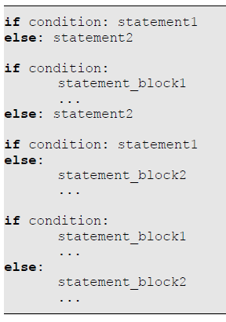
The if-else Statement
In such situations, we prefer using the if-else statement instead of 2 different if statements. Using if-else is more advantageous because only 1 condition drives the flow of control, thereby being more simple, more manageable and more efficient. The syntax of the if-else statement is given below:

Slide 14
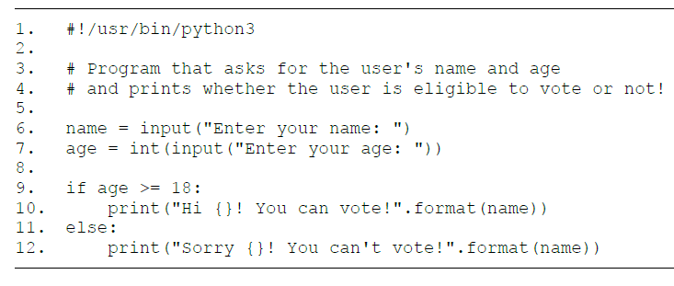
The if-else Statement

Slide 15
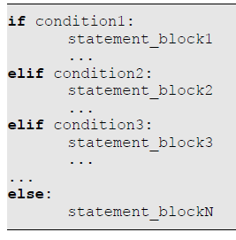
The if-elif-else Statement
Let us take the mutual exclusion concept a little further. We have so far concluded that if 2 conditions are mutually exclusive, we can use a single if-else statement instead of 2 independent if statements. Similarly, if we have more than 2 mutually exclusive conditions, we can use the if-elif-else statement. It's syntax is given below:

Slide 16
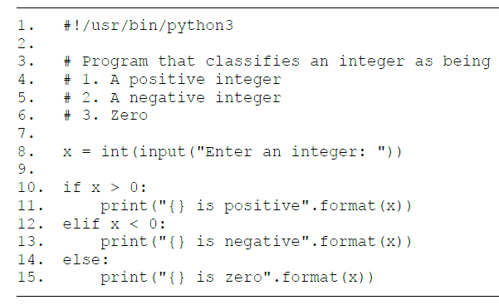
The if-elif-else Statement

Slide 17
The if-elif-else Statement
Let us write a program that classifies a given pair of coordinates. It has to tell us one of the following:
1. The point is on the origin
2. The point is on the x-axis
3. The point is on the y-axis
4. The quadrant the point belongs to, otherwise

Slide 18
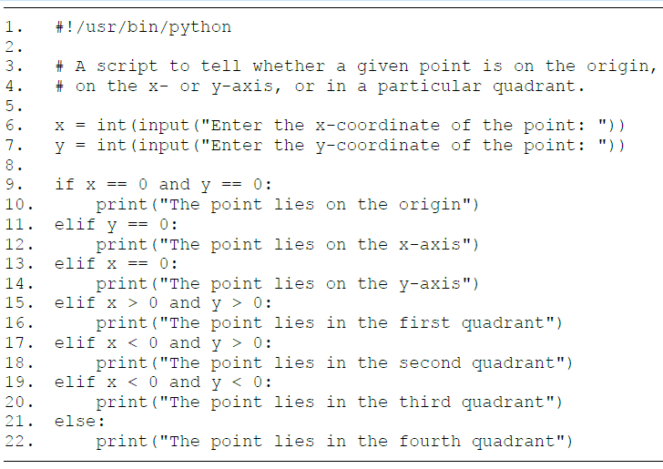
The if-elif-else Statement

Slide 19

The if-elif-else Statement
Let us write a program that finds the roots of a quadratic equation ax2+bx+c=0 using the formula:
We will also classify the roots of the equation based on the discriminant (b2-4ac) as follows:
1. Real and equal, if discriminant is 0
2. Real and distinct, if discriminant > 0
3. Imaginary, if discriminant < 0

Slide 20
The if-elif-else Statement
#!/usr/bin/python
# Script to classify and determine
# the roots of a quadratic equation
import math
a = int(input("Enter the value of a: "))
b = int(input("Enter the value of b: "))
c = int(input("Enter the value of c: "))
discriminant = b**2 - 4*a*c
if discriminant == 0:
print("The roots are real and equal")
x = -b/(2*a)
print("The root is",x)
elif discriminant > 0:
print("The roots are real and distinct")
part1 = -b/(2*a)
part2 = math.sqrt(discriminant)/(2*a)
x1 = part1 + part2
x2 = part1 - part2
print("The roots are", x1, "and", x2)
else:
print("The roots are imaginary")
part1 = -b/(2*a)
part2 = math.sqrt(-discriminant)/(2*a)
x1 = complex(part1, part2)
x2 = complex(part1, -part2)
print("The roots are", x1, "and", x2)

Slide 21
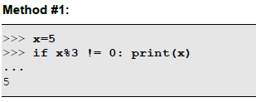
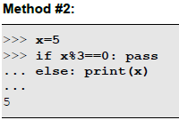
Empty Blocks and the pass Keyword
There are situations when we need a block to be empty – something that is not permitted in Python. This could be because out of the many conditions that we would like to handle in particular ways, there might be certain exceptions that we don't want to process at all.
To demonstrate the usage of pass, consider the objective of printing the value of the variable x if it is not divisible by 3. Here are 2 ways of doing it:

Slide 22
Nested if Statements
An if statement within an if statement is called a nested if statement. Of course, the inner if statement can be within either the if block or an elif block or the else block of the outer if statement. The indentation level helps Python realize to which block a statement belongs to. Statements belonging to the inner if will be indented one level deeper than statements belonging to the outer if.

Slide 23
Nested if Statements - Example
Let us write a program that accepts a word from the user and tells us which of the following attributes hold good on the complete word:
• Alphanumeric characters
• Alphabetic characters
• Uppercase characters
• Lowercase characters
• Titlecase characters
• Numeric characters
• Whitespace characters

Slide 24
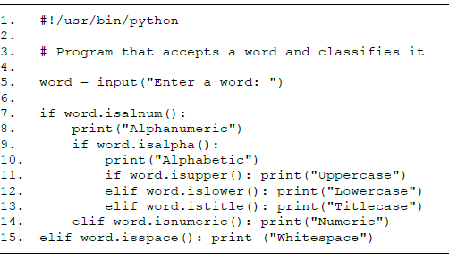
Nested if Statements - Example

Slide 25
Thank for your Attention
Any Question?

