Slide 1


Slide 2


Basic programming Session10: FUNCTIONS
CS1401-2
2
Notes:
2

Slide 3
Functions
In this session you will be able to:
Define Functions and call them.
Pass and Receive Positional Arguments, Default Arguments, Keyword Arguments and Variable Arguments.
Return single values as well as collections from functions.
Define and use nested functions and lambda expressions.
Unpack arguments from collections and pass them as function arguments.

Slide 4
Introduction to Functions
Functions are self-contained blocks of code to perform a specific task. Functions are used for the following reasons:
They help reduce code redundancy: when the same piece of code is required in multiple places within a program, the piece of code can be converted into a function, which can then be called whenever and wherever required within the program.
They help increase code reusability: a function once defined can be called any number of times and can even be called from other programs
They help improve program clarity: putting all instructions in one place results in cluttering, making the program difficult to read, understand and maintain.

Slide 5
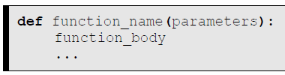

Function Definition
Before a function can be called, it needs to be defined.
The function definition contains the body of the function – the instructions that constitute what will happen when the function is called. A function definition has the following syntax:
The def keyword specifies that we are defining a function.
The function name should be a valid identifier.
The function body is a sequence of instructions and can span any number of lines (including blank lines).
Here is the definition of a function called hi that prints “Hello World” when called:

Slide 6

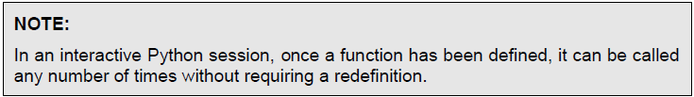
Function Call
Once a function has been defined, it can be called as many times as required, from almost any place thereafter in the script and with any arguments as required.
A function call is identified by the parentheses () that immediately follow the function name.
Thus, the function hi defined earlier can be called in the following manner:

Slide 7
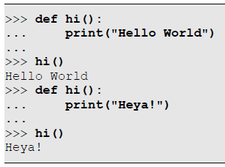
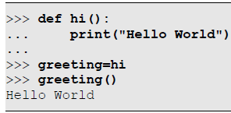
Function Call
Functions once defined can be redefined later to perform a different task. The latest definition seen will be used when a function call is executed:
A function name without the parentheses is a reference to the function and as such can be stored in variables and used later as a replacement for the original function name:

Slide 8
Positional Arguments
While a function is a self-contained piece of code, it does interact with the calling routine in 2 ways:
It can receive parameters from the calling routine
It can return a value back to the calling routine

Slide 9
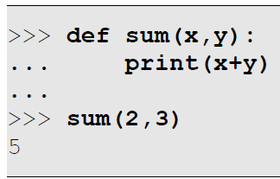
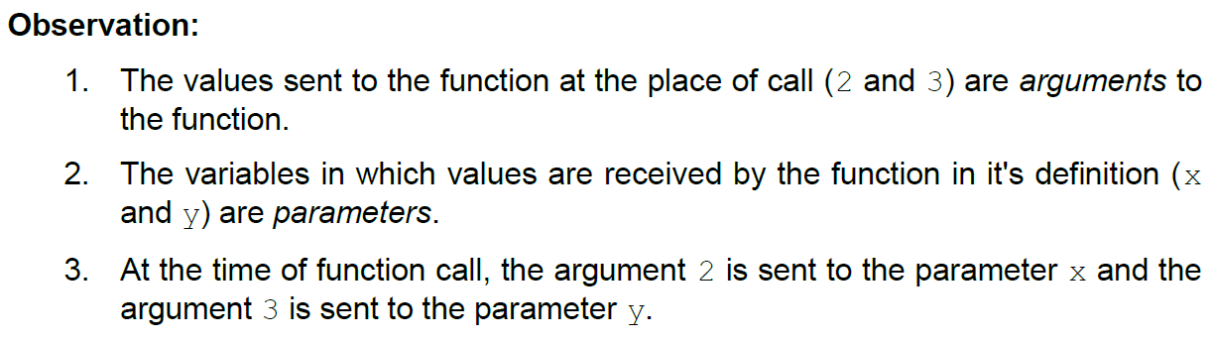
Positional Arguments
A function can not only perform a specific task it was meant to do, it can also receive inputs from the caller in order to perform the task.
Arguments: The values that are sent to a function as part of the function call.
Parameters: The values that are received by the function in it's definition.

Slide 10
Default Arguments
Ideally, the number of parameters in the function definition and the number of arguments in the function call would be the same.
Default argument values are values that are assumed to be present if not provided explicitly. This makes the argument optional at the place of call, but the parameter compulsory.
If the programmer is happy with the default value for the parameter, the programmer saves the effort of having to provide it manually at the place of call.
On the other hand, if the programmer is not happy with the default value, it can be overridden by providing it explicitly like any other argument.

Slide 11
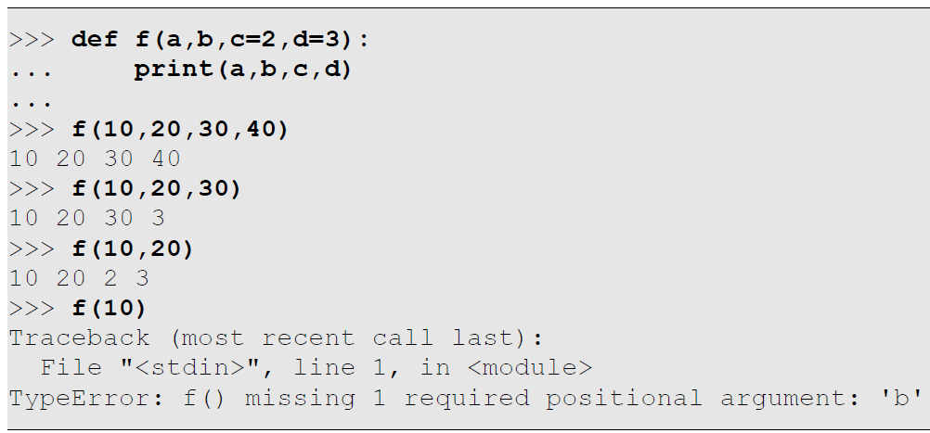
Default Arguments
Here is an example of a function that receives 4 parameters – 2 of them are compulsory, like the previous example, while 2 of them are optional with default values:

Slide 12
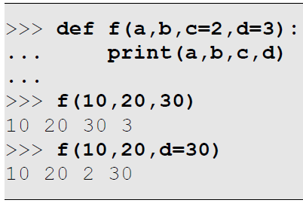
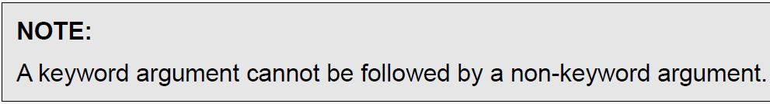
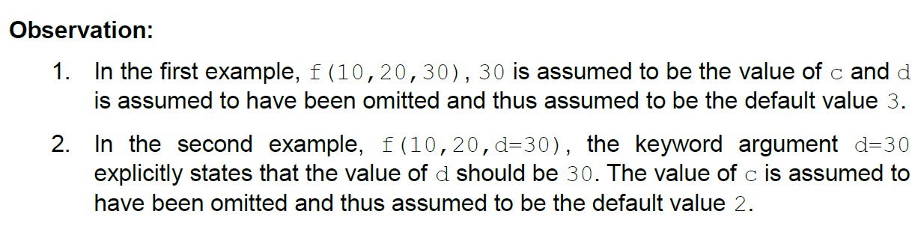
Keyword Arguments for Default Arguments
One of the problems in using default arguments is that the order has to be retained.
Thus, given 2 default consecutive arguments, it is not possible to skip the first one while providing an explicit value for the second one. But this becomes possible now using keyword arguments as shown below:

Slide 13
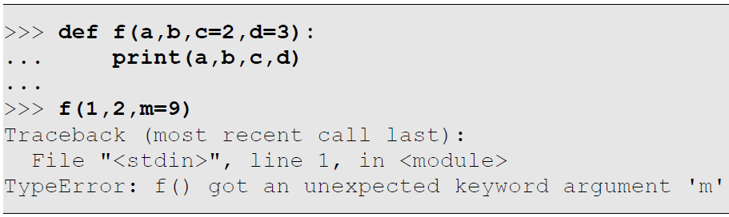
Keyword Arguments for Additional Arguments
When keyword arguments are to replace positional parameters or default arguments, as shown in the previous sections, it is an offence to provide a keyword argument for a parameter that does not exist in the parameter list, as shown in the example below:

Slide 14
Keyword Arguments for Additional Arguments
It is however possible to invent additional keyword arguments that are not even present in the formal parameter list! These additional keyword arguments can then be received as a dictionary, the keys of which are parameter names and values are argument values. The special syntax ** prefix is used for this purpose as shown in the example in the next slide.

Slide 15
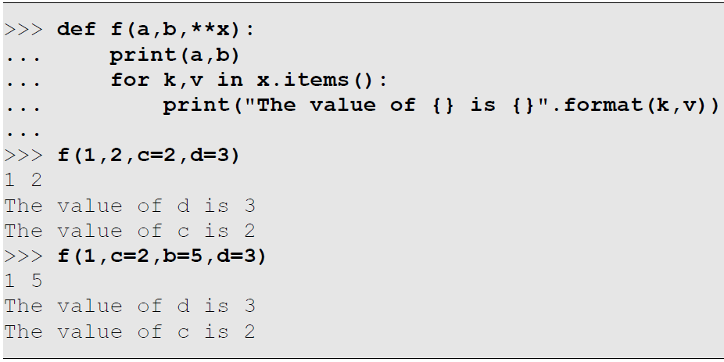
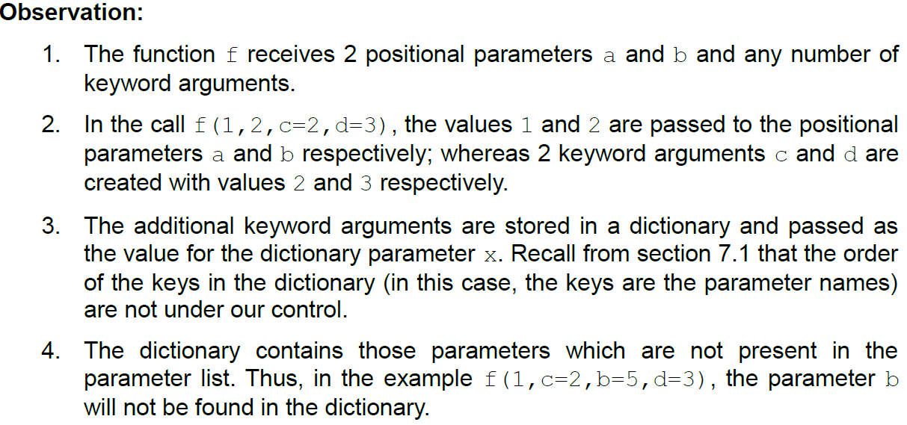
Keyword Arguments for Additional Arguments

Slide 16
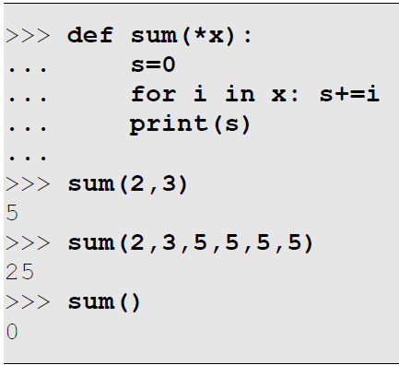
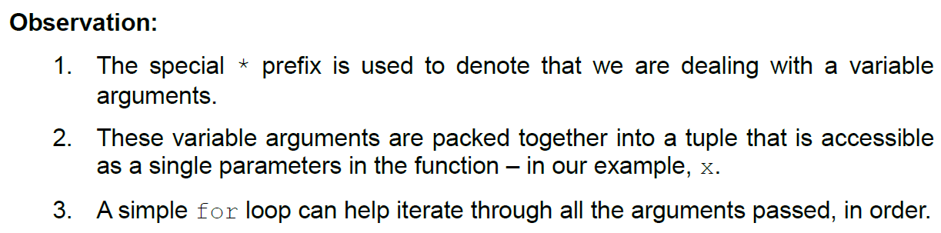
Variable Arguments
A function in Python can be designed to receive any number of arguments. In other words, the number of arguments can vary from call to call.
For example, consider a function sum that is supposed to add multiple values. We do not know how many values will be provided – in some calls there may be only 2 values, but some other calls may provide 5 values for example. Here is an example of how we could write the function sum using the concept of variable arguments:

Slide 17
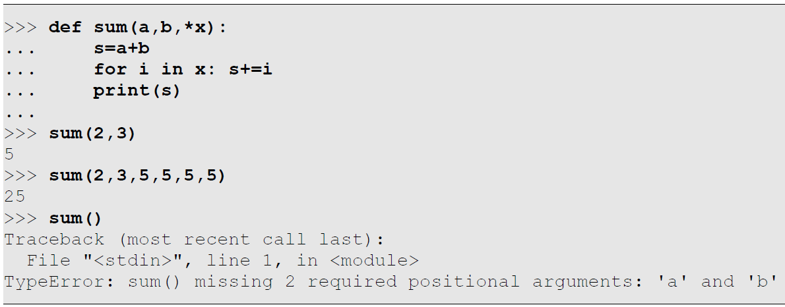
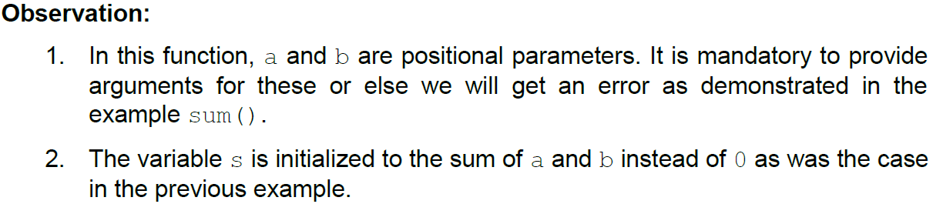
Variable Arguments With Positional Parameters
It is possible to combine positional parameters with variable arguments. These are helpful in cases where we expect a known number of values followed by an optional sequence of additional values. Let us redesign the sum function to add at least 2 values when called:

Slide 18
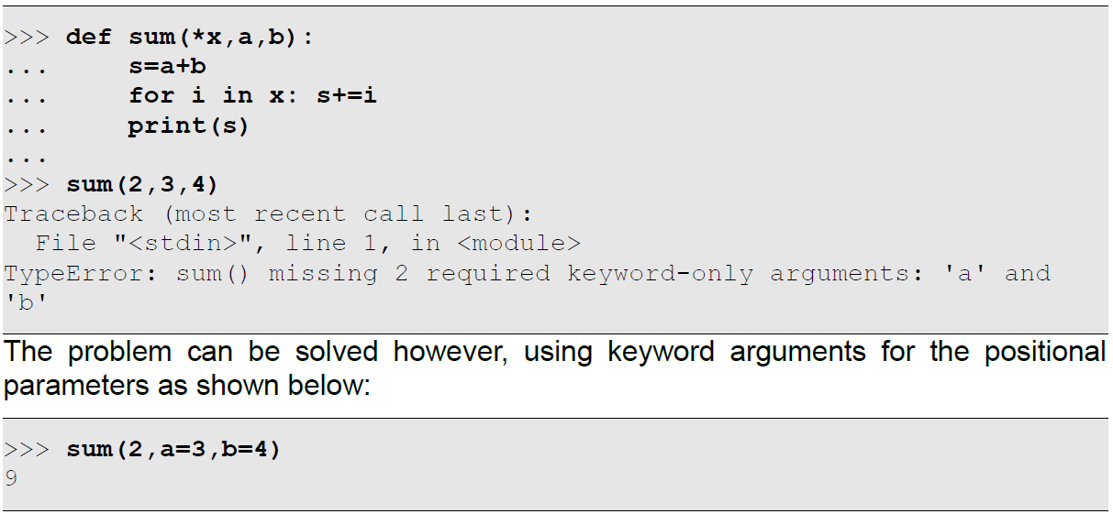
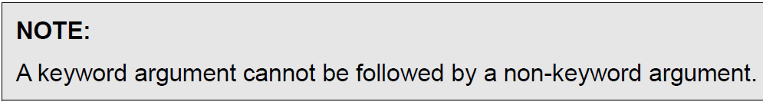
Variable Arguments With Positional Parameters
The * parameter (x in our previous example) is greedy and will take up all remaining arguments. Therefore, we will never provide positional parameters after variable arguments, as demonstrated by this example:

Slide 19
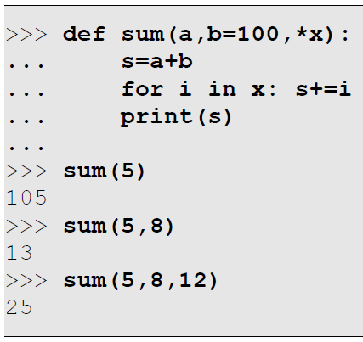
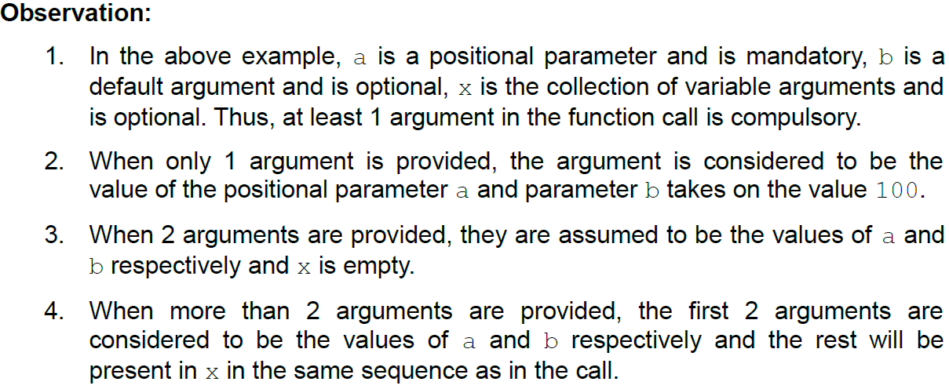
Variable Arguments With Default Arguments
Default arguments are optional and variable arguments are greedy! Here is an example to show how the combination behaves:

Slide 20
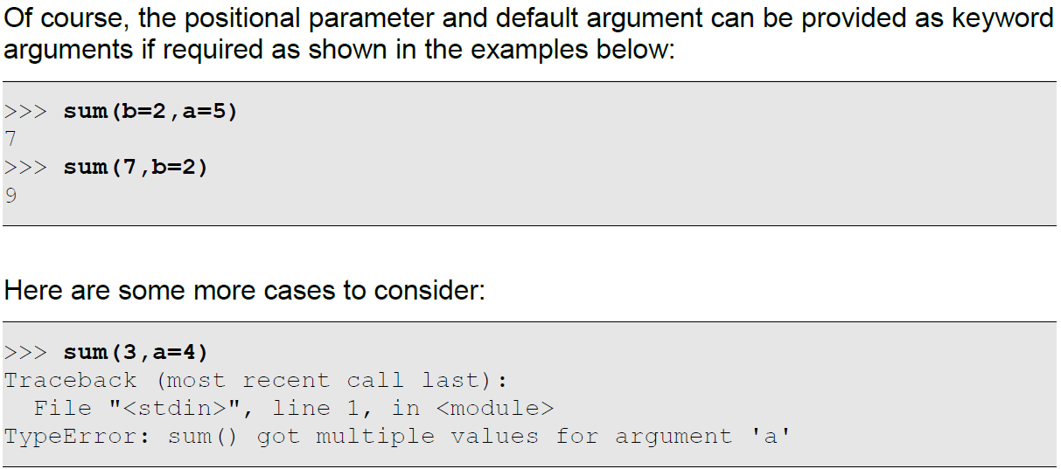
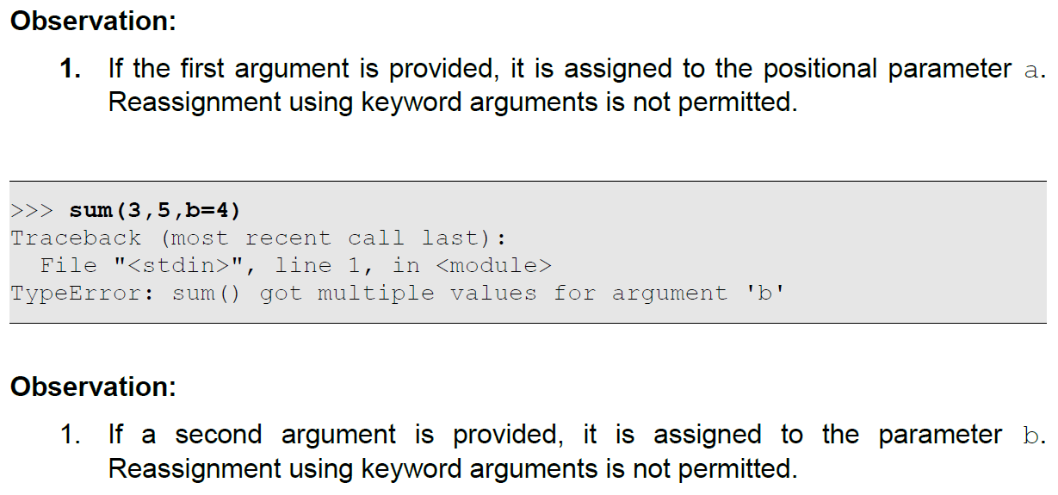
Variable Arguments With Default Arguments

Slide 21
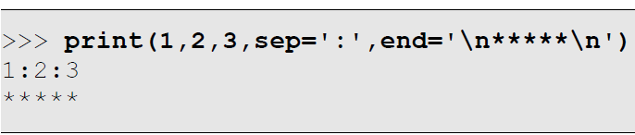
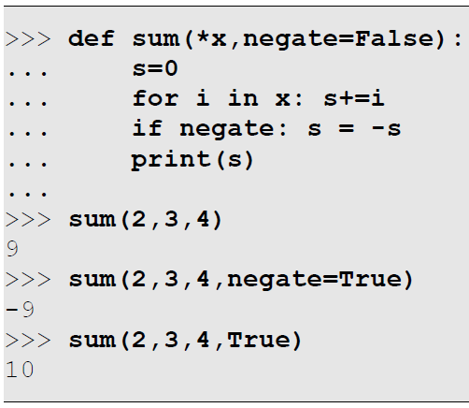
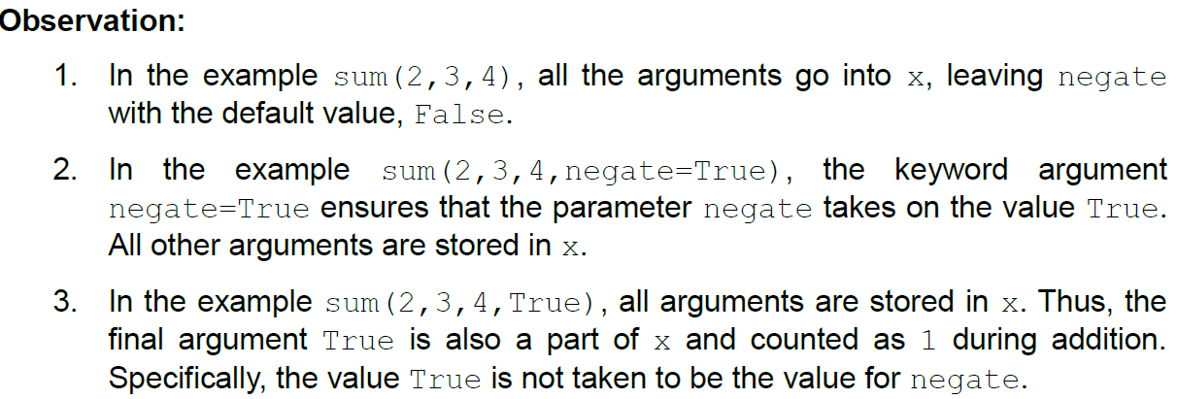
Variable Arguments Followed by Default Arguments
As a special case, if variable arguments are followed by default arguments, the result is that the value for the default argument can only be explicitly provided using keyword arguments.
Recollect the built-in print() function: it obviously supports variable arguments since it can print any number of values. It also uses a separator with a default value of space and a terminator with a default value of newline. The only way to specify a custom separator or terminator is by using keyword arguments:
Here is a function sum that receives variable arguments along with a default argument following it:

Slide 22
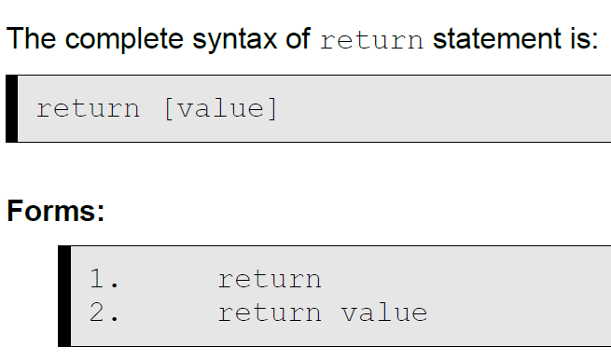
Returning From Functions
When a function is called, it returns automatically after it's entire body executes by default. It is possible to ensure that the function returns immediately, whenever required, using the return statement. On execution, the return statement immediately transfers control back to the caller.

Slide 23
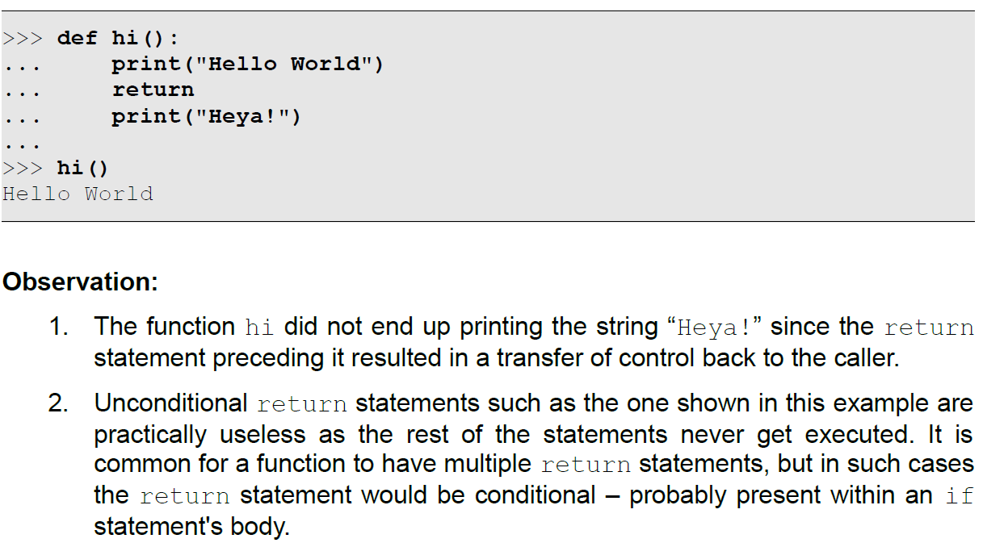
Returning From Functions – Form1

Slide 24
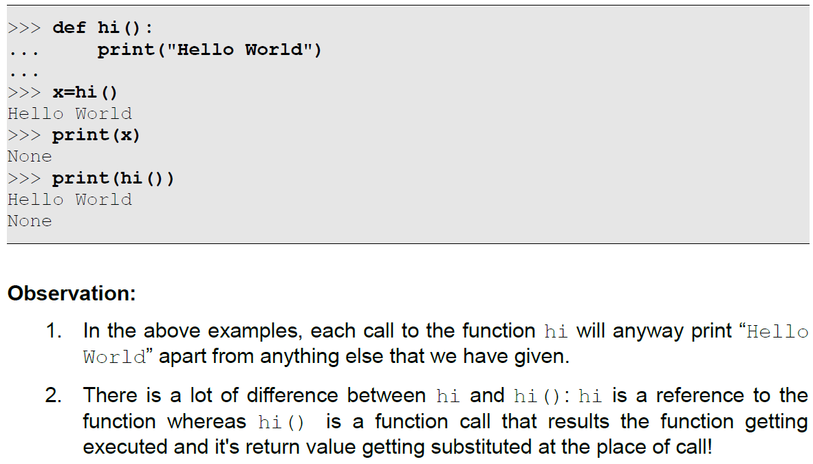
Returning Single Values From Functions
The previous function did not return any value back to the caller.
As per the definition of functions in classical computer science, a function must return a value.
Python acknowledges this rule by ensuring that functions that return nothing end up returning None by default! This can be verified by assigning the function call to a variable and examining it's value or directly printing the value returned by the function call, both of which are shown below:

Slide 25
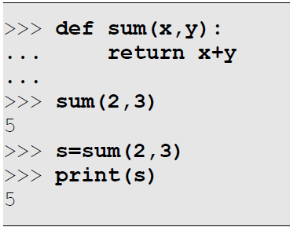
Returning Single Values From Functions
But what is practically more useful however is that we can return values from functions. The return statement also permits the optional return of a single value that will be substituted at the place of call.
We have dealt with the sum function many times before, but each time it was printing the result on the standard output. This time, we will modify it to return the sum instead of printing it:

Slide 26
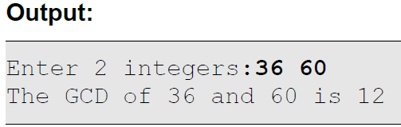
Program to find the GCD of 2 integers using functions
# Program to find the GCD of 2 integers using functions
def gcd(x,y):
if x==y: return x
elif x>y: return gcd(x-y,y)
else: return gcd(x,y-x)
x,y = input("Enter 2 integers:").split(' ')
x,y = int(x),int(y)
print("The GCD of {} and {} is {}".format(x,y,gcd(x,y)))

Slide 27


Program to classify a given number as prime or composite
3. # Program to classify a given number as prime or composite using functions.
def isPrime(n):
for i in range(2,int(n/2)+1):
if n%i==0: return False
return True
n = int(input("Enter a positive integer: "))
if isPrime(n): print("Prime")else: print("Composite")

Slide 28
Returning Collections From Functions
There is a restriction that only a single value can be returned from a function. What if we want a function to return multiple values? An intelligent solution is to return a single collection instead! The collection could be a list, a tuple or a dictionary.

Slide 29
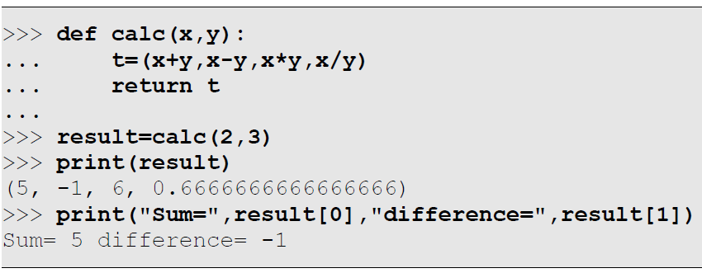
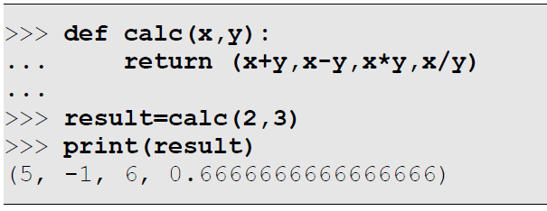
Returning Tuples From Functions
Here is a function called calc that returns a tuple containing the sum, difference, product and quotient after division, given 2 inputs x and y:
Of course, we do not necessarily need the temporary variable t in the function, and the function can as well be defined as follows:

Slide 30
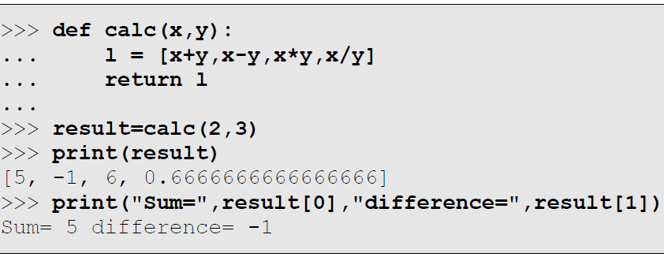
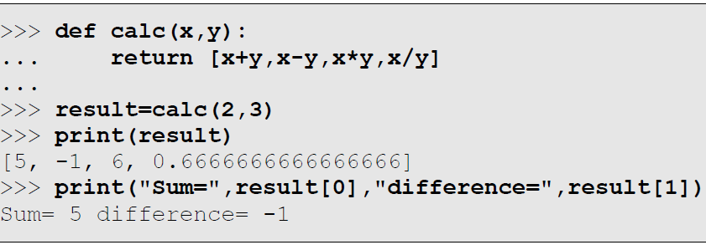
Returning Lists From Functions
Here is a function called calc that returns a list containing the sum, difference, product and quotient after division, given 2 inputs x and y:
Of course, we do not necessarily need the temporary variable l in the function, and the function can as well be defined as follows:

Slide 31
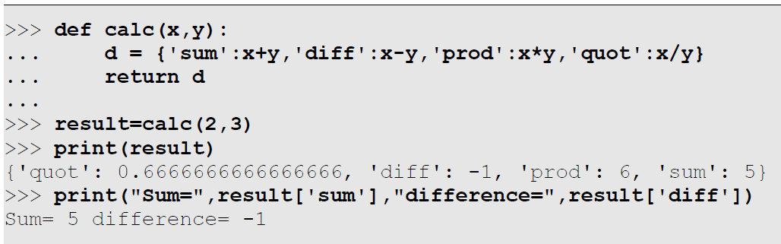
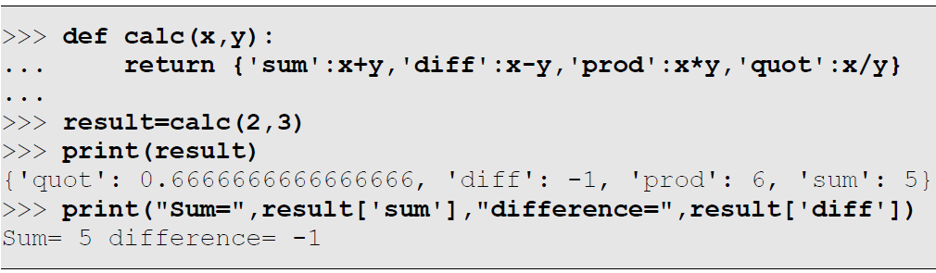
Returning Dictionaries From Functions
Here is a function called calc that returns a dictionary containing the sum, difference, product and quotient after division, given 2 inputs x and y:
Of course, we do not necessarily need the temporary variable d in the function, and the function can as well be defined as follows:

Slide 32
Global Variables
Global variables are variables that are accessible throughout the script – including inside functions as well as outside of all functions. While this makes it convenient for multiple functions to share the same variable(s), it is frowned upon as being an unprofessional practice for the following reasons:
Global variables are invisibly tied to the function.
Global variables are shared by all functions
The dependency of the function on the global variable makes it more difficult to reuse the function across programs
When multiple such functions co-exist within the same program, there can be confusion related to which globals are used by which functions.
Global variables continue to exist till the end of the program
Thus, it is a bad idea to use global variables. But for now, we will continue with this topic and see how to make it possible to use globals in functions nevertheless.

Slide 33
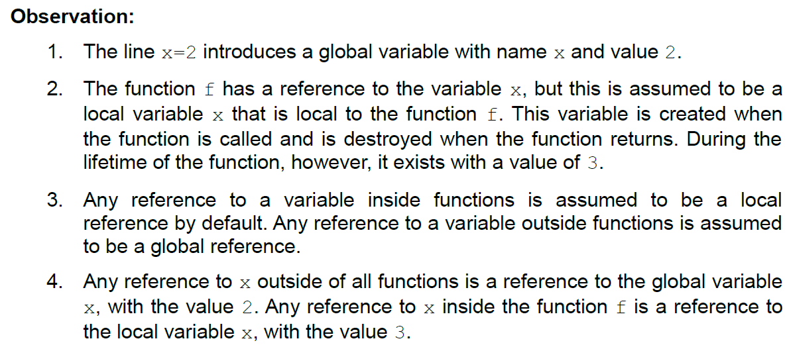
Global Variables
All variables used inside functions are local to the function by default. In other words, Python helps you by assuming you always want locals instead of globals. This is illustrated in the example below:
>>> x=2
>>> def f():
... x=3
... print(x)
...
>>> print(x)
2
>>> f()
3
>>> print(x)
2

Slide 34

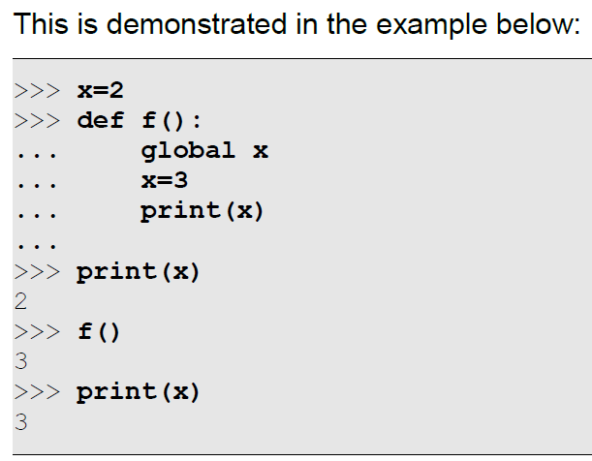
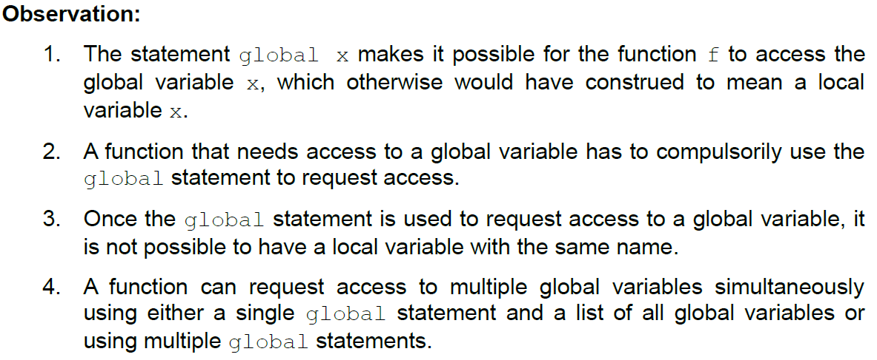
Global Variables
What if in the previous example, we want the function to use the global variable x instead of creating a new local variable? We make this intention known to Python using the keyword global to seek access to one or more global variables as shown in the syntax below:

Slide 35
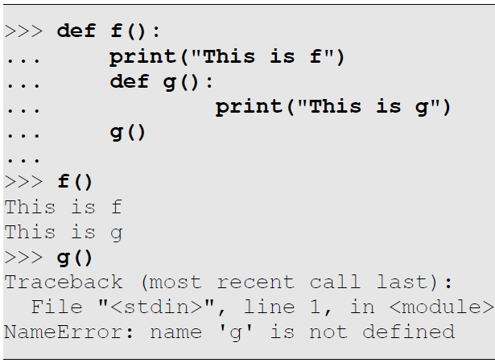
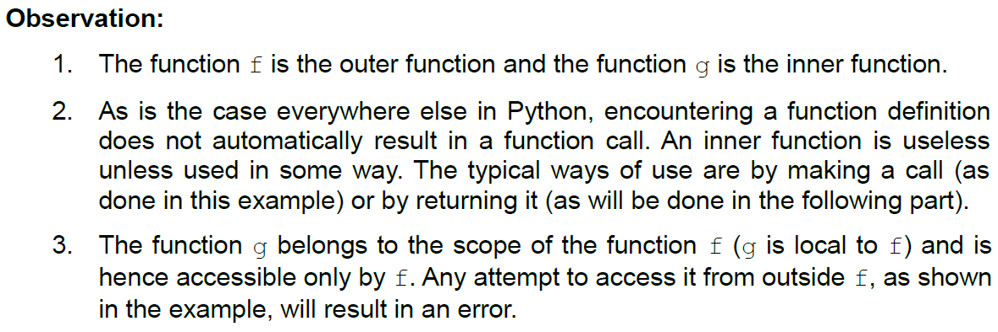
Nested Functions
A function defined within another function is called a nested function. In such cases, we differentiate between these functions using the terminology of outer function and inner function. Thus, the inner function is the one that is defined inside of the outer function, is local to the outer function, and accessible only to the outer function.

Slide 36

Lambda Expressions
Python provides a convenient mechanism for creating anonymous functions called Lambda Expressions and permits invoking them using their reference.
Lambda expressions are ideally used when we have something simple to be done (something that can fit within a single expression), and we are more interested in quickly getting the job done rather than formally naming the function.
Before we go on to powerful examples, let us consider some simple ones. But first, here is the syntax of a lambda expression:

Slide 37
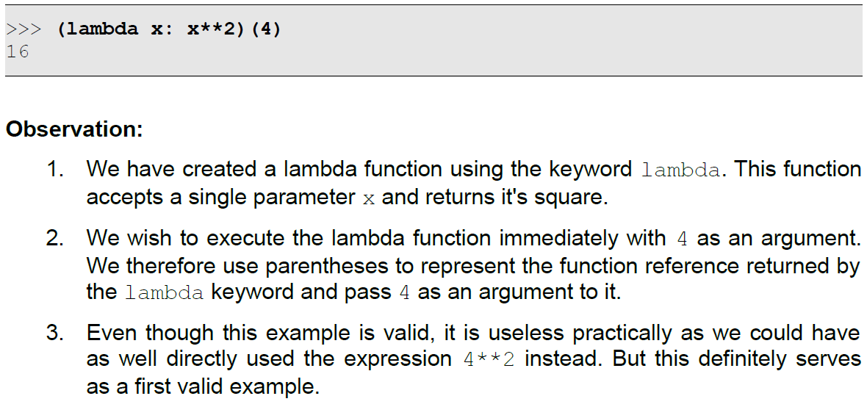
Lambda Expressions
A lambda can receive 0 or more parameters (just like functions) and end up returning the value of the expression on execution. Here is the first example:

Slide 38
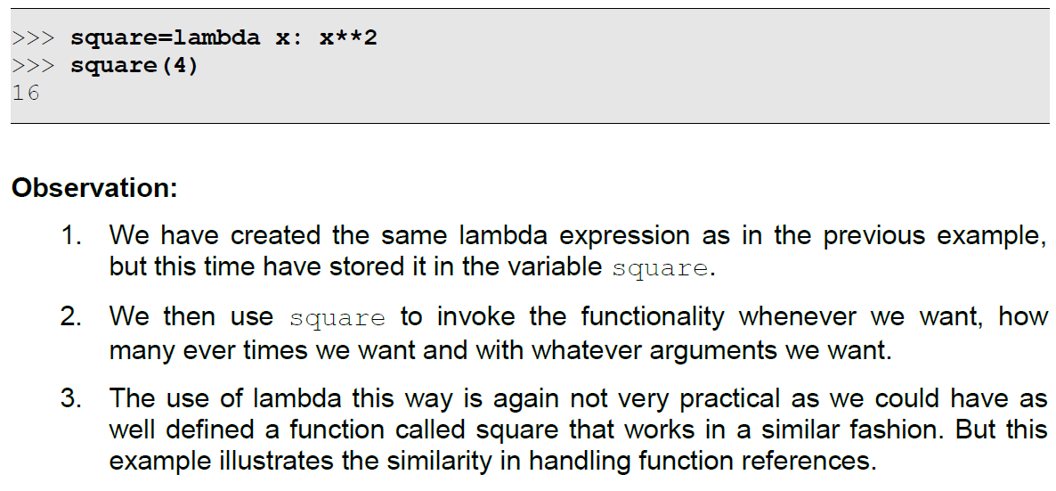
Lambda Expressions
Since the keyword lambda manufactures a function and returns it's reference, we can store the function reference in any variable and then use that variable like a function. This is illustrated below:
Lambda expressions are especially useful when function objects are required. A function object is a reference to a function that can be stored (in variables), passed around in the script (as arguments to functions and return values from functions) and can be invoked whenever required.

Slide 39
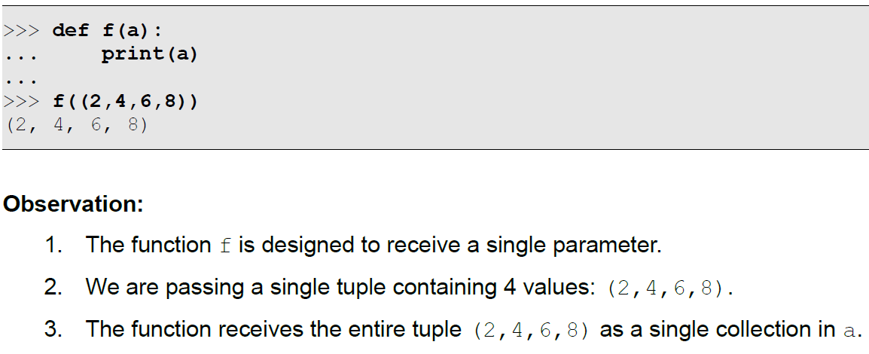
Unpacking Argument Lists
When a collection is passed as an argument to a function, it is received as a collection object only and not as individual elements of the collection. To illustrate, consider the following example:

Slide 40
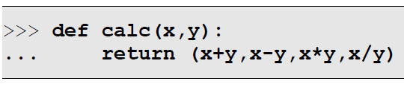
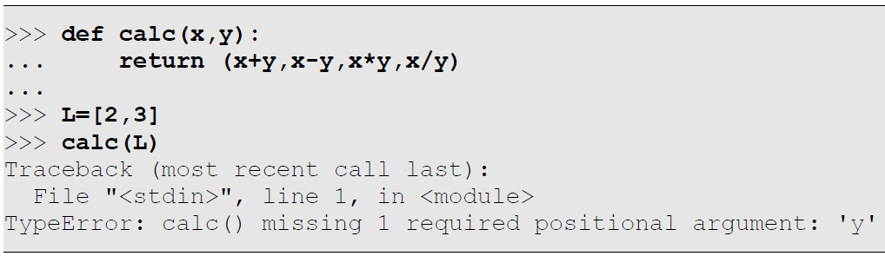
Unpacking Argument Lists
This behavior is useful when we specifically want a function to receive collections like tuples, lists, sets and dictionaries. But what if we have multiple values already stored in a collection and we wish to send them as individual arguments to a function?
Given 2 values, this function will return as tuple containing their sum, difference, product and quotient.
If we have the 2 input values already in a list, we will not be able to directly pass the list as an argument as it will be considered to be a single list argument, as illustrated below:

Slide 41
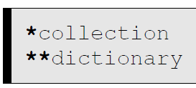
Unpacking Argument Lists
The solution is argument unpacking: extracting individual elements from a collection and considering them to be individual arguments. The syntax for argument unpacking is shown below:

Slide 42
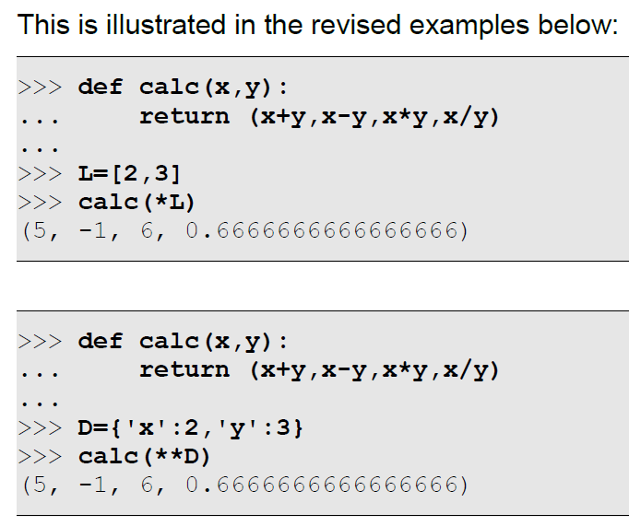
Unpacking Argument Lists
Note:
The *collection syntax is used for tuples, lists and sets whereas the **dictionary syntax is used specifically for dictionaries.
The *collection syntax expands the collection into arguments that can either map on to corresponding parameters of a function or can be received as variable arguments using the *args syntax.
The **dictionary syntax expands the dictionary into keyword arguments that can either map on to corresponding named parameters of a function or can be received as additional keyword arguments using the **kargs syntax.

Slide 43
HomeWork6
Write a program to find the combination of 2 integers using functions.
Write a function in Python to calculate and return the average of a given list of integers.
Write a script in Python to demonstrate nested functions.
Write a lambda expression to convert a given angle from degrees to radians.
Write a function to find the distance between 2 points, where each point is passed as a tuple to the function.

Slide 44
Thank for your Attention
Any Question?

