Slide 1


Slide 2


Basic programming Session3: PYTHON BASICS
CS1401-2
2
Notes:
2

Slide 3
PYTHON BASICS
In this session you will be able to:
Understand how statements make up a Python script.
Work with the basic data types of Python and operate upon them.
Understand how to use variables in Python and differentiate between references and objects.
Take input from the user and generate formatted output.

Slide 4
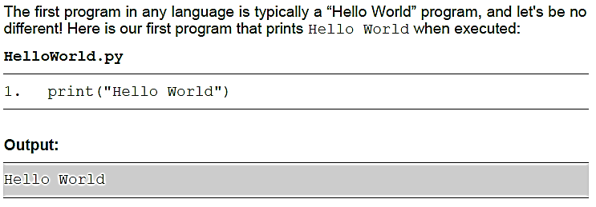
Our First Python Script
Type the above program in your favourite text editor or IDE (See session 2 for help in selecting) and execute it.

Slide 5
Statements and Lines
A statement is a unit logical instruction to the interpreter. Our HelloWorld.py program was made up of just 1 statement. A program, therefore, is an integral collection of statements.
A line is a sequence of characters terminated by the newline character. Our Helloworld.py program was a 1-line program. Thus, our program was both a 1-line program as well as contained just a single statement.
Statements in most popular programming languages end with a semi-colon, but this is not the case in Python.
In Python, a line is typically considered to host 1 statement. Thus, as long as there is 1 statement per line, there is no need of using semi-colons at the end of the line.

Slide 6
Statements and Lines
Python relies on indentation rules to decide which statements belong to which block and uses the newline character as the statement terminator. In other words, a statement in Python is understood to be terminated in the same line.
Let us revisit Helloworld.py and write multiple statements – of course, one per line.
HelloWorld2.py
print("Hello World")
print("Hi from Iran!")
Output:
Hello World
Hi from Iran!

Slide 7
Multiple Statements Per Line
Python uses semi-colons as statement separators and this behavior is elaborated below:
As a statement separator, the role of a semi-colon is to ensure that multiple statements can be given in one line and the translator is able to differentiate them as separate statements because of the semi-colon separating them.
Let us revisit HelloWorld2.py and write multiple statements in a single line.
HelloWorld3.py
print("Hello World"); print("Hi from Iran!")
Output:
Hello World
Hi from Iran!

Slide 8
One Statement Spanning Multiple Lines
A single statement can span multiple lines if required, but this information needs to be conveyed to the Python interpreter. Any line that is going to be continued in the next line needs to end with a backslash (\).
Let us intentionally rewrite HelloWorld3.py using multiple lines.
HelloWorld4.py
1. print(\
2. "Hello \
3. World")
4. print("Hi fr\
5. om Iran!")
Output:
Hello World
Hi from Iran!

Slide 9
Quotation Marks
Strings in Python are enclosed in quotations, but unlike most other programming languages, Python does not differentiate between single quotes and double quotes.
Double Quotes
A string can well be enclosed in single quotes.
HelloWorld5.py
1. print('Hello World')
2. print('"Hi" from \'Iran\'!')
Output:
Hello World
"Hi" from 'Iran'!

Slide 10
Quotation Marks
Strings in Python are enclosed in quotations, but unlike most other programming languages, Python does not differentiate between single quotes and double quotes.
Double Quotes
Just like single quotes, a string can well be enclosed in double quotes too.
HelloWorld6.py
1. print("Hello World")
2. print("'Hi' from \"Iran\"!")
Output:
Hello World
'Hi' from "Iran"!

Slide 11
Quotation Marks
Strings in Python are enclosed in quotations, but unlike most other programming languages, Python does not differentiate between single quotes and double quotes.
Triple Quotes
Python also supports a special kind of quotation mark made up 3 single-quotes (''') or 3 double-quotes ("""). Triple quotes allow a string to span multiple lines.
HelloWorld7.py
1. print("""Hello World
2. 'Hi' from "Iran"!""")
Output:
Hello World
'Hi' from "Iran"!

Slide 12
Comments
Comments are pieces of text added within programs to improve the readability.
Comments are non-executable and the interpreter will ignore it's contents.
A comment in Python is indicated by the hash (#) symbol – everything from the hash till the end of that line is considered to be a comment.
HelloWorld8.py
1. #Script to print "Hello World"
2. #This two lines are comments
3. print("Hello World") #One more comment
4. print("Hi from Iran!")
Output:
Hello World
Hi from Iran!

Slide 13
Basic Data Types
One of the first things to learn in a programming language is what kinds of data types it provides.
We are going to cover the following data types in the following session:
1. Integers (int)
2. Real numbers (float)
3. Complex numbers (complex)
4. Strings (str)
5. Boolean (bool)

Slide 14
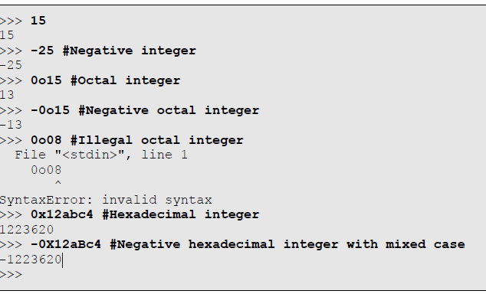
The int type
The simplest numeric data type to deal with is int. Objects of this type represent integers (both positive and negative) and cannot store a fractional part. The range is not limited in Python and we can store very large integers without worrying about whether Python will be able to handle it!

Slide 15

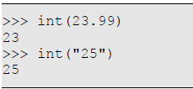
The int type
Objects of type int can also be created using the explicit constructor of class int.
This of course also resembles a function call for type conversion. Thus, the following two statements are identical in function:
This built-in function is also helpful for converting other types like float and string to the type int:

Slide 16
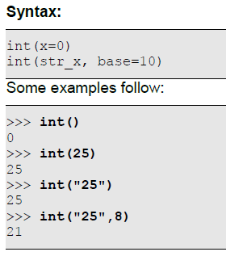
The int type
The default constructor of int class will create an integer with value 0, and a 2- argument constructor has been provided to convert a string representation of an integer in a particular base into a normal integer. The constructors have the following declaration:

Slide 17
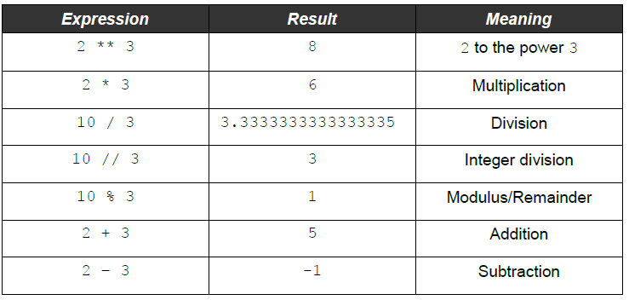
Operations on Type int
The following table lists out the arithmetic operators that can be used with data items of type int:

Slide 18
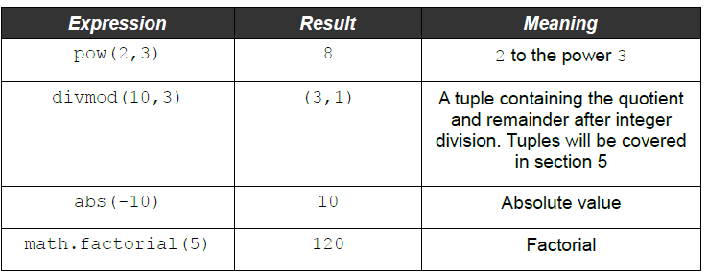
Operations on Type int
The following mathematical functions are available on type int:

Slide 19
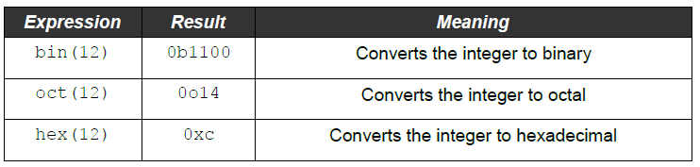
Operations on Type int
Objects of type int can be converted to other bases using these built-in functions:

Slide 20
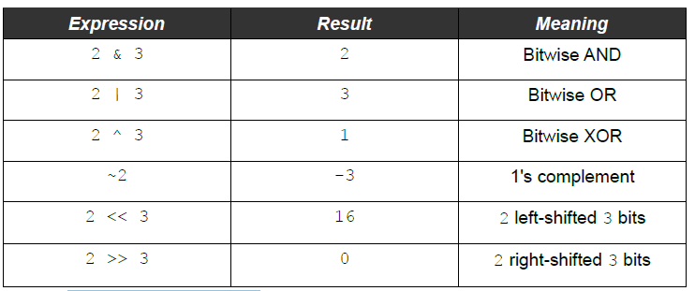
Bitwise operations on int
The following bitwise operators are available on type int:

Slide 21
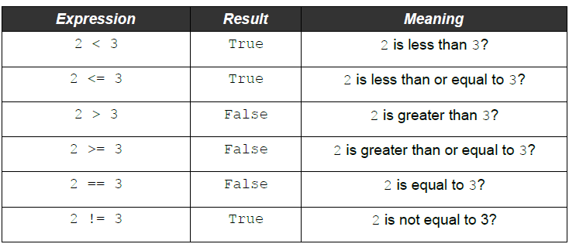
Comparison operations on int
The following comparisons are possible on type int:

Slide 22
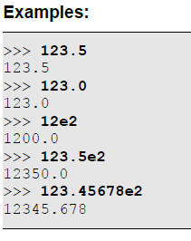
The float type
The float data type of Python allows us to store numbers that have a decimal part too.
Literals of Type float
Any literal constant made up of only digits (with an optional leading sign) with either a decimal point (.) or an exponentiation (e/E) is considered as a float constant.

Slide 23
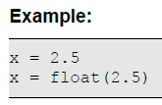
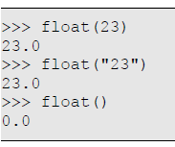
The float type
Objects of type float can also be created using the explicit constructor of class float.
This built-in function is also helpful for converting other types like int and string to the type float.

Slide 24
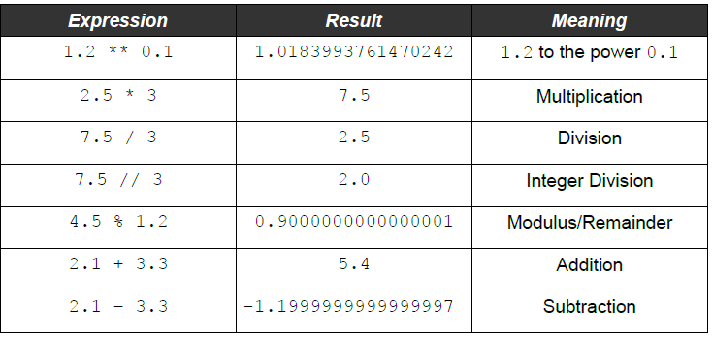
Operations on Type float
The following table lists out the arithmetic operators that can be used with data items of type float:
Arithmetic operations on float

Slide 25
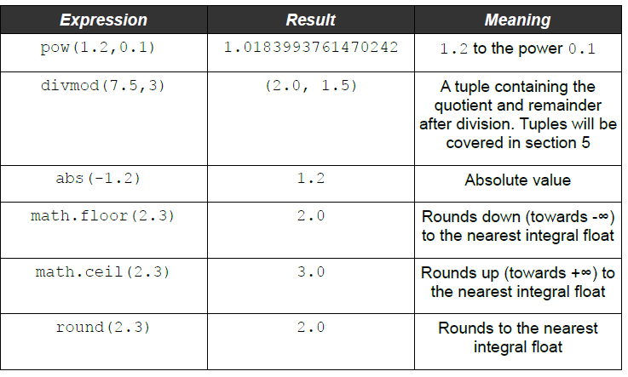
Operations on Type float
The following mathematical functions are available on type float:

Slide 26
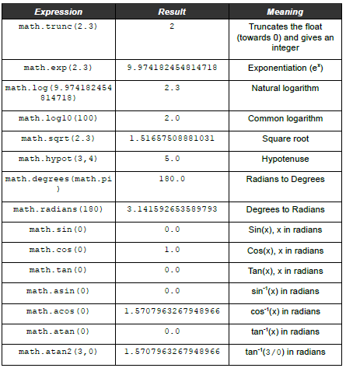
Operations on Type float

Slide 27
The str type
The string type (str) allows us to store non-numeric values in addition to numeric values.
Literals of Type str
Examples:
>>> 'Hello "World" from \’Iran\''
'Hello "World" from \'Iran\''
>>> "Hello \"World\" from 'Iran'"
'Hello "World" from \'Iran\''
>>> """Hello "World" from 'Iran'"""
'Hello "World" from \'Iran\''
>>> '''Hello "World" from 'Iran\''''
'Hello "World" from \'Iran\''

Slide 28
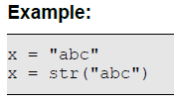
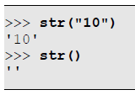
The str type
Objects of type str can also be created using the explicit constructor of class str.
This built-in function is also helpful for converting other types like int and float to the type str.

Slide 29
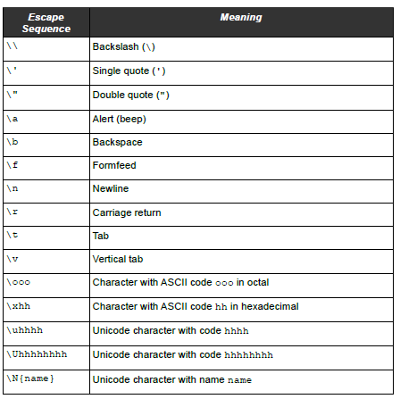
The str type
The following table shows the escape characters that can be used within strings:

Slide 30
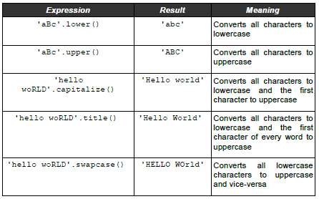
Operations on Type string
Many useful functions are present in the string class to process strings and while some of them are documented in the tables below.

Slide 31
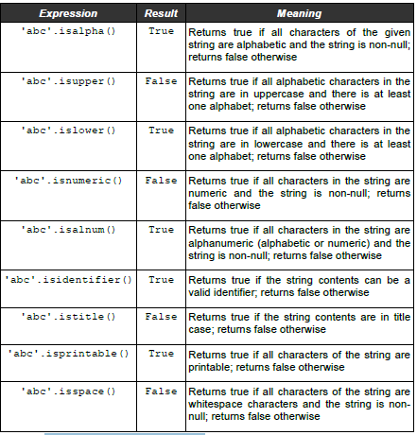
Content testing functions of string

Slide 32
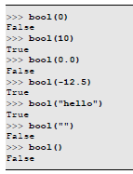

The bool type
The bool type allows us to represent Boolean values.
Objects of type bool can also be created using the explicit constructor of class bool.

Slide 33
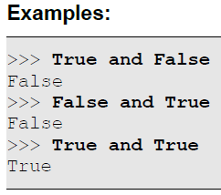
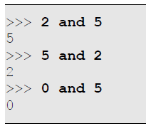
Operations on Type bool
The most common and practical operations on Boolean types are Boolean operations of and, or and not.
The and operator performs a logical AND operation.
consider the example x and y.
If x evaluates to False, the result is x
If x evaluates to True, the result is y

Slide 34
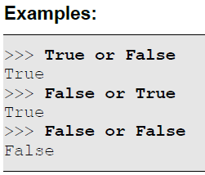
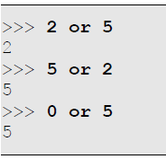
Operations on Type bool
The or operator performs a logical OR operation.
consider the example x or y.
• If x evaluates to False, the result is y
• If x evaluates to True, the result is x

Slide 35
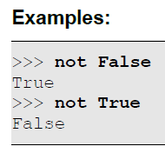
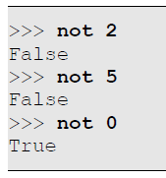
Operations on Type bool
The not operator performs a logical NOT operation.
consider the example not x.
• If x evaluates to False, the result is True
• If x evaluates to True, the result is False

Slide 36
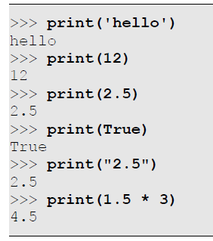
Basic Input and Output
Printing Using the print() Function
There are multiple ways of generating output from a Python script – the simplest method being using the print() built-in function. The print() function can print multiple objects one after another, with a user-defined separator string and a user-defined terminator string and with defaults in place.

Slide 37
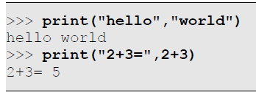
Printing Using the print() Function
Printing Multiple Items
To print multiple items, we pass all the items in sequence separated by commas as shown in the examples below.
Do not that they are automatically separated by spaces.

Slide 38
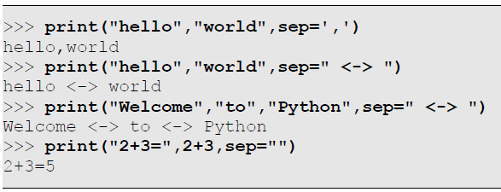
Printing Using the print() Function
Separating Items
If we want to print multiple items but do not want space to be the separator, we can pass the separator string as an argument to print() as shown in the examples below.

Slide 39

Formatting Strings Using the format() Function
The format() function searches the string for placeholders. These placeholders are indicated by braces({}) and indicate that some value needs to be substituted there.

Slide 40


Substituting Arguments
string.format(value1, value2...)
The format() function can receive multiple arguments which are implicitly numbered from 0.
#named indexes:
txt1 = "My familyname is {fname}, I'm {age}".format(fname = "Salehnasab", age = 41)
#numbered indexes:
txt2 = "My familyname is {0}, I'm {1}".format("Salehnasab",41)
#empty placeholders:
txt3 = "My familyname is {}, I'm {}".format("Salehnasab",41)
print(txt1)
print(txt2)
print(txt3)

Slide 41

Taking Input Using the input() Function
To receive any input from the user, the input() function can be used.
name=input()
language=input()
print('{} is learning {}'.format(name, language))

Slide 42

Taking an input After Prompting
As is evident from the output above, when the input() function is executed, it merely waits for the user to enter a line of input.
name=input("Enter your name:")
age=input("Enter your age:")
txt3 = "Your familyname is {}, You are {}".format(name, age)
print(txt3)

Slide 43
Thank for your Attention
Any Question?

