Slide 1


Slide 2


Basic programming Session5: Python Control Structures(Loops)
CS1401-2
2
Notes:
2

Slide 3
Python Control Structures(Loops)
In this session you will be able to:
Frame loop constructs to repeat instructions as many times as required.
Learn how to terminate control from a loop, a function, a block and a script.

Slide 4
Loops
It is now time to explore the final basic control structure – loops. A loop is defined as a set of statements executed over and over again.
A finite loop is one that runs a finite number of times and then passes control to the statement following it
An infinite loop is one that never terminates (and therefore might require user intervention to terminate it along with termination of the script, like pressing control+C).
A definite loop is one that runs a fixed number of times (and the number of times it runs is evident in the script)
An indefinite loop is one that runs as long as a condition is satisfied and without knowing the actual data, is impossible to predict exactly how many times.

Slide 5
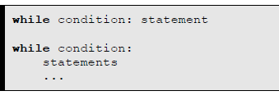
The while Loop
The simplest looping control structure in Python is the while loop. It's syntax is very similar to that of the if statement. While in the case of the if statement the condition is tested only once, in the case of the while statement the condition is tested till it evaluates to False, executing the body of the loop each time the condition evaluated True. Th statement, just like the if statement. Each time the loops runs, it is counted as an iteration. Thus, a loop typically is used when we want multiple iterations, controlled using a condition.
The syntax of the while loop is shown below:

Slide 6
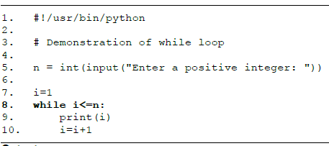
The while Loop
Let us write a program to print all integers from 1 to n, where n is given by the user.

Slide 7
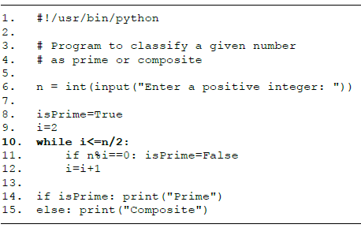
The while Loop
Let us write a program that tells whether a given number is prime or composite.

Slide 8
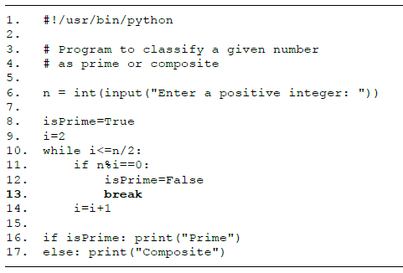
Using break in while
The break statement results in an immediate exit from a loop. This could be useful when another condition has been found in the body of a loop that should result in the immediate termination of the loop. On execution of the break statement, control flows to the first statement outside the loop.

Slide 9
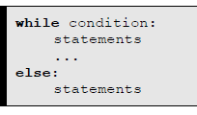
The while Loop with else Clause
The while loop also supports an optional else clause that can enclose a body which will be executed if control came out of the loop because of the loop condition evaluating to False.

Slide 10
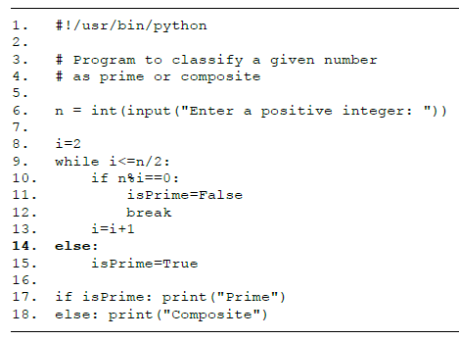
The while Loop with else Clause

Slide 11
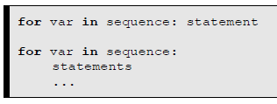
The for Loop
The for loop is another looping control structure provided by Python and can be very powerful and convenient at the same time. The for loop basically iterates over a sequence of items, and each time an item is found in the sequence, it will store it in the loop control variable and executes the body of the loop. It's syntax is given below:

Slide 12
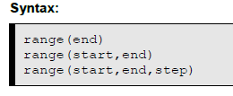
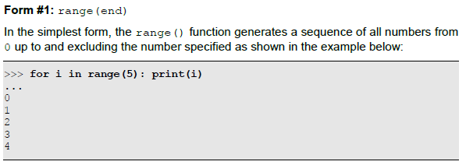
Using range() in for Loops

Slide 13
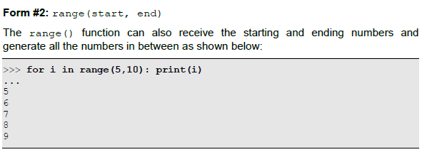

Using range() in for Loops

Slide 14
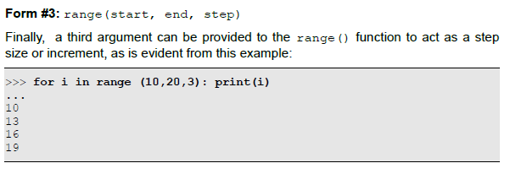
Using range() in for Loops

Slide 15
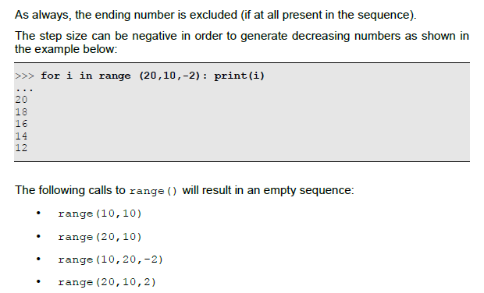
Using range() in for Loops

Slide 16
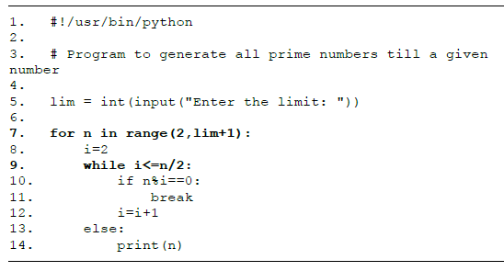
Nested Loops
A loop within a loop is called a nested loop. It is possible to nest both while and for loops within both for and while loops and any number of levels of such nesting is possible.

Slide 17
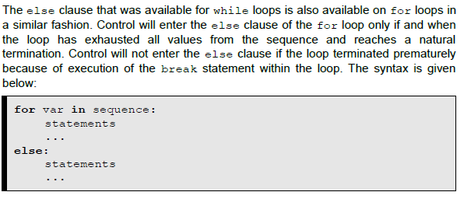
The for Loop With else Clause

Slide 18
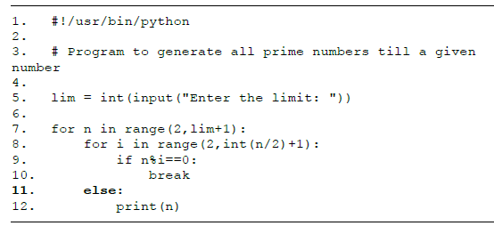
The for Loop With else Clause

Slide 19
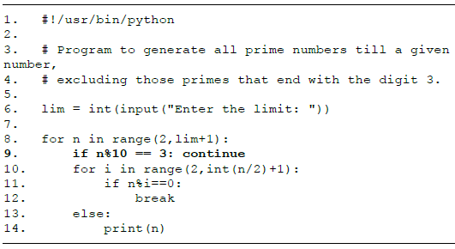
The continue Statement
Just as how the break statement can be used within the body of a loop in order to immediately terminate the loop, the continue statement can be used within the body of a loop to immediately continue with the next iteration of the loop, discarding the current iteration.

Slide 20
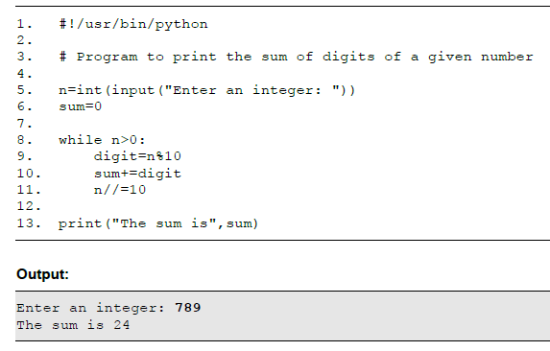
More Programs on Loops

Slide 21
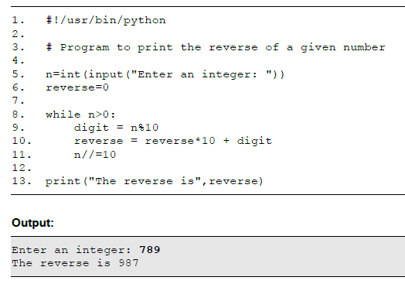
More Programs on Loops

Slide 22
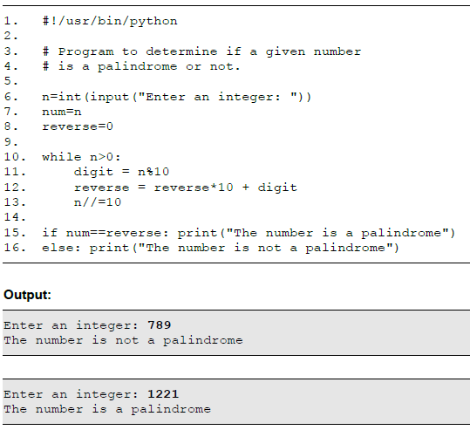
More Programs on Loops

Slide 23
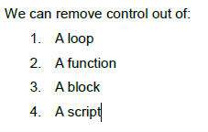
Terminating Control
While all the previous sections concentrated on controlling the flow of control down in the program, this section emphasizes on removing control away from a control structure!

Slide 24
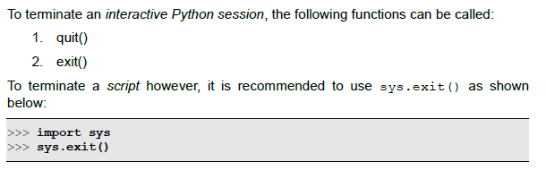
Terminating Control
Terminating a Loop
the break statement
Terminating a Function
The return statement is used to terminate a function
Terminating a Block
The raise statement is used to raise an exception
Terminating a Script

Slide 25
Thank for your Attention
Any Question?

