Slide 1


Slide 2


Basic programming Session6: LISTS
CS1401-2
2
Notes:
2

Slide 3
LISTS
In this session you will be able to:
Create lists and access their elements.
Iterate through lists and search for specific elements.
Extract sub-lists from lists using the concept of list slices.
Add, Delete and Modify elements in a list.
Deal with nested lists.

Slide 4
List definition
A list in Python is defined as an ordered sequence of elements that can be dynamically altered.
Ordered means that each item in a list has an index based on it's position in the list.
Sequence means that the elements are arranged in order, based on their indices, and a sequential traversal through the list will give us the elements in the order of their indices.
The phrase “dynamically altered” means that each item in the list can be changed and the list itself can be changed – more items can be added, and existing items can be replaced or removed.

Slide 5
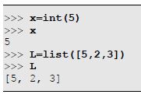
Creating Lists
Just as how an integer object can be created and assigned to a variable using the int() function, a list object can be created and assigned to a variable using the list() function:
Since a list is a collection of values, the square brackets ([]) are used to enclose the collection, and are always used in Python to denote a list.

Slide 6
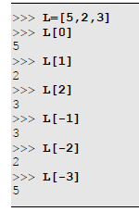
Accessing List Elements
Each element in a list has an index which can be used to identify the element.
This index increases from left to right, starting from 0.
Negative indices are relative to the end of the list, and increase in absolute magnitude from right to left, starting with -1 from the end of the list.
Thus, each element in a list has 2 indices associated with it – a non-negative one that is counted from the beginning of the list and a negative one that is counted from the end of the list.
Together with the [] operator, we can identify any element in the list as shown in the examples below:

Slide 7
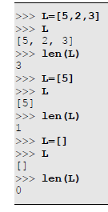
Counting List Elements
The len() function is available to count the number of elements in a list. The minimum size of any list is 0, corresponding to an empty list (denoted by []).

Slide 8
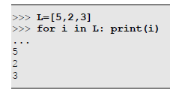
Iterating Through List Elements
One of the most practical operations we end up performing on lists is iterating through them and processing each element in sequence. Since lists are sequences, the for loop is directly compatible for iterating as shown in the example below:

Slide 9
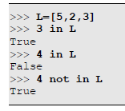
Searching Elements within Lists
Given that a list can contain multiple items, we may need to know if a particular element is present in a list or not, and if present, how many times and where all in the list. There are functions for all of these in Python.
Checking for Existence
The in and not in operators help us to verify whether a particular element is present in a list or not.

Slide 10
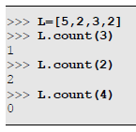
Searching Elements within Lists
Counting Occurrences
The count() member function of list tells us how many instances of the specified object is present in the list.

Slide 11

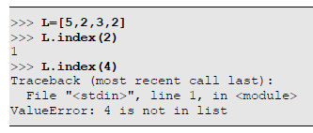
Searching Elements within Lists
Locating Elements
The index() member function of list searches for the first occurrence of an element within a list and returns the index where it was found, and throws a ValueError if not found. It's complete syntax is:
Form #1: list.index(x)
This searches for the first occurrence of the element x in the list list and returns the index where it was found or raises a ValueError if the element was not found.
X is a value.

Slide 12

Searching Elements within Lists
Locating Elements
The index() member function of list searches for the first occurrence of an element within a list and returns the index where it was found, and throws a ValueError if not found. It's complete syntax is:
Form #2: list.index(x,i)
If the second argument (i) is given, the search starts from index i instead of 0. This allows us to search for other occurrences of an element or to skip some initial elements in the search. In all other respects, this form is similar to form #1.

Slide 13
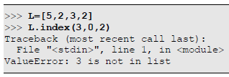
Searching Elements within Lists
Locating Elements
The index() member function of list searches for the first occurrence of an element within a list and returns the index where it was found, and throws a ValueError if not found. It's complete syntax is:
Form #3: list.index(x,i,j)
If the third argument (j) is given, the search will start at index i but will stop at index j (excluding index j). Remember that if an element is not found when it stops, it will throw ValueError.

Slide 14
List Slices
A list slice is a sub-list extracted from a list – it is a list comprising of a part of an existing list.
A list slice uses syntax list[start:end], where list is the parent list from which to extract elements, start is the starting index from where to start extracting elements and end is the ending index (excluding end) till where to extract the elements.
The parent list does not undergo any change unless an assignment is made to the list slice. Both start and end are optional, with start defaulting to 0 (index of the first element) and end defaulting to len(list), i.e. the end of the list.

Slide 15
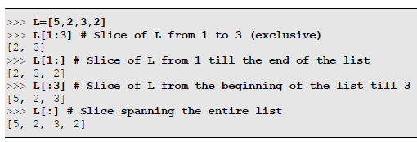

List Slices
Some examples follow:
The first example shows how to replace a few elements of a list with a different set of elements without changing the list size:

Slide 16


List Slices
The number of elements assigned to a list slice need not be of the same size! Here is an example of putting in more number of elements than the number of elements deleted:
Similarly, here is an example of putting in fewer number of elements than the number of elements deleted:

Slide 17
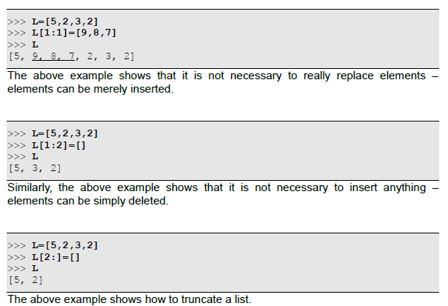
List Slices
Let's discuss some special cases now!

Slide 18
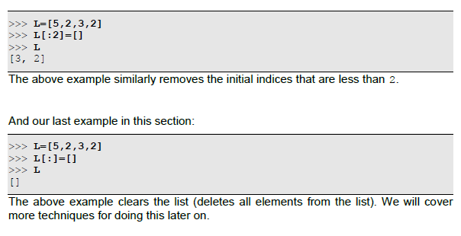
List Slices
Let's discuss some special cases now!

Slide 19

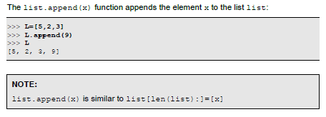
Adding and Deleting Elements
We have already seen how we can add and delete elements from a list using assignment to list slices.
Appending Elements
To add one element to the end of a list, the following function can be used:

Slide 20

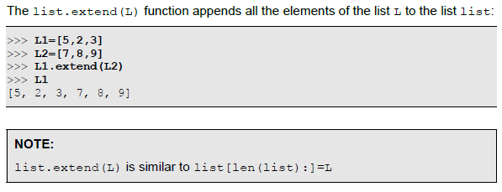
Adding and Deleting Elements
Appending Elements
To add more elements to the end of a list, the following function can be used:

Slide 21

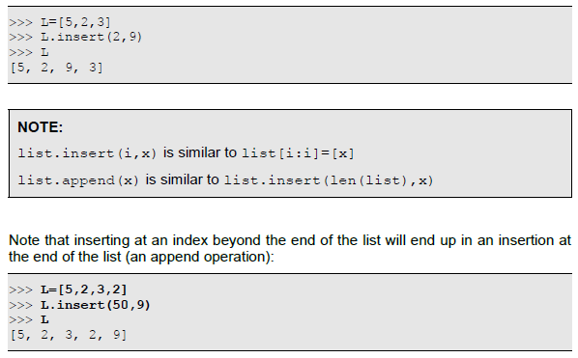
Adding and Deleting Elements
Inserting Elements
To add elements at any desired location within the list, the list.insert(i,x)function can be used, which inserts the element x at index i within the list list

Slide 22

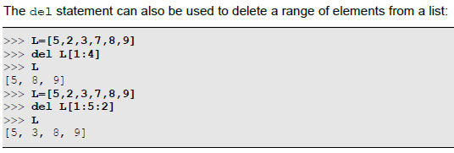
Adding and Deleting Elements
Deleting Elements
There are many different ways of deleting elements from a list.
Using del to Delete an Element : The first way to delete an element at a specific position in the list is by using the del statement
In the last example where we have used del L[1:5:2], it will delete elements from index 1 onwards till index 5 (excluding 5) in steps of 2.

Slide 23
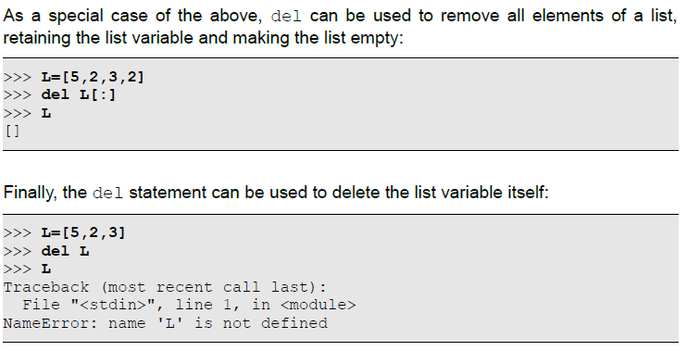
Adding and Deleting Elements
Deleting Elements

Slide 24

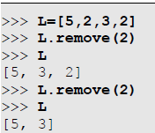
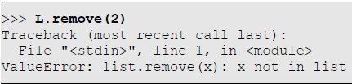
Adding and Deleting Elements
Using remove() to Delete an Element
If we wish to delete a specific element regardless of it's position, we can use the list.remove(x) which searches and removes the first occurrence of x in the list list. If the element x is not present in the list, it will throw a ValueError:

Slide 25

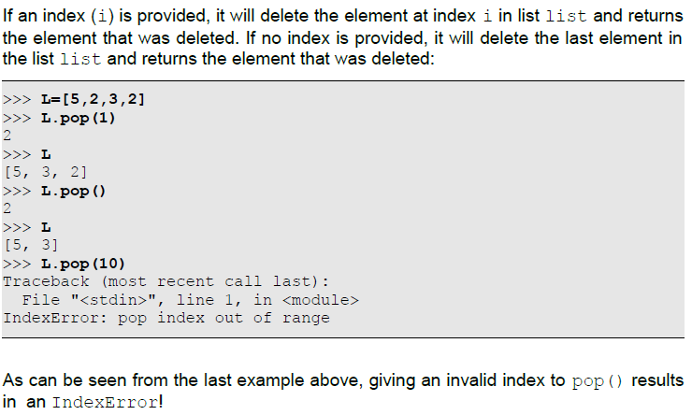
Adding and Deleting Elements
Using pop() to Delete Elements
Another method to delete an element at a specific position or at the end of a list and return the element that was deleted is by using the list.pop()function.

Slide 26

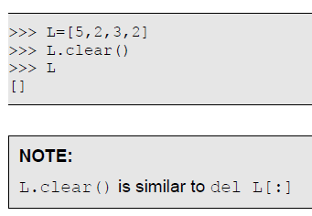
Adding and Deleting Elements
Using clear() To Delete All Elements of a List
While most of the functions discussed earlier delete one or more elements from a list, the list.clear() function deletes all elements from the list list and makes it empty.

Slide 27
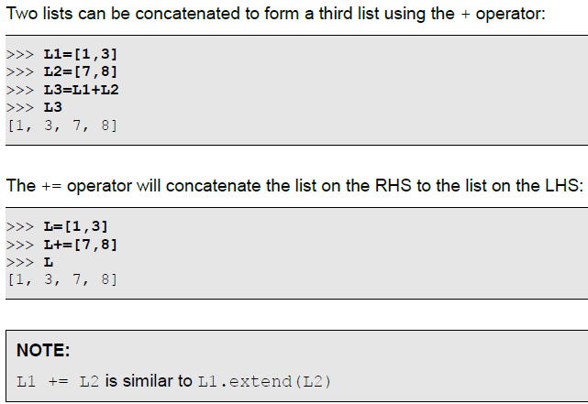
Adding and Deleting Elements
Adding, Multiplying and Copying Lists
The + (addition), += (addition and assignment), * (multiplication), *= (multiplication and assignment) and = (assignment) operators are available to operate on lists.
Adding Lists

Slide 28
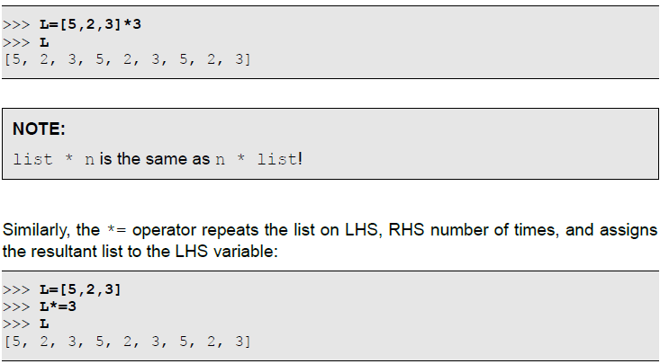
Adding and Deleting Elements
Multiplying Lists
A list L can be multiplied by an integer n to denote the list L repeated n times.

Slide 29
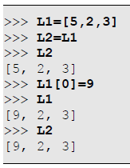
Adding and Deleting Elements
Assigning Lists
The = operator allows us to assign a list to a list variable. However, this is not the same as copying elements of a list to another and is demonstrated in the example below.
Lists are objects and list variables are references to such objects, and the = operator only copies the reference, not the objects!

Slide 30
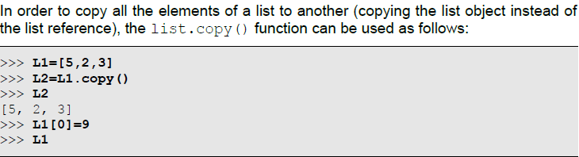
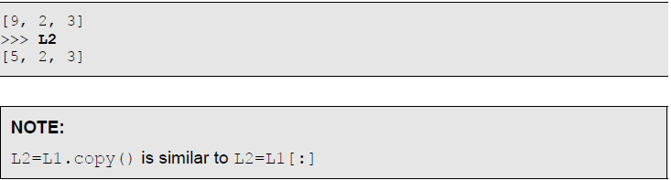
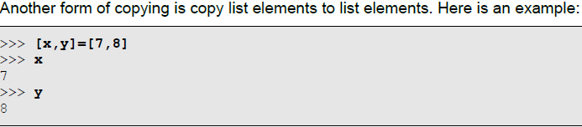
Adding and Deleting Elements
Copying Lists

Slide 31
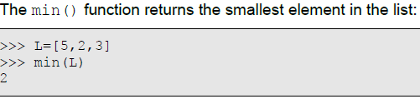
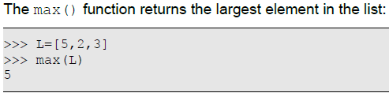
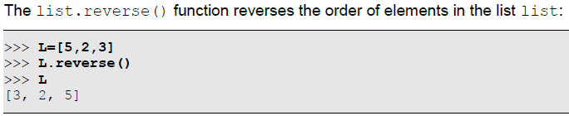
Miscellaneous Operations on Lists
Finding the Smallest Element in a List
Finding the Largest Element in a List
Reversing a List

Slide 32
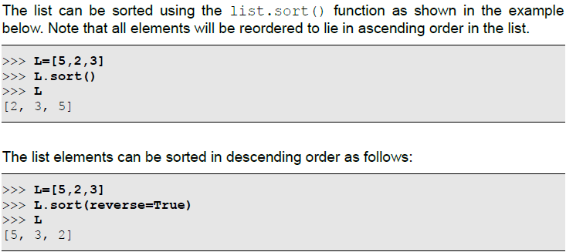
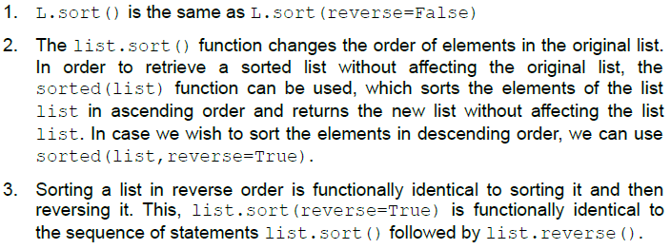
Miscellaneous Operations on Lists
Sorting a List

Slide 33
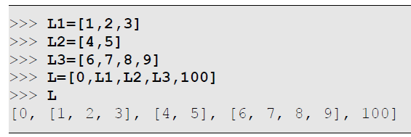
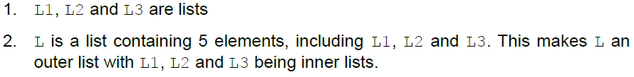
Nested Lists
A list contains elements which are references to objects, and these objects could be of any type, including lists. A list within a list is called a nested list. Thus, a nested list comprises of elements, some (or possibly all) of which are lists themselves.
In the case of a nested list, the list that contains other lists can be designated to be the outer list whereas each list inside this outer list can be designated to be an inner list. Each inner list behaves both as an element of the outer list as well as a list by itself.

Slide 34
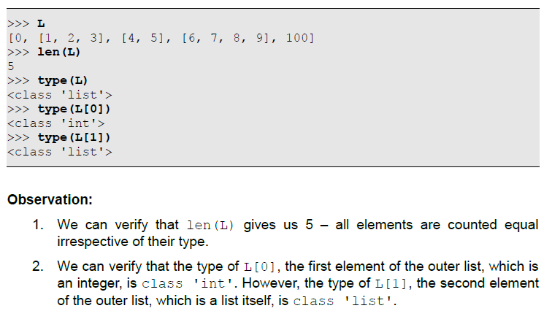
Nested Lists

Slide 35
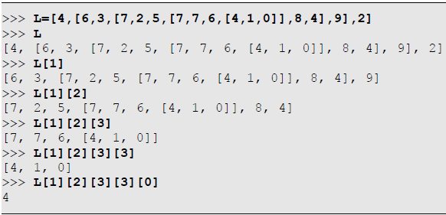
Nested Lists
We can nest lists within lists to any depth depending on our requirement! This is illustrated below:

Slide 36
HomeWorks
Write a program to store country names and print the names of those countries whose length is greater than 5.
Write a program to accept country names and print the names of those countries whose length is greater than 5.
Write a program to accept country names and print their capitals.
Write a program to print unique values from a list.
Write a program to remove duplicates from a list.
Write a program to get the largest and smallest number in a list.
Write a program to accept a single digit and print it in words (e.g. if get 1 then print “one”.)
Write a program to print a number in words (For simplicity, you limit the number to 9999.)

Slide 37
Thank for your Attention
Any Question?

