Slide 1


Slide 2


Basic programming Session7: TUPLES
CS1401-2
2
Notes:
2

Slide 3
TUPLES
In this session you will be able to:
Create tuples and access their elements.
Iterate through tuples and search for specific elements.
Extract sub-tuples from tuples using the concept of tuple slices.
Concatenate tuples and populate tuples instantly using tuple multiplication.
Learn to differentiate between lists and tuples.

Slide 4
TUPLES definition
A tuple in Python is defined as an immutable ordered sequence of elements.
Immutable means that the contents of a tuple cannot be changed once created.
Ordered means that each item in a tuple has an index based on it's position in the tuple.
Sequence means that the elements are arranged in order, based on their indices, and a sequential traversal through the tuple will give us the elements in the order of their indices.

Slide 5
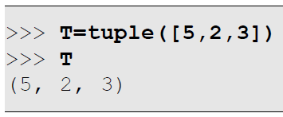
Creating Tuples
Just as how a list object can be created and assigned to a variable using the list()function, a tuple object can be created from a list and assigned to a variable using the tuple() function:
The tuple() function accepts an iterable object – an object over which it can iterate and fetch values one by one. Lists are examples of iterables, and there are many other iterable types.

Slide 6
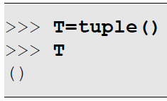
Creating Empty Tuples Using tuple()
If a list is not passed as an argument, an empty tuple is created:

Slide 7
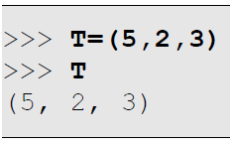
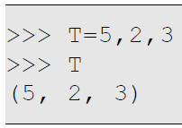
Creating Tuples Using (,)
Just as how [] indicate list literals, () indicate tuple literals provided there is at least one comma within the parentheses:
The parentheses are used primarily for readability, and it is the presence of the comma that actually drives Python into concluding that we are dealing with a tuple! It is also possible to leave out the parentheses if required:

Slide 8
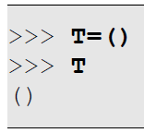
Creating Empty Tuples Using ()
Just as how [] represents an empty list, () represents an empty tuple:

Slide 9
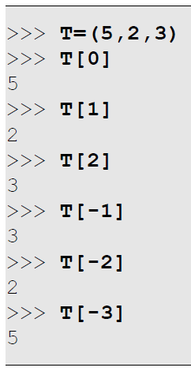
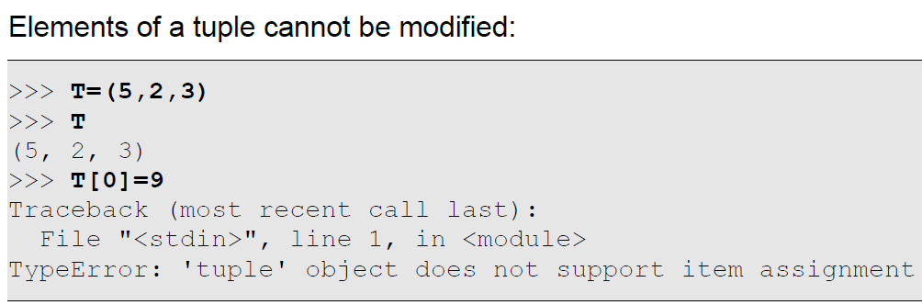
Accessing Tuple Elements
We can access individual elements of a tuple in exactly the same way as we do for lists:

Slide 10
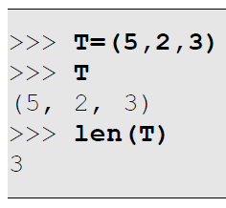
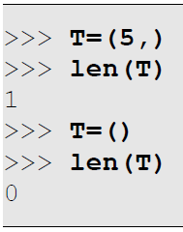
Counting Tuple Elements
The len() function is available to count the number of elements in a tuple. The minimum size of any tuple is 0, corresponding to an empty tuple (denoted by ()).

Slide 11
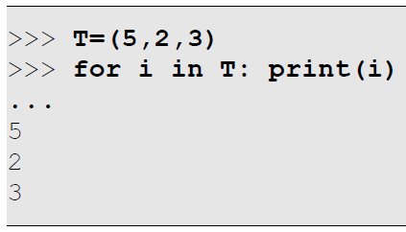
Iterating Through Tuple Elements
One of the most practical operations we end up performing on tuples is iterating through them and processing each element in sequence. Since tuples are sequences, the for loop is directly compatible for iterating as shown in the example below:

Slide 12
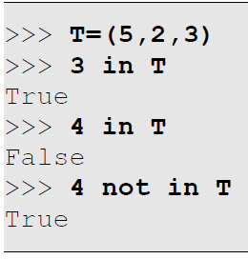
Searching Elements Within Tuples
We can search for elements within tuples the same way we search in lists.
Checking for Existence
The in and not in operators help us to verify whether a particular element is present in a tuple or not.

Slide 13
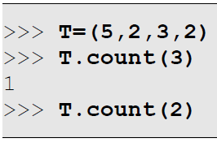
Searching Elements Within Tuples
Counting Occurrences
The count() member function of tuple tells us how many instances of the specified object is present in the tuple.

Slide 14

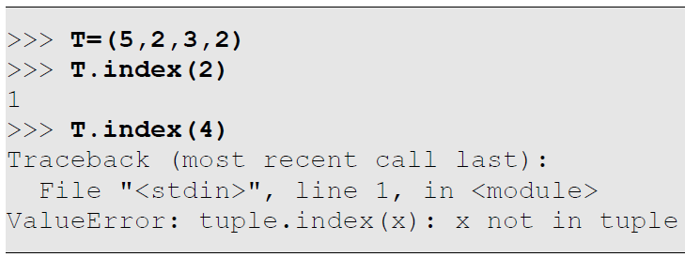
Searching Elements Within Tuples
Locating Elements
The index() member function of tuple searches for the first occurrence of an element within a tuple and returns the index where it was found, and throws a ValueError if not found. It's complete syntax is:
Form #1: tuple.index(x)
This searches for the first occurrence of the element x in the tuple tuple, as shown in the example below:
X is a value.

Slide 15
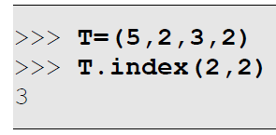
Searching Elements Within Tuples
Locating Elements
The index() member function of tuple searches for the first occurrence of an element within a tuple and returns the index where it was found, and throws a ValueError if not found. It's complete syntax is:
Form #2: tuple.index(x,i)
If the second argument (i) is given, the search starts from index i instead of 0. This allows us to search for other occurrences of an element or to skip some initial elements in the search.

Slide 16
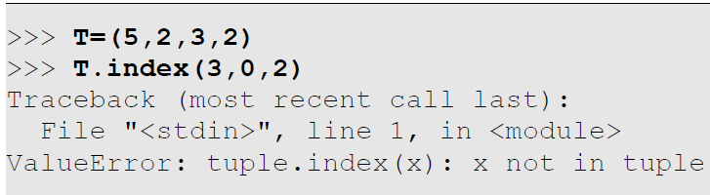
Searching Elements Within Tuples
Locating Elements
The index() member function of tuple searches for the first occurrence of an element within a tuple and returns the index where it was found, and throws a ValueError if not found. It's complete syntax is:
Form #3: tuple.index(x,i,j)
If the third argument (j) is given, the search will start at index i and stop at index j (excluding index j). Remember that if an element is not found when it stops, it will throw ValueError.

Slide 17
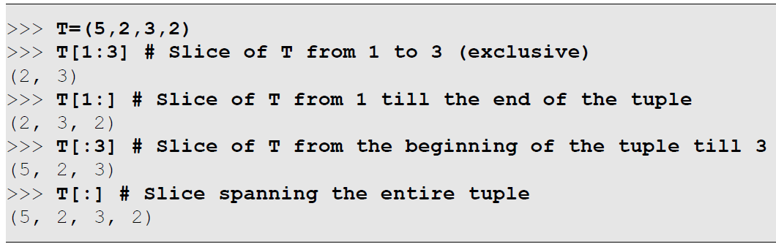
Tuple Slices
Just like a list slice, a tuple slice is a sub-tuble extracted from a tuple – it is a tuple comprising of a part of an existing tuple.
A tuple slice uses syntax tuple[start:end], where tuple is the parent tuple from which to extract elements, start is the starting index from where to start extracting elements and end is the ending index (excluding end) till where to extract the elements.
The parent tuple does not undergo any change. Both start and end are optional, with start defaulting to 0 (index of the first element) and end defaulting to len(tuple), i.e. the end of the tuple. Some examples follow:

Slide 18
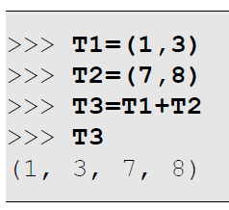
Adding, Multiplying and Copying Tuples
The + (addition), += (addition and assignment), * (multiplication), *= (multiplication and assignment) and = (assignment) operators are available to operate on tuples
Adding Tuples
Two tuples can be concatenated to form a third tuple using the + operator:

Slide 19
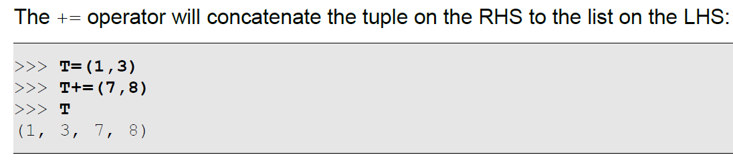
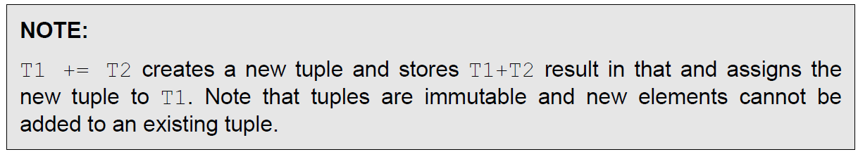
Adding, Multiplying and Copying Tuples
The + (addition), += (addition and assignment), * (multiplication), *= (multiplication and assignment) and = (assignment) operators are available to operate on tuples
Adding Tuples

Slide 20
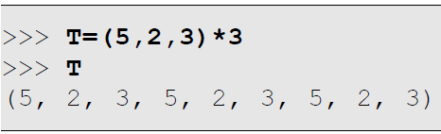
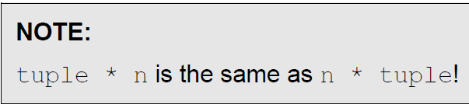
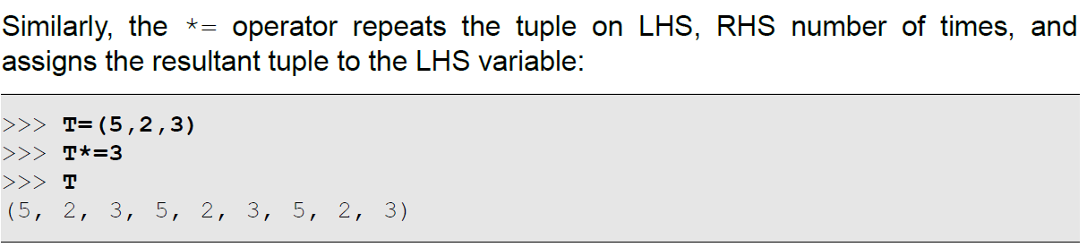
Adding, Multiplying and Copying Tuples
Multiplying Tuples
A tuple T can be multiplied by an integer n to denote the tuple T repeated n times:

Slide 21
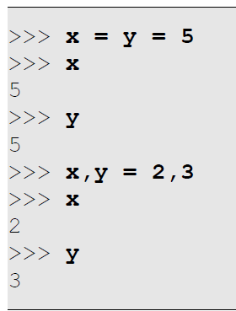
Assigning and Copying Tuples
Before we proceed with assigning and copying tuples, we need to understand a basic point: even though a tuple is immutable, the elements within a tuple need not be immutable!
A tuple is immutable and that means that we cannot add elements to a tuple and cannot remove elements from a tuple. We also cannot change the elements of a tuple.
An element in a tuple can be a reference to some object. We cannot change this reference, as suggested in the point above, but can change the contents of the object! Thus, if a tuple contains a list, we can add/remove/change elements in the list for instance.
Tuples can be assigned to tuples

Slide 22
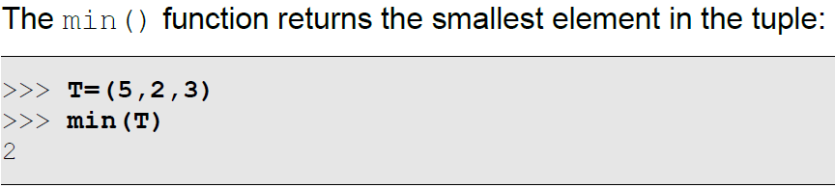
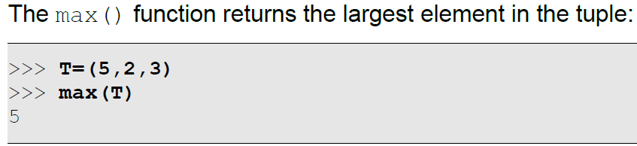
Miscellaneous Operations on Tuples
Finding the Smallest Element in a Tuple
Finding the Largest Element in a Tuple

Slide 23
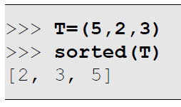
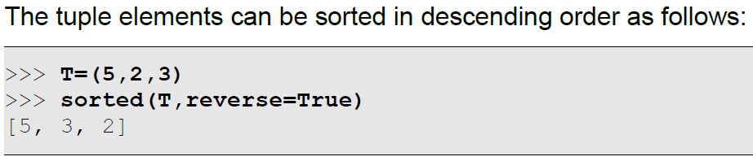
Miscellaneous Operations on Tuples
Sorting a Tuple
Since in-place sorting of a tuple is not possible, owing to the fact that they are immutable, the sorted() function can be used to obtain a copy of the sorted elements of a tuple as shown in the example below:

Slide 24
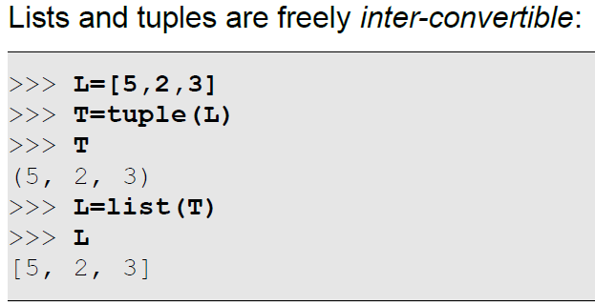
Comparison of Lists and Tuples
Both lists and tuples are ordered sequences – elements within them are organized based on indices and can be identified by their indices.
Both of them support a very similar set of operations as far as searching for an element within them are concerned.
The biggest difference between them is the fact that tuples are immutable and lists are dynamically alterable!

Slide 25

HomeWork3
Write a program to accept country names and print their capitals.
Write a program to generate the first 'n' Fibonacci terms.
(t1 = t2 = 1 and $t_{n}=t_{n−1}+t_{n−2}$)

Slide 26
Thank for your Attention
Any Question?

