Slide 1


Slide 2


Basic programming Session8: SETS
CS1401-2
2
Notes:
2

Slide 3
SETS
In this session you will be able to:
Create a set and access its elements.
Iterate through sets and search for specific elements.
Add and Delete elements in a set.
Perform set operations like union, intersection, difference and symmetric difference.
Check for disjoint sets, subsets and supersets.

Slide 4
SETS definition
A set is an unordered collection of unique elements.
Unordered means that elements in a set do not have an index by which they can be addressed.
Unique means that duplicates are not tolerated (attempt to add an element into a set when the element already exists will be ignored).

Slide 5
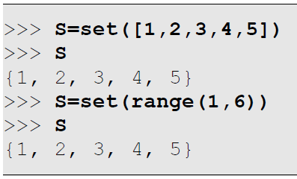
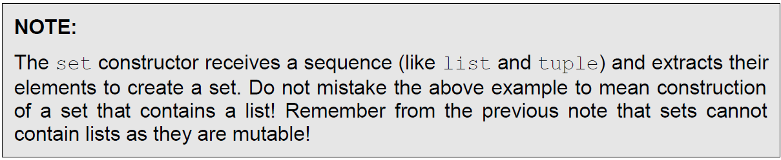
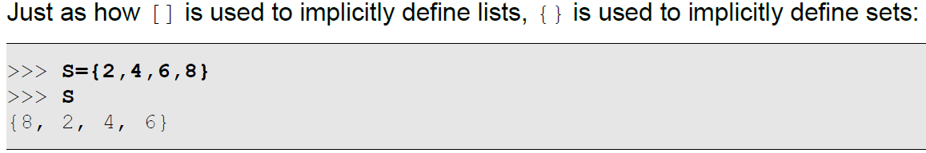
Creating Sets
Just as how the list() function is used to create a list, the set() function is used to create a set:

Slide 6
Accessing Set Elements
Being unordered collections, it is not possible to identify an element within a set using an index or any other mechanism. Therefore, the operations normally performed on a set is checking for the existence of an element within a set rather than accessing a particular element in the set. Of course, iterating through a set is still possible and meaningful.

Slide 7
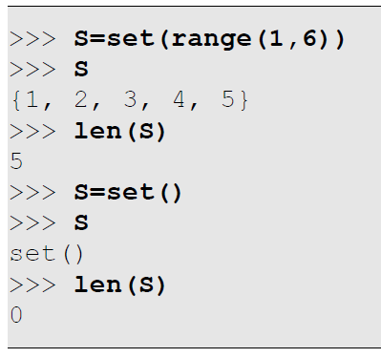
Counting Set Elements
The len() function is available to count the number of elements in a set. The minimum size of any set is 0, corresponding to an empty set (denoted by set() and not {}).

Slide 8
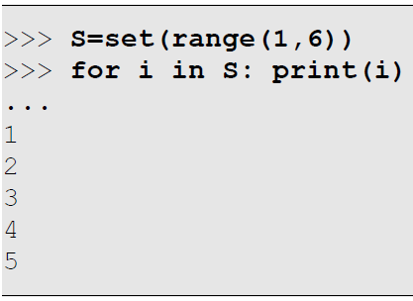
Iterating Through Set Elements
Since accessing particular set elements is not possible, iterating through a set is the only option to determine the contents of a set. The normal for loop can be used for this purpose:

Slide 9
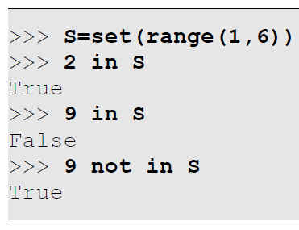
Searching Elements within Sets
We can search for elements within tuples the same way we search in lists.
Checking for Existence
Checking for the existence of an element within a set is a very efficient operation (compared to a similar search within a list or a tuple). The in and not in operators can be used for this purpose:

Slide 10
Adding and Deleting Elements
It is possible to add elements to a set and delete elements from a set. While adding, keep in mind that addition of duplicates are ignored. While deleting, we need to consider the situation what happens if we attempt to delete something that doesn’t exist. We will explore various methods to add and delete elements.

Slide 11
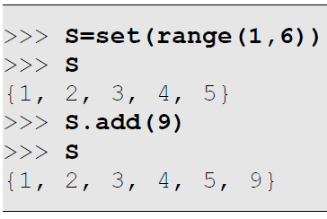
Adding Elements
Adding Individual Elements to a Set
To add an element to a set, the set.add(x) function can be used which adds the element x to the set set:

Slide 12
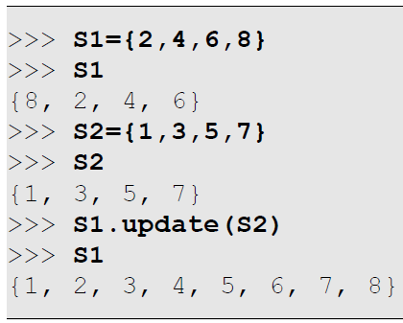
Adding Elements
Adding a Set of Elements to a Set
To add a set of elements to another, the set.update(s) function can be used, which updates the set set to contain the union of the set set and the set s – in simple terms, it adds all the elements of the set s to the set set:

Slide 13
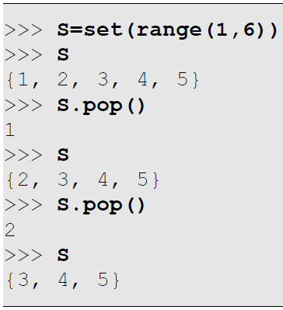
Deleting Elements
There are many ways of deleting elements from a set. These not only differ in how they allow the user to choose the element to be deleted, but also differ in what happens if they are unable to delete.
Using pop() to Delete an Element
The set.pop() function deletes an element from the set set and returns the element deleted. Since sets are unordered, we cannot predict which element will actually get deleted in the set. As a special case, if the set is empty, this function generates a KeyError.

Slide 14
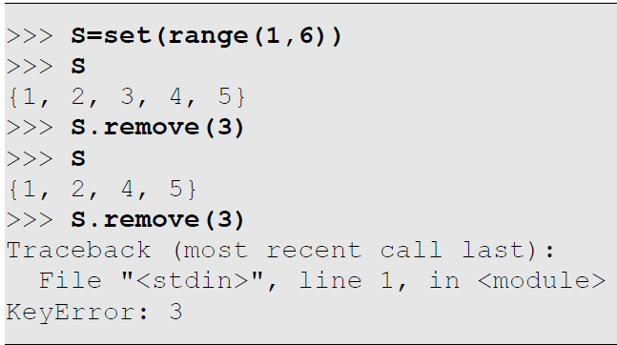
Deleting Elements
Using remove() to Delete an Element
The set.remove(x) function removes the element x from the set set. If x was not found, it will produce a KeyError.

Slide 15
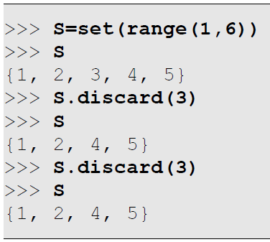
Deleting Elements
Using discard() to Delete an Element
The set.discard(x) function deletes the element x from the set set. Where it differs from the remove() function is that if the element x was not found, it does nothing instead of generating an error.

Slide 16
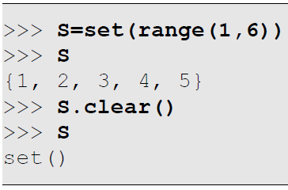
Deleting Elements
Using clear() to Delete All Elements
The set.clear() function deletes all elements in the set set.

Slide 17
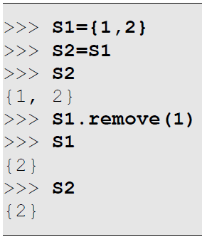
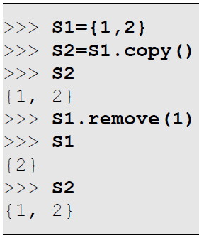
Assigning and Copying Sets
The = operator can assign a set to a variable. However, this only ends up copying a reference to a set as demonstrated below:
In order to copy the elements of a set to another, the set.copy() function can be used:

Slide 18
Set Operations
Mathematically, a variety of operations can be performed on sets:
The union of set A and set B is a set comprising of all elements found in either set A or set B. The union of {1,2} and {2,3} is {1,2,3}.
The intersection of set A and set B is a set comprising of all elements found in both set A and set B. The intersection of {1,2} and {2,3} is {2}.
The difference of set A and set B (set A – set B) is a set comprising of all elements found in set A with all elements of set B removed from it. The difference of {1,2} and {2,3} is {1}.
The symmetric difference of set A and set B is a set comprising of all elements found in either set A or set B, but not in both. The symmetric difference of {1,2} and {2,3} is {1,3}.
In addition:
Two sets are said to be disjoint if there are no elements in common within them. The sets {1,2} and {2,3} are not disjoint because of the common element 2.
A set A is said to be a subset of set B if all elements of set A are present in set B. Similarly, in such a case, set B is said to be a superset of set A. Neither is {1,2} a subset of {2,3}, nor the other way around.

Slide 19
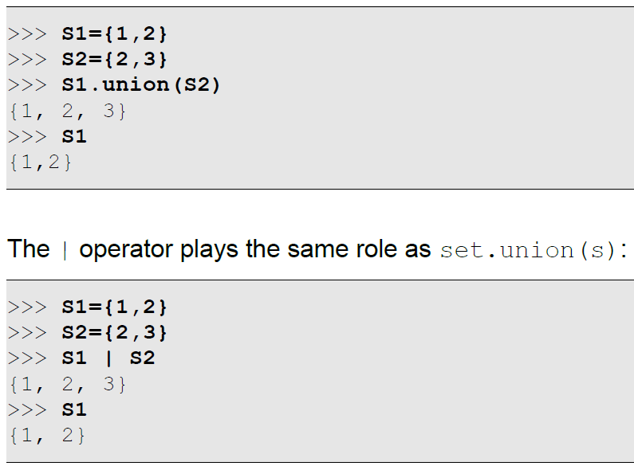
Set Union
The set.union(s) function returns a new set that represents the union of the set set and the set s:

Slide 20
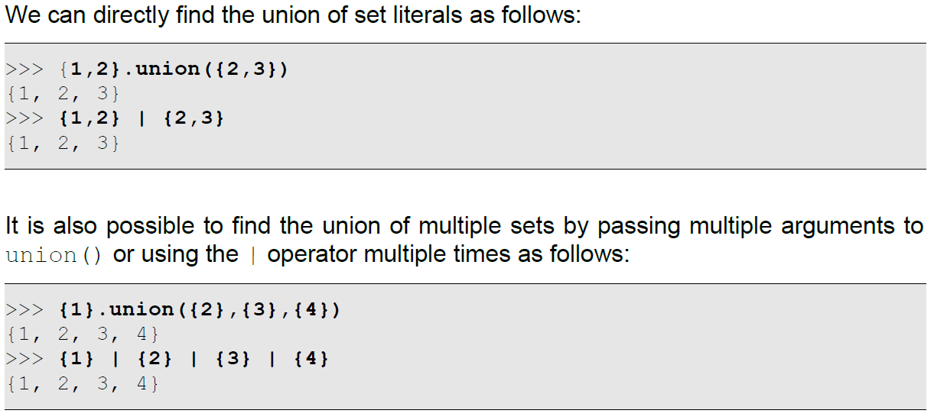
Set Union

Slide 21
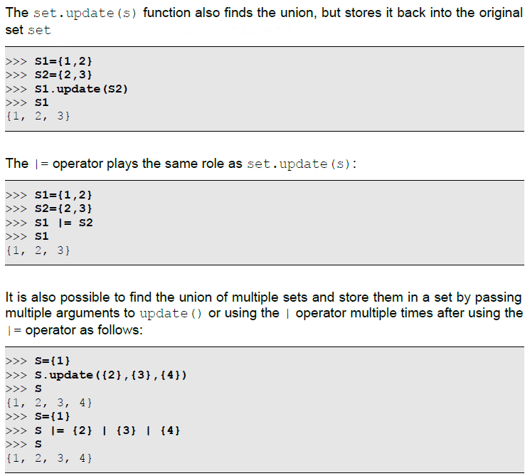
Set Union

Slide 22
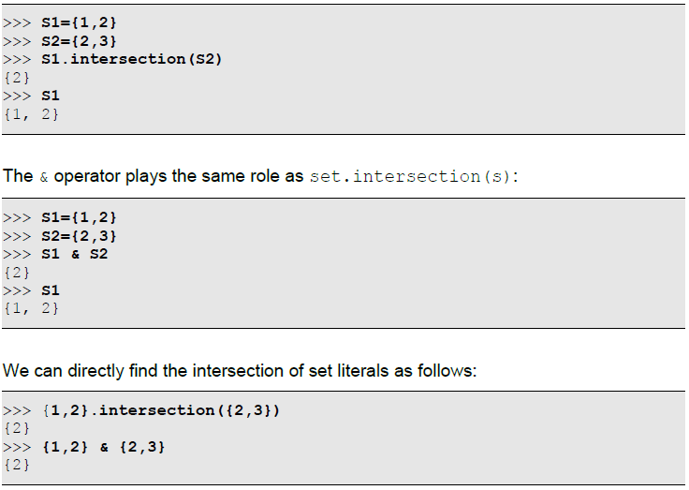
Set Intersection
The set.intersection(s) function returns a new set that represents the intersection of the set and the set s:

Slide 23
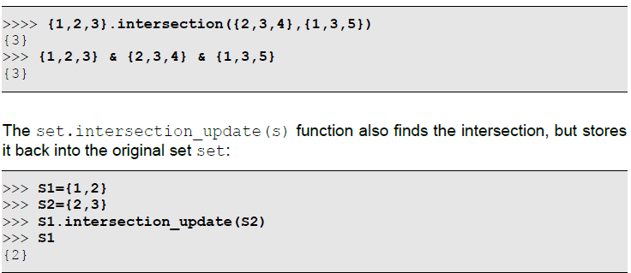
Set Intersection
It is also possible to find the intersection of multiple sets by passing multiple arguments to intersection() or using the & operator multiple times as follows:

Slide 24
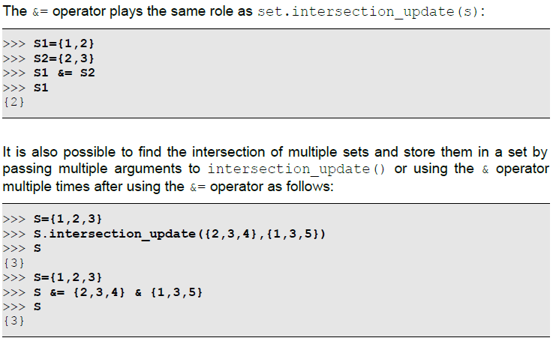
Set Intersection

Slide 25
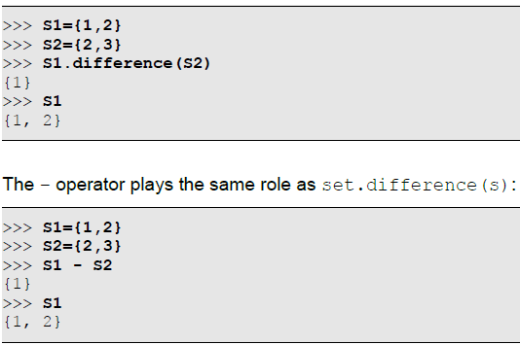
Set Difference
The set.difference(s) function returns a new set that represents the difference of the set set and the set s:

Slide 26
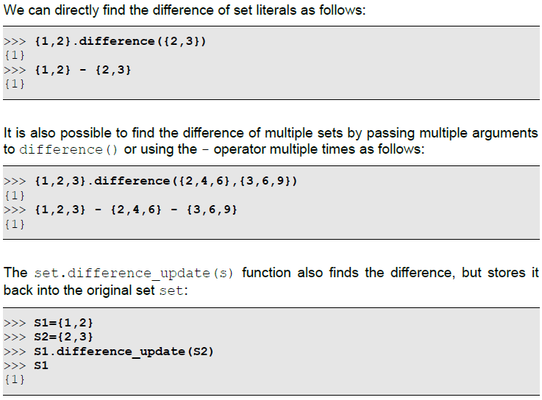
Set Difference

Slide 27
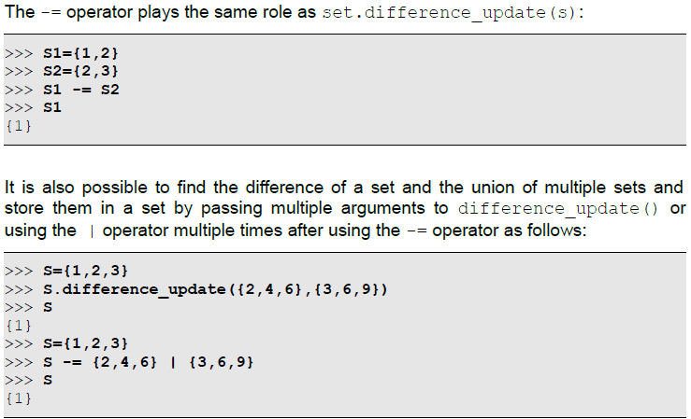
Set Difference

Slide 28
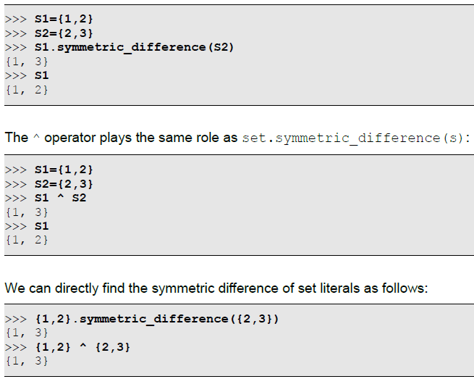
Set Symmetric Difference
The set.symmetric_difference(s) function returns a new set that represents the symmetric difference of the set set and the set s:

Slide 29
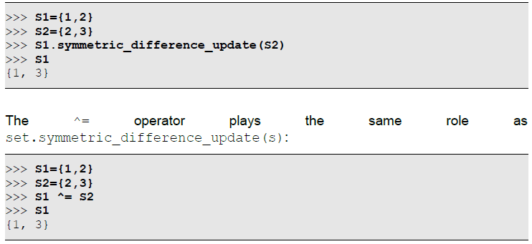
Set Symmetric Difference
The set.symmetric_difference_update(s) function also finds the symmetric difference, but stores it back into the original set set:

Slide 30
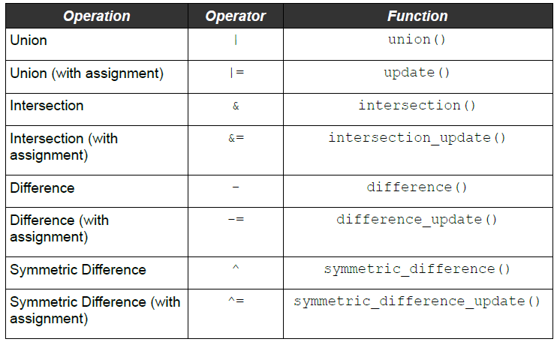
Summary of Fundamental Set Operations

Slide 31
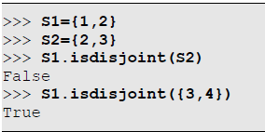
Disjoint Sets
The set.isdisjoint(s) function tells whether the set set and the set s are disjoint or not:

Slide 32
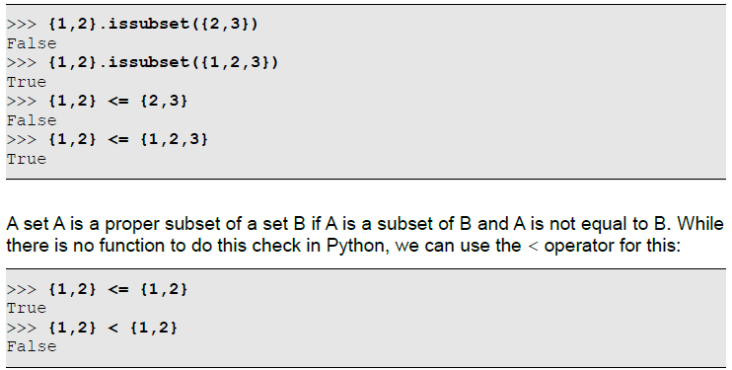
Subsets and Supersets
The set.issubset(s) function tells whether the set set is a subset of the set s or not. The <= operator plays the same role.

Slide 33
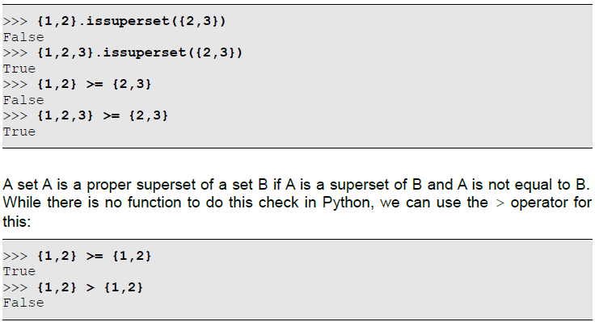
Subsets and Supersets
The set.issuperset(s) function tells whether the set set is a superset of the set s or not. The >= operator plays the same role.

Slide 34
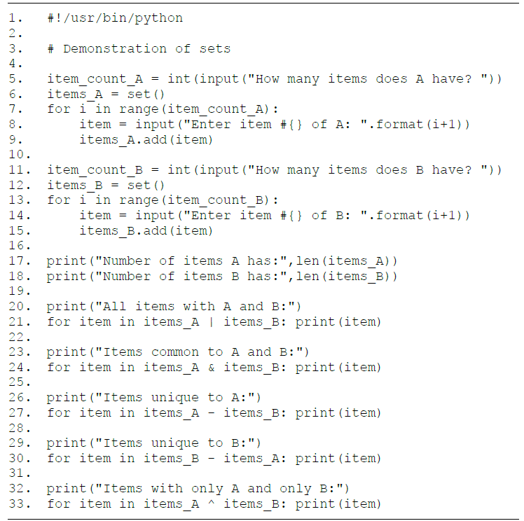
HomeWork4
Please send a line-by-line explanation of the following program in the form of a PDF file through the Email.

Slide 35
Thank for your Attention
Any Question?

