Slide 1


Slide 2


Basic programming Session9: DICTIONARIES
CS1401-2
2
Notes:
2

Slide 3
DICTIONARIES
In this session you will be able to:
Create a dictionary and access its elements.
Iterate through dictionary pairs, keys and values.
Check for the existence of a particular key in a dictionary and fetch the corresponding value.
Add and Delete elements in a dictionary.

Slide 4
DICTIONARIES definition
A dictionary is a collection of key-value pairs subject to the constraint that all the keys should be unique.
The keys of a dictionary can be considered to be members of a set (and are thus unique), with each key keeping track of a value.

Slide 5

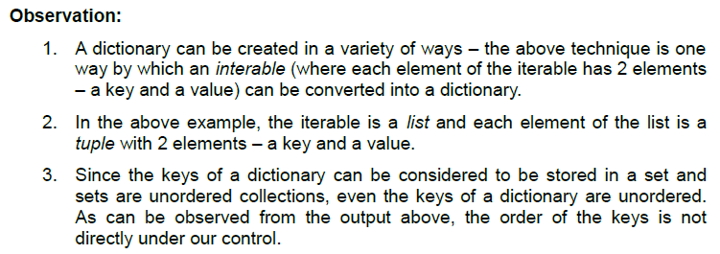
Creating Dictionaries
Just as how a list object can be created and assigned to a variable using the list() function, a dictionary object can be created and assigned to a variable using the dict() function:

Slide 6
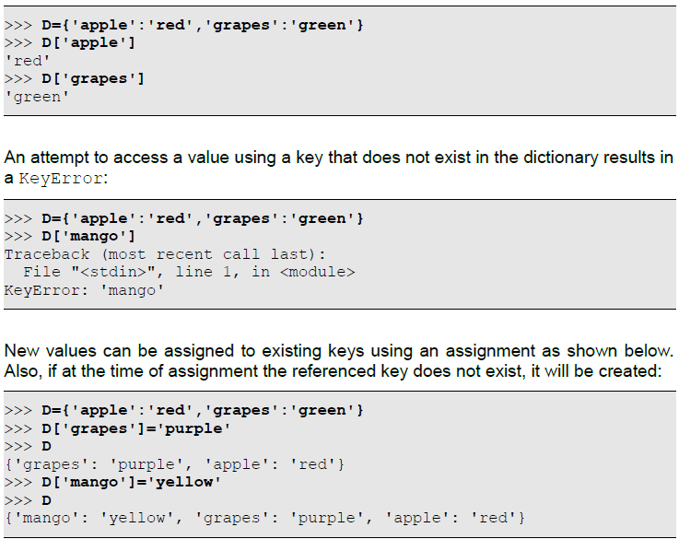
Accessing Dictionary Elements
A dictionary can be viewed as a special kind of array whose subscripts are strings instead of integers. Such arrays are called associative arrays. The same [] operator that is used to access an element of a list given it's index can be used to access a value in a dictionary given it's key:

Slide 7
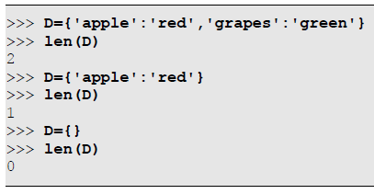
Counting Dictionary Elements
The len() function can be used to count the number of key-value pairs in a dictionary:

Slide 8
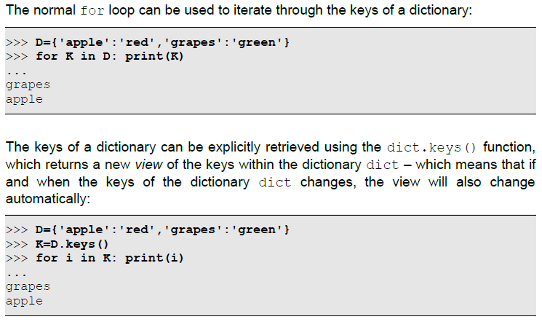
Iterating through Dictionary Elements
Since each element in a dictionary is a key-value pair, iterating through a dictionary can be of multiple forms: iterating through the keys in a dictionary or iterating through the values or iterating through the elements (key-value pairs).
Iterating Through the Keys of a Dictionary

Slide 9
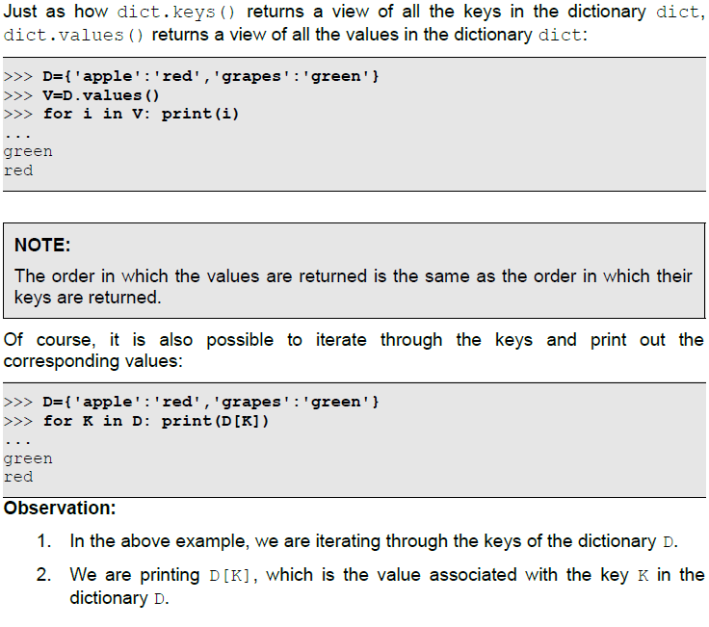
Iterating through Dictionary Elements
Iterating Through the Values of a Dictionary

Slide 10
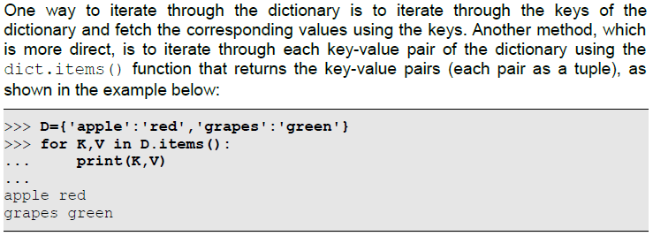
Iterating through Dictionary Elements
Iterating Through the Key-Value Pairs of a Dictionary

Slide 11
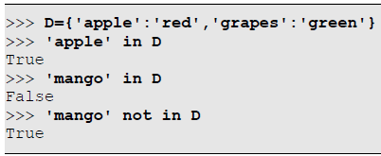
Searching Elements within Dictionaries
Checking for the Existence of a Key in a Dictionary
One of the most efficient operations on dictionaries is checking whether a key exists, and extracting the corresponding value if the key exists.
The in and not in operators can be used to check if a key exists in a dictionary:

Slide 12
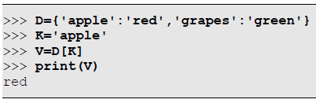
Searching Elements within Dictionaries
Extracting the Value of a Key Using []
Given a key that exists in a dictionary, extracting the corresponding value is a trivial operation, but is nevertheless presented below:

Slide 13
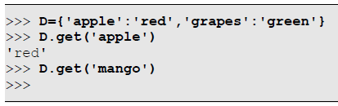
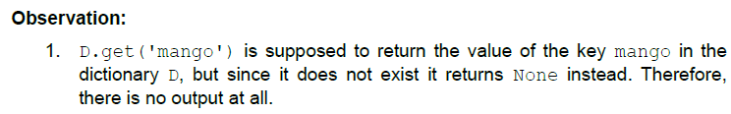
Searching Elements within Dictionaries
Extracting the Value of a Key Using dict.get()
Another method of extracting the value associated with a key is by using the dict.get(key) function, which returns the value corresponding to the key key in the dictionary dict, if the key exists, and returns None if the key was not found. Unlike in the previous method of using [], this function does not generate a KeyError if the key was not found.

Slide 14
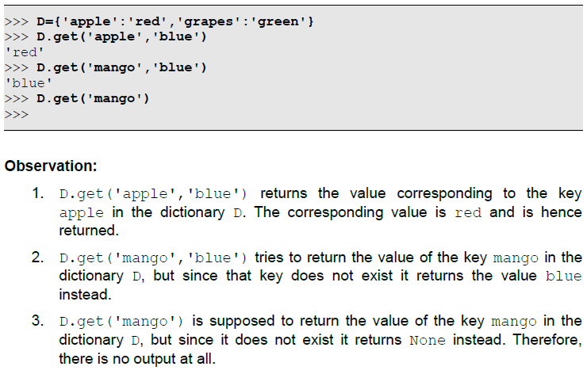
Searching Elements within Dictionaries
Extracting the Value of a Key Using dict.get()
The complete version is dict.get(key,default) function, which returns the value corresponding to the key key in the dictionary dict if the key exists, and returns the value default if the key was not found.

Slide 15
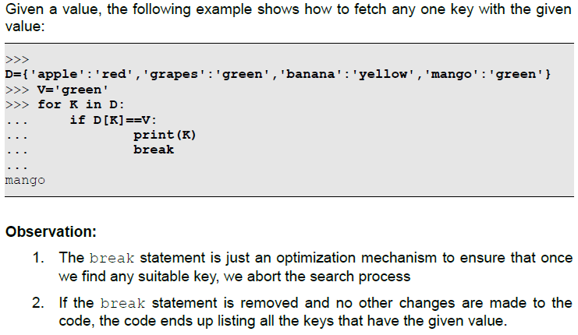
Searching Elements within Dictionaries
Extracting a Key Given it's Associated Value
While it is a trivial operation to extract the value associated with a key, extracting a key from it's value is slightly more complicated due to the following reasons:
There is no direct mechanism to extract a key from it's value
The values need not be unique. When there are multiple identical values, the question of which key to fetch comes into the picture. The only possibilities are to fetch any one of the candidate keys or fetch all the candidate keys.

Slide 16
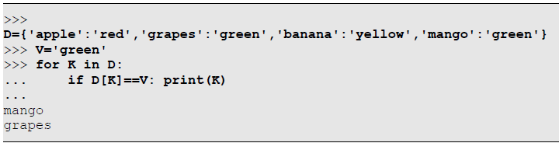
Searching Elements within Dictionaries
Extracting All Keys With a Particular Value
Based on the previous piece of code, here is a code snippet to print all keys that have a given value:

Slide 17
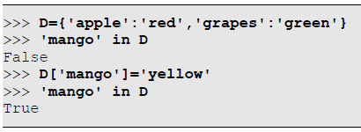
Adding Elements
Adding Elements Using []
If an assignment is made to an element of a dictionary using a key that does not exist, the key is created with the given associated value:

Slide 18
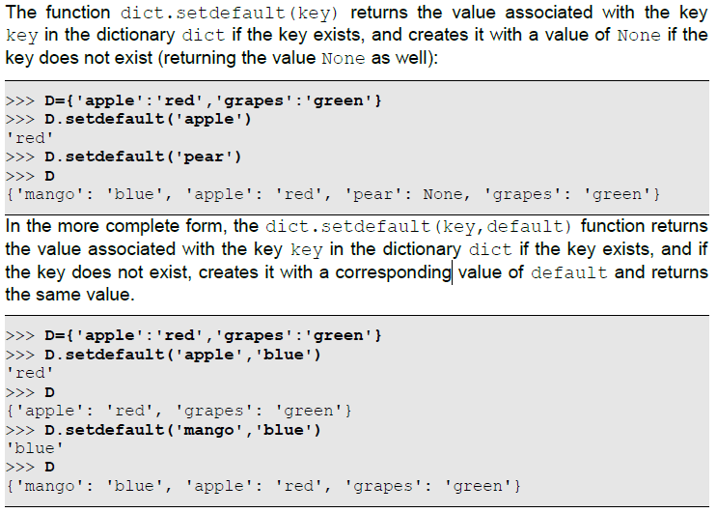
Adding Elements
Adding Elements Using setdefault()

Slide 19
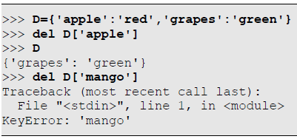
Deleting Elements
An element (key-value pair) can be deleted from a dictionary using a variety of ways. Note that deleting an element is different from deleting the value associated with a key in the dictionary (which is nothing but setting the value as None for a given key in a dictionary).
Using del to Delete an Element
The del statement can be used to delete an element from a dictionary, identifying the element using it's key. The specified key needs to exist, otherwise a KeyError will be generated:

Slide 20
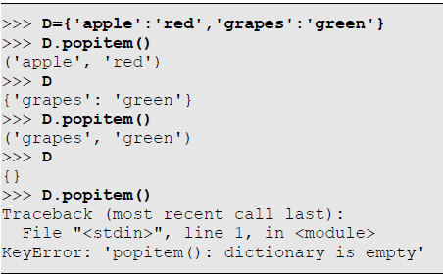
Deleting Elements
Using popitem() to Delete Elements
The dict.popitem() function removes an element (key-value pair) from the dictionary dict and returns the pair in the form of a tuple. Each time this function is invoked, the size of the dictionary dict reduces by one. It generates KeyError however if invoked on an empty dictionary:

Slide 21
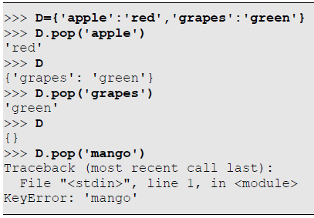
Deleting Elements
Using pop() to Delete Elements
The dict.pop(key) function deletes the element (key-value pair) with the key key from the dictionary dict and returns the corresponding value of the deleted key. If the key does not exist, it generates a KeyError:

Slide 22
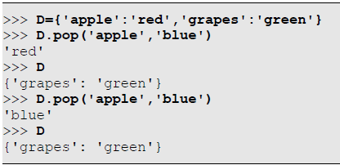
Deleting Elements
Using pop() to Delete Elements
Another version of the function is dict.pop(key,default), which deletes the element with key key from the dictionary dict and returns it's value if the key was found. If the key was not found, it returns the value default instead without deleting anything:

Slide 23
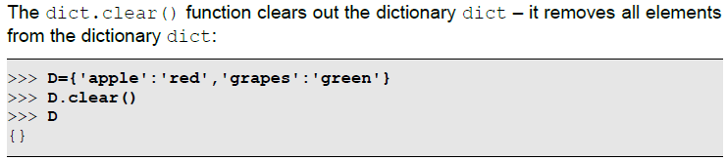
Deleting Elements
Using clear() To Delete All Elements of a Dictionary

Slide 24
HomeWork5
Write a program to accept country names and print their capitals (using Dictionaries)/
Write a Program to convert a single Roman numeral to decimal and words.
roman={'I':1,'V':5,'X':10,'L':50,'C':100,'D':500,'M':1000}
onesWords=('zero','one','two','three','four', 'five','six','seven','eight','nine')
tensWords=('','ten','twenty','thirty','forty','fifty','sixty','seventy','eighty','ninety')
teensWords=('','eleven','twelve','thirteen','fourteen','fifteen','sixteen','seventeen','eighteen','nineteen')

Slide 25
Thank for your Attention
Any Question?

