Slide 1

Notes:
Introduction

Slide 2
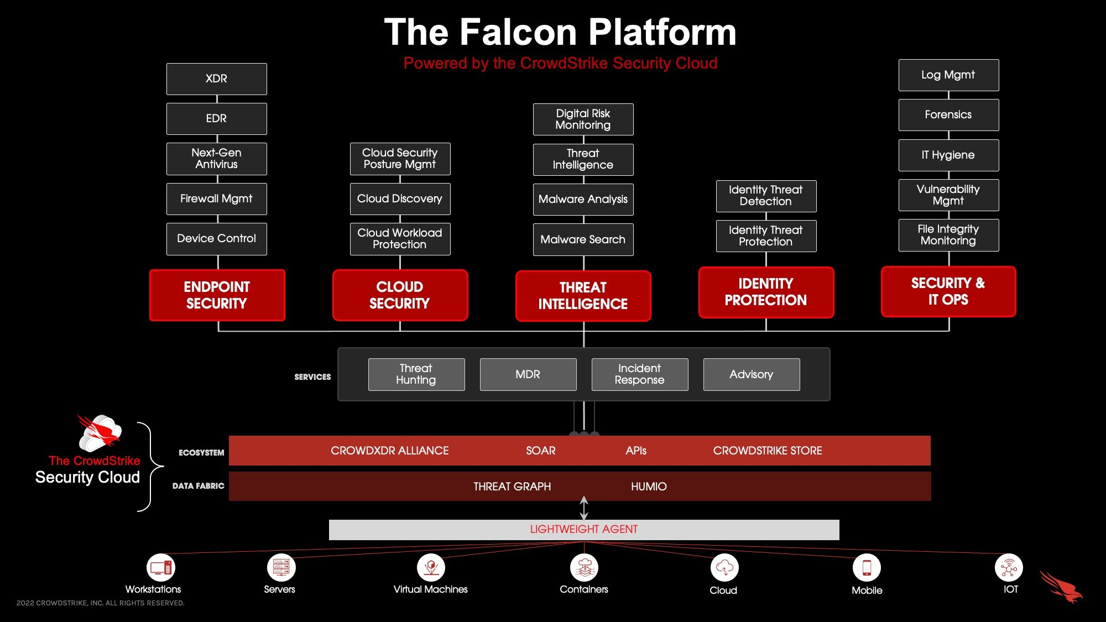
Notes:
Business Model

Slide 3
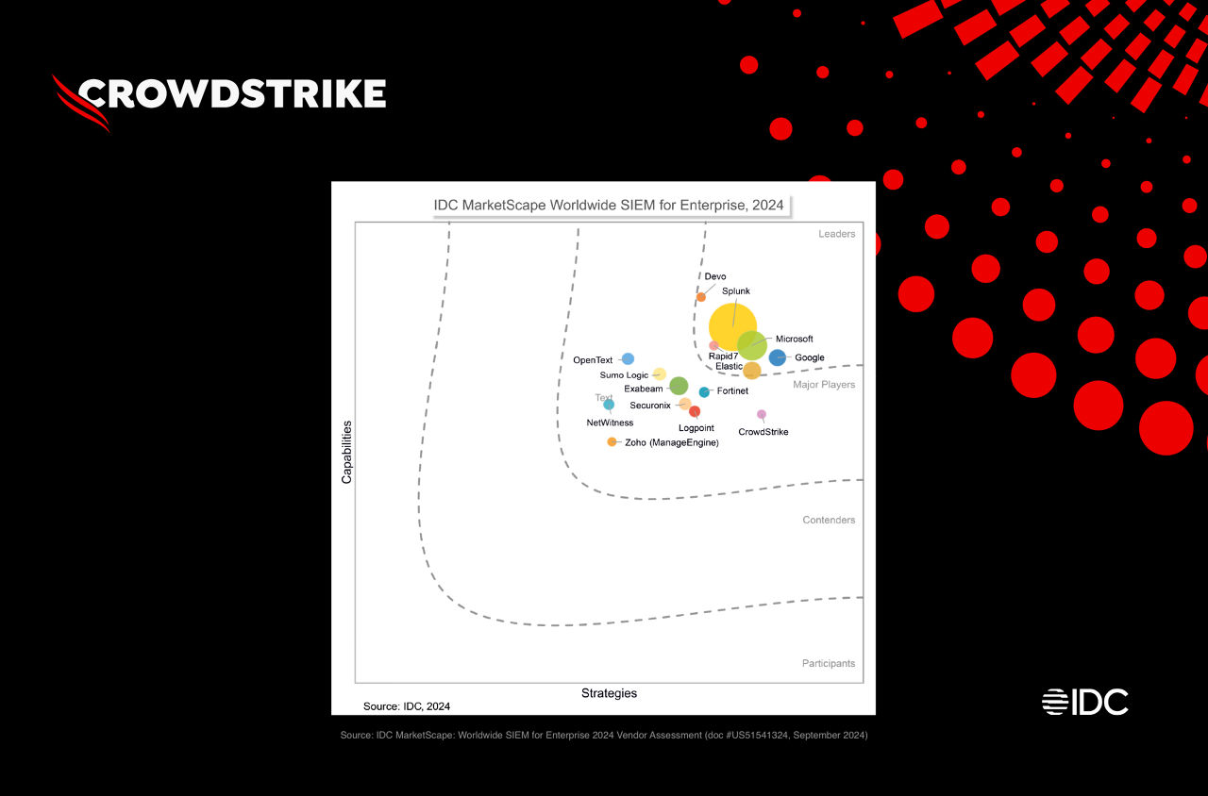
Notes:
Market and Consumer Base

Slide 4
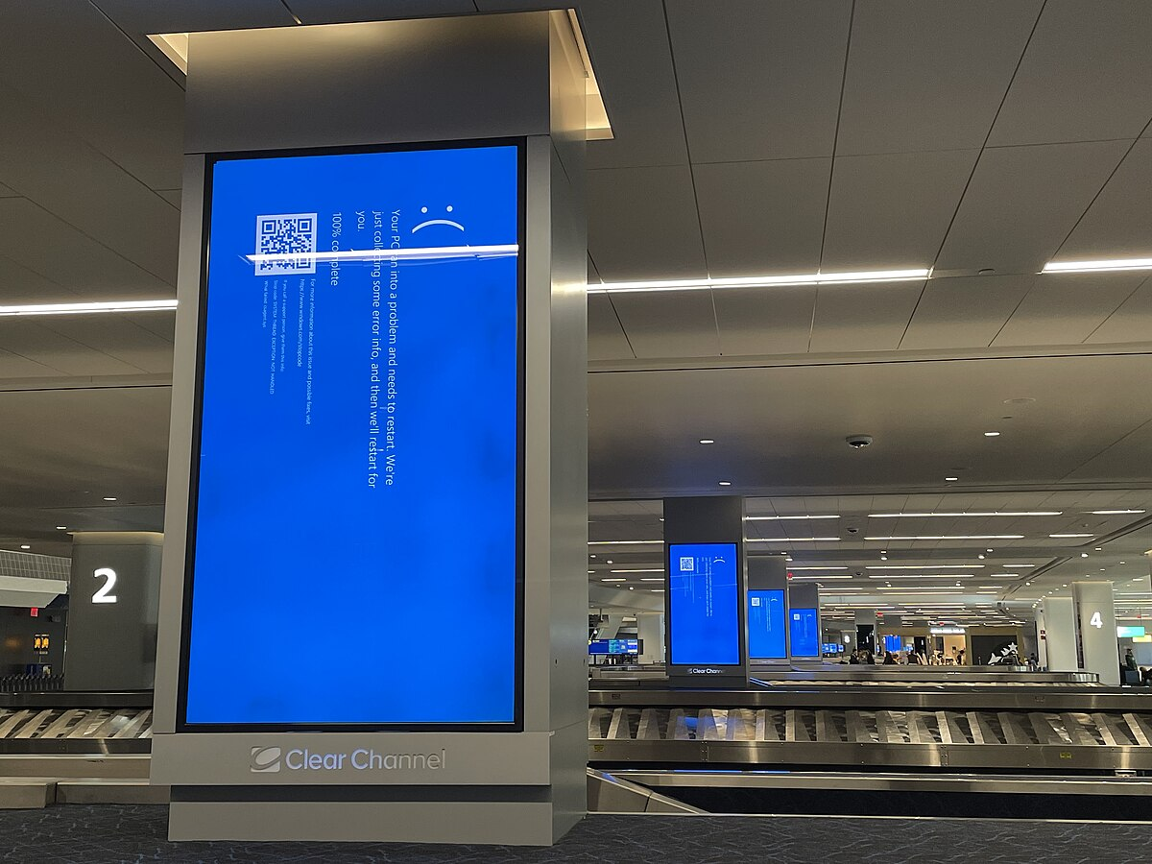
Notes:
Financial Health

Slide 5

Notes:
Challenges and Risks

Slide 6
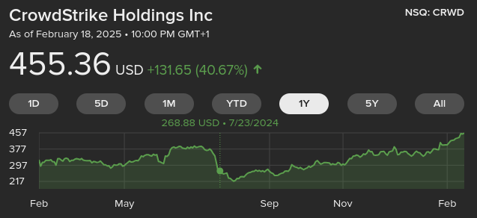
Notes:
Growth and Future Plans

