Slide 1
Automated Resume classification
Presented by :
Mohamed Salem Krichen
Fatma Ghorbel
Salah Marzougui
2020/2021

Slide 2
Plan
Introduction
Traditional Approach
Proposed solution
Conclusion

Slide 3


Introduction
Today , It has become challenging task for the job provider as well as seeker to get the one as they expect. The main challenge is at initial level.
For job provider the challenge is the extraction of the required data. In case of job seeker the challenge to get to the place where their talent could be utilized or to the place they deserve.

Slide 4


Traditional approach
Traditional approach of applying to the job is to look for the job and then apply by sending resume or CV to the place.
Manually it is difficult to extract. One method is of filtering but to identify the potential resumes by examining each resume, since these filtered resumes are similar to each other.

Slide 5

Proposed Solution
In this proposed method we have focused in improving the performance of resume selection process.
A method is proposed to categorize a given resume and job profile accordingly .
This solution will provide HR team option to customize each and every job before uploading as per requirement and skill set required.

Slide 6
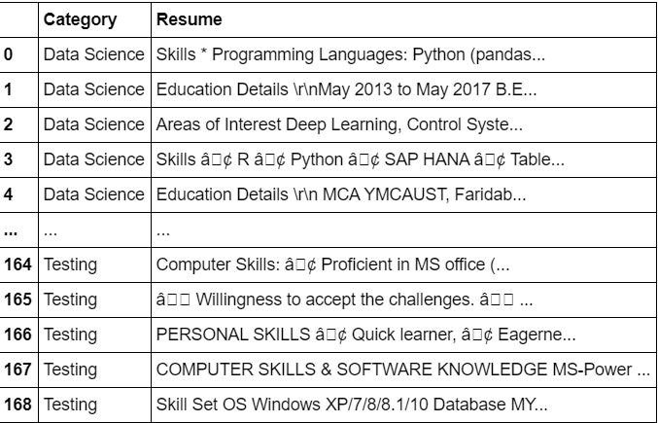
Dataset Description
Our dataset is composed of :
Two Columns and 168 rows .

Slide 7
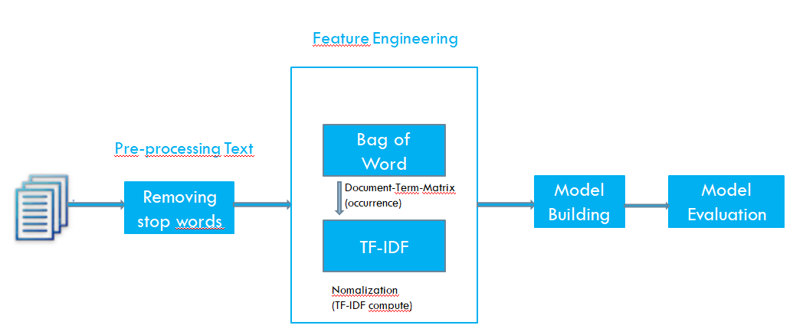
Process for Text Classification
Classification

Slide 8
Algorithms
Text mining :
is a process of exploring sizeable unstructured and structured textual data to extract high-quality information and find patterns.

Slide 9
Algorithm
Stopwords
Stopwords considered as noise in the text. Text may contain stop words such as is, am, are, this, a, an, the…
Bag-of-words model(n-gram) converts text into the matrix of occurrence of words within a document
In our code , we have used scikit-learn's CountVectorizer to generate this Matrix
from sklearn.feature_extraction.text import CountVectorizer
count_vect = CountVectorizer(stop_words='english')
X_train_counts = count_vect.fit_transform(X_train)

Slide 10
TF-IDF (Term Frequency-Inverse Document Frequency) normalizes the document term matrix. It is the product of TF and IDF
the number of words occurred in each document
Measures the amount of information a given word provides across the document
In our code , we have used scikit-learn's TfidfTransformer to normalize our document term Matrix :
from sklearn.feature_extraction.text import TfidfTransformer
tfidf_transformer = TfidfTransformer()
X_train_tfidf = tfidf_transformer.fit_transform(X_train_counts)

Slide 11
Classifier:
The class SGDClassifier implements a plain stochastic gradient descent learning routine which supports different loss functions and penalties for classification.
In our example, we have used :
clf = SGDClassifier(loss='hinge', penalty='l1', alpha=1e-3, random_state=42, max_iter=5, tol=None) clf.fit(X_train_tfidf, y_train)

Slide 12
Conclusion
The problems that the HR team face while shortlisting candidates CV are very time consuming and involves lots of human efforts.
So using our proposed solution :
eliminate the manual process of CV and reduce human error for choosing the suited candidate
reduce time and efforts of HR department in CV selection process.

