Slide 1


DEAL HUB
capstone 3
by :
الاء
باسل الطاسان
سالم المطيري

Slide 2
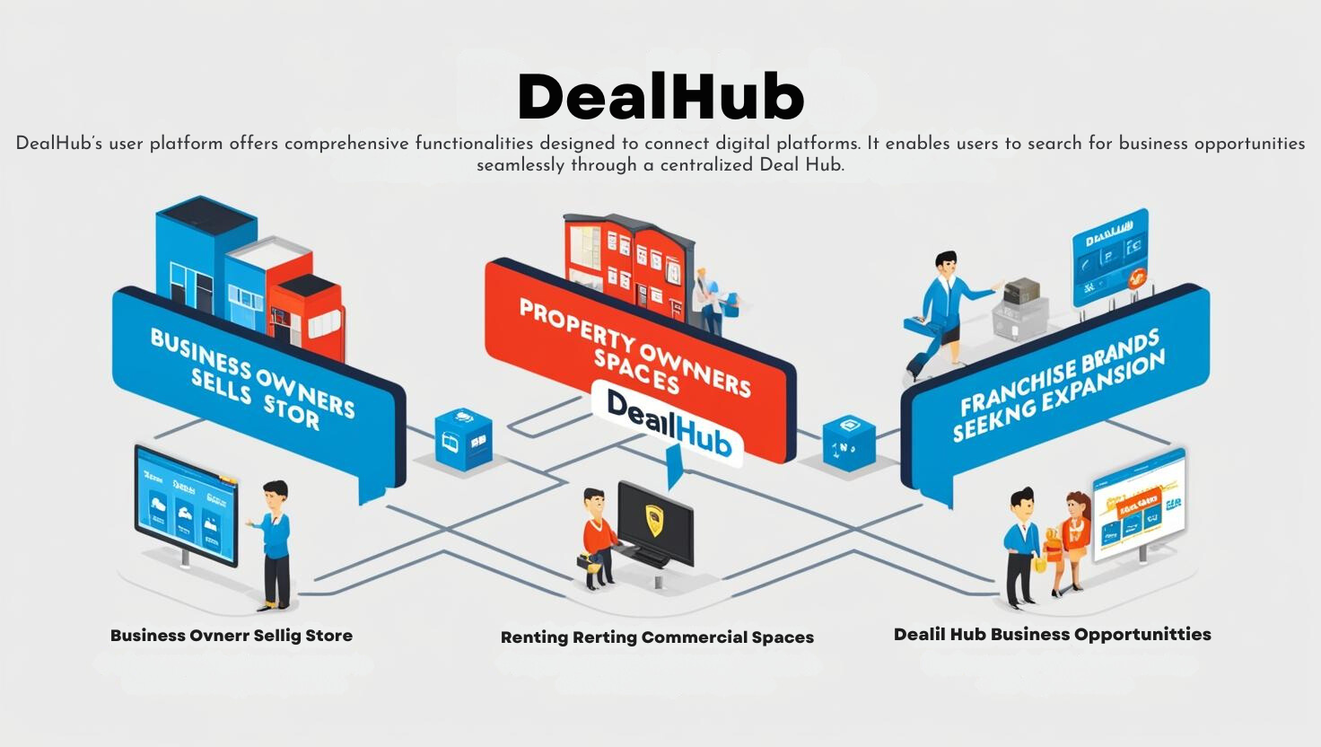
Deal Hub

Slide 3
Deal Hub
Introduction
This website is designed to help shop and commercial property owners easily list their properties and benefit from rental requests, property transfers (Taqbeel), or franchising opportunities to expand their businesses. Users can negotiate deals, manage requests, and finalize contracts in a smooth and efficient way.

Slide 4
Deal Hub
Problem Solving
Property owners often face difficulties finding suitable tenants or buyers, while renters and franchisees struggle to locate the right opportunities. Traditional methods take time and lack transparency. This platform solves these issues by offering a unified, easy-to-use solution where owners can list properties and connect with potential renters or buyers.

Slide 5

Deal Hub
KEY FEATURES
Requests and Negotiation
Property Listing
Contract Management

Slide 6

Deal Hub
first flow
Franchising opportunities

Slide 7
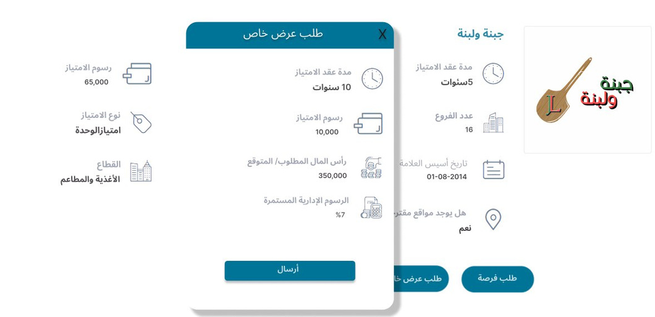
Deal Hub
first flow
Franchising opportunities

Slide 8
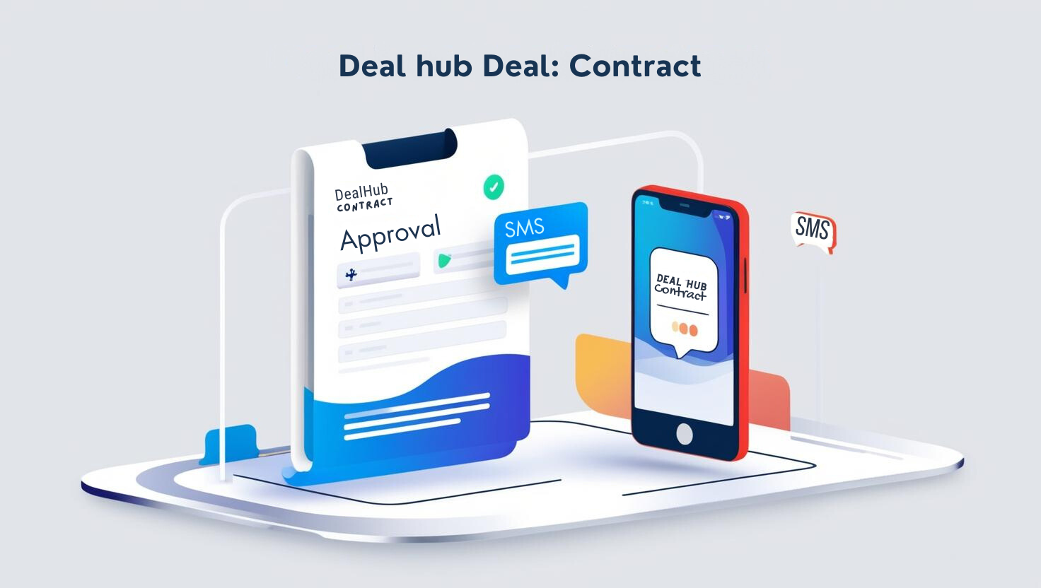
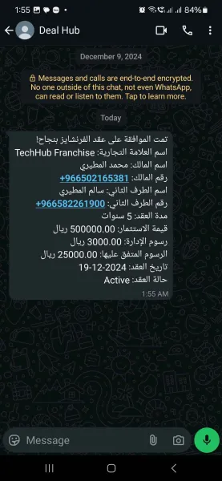

Slide 9



Slide 10
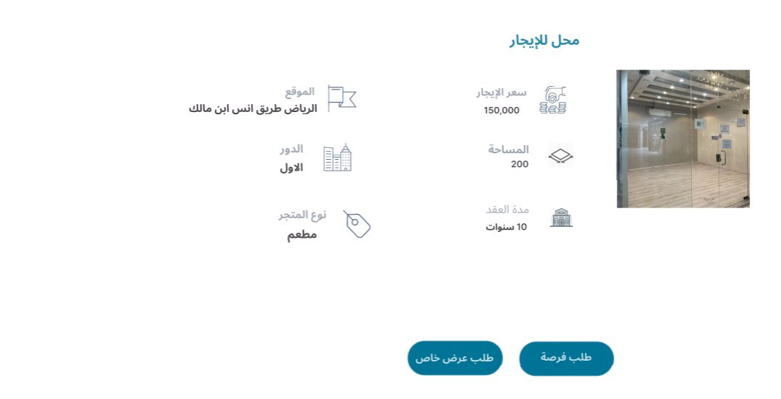
Deal Hub
second flow
Rental requests

Slide 11
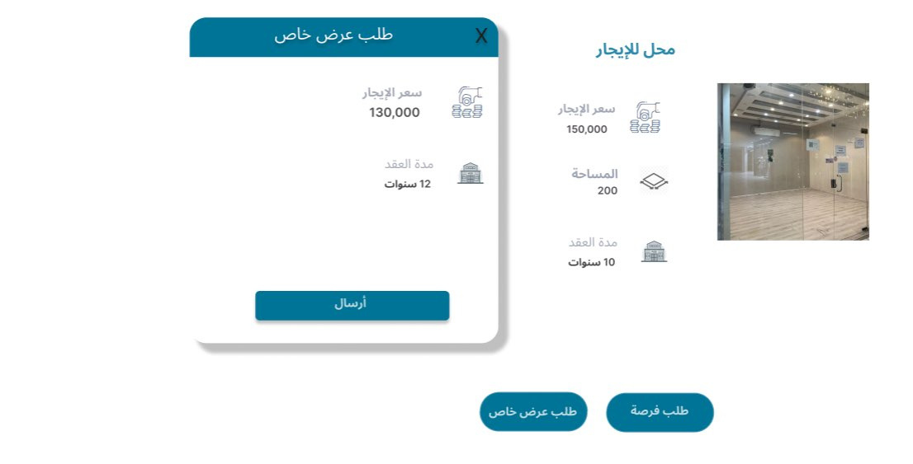
Deal Hub
second flow
Rental requests

Slide 12
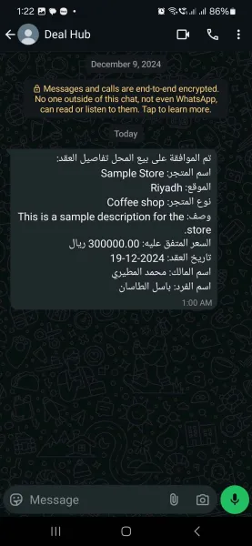

Slide 13
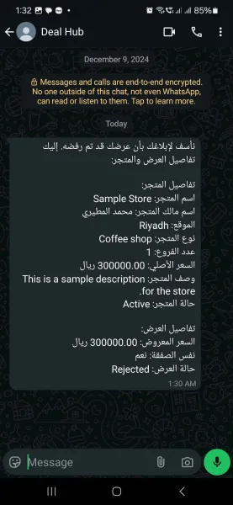

Slide 14

Deal Hub
third flow
Property transfer

Slide 15
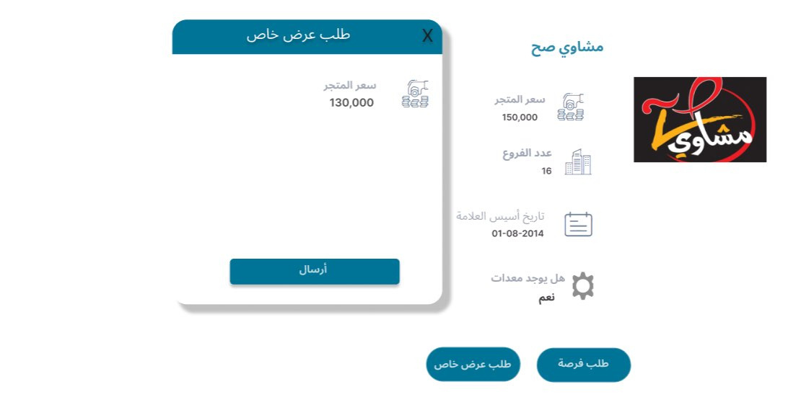
Deal Hub
third flow
Property transfer

Slide 18

THANK YOU
Now we well start testing on post man

