Slide 1

Chess Winner Prediction
Salem EID
2021 DEC 16

Slide 2

Chess Winner Prediction
Introduction
Dataset
Tools to be used.
Processes
Cleaning
Preprocessing
EDA
Modelling
Results
Future

Slide 3
Introduction
Imagine that we have a chess competition to prepare for and we need to find each player favorite opening move, to increase our chance of winning through data. The main goal of this data science research is to answer the following question:
Can I Predict the winner of a chess match using ML and past games dataset ?

Slide 4

Dataset
The dataset was obtained from Kaggle, it’s rich in information which needs to be handled with first before performing nay modellings it contains 20,000 datapoints and 16 features.
Data Feature | Description
Game ID | System generated game ID.
Rated (T/F) | Either the game is rated for points or casual
Start Time | start time of the game
End Time | end time of the game
Number of Turns | number of turns the game took
Game Status | game end status (mate, out of time, draw, resign)
Winner | White, Black or Draw
Time Increment | A fixed amount of time (in minutes) assigned at move 0 for the entire game, and increment (in seconds) is the Amount added after each move., more info increment methods
White Player ID | White player name
White Player Rating | White player level - the higher the more victories and experience
Black Player ID | Black player name
Black Player Rating | Black player level - the higher the more victories and experience
Moves | All Moves in Standard Chess Notation;
Opening Eco | Standard Code for opening moves
Opening Name | A set of moves in the beginning of the game which form into a move
Opening Ply | Number of moves in the opening phase which belongs to the opening moves

Slide 5







Tools to be used
Programming Language | Data Handling Libraries | Modelling Libraries | Visualizations Libraries

Slide 6
Process
Data Science Project Process
Getting Data and Question
Cleaning Data
Importing The Libraries
Preprocessing
Explore The Data
Modelling
Conclusion
Meet Data requirements min. 10,000 x 15
Ask Data Science question
Import Libraries for next steps
Check Columns names
Check Rows Duplicate
Check and Handle Missing
Check Data types
Convert Data types
Feature Engineering
Check Target
Check Independent Features
Check Correlation
Plot Visualizations/ Pair Plot
One Hot Encoding
Scale or Normalize the data
Cure Imbalances
Initiate appropriate Models
Improve Results
Improve Code

Slide 7
Cleaning Data
400 + Duplicated data records
Converted timestamp feature(created_at, last_move_at) which was in Unix format
Decode increment_code column
Shorten opening names which had many sub variations
Extracted rating difference for each game
Categorized games based on rating average.

Slide 8
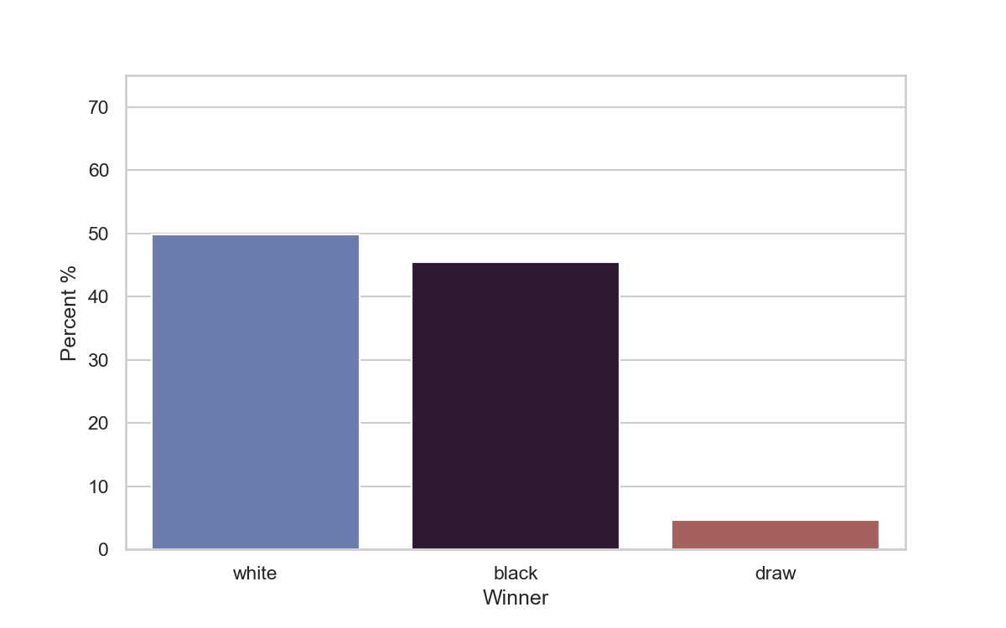
Target data
The fight between white and black is a close call , white edges a little bit.
This a multi-classification problem

Slide 9
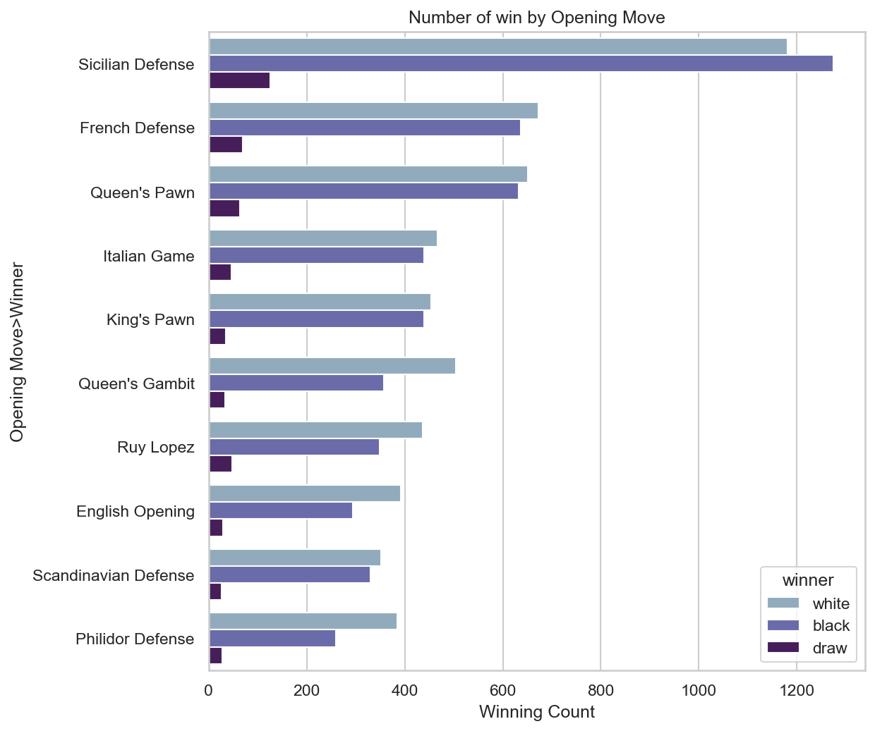
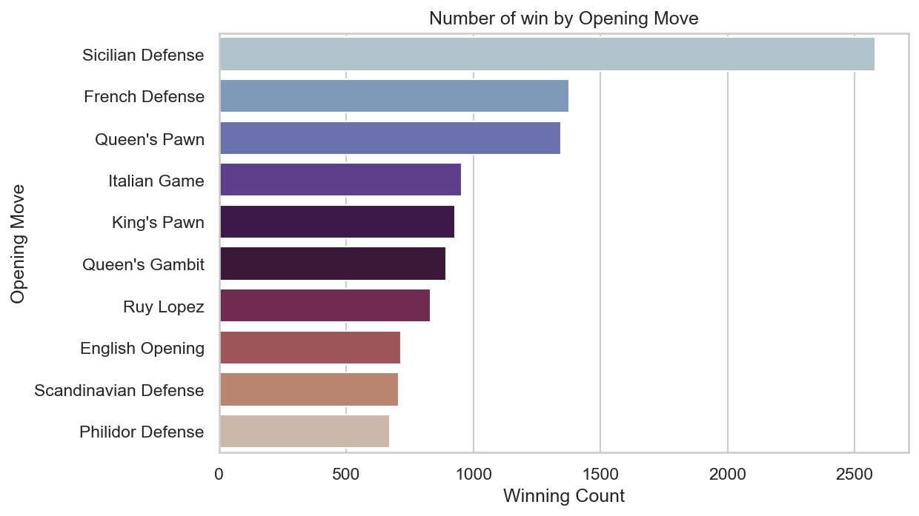
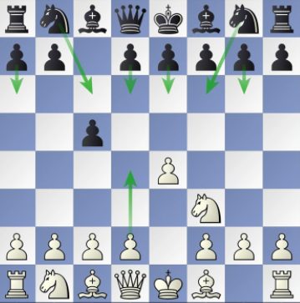
Opening moves data
Sicilian Defense

Slide 10
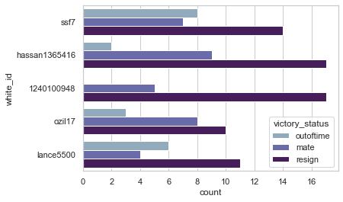
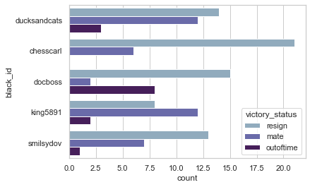
Top White and Black Players

Slide 11
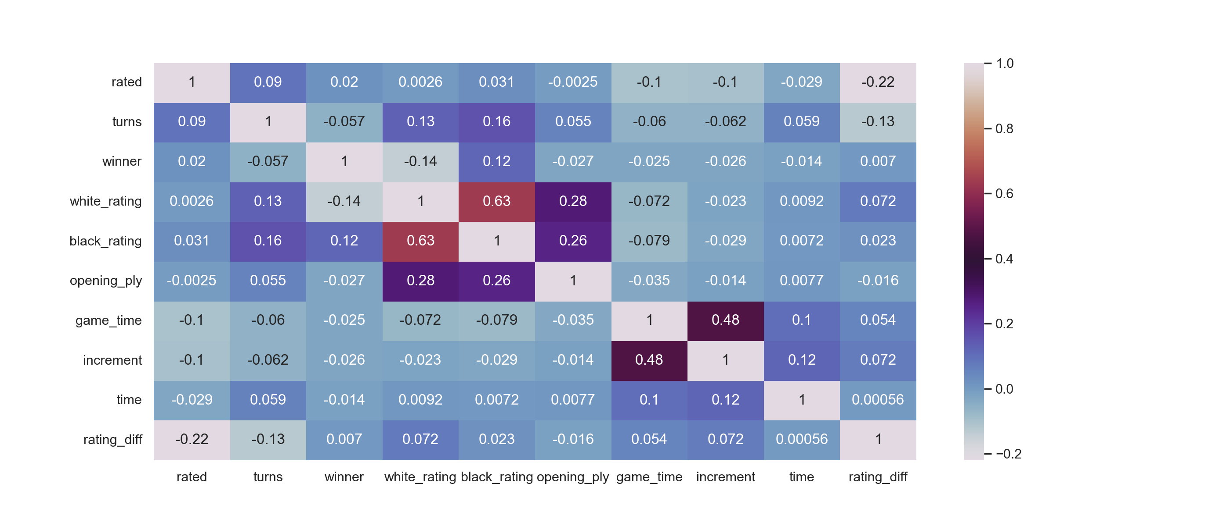
Features Correlation Heatmap

Slide 12
Scorings
Models | Accuracy Score | F1 Score
Logistic Regression | 0.665053 | 0.664628
Random Forest | 0.67244 | 0.672021
XGBoost | 0.875191 | 0.875144
SVM | 0.643148 | 0.642504
KNN | 0.625064 | 0.624595

Slide 13
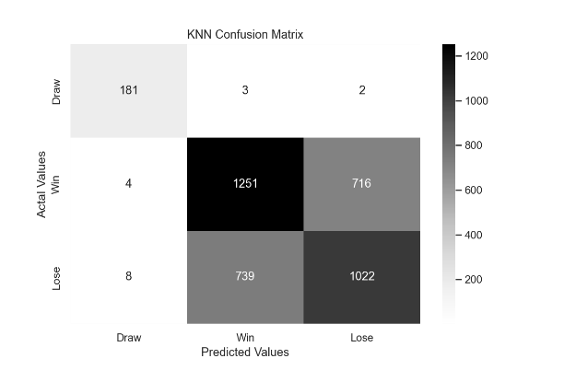
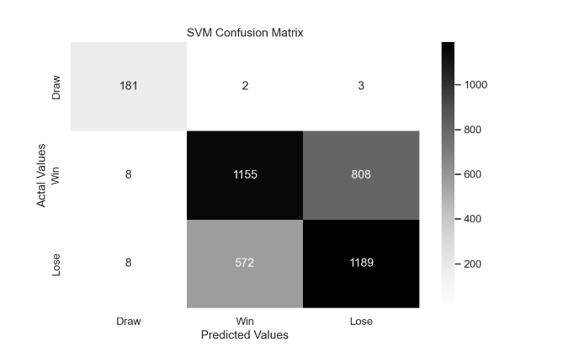
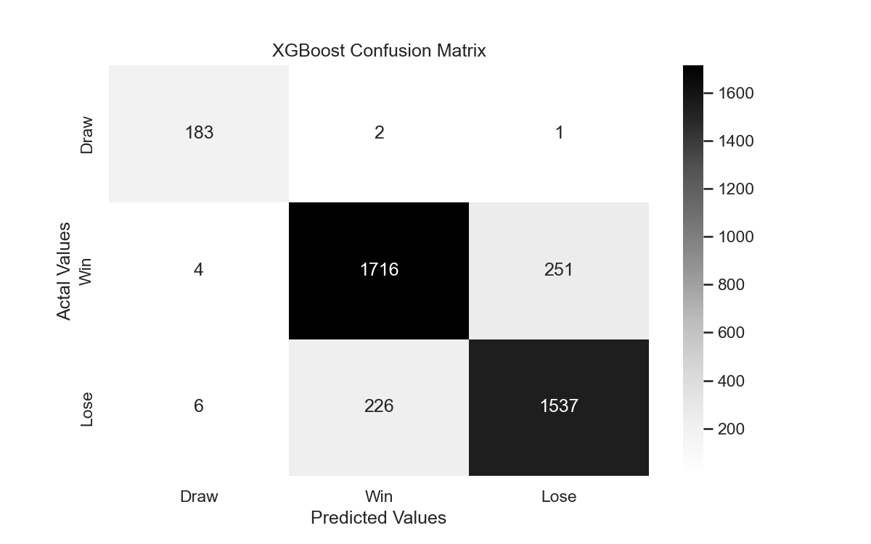
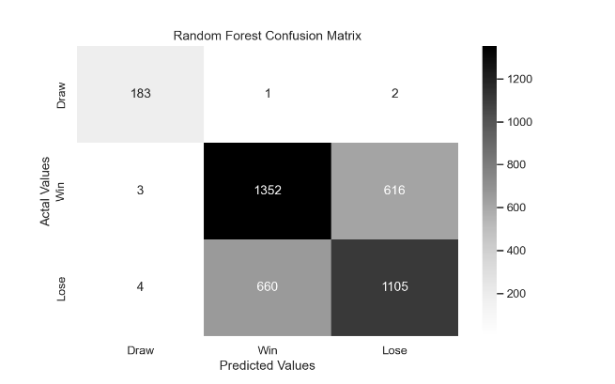
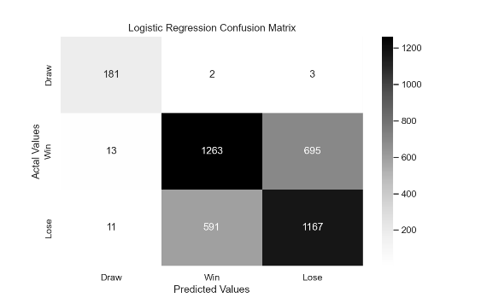
Confusion Matrix

Slide 14
Future Direction
Connect the model with the original lichess.org API to be updated with realtime data.
Deploy to production on a webapp using Flask.
Apply the model on different sport games.
Upgrade the model to including detailed movement analysis using on Neural Network models.
Players Ratings
Opening Move
Model
Winner
Time Rules
Number of moves

Slide 15
Thank you
Any Questions?

