Slide 1
Z
ZVKY FORGE
art asset & animation pipeline
Studio Pipeline Overview
One slide per module, with screenshots from the running application
Internal induction deck · built 2026-09-06
Notes:
Companion to the full User Manual and Reference. This deck is the ten-minute version; the manual is the one to follow at a keyboard.

Slide 2
Z
THE SHAPE OF IT
One place where every piece of work lives
10
60
64
1
stages from Not Assigned to Delivered
designations, each with its own view
permissions a Super Admin controls
active task per person at a time
Every asset carries who did what and when. Nothing moves except through a recorded step, and every step is one somebody was allowed to take.
2
Notes:
The four numbers are the whole design: a fixed pipeline, a role system fine enough to match a real studio, and one rule about focus.

Slide 3
Z
CONTENTS
What this deck covers
Signing in, the tour, the header
4-5
Project reviews and Pending Actions
Keeping the documentation current
18
28
The Dashboard
6
Time Sheet
19
Clients and projects
7
Reports
20
Assets, and bulk upload
8-9
People
21
The asset panel and preview images
10-11
Chat
22
The workflow, and one active task
12-14
Notifications and your profile
23
The two review gates
15-16
Settings and permissions
24-26
Delivery and the client loop
17
The Activity Log
27
3

Slide 4
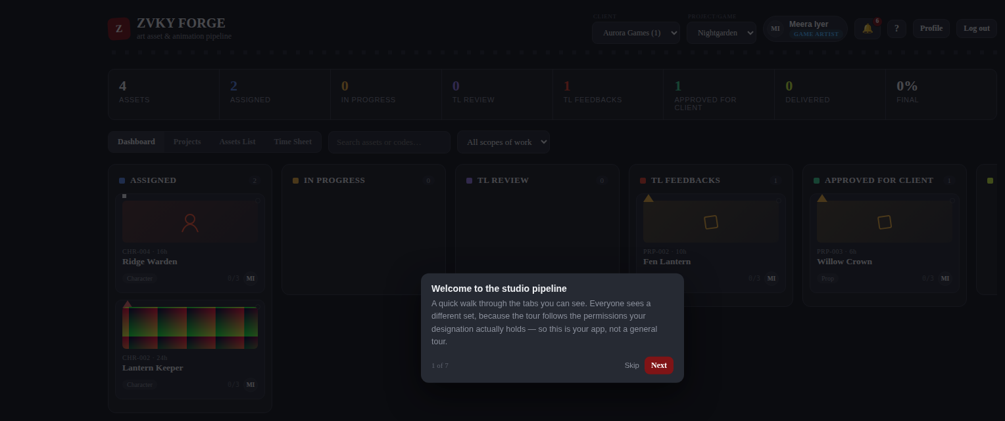
Z
GETTING IN
Signing in, and the tour that meets you
Sign in with the email the studio issued and your password.
A guided Quick Tour opens by itself the first time. It walks only the tabs your designation actually gives you.
The question-mark icon in the header reopens it whenever you want.
Passwords need 10 characters, upper and lower case, a number and a symbol.
The tour opening on a first sign-in. Seven steps for a Game Artist.
WHO Everybody. The tour needs no permission and shows each person a different walk.
4
Notes:
Worth demonstrating live: sign in as an artist and as a producer and show the tour differing.

Slide 5
Z
GETTING AROUND
The header decides what you are looking at
Client, then Project — everything below follows the pair you choose here.
Your name and designation, so you always know which view you are in.
The bell carries unread notifications; the question mark reopens the tour.
The tab row is built from your permissions. Nobody sees a tab they cannot use.
The header, from the brand mark to Log out.
WHO Everybody, but no two designations see the same tab row.
5

Slide 6
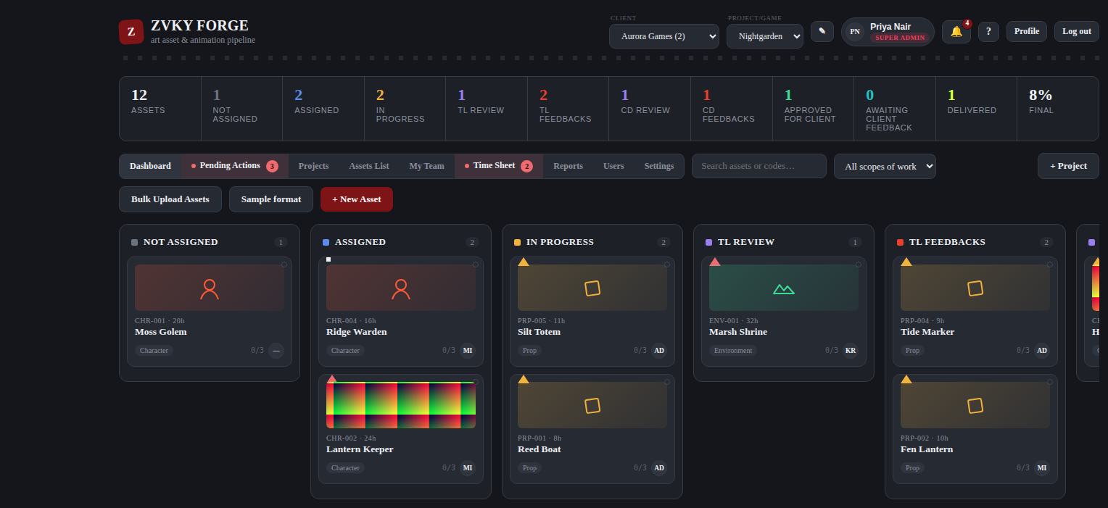
Z
DASHBOARD
The board answers "where is this?"
One column per stage, one card per asset.
The strip above counts every stage and the share of the project that is finished.
A card shows the preview image, the code, the estimate, the name and who holds it.
The counts are what YOU may see — an artist and a producer read different numbers off the same project.
The Dashboard as a Super Admin sees it.
WHO Everybody. Reach comes from the designation, not from the screen.
6

Slide 7
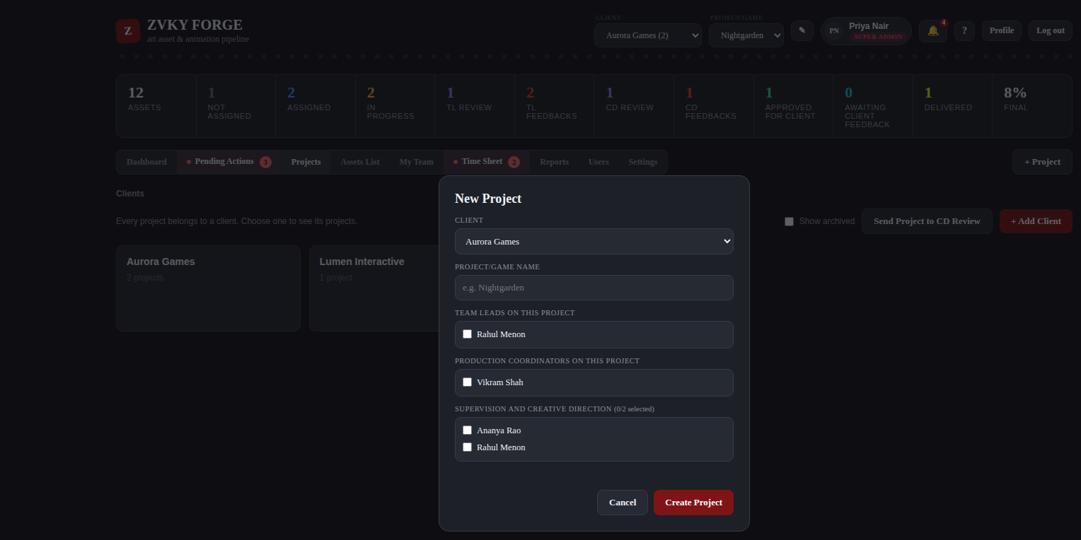
Z
CLIENTS AND PROJECTS
Projects sit under clients
Create a project against a client, and name the team leads who run its first review gate.
Add production coordinators if the studio uses them.
Name up to two people to supervise it — the cap is enforced by the server, because five supervisors means none.
A finished project is closed rather than deleted, so its assets and history stay readable.
The new-project form.
WHO Administration — 8 designations. Everyone else sees the clients they work under.
7

Slide 8
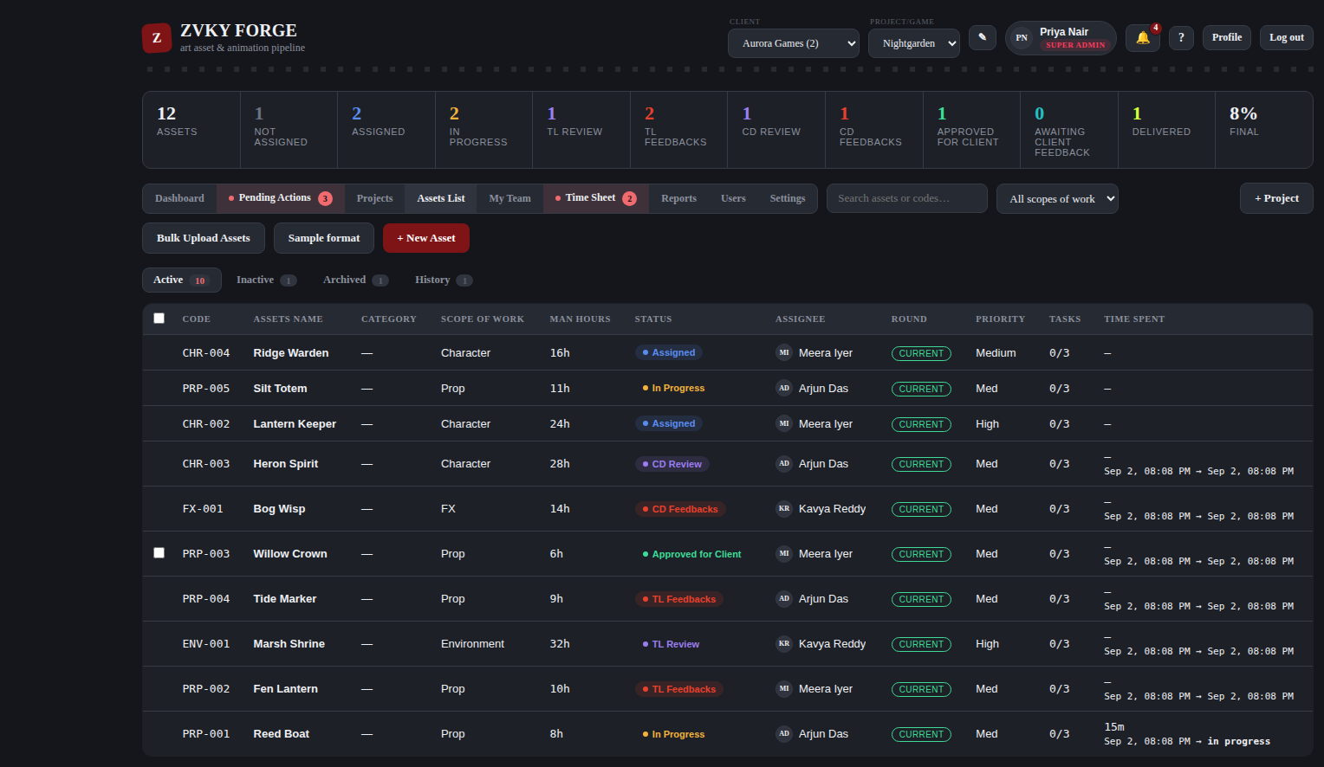
Z
ASSETS
One asset, or two hundred
New Asset takes a name and a scope of work; the code is generated (CHR-004).
Bulk Upload Assets takes a spreadsheet of nine columns — press Sample format first.
A bad row is reported with its row number and reason; the good rows still import.
An unrecognised column heading is reported, never silently dropped.
The Assets List, on its Active sub-tab.
WHO Production planning — 23 designations. Deleting an asset is administration only.
8

Slide 9
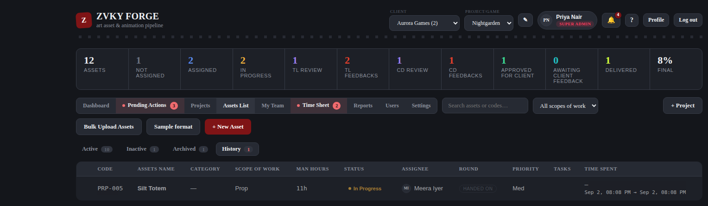
Z
ASSETS
Four sub-tabs, and an asset is in exactly one
Active — everything still moving.
Inactive — work on hold.
Archived — delivered, kept for the record.
History — every stage change, who made it and when.
Tick several rows to deliver them in one action; each is still recorded individually.
The History sub-tab.
WHO Everybody sees the list. Bulk delivery sits with the delivery band — 18 designations.
9

Slide 10
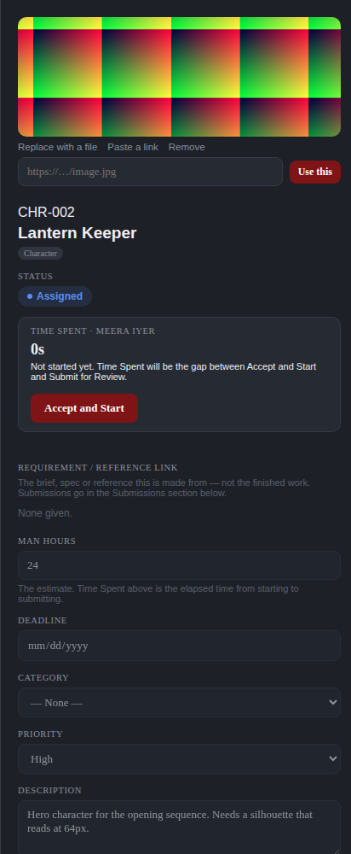
Z
THE ASSET PANEL
Everything about one asset, in one place
Opens from any card or any row.
Preview image, code, name, stage, and Time Spent at the top.
The brief, the estimate, the deadline, the category, the priority and the description.
Tasks, notes, submissions and the asset’s own history further down.
WHO Everybody who can see the asset. What you may change depends on your designation.
The asset panel.
10

Slide 11
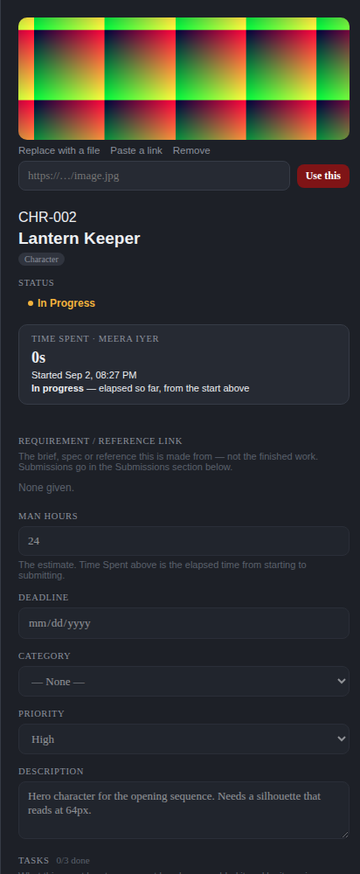
Z
PREVIEW IMAGES
Upload a file, or paste a link
Upload a JPG or PNG of up to 5 MB, or paste an http/https image address.
An asset holds one or the other, never both.
A linked image stays current with its source — and falls back to the scope-of-work icon if the link dies, rather than showing a broken picture.
Both setting and removing are recorded in the Activity Log, naming the person and the kind.
WHO The assignee can always set their own asset’s preview. Anybody else needs Asset Edit.
An asset with an uploaded preview, in progress.
11

Slide 12
Z
THE WORKFLOW
Ten stages, and no way round them
Not Assigned
Assigned
In Progress
TL Review
TL Feedbacks
1
2
3
4
5
CD Review
CD Feedbacks
Approved for Client
Awaiting Client
Delivered
6
7
8
9
10
Feedback at either gate sends the asset back a stage, not to the beginning. Stage colours are deliberately distinct from the brand colour, so a red card never reads as branding.
12
Notes:
Fifteen moves connect these ten stages. The manual has the full table; this deck shows the shape.

Slide 13
Z
DOING THE WORK
Accept and Start, then Submit for Review
Accept and Start moves the asset to In Progress and stamps the time.
Time Spent is the gap between that stamp and your submission, less any stretch put on hold.
Submit for Review sends it to the first gate with the file or the link attached.
You cannot submit work you never started, which is what makes Time Spent mean anything.
WHO The person the asset is assigned to, and nobody else.
Before accepting. Time Spent reads 0s.
13

Slide 14
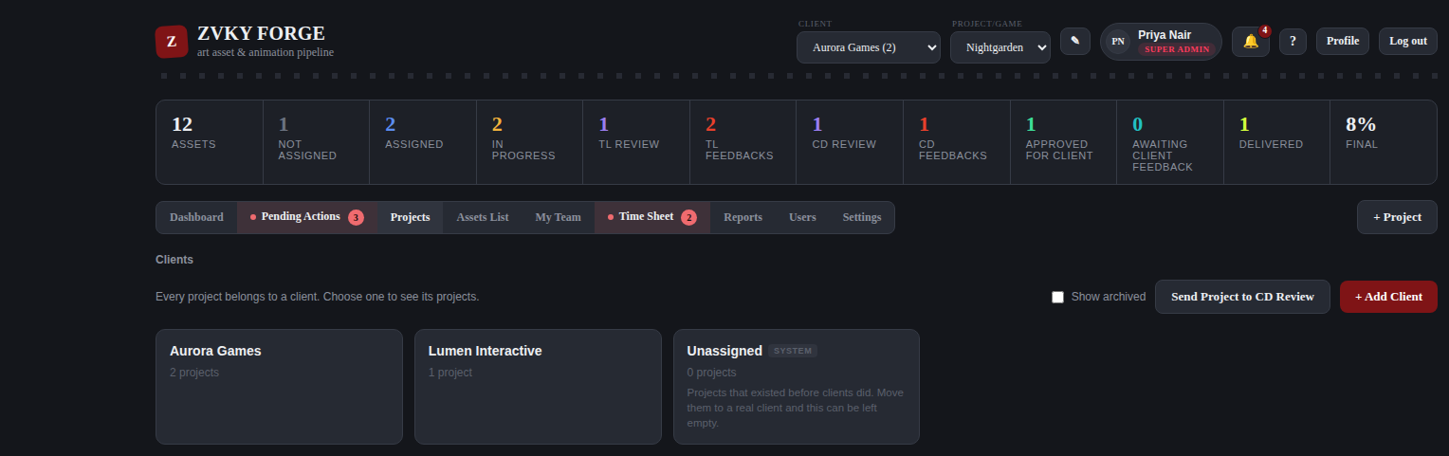
Z
PROJECTS
What a project is, and how it is going
Category, Start Date and End Date describe the project. They are set on Add Project and are plain information — nothing warns or blocks when an end date passes.
"+ Add Category" creates a category from inside the form and selects it straight away.
Total Bid Hours adds up every asset’s Man Hours — every asset, at every stage, including delivered ones.
Spent Time adds up every round of every asset, held time excluded. The same figure the Efficiency report shows.
Neither figure is stored. Both are counted from the assets each time the tab is drawn, so they are never out of date.
The projects under a client.
WHO Anyone who can see clients sees the columns. Creating and editing projects is the existing project permission; managing the Project Categories list is its own Settings permission, separate from asset categories.
14

Slide 15
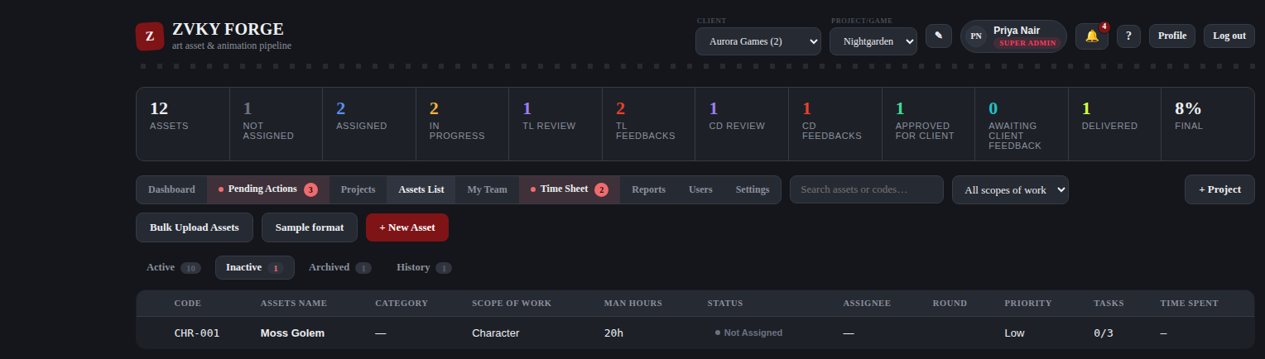
Z
BULK ASSIGN
Hand out and schedule a batch in one action
Tick the assets on the Assets List — Inactive sub-tab — and press Assign & Schedule.
One assignee, one Start Date, one End Date, applied to all of them. Each field is optional.
Only work nobody has started. Anything already on somebody’s desk is skipped and listed with the reason.
Each asset gets its own Round, its own history line and its own notification, exactly as a single assignment does.
The button says how many of your selection it will touch before you press it.
The Assets List, where a batch is selected.
WHO Super Admin alone out of the box. Granted in Settings to the coordinators who plan work — which opens the bulk panel without widening whose assets anybody may touch.
15

Slide 16
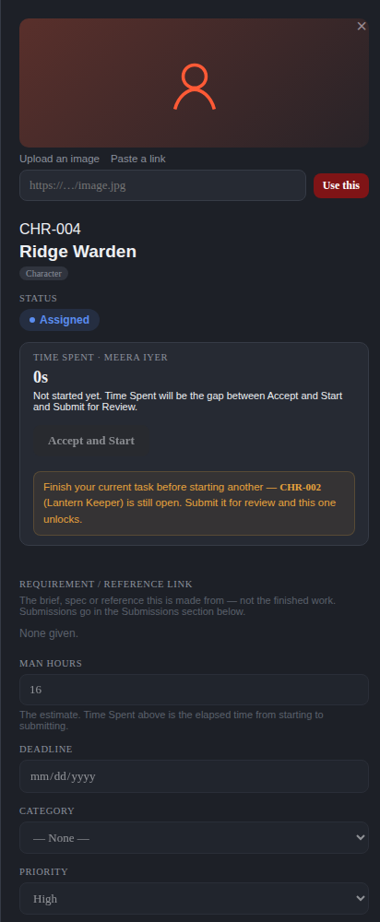
Z
ONE AT A TIME
One active task, enforced
While one of your assets is open, Accept and Start on every other one is disabled.
The message names the asset that is holding you up.
Submit the open one and every other unlocks immediately.
Enforced on the server as well as the screen, so a second browser tab does not get round it.
It restricts starting your own work and nothing else — reviewing, approving and time sheets are untouched.
WHO Applies to everybody who accepts work. A lead with an asset under way still runs their queue.
A second asset, refused, naming the open one.
16

Slide 17
Z
HOLD
Put a task down without handing it in
Hold stops the count on a task and frees you to start another one.
The held time is left out of that asset’s Time Spent. Say why in a line, or leave it blank.
It stays in its stage and carries an On hold badge, so a lead can see the work has stopped.
Resume obeys the same one-task rule as starting, so holding is not a way around it.
Time Spent now depends on people pressing the button, exactly as the Time Sheet does.
WHO The person the task is assigned to, with Hold / Resume Own Task — on for every designation by default, and switchable off in Settings. Nobody can hold somebody else’s task in this version.
A task in progress, where the Hold button sits.
17

Slide 18
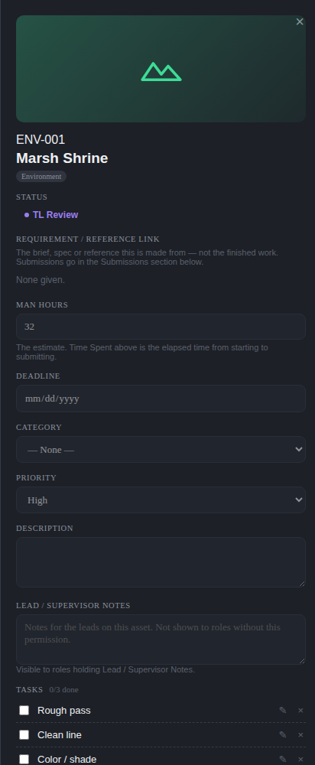
Z
FIRST REVIEW GATE
The team lead sees it first
Approve to send it on to the Creative Director.
Request changes to send it back as TL Feedbacks, with a note.
A studio without a Creative Director gate can send straight to Approved for Client, if the reviewer holds that permission.
Rework comes back through this same gate.
WHO First review gate — 23 designations: leads, supervisors, production and creative direction.
An asset at TL Review.
18

Slide 19
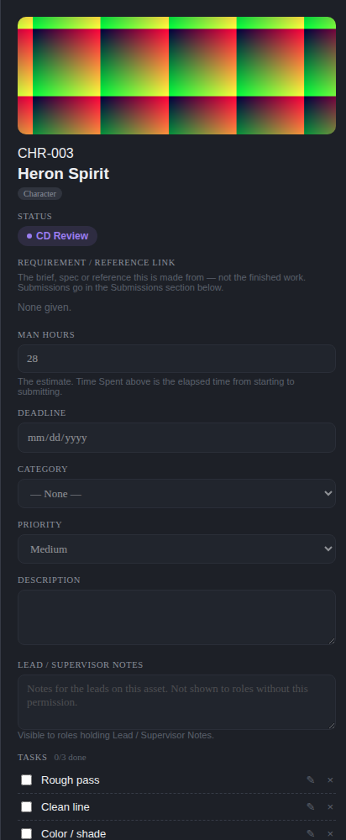
Z
SECOND REVIEW GATE
The Creative Director, and the relay
Approve for client, or Submit Feedback — one action, not two competing decisions.
Feedback goes to CD Feedbacks, which sits with the team lead first.
The lead reads the notes, adds their own reading, and relays them to the artist.
Until they do, the artist cannot start the rework — and the application says so plainly.
WHO Creative direction — 9 designations: art direction and above.
An asset at CD Review.
19

Slide 20
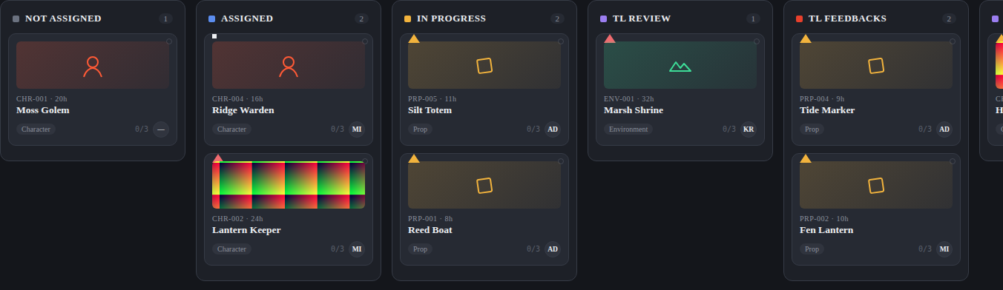
Z
DELIVERY
Two ways out of the studio
Deliver — handed over, and the asset is Delivered. One step.
Send to client review — the asset waits at Awaiting Client Feedback.
Client approved sends it to Delivered; client changes send it back to TL Feedbacks and round again.
A studio uses whichever route matches how it works with that client.
The later columns on the board.
WHO Delivery — 18 designations. The whole client-feedback loop is Super Admin only until granted.
20

Slide 21
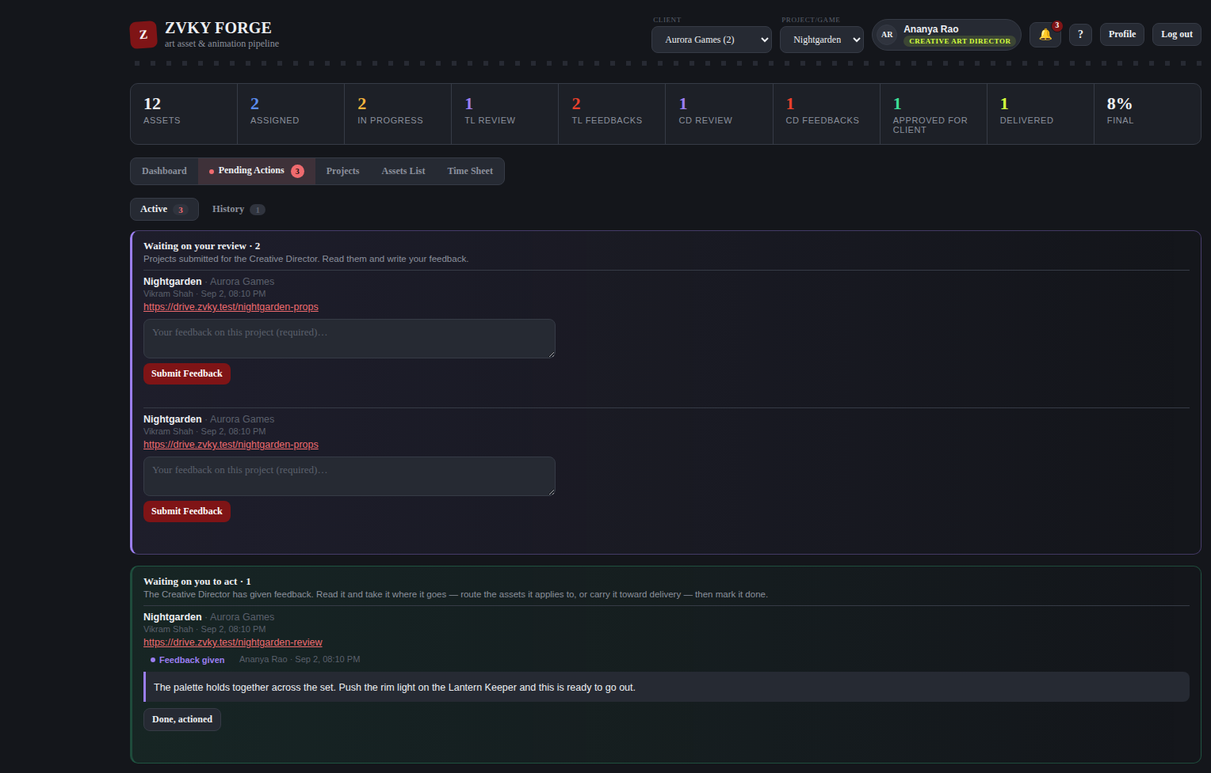
Z
PROJECT REVIEWS
A project, not an asset
A producer sends a project to the Creative Director with a question.
It lands in the reviewer’s Pending Actions, which carries a count and highlights while something waits.
The reviewer answers with Submit Feedback; the submitter is notified at once.
The submitter reads it and presses Acknowledge and Close.
Your own submissions never appear in your queue to answer, only in your queue to read.
WHO Creative Art Director and Super Admin. Sending, and seeing your own submissions, are Super Admin only until granted.
Pending Actions, as the Creative Director.
21
Notes:
Flag this one in induction: the permissions here are narrow out of the box, and a studio must grant them before producers and directors can use the feature.

Slide 22
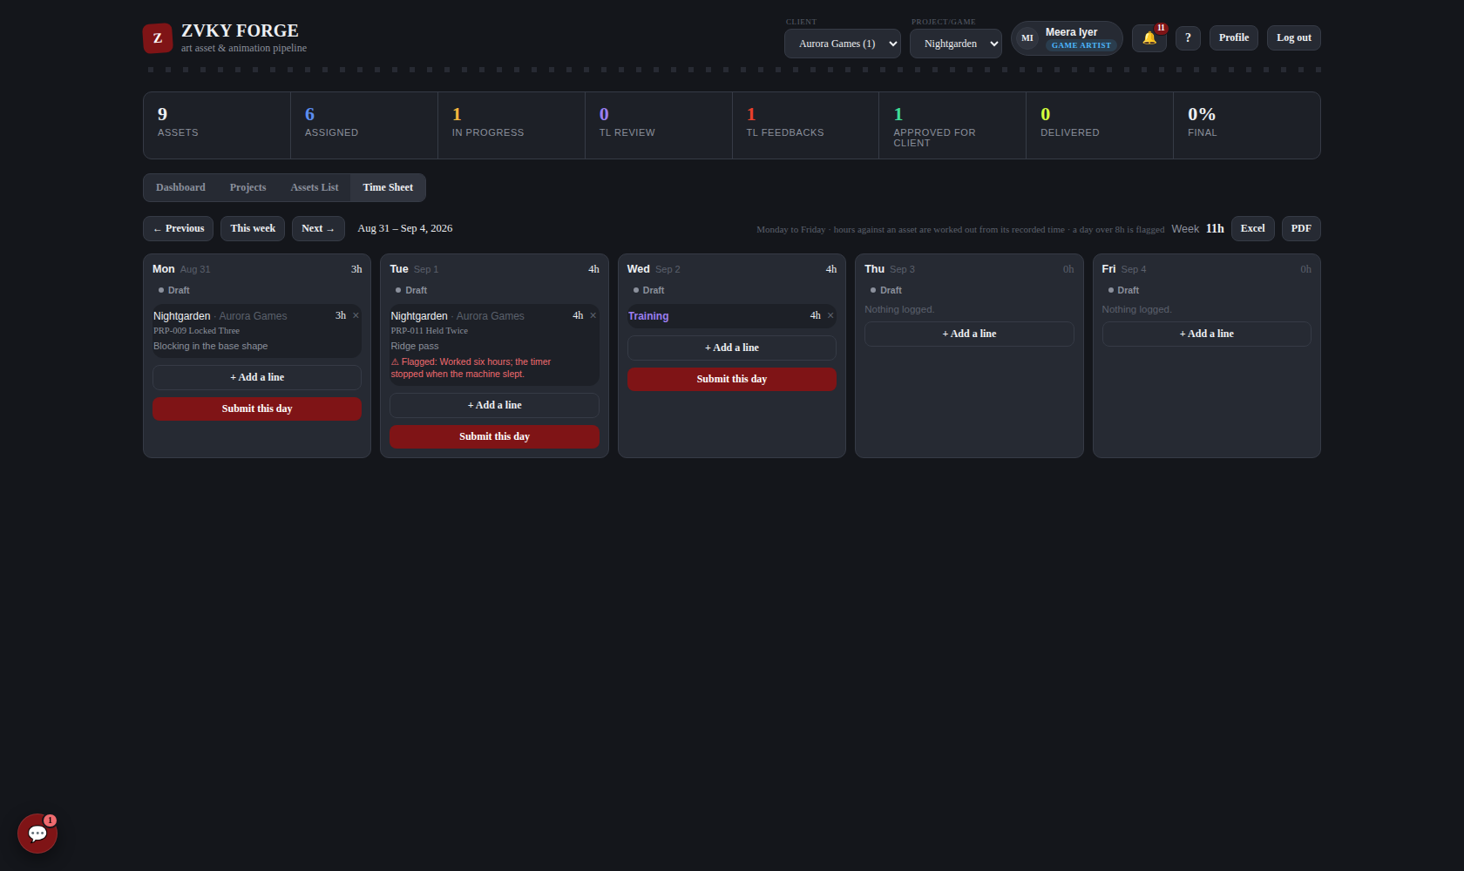
Z
TIME SHEET
A weekday at a time, in IST
Monday to Friday. There is no Saturday or Sunday row, and the API refuses a line dated to one.
A line is a number of HOURS against a project, an asset or non-project time. No start and end times.
Pick an asset and its hours are WORKED OUT and the field locks — what it recorded, less what you have already filed against it, so a multi-day job is never counted twice. Weekend work still counts towards it.
Time with no asset — leave, a meeting, training — is typed in as before. There is nothing to calculate it from.
If a calculated figure looks wrong, flag it with a reason. Nobody edits it; the disagreement goes on the record beside it.
A day over 8 hours is flagged, not refused. A long day is real; a form that refuses one is not.
Submission is daily, and nobody approves it. Submitting locks the day; its owner can reopen it.
WHO Everybody fills in their own. Reading a team’s sits with leads and producers — 18 designations. There is no Approve Timesheets permission any more.
A working week: an asset line, a flagged figure and non-project time.
22

Slide 23
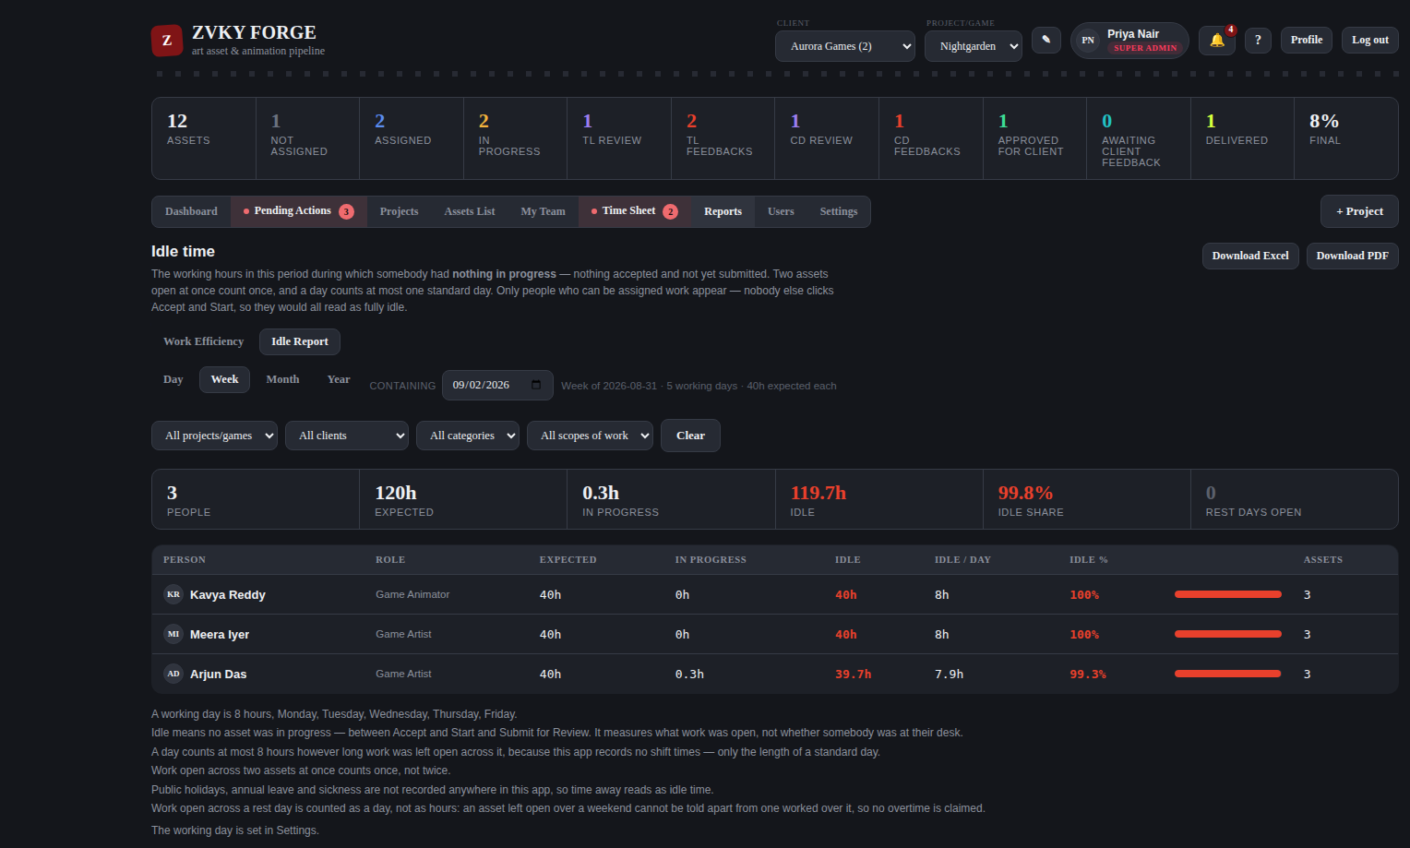
Z
REPORTS
Estimate against actual, and time with nothing open
Efficiency compares each asset’s man hours against Time Spent, by user, asset, project or scope of work.
It says how many assets had time held back, and Idle counts that same held time as idle — the two reports are meant to disagree there.
Idle is working time during which somebody had nothing started.
Idle counts against the configured working hours, so evenings and lunch are not counted as idle.
Idle Now answers the immediate question: who has nothing open right now.
Every report exports to Excel and PDF, named after the view you were looking at.
WHO Studio leadership — 7 designations, plus anyone given View Reports. Team Lead is a common addition.
The Idle report.
23

Slide 24
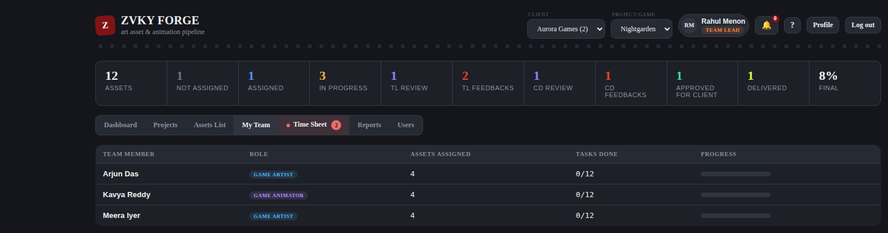
Z
PEOPLE
The staff list, and your own team
Add a person with their name, sign-in email, designation, reporting line and project.
What a designation can do comes from the tier behind it — pick the closest match.
Bulk import takes name, email and role as required columns.
RESET PASSWORD sets the studio’s standing password — the same one new accounts get — signs their devices out and forces them to choose a new one. Tell them promptly: until they do, anybody who knows that password could set it for them. Super Admin only until granted in Settings.
My Team shows the people who report to you, what they are carrying and how far along it is.
My Team, as a Team Lead.
WHO Administration — 8 designations. My Team is open to anyone who supervises people — 14.
24

Slide 25
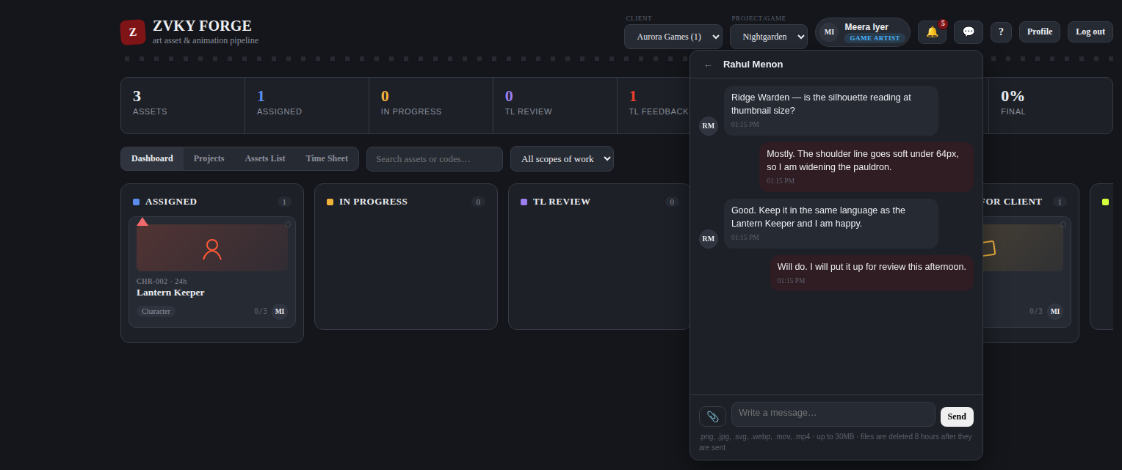
Z
CHAT
Talk to anybody; groups are for the people who run work
The speech-bubble icon beside the bell. One to one with anybody in the studio, with no permission needed.
Groups hold thirty people, counting whoever made them, and are started by Leads, Production and Creative Direction.
The owner renames the group, adds and removes people; anybody can leave. An owner who leaves hands it on.
Files: .png, .jpg, .svg, .webp, .mov, .mp4 up to 30MB — deleted after twelve hours. The message stays and says the file expired.
Private INSIDE chat: nobody reads a conversation they are not in through the panel, Super Admin included.
OUTSIDE it there is one screen — Settings → Chat Activity — that reads everything, behind its own permission, held by the Super Admin alone. Reading it is itself recorded. Tell staff chat is logged.
A new message also raises a DESKTOP notification, as an assignment does. Everyone is asked for browser permission; a refusal is reported in the app, not swallowed.
A one-to-one conversation.
WHO Everybody chats. Production planning and creative direction — 25 designations — may start a group.
25

Slide 26
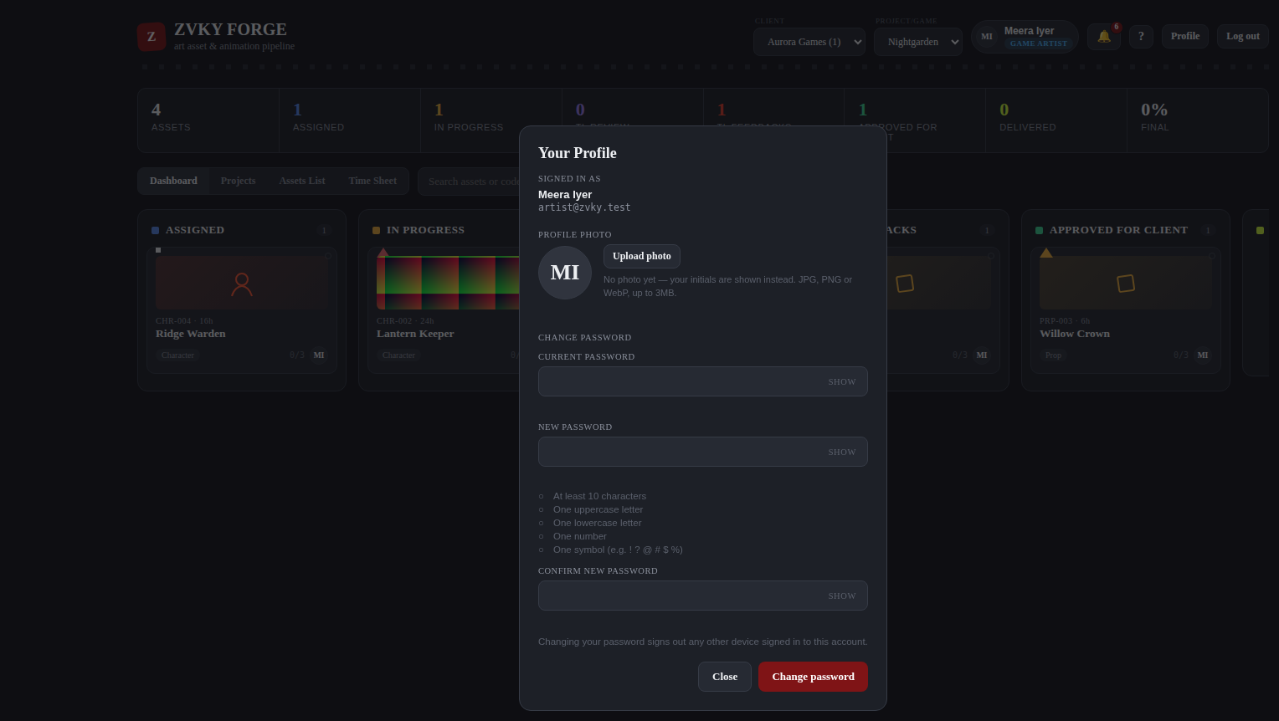
Z
YOU
Notifications, your photo, your password
The bell carries unread notifications: work assigned to you, reviews coming back, feedback landing.
Profile holds your photo, which then appears everywhere you are represented.
Profile also holds your password.
Changing your password signs out every other session — deliberately, since a password is changed because it may be known.
The Profile panel.
WHO Everybody, for themselves.
26

Slide 27
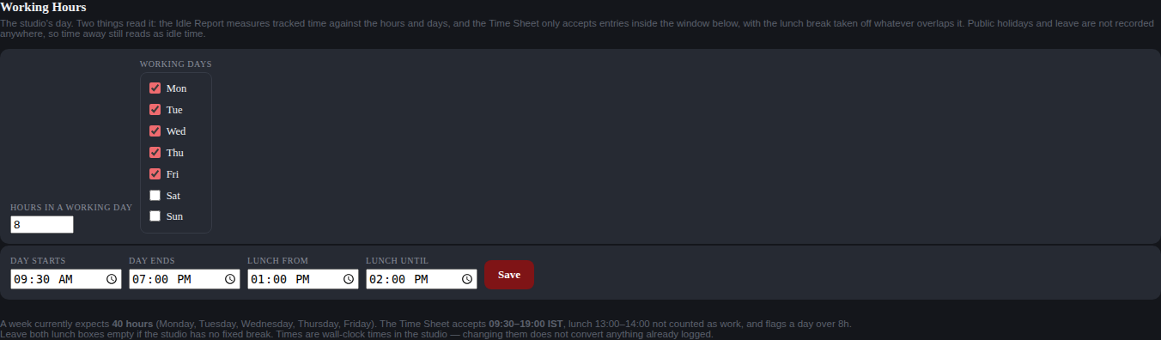
Z
SETTINGS
Not one screen, but the ones you hold
Working hours — the standard day the Idle report measures against.
Branding — the studio name and the colour used across the application.
Five value lists: Scope of Work, Priorities, Asset Categories, Project Categories and Roles.
Renaming a value is safe; a value in use cannot be deleted, only deactivated.
A person given one Settings permission gets this page with exactly that one section on it.
The working-hours control.
WHO Studio leadership — 7 designations, one permission per section.
27

Slide 28
Z
PERMISSIONS
Twelve access bands, not sixty role lists
65 permissions across 60 designations, in only fourteen distinct groups of holders.
Everyone
60
Everyone who works on assets
51
Production planning
23
4 permissions
2 permissions
2 permissions
First review gate
23
Leads and producers
18
Anyone who supervises people
14
1 permission
2 permissions
1 permission
Delivery
18
Creative direction
9
Administration
8
1 permission
2 permissions
18 permissions
Studio leadership
7
Everyone except the shielded designations
58
Production planning and creative direction
25
16 permissions
1 permission
1 permission
The large number on each card is how many designations hold that band. Super Admin holds everything, including any permission added in future, without anybody switching it on.
Creative Art Director and Super Admin
2
Super Admin only
1
3 permissions
11 permissions
28
Notes:
These fourteen bands are generated from the permission table, not written by hand. Appendix A of the manual lists every designation in each.

Slide 29
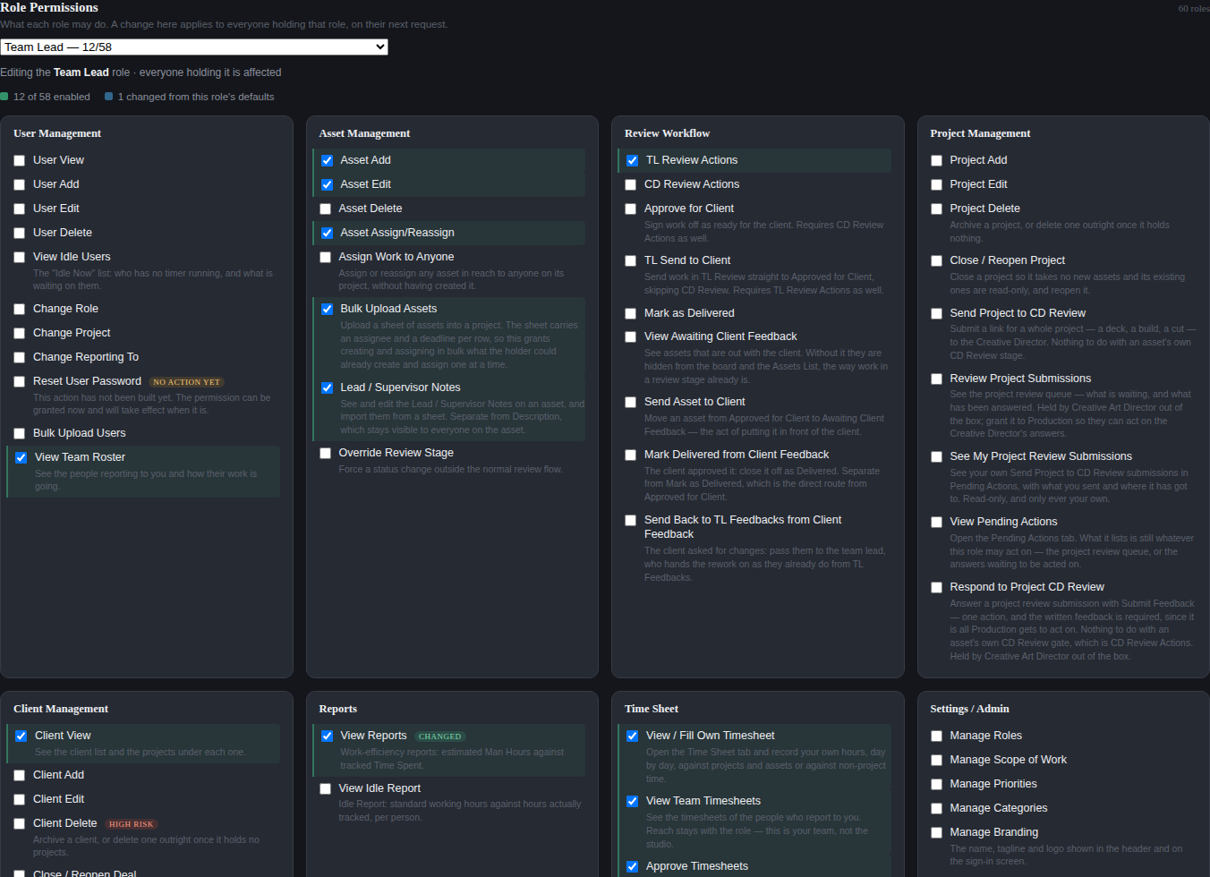
Z
PERMISSIONS
One screen decides what everybody else may do
Choose a designation, tick the actions it should hold, save.
The change applies to everybody holding that designation, on their next request.
Super Admin holds every permission and cannot be edited down.
Every change is written to the Activity Log — the designation, the permission and the direction.
WHO Super Admin, and nobody else.
The permission grid for one designation (first screenful).
29

Slide 30
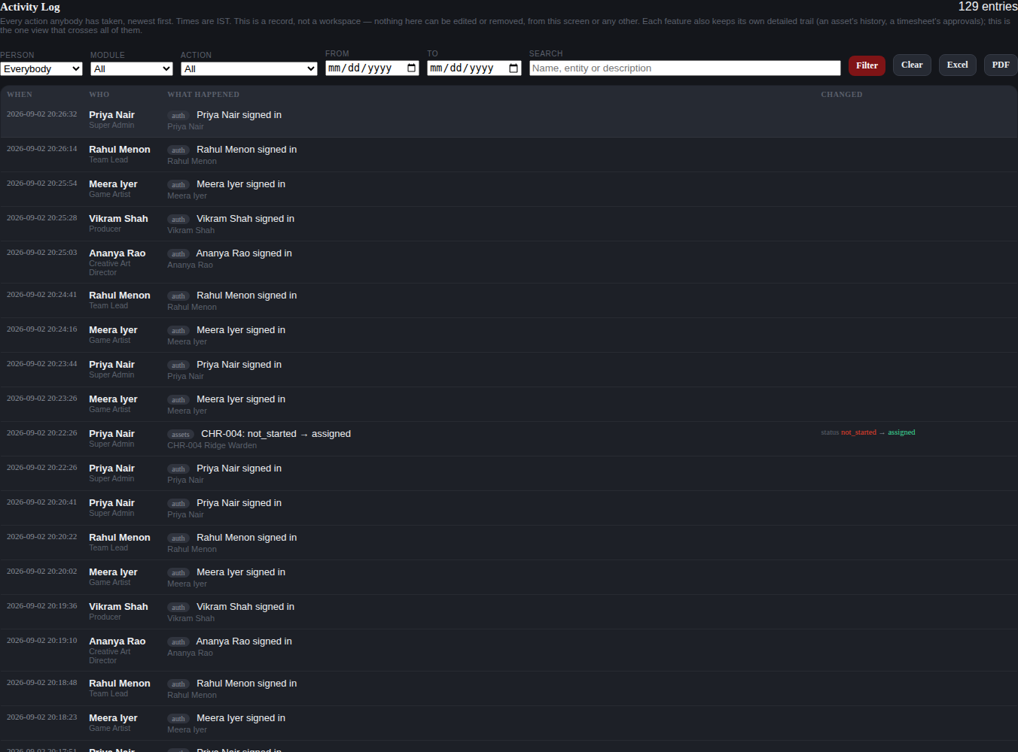
Z
ACTIVITY LOG
One record that crosses every module
Every action anybody takes, newest first, with the person’s name and designation.
Filter by person, module, action or date; search the text.
Where a change has a before and an after, the entry shows both.
Nothing here can be edited or removed, from this screen or any other.
The asset history, the review trail and the time-sheet log all still exist — this is the view that crosses them.
WHO Studio leadership — 7 designations. Readable, filterable, exportable, editable by nobody.
The Activity Log (first screenful).
30

Slide 31
Z
KEEPING IT CURRENT
The documentation is built, not written
Screenshots
Permission tables
Access bands
Captured by a script that signs in as each demo designation and drives the real buttons. A rebuild cannot leave last month’s picture behind.
Read out of a pristine deployment, so they say what the software ships with rather than what somebody remembers.
Derived from those tables. A new permission appears in the manual on the next build with nobody editing it.
What a new feature needs
A section in the right chapter of the manual, written as steps somebody can follow.
A screenshot, added to the capture script so it is re-taken on every build.
A role note naming the access band — which the permission tables already know about.
A slide here, if it is something a new joiner needs to know exists.
31
Notes:
The standing rule: every feature prompt from here on should say what the documentation needs added.

