Slide 1
Cortracker HRMS Smart. Seamless. Scalable Workforce Management
Empowering organizations with intelligent HR automation and real-time insights

Slide 2
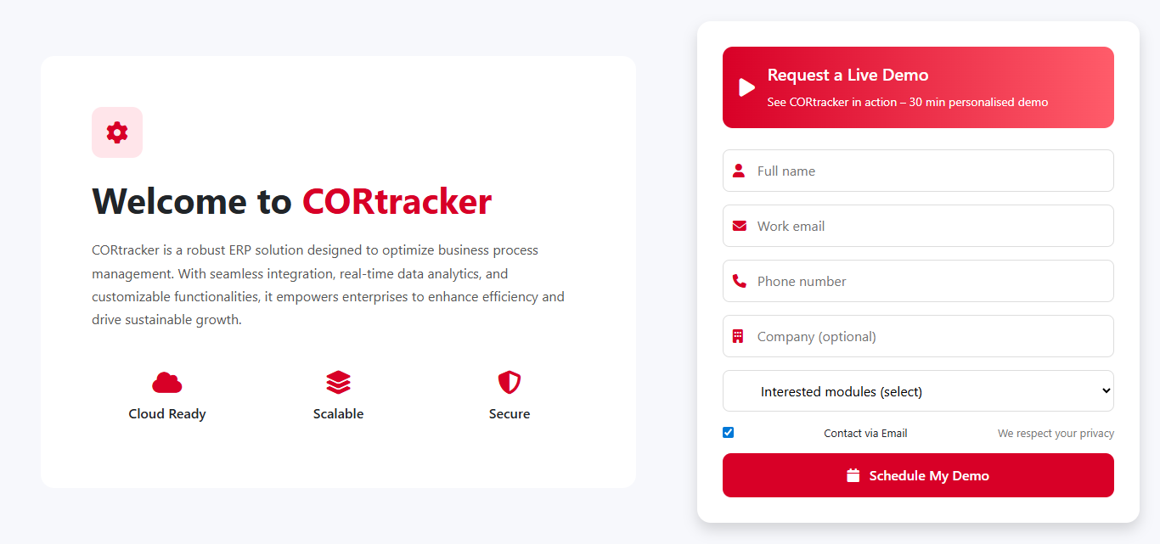
Welcome Demo Access Entry point to the Cortracker HRMS system Users can generate secure login credentials instantly Provides full access to key modules for evaluation Validity: 7 Days Trial Access Designed for quick onboarding and product experience

Slide 3
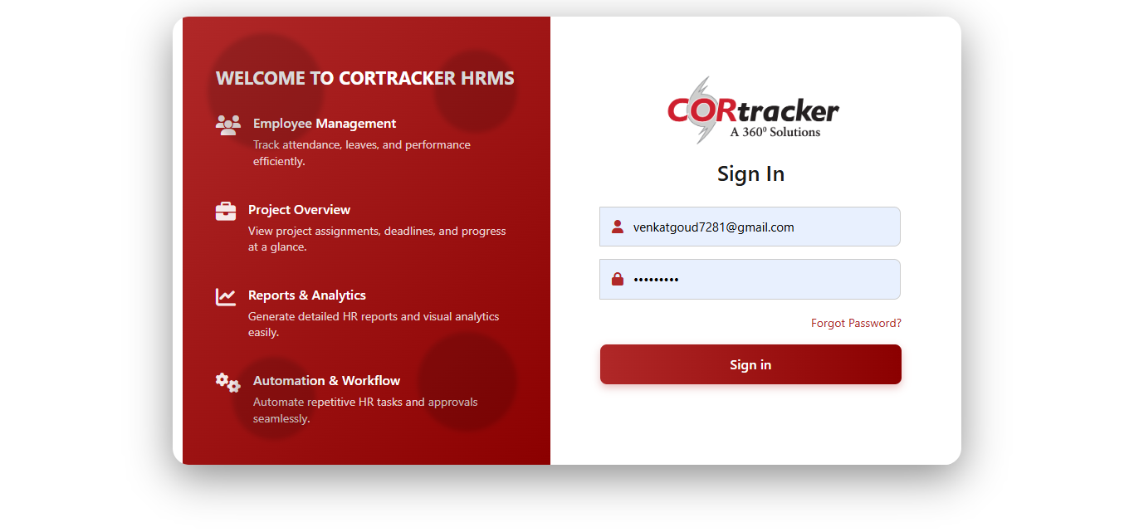
Admin Portal Login
User enters login credentials (User ID & Password)
Backend validates credentials against the system database
Role-based authentication is applied Successful login → Redirect to Admin Portal Dashboard
Failed login → Error message with retry option

Slide 4
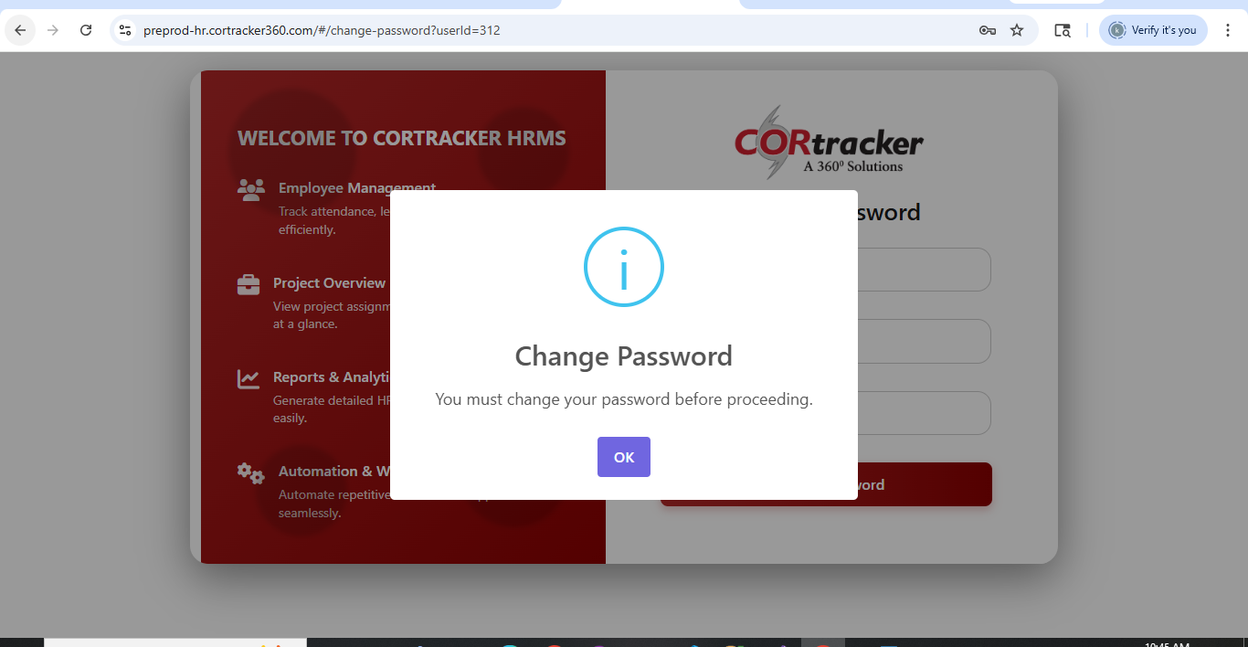
User logs in with initial credentials
Popup prompts for password update
Enter Old Password → Set New Password → Confirm Password
System validates and updates credentials
Redirects user to dashboard upon success
Password Change Workflow

Slide 5
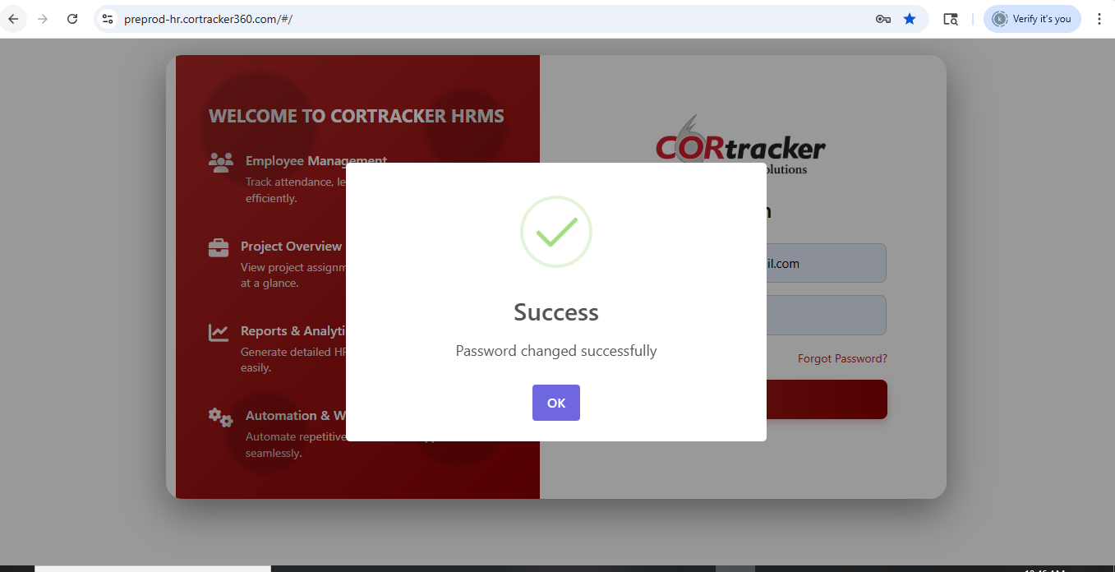
Post Password Change Flow
User submits new password details
System validates and updates credentials
Success notification is displayed
Automatic redirection to Login Page
User logs in with new password to continue

Slide 6
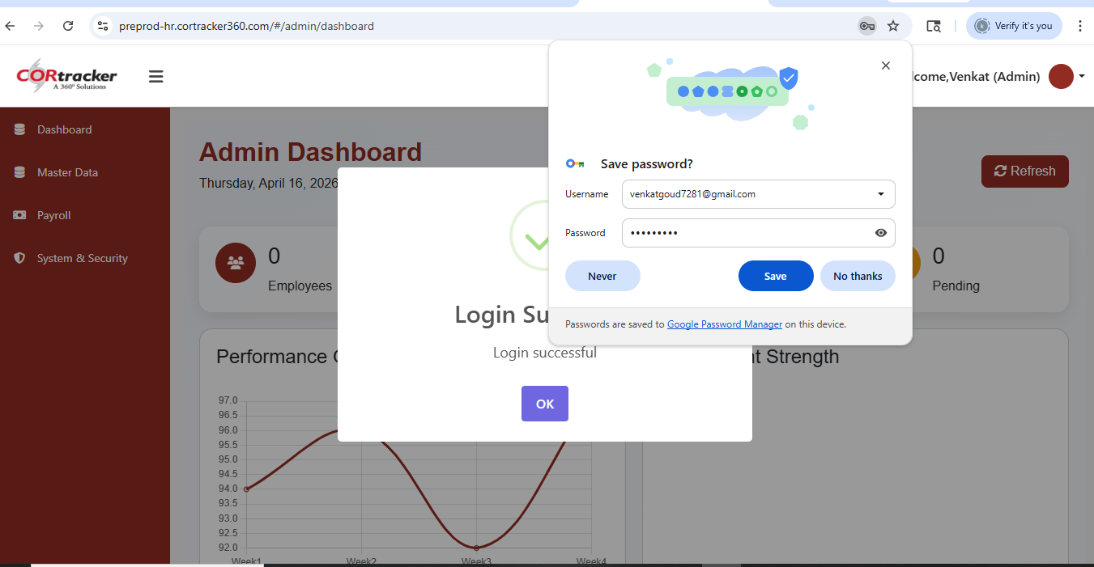
Login Validation Flow
User submits login credentials
System performs authentication and validation
On success → Displays “Login Successful” notification
Automatically navigates to Admin Dashboard
Grants role-based access to system modules

Slide 7
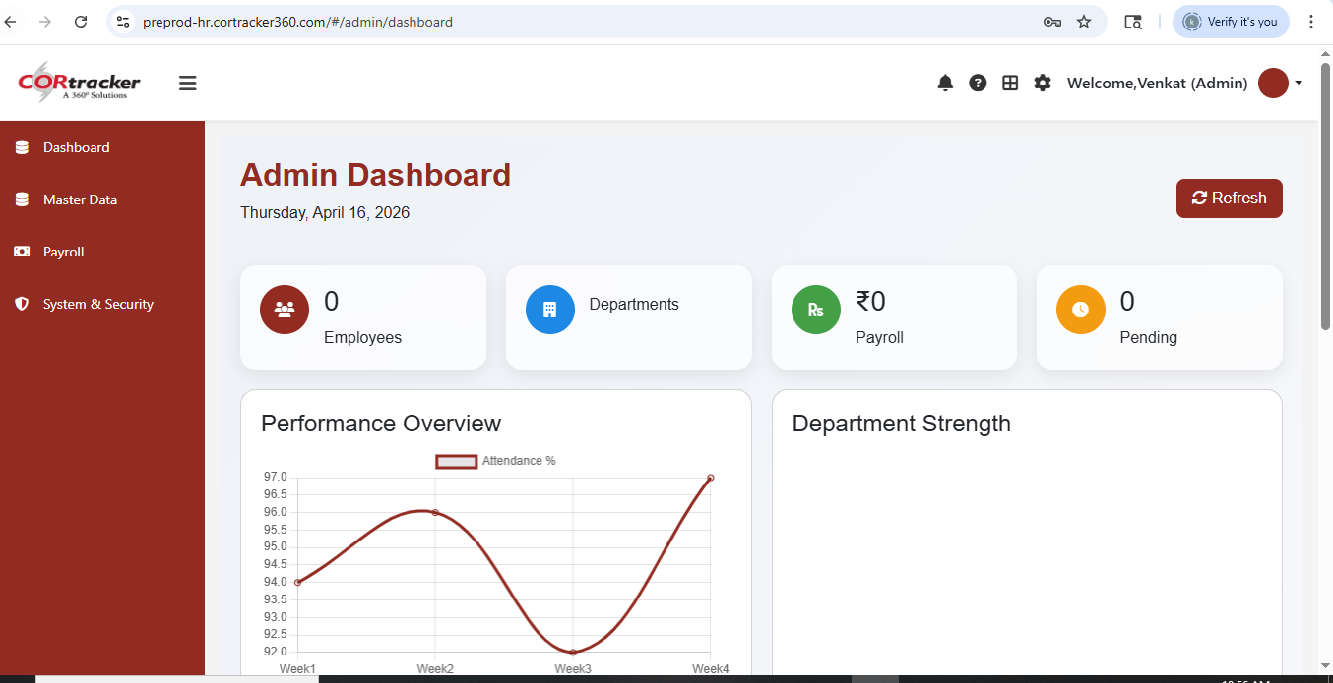
Admin Dashboard Overview
Comprehensive access to all administrative features
Explore modules including HR, Employee Management, and Settings
Manage master data and system configurations
Gain insights through dashboards and reports

Slide 8
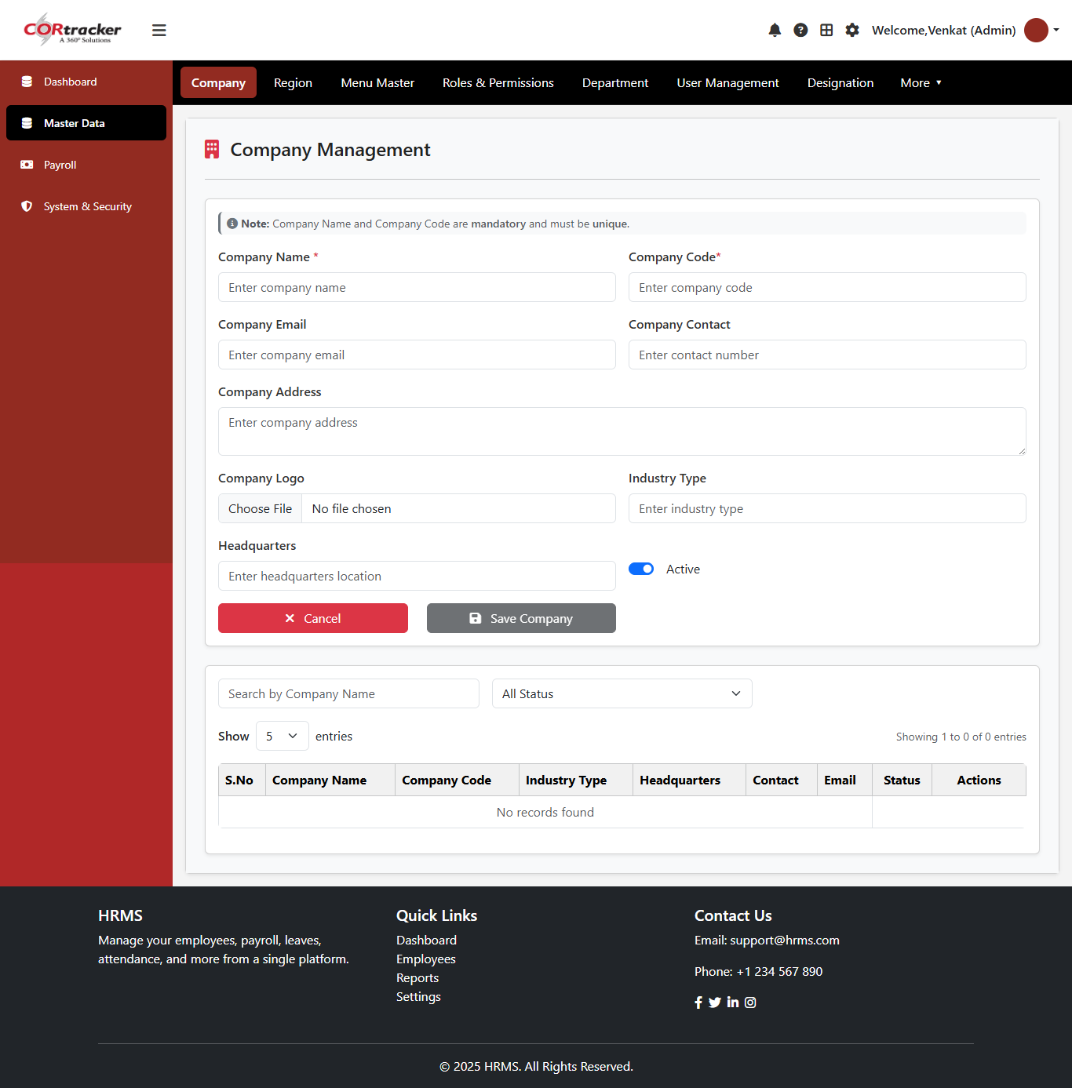
Company Master – Manage Company Information
Capture and store complete company details
Centralized management of organizational data
Supports full CRUD functionality for data handling
Ensures accuracy and easy updates of company records

Slide 9
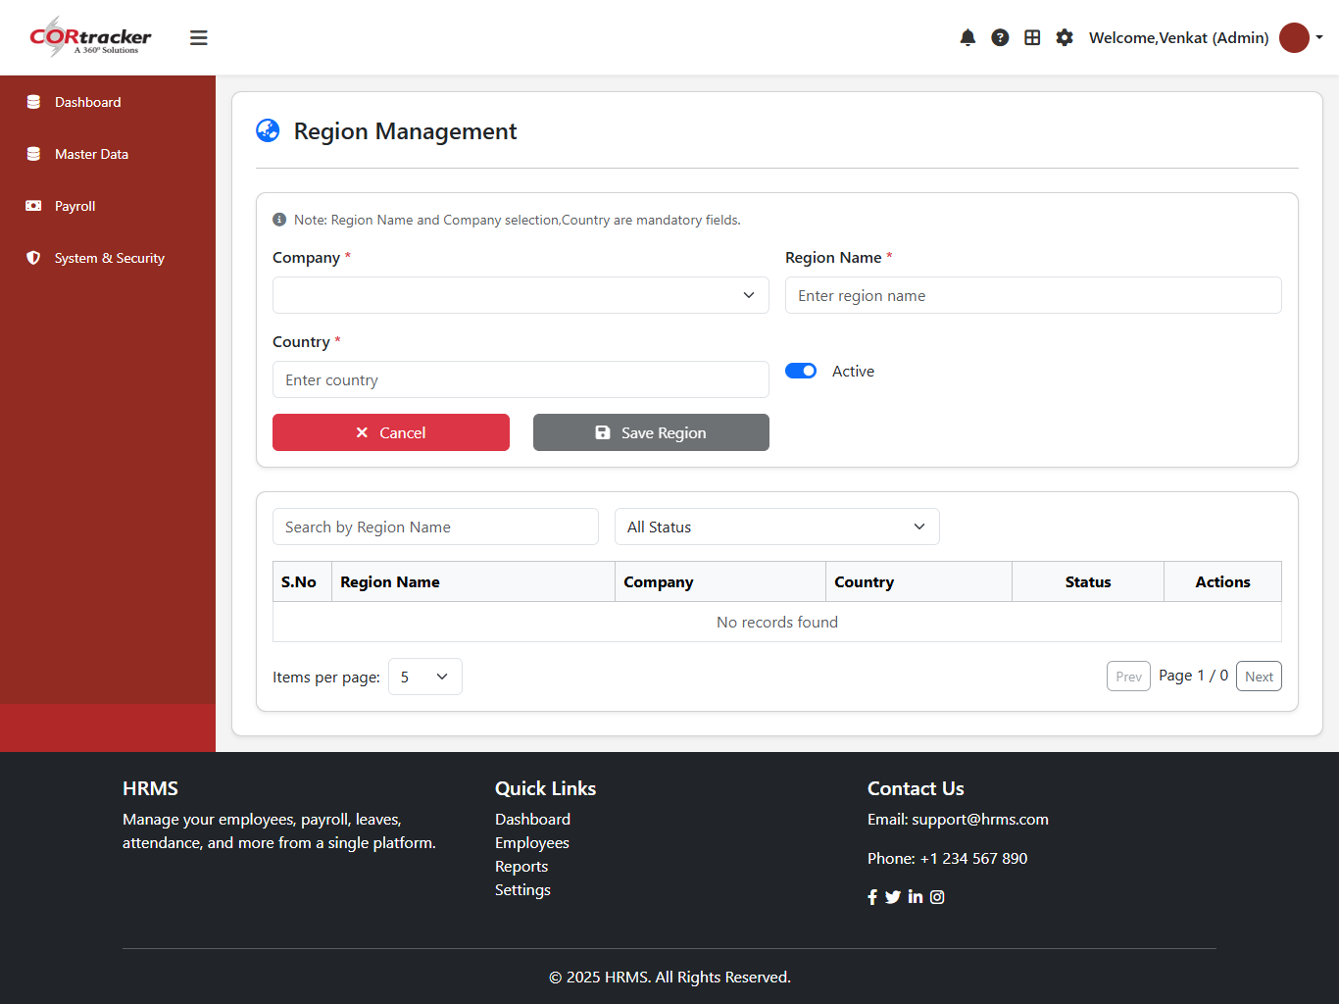
Region Master – Company-Wise Region Management
Define regions associated with specific companies
Select Company Name to create region mapping
Centralized management of region data
Supports full CRUD functionality for efficient updates

Slide 10
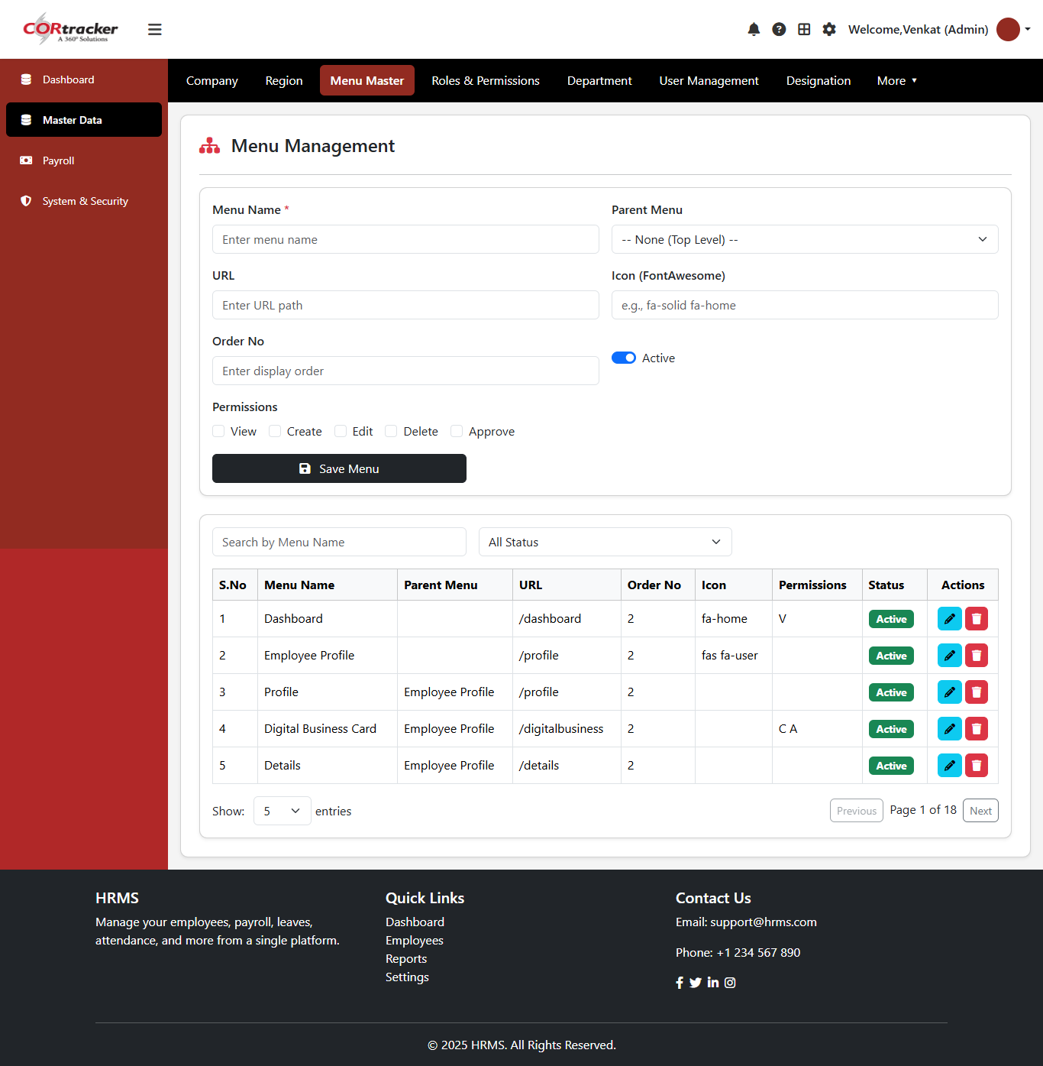
Menu Access Workflow
System maintains a fixed order of navbar modules
Admin configures access in Roles & Permissions section
Assign permissions to users or roles
Activate/Deactivate modules to control visibility and access

Slide 11
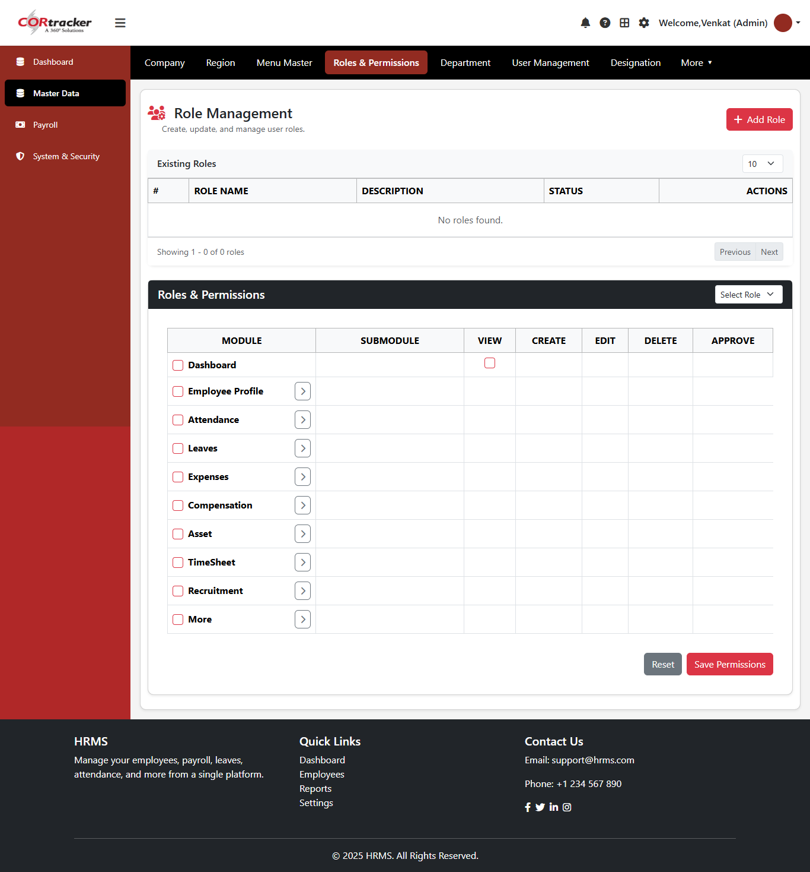
Role & Permission Workflow
Step 1: Create a new role
Step 2: Select the role for configuration
Step 3: Assign menu-level permissions
Step 4: Activate/Deactivate module access
Step 5: Save role permissions to apply changes

Slide 12
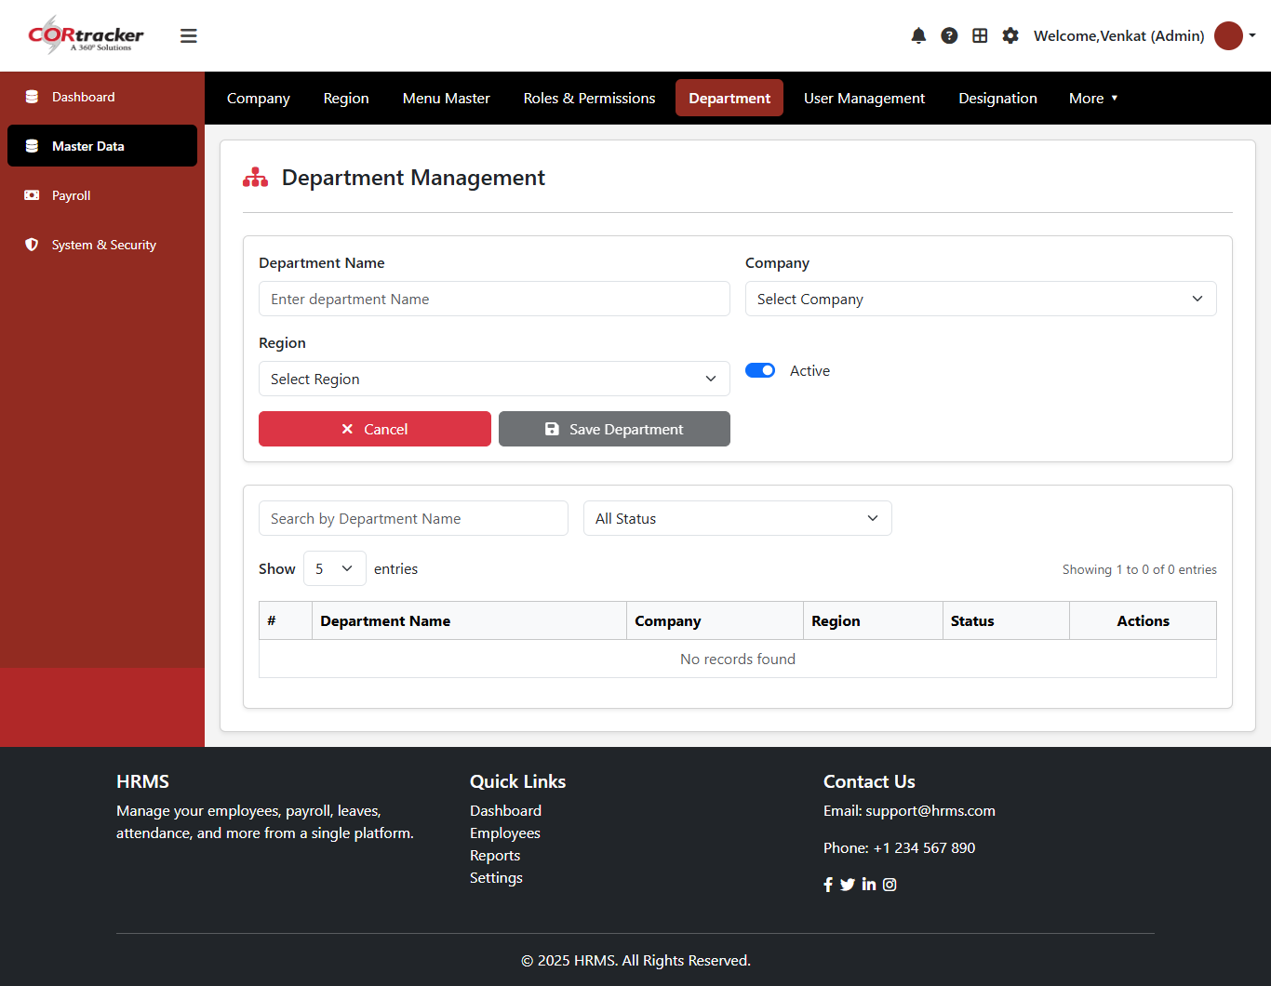
Department Creation Workflow
Select Company Name
Choose corresponding Region
Enter department details
Click Save to store information
Update or delete records as required (CRUD Operations)

Slide 13
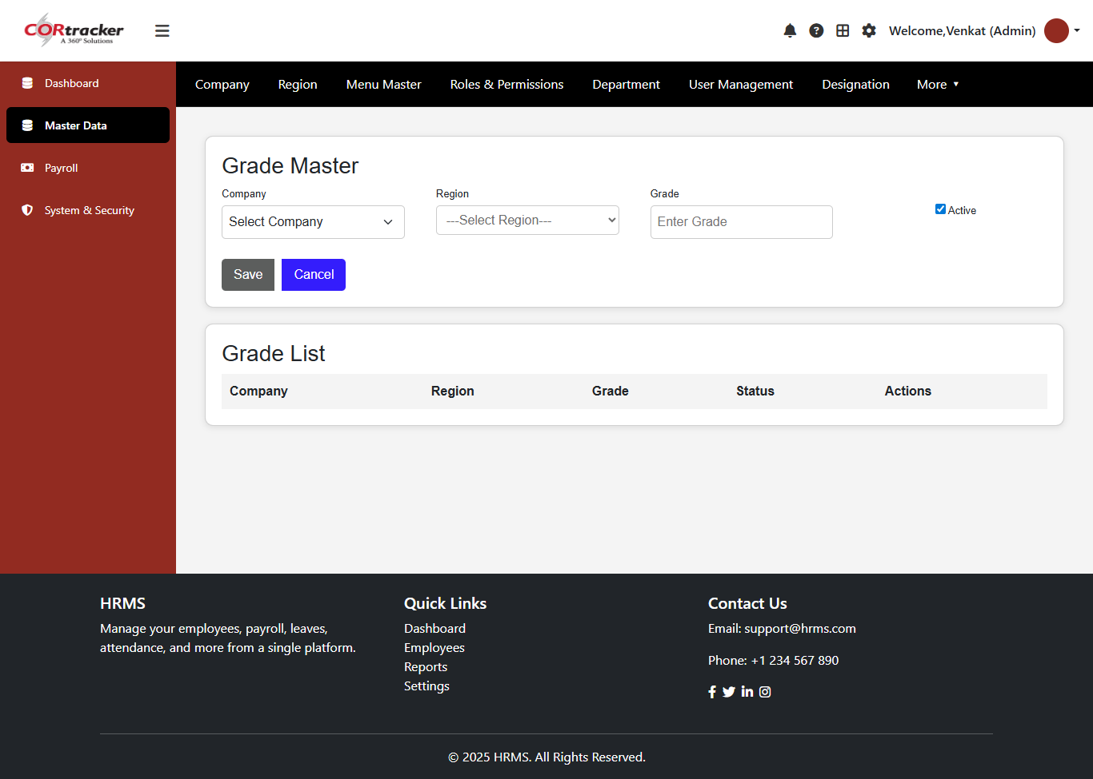
Grade Creation Workflow
Select Company Name
Choose corresponding Region
Enter grade details (e.g., Grade Name, Description)
Click Save to store data
Modify or delete records as required (CRUD Operations)

Slide 14
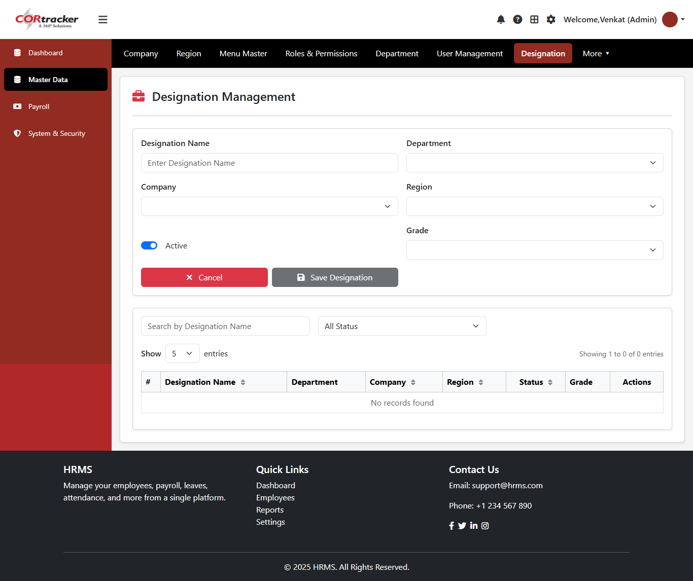
Designation Creation Workflow
Select Company
Choose Region and Department
Select applicable Grade
Enter designation details
Click Save to create designation
Update or delete records as needed (CRUD Operations)

Slide 15
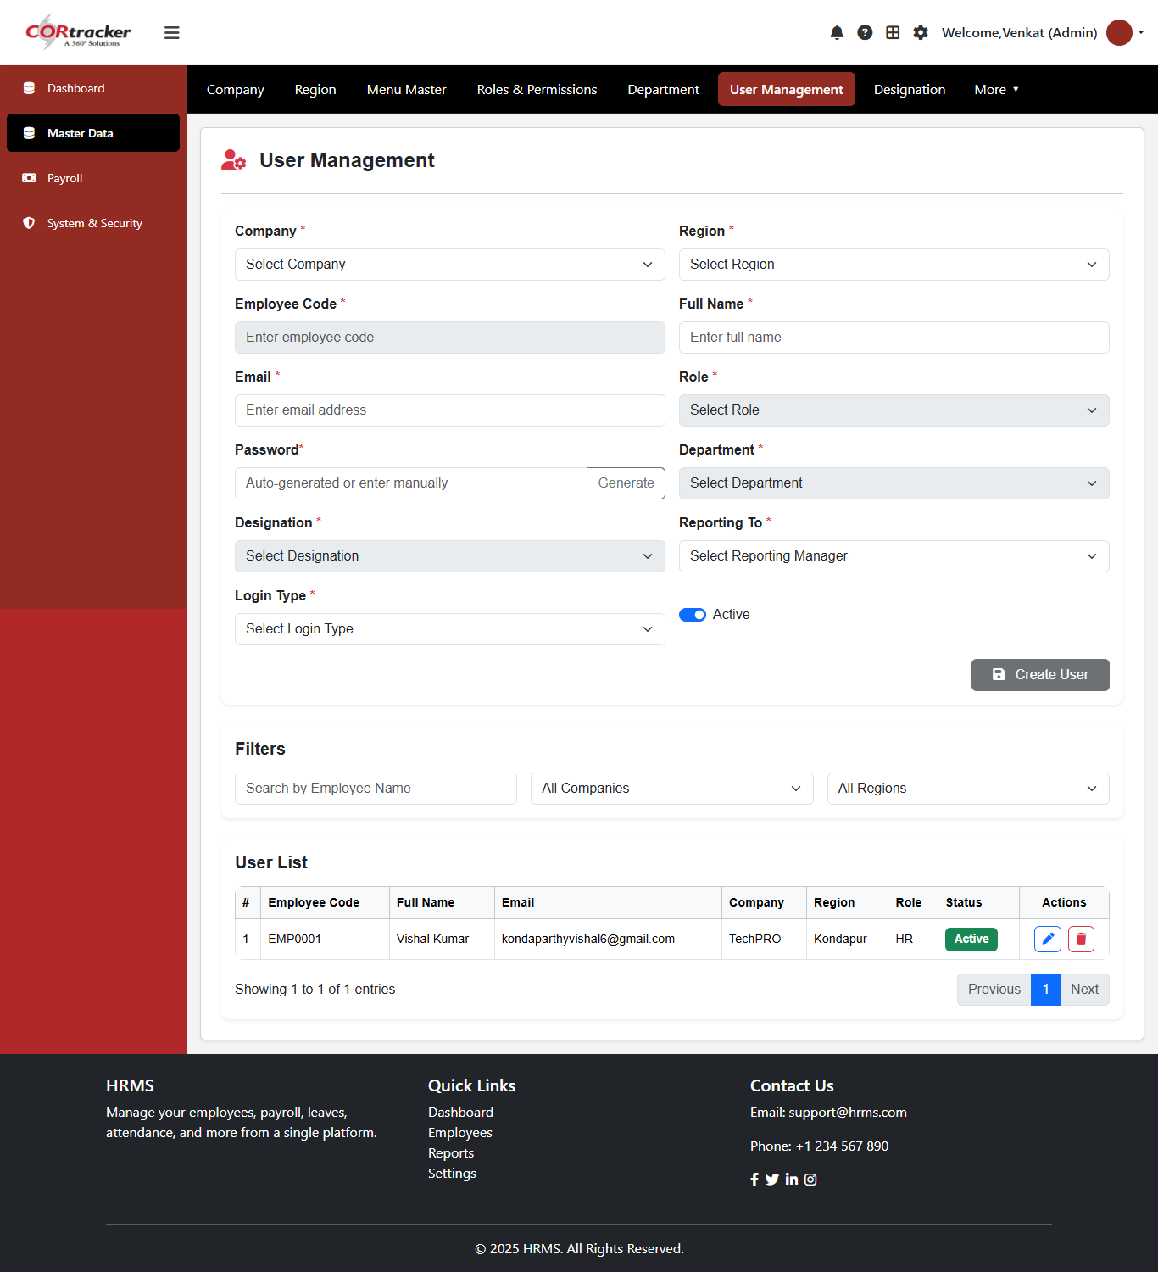
User Creation & Onboarding
Define users aligned with organizational hierarchy
Mapping includes Company, Region, Role, Department, and Designation
Assign reporting structure through Manager ID
System generates secure login credentials automatically
Users receive email notification with login URL and credentials

Slide 16
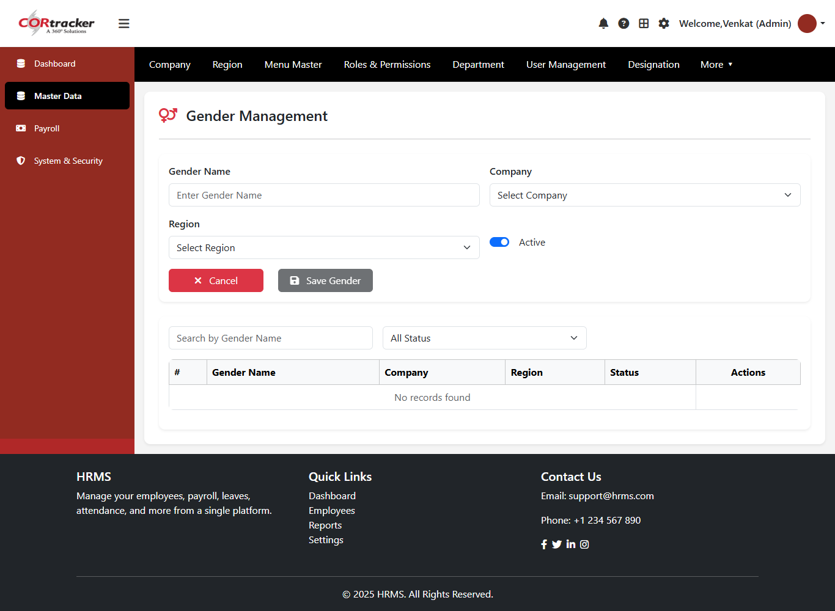
Gender Master – Data Configuration
Define gender categories aligned with company and region
Ensure standardized data management across the organization
Centralized control of gender master data
Supports full CRUD functionality for easy updates

Slide 17
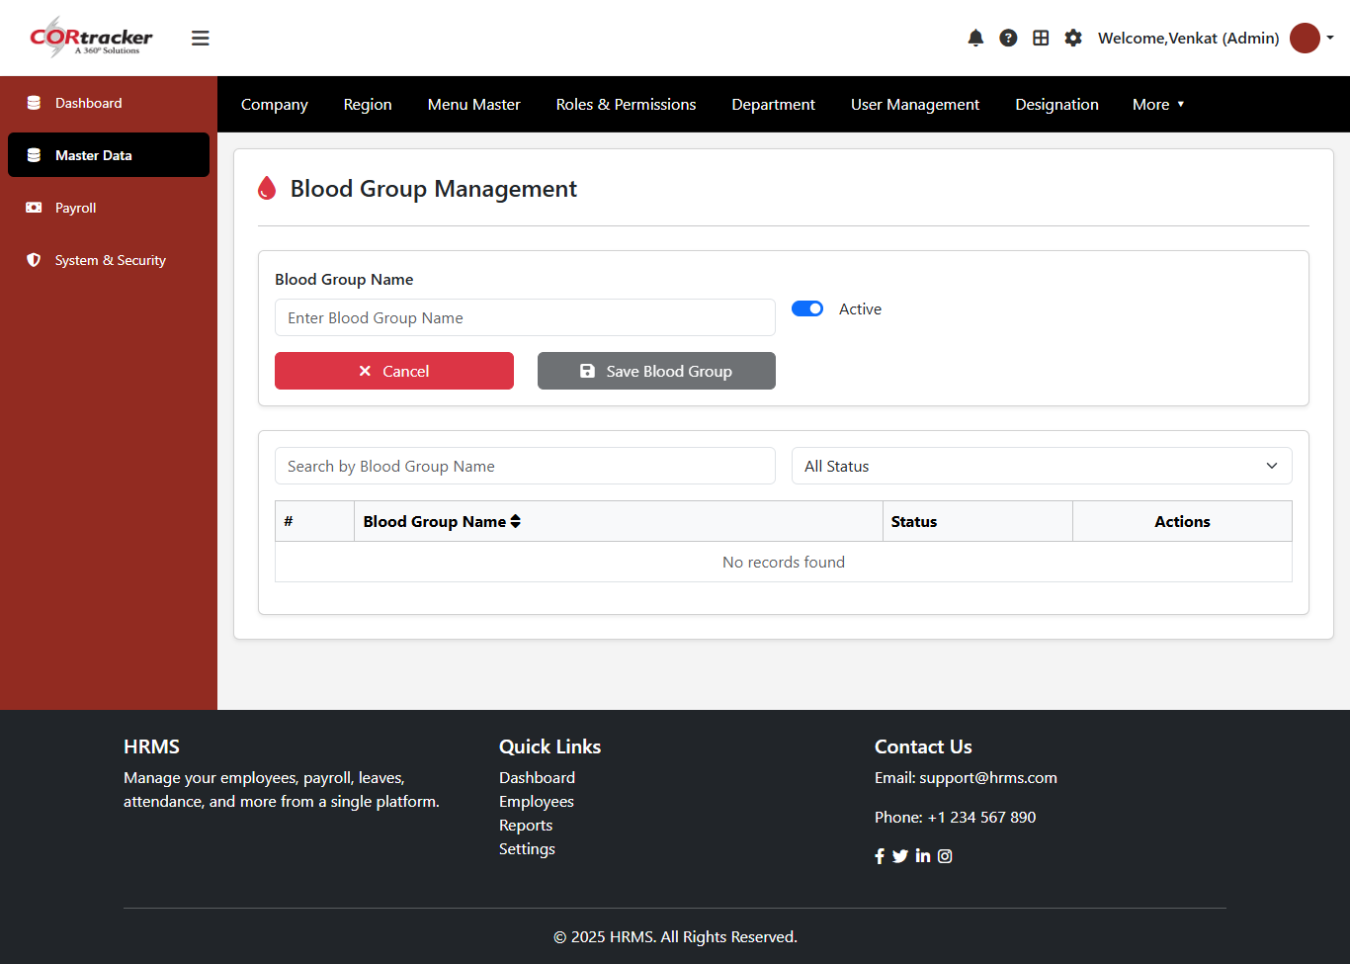
Blood Group Master – Configuration
Define and manage blood group details centrally
Ensure standardized data across the organization
Supports full CRUD functionality for efficient updates
Enhances accuracy in employee medical information

Slide 18
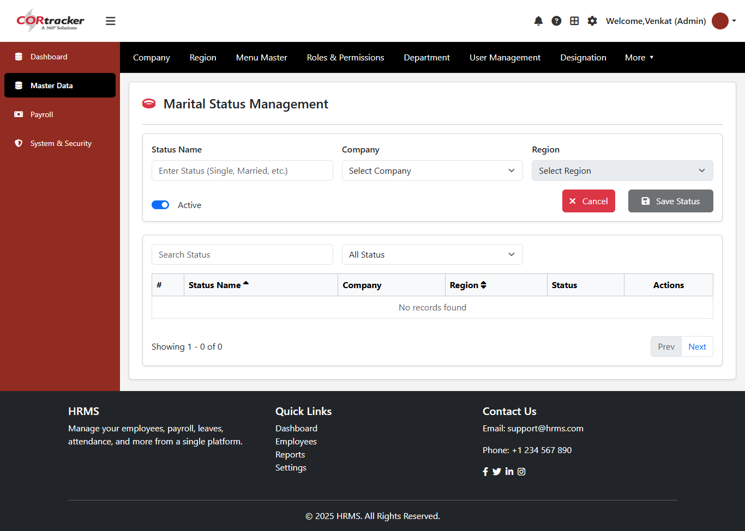
Marital Status Master – Company & Region Based
Enter marital status details through the form
Select Company and Region for mapping
Save information securely in the system
Perform CRUD operations (Create, Read, Update, Delete)
Maintain accurate employee personal data

Slide 19

Relationship Master – Company & Region Based
Enter relationship details through the form
Select Company and Region for mapping
Save information securely in the system
Perform CRUD operations (Create, Read, Update, Delete)
Maintain accurate relationship data for employee records

Slide 20
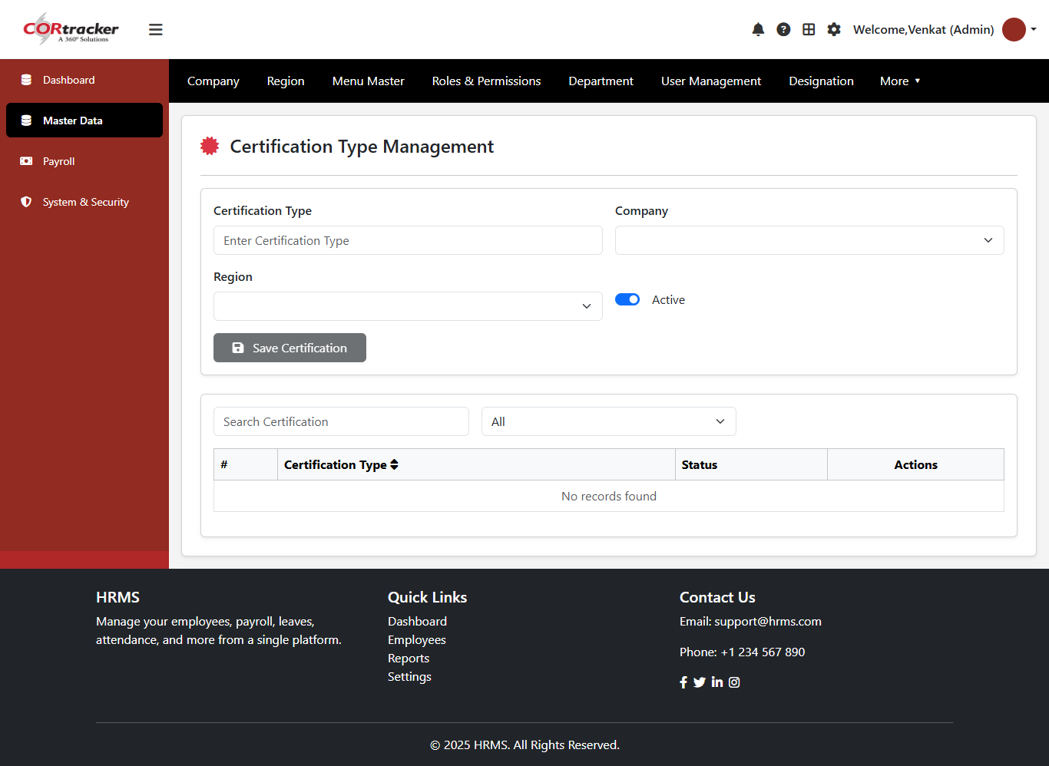
Certification Type Master – Company & Region Based
Enter certification type details through the form
Select Company and Region for mapping
Save information securely in the system
Perform CRUD operations (Create, Read, Update, Delete)
Maintain standardized certification records

Slide 21
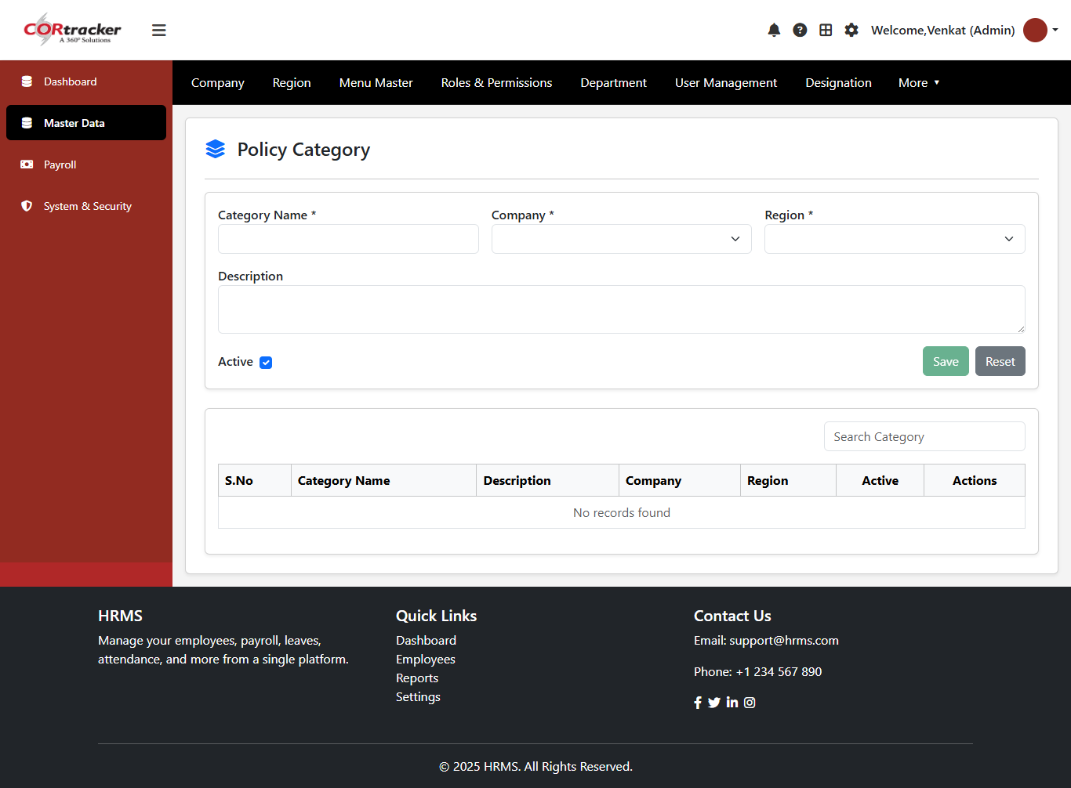
Policy Category Master – Company & Region Based
Enter policy category details through the form
Select Company and Region for mapping
Save information securely in the system
Perform CRUD operations (Create, Read, Update, Delete)
Maintain organized policy categories

Slide 22
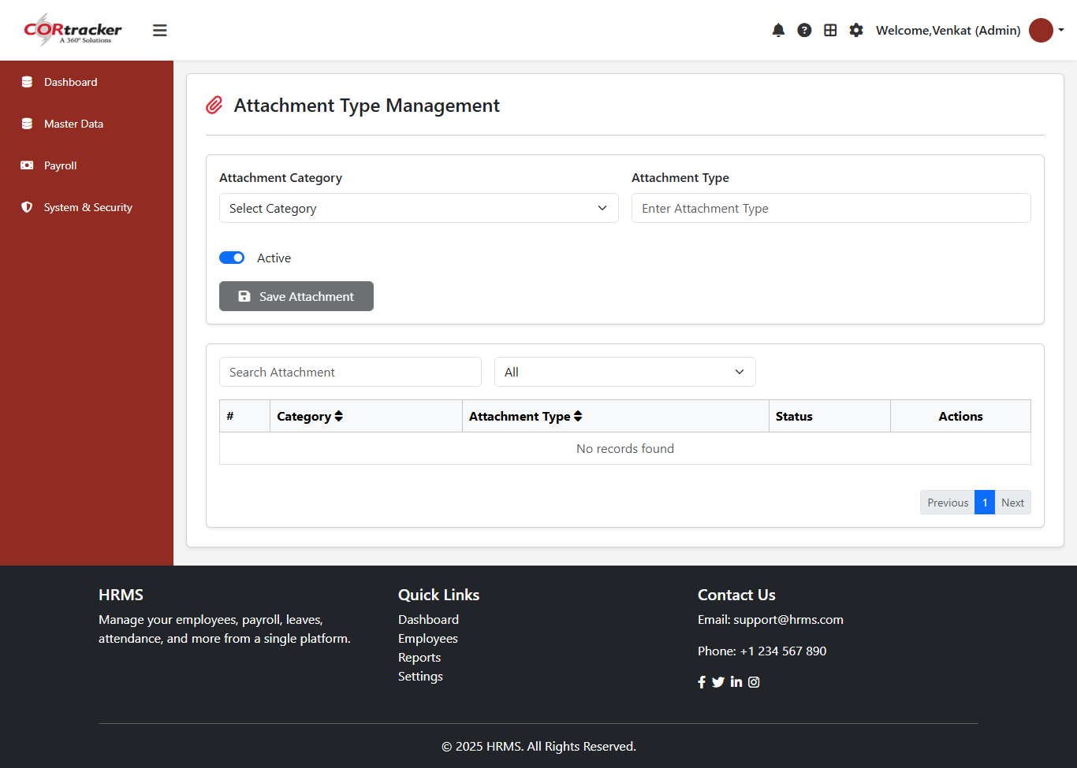
Attachment Type Master – Company & Region Based
Enter attachment type details through the form
Select Company and Region for mapping
Save information securely in the system
Perform CRUD operations (Create, Read, Update, Delete)
Manage document and attachment types efficiently

Slide 23

Project Status Master – Company & Region Based
Enter project status details through the form
Select Company and Region for mapping
Save information securely in the system
Perform CRUD operations (Create, Read, Update, Delete)
Manage and track project status effectively

Slide 24
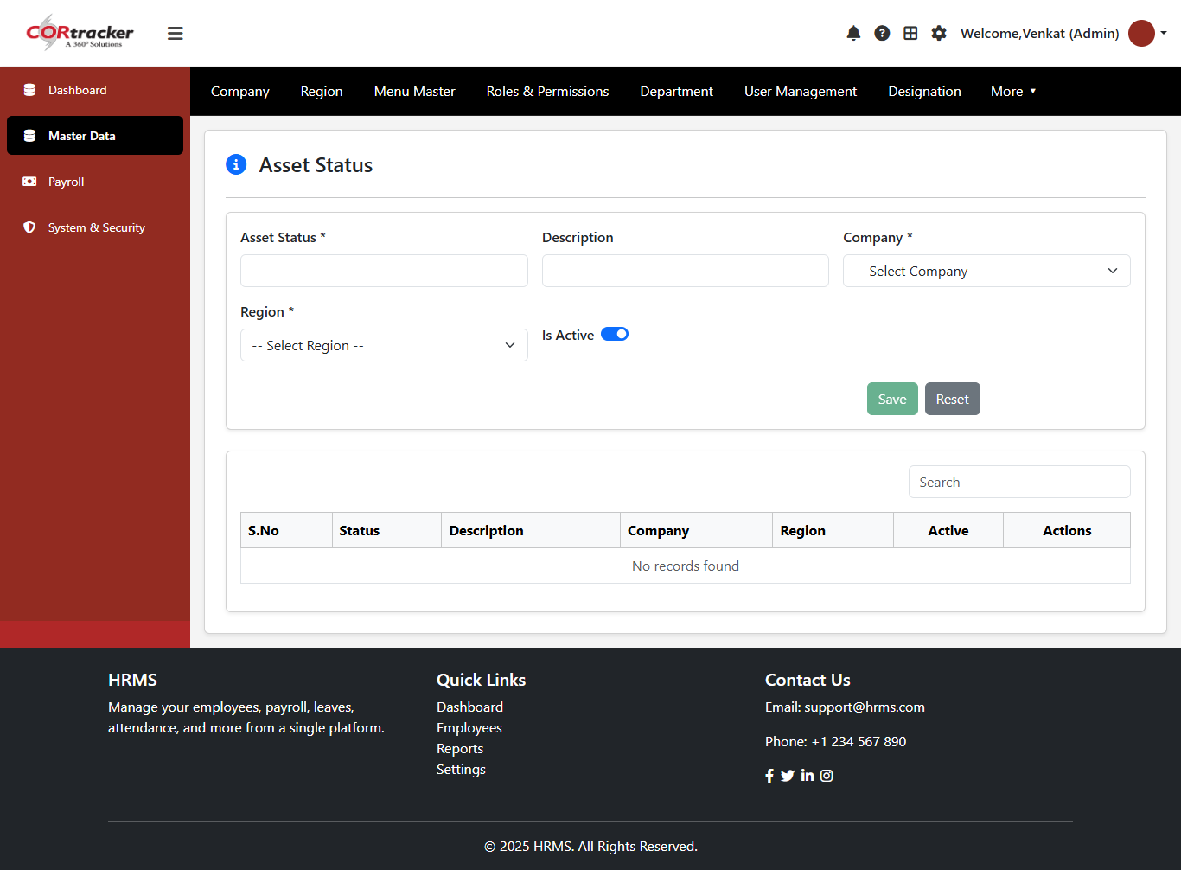
Asset Status Master – Company & Region Based
Enter asset status details through the form
Select Company and Region for mapping
Save information securely in the system
Perform CRUD operations (Create, Read, Update, Delete)
Manage and track asset status efficiently

Slide 25
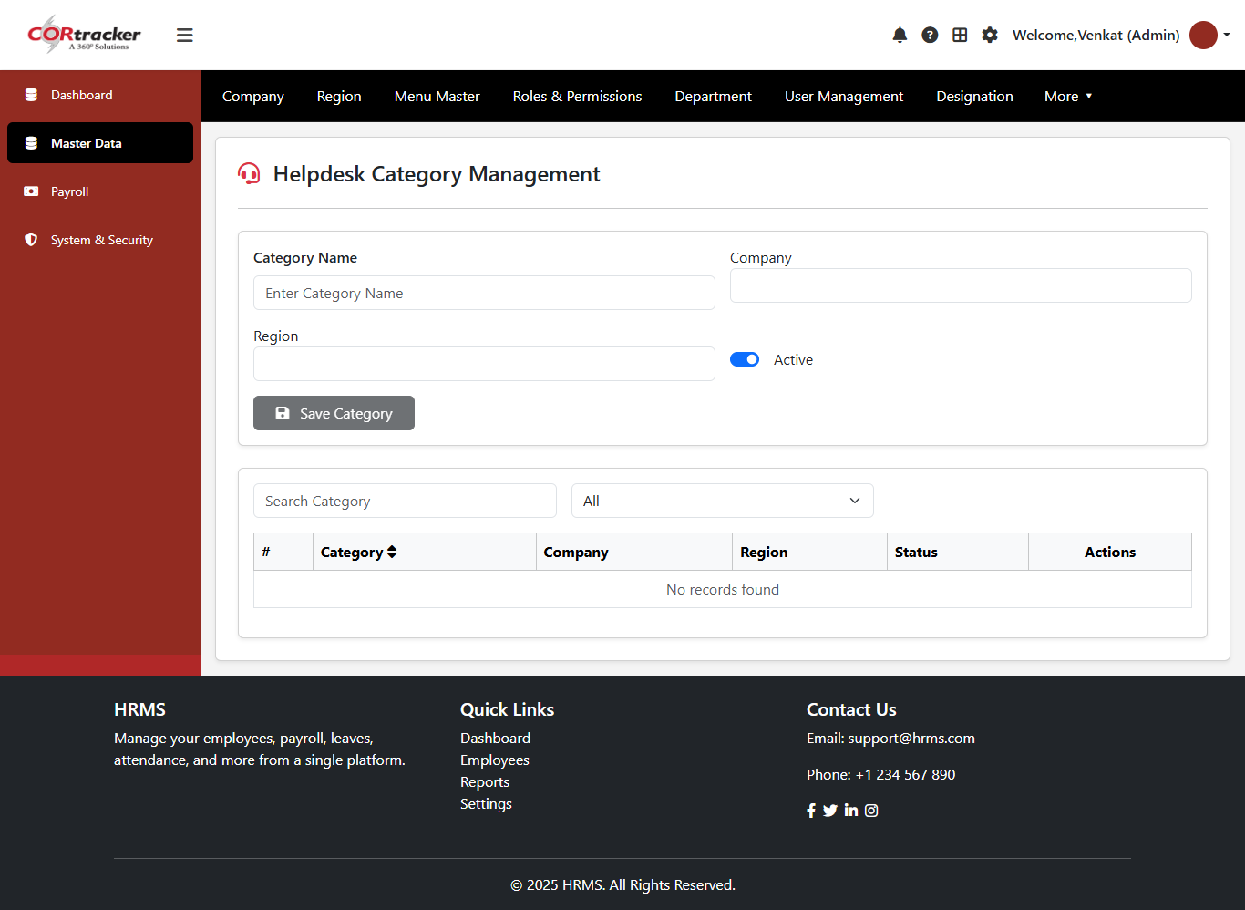
Helpdesk Master – Company & Region Based
Enter helpdesk details through the form
Select Company and Region for mapping
Save information securely in the system
Perform CRUD operations (Create, Read, Update, Delete)
Manage helpdesk records efficiently

Slide 26
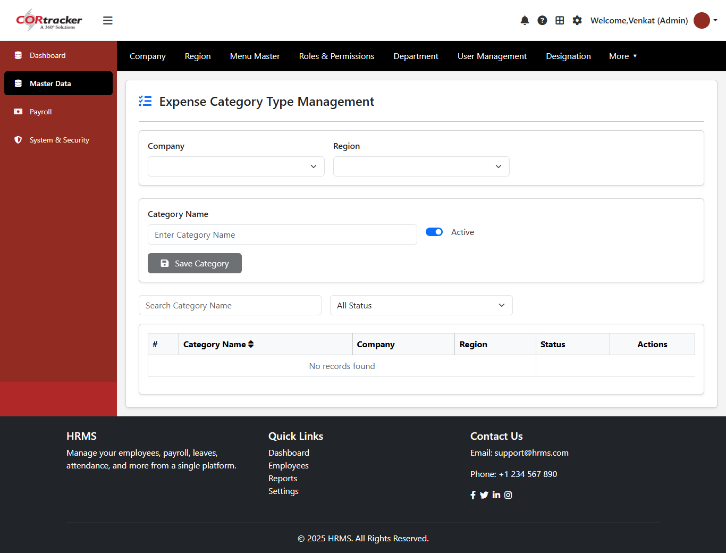
Expense Category Master – Company & Region Based
Enter expense category details through the form
Select Company and Region for mapping
Save information securely in the system
Perform CRUD operations (Create, Read, Update, Delete)
Manage expense categories efficiently

Slide 27
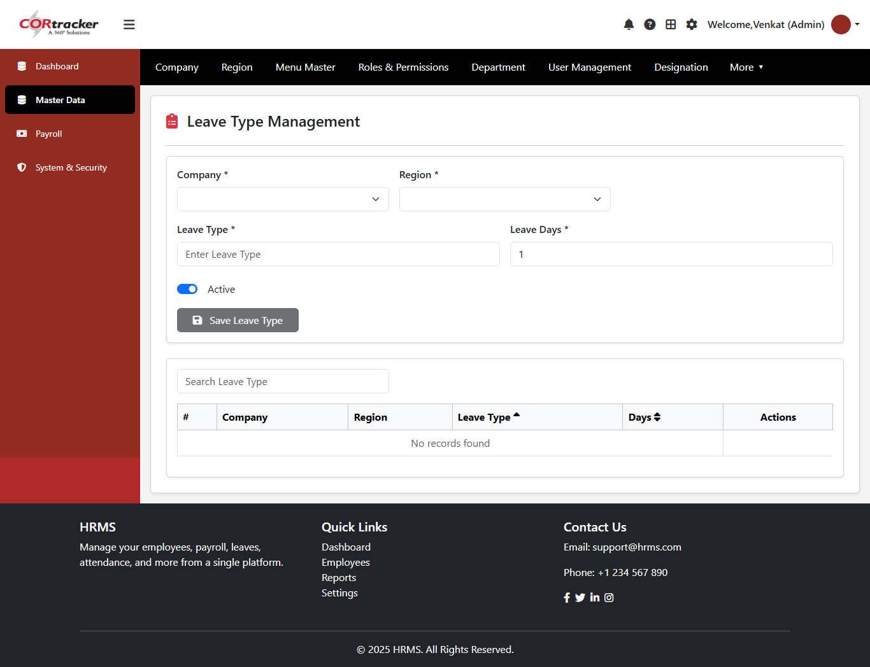
Leave Management Configuration
Define leave types (e.g., Casual Leave, Sick Leave, Annual Leave)
Configure eligible leave days per policy
Align leave setup with company and region
Centralized management of leave data
Supports full CRUD functionality for easy updates

Slide 28
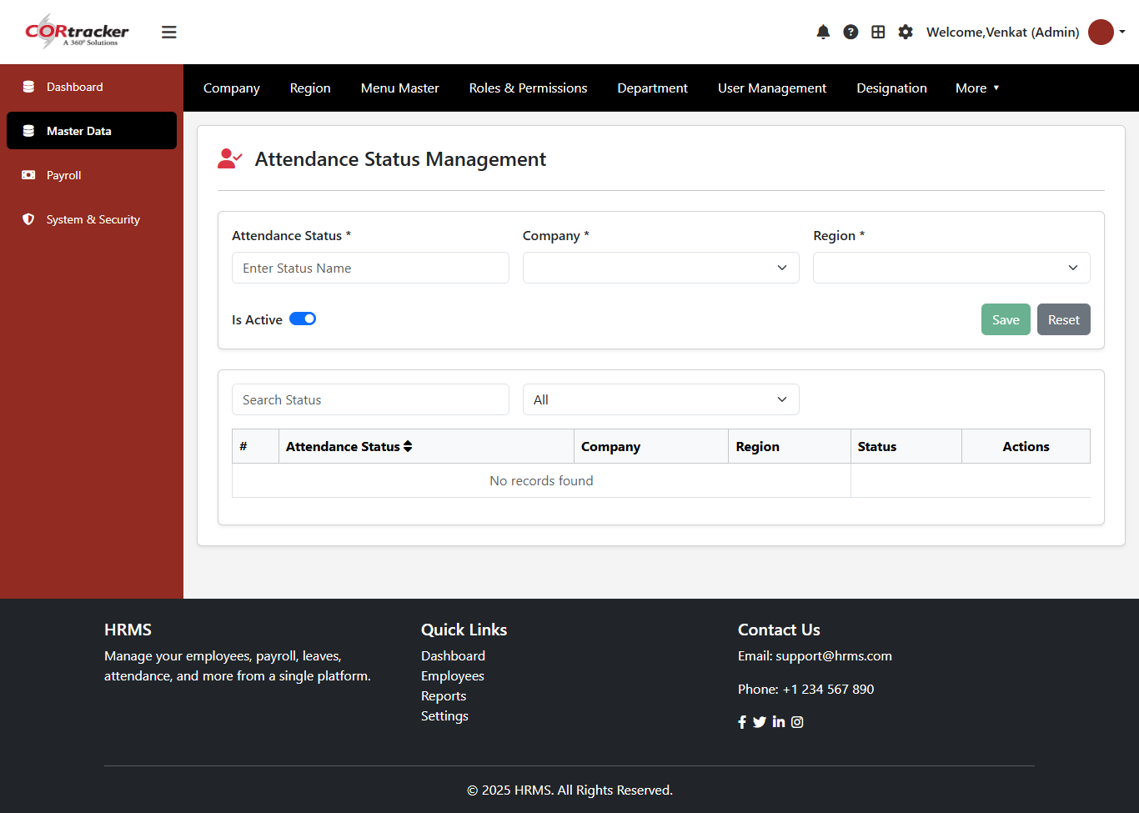
Attendance Status Master – Configuration
Define attendance statuses (e.g., Present, Absent, Leave, Work From Home)
Align configurations with company and region policies
Centralized management of attendance status data
Supports full CRUD functionality for easy updates and maintenance

Slide 29

Priority Master – Configuration
Define priority levels (e.g., High, Medium, Low)
Align priority settings with company and region requirements
Centralized management of priority data
Supports full CRUD functionality for easy updates and maintenance

Slide 30
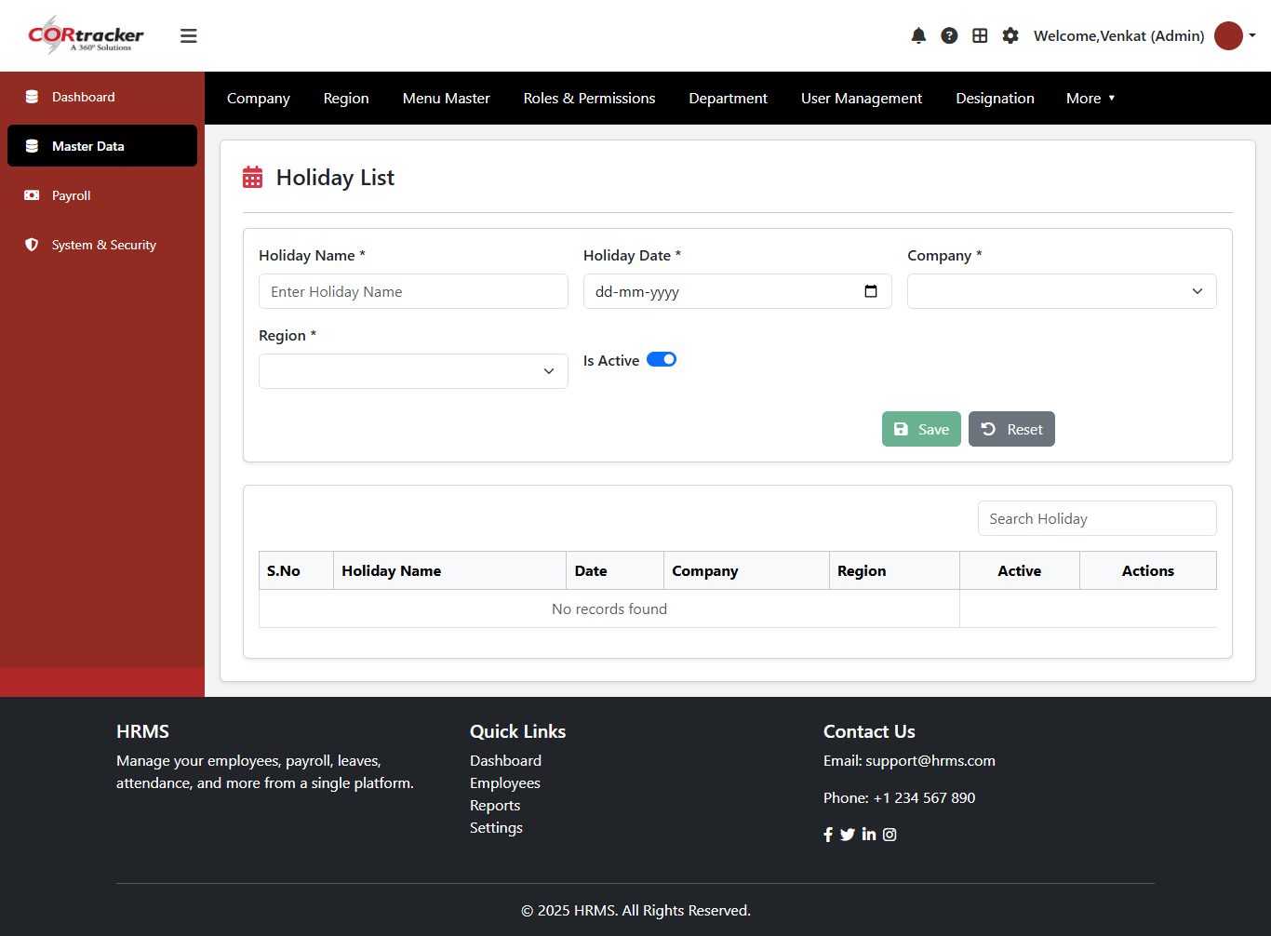
Holiday Management – Configuration
Define holidays aligned with company and regional policies
Capture holiday name and corresponding date
Centralized management of holiday calendar
Supports full CRUD functionality for easy updates and maintenance
Ensures consistency across organizational schedules

Slide 31

Week-Off Master – Company & Region Based
Enter week-off details through the form (e.g., Sunday, Saturday)
Select Company and Region for mapping
Save week-off configuration securely in the system
Perform CRUD operations (Create, Read, Update, Delete)
Manage employee weekly off schedules efficiently

Slide 32
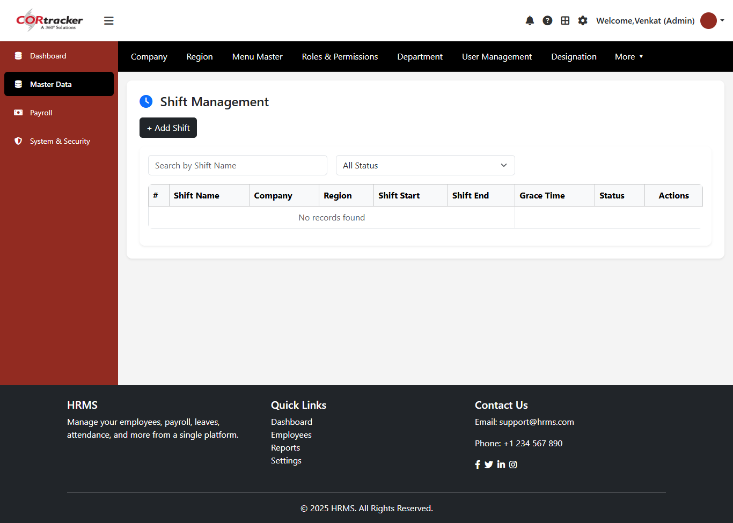
Shift Management – Company & Region Based
Enter Shift Name, Start Time, End Time, and Grace Time
Select Company and Region for mapping
Save shift details securely in the system
Perform CRUD operations (Create, Read, Update, Delete)
Manage employee shift schedules efficiently

Slide 33
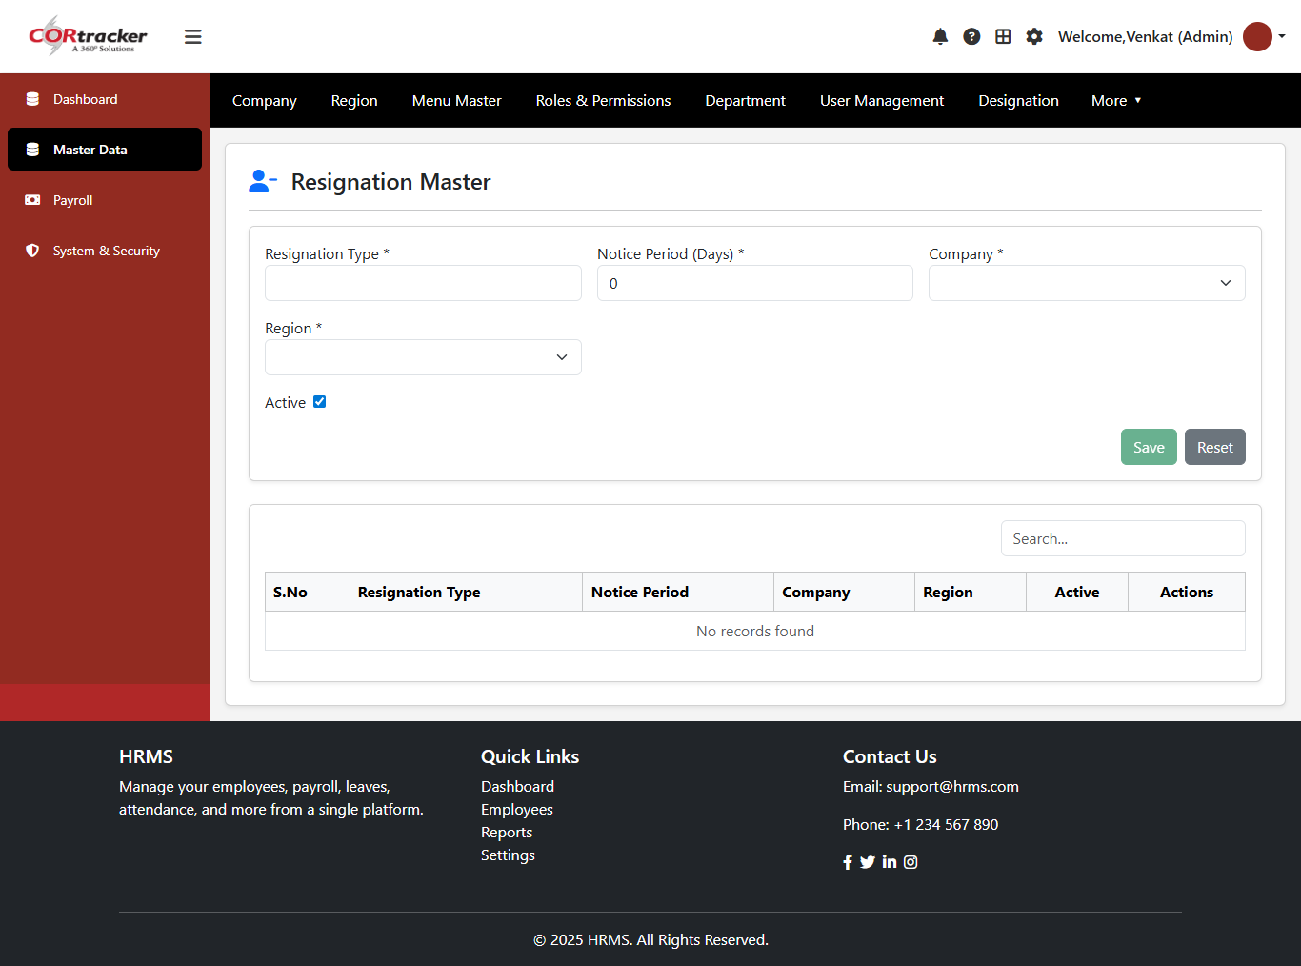
Resignation Management – Configuration
Define resignation types (e.g., Voluntary, Termination, Retirement)
Configure notice period policies for each type
Align setup with company and regional guidelines
Centralized management of resignation data
Supports full CRUD functionality for easy updates and maintenance

Slide 34
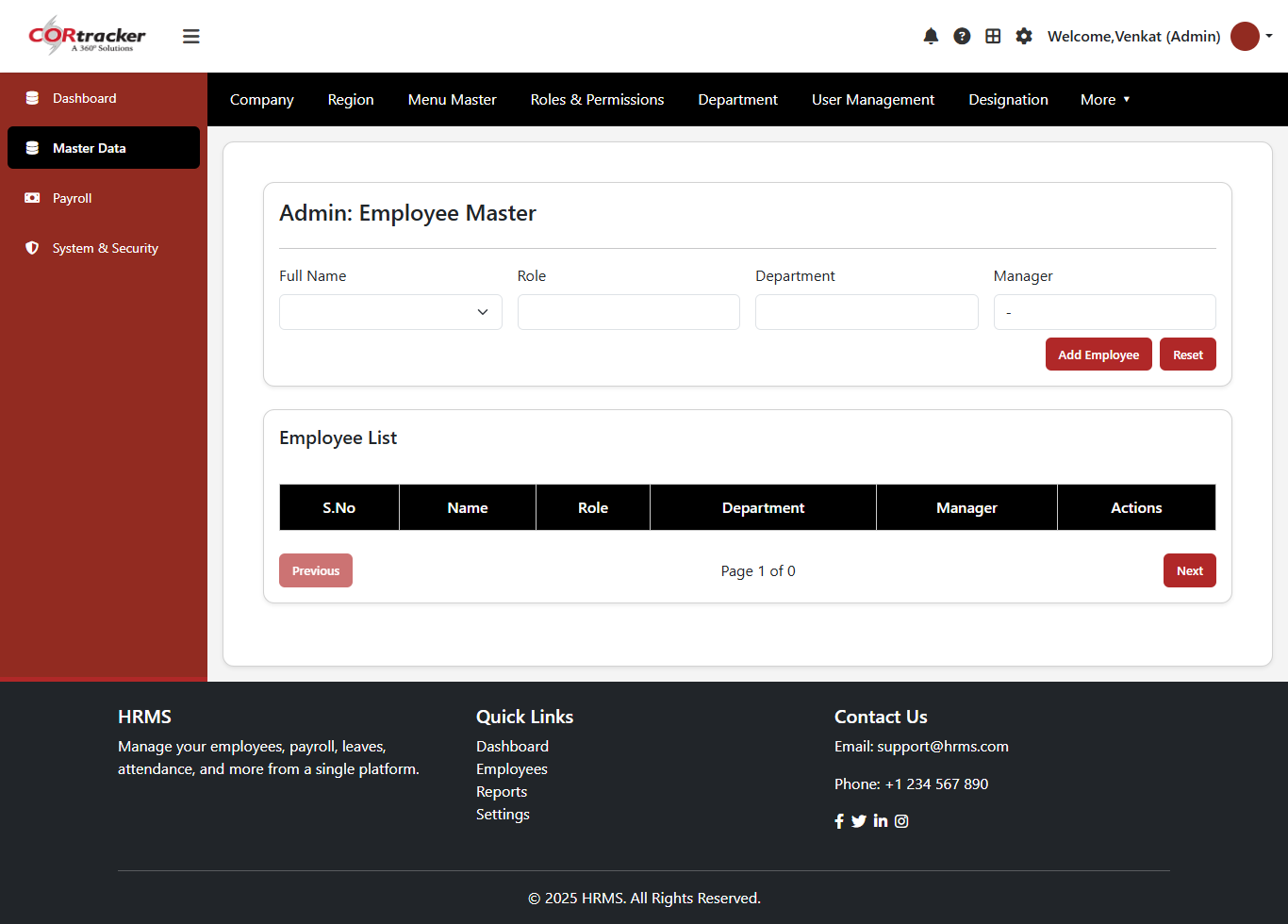
My Team Configuration – Employee Setup
Enter team member details: Name, Role, Department, and Manager
Map employees within the organizational hierarchy
Save information securely in the system
Perform CRUD operations (Create, Read, Update, Delete)
Manage team structure efficiently

Slide 35
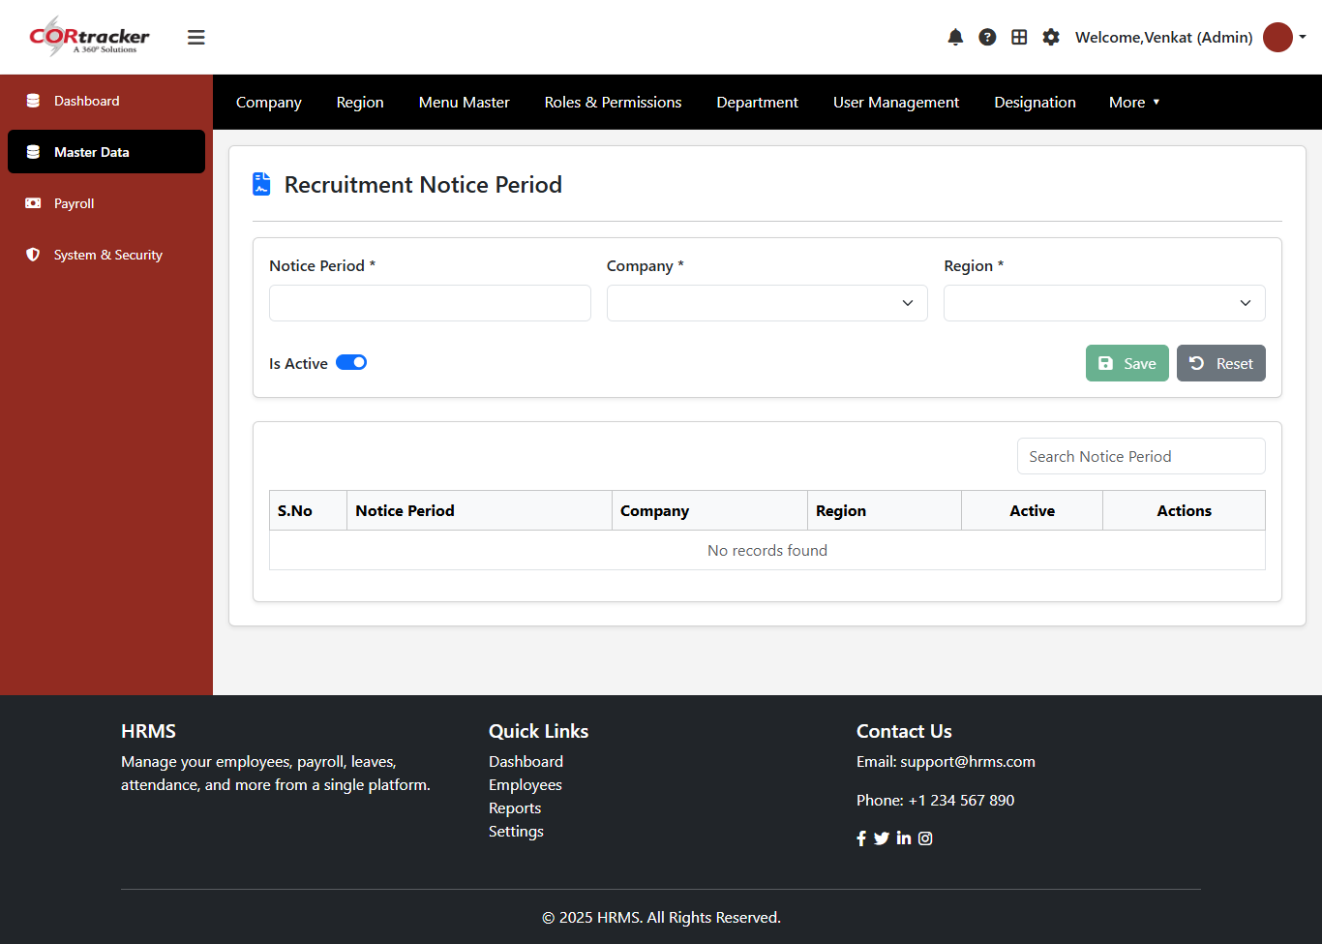
Recruitment Notice Period – Configuration
Define notice period requirements for recruitment
Align hiring timelines with company and regional policies
Centralized management of notice period data
Supports full CRUD functionality for easy updates and maintenance
Ensures consistency in recruitment planning

Slide 36

Interview Level Master – Company & Region Based
Select Company and Region for mapping
Save information securely in the system
Perform CRUD operations (Create, Read, Update, Delete)
Manage interview stages efficiently

Slide 37
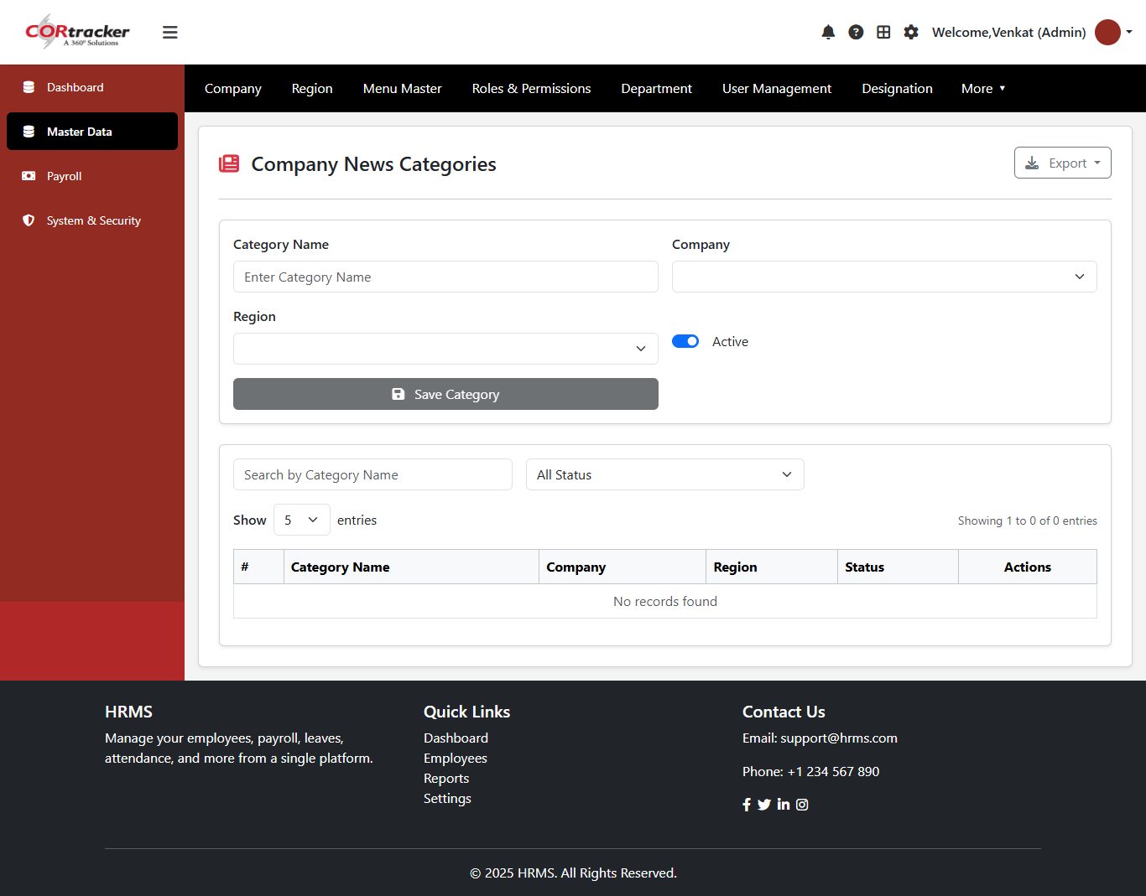
Company News Category – Configuration
Define news categories (e.g., Announcements, Events, Updates)
Align categories with company and regional communication needs
Centralized management of news category data
Supports full CRUD functionality for easy updates and maintenance

Slide 38

Employment Type Master – Company & Region Based
Enter employment type details (e.g., Full-Time, Part-Time, Contract)
Select Company and Region for mapping
Save information securely in the system
Perform CRUD operations (Create, Read, Update, Delete)
Manage employment types efficiently

Slide 39
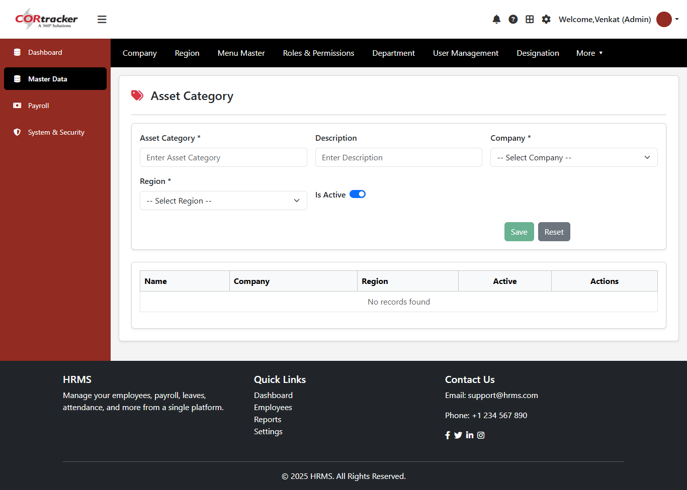
Asset Category Master – Company & Region Based
Enter asset category details (e.g., IT Assets, Furniture, Equipment)
Select Company and Region for mapping
Save information securely in the system
Perform CRUD operations (Create, Read, Update, Delete)
Manage asset categories efficiently

Slide 40
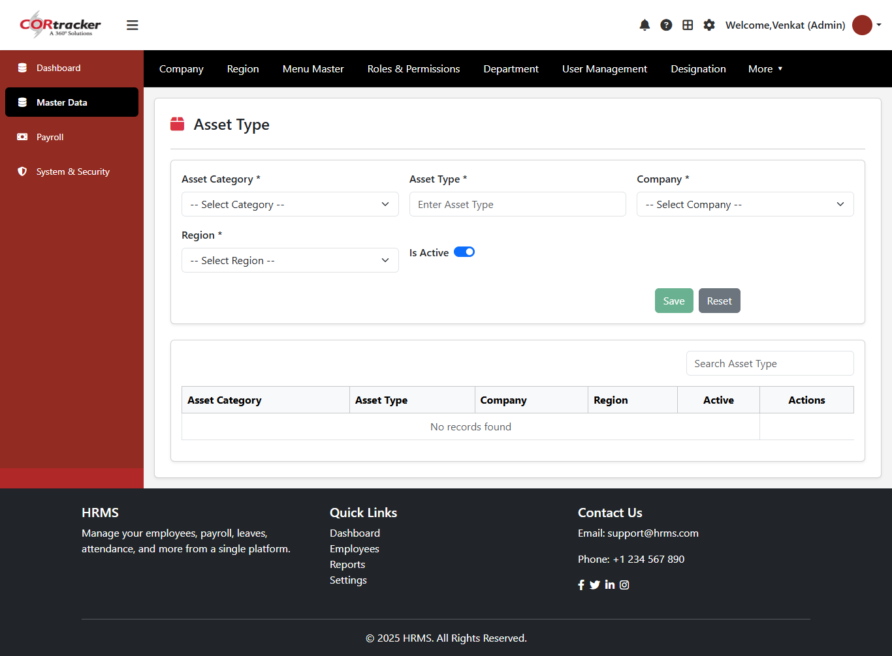
Asset Category & Asset Type – Company & Region Based
Enter Asset Category and Asset Type details
Select Company and Region for mapping
Save information securely in the system
Perform CRUD operations (Create, Read, Update, Delete)
Manage asset classification efficiently

Slide 41

Currency Configuration – Standardization
Define currency codes (e.g., USD, INR, EUR) and names
Align currency setup with company and regional operations
Ensure consistency in financial transactions and reporting
Centralized management with full CRUD functionality

Slide 42
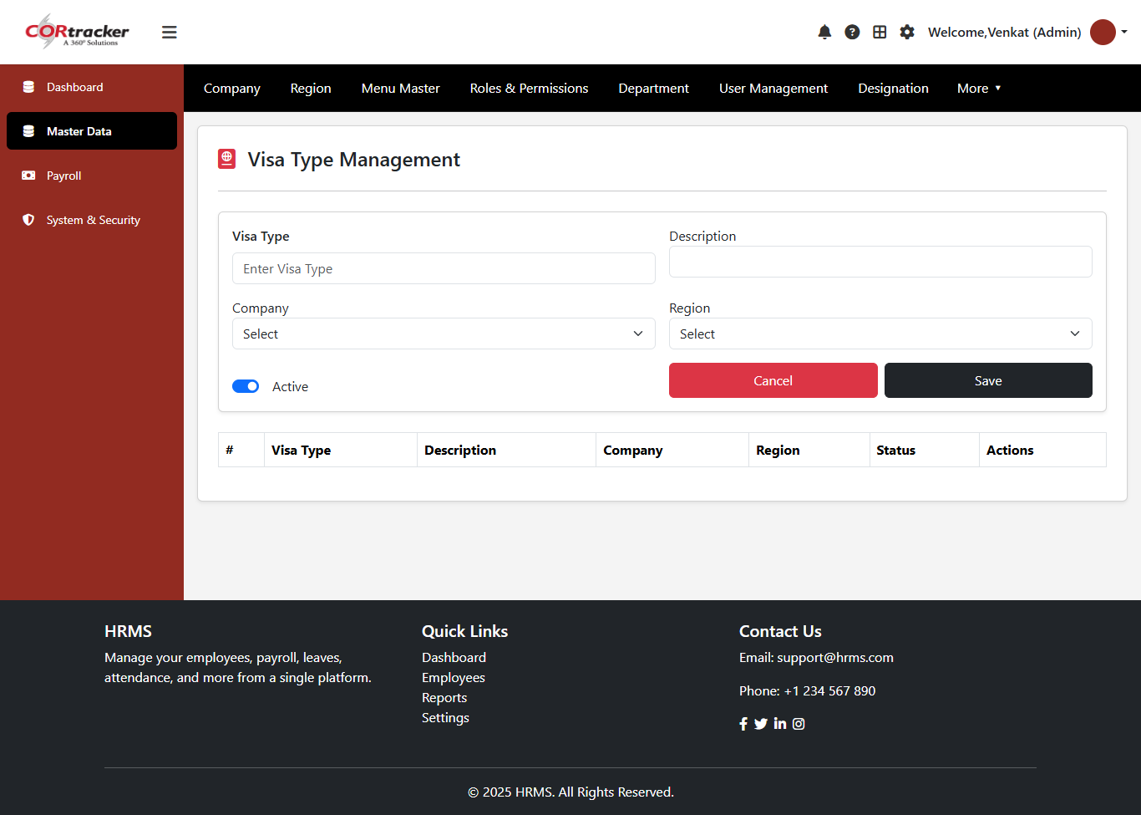
Visa Type Configuration – Compliance Management
Define visa types (e.g., Work Visa, Business Visa, Student Visa)
Capture detailed descriptions for each visa type
Align configuration with company and regional compliance requirements
Centralized management with full CRUD functionality

Slide 43
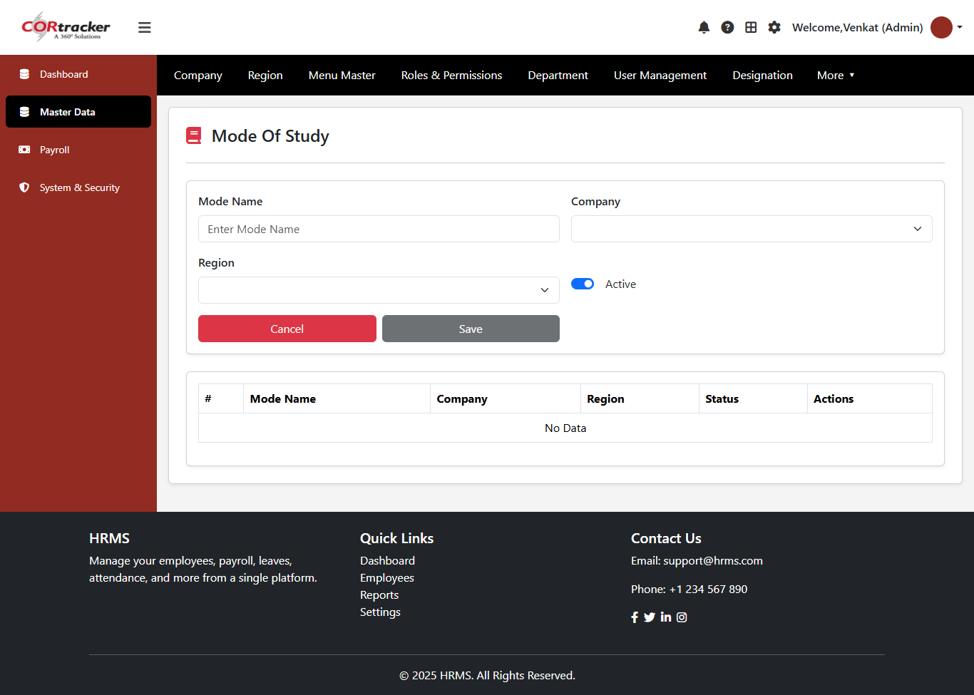
Mode of Study Master – Company & Region Based
Enter Mode of Study details (e.g., Full-Time, Part-Time, Distance Learning)
Select Company and Region for mapping
Save information securely in the system
Perform CRUD operations (Create, Read, Update, Delete)
Manage education modes efficiently

Slide 44
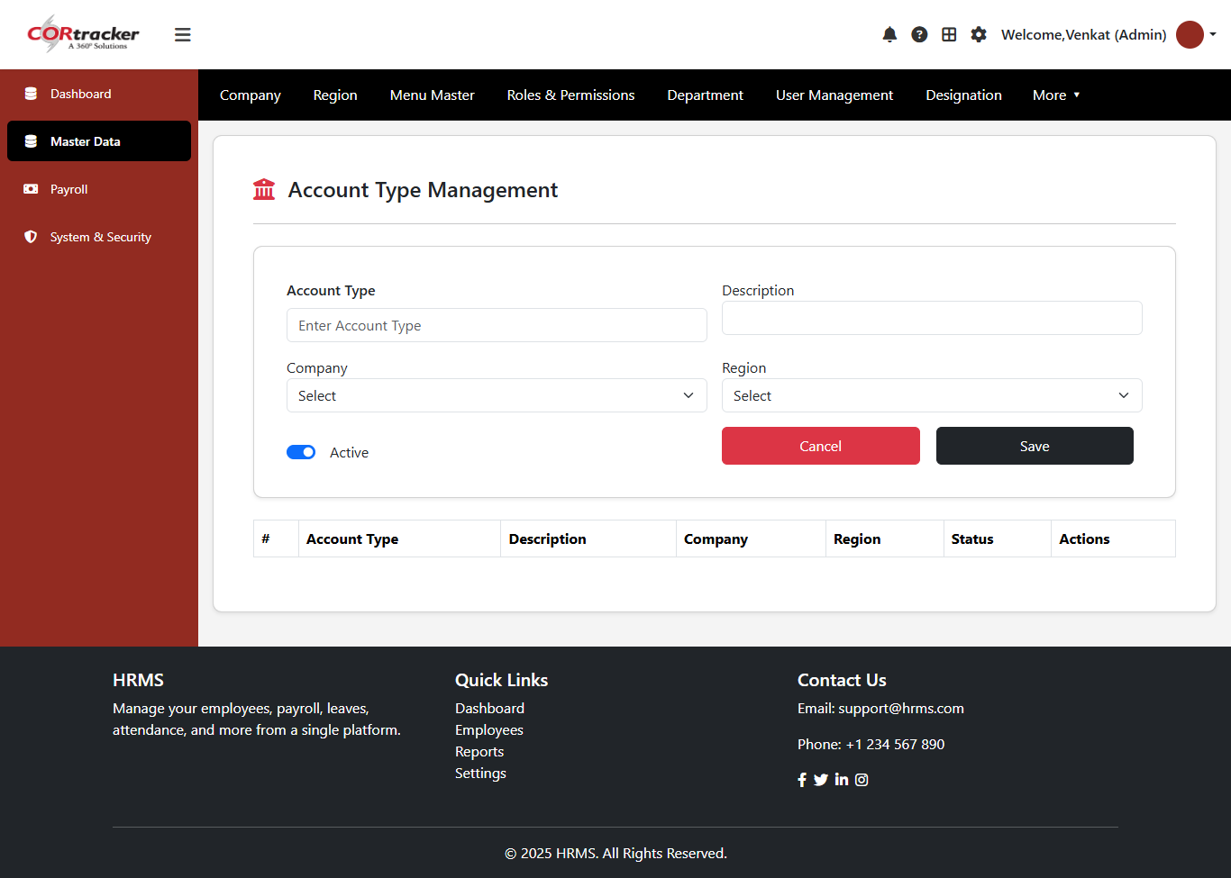
Account Type Master – Company & Region Based
Define account types (e.g., Savings, Current, Salary Account)
Capture detailed descriptions for each account type
Align configuration with company and regional requirements
Centralized management with full CRUD functionality

Slide 45

Project Master – Company & Region Based
Enter Project Name details
Select Company and Region for mapping
Save project information securely in the system
Perform CRUD operations (Create, Read, Update, Delete)
Manage projects efficiently

Slide 46
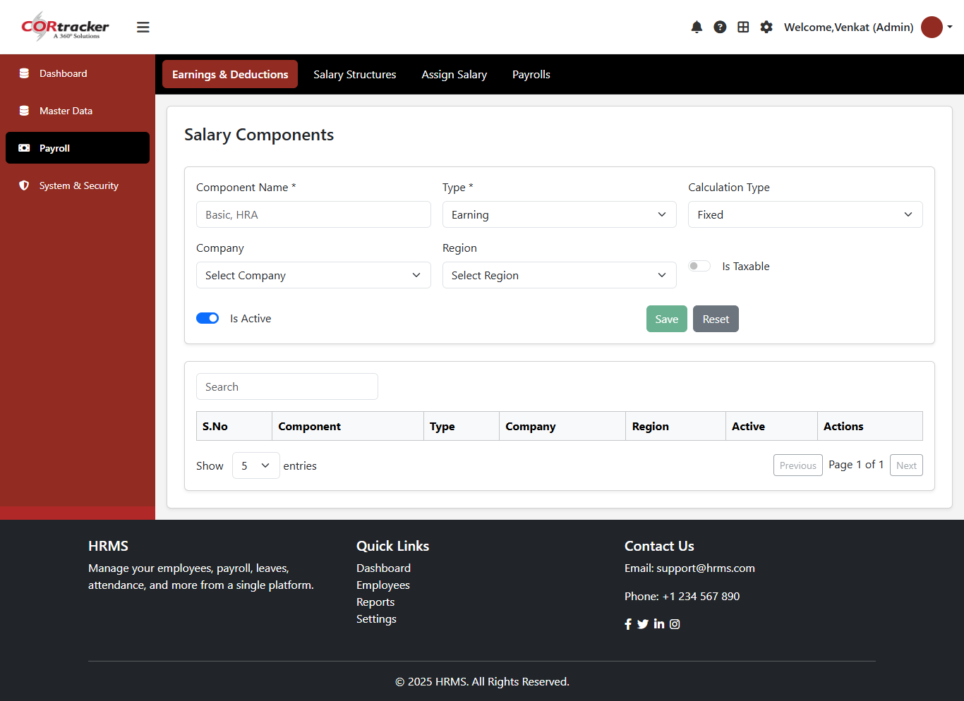
Salary Component Configuration – Company & Region Based
Define and manage salary components such as Basic, HRA, Allowances, and Deductions
Configure component type, calculation method, and applicability based on company and region
Enable control over taxability and activation status of each component
Ensure standardized and flexible salary structure across the organization
Access a searchable list view for easy tracking and management of all configured components
Supports efficient payroll processing with structured and compliant configurations

Slide 47
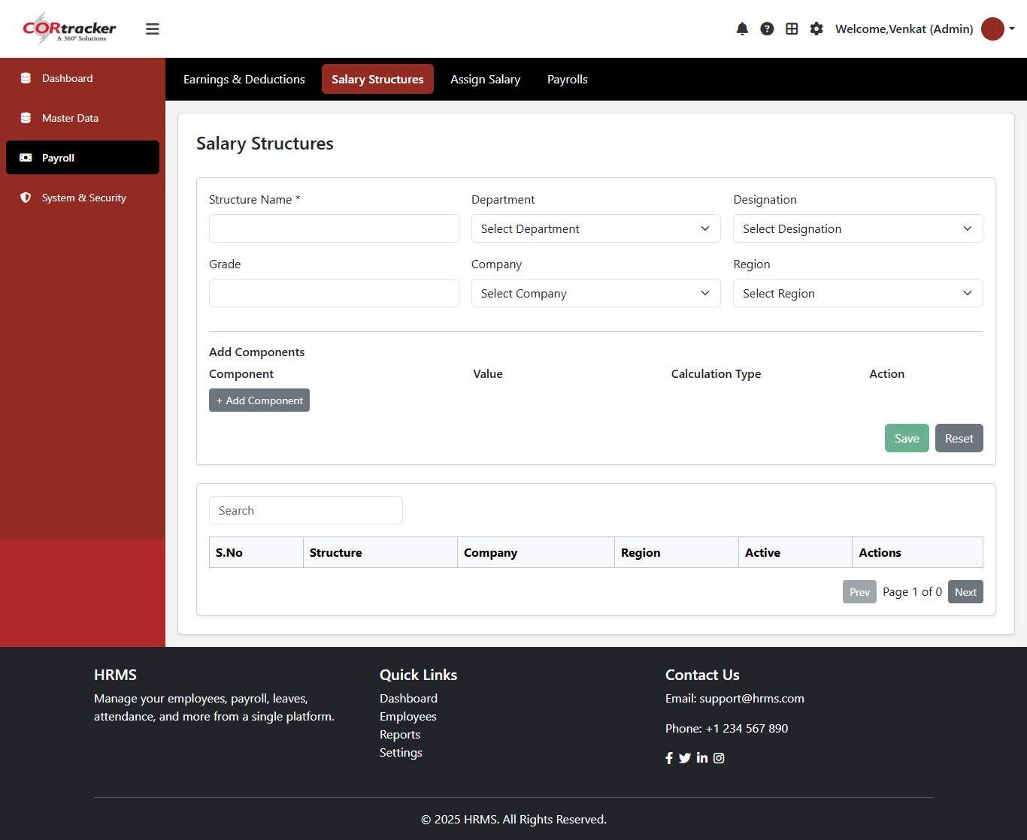
Salary Structure Management – Company & Region Based
Create and manage salary structures by defining Structure Name
Map structures to Department, Designation, and Grade
Associate configurations with specific Company and Region
Add multiple Salary Components with defined values and calculation types
Ensure consistent and standardized salary structures across the organization
Access a searchable list view for easy management and updates
Supports efficient payroll processing and compliance

Slide 48
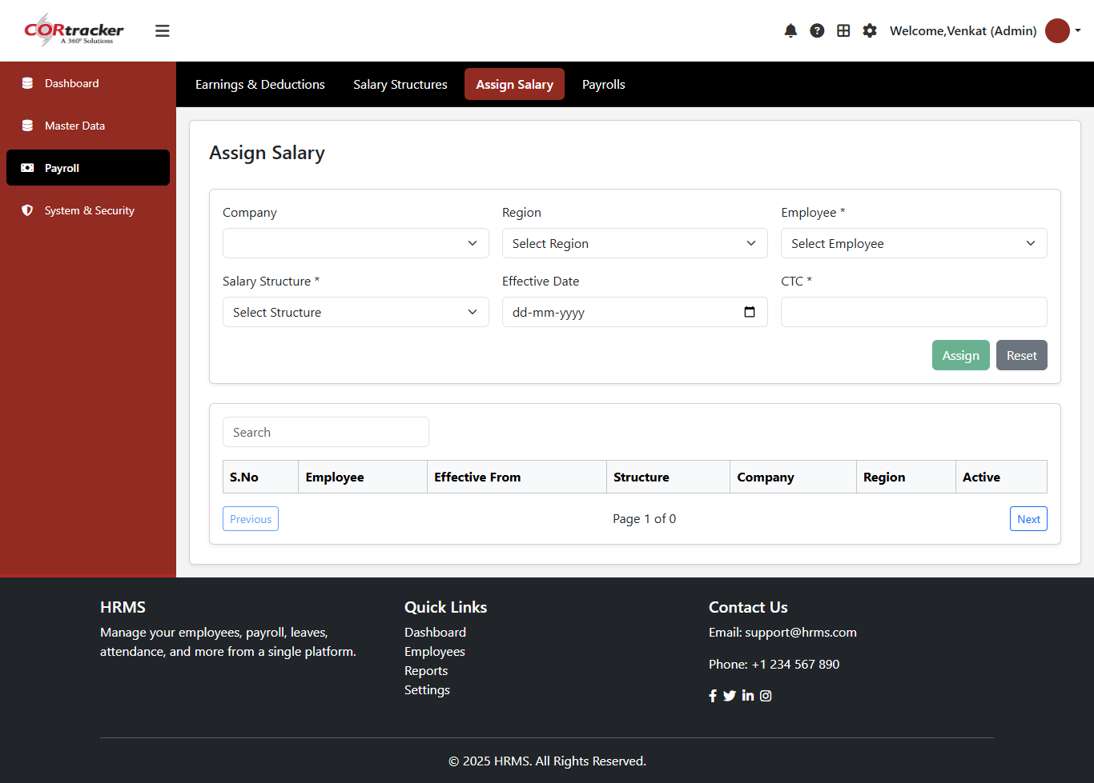
Employee Salary Structure Assignment
Assign salary structures to employees based on Company, Region, and Effective Date
Capture and manage CTC (Cost to Company) details for each employee
Ensure accurate alignment of salary structures with organizational policies
Maintain flexibility to update assignments based on role or location changes

Slide 49
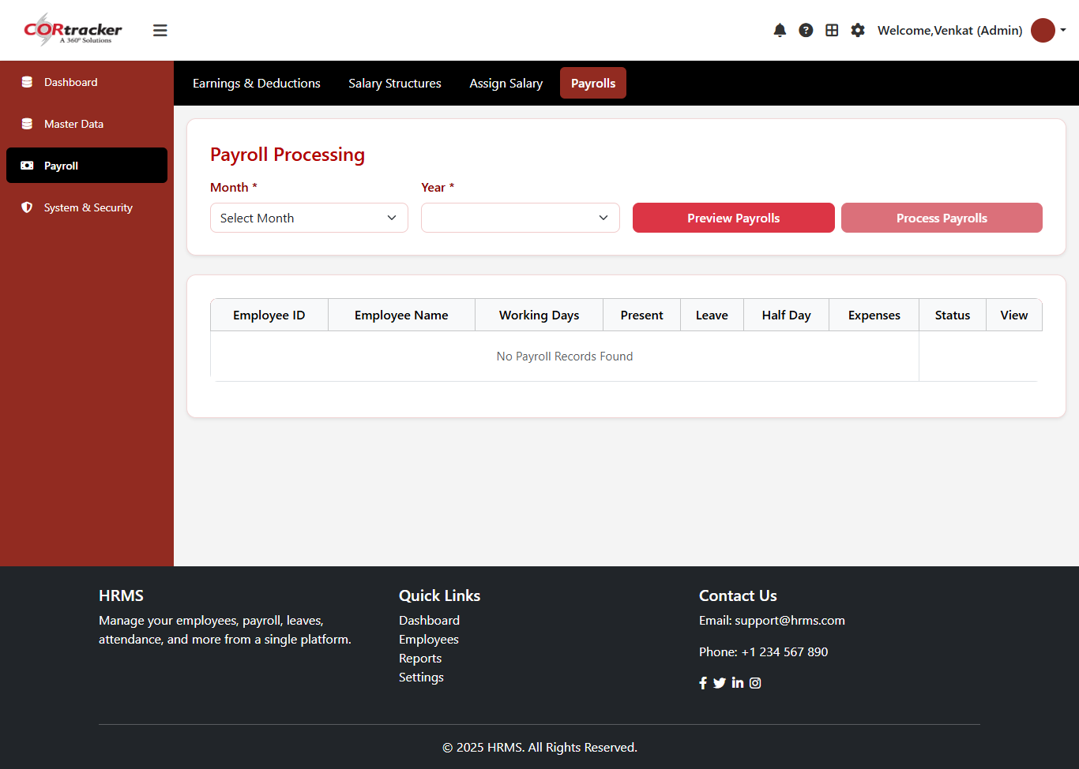
Monthly Payroll Processing
Process payroll efficiently by selecting the Month and Year
View detailed employee data including Working Days, Leaves, and Expenses
Ensure accurate salary calculations based on attendance and inputs

Slide 50
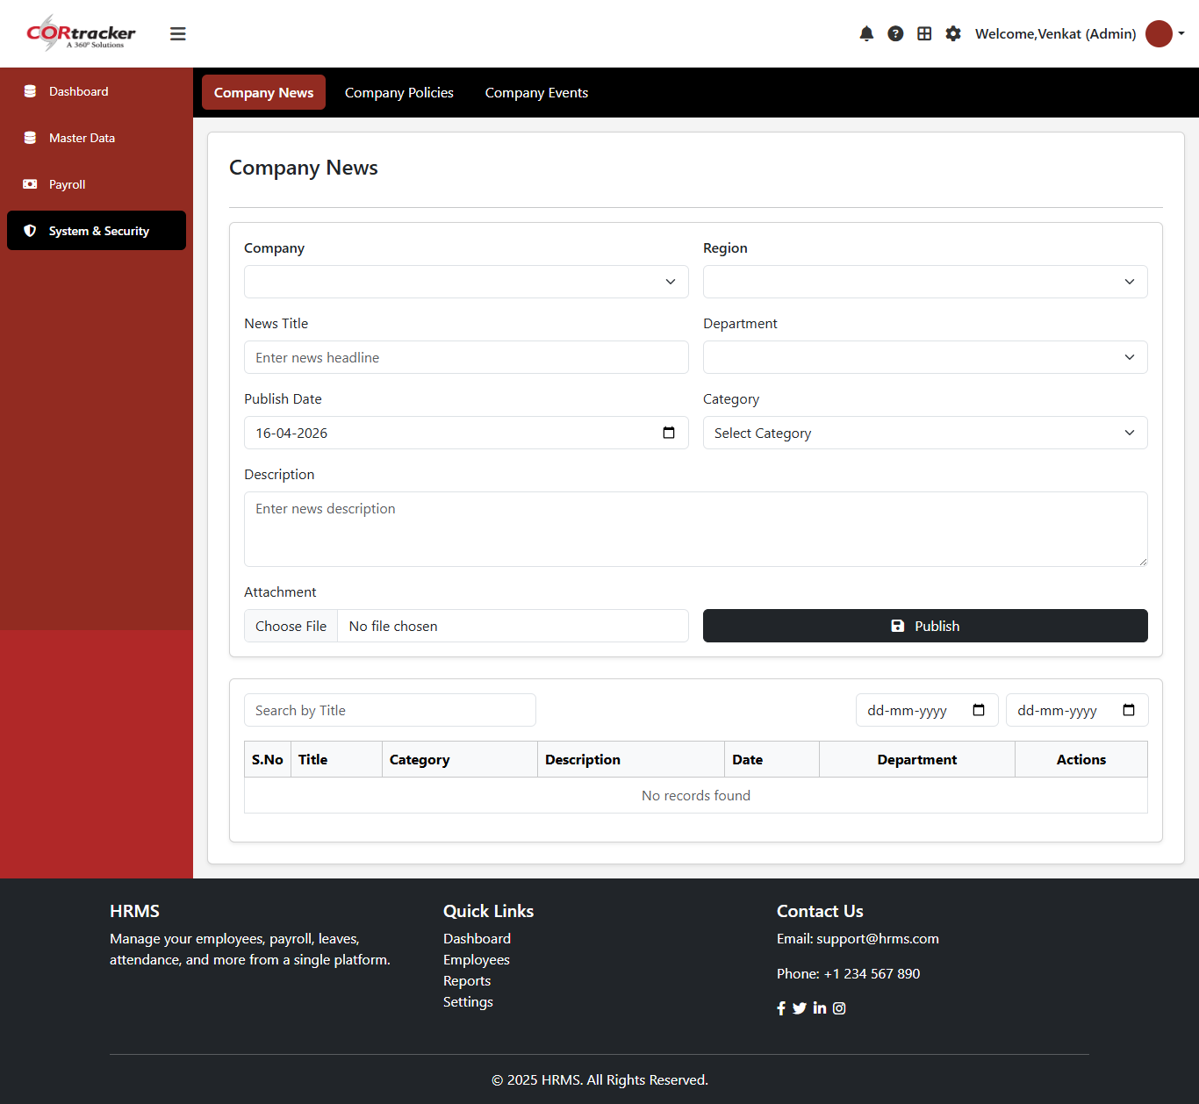
Company News Management
Create and publish company news with details like Title, Category, Department, and Publish Date
Attach relevant documents or files to enhance communication
Ensure timely sharing of important updates across the organization

Slide 51
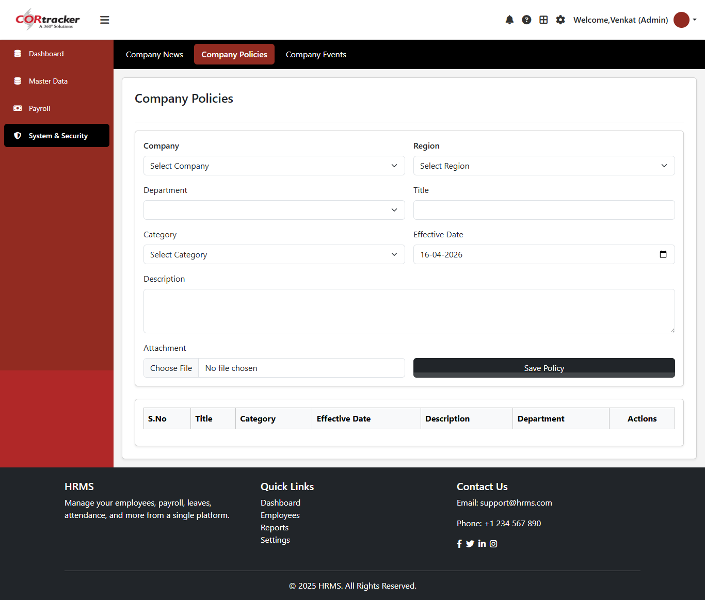
Company Policy Management
Create and manage company policies with details like Title
, Category, Department, and Effective Date
Attach relevant documents to ensure clarity and compliance
Maintain up-to-date policies aligned with organizational standards

Slide 52
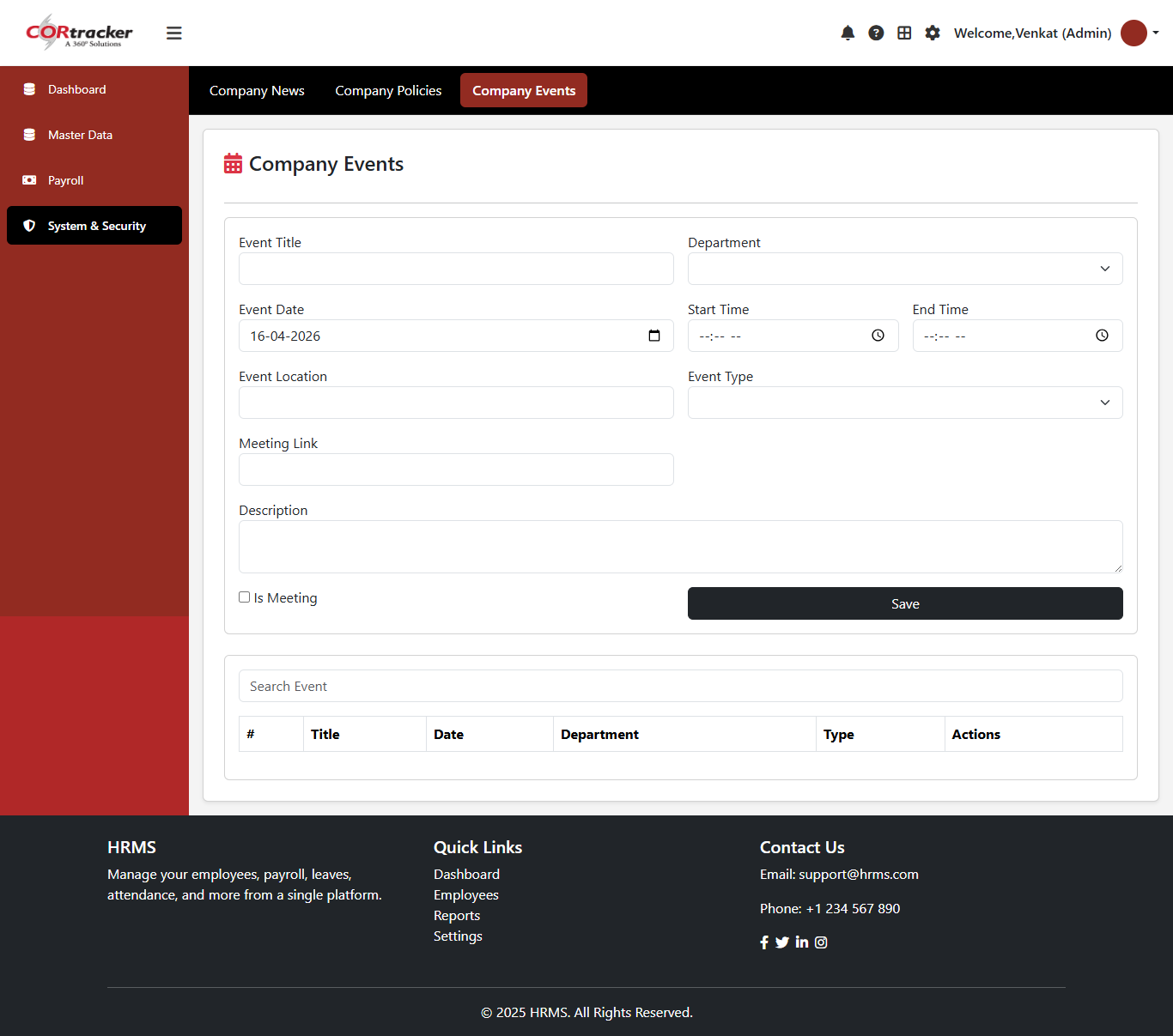
Company Events Management
Create and manage company events by defining details such as Title, Date,
Time, Location, and Event Type
Ensure smooth planning and communication of organizational events
Keep employees informed about upcoming activities and schedules

Slide 53
USER SCREEN Smart. Seamless. Scalable Workforce Management Empowering organizations with intelligent HR automation and real-time insights

Slide 54
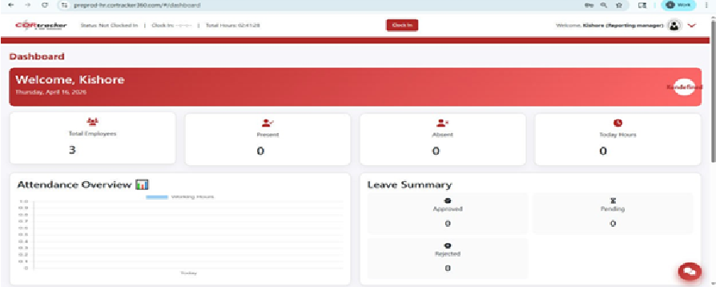
Employee Dashboard Overview
Provides a comprehensive view of key employee metrics in a single screen
Displays real-time data for better monitoring and decision-making
Key Highlights:
Total Employee Count for overall workforce visibility
Daily Attendance Summary including Present, Absent, and Leave status
Overview of Timesheet Entries to track work hours and productivity
Snapshot of Help Desk Requests for issue tracking and resolution

Slide 55
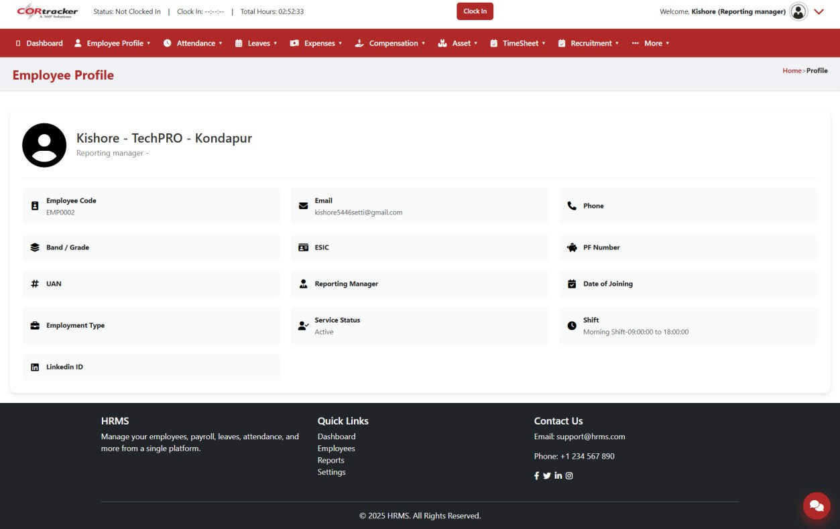
Employee Profile (Read-Only View)
Displays core employee information in a structured format
Serves as the primary record for each employee within the system
Ensures data consistency and prevents unauthorized modifications
Key Information Includes:
Employee Name & Employee Code
Email Address & Contact Information
Professional and Organizational Details

Slide 56
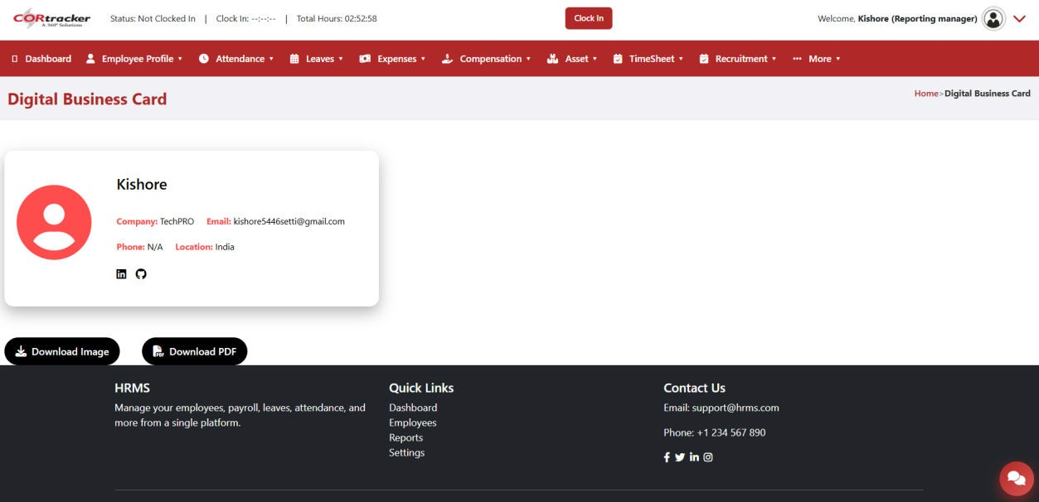
Digital Business Card
Provides employees with a virtual business card for easy sharing and professional representation
Enhances communication and accessibility within and outside the organization
Key Details Included:
Company Name
Employee Email Address
Contact Number
Profile Picture

Slide 57
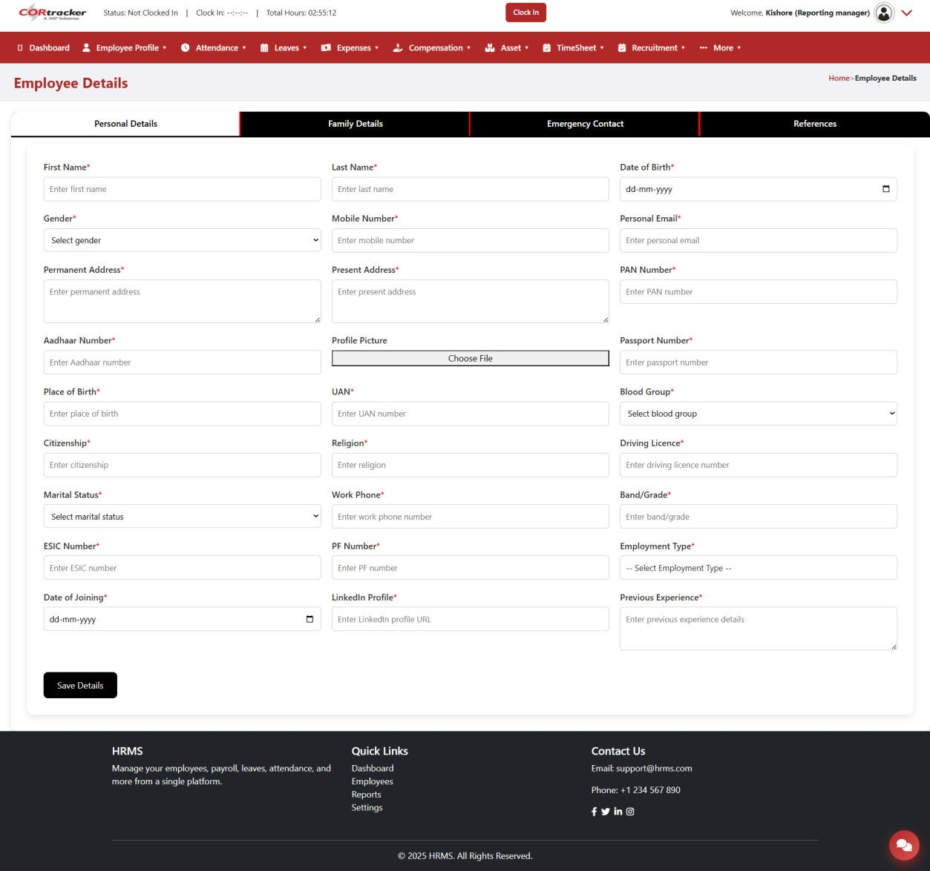
Employee Details Module – Personal Details
Captures comprehensive personal and demographic information of employees
Serves as the foundation for maintaining accurate employee records
Supports efficient HR operations and compliance requirements
Key Information Includes:
Basic details such as Name, Gender, and Date of Birth
Contact Information including address and phone details
Identity Details for verification and record-keeping
Additional fields to capture complete employee profile data

Slide 58
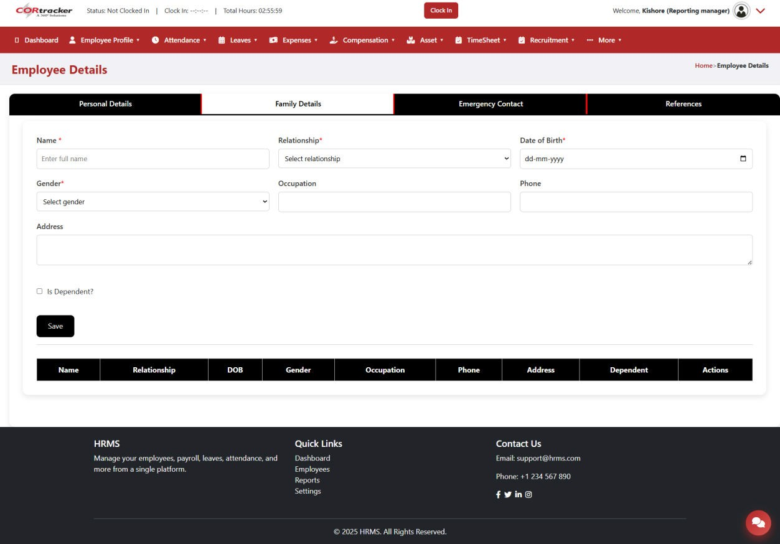
Employee Details Module – Family Details
Stores information about employee’s family members for official records and benefits processing
Allows adding multiple family member records for each employee
Supports accurate and complete employee-related documentation
Key Information Includes:
Family Member Name & Relationship
Date of Birth & Contact Details
Additional details required for benefits and compliance

Slide 59
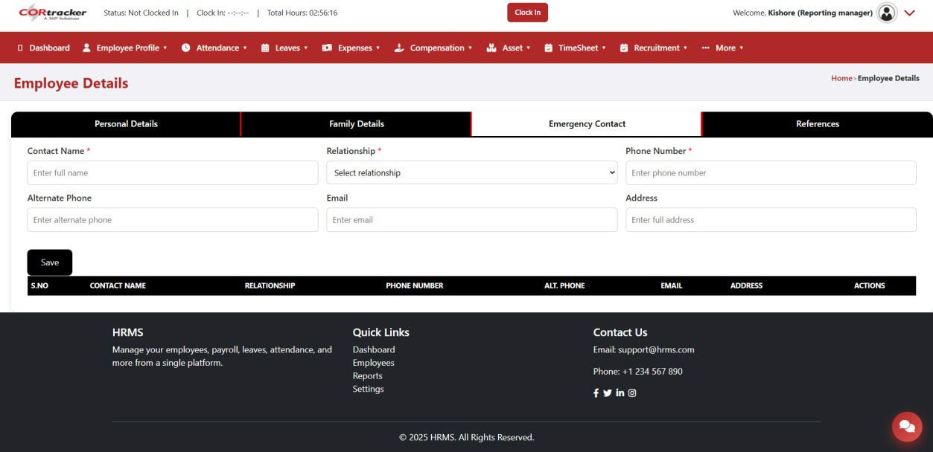
Employee Details Module – Emergency Contact Details
Maintains emergency contact information for employee safety and quick response
Ensures the organization can reach the right person during emergencies
Key Information Includes:
Contact Name
Phone Number
Relationship with Employee

Slide 60
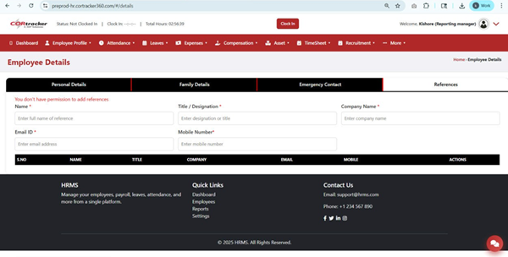
Employee Details Module – Referral Contact
Captures referral information when an employee is recommended by an internal or external source
Helps track and manage employee referral programs effectively
Key Information Includes:
Referrer Name
Contact Details

Slide 61

Employee Details Module – Job History
Maintains a record of employee’s previous work experience
Helps in understanding professional background and career progression
Supports HR in decision-making and profile evaluation
Key Information Includes:
Company Name
Designation / Role
Employment Duration

Slide 62

Employee Details Module – Certifications
Captures and manages employee certification details to track skills and qualifications
Helps in maintaining up-to-date records of professional achievements
Key Information Includes:
Certification Name
Certification Type (e.g., Technical, Professional, Compliance)
Description of the certification
Document Upload for proof and verification

Slide 63
Employee Details Module – Education Details
Captures complete educational qualifications of employees
Helps maintain accurate academic records for verification and career development
Key Information Includes:
Qualification / Degree and Specialization / Major
Institution / University and Board
Start Date and End Date / Year of Passing
Percentage / CGPA / Grade
Mode of Study (e.g., Full-Time, Part-Time, Distance)
Certificate / Document Upload for validation

Slide 64


Slide 65
Employee Details Module – Document Management
Manages and stores employee-related documents in a centralized system
Ensures secure handling and easy access to important records
Key Information Includes:
Document Type and Document Title / Name
Employee Name and Employee Code / ID
Issued Date and Validity Date
File Upload for document storage
Remarks / Notes for additional information
Option to Mark as Confidential for sensitive documents
Key Features:
Secure and organized document repository
Easy to upload, view, and manage employee documents
Confidential access control for sensitive files
Supports compliance, audits, and verification processes

Slide 66


Slide 67
Employee Details Module – Forms & Document Submission
Enables employees to submit and manage forms and documents efficiently
Ensures proper record-keeping and streamlined document handling
Key Information Includes:
Form / Document Type and Form / Document Name
Employee Name and Employee Code / ID
Issued / Submitted Date
File Upload (PDF, DOC, DOCX, JPG, PNG – Max 5 MB)
Remarks / Notes for additional details
Option to Mark as Confidential for sensitive information
Key Features:
Secure and centralized document submission process
Supports multiple file formats with size validation
Easy to upload, view, and manage submitted documents
Confidential access control for sensitive records

Slide 68


Slide 69
Employee Details Module – Document Records
Manages and stores essential employee document records in a secure and organized manner
Ensures proper tracking of document validity and compliance requirements
Key Information Includes:
Document Type and Document Name / Title
Document Number for identification and reference
Issued Date and Expiry Date
File Upload (PDF, JPG, PNG – Max 5 MB)
Remarks / Notes for additional details
Option to Mark as Confidential for sensitive documents
Key Features:
Centralized and secure document repository
Tracks document validity and expiration
Easy to upload, view, and manage records
Confidential access control for sensitive information
Supports compliance and audit requirements

Slide 70


Slide 71
Employee Details Module – Letters & Forms List (View Only)
Displays a structured list of all issued letters and submitted forms
Provides a read-only view for easy reference and tracking
Letters List Includes:
S. No
Document Type
Document Title
Employee Code & Name
Issued Date and Validity
File Attachment
Forms List Includes:
S. No
Type and Form Name
Employee Name & Code
Date
File Attachment

Slide 72


Slide 73
Employee Details Module – Bank Details
Captures and manages employee bank account information for payroll processing
Ensures accurate and secure salary disbursement
Key Information Includes:
Bank Name and Branch Name
Account Holder Name
Account Number and Account Type
IFSC Code and MICR Code
UPI ID (for digital transactions)

Slide 74


Slide 75
Employee Details Module – Demand Draft (DD) Details
Captures and manages Demand Draft (DD) payment information for financial transactions
Ensures proper tracking and documentation of DD-based payments
Key Information Includes:
DD Number and DD Date
Bank Name and Branch Name
Amount (INR)
Payee Name
DD Copy Upload for record and verification

Slide 76


Slide 77
Employee Details Module – Tax InformationEmployee Details Module – Tax Information
Captures employee tax-related details required for payroll and compliance
Ensures accurate calculation of tax deductions and statutory filings
Key Information Includes:
Employee Name (First, Middle Initial, Last Name)
SSN / Tax Identification Number
Address Details (City, State, ZIP Code)
Filing Status and Multiple Jobs / Spouse Work Details
Dependents and Dependent Amounts
Other Income, Deductions, and Extra Withholding
Employee Signature and Date for declaration

Slide 78


Slide 79
Employee Separation – Resignation Management
Facilitates employees to submit resignation details in a structured manner
Enables HR to efficiently manage and track the employee exit process
Key Information Includes:
Employee Code and Employee Name
Resignation Type (e.g., Voluntary, Involuntary)
Notice Period and Last Working Day
Resignation Reason
HR Email (CC) for communication and tracking

Slide 80


Slide 81
Resignation Requests – Manager Review
Enables managers to review and take action on employee resignation requests
Provides complete visibility into resignation details and approval status
Key Information Includes:
Employee Code
Resignation Type
Notice Period and Last Working Day
Resignation Reason
Status (Approved / Rejected / Pending)
Manager Comments and Action Taken

Slide 82


Slide 83
Employee Details Module – Personal & Visa Information
Captures comprehensive personal, passport, and visa/work permit details
Ensures compliance with international employment and legal requirements
Personal Information Includes:
Full Name, Employee ID / Code
Date of Birth and Nationality / Citizenship
Passport Number and Expiry Date
Visa / Work Permit Details:
Visa Type and Visa / Permit Number
Issuing Country, Issue Date, and Expiry Date
Work Authorization / Permit Status
Employer / Sponsorship Details:
Employer / Sponsor Name and Address
HR / Contact Person
Employer Contact Email / Phone

Slide 84


Slide 85
Attendance Management – Clock In / Clock Out
Tracks daily employee attendance with real-time clock-in and clock-out details
Provides visibility into working hours and shift adherence
Employee Details:
Employee Code: EMP0001
Employee Name: Durga Prasad
Date: 20 Apr 2026
Shift Timings: Day Shift (09:00 AM – 06:00 PM)
Attendance Summary:
Clock In Time: 09:12 AM
Clock Out Time: --:-- (Not yet recorded)
Duration of Day: --:-- (Calculated after clock-out)

Slide 86


Slide 87
Attendance Management – Shift Allocation
Enables assigning work shifts to employees for effective attendance tracking
Ensures proper alignment of employees with organizational schedules
Key Information Includes:
Employee Name and Employee Code
Shift Selection (e.g., Day Shift, Night Shift)
Start Date and End Date of the assignment
Active Assignment Status

Slide 88


Slide 89
Attendance Management – WFH / Remote Request
Enables employees to request Work From Home (WFH) or remote work in a structured manner
Ensures proper approval workflow and record management
Key Information Includes:
From Date and To Date
Request Type (WFH / Remote)
Supporting Document Upload (if required)
Reason / Remarks for the request
HR Email (CC) for communication

Slide 90


Slide 91
WFH / Remote Requests – Pending Approvals
Displays all pending Work From Home (WFH) / Remote requests for manager review
Provides a clear overview of request details and current status
Key Information Includes:
Employee Name
From Date and To Date
Request Type (WFH / Remote)
Reason for Request
Status (Pending / Approved / Rejected)
Manager Remarks
Current Status:
No pending approvals (“No pending approvals” message displayed when no records exist)

Slide 92


Slide 93
Attendance Management – Missed Punch Request
Allows employees to request corrections for missed clock-in or clock-out entries
Ensures accurate attendance records and payroll processing
Key Information Includes:
Date of missed punch
Missed Type (Clock In / Clock Out)
Correct Clock In and Clock Out Time
Reason for missed punch
HR Email (CC) for communication

Slide 94


Slide 95
Attendance Management – Pending Approvals (Missed Punch)
Displays pending missed punch requests for manager review and approval
Provides complete visibility into employee correction requests
Key Information Includes:
Employee Name
Date of Request
Request Type (e.g., Missed Clock In / Clock Out)
Correct In & Out Time
Reason for Request
Remarks and Action (Approve / Reject)
Example Scenario:
Employee: Sai Kishore
Date: Apr 7, 2026
Type: Missed Clock In
Correct In Time: 09:10 AM
Reason: Forgot to clock in

Slide 96


Slide 97
Attendance Management – Employee Attendance
Provides a centralized view to manage and save daily employee attendance
Allows selection of a specific date to load and update attendance records
Key Functions:
Select Date to load attendance (e.g., 20 Apr 2026)
Option to Load Attendance and identify missing entries
Alert for unsaved attendance records
Save All Attendance option for bulk updates
Attendance Details Include:
Employee Code & Employee Name
Shift Timings
Clock In & Clock Out Time
Late Arrivals
Gross Working Time
Attendance Status (Present / Absent / Leave)

Slide 98


Slide 99
Leave Management – Apply for Leave
Enables employees to submit leave requests in a structured and efficient manner
Supports smooth approval workflow and leave tracking
Key Information Includes:
Leave Type (e.g., Casual, Sick, Earned Leave)
Option for Half Day Leave
Start Date and End Date
Total Leave Days (auto-calculated)
Reason / Remarks for leave request
Supporting Document Upload (if required)
Reporting Manager and HR Email (CC)

Slide 100


Slide 101
Leave Management – Leave Approvals (Manager View)
Enables managers to review and manage employee leave requests
Provides a clear overview of leave details and approval status
Key Information Includes:
Employee Name
Leave Type
From Date and To Date
Number of Days
Reason for Leave
Status (Approved / Rejected / Pending)
Actions (Approve / Reject)
Example Scenario:
Employee: Rajitha Pavuluru
Leave Type: Sick Leave
Duration: 08 Apr 2026 – 10 Apr 2026 (3 Days)
Reason: Going to Thirumala
Status: Approved

Slide 102


Slide 103
Leave Management – Leave Calendar View
Provides a monthly calendar view of employee leave records
Helps visualize leave distribution and workforce availability
Key Features:
Displays leave data for selected month and employees
Supports different leave types (Casual, Sick, Earned Leave)
Clearly indicates approval status (Approved / Pending / Rejected)
Easy navigation across days, weeks, and months
Calendar Highlights:
Shows leave entries mapped to specific dates
Multiple leave records visible on the same day
Helps identify peak leave periods and overlaps

Slide 104


Slide 105
Expense Management – Expense Submission
Enables employees to submit expense claims for reimbursement
Ensures proper tracking and approval of business-related expenses
Key Information Includes:
Project / Engagement and Category
Location and Country
Department (e.g., Development Department)
Amount and Date of Expense
Reason / Description for the expense
Receipt Upload for verification
HR Email (CC) for communication

Slide 106


Slide 107
Expense Management – Expense List & Tracking
Provides a centralized view of all submitted expenses across projects and categories
Enables easy tracking of expense status and details
Filters Available:
Project
Category
Country
Status (Pending / Approved / Rejected)
Expense Details Include:
Project
Category (e.g., Travel Expenses)
Country (e.g., USA)
Amount (INR)
Date of Expense
Status
Example Record:
Project: 9
Category: Travel Expenses
Country: USA
Amount: 88.00 INR
Date: 15 Apr 2026
Status: Pending

Slide 108


Slide 109
Expense Management – Approval Requests
Enables managers to review and approve employee expense claims
Provides a clear overview of submitted expenses with approval status
Filters Available:
Project
Category
Country
Status (Pending / Approved / Rejected)
Expense Details Include:
Project
Category (e.g., Travel Expenses)
Country
Amount
Date of Submission
Submitted By (Employee Name)
Status

Slide 110


Slide 111
Payroll Management – Payslip Generation
Allows employees to generate and view payslips for a selected time period
Provides flexibility to access salary details across multiple months
Key Inputs Include:
From Month and To Month selection
Year selection
Key Features:
Generate payslips for a specific date range
Easy access to historical salary records
Supports download and review of payslips
Improves transparency in salary and deductions

Slide 112


Slide 113
Payroll Management – HR Payslip Dashboard
Provides HR with a centralized dashboard to manage payslip requests and payroll reports
Enables efficient monitoring and downloading of employee payroll data
Payslip Requests Section:
Displays employee requests with:
Employee Name
From Month & To Month
Year
Action (Generate / Download)
Shows message when no requests are pending
“No pending requests available”
All Payrolls Section:
Allows filtering of payroll data by:
Employees
From Month & To Month
Year
Key Features:
Generate and download bulk payroll reports
Easy filtering for quick data retrieval
Centralized payroll management for HR
Improves efficiency in handling employee payslip requests

Slide 114


Slide 115
Asset Management – Asset Creation & Management
Enables organizations to create and manage company assets efficiently
Maintains complete records of asset details, ownership, and lifecycle
Key Information Includes:
Asset Name and Asset Code
Asset Category and Asset Type
Asset Location
Asset Cost
Asset Description and Model / Version
Purchase Order Details
Lifecycle & Tracking Details:
Warranty Start & End Date
Asset Return Date
Asset Status (Active / In Use / Returned / Damaged)

Slide 116


Slide 117
Asset Management – Asset Request
Enables employees to request company assets based on their work requirements
Ensures a structured approval and allocation process
Employee Details:
Employee Name: Durga Prasad
Employee ID: EMP0001
Department and Reporting Manager
Request Information Includes:
Asset Category and Asset Type
Required Date
Priority (Low / Medium / High)
Reason for Request
Supporting Document Upload (if required)
HR Email (CC) for communication

Slide 118


Slide 119
Asset Management – Asset Approvals
Enables managers and HR to review and approve employee asset requests
Provides a structured view of all pending and processed asset requests
Filters Available:
Employee Name
From Date and To Date
Asset Type
Status (Pending / Approved / Rejected)
Approval Details Include:
Request ID
Employee Name
Asset Type
Required Date
Priority Level
Status
Key Features:
Centralized asset request approval workflow
Easy filtering for quick search and tracking
Enables approve/reject actions with visibility
Improves accountability and timely asset allocation

Slide 120


Slide 121
Asset Management – Asset Assignment
Enables HR/Admin to assign approved assets to employees
Ensures proper tracking of asset allocation and return details
Key Information Includes:
Request ID (linked to approved request)
Employee Name
Asset Type and Select Asset
Asset Code
Assign Date
Return Date (if applicable)
Remarks / Notes
Key Features:
Seamless mapping of approved requests to asset allocation
Tracks asset ownership and assignment history
Supports planned return and lifecycle management
Ensures accountability for assigned assets

Slide 122


Slide 123
Asset Management – My Assets
Provides employees with a personalized view of all requested and assigned assets
Helps track the status and details of asset requests
Filters Available:
Asset Type
Status (Pending / Approved / Assigned / Rejected)
Asset Details Include:
Request ID
Asset Type
Category
Required Date
Priority Level
Reason for Request
Status
Key Features:
Centralized view of individual asset requests
Real-time tracking of request and allocation status
Easy filtering for quick access to records
Improves transparency for employees

Slide 124


Slide 125
Timesheet Management – Timesheet Entry
Enables employees to log daily work hours and project activities
Helps track productivity and project-wise time utilization
Employee Details:
Employee Name: Durga Prasad
Employee Code: EMP0001
Date of timesheet entry
Timesheet Information Includes:
Project Name (e.g., Project 1)
Start Time and End Time
Total Working Hours (auto-calculated)
Overtime (OT) Hours
Comments / Work Description
Attachment Upload (if required)
HR Email (CC) for communication

Slide 126


Slide 127
Timesheet Management – Timesheet Approvals
Enables managers to review and approve employee timesheets
Provides a centralized view of submitted timesheet records
Filters Available:
Search by Employee Name
From Date and To Date
Quick option to view Today’s Timesheets
Timesheet Details Include:
Employee Name
Employee ID
Date
Total Working Hours
Overtime (OT) Hours
Approver Comments
Status (Pending / Approved / Rejected)
Action (Approve / Reject)

Slide 128


Slide 129
Recruitment Management – Resume Upload & Candidate Management
Enables HR to capture and manage candidate details efficiently
Supports complete tracking from application to hiring stage
Personal & Application Details:
Applied Date
Candidate Name, Email, Mobile
Gender, Date of Birth, Marital Status
Current & Expected Salary
Reference Source
Designation & Department
Skills, Experience, Notice Period
Current Offers, Preferred Location, Reason for Change
Resume Upload
Experience & Qualification Details:
Add Previous Work Experience (Organization, Role, Duration)
Add Educational Qualifications (Degree, University, Duration)
Supports multiple records for both sections
Candidates Listing Includes:
Candidate Name & Sequence ID
Designation Applied
Contact Details
Applied Date & Resume File
Recruitment Stage & Progress
Actions (View / Update / Move to Next Stage)

Slide 130


Slide 131
Recruitment Management – Screening Process
Enables HR and recruiters to screen candidates based on job requirements
Helps shortlist candidates for further interview rounds
Key Information Includes:
Designation and Department
Candidate List with:
Sequence ID
Candidate Name
Mobile Number
Expected Salary
Screening Actions:
Assign Recruiters
Add Remarks / Evaluation Notes
Record Screening Results (Selected / Rejected / On Hold)
Screening Records Include:
Candidate Name & Sequence ID
Assigned Recruiter(s)
Screening Result
Remarks
Screening Date
Progress Status
Action (View / Update)

Slide 132


Slide 133
Recruitment Management – Interview Scheduling & Feedback
Enables HR to schedule interviews and capture feedback efficiently
Ensures smooth coordination between candidates and interviewers
Interview Scheduling Details:
Designation and Department
Interview Level (Technical / HR / Managerial)
Interviewer(s) Assignment
Date & Time of Interview
Location (Office / Online)
Meeting Link (for virtual interviews)
Description / Instructions
HR Email (CC) for communication
Candidate Information Includes:
Candidate Name & Sequence ID
Mobile Number
Expected Salary
Interview Records Include:
Candidate Name
Interview Level
Interviewer
Date & Time
Location / Mode
Description / Feedback
Progress Status
Actions (Update / View)

Slide 134


Slide 135
Recruitment Management – Appointment Details
Manages interview appointment scheduling and attendee tracking
Ensures structured coordination between candidates and interview sessions
Appointment Details Include:
Interview Selection
Sequence ID & Date
Designation
Venue (Office / Online Location)
Description / Notes
Action (View / Update / Manage)
Attendee Details Include:
Sequence ID & Candidate Name
Gender & Mobile Number
Expected Salary
Status (Scheduled / Attended / Not Attended)
Description / Feedback
Reported By (Recruiter / HR)

Slide 136


Slide 137
Recruitment Management – Offer Management
Manages the offer creation, approval, and tracking process for selected candidates
Ensures smooth transition from interview stage to onboarding
Offer Details Include:
Designation and Department
Candidate selection details (Name, Mobile, Expected Salary)
CTC (Cost to Company)
Expected Date of Joining (DOJ)
Offer Status (Draft / Sent / Accepted / Rejected)
HR Email (CC) for communication
Offers List Includes:
Candidate Name
Designation
CTC Offered
DOJ
Status
Progress Tracking
Actions (View / Edit / Send Offer)

Slide 138


Slide 139
Recruitment Management – Onboarding
Manages the final stage of the hiring process, ensuring smooth employee joining
Tracks all onboarding activities and required formalities
Onboarding Details Include:
Designation and Department
Candidate details (Name, Mobile, Expected Salary)
Joining Date
Documents Collected Status (Yes / No)
Background Check Status (Pending / Completed)
Laptop Issued Status (Yes / No)
HR Name / Buddy Assignment
Onboarding Status Tracking
Onboarding List Includes:
Candidate Name
Joining Date
Documents Status
Background Check Status
Laptop Allocation Status
Buddy Assignment
Progress Status

Slide 140


Slide 141
Performance Management – KPI Submission & Review
Enables employees to submit self-performance KPIs and reviews
Supports structured evaluation by managers for appraisal cycles
Employee Details:
Employee Code: EMP0001
Employee Name: Durga Prasad
Designation & Department: Development Department
Reporting Manager: Naresh Kumar
Performance Details Include:
Performance Cycle (e.g., Quarterly)
Project Details
Appraisal Year (2026)
Applicable Start & End Date
Self Review Summary
HR Email (CC) for communication
Workflow:
Employee Submission → Manager Review & Approval

Slide 142


Slide 143
Performance Management – Pending KPI Reviews
Displays all pending performance and KPI submissions awaiting manager evaluation
Helps managers efficiently review and process multiple employee appraisals
Review Details Include:
Employee Name / Code
Project Details
Appraisal Year
Current Status (Pending / In Review / Completed)
Actions (Approve / Reject / Request Changes)
Bulk Actions:
Enables managers to perform bulk approval or updates for multiple employees
Improves efficiency in handling large appraisal cycles
Key Features:
Centralized dashboard for KPI review tracking
Supports quick filtering and bulk operations
Ensures timely completion of appraisal cycles
Improves transparency in performance evaluation

Slide 144


Slide 145
Help Desk Management – Raise Ticket
Enables employees to raise support tickets for issues and service requests
Ensures quick resolution through proper tracking and assignment
Ticket Details Include:
Employee Name / ID: Durga Prasad
Department: Development Department
Category (e.g., IT, HR, Payroll, Access Issues)
Issue Subject
Priority Level (Low / Medium / High / Critical)
Description of Issue
Attachment Upload (if required)
HR Email (CC) for communication
Key Sections:
My Tickets – View all raised tickets and their status
Ticket Approval – Manager/HR approval for applicable requests

Slide 146


Slide 147
Help Desk Management – My Tickets
Provides employees a personal dashboard to track all raised tickets
Helps monitor issue status and progress in real time
Filters Available:
Category (IT / HR / Payroll / Access / Others)
Status (Open / In Progress / Resolved / Closed)
Date Range (From – To)
Ticket Details Include:
S. No
Ticket No
Category
Subject / Issue Description
Priority Level
Current Status
Raised Date

Slide 149
Help Desk Management – Approve Tickets
Enables managers/HR to review and approve employee raised tickets
Ensures proper validation and prioritization of support requests
Filters Available:
Employee Name (All Employees)
Status (All Status)
From Date and To Date
Ticket Details Include:
Ticket No
Employee Name
Category (IT / HR / Payroll / Access / Others)
Subject / Issue Description
Status (Open / In Progress / Approved / Rejected / Resolved)
Priority Level
Raised On Date
Manager Comments

Slide 150


Slide 151
Company News – Management Module
Enables HR/Admin to create and manage company-wide news and updates
Ensures timely communication of important organizational information
News Details Include:
Category (e.g., HR Updates, Policy Changes, Events, Announcements)
Select Date for publishing news
Title & Content of News (as applicable)
Attachments (if required for supporting documents)

Slide 152


Slide 153
Company Policies – Employee Policy Management
Provides employees access to company policies and guidelines in a centralized system
Ensures transparency and consistent communication of organizational rules
Policy Filters Include:
Category (All Categories / HR / IT / Finance / Compliance, etc.)
From Date for filtering policy updates and effective periods
Policy Details Include:
Policy Title
Category
Effective Date
Department (if applicable)
Policy Document / Attachment

Slide 154


Slide 155
Events Management – My Events Calendar
Provides a monthly calendar view of all company events and schedules
Helps employees stay informed about upcoming organizational activities
Calendar View Includes:
Month & Year Display (e.g., April 2026)
Day-wise Event Mapping (Sun–Sat)
Date-wise Event Listings
Key Features:
Visual calendar for easy event tracking
Displays scheduled company events in a structured format
Supports monthly navigation for past and upcoming events
Helps improve participation and awareness

Slide 156


Slide 157
Employee Management – My Team / Subordinates
Provides managers a structured view of their reporting employees (team members)
Helps monitor team structure and employee relationships within the organization
Key Information Includes:
Manager View: My Team / Subordinates
Employee Name: Durga Prasad (Example)
Hierarchical display of reporting structure
Navigation breadcrumb for easy access (Home > More > My Team)

Slide 158


Slide 159
Employee Management – My Calendar View
Provides employees with a personal calendar view of their daily work activities and schedules
Helps track attendance, leave, events, and work-related updates in one place
Calendar View Includes:
Month-wise navigation for easy tracking
Display of attendance status (Present / Absent / Leave)
Highlighted approved leaves and WFH requests
Company events and holidays
Timesheet or task-related reminders (if applicable)
Key Features:
Centralized personal schedule dashboard
Color-coded indicators for different activity types
Easy navigation across days, weeks, and months

Slide 160


