Slide 1

Meet Zana
A command center
for AI coding agents
Run your tools across your projects.
Keep decisions and results in view.
zana-ide.com
Zana
01
Notes:
Sources: https://github.com/salesforce/zana/blob/main/README.md; https://github.com/salesforce/zana/blob/main/docs/using-zana.md. Repository snapshot reviewed September 2026. Artwork: resources/icon.svg and docs/assets/zana-readme-hero.svg in the Zana repository.

Slide 2
Multiple agents create coordination work
Each session can produce progress, questions, and results.
Code change
A patch needs review
Your attention
Investigation
Which session needs you?
What is ready to review?
What should the next agent know?
A question needs an answer
Review
Findings need a home
Zana
02
Notes:
Sources: https://github.com/salesforce/zana/blob/main/README.md; https://github.com/salesforce/zana/blob/main/docs/using-zana.md. Repository snapshot reviewed September 2026. The parallel tasks are an illustrative workflow, not a claim about measured results.

Slide 3
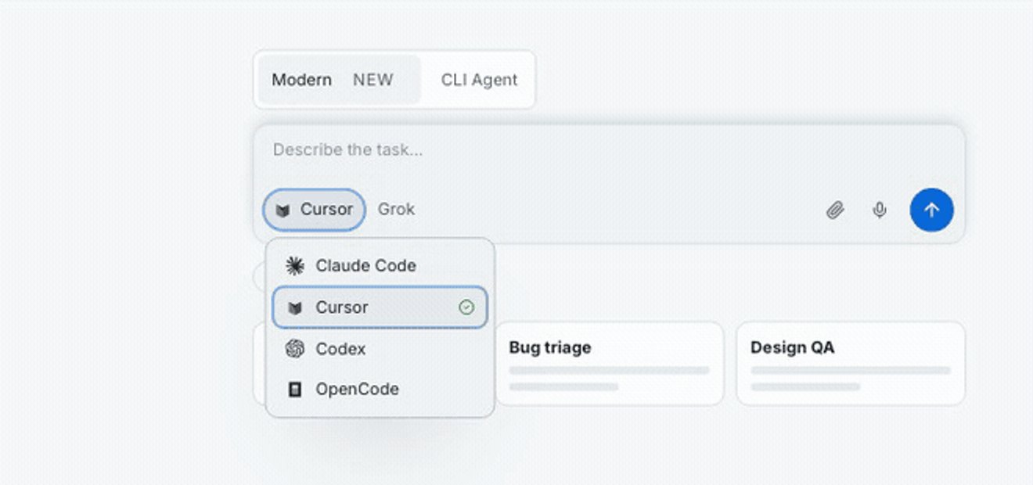
Your existing coding tools
Choose a structured Thread or a native CLI Agent session.
Claude Code
Codex
Cursor
OpenCode
Pi
Choose the agent for the task
Zana
03
Notes:
Sources: https://github.com/salesforce/zana/blob/main/README.md; https://github.com/salesforce/zana/blob/main/docs/using-zana.md. Repository snapshot reviewed September 2026. Screenshot: docs/assets/product-demo.gif, frame 20, cropped to the provider picker. This is the repository demo, not a capture of private customer work. The demo uses an older “Modern” label for Threads. Provider availability depends on installed integrations and CLIs.

Slide 4
Projects across your machines
Keep the repository, agent session, and files in context.
This Mac
Local repositories
Zana Projects
Enrolled machines
A shared place to
organize your work
Paired execution hosts
SSH projects
Existing remote environments
Zana
04
Notes:
Sources: https://github.com/salesforce/zana/blob/main/README.md; https://github.com/salesforce/zana/blob/main/docs/using-zana.md. Repository snapshot reviewed September 2026. Source: https://github.com/salesforce/zana/blob/main/docs/multiple-devices.md. Local, enrolled, and SSH locations are distinct connection paths; this diagram does not imply identical routing for every execution surface.

Slide 5
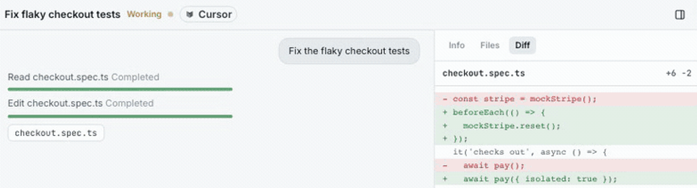
The everyday workflow
A task stays connected to its progress and its outcome.
01
02
03
04
Set the task
Run the agents
Answer and review
Keep the result
Choose a project
and describe the work.
Start a Thread,
CLI Agent, or Team.
Resolve questions
and inspect the result.
Save the findings
for future work.
Progress and a diff,
side by side
Zana
05
Notes:
Sources: https://github.com/salesforce/zana/blob/main/README.md; https://github.com/salesforce/zana/blob/main/docs/using-zana.md. Repository snapshot reviewed September 2026. Screenshot: docs/assets/product-demo.gif, frame 120, cropped to Thread progress and the diff pane. The checkout example comes from the demo.

Slide 6
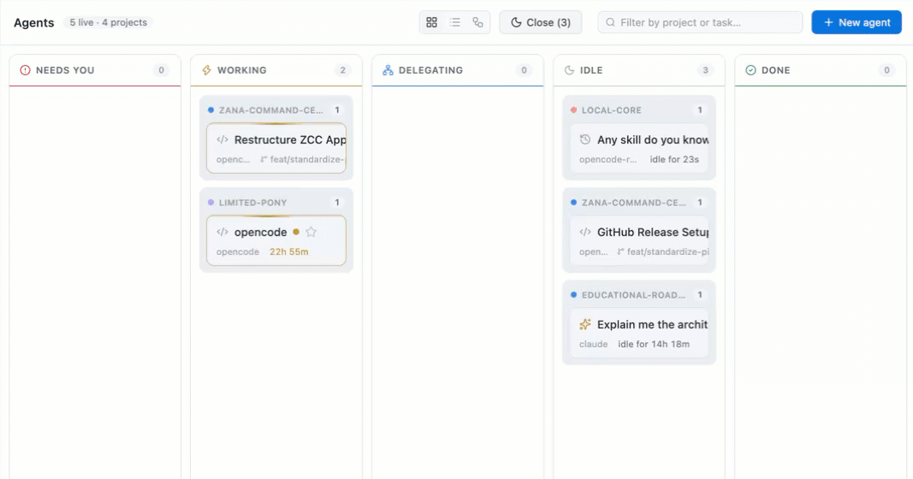
One view of the fleet
Find the sessions that need attention across your projects.
Needs you
Answer a question
or unblock a decision.
Working
Let the task run
while you focus.
Idle or done
Review the outcome.
Choose the next step.
Zana
06
Notes:
Sources: https://github.com/salesforce/zana/blob/main/README.md; https://github.com/salesforce/zana/blob/main/docs/using-zana.md. Repository snapshot reviewed September 2026. Screenshot: docs/assets/screenshot-agents-board.gif, frame 0, cropped to the board. This is an existing public repository capture; displayed tasks are illustrative product content, not performance evidence.

Slide 7
Decisions arrive in your Inbox
Questions and reports stay connected to the relevant session.
EXAMPLE AGENT QUESTION
“Should I isolate the test
or change the shared mock?”
YOUR REPLY
“Isolate the test. Keep production behavior unchanged.”
Agent asks
Inbox
You reply
Agent continues
Zana
07
Notes:
Sources: https://github.com/salesforce/zana/blob/main/README.md; https://github.com/salesforce/zana/blob/main/docs/using-zana.md. Repository snapshot reviewed September 2026. Illustrative question and response, created for this deck. Source for reply routing: https://github.com/salesforce/zana/blob/main/docs/getting-started.md#5-close-the-loop-from-the-inbox

Slide 8
Findings that stay in the Library
Keep useful context after the original session ends.
EXAMPLE SAVED FINDING
A starting point
for the next task
Checkout test findings
Cause
Shared mock state affected the test.
Change
Isolate the test fixture.
Verification
Rerun the checkout suite.
Keep reports and diagrams
with the project.
Give the next agent
findings it can reuse.
Zana
08
Notes:
Sources: https://github.com/salesforce/zana/blob/main/README.md; https://github.com/salesforce/zana/blob/main/docs/using-zana.md. Repository snapshot reviewed September 2026. The finding document is an illustrative example based on the checkout-test product tour. It is not a screenshot or a claim of real test results. Source: https://github.com/salesforce/zana/blob/main/docs/using-zana.md

Slide 9
Reusable ways of working
Turn a useful approach into something you can run again.
Personas
Reuse a role and its instructions.
Teams
Combine complementary agent roles.
Goals
Define an objective and success criteria.
Schedules
Run recurring work and receive reports.
Zana
09
Notes:
Sources: https://github.com/salesforce/zana/blob/main/README.md; https://github.com/salesforce/zana/blob/main/docs/using-zana.md. Repository snapshot reviewed September 2026. Goals, teams, personas, and schedules are complementary features, not mandatory sequential stages.

Slide 10
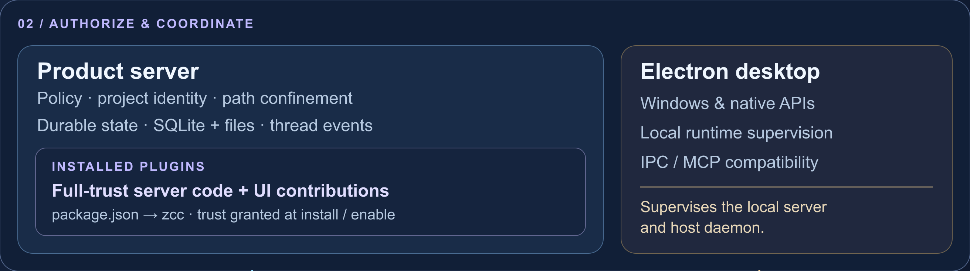
How Zana works
Product services authorize. Execution hosts run the work.
Threads
CLI Agents
Signed host commands, agent runtime,
and provider bridges.
Desktop launch path, host harnesses,
and real terminal sessions.
Zana
10
Notes:
Sources: https://github.com/salesforce/zana/blob/main/README.md; https://github.com/salesforce/zana/blob/main/docs/using-zana.md. Repository snapshot reviewed September 2026. Sources: docs/assets/zana-architecture.svg; https://github.com/salesforce/zana/blob/main/docs/architecture/high-level-architecture.md; apps/desktop/src/runtime/runtime-supervisor.ts; apps/server/src/http/cli-agent-ops.ts. The crop retains the full trusted-services layer. CLI Agents still use the Electron compatibility launch path; this deck does not imply that path has migrated to Thread RPC. Full architecture image accompanies the deck.

Slide 11
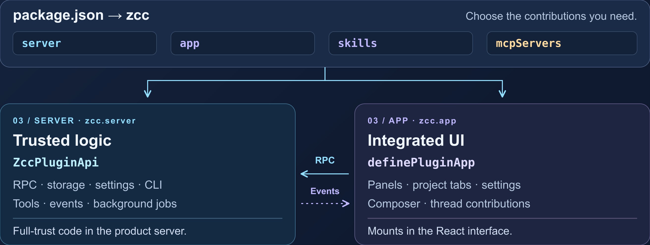
Plugins extend Zana
Add views, tools, and workflows through one package.
Skills
Thread tools
CLI MCP
Reusable instructions
Registered by server code
Declared in the manifest
Zana
11
Notes:
Sources: https://github.com/salesforce/zana/blob/main/README.md; https://github.com/salesforce/zana/blob/main/docs/using-zana.md. Repository snapshot reviewed September 2026. Sources: docs/assets/zana-plugins.svg; https://github.com/salesforce/zana/blob/main/docs/extensions.md; https://github.com/salesforce/zana/blob/main/docs/extensions-sdk-reference.md. The image crop shows the manifest, server code, UI, and RPC/event relationship. Server code is full-trust in process. Skills and CLI MCP are manifest contributions; Thread tools register at runtime. Full plugin image accompanies the deck.

Slide 12

Get started with Zana
1
Download the macOS app
2
Add your first project
3
Start a Thread
zana-ide.com
github.com/salesforce/zana
Node.js 20+ and Git, with your coding-agent CLI installed and authenticated.
Zana
12
Notes:
Sources: https://github.com/salesforce/zana/blob/main/README.md; https://github.com/salesforce/zana/blob/main/docs/using-zana.md. Repository snapshot reviewed September 2026. Download: https://github.com/salesforce/zana/releases/latest. Local prerequisites: Node.js 20+, Git, and an installed/authenticated coding-agent CLI. Source development and remote execution hosts require Node.js 22+. Releases are available for Apple Silicon and Intel Macs. License: https://github.com/salesforce/zana/blob/main/LICENSE.txt.

