Slide 1


Capstone Project:
Sales Management System for Major Education
GSP21SE12
Mr. Lai duc hung (Instructor)

Slide 2
Team members
Pham Thi Ngoc Ha (SE130460) Team Leader
Le Gia Nguyen (SE63042) Team Member
Nguyen Hoang Gia (SE63203) Team Member

Slide 3
Outline
Introduce Product Background
Techniques & Technologies
Admin’s flow – Demo
Target Schools Management flow – Demo
Reports Management flow – Demo
Demo Work-plans
Future plans

Slide 4


Who is our Customer?

Slide 5











Current workflow

Slide 6
Problems

Slide 7
Solutions
SMSME

Slide 8
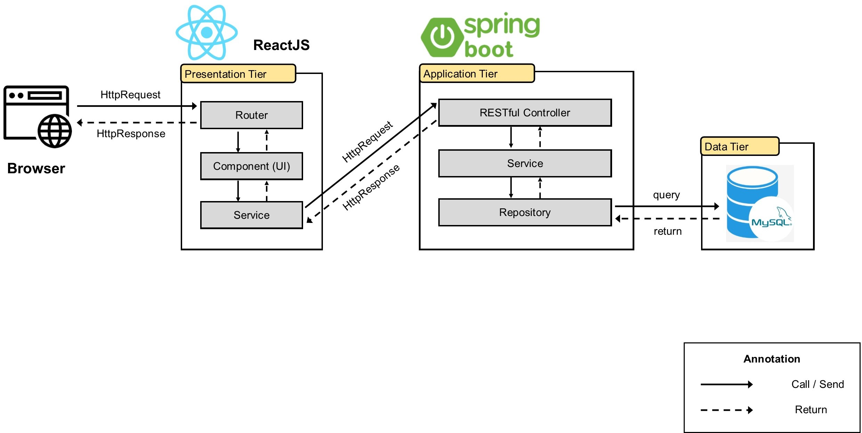
System Architecture

Slide 9





Technologies
User Interface Libraries:
Framework:
Services:

Slide 10



Admin’s flow

Slide 11
Demo
Admin’s flow

Slide 12





Target Schools Management flow
initial list
principal’s
information
updated list

Slide 13
Demo
Target Schools Management flow

Slide 14
Reports Management flow Salesman
My reports
All reports

Slide 15

Reports Management flow Manager
All reports

Slide 16
Demo
reports Management flow

Slide 17
Demo
Work-plans

Slide 18
Future plans
Support Mobile platform
Support “Contract” feature
“Salesmen ranking” feature
Integrate to Major’s current systems

Slide 19
Q & A

