Slide 1


Applied Data Mining
Preliminary data analysis Automata-based CER with FlinkCEP Logic-based CER with RTEC
Alevizopoulou Sofia 2022201704002
Avgeros Giannis 2022201704003
Tsiatsios George 2022201704024
MSC Data Science Athens 2018

Slide 2
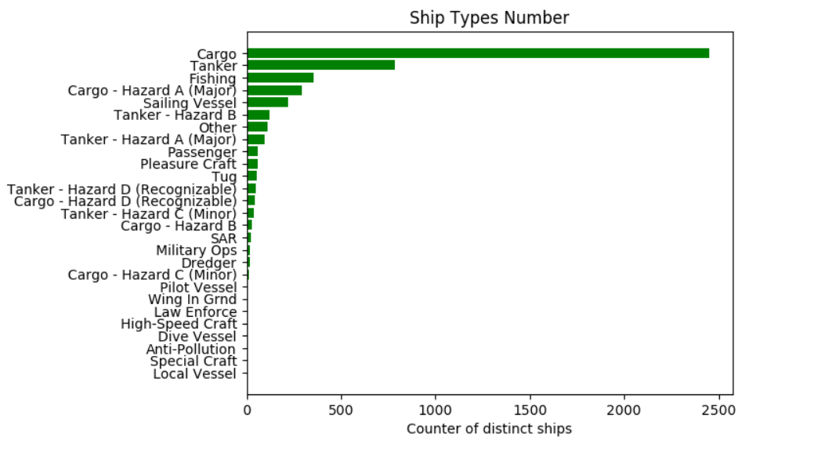
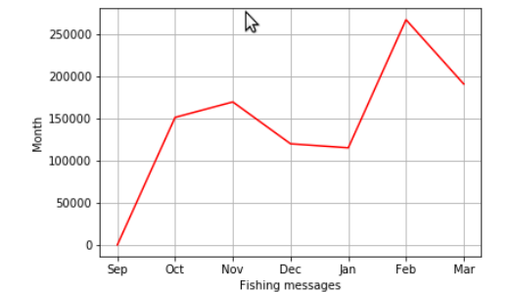
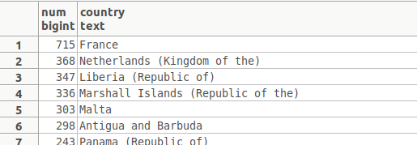
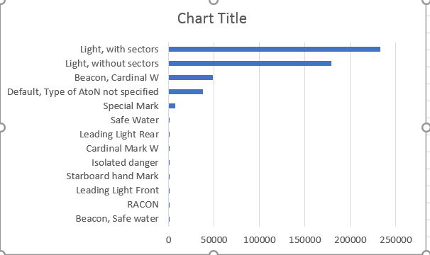
Preliminary data analysis
Simple and basic analysis by running some SQL queries
Figure 3:Fishing messages per month
Figure 5:Vessels per country
Figure 1: Vessel types
Figure 2:Type of atons
Figure 4:Fishing messages
Figure 6:Trffic per month
https://github.com/salevizo/cer.git

Slide 3
Automata-based CER with FlinkCEP [1/3]
System Deployment
Detects complex patterns in a stream of AIS messages
Monitoring of about 1000000 ais messages
AIS messages are stored in a PSQL database
A python script fetches these messages from database and saved them on a txt file
A python script reads this txt file and forward its context to a kafka topic named “AIS ”
Execution Time: more than 1h
https://github.com/salevizo/flinkcep.git

Slide 4
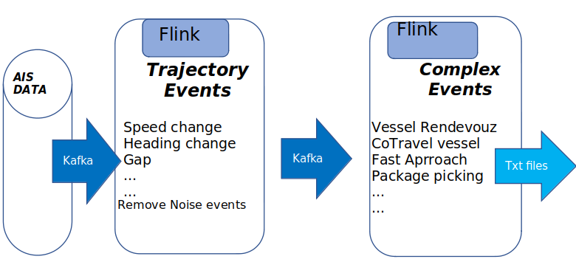
Automata-based CER with FlinkCEP [2/3]
System Deployment
Consists of 2 different jobs
1st one is used to detect trajectory events for one vessel
2nd to detect complex event for more than one vessels
based on the trajectory events that have been already
detected at the previous step
Serialize the output of 1st job to be used as input form the 2nd job
Deserialize the stream given as input at the 2nd job
https://github.com/salevizo/flinkcep.git

Slide 5
Automata-based CER with FlinkCEP [3/3]
Grid partitioning
Geohash is a geocoding system based on a hierarchical spatial
data structure which subdivides space into buckets of grid,
translates the coordinates of a vessel and check how far is
from an area or how far is from other vessels
GeoHash.encodeHash(lat,lon, geo precision)
Out of order events – Watermark
Assigning a timestamp into an event by using one of its fields instead of using the time that the event was consumed
by the system, not accept events arriving out of order
.within(Time.seconds(1200)): assigns the timestamp of the AIS message to the event
Input stream
Non Partitioned Input stream: default stream
Partioned Input stream: stream is conditioned by vessel id
Each event based on its functionality uses one of the above streams as input
Geohash precision | Cell dimension
4 | 39,1 km x 19,5 km
5 | 4,9 km x 4,9 km
6 | 1,2 km x 600,4m
7 | 152,9km x 152.4m
github.com/davidmoten/geo

Slide 6
CER with FlinkCEP – Trajectory events [1/2]
Trajectory Events
A sample AIS message that is consumed by the trajectory patterns is:
"lat":2.541122,"lon":3.90484,"mmsi":14,"status":7,"speed":30,"turn":,"heading":36,"course":13,1, "t": 1443650402
Detected trajectory events are:
Gaps in communication
Partioned input stream per vessel id
SKIP_PAST_LAST_EVENT: Discards every partial match that started after the match started but before it ended
hasn’t received an AIS message between 600 seconds an vessel is far away from a port (grid 1,2 km x 600,4m) (there is a csv file contains ports’ geohash)
Vessel speed according its type
Partioned input stream per vessel id
SKIP_PAST_LAST_EVENT
all AIS messages come from one mmsi in the time window of 30 secs have overcome the minimum or maximum speed according their type (there is a csv file contains max and min speed per vessel type)
Course of ground (COG) differentiates from the heading of a vessel
Partioned input stream per vessel id
no selection strategy
every difference bigger than 10 degrees and smaller than 60 degrees with vessel speed between 1-48.6 KNOTS (under way)

Slide 7
CER with FlinkCEP – Trajectory events [2/2]
High speed near port
Partioned input stream per vessel id
SKIP_PAST_LAST_EVENT
.times(10) .consecutive()
vessels whose speed is bigger than 5KNOTS, they are near ports (grid 1,2 km x 600,4m) and at least 10 consecutive messages of them satisfy those conditions
Long Term Stop
Partioned input stream per vessel id
SKIP_PAST_LAST_EVENT
vessel’s speed is less than 1KNOT and the next M messages, within 200 seconds are inside a predefined area (grid 1,2 km x 600,4m)
Vessels with false status
Non Partitioned input stream
no selection strategy
vessels with wrong status, for example vessels with speed more than 5KNOTS and status moored or at anchor

Slide 8
CER with FlinkCEP – Complex events [1/4]
Complex event
consumes the output of the Trajectory detection module process and recognize in real time potentially complex maritime situations
Detected Complex events are:
Two vessels co-travelling
AIS messages from 2 different vessels are between a time period of 15 seconds, the speed of the vessels should be bigger than 1KNOT and vessels should be located in the same grid (grid: 1.2 km x 600m) for more than 180 seconds
1st Flinkcep job:
Partioned input stream per vessel id
No selection strategy
all the AIS messages (for all vessels) in a time window of 35 seconds which are at the same geohash
Serialize the output to be given as input at the 2nd job
2nd Flinkcep job:
Deserialize the input
Partioned input stream per vessel id
SKIP_PAST_LAST_EVENT
Two different messages for two different ships that co-exist in the same grid, differentiated by a margin of 35 seconds. Going backwards to the accepted messages following the first rule, these messages surpass in total the 180 seconds margin

Slide 9
CER with FlinkCEP – Complex events [2/4]
Fishing Activity
Partioned input stream per vessel id
No selection strategy
2 continuous trajectory events
continuous changes of the heading (changes between 15 and 60 degrees) , followed by a gap in communication (600 seconds ) and a final turn in the end (change between 15 and 60 degrees
Vessel Rendezvous
AIS messages from 2 different vessels with gap in their communication and they are in the same geohash grid (grid: 1,2 km x 600,4m)
1st Flinkcep job:
Partioned input stream per vessel id
SKIP_PAST_LAST_EVENT
hasn’t received an AIS message between 600 seconds and the vessel is far away from a port (grid 1,2 km x 600,4m)
Serialize the output to be given as input at the 2nd job
2nd Flinkcep job:
Deserialize the input
Partioned input stream per vessel id
No selection strategy
Two different vessels with the same geohash at the same time

Slide 10
CER with FlinkCEP – Complex events [3/4]
Adrift
Vessels that may have a problematic route, suspicious difference between heading and course of ground (trajectory events)
1st Flinkcep job:
Partioned input stream per vessel id
no selection strategy
every difference bigger than 10 and smaller than 60 degrees and vessel speed between 1-48.6 KNOTS (under way)
Serialize the output to be given as input at the 2nd job
2nd Flinkcep job:
Deserialize the input
Partioned input stream per vessel id
SKIP_PAST_LAST_EVENT
Two consecutive messages for a vessel must be on a time range of 20 seconds. Going backwards to the accepted messages these messages surpass in total the 180 seconds margin. Base event is considered the latest, and we move iteratively backwards until we find a series of messages that the difference between an event and the base event is more than 120 seconds.

Slide 11
CER with FlinkCEP – Complex events [4/4]
Package Picking
One of the vessel drops a package at some area and another vessel appears later in order to pick it up. Vessles that have long stops in the same area where the package picking is possible, this area is away from ports
1st Flinkcep job:
Partioned input stream per vessel id
SKIP_PAST_LAST_EVENT
vessel’s speed is less than 1KNOT and the next M messages, within 200 seconds are inside a predefined area (grid 1,2 km x 600,4m)
Serialize the output to be given as input at the 2nd job
2nd Flinkcep job:
Deserialize the input
No Partioned input stream per vessel id
No selection strategy
Time difference between the vessels to be in the same geohash area is 60 seconds
Loitering
Partioned input stream per vessel id
No selection strategy
2 continuous trajectory events
Vessel remaining in a particular area (grid: 1,2 km x 600,4m) for a long period 1800 seconds without purpose. Vessels with low speed, anchored or moored are filtered out

Slide 12
CER with FlinkCEP – Empirical evaluation
Empirical Evaluation

Slide 13
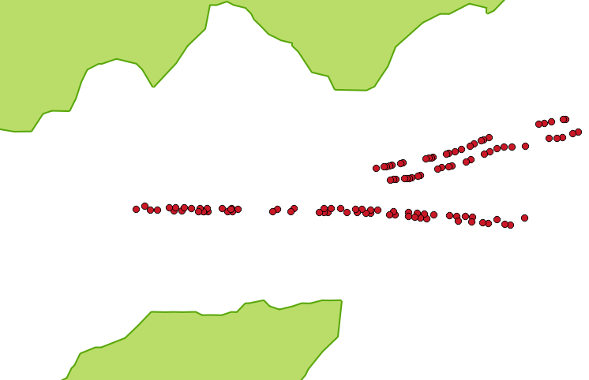
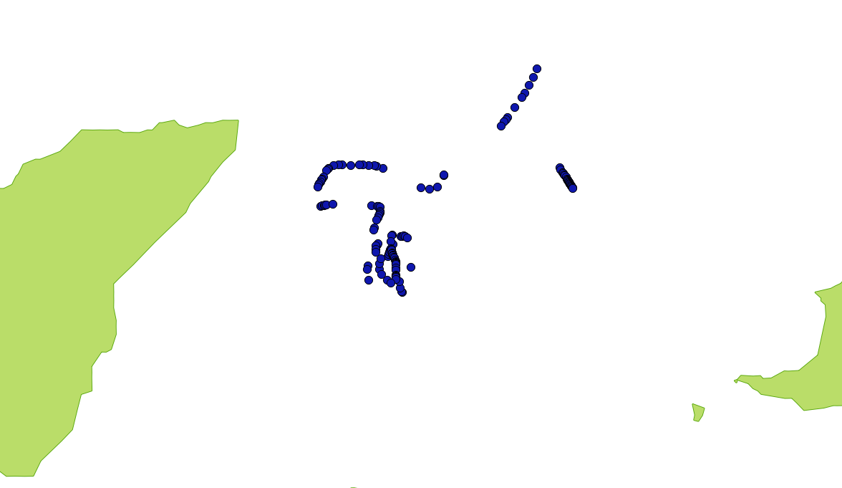
CER with FlinkCEP – Visualization [1/4]
Cotraveling Activity
Adrift Activity
Cotraveling Activity, 7 mmsis detected
Adrift Activity

Slide 14


CER with FlinkCEP – Visualization [2/4]
High speed near port
Geohash index 6 (1.2km x 609.4m near port), 6 mmsis detected
Geohash index 5 (4.9km x 4.9km near port), 108 mmsis detected

Slide 15
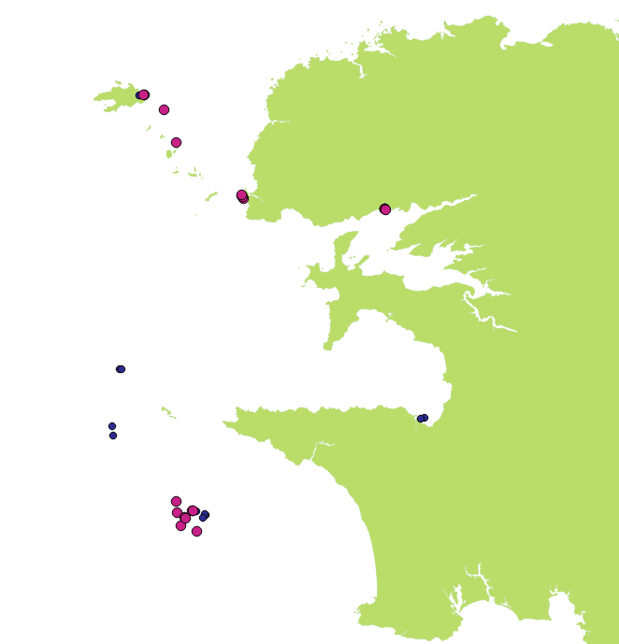
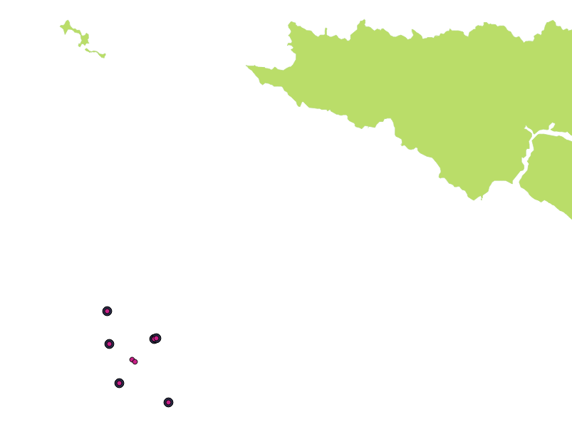
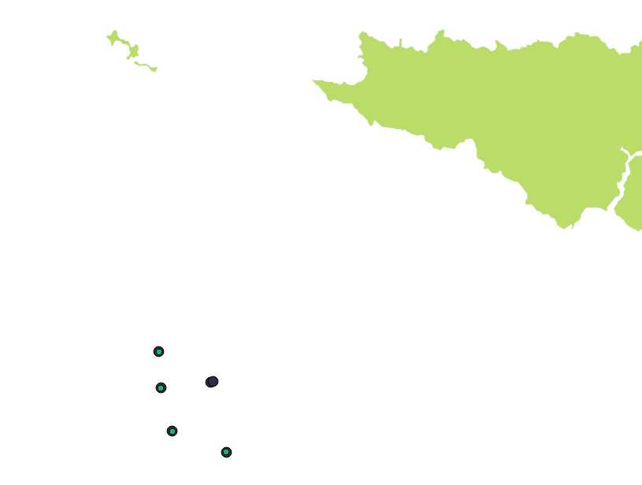
CER with FlinkCEP – Visualization [3/4]
Fishing Activity
Blue: 300 secs gap in communication, 16 events
Purple: 600 secs gap in communication, 10 events
Purple: 600 secs gap in communication, 10 events
Black: 900 secs gap in communication, 9 events
Black: 900 secs gap in communication, 9 events
Green:1200 secs gap in communication, 8 events

Slide 16
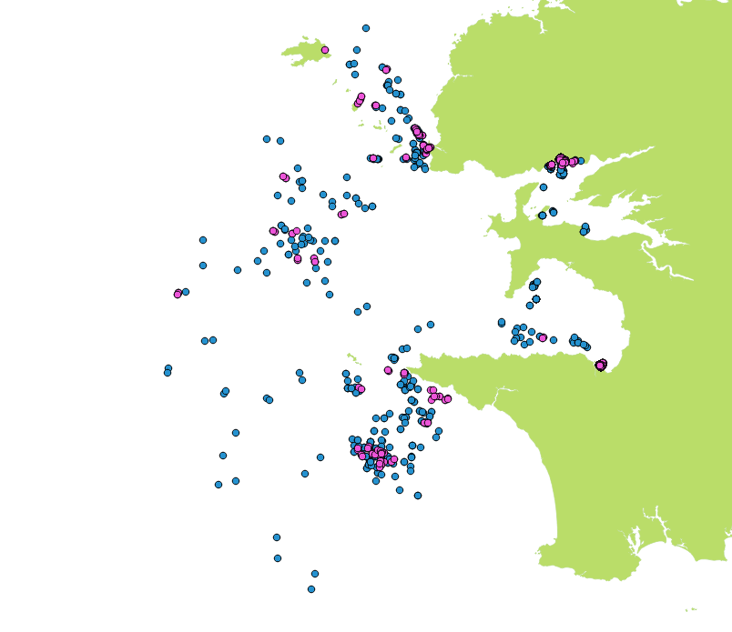
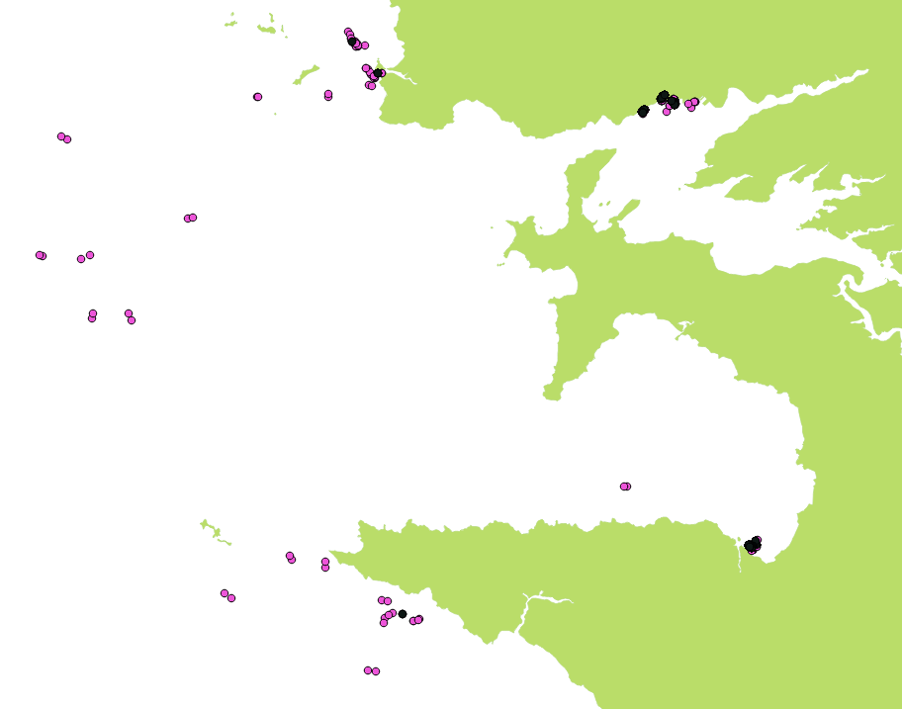
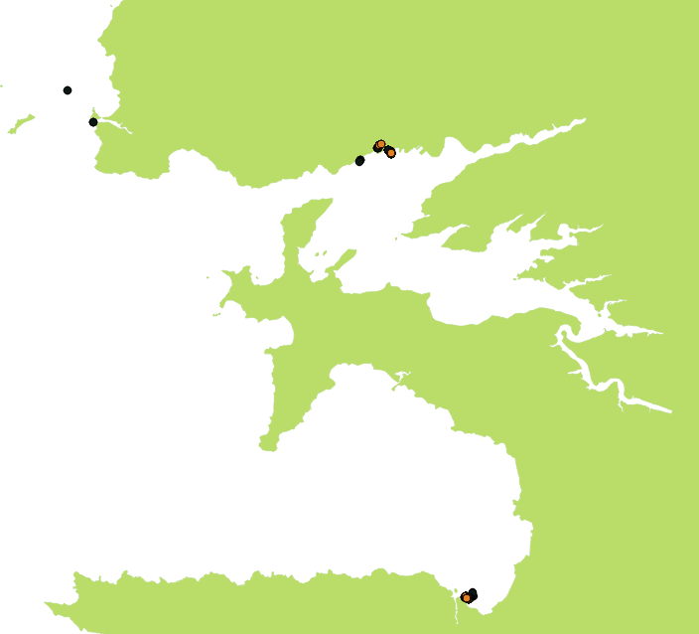
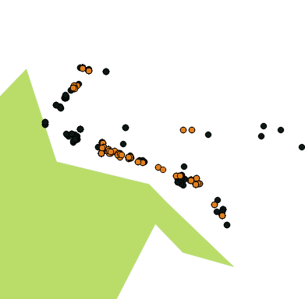
CER with Flink – Visualization [4/4]
Vessel rendezvous
Blue: Geohash grid of 4.9km x 4.9km, 476 events
Purple : Geohash grid of 1.2km x 609.4m, 432 events
Purple : Geohash grid of 1.2km x 609.4m, 432 events
Black: Geohash grid of 152m x 152m, 195 events
Black: Geohash grid of 152m x 152m, 195 events
Yellow : Geohash grid of 38.2m x 19m, 58events

Slide 17
Logic-based CER with RTEC
System deployment
Online monitoring system
Uses the prolog patterns which have been compiled
Its input file contains critical events ( trajectory events written on a txt file)
Consists of:
a function ‘continuousER’ that executes all the prolog patterns on the given critical events
run the monitoring systems for window size 600secs in order to do the same executions as we have already done on flinkcep
Monitoring of about 1048576 critical events
Execution Time: less than 1h
https://github.com/salevizo/flinkcep.git

Slide 18
CER with RTEC - Trajectory events
Trajectory Events
critical events related to the time period ['1443650402','1444660250’]
A python script filters the critical events in order to cover the same time period like FlinkCep
A sample trajectory message that is consumed by the patterns written for complex event detection is:
Event, timestamp_start, timestamp_end, mmsi, other_info_describes_the_critical_event
Below are listed some of the trajectory events that are implemented
coord
velocity
slow_motion_end
entersArea
slow_motion_start
…

Slide 19
CER with RTEC - Complex events
Complex event
consumes the output of the Trajectory detection module process and recognize in real time potentially complex maritime situations
Below are listed the complex events which are implemented
gap
stopped
changingSpeed
withinArea
underWay
highSpeedNearCoast
anchored or moored
anchored or moored
Movement ability affected
adrift
rendezVous
fishing
lowspeed

Slide 20
CER with RTEC – Window sizes
Running patterns for different window size
Bigger window size
less trajectory events are detected
patterns become stricter
Detected events come from complex events whose duration is bigger are more
Example:
300 secs as window size only 2 rendezvous events are detected
600 secs, 45 events are detected
Detected event | 300 secs | 600 secs
gap | 82003 | 41508
stopped | 25064 | 25299
changingSpeed | 6456 | 7281
atAnchorOrMoored | 3821 | 3726
fishing | 2969 | 5625
adrift | 2367 | 5103
speedLTMin | 34589 | 21447
highSpeedNearCoast | 168 | 252
rendezVous | 2 | 45

Slide 21
CER with RTEC vs CER with flinkCEP
FlinCEP outcomes VS RTEC outcomes for 2 patterns
﻿ High Speed near port / coast
Rendezvous
Monitoring System | Detected events
FlinkCep – near port | 41
RTEC – near coast | 252
Monitoring System | Detected events
FlinkCep | 58
RTEC | 45

Slide 22
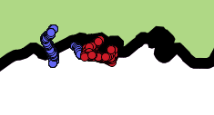
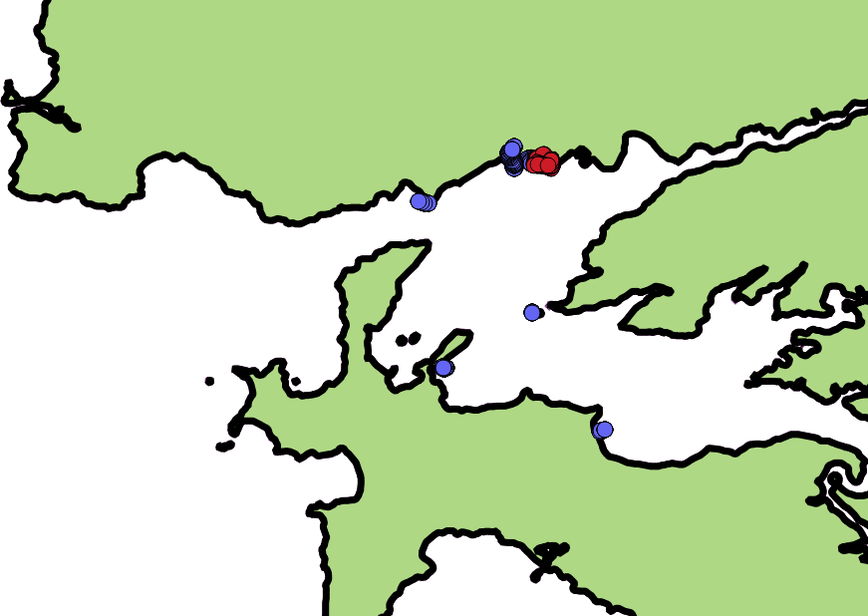
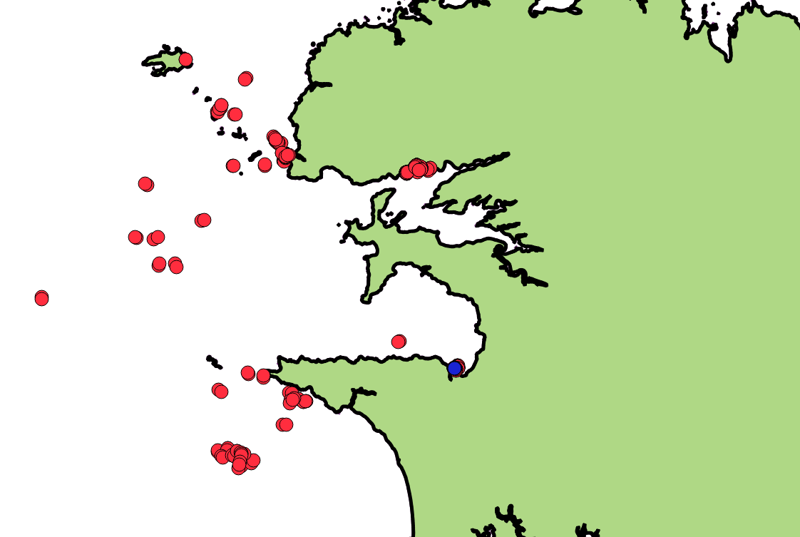
CER with RTEC vs CER with flinkCEP – Visualizations [1/2]
High Speed Near Coast
Vessel rendezvous
Cotraveling activity (7 mmsis)
Adrift activity
Blue: RTEC, 252 events - Red: FlinkCEP, 41 events
Blue: RTEC, 45 events - Red: FlinkCEP, 58 events

Slide 23
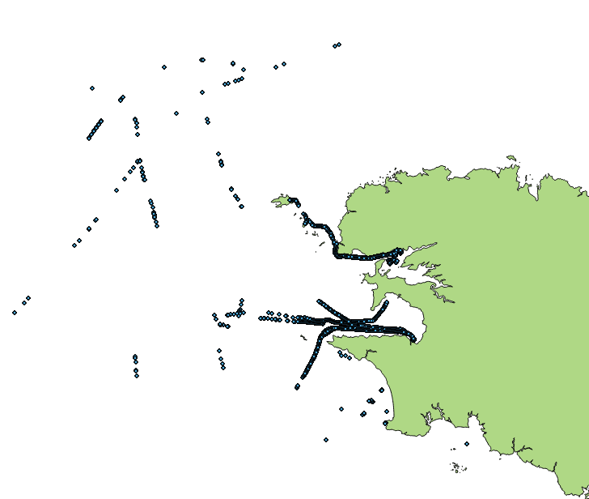
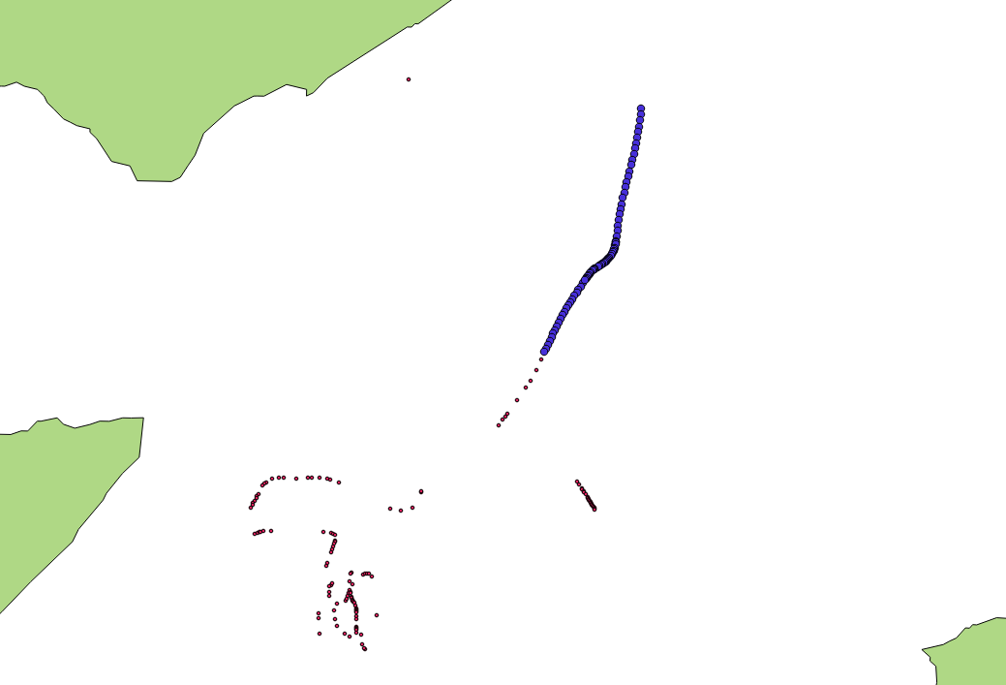
CER with RTEC vs CER with flinkCEP – Visualizations [2/2]
Adrift Activity
Adrift activity
Adrift activity from RTEC
Adrift for mmsi: 228064900, blue: RTEC, Red: FlinkCEP

Slide 24
Repositories
https://github.com/salevizo/cer.git
https://github.com/salevizo/flinkcep.git
https://github.com/salevizo/rtec.git

Slide 25

Thank you

