Slide 1


Applied Data Mining
Alevizopoulou Sofia 2022201704002
Avgeros Giannis 2022201704003
Tsiatsios George 2022201704024
MSC Data Science Athens 2018

Slide 2
Preliminary data analysis Automata-based CER with FlinkCEP Logic-based CER with RTEC

Slide 3
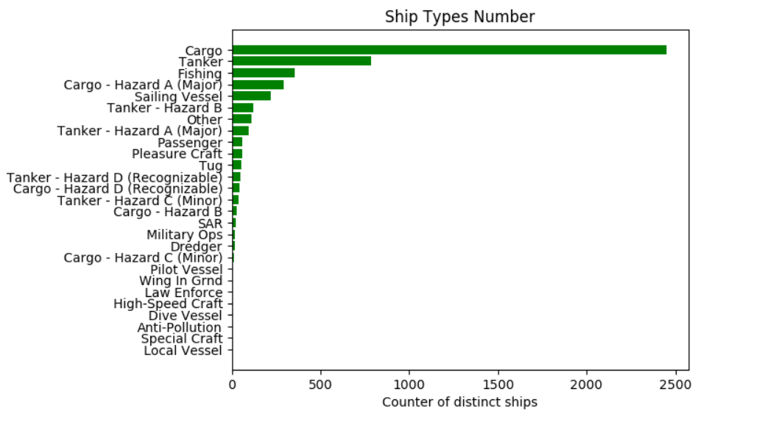
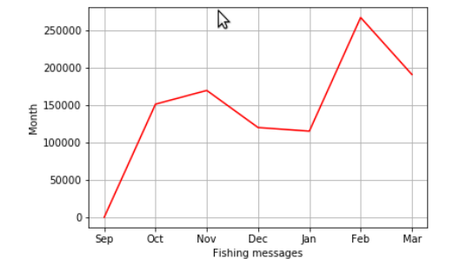
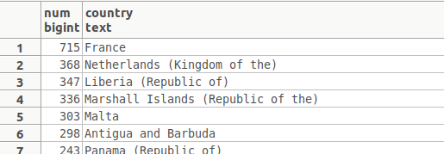
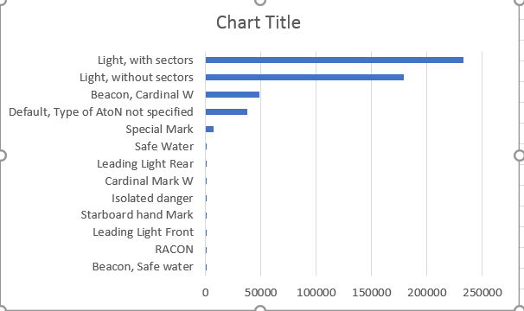
Preliminary data analysis
Simple and basic analysis by running some SQL queries
Figure 3:Fishing messages per month
Figure 5:Vessels per country
Figure 1: Vessel types
Figure 2:Type of atons
Figure 4:Fishing messages
Figure 6:Trffic per month
https://github.com/salevizo/cer.git

Slide 4
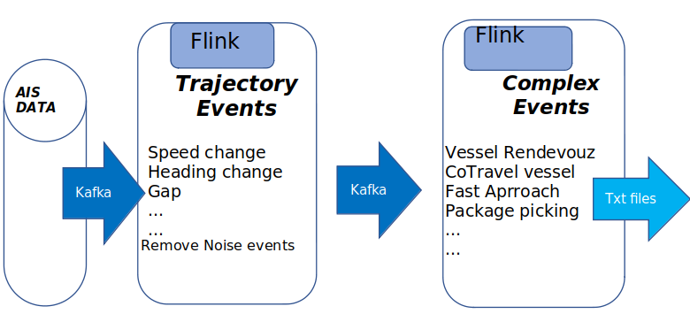
Automata-based CER with FlinkCEP [1/2]
System Deployment
Detects complex patterns in a stream of AIS messages
AIS messages are stored in a PSQL database
A python script has been written in order to fetch these messages from database and forward them to a kafka topic named “AIS ”
Consists of 2 different jobs
1st one is used to detect trajectory events for one vessel
2nd to detect complex event for more than one vessels
based on the trajectory events that have been already
detected at the previous step
https://github.com/salevizo/flinkcep.git

Slide 5
Automata-based CER with FlinkCEP [2/2]
Grid partitioning
Geohash is a geocoding system based on a hierarchical spatial data structure which subdivides space into buckets of grid translate the coordinates of a vessel and check how far is from an area or how far is from other vessels
Watermark
Assigning of a timestamp into an event by using one of its fields instead of using the time that the event was consumed by the system
Precision | Cell dimension
4 | 39,1 km x 19,5 km
5 | 4,9 km x 4,9 km
6 | 1,2 km x 600,4m
7 | 152,9km x 152.4m
github.com/davidmoten/geo

Slide 6
CER with FlinkCEP – Trajectory events
Monitoring of about 1000000 ais messages
Execution Time: more than 1h
Trajectory Events
A sample AIS message that is consumed by the patterns written for trajectory detection is:
"lat":2.541122,"lon":3.90484,"mmsi":14,"status":7,"speed":30,"turn":,"heading":36,"course":13,1, "t": 1443650402
Below are described the trajectory events we have implemented
Gaps in communication
Vessel speed according its type
Adrift - Course of ground (COG) differentiates from the heading of a vessel
High speed near port
Long Term Stop
Vessels with false status

Slide 7
CER with FlinkCEP – Complex events
Complex event
consumes the output of the Trajectory detection module process the results and recognize in real time potentially complex maritime situations
Below are described the complex events we have implemented
Two vessels co-travelling
Fishing Activity
Vessel Rendezvous
Adrift
Package Picking
Loitering

Slide 8
CER with FlinkCEP – Empirical evaluation
Empirical Evaluation
Rendezvous
Illegal Fishing
Speed near port
GeoHash | Detected events
5 4.9km x 4.9km | 476
6 1.2km x 609.4m | 432
7 152m x 152m | 195
8 38.2m x 19m | 58
GeoHash for near port | Detected events
5 4.9km x 4.9km | 1545
6 1.2km x 609.4m | 41
7 152m x 152m | 0
8 38.2m x 19m | 0
Seconds of gap in a suspected fishing activity(max 1200) | Detected illegal fishing events
300 | 16
600 | 10
900 | 9
1200 | 8

Slide 9
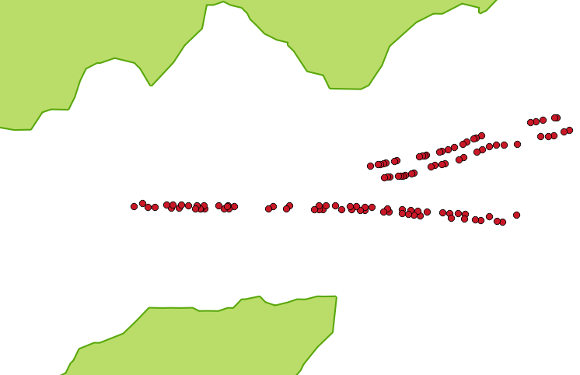
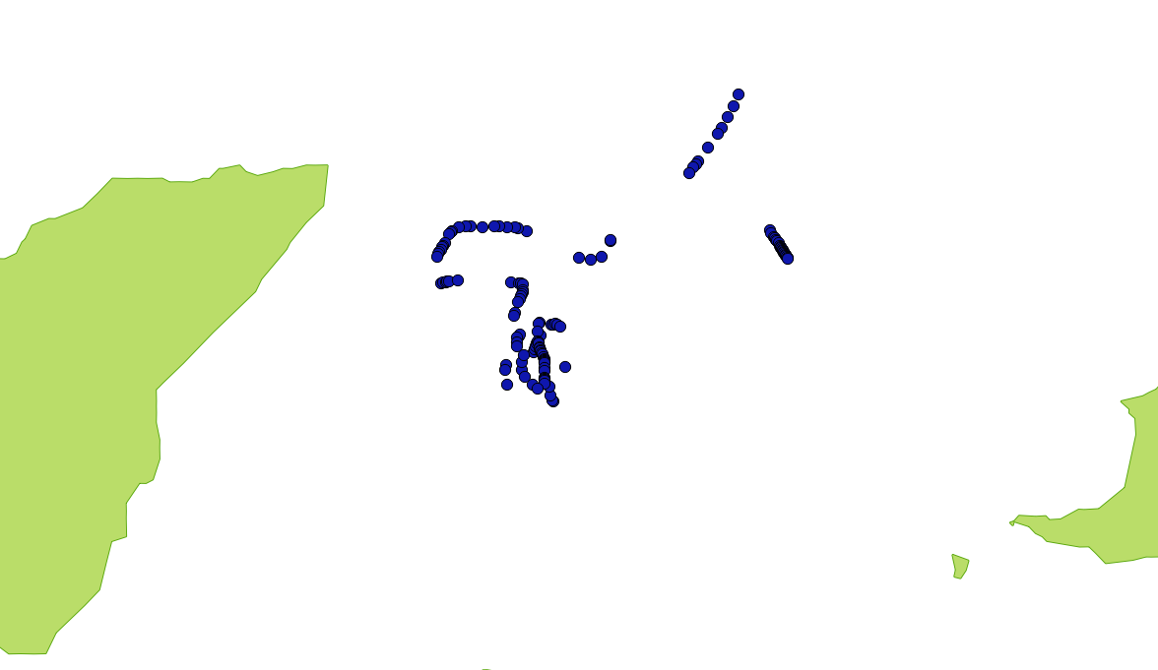
CER with FlinkCEP – Visualization [1/4]
Cotraveling Activity
Adrift Activity
Cotraveling activity (7 mmsis)
Adrift activity

Slide 10


CER with FlinkCEP – Visualization [2/4]
High speed near port
geohash index 6 (1.2 km x 609.4 m near port) -6 mmsis
geohash index 5 (4.9 km x 4.9km near port) - 108 mmsis

Slide 11
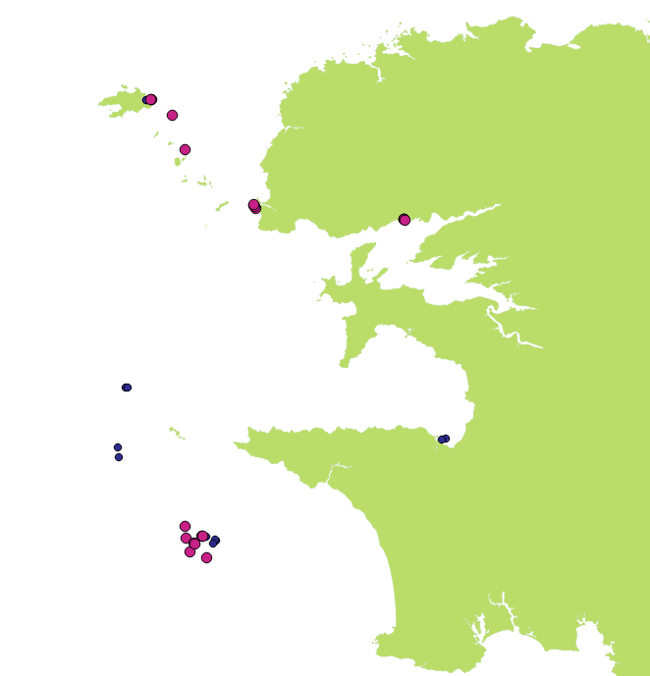
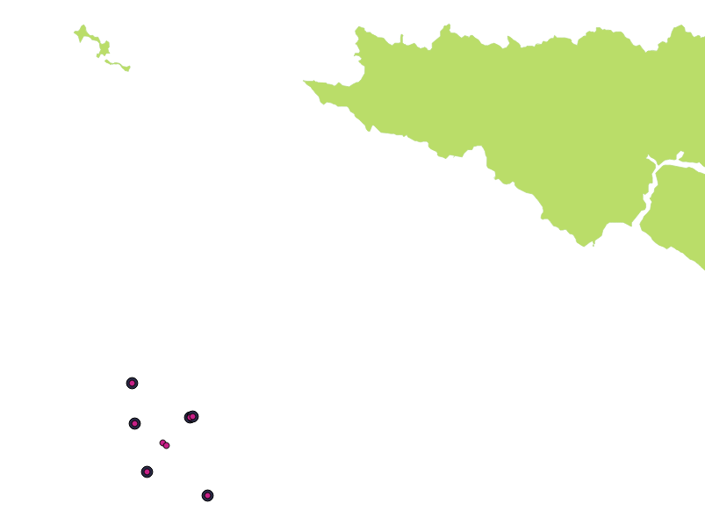
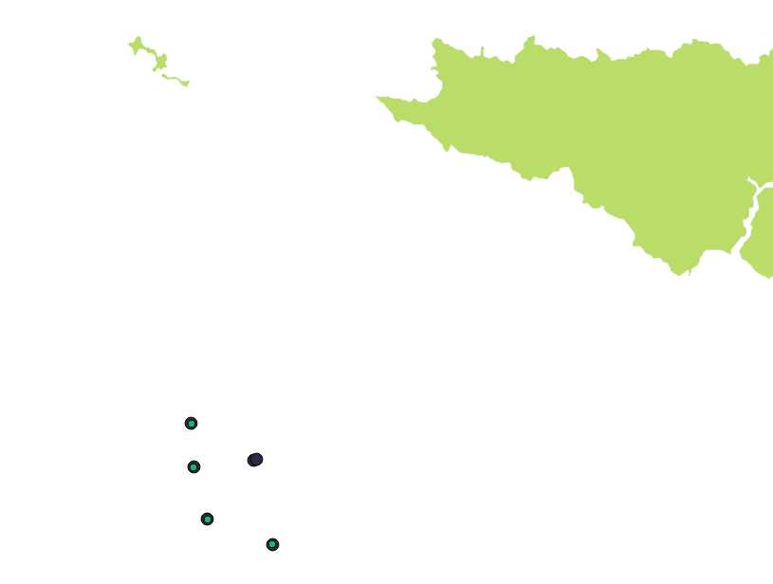
CER with FlinkCEP – Visualization [3/4]
Fishing Activity
300 – 600 seconds gap in communication (blue:300 sec – 16 events, purle:600 secs – 10 events)
600 – 900 seconds gap in communication (purple:600 secs – 10 events, black:900 secs – 9 events)
Fishing activity, 900 - 1200 seconds gap in communication (green:1200 secs - events, black:900 secs – 9 events)

Slide 12
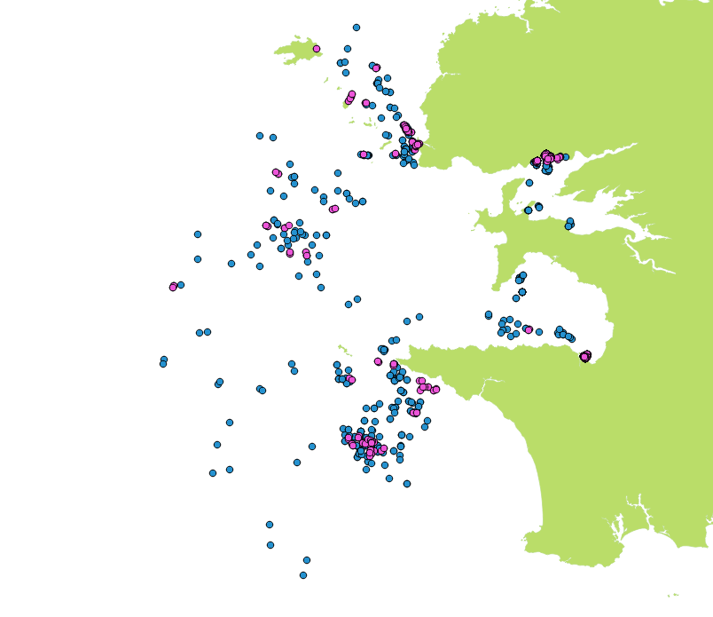
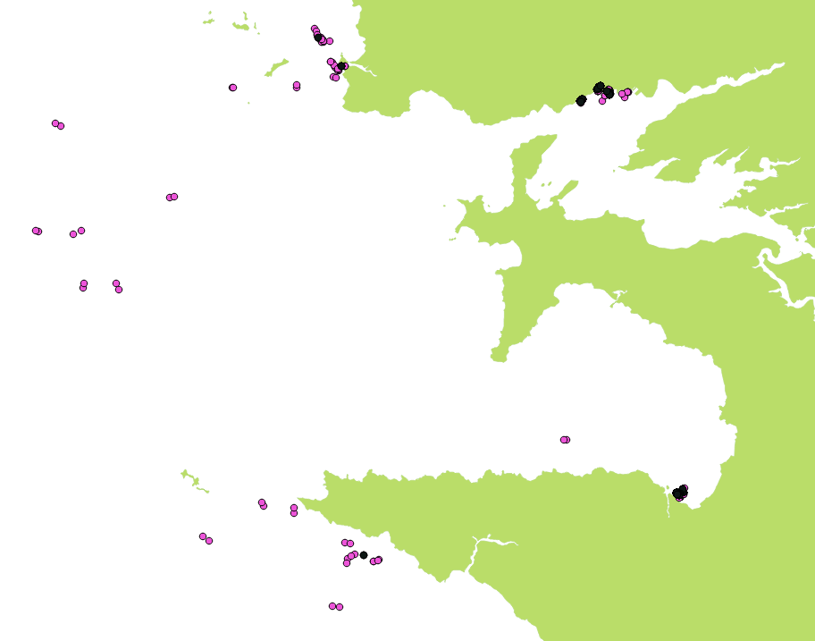
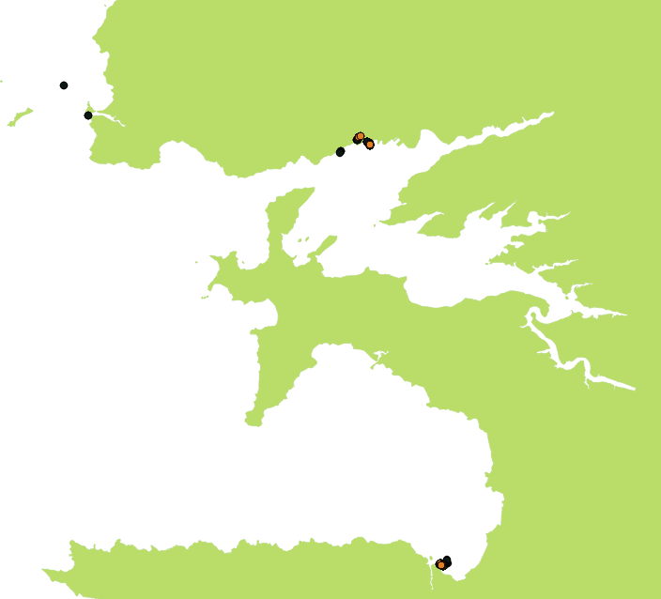
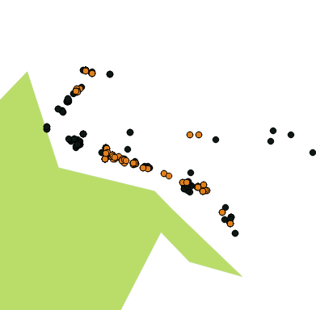
CER with Flink – Visualization [4/4]
Vessel rendezvous
blue: grid of 4.9km x 4.9km – 209 events, purple: grid 1.2km x 609.4m – 179 events
black: grid of 152 m x 152m – 195 events , purple: grid 1.2km x 609.4m – 432 events
black: grid of 152 m x 152m – 195 events , yellow: grid 38,2 m x 19m – 58 events

Slide 13
Logic-based CER with RTEC
System deployment
Online monitoring system
Uses the prolog patterns which have been compiled
Its input file contains critical events ( trajectory events written on a txt file)
Consists of:
a function ‘continuousER’ that executes all the prolog patterns on the given critical events
run the monitoring systems for window size 600secs in order to do the same executions as we have already done on flinkcep
Monitoring of about 1048576 critical events
Execution Time: less than 1h
https://github.com/salevizo/flinkcep.git

Slide 14
CER with RTEC - Trajectory events
Trajectory Events
critical events related to the time period ['1443650402','1444660250’]
same duration has been used for the ais message on flinkCEP
Input of the monitoring system
A sample trajectory message that is consumed by the patterns written for complex event detection is:
Event, timestamp_start, timestamp_end, mmsi, other_info_describes_the_critical_event
Below are described some the trajectory events that are implemented
coord
velocity
slow_motion_end
entersArea
slow_motion_start
…

Slide 15
CER with RTEC - Complex events
Complex event
consumes the output of the Trajectory detection module process the results and recognize in real time potentially complex maritime situations
Below are described the complex events we have implemented
gap
stopped
changingSpeed
withinArea
underWay
highSpeedNearCoast
anchored or moored
anchored or moored
Movement ability affected
adrift
rendezVous
fishing
lowspeed

Slide 16
CER with RTEC – Window sizes
Running patterns for different window size
Bigger window size
less trajectory events are detected
patterns become stricter
Detected events come from complex events whose duration should be bigger are more
Example:
300 secs as window size only 2 rendezvous events are detected
600 secs, 45 evets are detected
Detected event | 300 secs | 600 secs
gap | 82003 | 41508
stopped | 25064 | 25299
changingSpeed | 6456 | 7281
atAnchorOrMoored | 3821 | 3726
fishing | 2969 | 5625
adrift | 2367 | 5103
speedLTMin | 34589 | 21447
highSpeedNearCoast | 168 | 252
rendezVous | 2 | 45

Slide 17
CER with RTEC vs CER with flinkCEP
FlinCEP outcomes VS RTEC outcomes
﻿ High Speed near port / coast
Rendezvous
Monitoring System | Detected events
FlinkCep – near port | 41
RTEC – near coast | 252
Monitoring System | Detected events
FlinkCep | 58
RTEC | 45

Slide 18
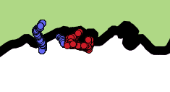
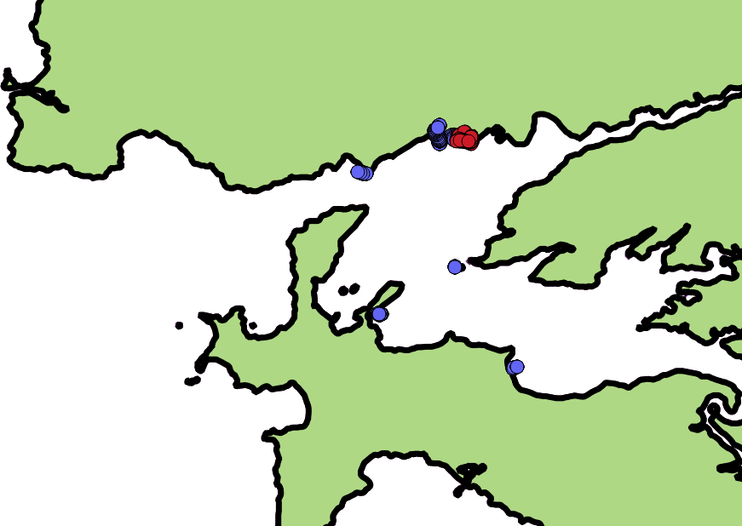
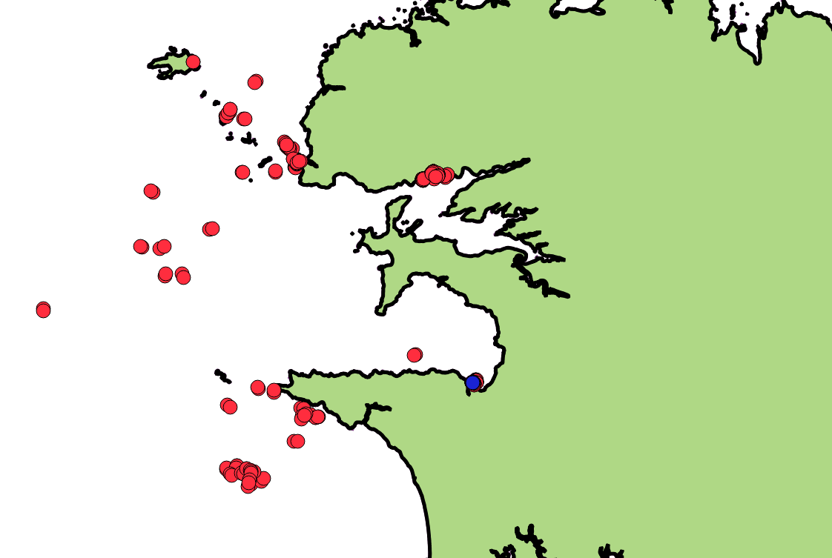
CER with RTEC – Visualization [1/2]
High Speed Near Coast
Vessel rendezvous
Cotraveling activity (7 mmsis)
Adrift activity
blue: RTEC -252 events, red :flinkcep -41 events
blue: RTEC -45 events, red :flinkcep -58 events

Slide 19
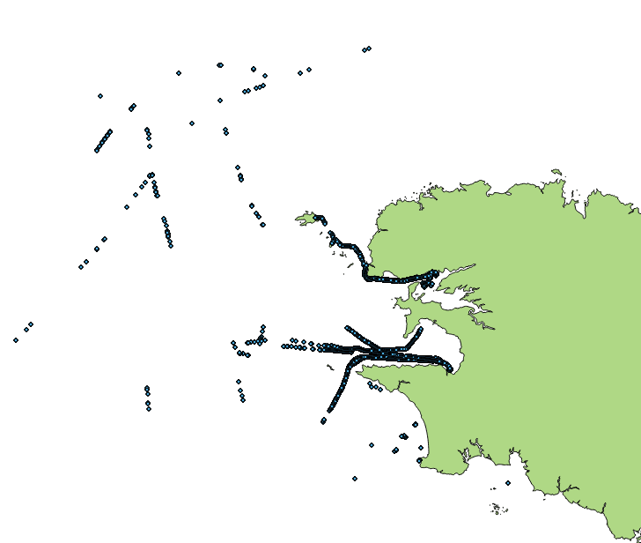
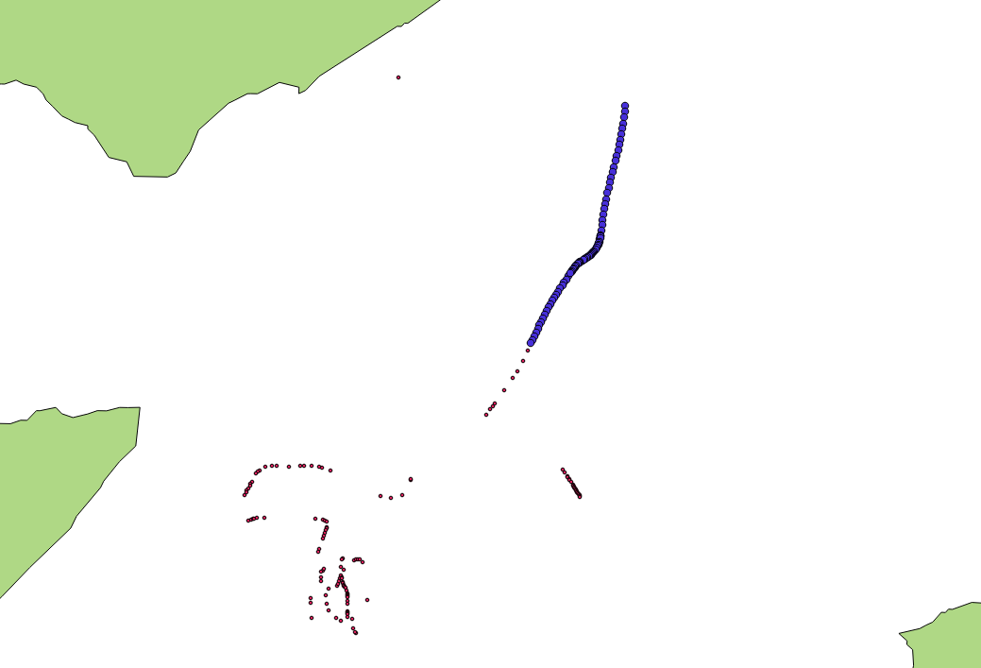
CER with RTEC – Visualization [2/2]
Adrift Activity
Adrift activity
Adrift from RTEC
mmsi: 228064900 - blue: RTEC, red: flinkCEP

Slide 20
Repositories
https://github.com/salevizo/cer.git
https://github.com/salevizo/flinkcep.git
https://github.com/salevizo/rtec.git

Slide 21

Thank you

