Slide 1


Slide 2
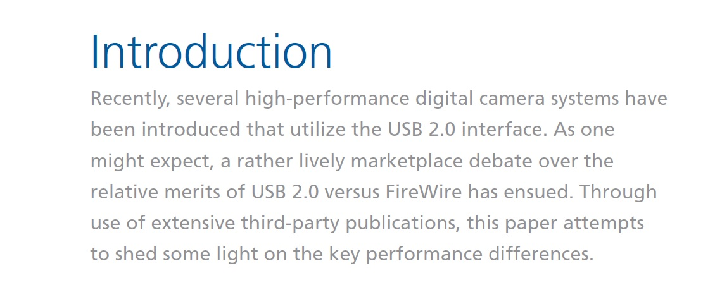

Slide 3
USB Technology Considerations
Computers and their peripherals became obsolete quicker than they could be made because they could not handle the fast development of processors and peripherals.
The drastic drop in computer prices made them more disposable and less attractive to upgrade.
Users and manufacturers were taking chances about what to include or exclude in their systems.
Something had to be done to make peripherals more compatible and computer systems more versatile and less complex .

Slide 4
USB Development
Since the introduction of the IBM PC in 1983,computers came equipped with serial, parallel, keyboard, mouse, SCSI and Ethernet ports.
USB and Operating Systems : The USB standard allows peripheral devices — items being plugged into the computer — to be self-configuring. This allows the user to plug in a USB device and lay the burden of installing the proper drivers to support the installed hardware on the operating system.

Slide 5
The Problem with USB
The biggest problem with USB is that the computer will have a current limit on the USB port. Most USB devices are powered from the USB connector, and the power that each peripheral device demands is not always clear. This means that plugging several peripherals that draw power from the USB may affect the performance of some of the peripherals if one demands more power than the others.
Another problem with USB ports is its speed limit. The USB ports have only 12Mbps speed (USB version 1.1). Even an old SCSI 1 external port is faster than it (SCSI 1 external port’s speed is 40Mbps). When a user tries to connect an external CD-ROM or CD-RW, scanner or a new high-resolution digital camera to a USB port, the transmission speed becomes very slow. As a result, there are still some devices that are utilizing SCSI ports to transmit the data to the computer. Finally, many USB devices run at 1.5Mbps, only a few are rated at 12Mbps.

Slide 6
FireWire Features
FireWire cable has an important feature in that the cable itself provides power supply to its device.
By using the 6-pin cable, the device does not need an extra power supply cable. The device will get the power from the computer.
FireWire uses isochronous data transmission that transfers data as a packet in digital form, which provides higher quality and greater reliability.
FireWire is best used in computers for transferring streaming video and audio because of its very high data transfer rate.

Slide 7
FireWire will replace the traditional A/V cable in the near future because of the increasing use of home networking.
With FireWire, all audiovisual and electronic products in a house can be connected to each other and inter-communicate.
It will facilitate connecting the stereo system to the computer, the VCR, the DVD player and the HDTV. The data or signals will be sent in high-quality digital form.
In the past, audio and video signals were transmitted in analog form. The environment and the length of the cable easily distorted analog signals. Even when the digital coaxial cable was developed to transfer the data in digital form, there were some limitations.
The major downside was the signal conversion from digital to analog or vice versa. Another weakness was that the A/V cable needed three lines: one for video signal and two for the left and right audio channels.
Furthermore, the S-video cable was developed to transfer the video signal in digital form, but it still needed other cables for the audio signal.

Slide 8
Nowadays, FireWire technology is the standard for transferring data from digital cameras or camcorders directly to the computer in order to edit, save, or transmit over the network or the Internet.
FireWire makes connection between computers and peripheral devices easier and satisfies consumer needs. FireWire is also used for connecting the computer 8 with the external hard drives or storage devices that require more data reliability, accuracy, and easy access.
FireWire bus provided a great advantage over its rival the SCSI bus which required connecting devices serially (daisy-chain) with a termination point. FireWire did not need a termination point. SCSI also required from the user to assign IDs for each device in order to prevent conflict among devices. FireWire can be connected in multiple configurations and automatically assigns the ID for each device connected to the bus.

Slide 9
FireWire can send a combination of digital signals, including audio, video, MIDI, and the control commands.
This distinguishes the FireWire from other systems which transmit only a single signal type.
Digital Video camera use DV format that exceed the quality of S-VHS. DV format gives very high resolution, bright with excellent depth and contrast image. It is stored in digital form, so it can be copied repeatedly without loss.
IEEE 1394 has the protocol that can transfer DV signal data to the PC and give the exact digital copy from the original source.

Slide 10
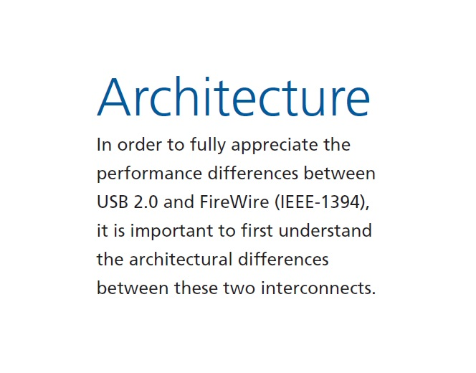

Slide 11

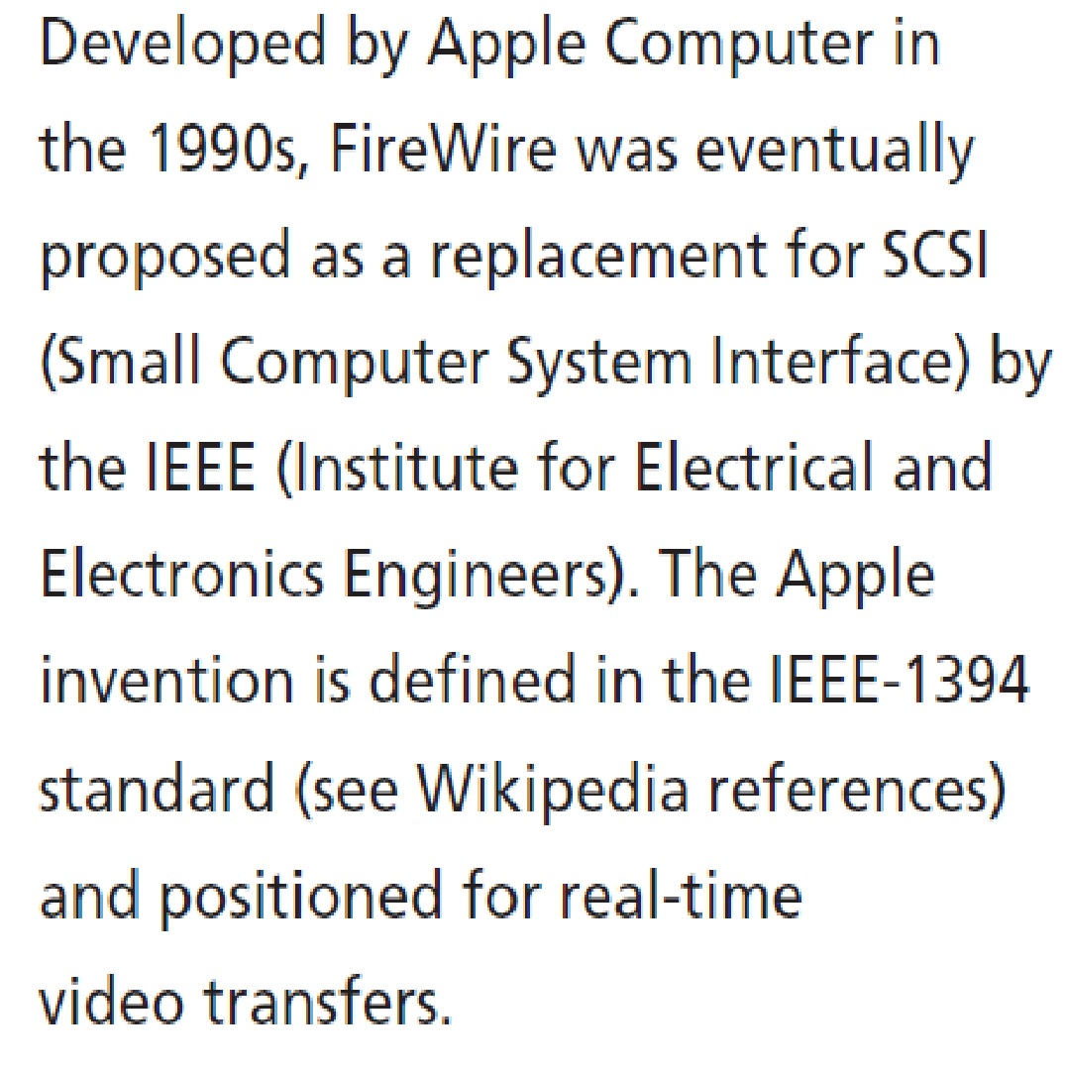
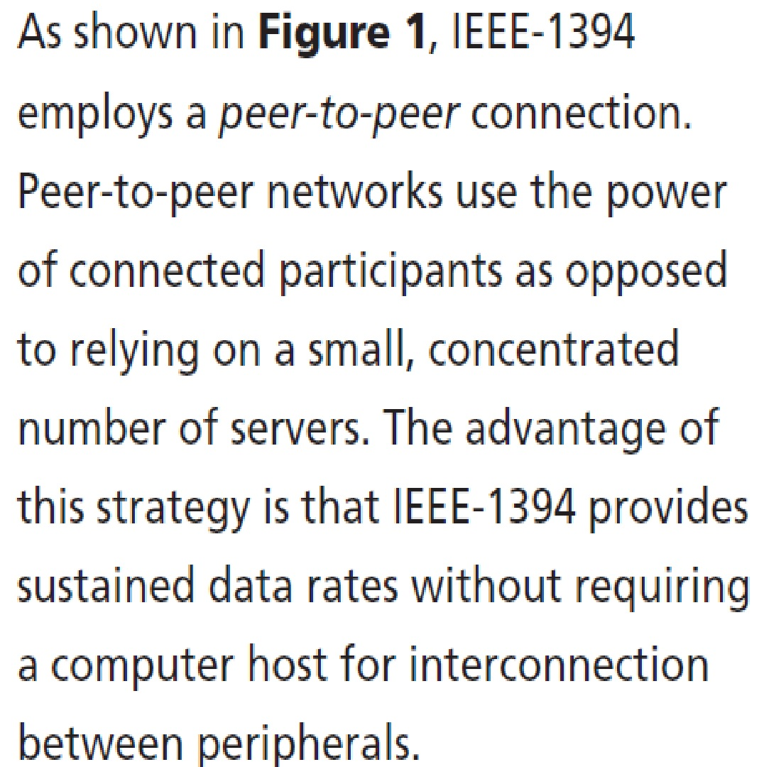

Slide 12
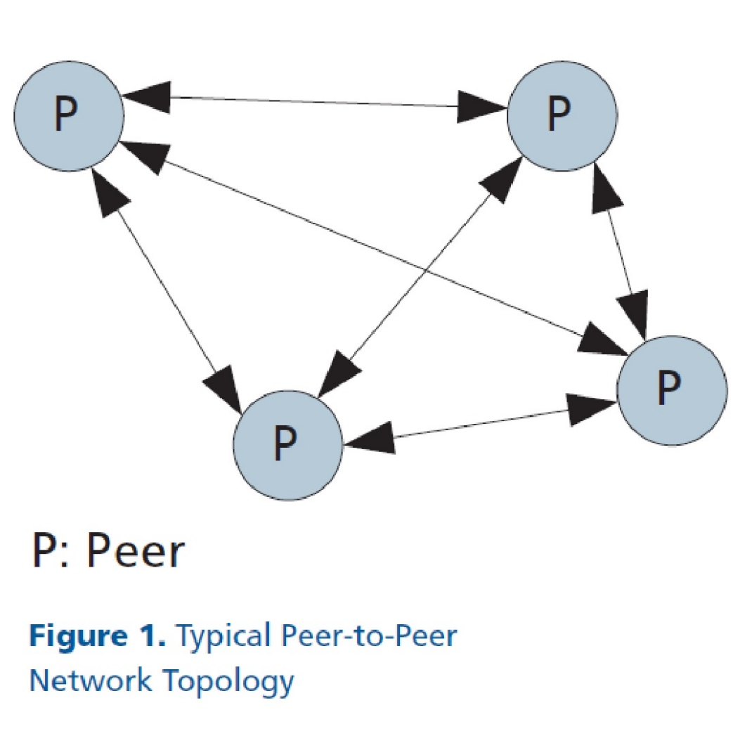

Slide 13

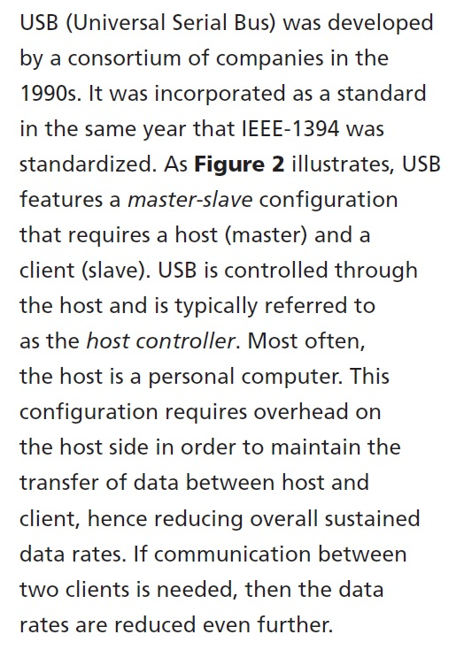
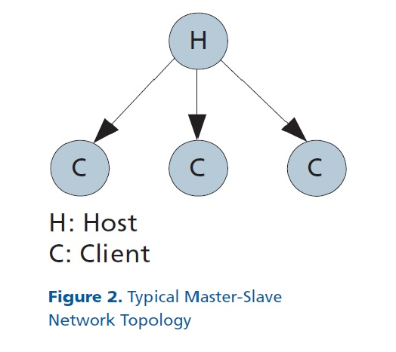

Slide 14


Slide 15
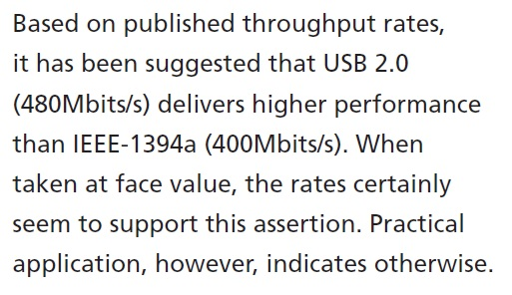
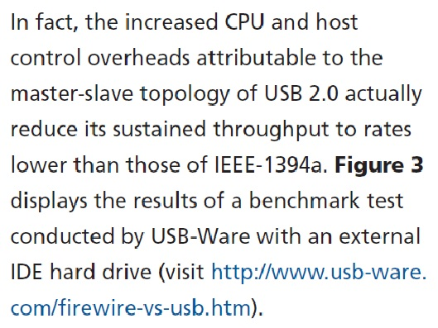

Slide 16
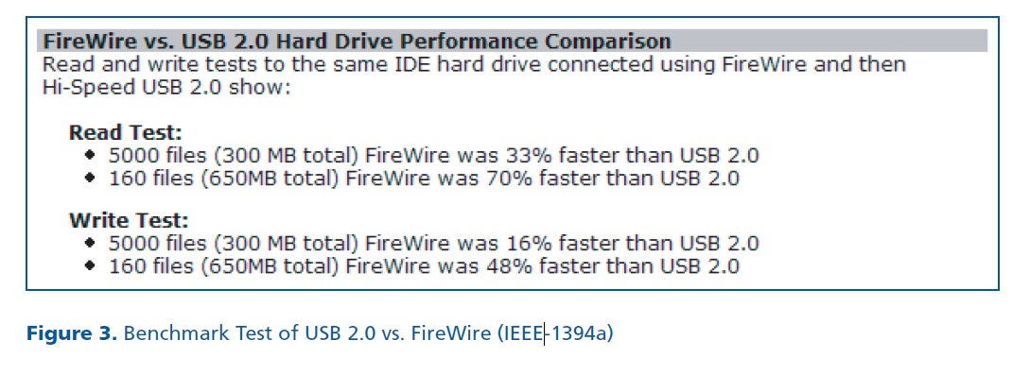

Slide 17
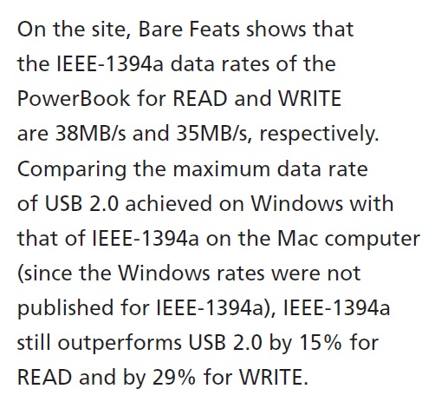
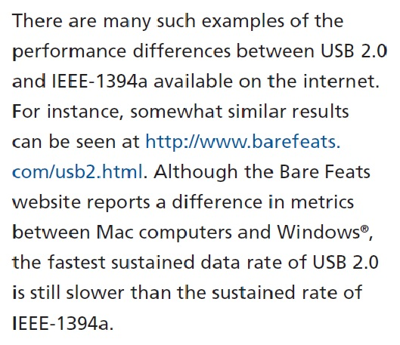

Slide 18


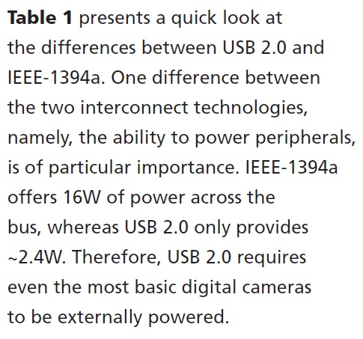

Slide 19
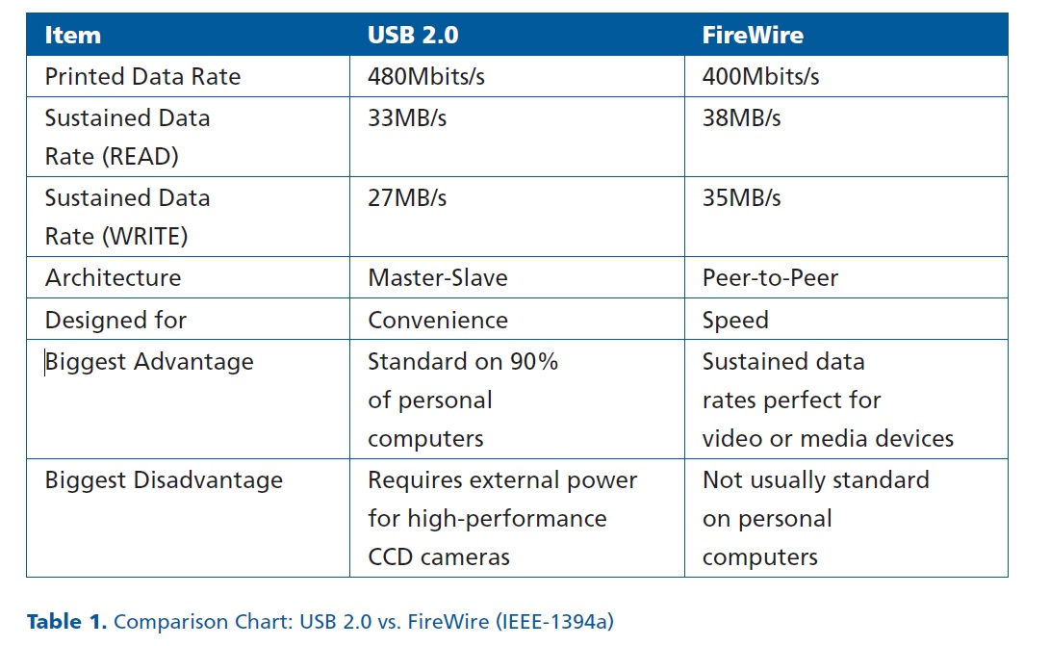

Slide 20
USB 2.0
1. 1.5 Mbps, 12Mbps, 480 Mbps supported.
2. USB controller is required to control the bus and data transfer.
3. Cable up to 5m.
4. Up to 127 devices supported.
5. Power supply to external devices is 500 mA/5V (max).
6. Full compatibility with USB 1.1 devices.
FireWire (IEEE 1394)
1. 100 Mbps, 200Mbps, 400 Mbps supported.
2. Works without control, devices communicate peer-to-peer.
3. Cable up to 4.5m.
4. Up to 63 devices supported.
5. Power supply to external devices is 1.25A/12V (max).
6. The only computer bus used in digital video cameras

Slide 21
Speed:
USB offers speeds ranging from 1 Mbps to 480 Mbps. In contrast, the current IEEE specification 1394 offers speeds starting at 100 Mbps and going up to 400 Mbps. P 1394b will start at 800 Mbps and is defining speeds of up to 3200 Mbps.

Slide 22
Application:
IEEE 1394 and USB are complimentary technologies. USB is a small and medium bandwidth connection for telephony products, digital still cameras, monitors, keyboards, mice, and other similar I/O devices. In contrast, IEEE 1394 is a high-speed bus designed for digital video cameras, DVD players, mass storage devices, and other peripherals that require greater bandwidth.

Slide 23
Cost:
USB2.0 is around $3 in OEM (Original Equipment Manufacturer) quantities. It is a very low-cost interconnected technology. Low-speed USB implementations for devices such as mice and keyboards typically cost less than $1 in OEM quantities, and even the medium-speed implementations for devices like scanners and modems are in the $1-2 range in OEM quantities. Due to relatively lower volumes and higher complexity, IEEE 1394 implementations are currently in the $9 range. This cost is expected to decrease as volume builds over the next few years.

Slide 24
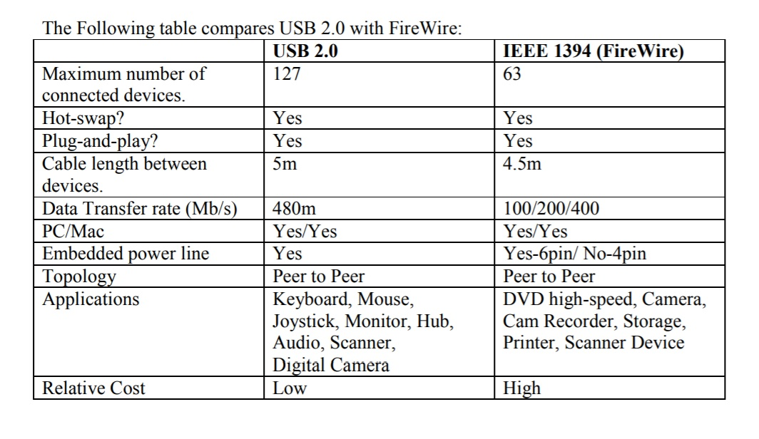

Slide 25
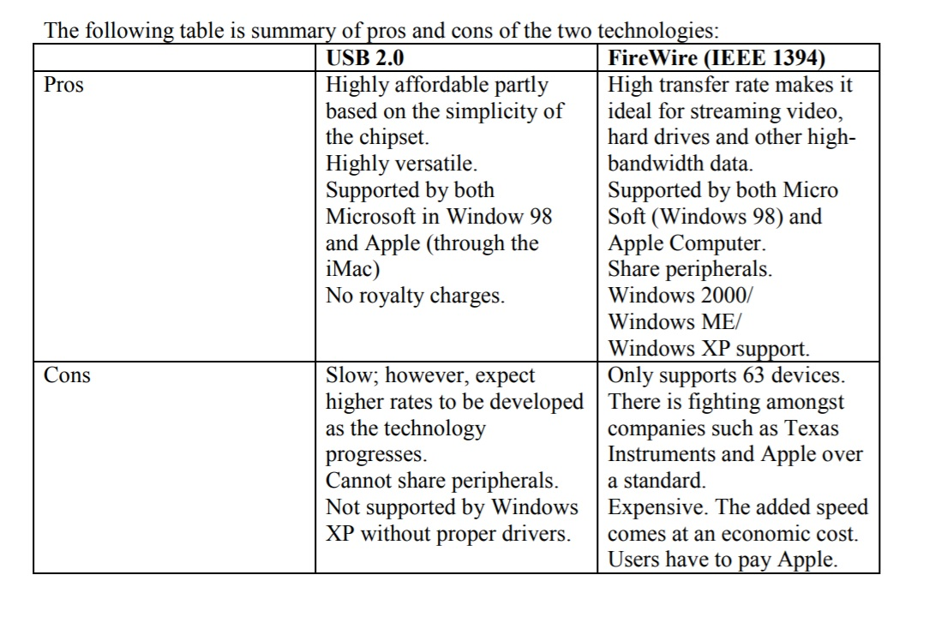

Slide 26
Meeting the needs for the future:
As expected after 2001, USB 2.0 dramatically increased its capacity to 480 Mbps, which challenges FireWire (IEEE 1394) as the serial interface of the future. Tomorrow’s PC will have a need for low-cost, low-bandwidth devices like mice, keyboards, and modems. USB provides a good fit for these devices. Tomorrow’s PC will also need a high-speed interface for connecting to high-speed printers, hard drives, and camcorders. IEEE 1394 is the technology that will allow these devices to interoperate with the PC. Both USB and IEEE 1394 will coexist on the future PC platforms to meet a wide range of growing peripheral interconnectivity needs.
In general, USB provides slower speed which is usually applied to keyboards, mice, and printers. FireWire provides faster speed; therefore, it is applied to most of the external storage devices such as scanners, hard drives, CD ROMs, DVD-RWs, and CD-RWs. Intel will introduce InfiniBand to try to take over the external storage market of USB 2.0 and IEEE 1394 (FireWire) such as hard drives, DVD recorders, cam recorders, etc.

Slide 27
The future of USB 2.0 will be InfiniBand, under development by Intel and introduced to the market in the next 5 years. The next generation of FireWire is IEEE 1394b. The IEEE 1394b standard covers such elements as cables and connectors for gigabit signaling; detection and resolution of physical loops in bus topology; circuit design for transmitting 8b/10b encoded signals; extension of the PHY/link interface for higher data rates over 12 either an 8-bit parallel or bit-serial bus; protocols to encode bus arbitration signals as symbols; protocols for signals speed negotiation between peer devices; and testing and compliance procedures for gigabit connections.

Slide 28

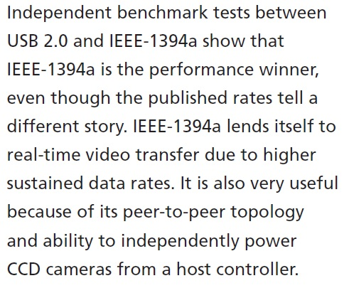

Slide 29
