Slide 1

http://flic.kr/p/6oP7x7
Version Control with Git

Slide 2
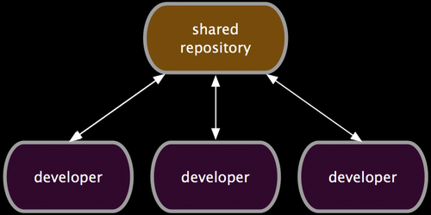
Collaborate: Work in parallel with teammates
http://git-scm.com/book/en/Distributed-Git-Distributed-Workflows

Slide 3
Version Control Systems (VCSs)
Help you track/manage/distribute revisions
Standard in modern development
Examples:
  Revision Control System (RCS)
  Concurrent Versions System (CVS)
  Subversion (SVN)
  Git
older
newer
Our focus

Slide 4


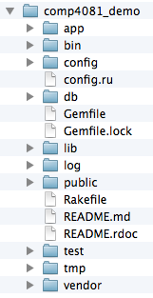
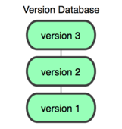
GitHub-User Perspective
You
GitHub
Working Dir
Local
Repos
Remote
Repos

Slide 5
Let’s begin with an example…
You
GitHub

Slide 6
Configure your Git client
(Rails Tutorial 1.3.1)
Install Git
Check config info:
Fix if necessary:
$ git config --list
user.name=Scott Fleming
user.email=Scott.Fleming@memphis.edu
$ git config --global user.name “foulan ben Faltan"
$ git config --global user.email foulen@gmc.com

Slide 7
Log into GitHub and create a repos
(with add README option)
You
GitHub
Remote
Repos

Slide 8
$ git clone https://github.com/sdflem/comp4081_demo.git
You
GitHub
Working Dir
Local
Repos
Remote
Repos

Slide 9
$ rails new comp4081_demo
You
GitHub
Working Dir
Local
Repos
Remote
Repos

Slide 10
$ cd comp4081_demo
$ git add -A
$ git commit –m "Created Rails project skeleton"
You
GitHub
Working Dir
Local
Repos
Remote
Repos

Slide 11
$ git push
You
GitHub
Working Dir
Local
Repos
Remote
Repos

Slide 12
Questions to answer
How organized?
You
GitHub
Working Dir
Local
Repos
Remote
Repos
What operations?

Slide 13
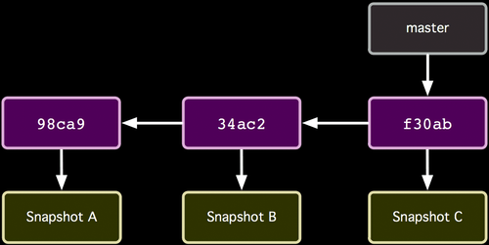
How the repos is organized
http://git-scm.com/book/

Slide 14
How the repos is organized
Commits (from oldest to newest; hashes as commit IDs)
http://git-scm.com/book/

Slide 15
How the repos is organized
Snapshot of all files at each commit
http://git-scm.com/book/

Slide 16
How the repos is organized
Branch (last commit)
http://git-scm.com/book/

Slide 17
How commit works
Before
http://git-scm.com/book/

Slide 18
How commit works
After
http://git-scm.com/book/

Slide 19
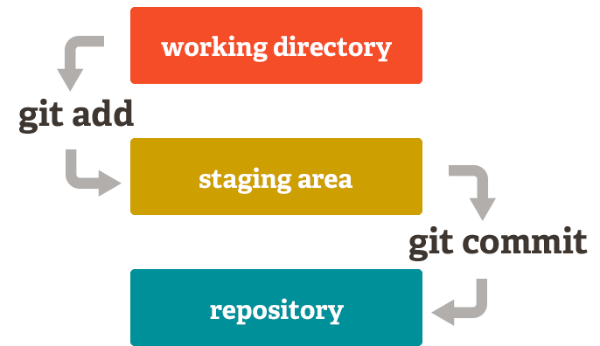

Slide 20
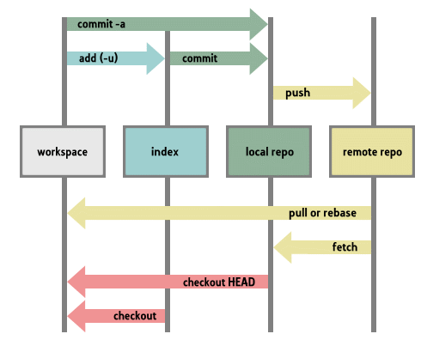

Slide 21

THANK YOU

