Slide 1
Operational analytics: throughput holds above target
Power BI readout · Q2 2026
CBC Israel · Web Coding · Sali Halif

Slide 2
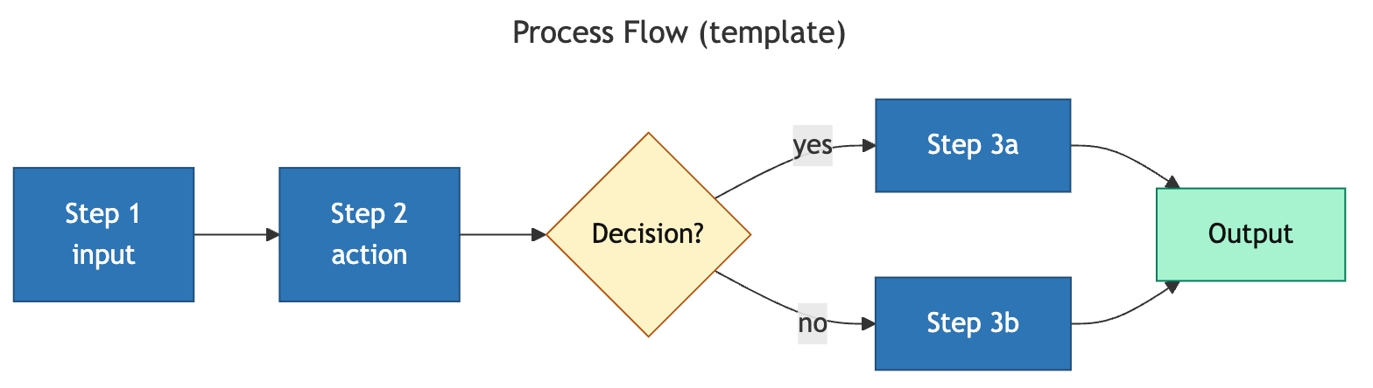
Data flows ingest → model → dashboard before any metric is read
Process infographic (data pipeline)

Slide 3
Throughput trended up; mix stayed PM-heavy
Data viz · chart-engine: line (trend) + doughnut (composition)

Slide 4
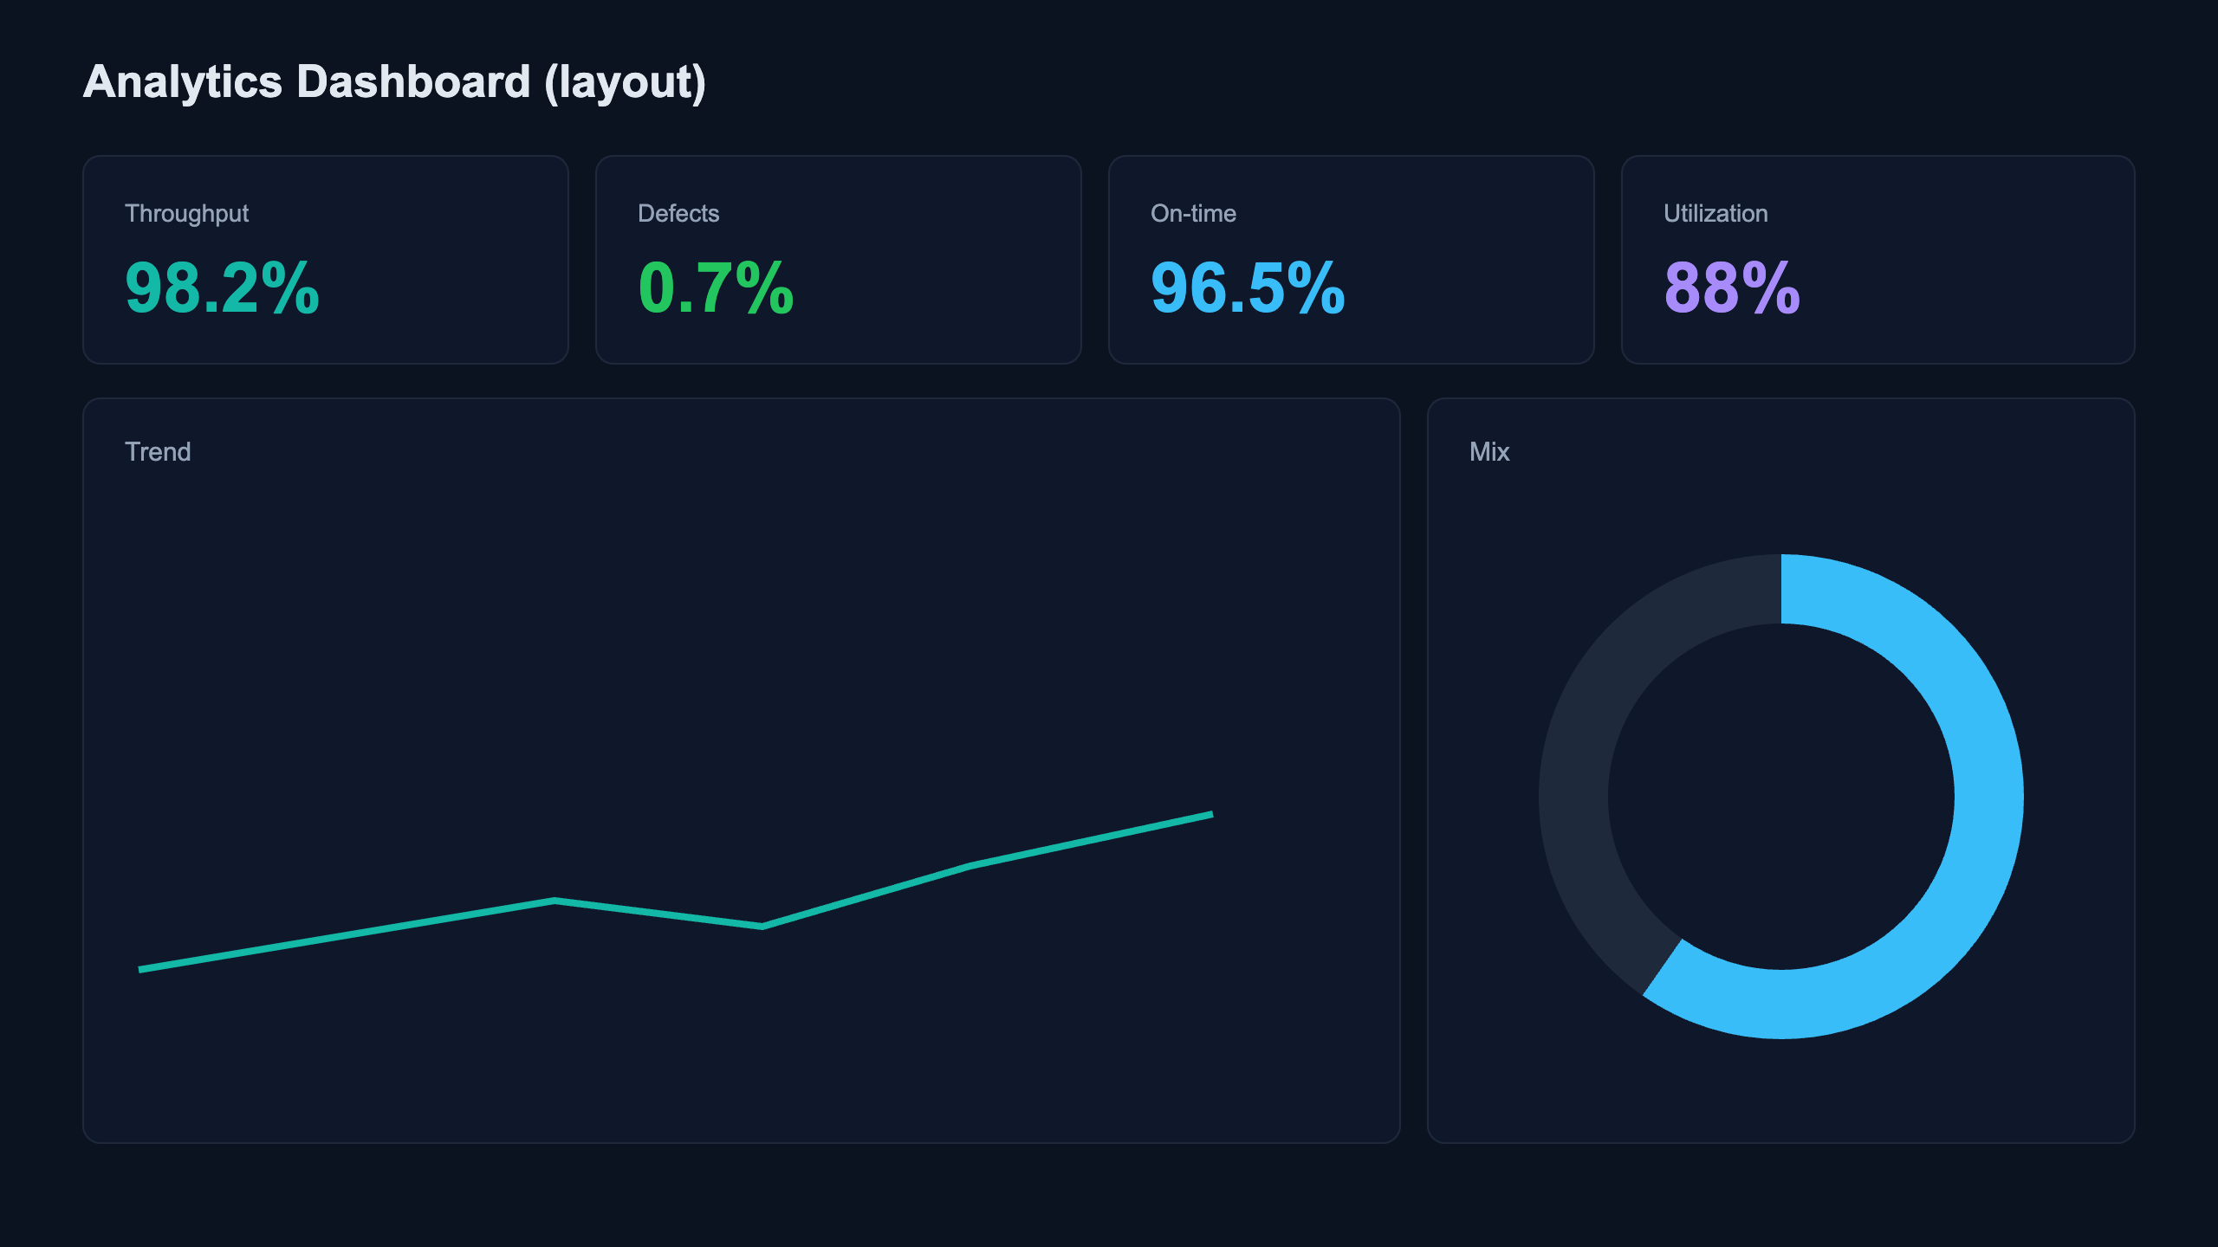
Summary dashboard: four KPIs, trend, and mix at a glance
Summary visual (dashboard layout)

Slide 5
Action
1. Hold the line on throughput; investigate flat utilization (88%).
2. Promote the PM mix gains; keep defect rate < 1%.
sali2610@gmail.com

