Slide 1
FY2026 forecast: revenue up 14%, margin expanding
FP&A · annual outlook
CBC Israel · Web Coding · Sali Halif

Slide 2
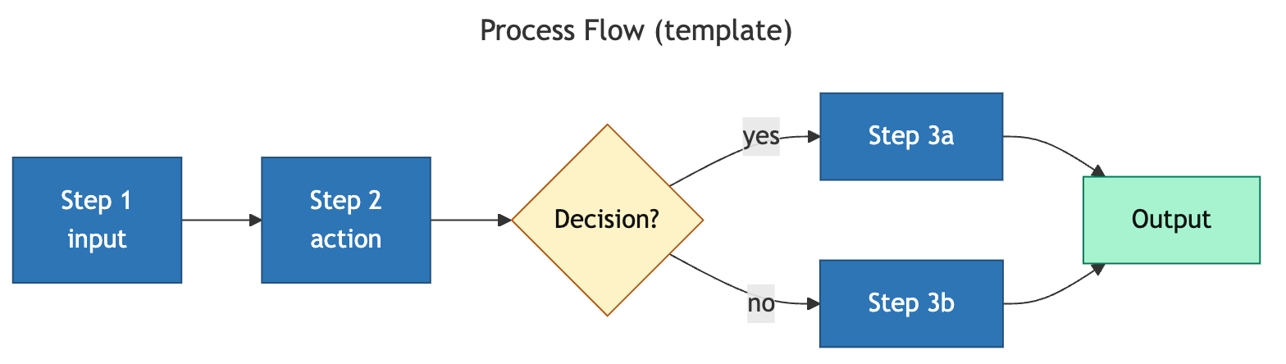
The forecast runs assumptions → model → bridge before the number
Process infographic (forecast pipeline)

Slide 3
Revenue is forecast to grow from 14.1M to 16.1M (+14%)
Data viz · chart-engine: line (trend)

Slide 4
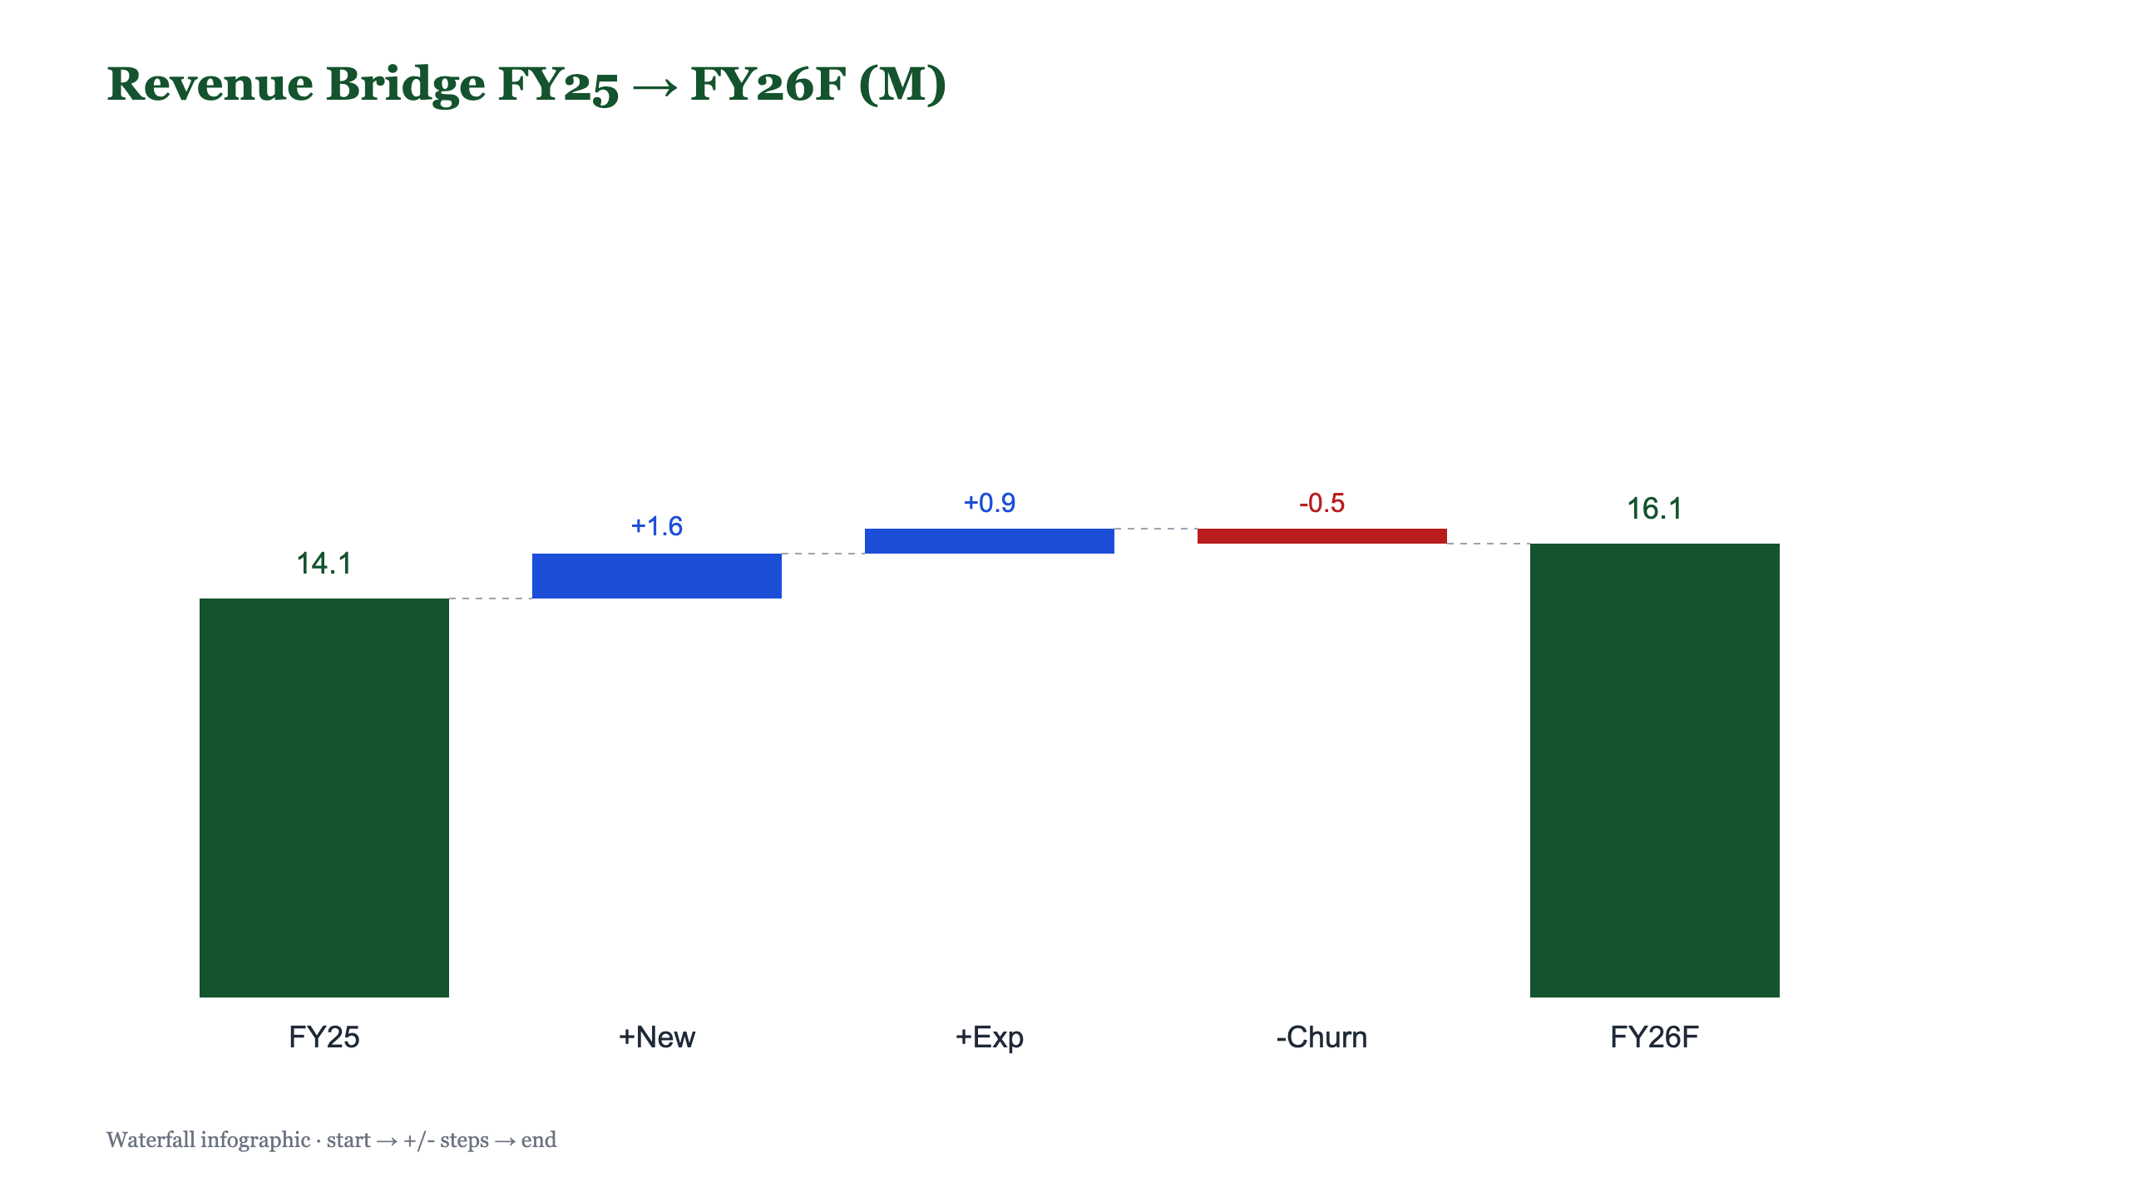
Summary bridge: volume adds, churn subtracts, margin holds
Summary visual (waterfall bridge)

Slide 5
Action
1. Approve the FY26 forecast: +14% revenue, +1.5pp net margin.
2. Fund expansion; hold OpEx growth to +7%.
sali2610@gmail.com

