Slide 1

Analysis of Algorithms 1
(Fall 2013)
Istanbul Technical University
Computer Eng. Dept.
Chapter 6: Heapsort
Course slides from
Susan Bridges @MS State
have been used in preparation of these slides.
Last updated: October 11, 2011

Slide 2
Purpose
Learn about the heap data structure and its operations
Learn about the heapsort
How to use heap for priority queues

Slide 3
Contents
Heaps
Maintaining the heap property
Building a heap
The heapsort algorithm
Priority queues

Slide 4
Heapsort
Running time of heapsort is O(n log₂n)
It sorts in place
It uses a data structure called a heap
The heap data structure is also used to implement a priority queue efficiently

Slide 5
Full and Complete Binary Trees
Full binary tree: binary tree in which each node is either a leaf node or has degree 2 (i.e., has exactly 2 children)
Complete binary tree: full binary tree in which all leaves have the same depth
Nearly complete binary tree: completely filled on all levels except possibly the lowest, which is filled from the left up to a point

Slide 6
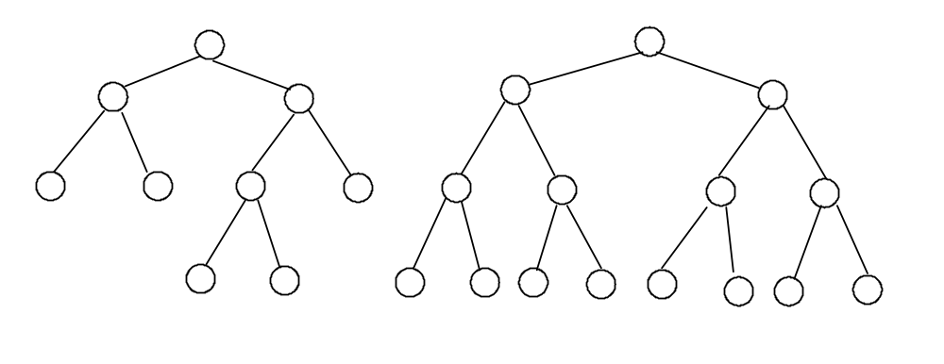
Examples
Full binary tree: Complete binary tree:

Slide 7
Representation of
Nearly Complete Binary Tree
A nearly complete binary tree may be represented as an array (i.e., no pointers):
Number the nodes, beginning with the root node and moving from level to level, left to right within a level.
The number assigned to a node is its index in the array.

Slide 8
Additional Properties of
Nearly Complete Binary Trees
The root of the tree is A[1].
If a node has index i, we can easily compute the indices of its:
  parent ⎣i/2⎦
  left child 2i
  right child 2i + 1

Slide 9
Numbering
Array:
16
14
10
8
7
9
3
2
4
1
1
Heap:
16
2
3
14
10
4
5
6
7
8
7
9
3
8
9
10
2
4
1

Slide 10
Heap
Implemented as an array object, A[ ]
Array A that implements the heap has two attributes
  length(A)
  heap-size(A)

Slide 11
Heap
A binary tree with n nodes and of height h is almost complete iff its nodes correspond to the nodes which are numbered 1 to n in the complete binary tree of height h.
A heap is an almost complete binary tree that satisfies the heap property:
max-heap: For every node i other than the root:
A[Parent(i)] ≥ A[i]
min-heap: For every node i other than the root:
A[Parent(i)] ≤ A[i]

Slide 12
Max-Heap
A max-heap is an almost complete binary tree that satisfies the heap property:
For every node i other than the root,
  A[PARENT(i)] ≥ A[i]
What does this mean?
the value of a node is at most the value of its parent
the largest element in the heap is stored in the root
subtrees rooted at a node contain smaller values than the node itself

Slide 13
1
16
2
3
14
10
4
5
6
7
8
7
9
3
8
9
10
2
4
1
16 14 10 8 7 9 3 2 4 1
1 2 3 4 5 6 7 8 9 10

Slide 14
Height of a node in a heap
The height of a node in a heap is the number of edges on the longest simple downward path from the node to a leaf.
The height of a heap is the height of its root.
Since a heap of n elements is based on a complete binary tree, its height is Θ(lg n).

Slide 15
Heaps have 5 basic procedures
HEAPIFY: maintains the heap property
BUILD-HEAP: builds a heap from an unordered array
HEAPSORT: sorts an array in place
EXTRACT-MAX: selects max element
INSERT: inserts a new element
We will work with MAX heaps

Slide 16
MAX-HEAPIFY(A,i)
Goal is to put the i^{th} element in the correct place in a portion of the array that “almost” has the heap property.
The only element with index of i or greater that is out of place is A[i].
Assume that left and right subtrees of A[i] have the heap property.
“Sift” A[i] down to the right position.

Slide 17
Array element 2, the “4”, is out of place
1
16
2
3
i
4
10
4
5
6
7
14
7
9
3
8
9
10
2
8
1
MAX-HEAPIFY(A,2) heap-size[A] = 10

Slide 18
Moving the 4 down
1
16
2
3
14
10
4
5
6
7
i
4
7
9
3
8
9
10
2
8
1
MAX-HEAPIFY(A,4) heap-size[A] = 10

Slide 19
The 4 is in the right spot, and the heap property of the tree has been restored.
1
16
2
3
14
10
4
5
6
7
8
7
9
3
8
9
10
2
4
1
MAX-HEAPIFY(A,9) heap-size[A] = 10

Slide 20
MAX-HEAPIFY
MAX-HEAPIFY(A, i)
l ← LEFT(i)
r ← RIGHT(i) ; largest ← i
if l ≤ heap-size[A] and A[l] > A[i]
then largest ← l
else largest ← i
if r ≤ heap-size[A] and A[r] > A[largest]
then largest ← r
if largest ≠ i
then exchange A[i] ↔ A[largest]
MAX-HEAPIFY(A, largest)

Slide 21
Running time of MAX-HEAPIFY
Run time of MAX-HEAPIFY(A,i)
  Look at lines 1 –9
  Is there a loop? No.
  Does the number of steps depend upon n? No.
  So the running time so far is Θ(1)
  How about line 10? We do not know yet.

Slide 22
Running time of MAX-HEAPIFY
The recursive call to MAX-HEAPIFY in line 10 implies a recurrence relation.
When we call MAX_HEAPIFY again, we already know that lines 1-9 cost Θ(1) steps.
But we may need to call MAX-HEAPIFY on a subtree rooted at one of the children of the current node, so we have to add the cost of doing that.

Slide 23
Running time of MAX-HEAPIFY
How many nodes might be involved?
In the case of a full binary tree, about half of the tree might be involved.

Slide 24
Running time of MAX-HEAPIFY
In a complete binary tree with 15 nodes, 8 of those nodes are leaves at the bottom level.
If we perform MAX-HEAPIFY on node i, 7 of the 15 nodes will be involved – about ½ of the nodes.
i

Slide 25
Running time of MAX-HEAPIFY
What is the worst case?
When the last row of the tree is half full.
1
Here 7 out of 11 nodes are involved.
In general, ≤ 2/3^{rds} of the tree might be involved in the worst case.
16
2
3
14
10
4
5
6
7
8
7
9
3
8
9
10 11
2
4
1
5

Slide 26
Running time of MAX-HEAPIFY
Remember that, in a complete binary tree, more than half of the nodes in the entire tree are the leaf nodes on the bottom level of the tree.
But the only nodes involved in MAX-HEAPIFY are the descendants of A[i], which must be in A[i]’s half of the tree.
So worst case is when the last row of the tree is half full on the left side and A[i] is their ancestor.

Slide 27
Running time of MAX-HEAPIFY
The subtrees of the children of our current node have size at most 2n/3.
The running time of MAX_HEAPIFY can be described by the recurrence:
T(n) ≤ T(2n/3) + Θ(1)
This is Case 2 by the master method, so:
T(n) = O(lg n)

Slide 28
Running time of MAX-HEAPIFY
We could also describe the running time of MAX-HEAPIFY for a node of height h as O(h). (This is useful only if we know the height of a specific node.)

Slide 29
BUILD-MAX-HEAP
Use MAX-HEAPIFY in a bottom-up manner to convert an array A[1..n] into a heap.
Each leaf is initially a one-element heap. Elements A[⎣n/2⎦ + 1..n] are leaves.
MAX-HEAPIFY is called on all interior nodes.

Slide 30
BUILD-MAX-HEAP
BUILD-MAX-HEAP(A)
heap-size[A] ← length[A]
for i ← floor(length[A]/2) downto 1 do
MAX-HEAPIFY(A, i)

Slide 31
length(A) = 10
floor(length(A)/2) = 5
process from 5 to 1
1
a.
4
2
3
1
3
4
5
6
7
2
i
16
9
10
8
9
10
14
8
7
4 1 3 2 16 9 10 14 8 7
1 2 3 4 5 6 7 8 9 10

Slide 32
1
b.
4
2
3
1
3
4
5
6
7
2
i
16
9
10
8
9
10
14
8
7
4 1 3 2 16 9 10 14 8 7
1 2 3 4 5 6 7 8 9 10

Slide 33
1
4
c.
2
3
1
3
i
4
5
6
7
14
16
9
10
8
9
10
2
8
7
4 1 3 14 16 9 10 2 8 7
1 2 3 4 5 6 7 8 9 10

Slide 34
1
4
d.
2
3
i
1
10
4
5
6
7
14
16
9
3
8
9
10
2
8
7
4 1 10 14 16 9 3 2 8 7
1 2 3 4 5 6 7 8 9 10

Slide 35
1
i
4
e.
2
3
16
10
4
5
6
7
14
7
9
3
8
9
10
2
8
1
4 16 10 14 7 9 3 2 8 1
1 2 3 4 5 6 7 8 9 10

Slide 36
1
16
f.
2
3
14
10
4
5
6
7
8
7
9
3
8
9
10
2
4
1
16 14 10 8 7 9 3 2 4 1
1 2 3 4 5 6 7 8 9 10

Slide 37
Running Time of BUILD-MAX-HEAP
Simple upper bound:
  each call to MAX-HEAPIFY costs O(lg n)
  O(n) such calls
  running time at most O(n lg n)
Previous bound is not tight:
  lots of the elements are leaves
  most elements are near leaves (small height)

Slide 38
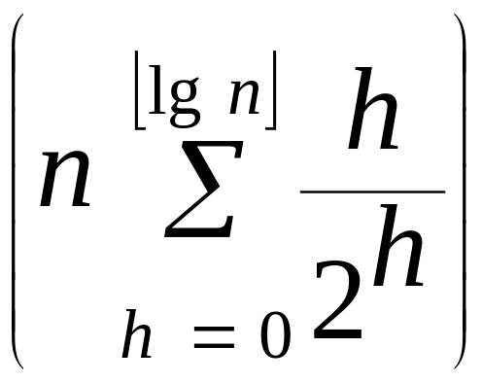
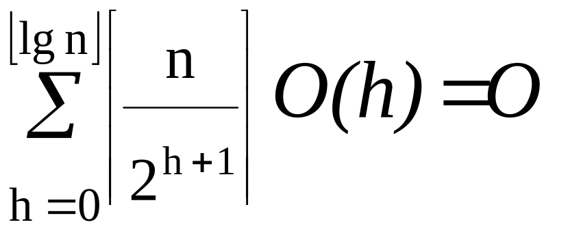
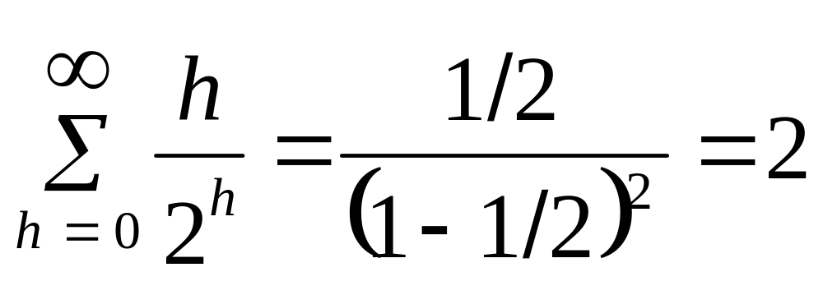
Tighter Bound for BUILD-MAX-HEAP
By substituting x = ½ in the formula for differentiating infinite geometric series, we have:

Slide 39
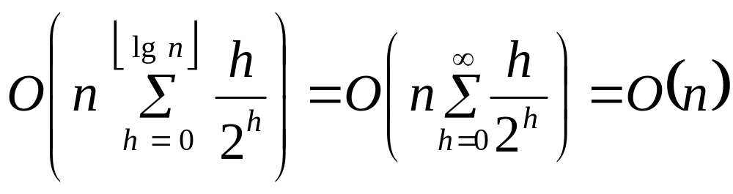
Tighter Bound for BUILD-MAX-HEAP (continued)
Thus the running time is bounded by:
Therefore, we can build a heap from an unordered array in linear time.

Slide 40
Heapsort
First build a heap.
Then successively remove the biggest element from the heap and move it to the first position in the sorted array.
The element currently in that position is then placed at the top of the heap and sifted to the proper position.

Slide 41
HEAPSORT
HEAPSORT(A)
BUILD-MAX-HEAP(A)
for i ← length[A] downto 2 do
exchange A[1] ↔ A[i]
heap-size[A] ← heap-size[A] – 1
MAX-HEAPIFY(A, 1)

Slide 42
BUILD-MAX-HEAP(A)
for i ← length[A] downto 2 do
exchange A[1] ↔ A[i]
heap-size[A] ← heap-size[A] – 1
MAX-HEAPIFY(A, 1)
1
16
2
3
14
10
4
5
6
7
8
7
9
3
8
9
10
2
4
1
16 14 10 8 7 9 3 2 4 1
1 2 3 4 5 6 7 8 9 10

Slide 43
BUILD-MAX-HEAP(A)
for i ← length[A] downto 2 do
exchange A[1] ↔ A[i]
heap-size[A] ← heap-size[A] – 1
MAX-HEAPIFY(A, 1)
1
1
2
3
14
10
4
5
6
7
8
7
9
3
8
9
10
2
4
16
1 14 10 8 7 9 3 2 4 16
1 2 3 4 5 6 7 8 9 10

Slide 44
BUILD-MAX-HEAP(A)
for i ← length[A] downto 2 do
exchange A[1] ↔ A[i]
heap-size[A] ← heap-size[A] – 1
MAX-HEAPIFY(A, 1)
1
14
2
3
8
10
4
5
6
7
4
7
9
3
8
9
10
2
1
16
14 8 10 4 7 9 3 2 1 16
1 2 3 4 5 6 7 8 9 10

Slide 45
BUILD-MAX-HEAP(A)
for i ← length[A] downto 2 do
exchange A[1] ↔ A[i]
heap-size[A] ← heap-size[A] – 1
MAX-HEAPIFY(A, 1)
1
14
2
3
8
10
4
5
6
7
4
7
9
3
8
9
10
2
1
16
14 8 10 4 7 9 3 2 1 16
1 2 3 4 5 6 7 8 9 10

Slide 46
BUILD-MAX-HEAP(A)
for i ← length[A] downto 2 do
exchange A[1] ↔ A[i]
heap-size[A] ← heap-size[A] – 1
MAX-HEAPIFY(A, 1)
1
1
2
3
8
10
4
5
6
7
4
7
9
3
8
9
10
2
14
16
1 8 10 4 7 9 3 2 14 16
1 2 3 4 5 6 7 8 9 10

Slide 47
BUILD-MAX-HEAP(A)
for i ← length[A] downto 2 do
exchange A[1] ↔ A[i]
heap-size[A] ← heap-size[A] – 1
MAX-HEAPIFY(A, 1)
1
10
2
3
8
9
4
5
6
7
4
7
1
3
8
9
10
2
14
16
10 8 9 4 7 1 3 2 14 16
1 2 3 4 5 6 7 8 9 10

Slide 48
BUILD-MAX-HEAP(A)
for i ← length[A] downto 2 do
exchange A[1] ↔ A[i]
heap-size[A] ← heap-size[A] – 1
MAX-HEAPIFY(A, 1)
1
10
2
3
8
9
4
5
6
7
4
7
1
3
8
9
10
2
14
16
10 8 9 4 7 1 3 2 14 16
1 2 3 4 5 6 7 8 9 10

Slide 49
BUILD-MAX-HEAP(A)
for i ← length[A] downto 2 do
exchange A[1] ↔ A[i]
heap-size[A] ← heap-size[A] – 1
MAX-HEAPIFY(A, 1)
1
2
2
3
8
9
4
5
6
7
4
7
1
3
8
9
10
10
14
16
2 8 9 4 7 1 3 10 14 16
1 2 3 4 5 6 7 8 9 10

Slide 50
BUILD-MAX-HEAP(A)
for i ← length[A] downto 2 do
exchange A[1] ↔ A[i]
heap-size[A] ← heap-size[A] – 1
MAX-HEAPIFY(A, 1)
1
9
2
3
8
3
4
5
6
7
4
7
1
2
8
9
10
10
14
16
9 8 3 4 7 1 2 10 14 16
1 2 3 4 5 6 7 8 9 10

Slide 51
BUILD-MAX-HEAP(A)
for i ← length[A] downto 2 do
exchange A[1] ↔ A[i]
heap-size[A] ← heap-size[A] – 1
MAX-HEAPIFY(A, 1)
1
9
2
3
8
3
4
5
6
7
4
7
1
2
8
9
10
10
14
16
9 8 3 4 7 1 2 10 14 16
1 2 3 4 5 6 7 8 9 10

Slide 52
BUILD-MAX-HEAP(A)
for i ← length[A] downto 2 do
exchange A[1] ↔ A[i]
heap-size[A] ← heap-size[A] – 1
MAX-HEAPIFY(A, 1)
1
2
2
3
8
3
4
5
6
7
4
7
1
9
8
9
10
10
14
16
2 8 3 4 7 1 9 10 14 16
1 2 3 4 5 6 7 8 9 10

Slide 53
BUILD-MAX-HEAP(A)
for i ← length[A] downto 2 do
exchange A[1] ↔ A[i]
heap-size[A] ← heap-size[A] – 1
MAX-HEAPIFY(A, 1)
1
8
2
3
7
3
4
5
6
7
4
2
1
9
8
9
10
10
14
16
8 7 3 4 2 1 9 10 14 16
1 2 3 4 5 6 7 8 9 10

Slide 54
BUILD-MAX-HEAP(A)
for i ← length[A] downto 2 do
exchange A[1] ↔ A[i]
heap-size[A] ← heap-size[A] – 1
MAX-HEAPIFY(A, 1)
1
8
2
3
7
3
4
5
6
7
4
2
1
9
8
9
10
10
14
16
8 7 3 4 2 1 9 10 14 16
1 2 3 4 5 6 7 8 9 10

Slide 55
BUILD-MAX-HEAP(A)
for i ← length[A] downto 2 do
exchange A[1] ↔ A[i]
heap-size[A] ← heap-size[A] – 1
MAX-HEAPIFY(A, 1)
1
1
2
3
7
3
4
5
6
7
4
2
8
9
8
9
10
10
14
16
1 7 3 4 2 8 9 10 14 16
1 2 3 4 5 6 7 8 9 10

Slide 56
BUILD-MAX-HEAP(A)
for i ← length[A] downto 2 do
exchange A[1] ↔ A[i]
heap-size[A] ← heap-size[A] – 1
MAX-HEAPIFY(A, 1)
1
7
2
3
4
3
4
5
6
7
1
2
8
9
8
9
10
10
14
16
7 4 3 1 2 8 9 10 14 16
1 2 3 4 5 6 7 8 9 10

Slide 57
BUILD-MAX-HEAP(A)
for i ← length[A] downto 2 do
exchange A[1] ↔ A[i]
heap-size[A] ← heap-size[A] – 1
MAX-HEAPIFY(A, 1)
1
7
2
3
4
3
4
5
6
7
1
2
8
9
8
9
10
10
14
16
7 4 3 1 2 8 9 10 14 16
1 2 3 4 5 6 7 8 9 10

Slide 58
BUILD-MAX-HEAP(A)
for i ← length[A] downto 2 do
exchange A[1] ↔ A[i]
heap-size[A] ← heap-size[A] – 1
MAX-HEAPIFY(A, 1)
1
2
2
3
4
3
4
5
6
7
1
7
8
9
8
9
10
10
14
16
2 4 3 1 7 8 9 10 14 16
1 2 3 4 5 6 7 8 9 10

Slide 59
BUILD-MAX-HEAP(A)
for i ← length[A] downto 2 do
exchange A[1] ↔ A[i]
heap-size[A] ← heap-size[A] – 1
MAX-HEAPIFY(A, 1)
1
4
2
3
2
3
4
5
6
7
1
7
8
9
8
9
10
10
14
16
4 2 3 1 7 8 9 10 14 16
1 2 3 4 5 6 7 8 9 10

Slide 60
BUILD-MAX-HEAP(A)
for i ← length[A] downto 2 do
exchange A[1] ↔ A[i]
heap-size[A] ← heap-size[A] – 1
MAX-HEAPIFY(A, 1)
1
4
2
3
2
3
4
5
6
7
1
7
8
9
8
9
10
10
14
16
4 2 3 1 7 8 9 10 14 16
1 2 3 4 5 6 7 8 9 10

Slide 61
BUILD-MAX-HEAP(A)
for i ← length[A] downto 2 do
exchange A[1] ↔ A[i]
heap-size[A] ← heap-size[A] – 1
MAX-HEAPIFY(A, 1)
1
1
2
3
2
3
4
5
6
7
4
7
8
9
8
9
10
10
14
16
1 2 3 4 7 8 9 10 14 16
1 2 3 4 5 6 7 8 9 10

Slide 62
BUILD-MAX-HEAP(A)
for i ← length[A] downto 2 do
exchange A[1] ↔ A[i]
heap-size[A] ← heap-size[A] – 1
MAX-HEAPIFY(A, 1)
1
3
2
3
2
1
4
5
6
7
4
7
8
9
8
9
10
10
14
16
3 2 1 4 7 8 9 10 14 16
1 2 3 4 5 6 7 8 9 10

Slide 63
BUILD-MAX-HEAP(A)
for i ← length[A] downto 2 do
exchange A[1] ↔ A[i]
heap-size[A] ← heap-size[A] – 1
MAX-HEAPIFY(A, 1)
1
3
2
3
2
1
4
5
6
7
4
7
8
9
8
9
10
10
14
16
3 2 1 4 7 8 9 10 14 16
1 2 3 4 5 6 7 8 9 10

Slide 64
BUILD-MAX-HEAP(A)
for i ← length[A] downto 2 do
exchange A[1] ↔ A[i]
heap-size[A] ← heap-size[A] – 1
MAX-HEAPIFY(A, 1)
1
1
2
3
2
3
4
5
6
7
4
7
8
9
8
9
10
10
14
16
1 2 3 4 7 8 9 10 14 16
1 2 3 4 5 6 7 8 9 10

Slide 65
BUILD-MAX-HEAP(A)
for i ← length[A] downto 2 do
exchange A[1] ↔ A[i]
heap-size[A] ← heap-size[A] – 1
MAX-HEAPIFY(A, 1)
1
2
2
3
1
3
4
5
6
7
4
7
8
9
8
9
10
10
14
16
2 1 3 4 7 8 9 10 14 16
1 2 3 4 5 6 7 8 9 10

Slide 66
BUILD-MAX-HEAP(A)
for i ← length[A] downto 2 do
exchange A[1] ↔ A[i]
heap-size[A] ← heap-size[A] – 1
MAX-HEAPIFY(A, 1)
1
2
2
3
1
3
4
5
6
7
4
7
8
9
8
9
10
10
14
16
2 1 3 4 7 8 9 10 14 16
1 2 3 4 5 6 7 8 9 10

Slide 67
BUILD-MAX-HEAP(A)
for i ← length[A] downto 2 do
exchange A[1] ↔ A[i]
heap-size[A] ← heap-size[A] – 1
MAX-HEAPIFY(A, 1)
1
1
2
3
2
3
4
5
6
7
4
7
8
9
8
9
10
10
14
16
1 2 3 4 7 8 9 10 14 16
1 2 3 4 5 6 7 8 9 10

Slide 68
BUILD-MAX-HEAP(A)
for i ← length[A] downto 2 do
exchange A[1] ↔ A[i]
heap-size[A] ← heap-size[A] – 1
MAX-HEAPIFY(A, 1)
1
1
2
3
2
3
4
5
6
7
4
7
8
9
8
9
10
10
14
16
1 2 3 4 7 8 9 10 14 16
1 2 3 4 5 6 7 8 9 10

Slide 69
Running time of Heapsort
HEAPSORT(A)
BUILD-MAX-HEAP(A)
for i ← length[A] downto 2 do
exchange A[1] ↔ A[i]
heap-size[A] ← heap-size[A] – 1
MAX-HEAPIFY(A, 1)
Is there a loop? If so, how many times will it execute? What is the cost of one iteration of the loop?

Slide 70
Running time of Heapsort
HEAPSORT(A)
BUILD-MAX-HEAP(A) O(n)
for i ← length[A] downto 2 do O(n-1)
exchange A[1] ↔ A[i] O(1)
heap-size[A] ← heap-size[A] – 1 O(1)
MAX-HEAPIFY(A, 1) O(lg n)
Total time is:
O(n) + O(n-1) * [ O(1) + O(1) + O(lg n) ]
which is approximately
O(n) + O(n lg n)
or just O(n lg n)

Slide 71
Running time of Heapsort
BUILD-MAX-HEAP takes O(n).
We have a loop. Each of the n-1 calls to MAX-HEAPIFY takes O(lg n) time.
Total time is O(n lg n).
Will heap sort always take O(n lg n) time? Is there a best-case scenario? Is there a worst-case scenario? Why or why not?

Slide 72

Running time of Heapsort
BUILD-MAX-HEAP takes O(n).
We have a loop. Each of the n-1 calls to MAX-HEAPIFY takes O(lg n) time.
Total time is O(n lg n).
Will heap sort always take O(n lg n) time? Is there a best-case scenario? Is there a worst-case scenario? Why or why not?

Slide 73
Space requirements of Heapsort
Heapsort uses an array as its data structure.
Heapsort sorts “in place”.
Any extra storage needed?
Only a negligible amount – one extra storage location is needed as temporary storage when swapping two array elements.

Slide 74
Priority Queues
A priority queue is a data structure for maintaining a set S of elements, each with an associated value called a key.
Applications include
  scheduling jobs on a shared computer (max-priority queue)
  event-driven simulators (min-priority queue)

Slide 75
Handles
Elements of priority queue correspond to objects in application.
We must be able to determine which application object corresponds to a given priority-queue element.
We store a handle (pointer, integer, etc.) to the corresponding application object in each heap element.
We also store a handle (array index) to the corresponding heap element in each application object.

Slide 76
Max-Priority Queue Operations
INSERT(S,x): insert element x into set S
MAXIMUM(S): return element of S with the largest key
EXTRACT-MAX(S): remove and return element of S with the largest key
INCREASE-KEY(S, x, k): increase value of x’s key to k, where k is at least as large as x’s current key value

Slide 77
Min-Priority Queue Operations
INSERT(S,x): insert element x into set S
MINIMUM(S): return element of S with the smallest key
EXTRACT-MIN(S): remove and return element of S with the smallest key
DECREASE-KEY(S, x, k): decrease value of x’s key to k, where k is at least as small as x’s current key value

Slide 78
Priority Queue Operations
All operations can be done on a set of size n in O(lg n) time

Slide 79
HEAP-MAXIMUM
HEAP-MAXIMUM(A)
return A[1]
Returns the item at the top of the heap
Runs in Θ(1) time

Slide 80
HEAP-EXTRACT-MAX
HEAP-EXTRACT-MAX(A)
1 if heap-size[A] < 1
2 then error “heap underflow”
3 max ← A[1]
4 A[1] ← A[heap-size[A]]
5 heap-size[A] ← heap-size[A] - 1
6 MAX-HEAPIFY(A,1)
7 return max

Slide 81
Running time of HEAP-EXTRACT-MAX
HEAP-EXTRACT-MAX(A)
1 if heap-size[A] < 1 O(1)
2 then error “heap underflow” O(1)
3 max ← A[1] O(1)
4 A[1] ← A[heap-size[A]] O(1)
5 heap-size[A] ← heap-size[A] – 1 O(1)
6 MAX-HEAPIFY(A,1) O(lg n)
7 return max O(1)
Any loops? No. So just sum up the times: O(6) + O(lg n)
The dominant term is O(lg n).

Slide 82
HEAP-INCREASE-KEY
HEAP-INCREASE-KEY(A, i, key)
1 if key < A[i]
2 then error “new key is smaller than current key”
3 A[i] ← key
4 while i > 1 and A[PARENT(i)] < A[i] do
exchange A[i] ↔ A[PARENT(i)]
i ← PARENT(i)

Slide 83
Example of HEAP-INCREASE-KEY
16
14
10
8
7
9
3
i
2
4
1

Slide 84
Example of HEAP-INCREASE-KEY (continued)
16
14
10
8
7
9
3
i
2
15
1

Slide 85
Example of HEAP-INCREASE-KEY (continued)
16
14
10
i
15
7
9
3
2
8
1

Slide 86
Example of HEAP-INCREASE-KEY (continued)
16
i
15
10
14
7
9
3
2
8
1

Slide 87
Running time of HEAP-INCREASE-KEY
HEAP-INCREASE-KEY(A, i, key)
1 if key < A[i] O(1)
2 then error O(1)
“new key is smaller than current key”
3 A[i] ← key O(1)
4 while i > 1 and A[PARENT(i)] < A[i] do O(lg n)
exchange A[i] ↔ A[PARENT(i)] O(3)
i ← PARENT(i) O(1)
Any loops? Yes. How many times will the loop execute? As many times as node i has ancestors, which = the depth of the tree. The depth of a binary tree is O(lg n). We do a constant amount of work in the loop. Cost is: O(3) + O(4 lg n), or just O(lg n)

Slide 88
MAX-HEAP-INSERT
MAX-HEAP-INSERT(A,key)
1 heap-size[A] ← heap-size[A] + 1
2 A[heap-size] ← -∞
3 HEAP-INCREASE-KEY(A, heap-size[A], key)

Slide 89
1
16
2
3
14
10
4
5
6
7
8
7
9
3
8
9
10
2
4
1
MAX-HEAP-INSERT(A,15)

Slide 90
1
16
2
3
14
10
4
5
6
7
8
7
9
3
8
9
10
2
4
1
HEAP-INSERT(A,15)

Slide 91
1
16
2
3
10
4
5
6
7
8
14
9
3
8
9
10
2
4
1
7
MAX-HEAP-INSERT(A,15)

Slide 92
1
16
2
3
15
10
4
5
6
7
8
14
9
3
8
9
10
2
4
1
7
MAX-HEAP-INSERT(A,15)

Slide 93
MAX-HEAP-INSERT
MAX-HEAP-INSERT(A,key)
1 heap-size[A] ← heap-size[A] + 1 O(1)
2 A[heap-size] ← -∞ O(1)
3 HEAP-INCREASE-KEY(A, heap-size[A], key) O(lg n)
Any loops? No.
Add up the times: O(1) + O(1) + O(lg n) = O(2) + O(lg n)
Dominant term is O(lg n), so running time is just O(lg n).

Slide 94
Summary
Definition of a heap
How to build a heap
How to use a heap for sorting
How to analyze running time of heapsort
Heapsort is in place (better than mergesort) and takes O(nlgn) (better than insertion)
How to use a heap for priority queues

Slide 95
Notes
For series sums, see the appendix at the end of the book or:
http://en.wikipedia.org/wiki/Summation

