Slide 1

Analysis of Algorithms 1
(Fall 2013)
Istanbul Technical University
Computer Eng. Dept.
Chapter 11
Hash Tables
Last updated: November 11, 2009

Slide 2
Purpose
Introduce dictionary
Introduce hash table as a dictionary implementation
Introduce methods of collision resolution in hash tables

Slide 3
Outline
Dictionary
Direct Access Table
Hash Table
  concept
  collision resolution
  choosing a hash function
  advanced collision resolution

Slide 4
Dictionary
Dictionary: a dynamic set that supports only INSERT, SEARCH, and DELETE
Hash table: an effective data structure for dictionaries
  O(n) time for search in worst case
  O(1) expected time for search
Applications: Any application that requires fast search and/or insert, e.g. actual dictionary, employee database, image/song/document database... etc.
Dictionaries and Hashing

Slide 5
Dictionary
A dictionary includes
  Unique identification code (key)
  Additional data (satellite data)
  Operations to work on keys
  Operations
    based on equality
    min, max, successor, predecessor are not musts
Dictionaries and Hashing

Slide 6
Dictionary
A dictionary supports three functions (methods):
Search(T, k)
returns a pointer x to an element where k = x.key
Insert(T, x)
adds the element pointed to by x to T
Delete(T, x)
removes the element pointed to by x from T
Dictionaries and Hashing

Slide 7
Dictionary
Could be implemented using different data structure
Arrays
Linked lists
Hash tables (This class)
Binary trees
Red/Black trees
AVL trees
B-trees

Slide 8
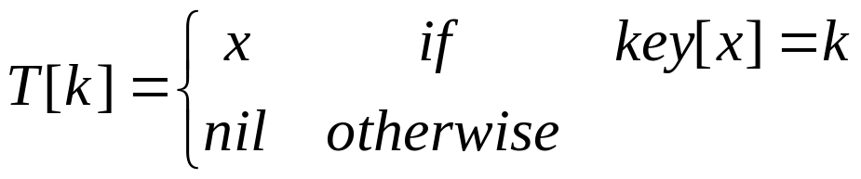
Direct Address Tables
Assume that the set of keys are drawn from the set
U = {0, 1, …, m–1}
Set up an an array (table) T [0…m-1] of m elements
If no two elements have the same key each search operation takes constant time
Problem:
The range of keys, i.e./ the size of the table can be huge:
e.g.
  64-bit numbers (which represent 18,446,744,073,709,551,616different keys),
  character strings (even larger!).

Slide 9
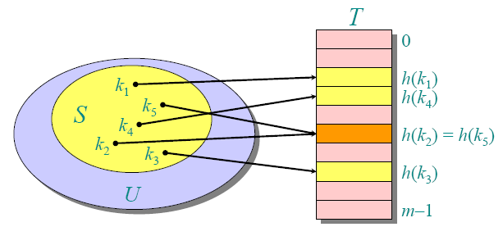
Hash Function
Problem:
The range of keys is huge
Solution:
Use a hash function h to map the universe U of all keys into {0, 1, …, m–1}

Slide 10
Hash Function
direct addressing: an element with key k is stored in slot k.
hashing: this element is stored in slot h(k);
we use a hash function h to compute the slot from the key k.
h maps the universe U of keys into the slots of a hash table T[0…m - 1]:
<number>/48

Slide 11
Collision Resolution
Collision: Two keys which have the same hash value
Collision is a problem.
A solution: Chaining
an array of links or a linked list to keep the elements having the same key
  …
  X X a X b X c null
  Y null
  Z Z c null
  …

Slide 12
Analysis of Hashing (with Chaining)
An element with key k is stored in slot h(k)
h(k) maps the universe of keys into the slots of hash table of length m
m is reasonably small
computation time of h(k) is Θ(1)
Uniform hashing: hashed keys are expected to be distributed into slots equally
Load factor (of a table): α=n/m
where
m is # of slots
n is # of elements being hold

Slide 13
Analysis of Hashing (with Chaining)
Searching for an element with a key k
  compute h(k)
  locate its slot in the hash table
  search for the element in the linked list
  if the given element is in the linked list
    return the element (with satellite data)
    Otherwise unsuccessful search
Average list length for uniform hashing: α = n/m
  i.e., expected number of elements to be visited

Slide 14
Analysis of Hashing (with Chaining)
Search time for an unsuccessful search:
O(1+ α)
Brief analysis of a successful search
  a new element is inserted at the end of the linked list following a successful search
      (think of searching algorithm and discuss the use of a tail pointer)
  the expected length of the list before the insertion of the i^{th} element is (i-1)/m

Slide 15
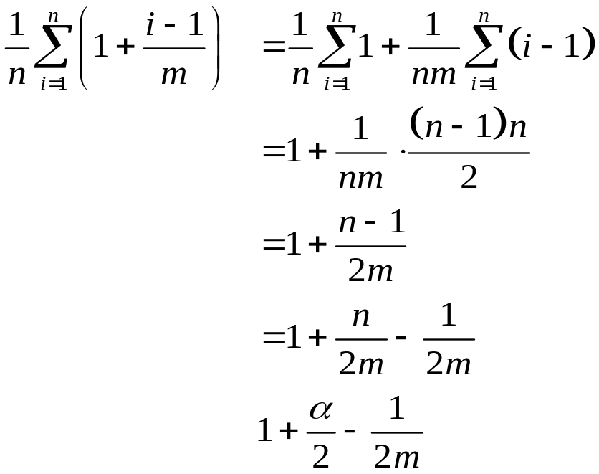

Analysis of Hashing (with Chaining)
The expected number of elements examined is
Considering the time
for computing the hash function

Slide 16
Analysis of Hashing (with Chaining)
If the number of hash table slots is at least proportional to the number of elements in the table
n=O(m)
and
α = n/m
= O(m)/m=O(1)
searching takes constant time on average
insertion takes O(1) worst-case time
deletion takes O(1) worst-case time when the lists are doubly-linked
ALL DICTIONARY OPERATIONS CAN BE SUPPORTED IN O(1) TIME!

Slide 17
Hash Functions
A good hash function
  quick to compute
  distributes keys uniformly: i.e. Each key is equally likely to hash any of the m slots.
Hashing non-integer keys
  turning the keys into integers
    remove hyphen or stroke
    add up the ASCII values of the characters
  then use a standard hash function on the integers

Slide 18
Hash Functions
Division Method:
  h(k) = k mod m
  k: key, m: hash table size
Multiplication Method:
  h(k) = floor(m(k A mod 1))
  A a constant, 0 <A < 1
  k A mod 1 == fractional part of kA
Universal Hashing:
  select hash functions at random (independent of the keys) from a carefully designed set of functions at the beginning of execution.
  Can yield provably good performance on average (see pp 233)

Slide 19
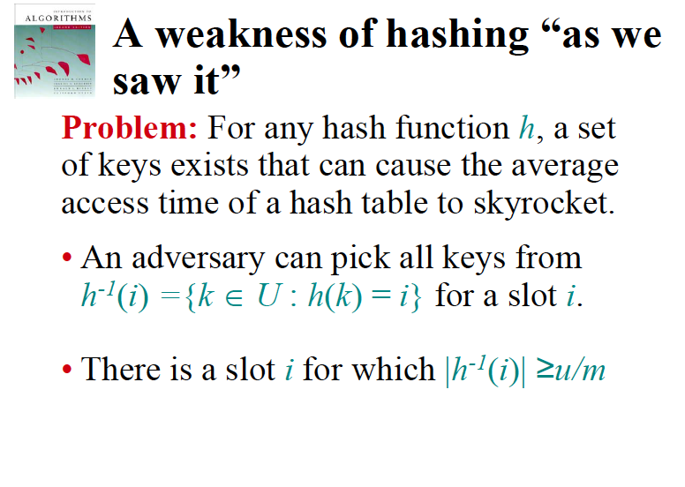
Universal Hashing
<number>/48

Slide 20
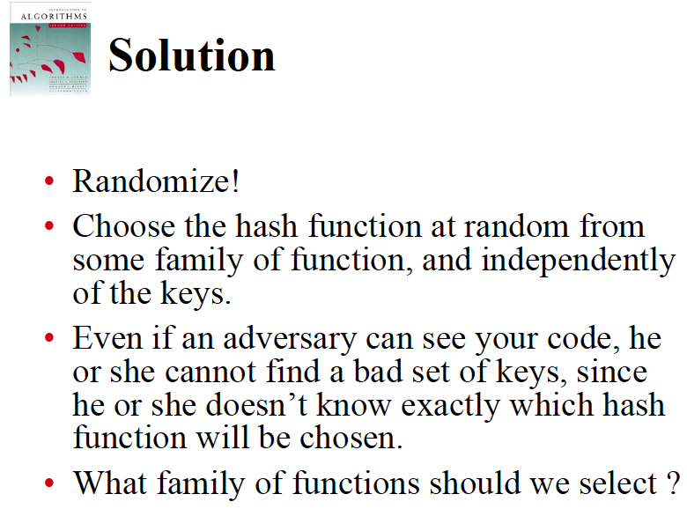
Universal Hashing
<number>/48

Slide 21
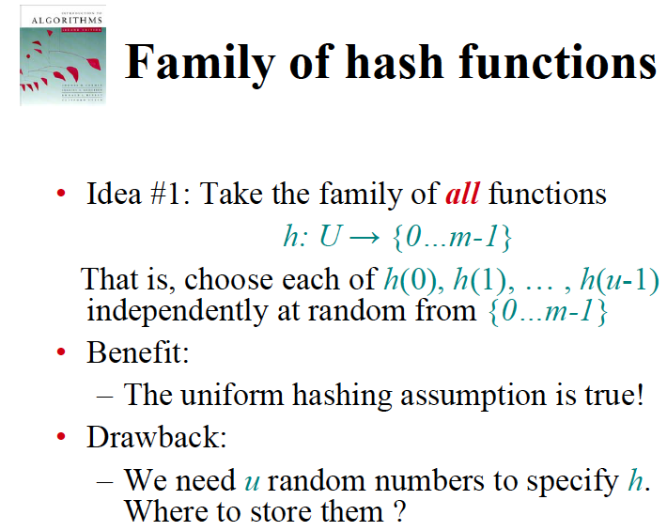
Universal Hashing
<number>/48

Slide 22
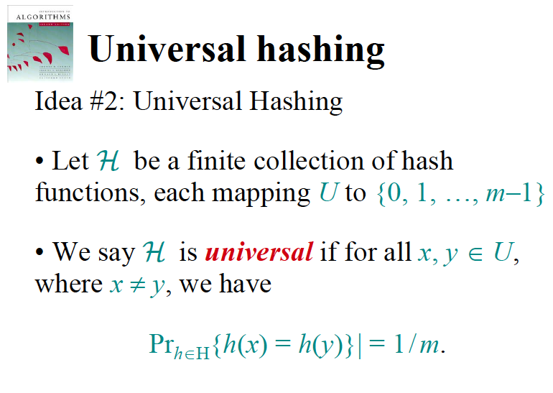
Universal Hashing
<number>/48

Slide 23
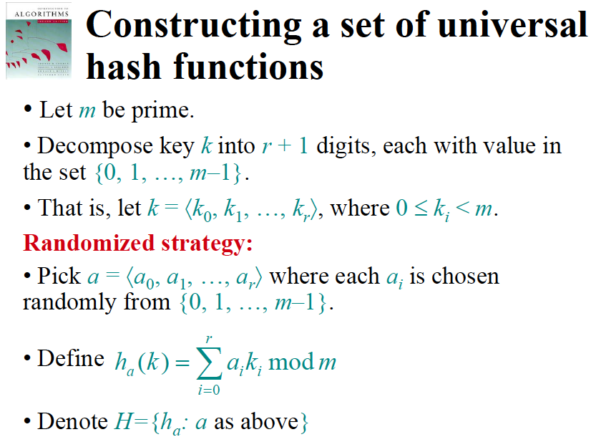
Universal Hashing
<number>/48

Slide 24
Resolving collisions by open addressing
Open addressing: No storage is used outside of the hash table itself.
(compare to chaining where linked lists are stored)
Insertion systematically probes the table until an empty slot is found.
The hash function depends on both the key and probe number:
  h: U×{0, 1, …, m–1} →{0, 1, …, m–1}.
The probe sequence <h(k,0), h(k,1), …, h(k,m–1)> should be a permutation of {0, 1, …, m–1}.
The table may fill up, and deletion is difficult (but not impossible).

Slide 25
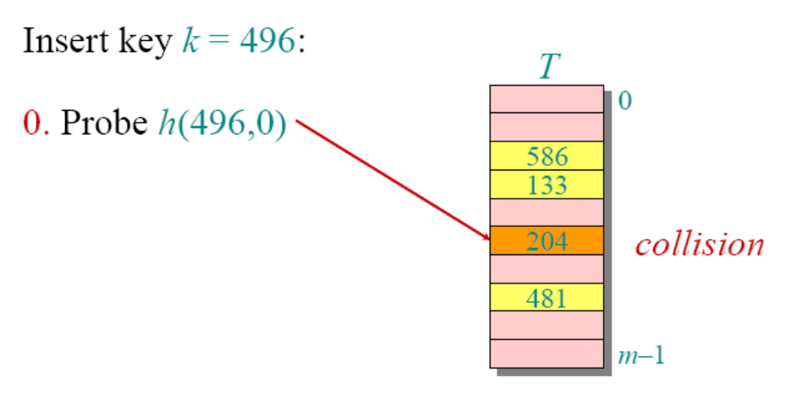
Open addressing example

Slide 26
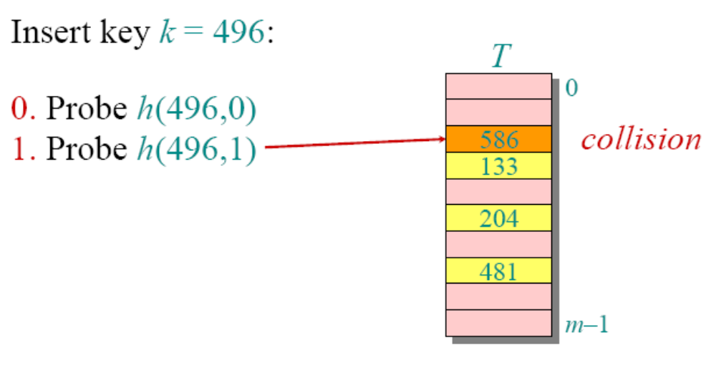
Open addressing example

Slide 27
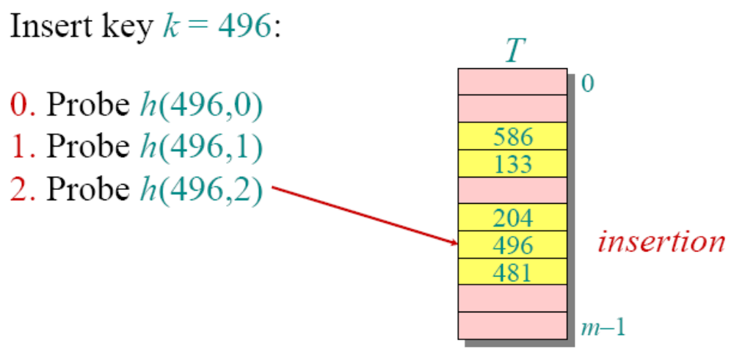
Open addressing example

Slide 28
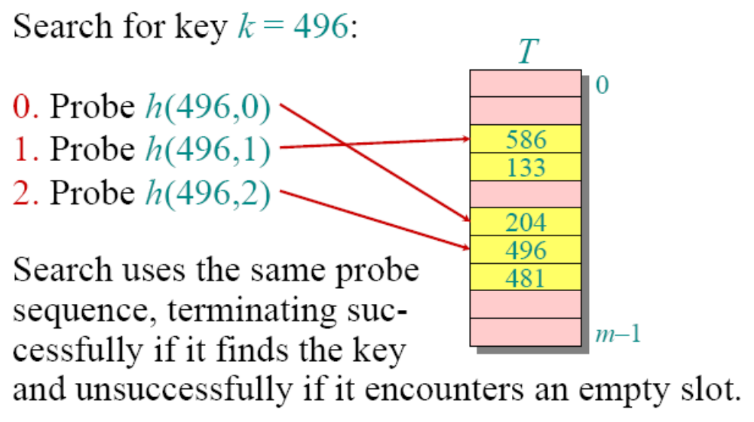
Open addressing example

Slide 29
Probing Strategies
Linear Probing
h(k,i) = (h’(k)+i) mod m
Quadratic Probing
h(k,i) = (h’(k)+c₁i + c₂i²) mod m
Double Hashing
h(k,i) = (h₁(k)+i h₂(k)) mod m

Slide 30
Linear Probing
Given an ordinary hash function h′(k), linear probing uses the hash function
  h(k,i) = (h′(k) +i) mod m.
This method, suffers from primary clustering, where long runs of occupied slots build up, increasing the average search time. Moreover, the long runs of occupied slots tend to get longer.

Slide 31
Double hashing
Given two ordinary hash functions h₁(k)and h₂(k), double hashing uses the hash function
  h(k,i) = (h₁(k) +i⋅h₂(k)) mod m.
This method generally produces excellent results, but h₂(k) must be relatively prime to m. One way is to make ma power of 2 and design h (k) to produce only odd numbers.

Slide 32
Example
Insert B={1,12,23,34,2}
into a hash table of size m=11,
a) using linear probing
b) Using double hashing with h2(k)=(k mod 7)

Slide 33
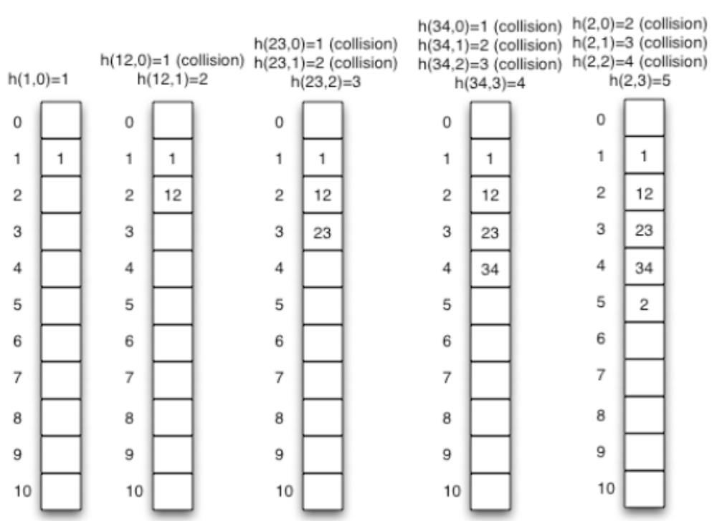
Example: linear probing

Slide 34
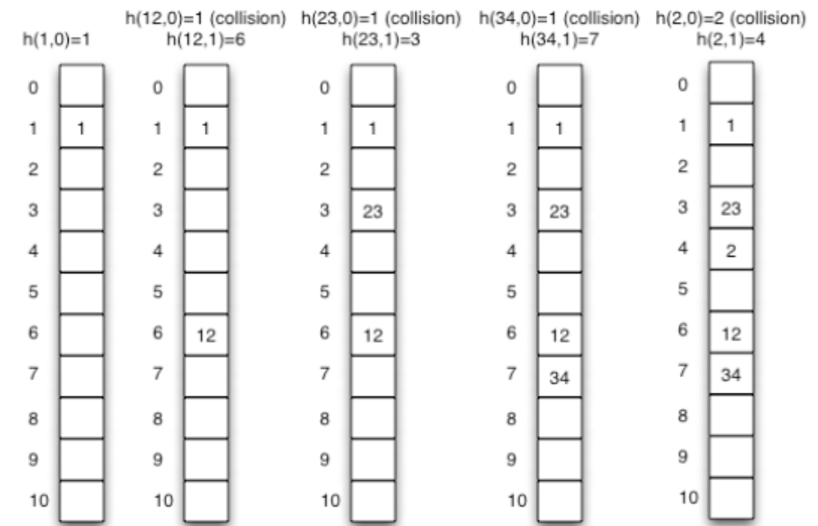
Example: double hashing

Slide 35
Perfect Hashing
perfect hashing if the worst-case number of memory accesses required to perform a search is O(1).
Use a two level hashing scheme with universal hashing at each level.

Slide 36
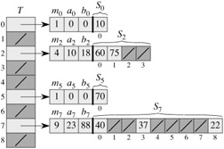
Perfect Hashing
Using perfect hashing to store the set K = {10, 22, 37, 40, 60, 70, 75}. The outer hash function is h(k) = ((ak + b) mod p) mod m, where a = 3, b = 42, p = 101, and m = 9. For example, h(75) = 2, so key 75 hashes to slot 2 of table T . A secondary hash table Sj stores all keys hashing to slot j . The size of hash table Sj is mj , and the associated hash function is hj (k) = ((aj k + bj) mod p) mod mj. Since h2(75) = 1, key 75 is stored in slot 1 of secondary hash table S2. There are no collisions in any of the secondary hash tables, and so searching takes constant time in the worst case.

Slide 37
Summary
Dictionary
Direct Access Table
Hash Table
  concept
  collision resolution
  choosing a hash function
  advanced collision resolution

