Slide 1

Analysis of Algorithms 1
(Fall 2011)
Istanbul Technical University
Computer Eng. Dept.
Chapter 14
Augmenting Data Structures
Last updated: December 16, 2009

Slide 2
Purpose
Understanding what “augmenting a data structure” means (augmenting=extending)
Go through examples cases where a known data structure is modified to solve a new problem.

Slide 3
Outline
Augmenting a data structure
Red and Black tree for order statistics (SELECT and RANK)
Interval trees

Slide 4
Augmenting a Data Structure
It is unusual to have to design an all-new data structure from scratch.
It is more common to take a data structure that you know and store additional information in it.
With the new information, the data structure can support new operations.
But. . . you have to figure out how to correctly maintain the new information without loss of efficiency.

Slide 5
Augment Red-Black Trees
So that we have
The usual dynamic-set operations
  INSERT(S, x): inserts element x into set S.
  MAXIMUM(S): returns element of S with largest key.
  EXTRACT-MAX(S): removes and returns element of S with largest key.
  INCREASE-KEY(S, x, k): increases value of element x.s key to k. Assume k ≥ x.s current key value.
PLUS the following order statistics related operations:
  OS-SELECT(x, i ): return pointer to node containing the i th smallest key of the subtree rooted at x.
  OS-RANK(T, x): return the rank of x in the linear order determined by an inorder walk of T .

Slide 6
REMINDER
Red-black trees
BSTs (Binary Search Tree) with an extra one-bit color field in each node.
Red-black properties:
Every node is either red or black.
The root and leaves (NIL’s) are black.
If a node is red, then its parent is black.
All simple paths from any node x to a descendant leaf have the same number of black nodes = black-height(x).

Slide 7
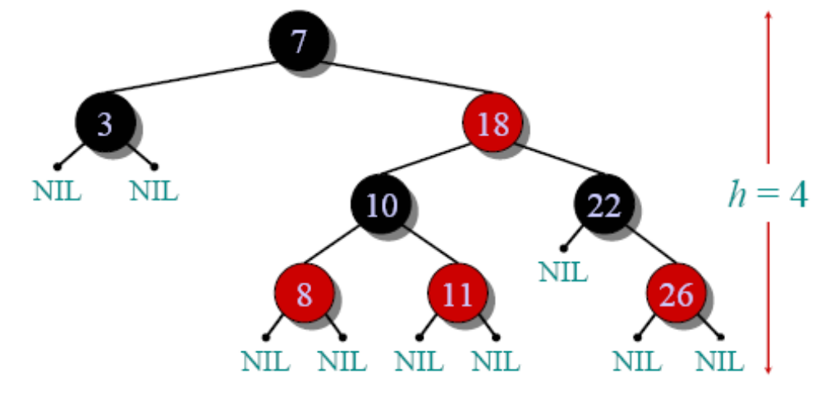
REMINDER
Red-black tree example

Slide 8
Red-Black Tree Augmenting
store in each node x:
size[x] = # of nodes in subtree rooted at x .
  Includes x itself.
  Does not include leaves (sentinels).
Define for sentinel size[nil[T ]] = 0.
Then size[x] = size[left[x]]+size[right[x]]+1
Note: OK for keys to not be distinct. Rank is defined with respect to position in inorder walk. So if we changed D to C, rank of original C is 2, rank of D changed to C is 3.

Slide 9
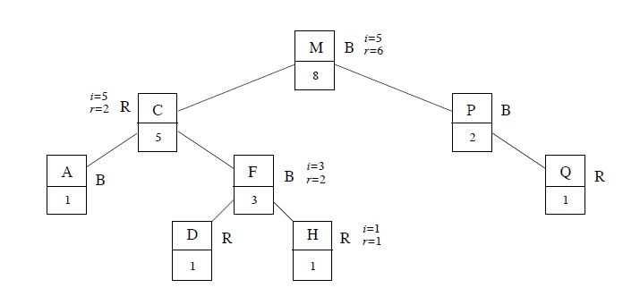
  OS-SELECT(x, i ): return pointer to node containing the i th smallest key of the subtree rooted at x.
OS-SELECT(x, i )
r ← size[left[x]]+1
if i = r
then return x
elseif i < r
then return OS-SELECT(left[x], i )
else return OS-SELECT(right[x], i − r )
Initial call: OS-SELECT(root[T ], i )
Example: OS-SELECT(root[T ], 5) (see figure).
Note: It is OK for keys to not be distinct. Rank is defined with respect to position in inorder walk. So if we changed D to C, rank of original C is 2, rank of D changed to C is 3.

Slide 10
Proof of Correctness and Efficiency
Correctness: r = rank of x within subtree rooted at x.
• If i = r , then we want x.
• If i < r , then i th smallest element is in x.s left subtree, and we want the i th smallest element in the subtree.
• If i > r , then i th smallest element is in x.s right subtree, but subtract off the r elements in x.s subtree that precede those in x.s right subtree.
• Like the randomized SELECT algorithm!
Analysis: Each recursive call goes down one level. Since R-B tree has O(lg n) levels, have O(lg n) calls ⇒ O(lg n) time.

Slide 11
Randomized Select
Order Statistics Chapter,
Finding the element of order i
REMINDER
RANDOMIZED-SELECT(A, p, r, i)
1 if p = r
2 then return A[p]
3 q ← RANDOMIZED-PARTITION(A, p, r)
4 k ← q - p + 1
5 if i = k ▹ the pivot value is the answer
6 then return A[q]
7 elseif i < k
8 then return RANDOMIZED-SELECT(A, p, q - 1, i)
9 else return RANDOMIZED-SELECT(A, q + 1, r, i - k)
expected time of RANDOMIZED-SELECT is Θ(n).

Slide 12
OS-RANK(T,x)
  //OS-RANK(T, x): return the rank of x in the linear order determined by an inorder walk of T .
OS-RANK(T, x)
r ← size[left[x]] + 1
y ← x
while y != root[T ]
do if y = right[p[y]]
then r ←r + size[left[p[y]]] + 1
y ← p[y]
return r

Slide 13
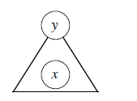
Correctness
Loop invariant: At start of each iteration of while loop, r = rank of key[x] in subtree rooted at y.
Initialization: Initially, r = rank of key[x] in subtree rooted at x, and y = x.
Termination: Loop terminates when y = root[T ] ⇒ subtree rooted at y is entire tree. Therefore, r = rank of key[x] in entire tree.
Maintenance: At end of each iteration, set y ← p[y]. So, show that if r = rank of key[x] in subtree rooted at y at start of
loop body, then r = rank of key[x] in subtree
rooted at p[y] at end of loop body.
[r = # of nodes in subtree rooted at y preceding x in inorder walk]

Slide 14
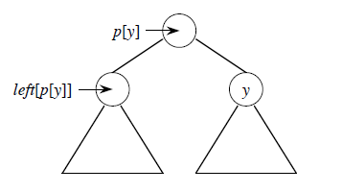
Correctness (cont)
Maintenance: At end of each iteration, set y ← p[y]. So, show that if r = rank of key[x] in subtree rooted at y at start of
loop body, then r = rank of key[x] in subtree
rooted at p[y] at end of loop body.
Must add nodes in y.s sibling.s subtree.
If y is a left child, its sibling.s subtree follows all nodes in y.s subtree ⇒ don.t change r .
If y is a right child, all nodes in y.s sibling.s subtree precede all nodes in y.s subtree ⇒add size of y.s sibling.s subtree, plus 1 for p[y], into r .
Analysis: y goes up one
level in each iteration ⇒
O(lg n) time.

Slide 15
Efficiency
Maintaining subtree sizes
Need to maintain size[x] fields during insert and delete operations.
Need to maintain them efficiently. Otherwise, might have to recompute them all, at a cost of (n).
Will see how to maintain without increasing O(lg n) time for insert and delete.

Slide 16
Efficiency
Insert:
During pass downward, we know that the new node will be a descendant of
each node we visit, and only of these nodes. Therefore, increment size field of each node visited.
Then there is the fixup pass:
• Goes up the tree.
• Changes colors O(lg n) times.
• Performs ≤ 2 rotations.
• Color changes don.t affect subtree sizes.
• Rotations do!
• But we can determine new sizes based on old sizes and sizes of children.

Slide 17
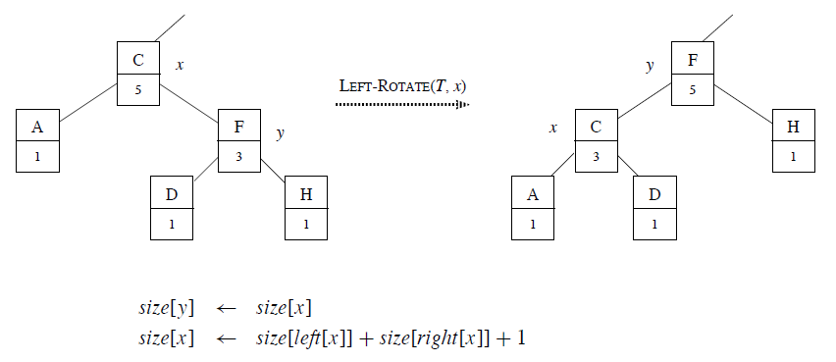
Efficiency (cont)
Similar for right rotation.
• Therefore, can update in O(1) time per rotation ⇒ O(1) time spent updating
size fields during fixup.
• Therefore, O(lg n) to insert.

Slide 18
Efficiency (cont)
Delete: Also 2 phases:
1. Splice out some node y.
2. Fixup.
After splicing out y, traverse a path y → root, decrementing size in each node on path. O(lg n) time.
During fixup, like insertion, only color changes and rotations.
• ≤ 3 rotations ⇒ O(1) time spent updating size fields during fixup.
• Therefore, O(lg n) to delete.
Done!

Slide 19
Methodology for augmenting a data structure
1. Choose an underlying data structure.
2. Determine additional information to maintain.
3. Verify that we can maintain additional information for existing data structure
operations.
4. Develop new operations.
1. R-B tree.
2. size[x].
3. Showed how to maintain size during insert and delete.
4. Developed OS-SELECT and OS-RANK.

Slide 20
Red-Black Trees Amenable to Augmentation
Theorem
Augment a R-B tree with field f , where f [x] depends only on information in x, left[x], and right[x] (including f [left[x]] and f [right[x]]). Then can maintain values of f in all nodes during insert and delete without affecting O(lg n) performance.
Proof Since f [x] depends only on x and its children, when we alter information in x, changes propagate only upward (to p[x], p[p[x]], . . . , root).
Height = O(lg n)⇒ O(lg n) updates, at O(1) each.
Insertion: see the book
Delete: see the book

Slide 21
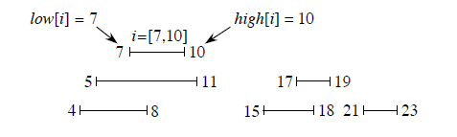
Interval Trees
Maintain a set of intervals. For instance, time intervals.

Slide 22
Interval Tree Properties
Operations
• INTERVAL-INSERT(T, x): int[x] already filled in.
• INTERVAL-DELETE(T, x)
• INTERVAL-SEARCH(T, i ): return pointer to a node x in T such that int[x] overlaps interval i . Any overlapping node in T is OK. Return pointer to sentinel nil[T ] if no overlapping node in T .
Interval i has low[i ], high[i ].
i and j overlap if and only if low[i ] ≤ high[ j ] and low[ j ] ≤ high[i ].

Slide 23
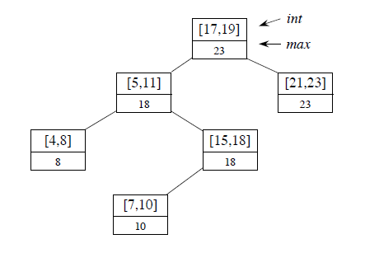
Augmenting to Get Interval-Trees
For interval trees
1. Use R-B trees.
Each node x contains interval int[x].
Key is low endpoint (low[int[x]]).
Inorder walk would list intervals sorted by low endpoint.
2. Each node x contains
max[x] = max endpoint
value in subtree rooted at x .

Slide 24
Summary
Binary Search Tree (BST) review
Red and Black Trees
2-3 and 2-3-4 trees
Operations on Red and Black Trees

