Slide 1

Analysis of Algorithms
(Fall 2013)
Istanbul Technical University
Computer Eng. Dept.
Chapter 17: Amortized Analysis
Course slides from
Susan Bridges @MS State
have been used in preparation of these slides.
Last updated: December 9, 2009

Slide 2
Purpose
Understand amortized analysis, when it is used, and how it differs from the average-case analysis
Be able to apply techniques of aggregate analysis, accounting method, and potential method to analyze operations on simple data structures

Slide 3
Outline
Dynamic Tables
Aggregate Analysis
Accounting Method
Potential Method

Slide 4
Amortized Analysis
We examined worst-case, average-case and best-case analysis performance
In amortized analysis we care for the cost of one
operation if considered in a sequence of n operations
  In a sequence of n operations, some operations may be cheap, some may be expensive (actual cost)
  The amortized cost of an operation equals the total cost of the n operations divided by n

Slide 5
Amortized Analysis
Think of it this way:
  You have a bank account with 1000TL and you want to go shopping and purchase some items
  Some items you buy cost 1TL, some items you buy cost 100TL
  You purchase 20 items in total, therefore the amortized cost of each purchase is 5TL

Slide 6
Amortized Analysis
Purpose is to accurately compute the total time spent in executing a sequence of operations on a data structure
Three different approaches:
  aggregate method: brute force
  accounting method: assign costs to each operation so that it is easy to sum them up while still ensuring that result is accurate
  potential method: a more sophisticated version of the accounting method

Slide 7
Dynamic Tables

Slide 8
How Large Should a Hash Table Be?
Goal: Make the table as small as possible, but
large enough so that it will not overflow (or otherwise become inefficient)
Problem: What if we do not know the proper size
in advance?
Solution: Dynamic tables
IDEA:
Whenever the table overflows, “grow” it
by allocating (via malloc or new) a new, larger
table
Move all items from the old table into the
new one, and free the storage for the old table

Slide 9
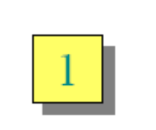
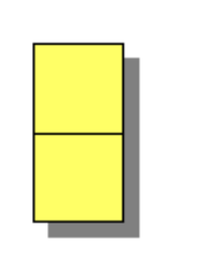
Example of a Dynamic Table
1. INSERT
2. INSERT
overflow

Slide 10
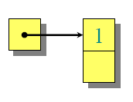
Example of a Dynamic Table
1. INSERT
2. INSERT
overflow

Slide 11
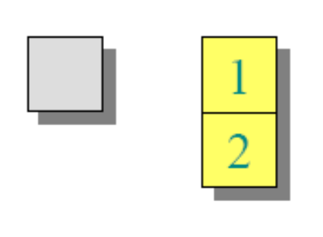
Example of a Dynamic Table
1. INSERT
2. INSERT

Slide 12
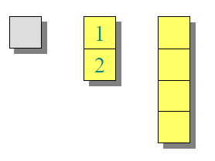
Example of a Dynamic Table
1. INSERT
2. INSERT
3. INSERT
overflow

Slide 13
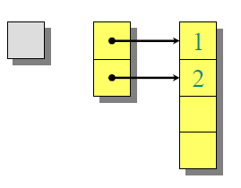
Example of a Dynamic Table
1. INSERT
2. INSERT
3. INSERT
overflow

Slide 14
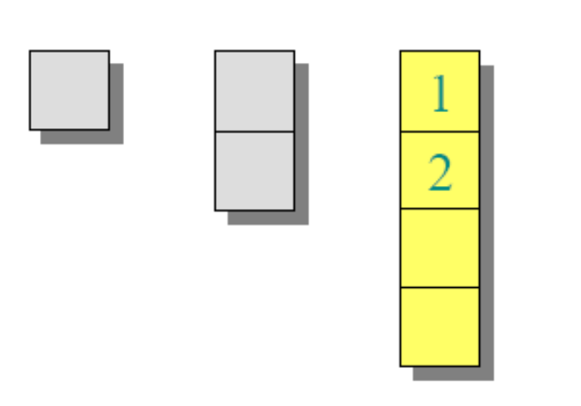
Example of a Dynamic Table
1. INSERT
2. INSERT
3. INSERT

Slide 15
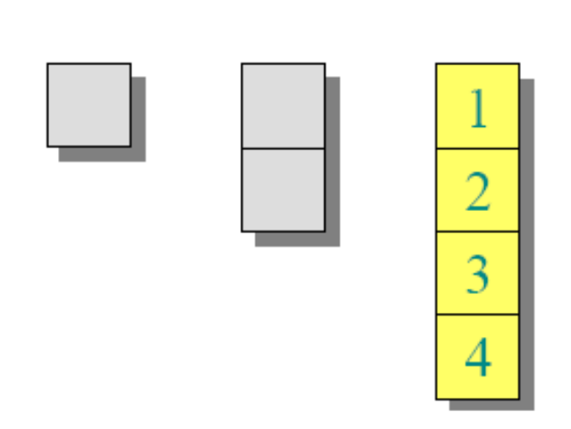
Example of a Dynamic Table
1. INSERT
2. INSERT
3. INSERT
4. INSERT

Slide 16
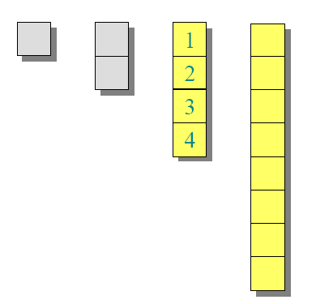
Example of a Dynamic Table
1. INSERT
2. INSERT
3. INSERT
4. INSERT
5. INSERT
overflow

Slide 17
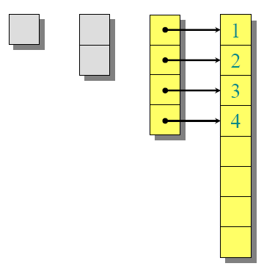
Example of a Dynamic Table
1. INSERT
2. INSERT
3. INSERT
4. INSERT
5. INSERT
overflow

Slide 18
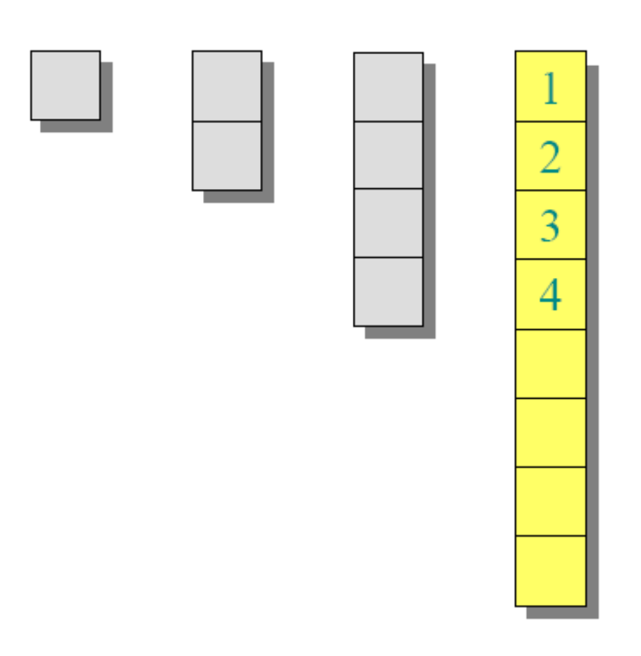
Example of a Dynamic Table
1. INSERT
2. INSERT
3. INSERT
4. INSERT
5. INSERT

Slide 19
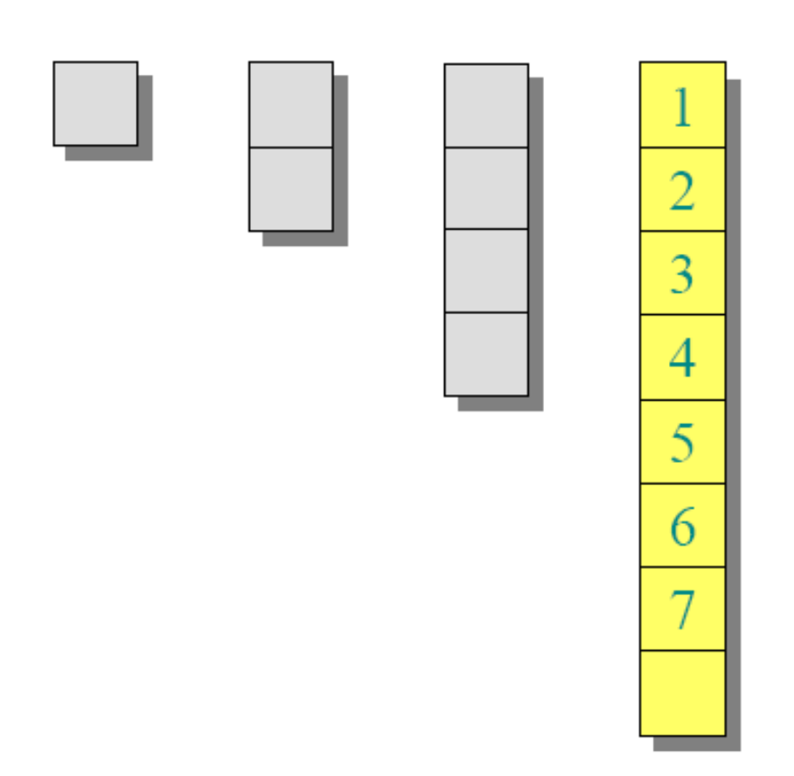
Example of a Dynamic Table
1. INSERT
2. INSERT
3. INSERT
4. INSERT
5. INSERT
6. INSERT
7. INSERT

Slide 20
Worst-Case Analysis
Consider a sequence of n insertions
Worst-case time to execute one insertion is Θ(n)
Therefore, the worst-case time for n insertions is
n·Θ(n) = Θ(n²)
WRONG! In fact, the worst-case cost for
n insertions is only Θ(n) ≪ Θ(n²).
Let us see why…

Slide 21
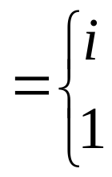
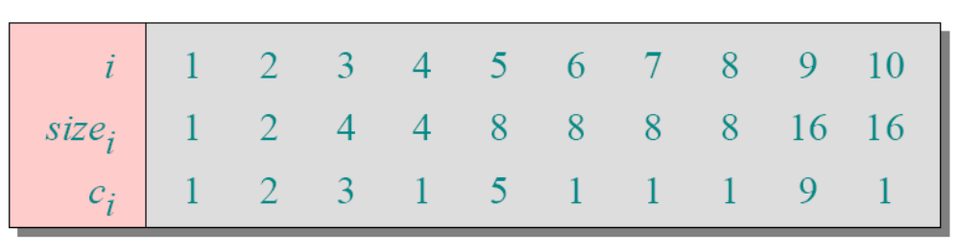
Tighter Analysis
Let c_{i} = the cost of the i th insertion
if i –1 is an exact power of 2,
otherwise

Slide 22
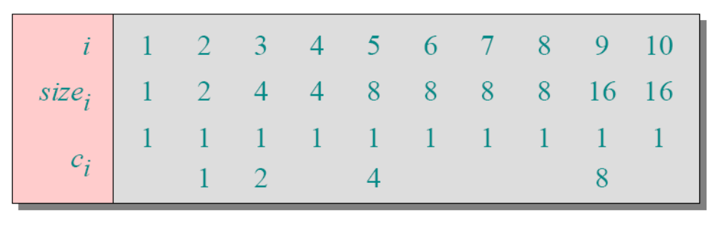
Tighter Analysis
Let c_{i} = the cost of the i th insertion
if i –1 is an exact power of 2,
otherwise

Slide 23
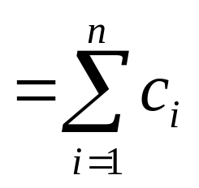
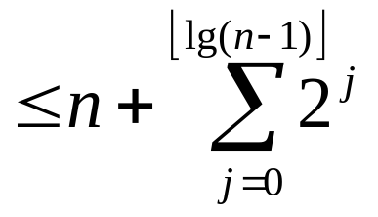


Tighter Analysis (cont.)
Cost of n insertions.
Thus, the average cost of each dynamic-table
operation is Θ(n)/n= Θ(1)

Slide 24
Amortized Analysis

Slide 25
Amortized Analysis
Is any strategy for analyzing a sequence of operations to show that
  average cost per operation is small, even though a single operation within sequence might be expensive
Does not involve probability even though we are taking averages! (differs from average-case analysis)
Guarantees average performance of each operation in worst case

Slide 26
Types of Amortized Analysis
Three most common techniques used in amortized analysis:
  aggregate analysis
  accounting method
  potential method

Slide 27
Aggregate Analysis
We determine an upper bound T(n) on total cost of sequence of n operations
Average cost per operation is then T(n)/n
We take average cost as amortized cost of each operation, so that all operations have same amortized cost

Slide 28
Accounting Method
We determine an amortized cost of each operation
When there is more than one type of operation, each type of operation may have a different amortized cost
Accounting method overcharges some operations early in the sequence, storing the overcharge as “prepaid credit” on specific objects in the data structure
The credit is used later in the sequence to pay for operations that are charged less than they actually cost

Slide 29
Potential Method
Is like accounting method in that we determine amortized cost of each operation and may overcharge operations early on to compensate for undercharges later
Maintains the credit as “potential energy” of data structure as a whole instead of associating the credit with individual objects within the data structure

Slide 30
Note
Charges assigned during an amortized analysis are for analysis pruposes only
They need not and should not appear in the code
If, for example, a credit is assigned to an object x when using the accounting method, there is no need to assign an appropriate amount to some attribute credit[x] in the code

Slide 31
Benefits of Amortized Analysis
The insight into a particular data structure gained by performing an amortized analysis can help in optimizing the design
We will use the potential method to analyze a dynamically expanding and contracting table later on

Slide 32
Aggregate Analysis

Slide 33
Aggregate Analysis
In aggregate analysis, we show that
  For all n, a sequence of operations takes worst-case time T(n) in total
In worst-case, average cost, or amortized cost, per operation is therefore T(n)/n
Note
  This amortized cost applies to each operation, even when there are several types of operations in the sequence
  The other two methods (accounting and potential) may assign different amortized costs to different types of operations

Slide 34
Aggregate Analysis:
Stack Operations
Example: Analyze stacks that have
been augmented with a new operation
Operations are
  Push(S, x): pushes object x
  onto stack S
  Pop(S): pops top of stack S,
  returns popped object
  Multipop(S, k): pops the top k elements, or pops entire stack if it contains fewer than k objects
seen in Ch. 10 Elementary Data Structures

Slide 35
Aggregate Analysis:
Stack Operations
Example: Analyze stacks that have
been augmented with a new operation
Operation STACK-EMPTY returns
TRUE if there are no objects currently
on the stack, and FALSE otherwise
MULTIPOP(S, k)
1 while not STACK-EMPTY(S) and k ≠ 0
2 do POP(S)
3 k ← k - 1

Slide 36
Aggregate Analysis:
Stack Operations
Example: Analyze stacks that have
been augmented with a new operation
top ->23
17
6
39
10
47
__
top -> 10
47
__
__
Top 4 objects popped
by MULTIPOP(S, 4)
MULTIPOP(S, 7) empties the
stack because there are fewer
than 7 objects remaining

Slide 37
Aggregate Analysis:
Stack Operations
Example: Analyze stacks that have
been augmented with a new operation
Running time of MULTIPOP(S, k) on a stack
of s objects?
  Actual running time linear in number of POP operations executed, and thus it suffices to analyze MULTIPOP in terms of abstract costs of 1 each for PUSH and POP
  Number of operations of while loop is number min(s, k) of objects popped off stack
  For each iteration of loop, one call made to POP in line 2
  Thus, total cost of MULTIPOP is min(s,k), and actual running time is linear function of this cost

Slide 38
Aggregate Analysis:
Stack Operations
Example: Analyze stacks that have
been augmented with a new operation
Implement with either array or linked list
  time for Push is O(1)
  time for Pop is O(1)
  time for Multipop is O(min(|S|,k))

Slide 39
Aggregate Analysis:
Stack Operations
Example: Analyze stacks that have
been augmented with a new operation
Let us analyze a sequence of n PUSH, POP,
and MULTIPOP operations on an initially
empty stack
  Worst-case cost of a MULTIPOP operation in the sequence is O(n), since stack size is at most n
  Worst-case cost of any stack operation is therefore O(n), and hence a sequence of n operations costs O(n²), since we may have O(n) MULTIPOP operations costing O(n) each
  Although this analysis is correct, O(n²) result, obtained by considering the worst-case cost of each operation individually, is not tight

Slide 40
Aggregate Analysis:
Stack Operations
Example: Analyze stacks that have
been augmented with a new operation
Using aggregate analysis, we can obtain a
better upper bound that considers the entire sequence of n operations
  In fact, although a single MULTIPOP operation can be expensive, any sequence of n PUSH, POP, and MULTIPOP operations on an initially empty stack can cost at most O(n)
  Why? Each object can be popped at most once for each time it is pushed
  Therefore, the number of times that POP can be called on a nonempty stack, including calls within MULTIPOP, is at most the number of PUSH operations, which is at most n

Slide 41
Aggregate Analysis:
Stack Operations
Example: Analyze stacks that have
been augmented with a new operation
Using aggregate analysis, we can obtain a
better upper bound that considers the entire sequence of n operations
  For any value of n, any sequence of n PUSH, POP, and MULTIPOP operations takes a total of O(n) time
  Average cost of an operation is O(n)/n = O(1)
  In aggregate analysis, we assign the amortized cost of each operation to be the average cost
  In this example, therefore, all three stack operations have an amortized cost of O(1)

Slide 42
Aggregate Analysis:
Stack Operations
Example: Analyze stacks that have
been augmented with a new operation
Using aggregate analysis, we can obtain a
better upper bound that considers the entire sequence of n operations
  We emphasize again that although we have just shown that the average cost, and hence running time, of a stack operation is O(1), no probabilistic reasoning was involved
  We actually showed a worst-case bound of O(n) on a sequence of n operations
  Dividing this cost by n yielded the average cost per operation, or the amortized cost

Slide 43
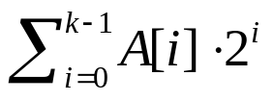
Aggregate Analysis: Incrementing a Binary Counter
Example: Implementing a k-bit binary counter that counts upward from 0
We use an array A[0..k-1] of bits, where length[A]=k, as the counter
A binary number x that is stored in the counter has its lowest-order bit in A[k-1], so that x =
Initially, x = 0, and thus A[i] = 0 for i= 0, 1, …, k-1
To add 1 (modulo 2^{k}) to the value in the counter, we use the following procedure

Slide 44
Aggregate Analysis: Incrementing a Binary Counter
INCREMENT(A)
1 i ← 0
2 while i < length[A] and A[i] = 1
do A[i] ← 0
i ← i + 1
if i < length[A]
then A[i] ← 1
This procedure resets the first i-th sequence of 1 bits and sets
A[i] equal to 1 (ex. 0011 → 0100, 0101 → 0110, 0111 → 1000)

Slide 45
Aggregate Analysis: Incrementing a Binary Counter
4-bit counter:
Counter value COUNTER Bits flipped (work T(n))
0 0 0 0 0 0
1 0 0 0 1 1
2 0 0 1 0 3
3 0 0 1 1 4
4 0 1 0 0 7
5 0 1 0 1 8
6 0 1 1 0 10
7 0 1 1 1 11
8 1 0 0 0 15
A₃A₂A₁A₀
highlighted are bits that
flip at each increment

Slide 46
Aggregate Analysis: Incrementing a Binary Counter
Example: Implementing a k-bit binary counter that counts upward from 0
A naive approach says that a sequence of n operations on a n-bit counter needs O(n²) work
Each INCREMENT() takes up to O(n) time. n INCREMENT() operations can take O(n²) time
Amortized analysis with accounting method
We show that amortized cost per INCREMENT() is only O(1) and the total work O(n)
OBSERVATION: In example, T(n) (work) is never twice the amount of counter value (total # of increments)

Slide 47
Aggregate Analysis: Incrementing a Binary Counter
Example: Implementing a k-bit binary counter that counts upward from 0
Charge each 0 → 1 flip 2TL in line 6
1TL pays for the 0 → 1 flip in line 6
1TL is deposited to pay for the 1 → 0 flip later in line 3
Therefore, a sequence of n INCREMENTS() needs
T(n)= 2n TL
Each INCREMENT() has an amortized cost of
2n/n = O(1)

Slide 48
Aggregate Analysis: Incrementing a Binary Counter
Credit invariant
TL
TL
0 0 0 0
0 0 0 1
0 0 1 0
Charge 2 TL for every 0→1 bit flip (1 TL pays for the actual operation)
Every 1 bit has 1 TL deposited to pay for 1→0 bit flip later
TL TL
0 0 1 1
TL TL
TL TL
TL
0 1 1 0
0 1 0 1
0 1 0 0

Slide 49
Types of Amortized Analysis
Three most common techniques used in amortized analysis:
• aggregate analysis
• accounting method
• potential method
We have just seen an aggregate analysis
The aggregate method, though simple, lacks the
precision of the other two methods
In particular, the accounting and potential methods
allow a specific amortized cost to be allocated to
each operation

Slide 50
Accounting Method

Slide 51
Accounting Method
We assign differing charges to different operations, with some operations charged more or less than they actually cost
The amount we charge an operation is called its amortized cost
When an operation’s amortized cost exceeds its actual cost, the difference is assigned to specific objects in the data structure as credit
Credit can be used later on to help pay for operations whose amortized cost is less than their actual cost
Thus, one can view the amortized cost of an operation as being split between its actual cost and credit that is either deposited or used up
This method is very different from aggregate analysis, in which all operations have the same amortized cost

Slide 52
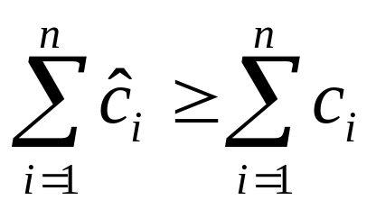
Accounting Method
Charge i th operation a fictitious amortized cost ĉ_{i} , where 1 TL pays for 1 unit of work (i.e., time)
This fee is consumed to perform the operation
Any amount not immediately consumed is stored in the bank for use by subsequent operations
The bank balance must not go negative! We must ensure that
for all n (where c_{i}: actual cost of i th operation)
Thus, the total amortized costs provide an upper bound on the total true costs

Slide 53
Accounting Method:
Stack Operations
Recall the actual costs of the operations were
  PUSH 1
  POP 1
  MULTIPOP min(k,s) (k: argument to MULTIPOP, s: stack size)
Let us assign the following amortized costs:
  PUSH 2
  POP 0
  MULTIPOP 0
Note: Amortized cost of MULTIPOP is a constant (0), whereas the actual cost is variable
Here, all three amortized costs are O(1), although in general the amortized costs of the operations under consideration may differ asymtotically

Slide 54
Accounting Method:
Stack Operations
We will now show that we can pay for any sequence of stack operations by charging the amortized costs
Suppose we use a 1 TL coin to represent each unit of cost
We start with an empty stack
Recall the analogy of Ch. 10 between the stack data structure and a stack of plates in a cafeteria
When we push a plate on the stack, we use 1 TL to pay the actual cost of the push and are left with a credit of 1 TL (out of the 2 TL charged), which we can put on top of the plate
At any point in time, every plate on the stack has a lira of credit on it

Slide 55
Accounting Method:
Stack Operations
The lira stored on the plate is prepayment for the cost of popping it from the stack
When we execute a POP operation, we charge the operation nothing and pay its actual cost using the credit stored in the stack
To pop a plate, we take the lira of credit off the plate and use it to pay the actual cost of the operation
Thus, by charging the PUSH operation a little bit more, we do not need to charge the POP operation anything

Slide 56
Accounting Method:
Stack Operations
We do not need to charge MULTIPOP operations anything either
To pop the first plate, we take the lira of credit off the plate and use it to pay the actual cost of the POP operation
To pop a second plate, we again have a lira of credit on the plate to pay for the POP operation, and so on
Thus, we have always charged enough up front to pay for MULTIPOP operations

Slide 57
Accounting Method:
Stack Operations
In other words, since each plate on the stack has 1 dollar of credit on it, and the stack always has a nonnegative number of plates, we have ensured that the amount of credit is always nonnegative
Thus, for any sequence of n PUSH, POP, and MULTIPOP operations, the total amortized cost is an upper bound on the total actual cost
Since the total amortized cost is O(n), so is the actual cost

Slide 58
Accounting Method:
Incrementing a Binary Counter
Example: Analyze the INCREMENT operation on a binary counter that starts at zero
As we observed earlier, running time of this operation is proportional to the number of bits flipped, which we will use as our cost for this example
Let us once again use a lira coin to represent each unit of cost (the flipping of a bit in this example)

Slide 59
Accounting Method:
Incrementing a Binary Counter
Example: Analyze the INCREMENT operation on a binary counter that starts at zero
For the amortized analysis, let us charge an amortized cost of 2 liras to set a bit to 1
When a bit is set, we use 1 lira (out of the 2 liras charged) to pay for the actual setting of the bit, and we place the other lira on the bit as credit to be used later when we flip the bit back to 0
At any point in time, every 1 in the counter has a lira of credit on it, and thus we do not need to charge anything to reset a bit to 0; we just pay for the reset with the lira coin on the bit

Slide 60
Accounting Method:
Incrementing a Binary Counter
Example: Analyze the INCREMENT operation on a binary counter that starts at zero
The amortized cost of INCREMENT can now be determined
The cost of resetting the bits within the while loop is paid for by the liras on the bits that are reset
At most one bit is set, in line 6 of INCREMENT, and therefore the amortized cost of an INCREMENT operation is at most 2 liras
The number of 1's in the counter is never negative, and thus the amount of credit is always nonnegative
Thus, for n INCREMENT operations, the total amortized cost is O(n), which bounds the total actual cost.

Slide 61
Accounting Analysis of Dynamic Tables
Charge an amortized cost of ĉ_{i} = 3TL for the i th
insertion.
• 1TL pays for the immediate insertion
• 2TL is stored for later table doubling
When the table doubles, 1TL pays to move a
recent item, and 1TL pays to move an old item
Example:
0TL
0TL
0TL
0TL
2TL
2TL
2TL
2TL
overflow

Slide 62
Accounting Analysis of Dynamic Tables
Charge an amortized cost of ĉ_{i} = 3TL for the i th
insertion.
• 1TL pays for the immediate insertion
• 2TL is stored for later table doubling
When the table doubles, 1TL pays to move a
recent item, and 1TL pays to move an old item
Example:
overflow
0TL
0TL
0TL
0TL
0TL
0TL
0TL
0TL

Slide 63
Accounting Analysis of Dynamic Tables
Charge an amortized cost of ĉ_{i} = 3TL for the i th
insertion.
• 1TL pays for the immediate insertion
• 2TL is stored for later table doubling
When the table doubles, 1TL pays to move a
recent item, and 1TL pays to move an old item
Example:
0TL
0TL
0TL
0TL
0TL
0TL
0TL
0TL
2TL
2TL
2TL

Slide 64
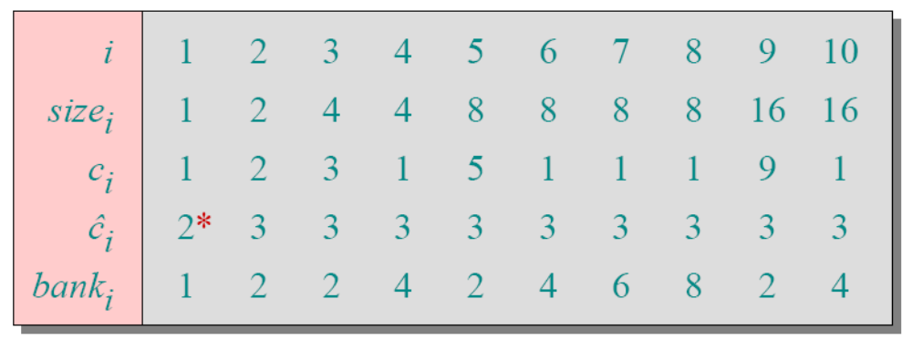
Accounting Analysis of Dynamic Tables (cont.)
Key invariant: Bank balance never drops below 0 Thus, the sum of the amortized costs provides an upper bound on the sum of the true costs
*Okay, so actually, the first operation costs only $2, not $3

Slide 65
Potential Method

Slide 66
Potential Method
Instead of representing prepaid work as credit stored with specific objects in the data structure
  potential method of amortized analysis represents the prepaid work as "potential energy," or just "potential," that can be released to pay for future operations
Potential is associated with data structure as a whole rather than with specific objects within data structure

Slide 67
Potential Method
IDEA: View the bank account as the potential energy (à la physics) of the dynamic set
Framework:
• Start with an initial data structure D₀
• Operation i transforms D_{i–1} to D_{i}
• Cost of operation i is c_{i}
• Define a potential function Φ: {D_{i}} →R,
such that Φ(D₀ ) = 0 and Φ(D_{i}) ≥ 0 for all i
• Amortized cost ĉ_{i} with respect to Φ is
defined to be ĉ_{i} = c_{i} + Φ(D_{i}) –Φ(D_{i–1}).

Slide 68
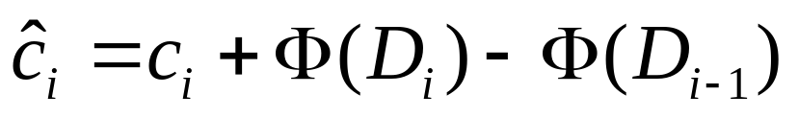
Understanding Potentials
potential difference ΔΦ_{i}
• If ΔΦi > 0, then ĉ_{i} > c_{i} : Operation i stores
work in the data structure for later use
• If ΔΦi < 0, then ĉ_{i} < c_{i} : The data structure
delivers up stored work to help pay for
operation i

Slide 69
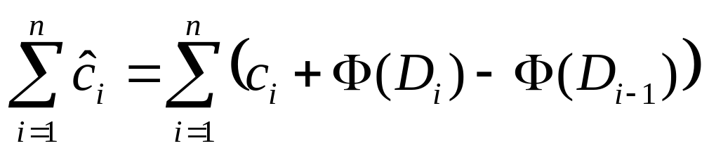
Amortized Costs Bound True Costs
The total amortized cost of n operations is
Summing both sides

Slide 70
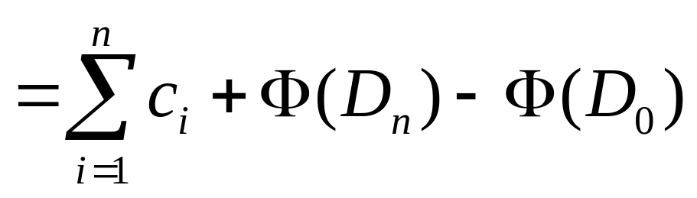
Amortized Costs Bound True Costs
The total amortized cost of n operations is
The series telescopes

Slide 71
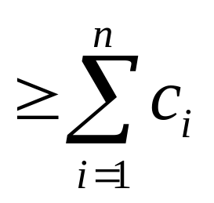
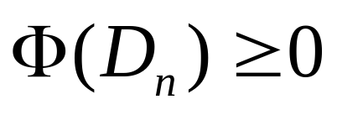
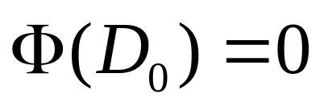
Amortized Costs Bound True Costs
The total amortized cost of n operations is
since
and

Slide 72
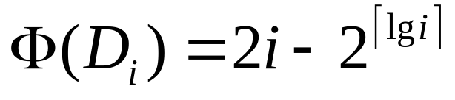
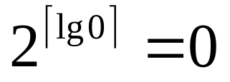
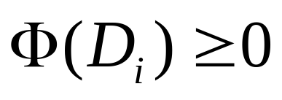
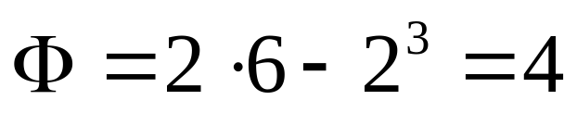
Potential Analysis of Table Doubling
Define the potential of the table after the ith
insertion by (Assume that
)
Note:
for all i
Example:
(
0TL
0TL
0TL
0TL
2TL
2TL
accounting method )

Slide 73
Calculation of Amortized Costs
The amortized cost of the i th insertion is

Slide 74

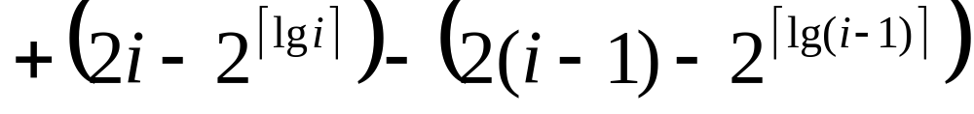
Calculation of Amortized Costs
The amortized cost of the i th insertion is
if i –1 is an exact power of 2,
otherwise;

Slide 75
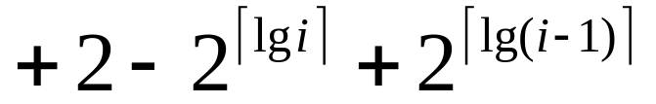
Calculation of Amortized Costs
The amortized cost of the i th insertion is
if i –1 is an exact power of 2,
otherwise;
if i –1 is an exact power of 2,
otherwise;

Slide 76
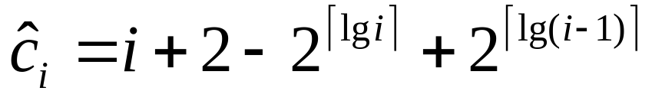
Calculation
Case 1: i –1 is an exact power of 2

Slide 77
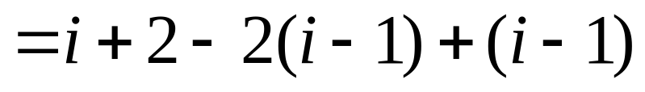
Calculation
Case 1: i –1 is an exact power of 2

Slide 78
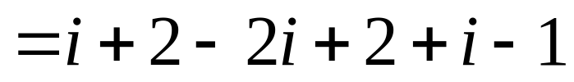
Calculation
Case 1: i –1 is an exact power of 2

Slide 79
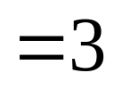
Calculation
Case 1: i –1 is an exact power of 2

Slide 80
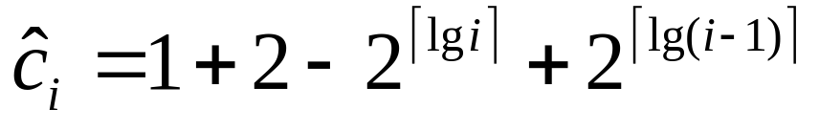
Calculation
Case 1: i –1 is an exact power of 2
Case 2: i –1 is not an exact power of 2

Slide 81
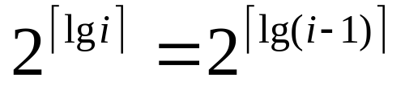
Calculation
Case 1: i –1 is an exact power of 2
Case 2: i –1 is not an exact power of 2
(since
)

Slide 82
Calculation
Case 1: i –1 is an exact power of 2
Case 2: i –1 is not an exact power of 2
Therefore, n insertions cost Θ(n) in the worst case

Slide 83
Calculation
Case 1: i –1 is an exact power of 2
Case 2: i –1 is not an exact power of 2
Therefore, n insertions cost Θ(n) in the worst case
Exercise: Fix the bug in this analysis to show that
the amortized cost of the first insertion is only 2

Slide 84
Summary
Amortized costs can provide a clean abstraction of data structure performance
Any of the analysis methods can be used when an amortized analysis is called for
  but each method has some situations where it is arguably the simplest or most precise
Different schemes may work for assigning amortized costs in the accounting method, or potentials in the potential method, sometimes yielding radically different bounds

Slide 85
Summary
Dynamic Tables
Aggregate Analysis
The Accounting Method
The Potential Method

