Slide 1

Analysis of Algorithms 1
(Fall 2016)
Istanbul Technical University
Computer Eng. Dept.
Introduction
Course slides from Leiserson’s MIT class have been used in preparation of these slides.
Last updated: September 20, 2016

Slide 2
Outline
About this course
Algorithms and data structures
Insertion Sort
  How to Analyze an Algorithm
    Correctness (Loop Invariants)
    Running Time for a Specific Input Size
      Worst Case Analysis
      Average Case Analysis

Slide 3
Course Information
Lecturers:
Dr. Ayşe Tosun
tosunay@itu.edu.tr
Dr. Hazım Kemal Ekenel ekenel@itu.edu.tr

Slide 4

Course Information
Textbook: “Introduction to Algorithms”,
2nd edition, Cormen et al, MIT Press.
Ninova: http://ninova.itu.edu.tr/Ders/3960/Sinif/22887
  Course slides
  Homework assignments
  Announcements
  Make sure you are added to Ninova site and check your ITU e-mail once every week!

Slide 5
Lectures, Assignments, and Examinations
Lectures to explain and to discuss concepts
Assignments to reinforce hands-on applications
Exams to check how well the material is learned

Slide 6
Some Tips
Come to lecture
Do the projects
  You will have difficulty with exams without doing the projects
Ask questions
Start assignments early

Slide 7
Academic Honesty
Examinations
  No talking, i.e., “No cheating!”
Assignments
  May talk to each other about solutions but never copy code or algorithms from others’ assignments
  Best solution: Do not even look at others’ codes!

Slide 8
Course Objectives
To explain why main memory algorithms are not efficient in external memory
To introduce advanced data structures which
  are able to handle large amounts of data due their efficient use of secondary storage
  can be used for fast solution of problems such as searching, sorting, etc.
To introduce structures and techniques necessary for other courses such as Analysis of Algorithms, Databases, Computer Networks, and Artificial Intelligence

Slide 9
Course Outline
21.09.2016 | Week1 | Ch1: Role of Algorithms in Computing (reading material: Secondary storage devices)
28.09.2016 | Week2 | Ch 2: Getting Started, Ch3. Growth of Functions
5.10.2016 | Week3 | Ch4. Recurrences | RECITATION1 | Project1 handed out
12.10.2016 | Week4 | Ch5. Probabilistic Analysis and Randomized Algorithms
19.10.2016 | Week5 | Ch7. Quicksort | RECITATION2 | Project2 handed out.
26.10.2016 | Week6 | Ch8. Sorting in Linear Time, Ch9. Medians and Order Statistics
2.11.2016 | Week7 | Ch6. Heapsort | RECITATION3 | Project3 handed out
9.11.2016 |  | FALL break
16.11.2016 | Week8 | MIDTERM
23.11.2016 | Week9 | Ch10. Elementary Data Structures (Review), Ch11. Hash Tables |  | Project 4 handed out
30.11.2016 | Week10 | Ch12. Binary Search Trees (Review) Ch13. Red-Black Trees, (reading material: 2-3 Trees, 2-3-4 Trees) | RECITATION4
7.12.2016 | Week11 | Ch14. Augmenting Data Structures |  | Project 5
14.12.2016 | Week12 | Ch17. Amortized Analysis, | RECITATION5
21.12.2016 | Week13 | Ch18. B Trees, [Briefly] Ch19. Binomial Heaps, Ch20. Fibonacci Heaps
28.12.2016 | Week 14 | Review | RECITATION6

Slide 10
Where Does This Course Fit In?
AOA 2
Graphs
Greedy Algorithms
Divide and Conquer
Dynamic Programming
Network Flow
NP and Computational Intractability
AOA 1
Secondary Storage Devices
Asymptotic Analysis
Recurrences
Sorting (Merge, Heap,Quick)
Sorting in Linear Time
Hashing
Binary Search Trees
Red-Black Trees
B-Trees
Amortized Analysis
Binomial Heaps
Fibonacci Heaps
DS
Pointers
Arrays
Queues
Lists
Dynamic and Static Memory
Sorting (Quick)
Searching
Trees
Heaps

Slide 11

Algorithm
Historical aside:
  Persian astronomer and
  mathematician
  Muhammad al-Khwarizmi
  (825 A.D.), in Latin
  Algoritmi (12th century)
  First algorithm: Euclidean Algorithm, greatest common divisor (300 B.C.)
More on algorithms in BLG 336E
Analysis of Algorithms next term
picture: google images

Slide 12
Analysis of Algorithms 1
Advanced data structures:
  Heap
  Hash table
  Red-black tree
  B-tree
  Binomial and Fibonacci heaps
Methods to analyze their performance:
  Growth of functions
  Recurrences
  Probabilistic, amortized analysis

Slide 13
Algorithm and Data Structure
Problem definition
Algorithm
  outline of computational procedure
  step-by-step list of instructions
Program
  implementation of algorithm in programming language
Data structure
  organization of data required to solve problem

Slide 14
A Complete Program
Investigating the problem
Designing a program
  Consider the computer architecture
  Decide on / develop / design algorithm
Writing the program (implementation)
Testing the program (verification)
Aiming at
  Correctness
  Efficiency
  Robustness
  Reusability
  Adaptability

Slide 15
Why Do You Need AOA?
Many experienced programmers were asked to code up binary search
80% got it wrong
What did they lack?
  Fundamental understanding of the algorithmic design techniques
  Abstract thinking
  Formal proof methods
from slides by Jeff Edmonds, York University

Slide 16
Top Interview Questions
Sorting (plus searching / binary search)
Divide-and-conquer
Dynamic programming / memoization
Greediness
Recursion
Algorithms associated with a specific data structure

Slide 17
A sample of interview questions
How to find middle element in a linked list through a single pass?
Write a Java program to sort an array using Bubble Sort algorithm?
How to reverse a linked list using recursion and iteration?
Design an algorithm to find all the common elements in two sorted lists of numbers.

Slide 18
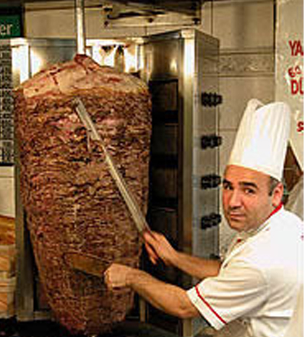
Why Do You Need AoA?
Boss assigns task:
Given
  today’s prices of meat (of lamb, donkey,...), bread
  constraints on what constitutes a döner
Make the cheapest döner sandwich
from slides by Jeff Edmonds, York University, pictures: google images

Slide 19
Why Do You Need AoA?
Your answer:
“Um? Tell me what to code.”
  With more sophisticated software engineering systems, demand for mundane programmers will diminish
“I learned this great algorithm that will work.”
  Soon all known algorithms will be available in libraries
from slides by Jeff Edmonds, York University

Slide 20
Why Do You Need AoA?
You need to understand
details of algorithms and data structures
in order to come up with
a good solution for a new problem
OR
a better solution for an existing problem
from slides by Jeff Edmonds, York University

Slide 21


Slide 22
Analysis of Algorithms 1
(Fall 2016)
Istanbul Technical University
Computer Eng. Dept.
CHAPTER 1
Role of Algorithms in Computing
Course slides from Leiserson’s MIT class have been used in preparation of these slides.
Last updated: September 20, 2016

Slide 23
Outline
What is an Algorithm?
Examples of Algorithms
Correctness of Algorithms
Specifying Algorithms
Data Structures
Algorithms as a Technology
Efficiency of Algorithms

Slide 24
Algorithms
Informally, an algorithm is any well-defined sequence of steps for solving well-specified computational problem
Computational problem is specified as input / output relationship
  An algorithm is thus a sequence of steps that transforms input into output

Slide 25
Example: Sorting
Sorting is a well-known computational problem
Input: Sequence of n numbers <a₁, a₂, …, a_{n}>
Output: Permutation (reordering)
<a'₁, a'₂, …, a'_{n}> of input sequence such that
a'₁ ≤ a'₂ ≤ … ≤ a'_{n}
Example
  Input: <31, 41, 59, 26, 41, 58>
  Output: <26, 31, 41, 41, 58, 59>

Slide 26
Correctness of Algorithms
Algorithm said to be correct if, for every input instance, it halts with correct output
Correct algorithm solves a given computational problem
Incorrect algorithm might not halt at all on some input instances, or it might halt with an answer other than desired one
  Can sometimes be useful, if their error rate can be controlled

Slide 27
Specifying Algorithms
Algorithm can be specified
  in English, Turkish, Chinese, etc. (i.e., natural languages)
  as a computer program
  as a hardware design
Only requirement: Specification must provide precise description of computational procedure to be followed

Slide 28
What Kinds of Problems Do Algorithms Solve?
Computational biology: analyzing three billion chemical base pairs that make up human DNA
Search engines: quickly finding pages that store relevant information
Computer networks: efficient routing
Electronic commerce: public-key cryptography and digital signatures
Manufacturing/commercial settings: assigning crew to flights in least expensive way

Slide 29
Data Structures
Data structure: way to store and organize data in order to facilitate access and modifications
No single data structure works well for all purposes
  Important to know strengths and limitations of several of them

Slide 30
Motivation for Data Structures
Similar to algorithms: “What is fastest way to solve problem X?”
Difference: Focuses on ways to organize typically long-lived corpus of data so that queries can be answered really fast
Typical example: web search engines
  Store sophisticated indexes that support a variety of queries (“What documents contain word X?”) quickly
  “Linear time” too slow: cannot afford to scan through entire web to answer a single query
  Goal: typically logarithmic or even constant time per query
  Space tends to become a more important issue because data corpus is usually big and we do not want a data structure that is larger (or even as large as) the data itself
from Prof. Erik Demaine’s MIT 6.897 ADS course

Slide 31
Motivation for Data Structures
Almost every algorithmic problem has at least a small data structural component and knowledge about data structures and the literature has made faster algorithms possible
from Prof. Erik Demaine’s MIT 6.897 ADS course

Slide 32

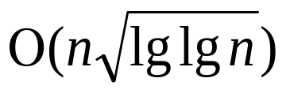

Examples of Recent and Cool Data Structures
Text indexing and web searching
  Preprocess text in linear time so that you can search for an arbitrary substring in time proportional to length of that substring
  Searching for one word is really really fast
  Recent improvement: Data structure can be made small, proportional to text size and if text is compressible, data structure can be equally compressed
Sorting
  Sorting is , but that is just in comparison model
  More typical example in ADS world is sorting integers: best known sorting algorithm runs in time, and it is even conceivable that sorting runs in time
from Prof. Erik Demaine’s MIT 6.897 ADS course

Slide 33


Examples of Recent and Cool Data Structures
Sorting and priority queues
  Any priority queue data structure can be turned into a sorting algorithm
  Reverse is also true: Any sorting algorithm that runs in
  time can be converted into a priority queue data structure with time per operation
Cache oblivious data structures
  Any problem (sorting, priority queues, etc.) is different when you are dealing with disk instead of main memory or you care about cache performance
  New wave of algorithms and data structures seems to capture most of these issues in theoretically clean way, and there have been several optimal results along these lines
from Prof. Erik Demaine’s MIT 6.897 ADS course

Slide 34
Technique
You can use your textbook as a “cookbook” for algorithms
You may someday encounter a problem for which you cannot readily find a published algorithm
We will learn techniques of algorithm design and analysis so that we can
  develop algorithms
  show that they give correct answer
  understand their efficiency

Slide 35
Algorithms as a Technology
Algorithms are a technology, just as are
  Fast hardware
  Graphical user interfaces
  Object-oriented systems
  Networks

Slide 36
Algorithms as a Technology
Suppose: Computers were infinitely fast and computer memory was free
Would you have any reason to study algorithms?
Yes, you would still like to demonstrate that your solution method terminates and does so with correct answer

Slide 37
Algorithms as a Technology
If computers were infinitely fast, any correct method for solving a problem would do
You would probably want your implementation to be within bounds of good software engineering practice (well designed and documented), but you would most often use whichever method was easiest to implement

Slide 38
Algorithms as a Technology
Computers may be fast, but they are not infinitely fast
Memory may be cheap, but it is not free
Computing time is a bounded resource and so is space in memory
These resources should be used wisely
  Algorithms that are efficient in terms of time or space will help you do so

Slide 39
Efficiency
Algorithms devised to solve same problem often differ dramatically in their efficiency
These differences can be much more significant than differences due to hardware and software

Slide 40
Efficiency: Two Algorithms for Sorting
Insertion sort
  c₁n² to sort n items, where constant c₁ does not depend on n (takes time roughly proportional to n²)
Merge sort
  Takes time roughly proportional to c₂nlgn,
  where lgn stands for log₂n and
  c₂ is another constant that does not depend on n

Slide 41
Insertion Sort vs. Merge Sort
Insertion sort usually has a smaller constant factor than merge sort, so that c₁ < c₂
Constant factors can be far less significant in running time than dependence on input size n
Where merge sort has a factor of lgn in its running time, insertion sort has a factor of n, which is much larger
Although insertion sort is usually faster than merge sort for small input sizes, once input size n becomes large enough, merge sort’s advantage of lgn vs. n will more than compensate for difference in constant factors
No matter how much smaller c₁ is than c₂, there will always be a crossover point beyond which merge sort is faster

Slide 42
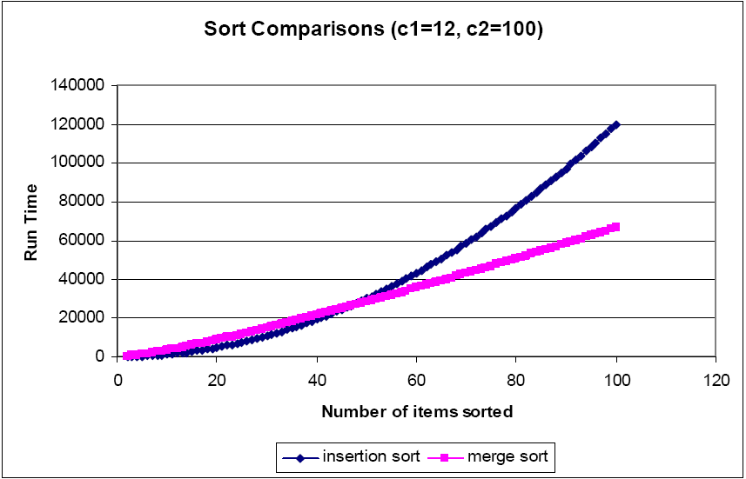
Insertion Sort vs. Merge Sort
Insertion sort usually has a smaller constant factor than merge sort, so that c₁ < c₂
Constant factors can be far less significant in running time than dependence on input size n
Where merge sort has a factor of lgn in its running time, insertion sort has a factor of n, which is much larger
Although insertion sort is usually faster than merge sort for small input sizes, once input size n becomes large enough, merge sort’s advantage of lgn vs. n will more than compensate for difference in constant factors
No matter how much smaller c₁ is than c₂, there will always be a crossover point beyond which merge sort is faster
from lecture notes by Prof. John Boon, Jr., Hood College

Slide 43

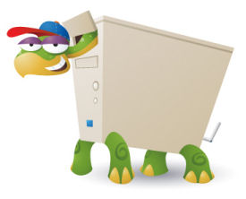
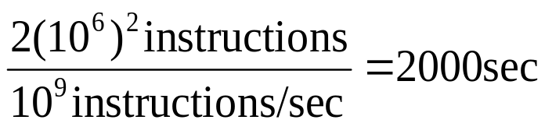
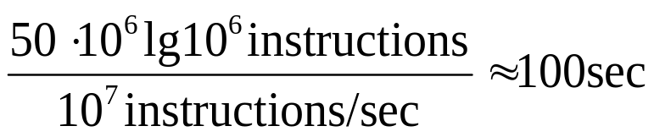
Efficiency: Concrete Example
Computer A
Computer B
Insertion sort
One billion instructions per second
World’s craftiest programmer, machine language
2n² instructions to sort n numbers
Sorting one million numbers takes
Sorting ten million numbers takes 2.3 days
Merge sort
Ten million instructions per second
Average programmer, high-level language with inefficient compiler
50nlgn instructions to sort n numbers
Sorting one million numbers takes
Sorting ten million numbers takes under 20 minutes
In general as problem size increases, so does
relative advantage of merge sort
pictures: google images

Slide 44
Comparison of Running Times
Running Time in μs | Maximum problem size (n)
 | 1 second | 1 minute | 1 hour
400n | 2500 | 150000 | 9000000
20n log n | 4096 | 166666 | 7826087
2n² | 707 | 5477 | 42426
n⁴ | 31 | 88 | 244
2^{n} | 19 | 25 | 31
For each function f(n) and time t, largest size n of a problem that can be solved in time t, assuming that algorithm to solve problem takes f(n) microseconds

Slide 45
Algorithms and Other Technologies
Example showed that algorithms, like computer hardware, are a technology
Total system performance depends on choosing efficient algorithms as much as on choosing fast hardware
Although there are some applications that do not explicitly require algorithmic content at the application level (e.g., some simple web-based applications), most also require a degree of algorithmic content on their own

Slide 46
Algorithms and Other Technologies
Even an application that does not require algorithmic content at the application level relies heavily upon algorithms
  GUI, networking, use of language other than machine code (processed by compiler, interpreter, or assembler)
With ever-increasing capacities of computers, we use them to solve larger problems than ever before
At larger problem sizes, differences in efficiencies in algorithms become particularly prominent
Having a solid base of algorithmic knowledge and technique is one characteristic that separates truly skilled programmers from novices

Slide 48

Analysis of Algorithms 1
(Fall 2016)
Istanbul Technical University
Computer Eng. Dept.
Chapter 2: Getting Started
Course slides from Leiserson’s @MIT
Edmonds@York Un.
Ruan @UTSA
have been used in preparation of these slides.
Last updated: Sept. 20, 2016

Slide 49
Outline
Insertion Sort
  Pseudocode Conventions
  Analysis of Insertion Sort
  Loop Invariants and Correctness
Merge Sort
  Divide and Conquer
  Analysis of Merge Sort
Growth of Functions
  Asymptotic notation
  Comparison of functions
  Standard notations and common functions

Slide 50
Sorting Problem
Input: A sequence of n numbers
<a₁, a₂,..., a_{n}>
Output: A permutation (reordering)
<a₁’, a₂’, ..., a_{n}’>
such that
a₁’<=a₂’ <=... <=a_{n}’

Slide 51
Sorting
Numbers to be sorted (a_{i}) also known as keys
  for example, studentID, checkNumber, etc.
In real implementations of sorting algorithms records need to also be moved with keys
To save time, pointers may be copied instead of actual records
Algorithm does not concern itself with these details, but it will be your job when you actually do the programming

Slide 52
Insertion Sort
Simple algorithm
Basic idea:
  Assume initial j-1 elements are sorted
  Until you find place to insert j^{th} element, move array elements to right
  Copy j^{th} element into its place
Insertion Sort is an “in place” sorting algorithm. No extra storage is required.

Slide 53

Insertion Sort Example

Slide 54
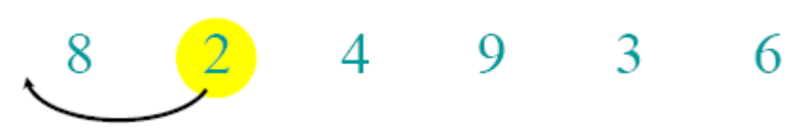
Insertion Sort Example

Slide 55
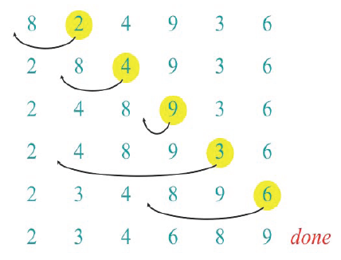
Insertion Sort Example

Slide 56
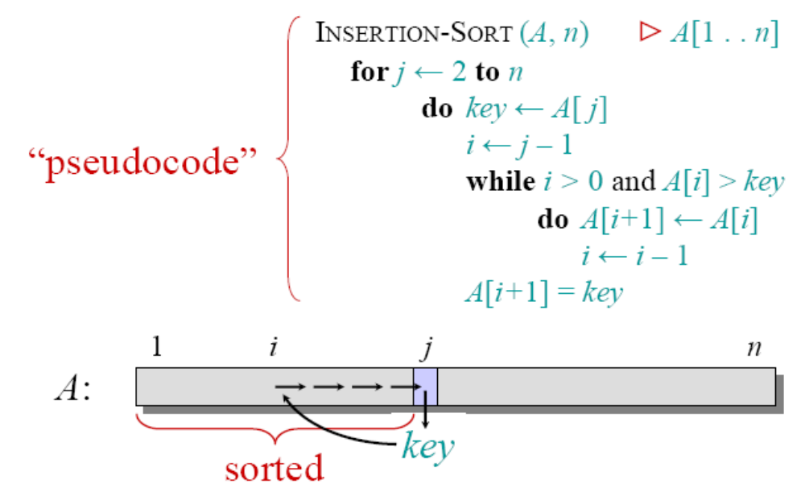
Insertion Sort

Slide 57

Pseudocode Conventions
Indentation
  indicates block structure
  saves space and writing time
Looping constructs (while, for, repeat) and conditional constructs (if, then, else)
  like in C, C++, and Java
  we assume that loop variable in a for loop is still defined when loop exits
Symbol “ ” indicates that remainder of line is comment
Multiple assignment i ← j ← e assigns to both variables i and j value of e (== j ← e, i ← j)
Variables are local, unless otherwise specified

Slide 58
Pseudocode Conventions
Array elements are accessed by specifying array name followed by index in square brackets
  A[i] indicates ith element of array A
  Notation “..” is used to indicate a range of values within an array (A[i..j] = A[1], A[2],…, A[j])
We often use objects, which have attributes (equivalently, fields)
  For an attribute attr of object x, we write attr[x]
  Equivalent of x.attr in Java or x-> attr in C++
Objects are treated as references, like in Java
  If x and y denote objects, then assignment y ← x makes x and y reference same object
  It does not cause attributes of one object to be copied to another

Slide 59
Pseudocode Conventions
Parameters are passed by value, as in Java and C (and the default mechanism in C++).
  When an object is passed by value, it is actually a reference (or pointer) that is passed
  Changes to the reference itself are not seen by caller, but changes to the object’s attributes are
Boolean operators “and” and “or” are short-circuiting
  If after evaluating left-hand operand, we know result of expression, then we do not evaluate right-hand operand
  If x is FALSE in “x and y”, then we do not evaluate y
  If x is TRUE in “x or y”, then we do not evaluate y

Slide 60
Efficiency
Correctness alone is not sufficient
Brute-force algorithms exist for most problems
To sort n numbers, we can enumerate all permutations of these numbers and test which permutation has the correct order
  Why cannot we do this?
  Too slow!
  By what standard?

Slide 61
How to measure complexity?
Accurate running time is not a good measure
It depends on input
It depends on the machine you used and who implemented the algorithm
We would like to have an analysis that does not depend on those factors

Slide 62
Machine-independent
A generic uniprocessor random-access machine (RAM) model
  No concurrent operations
  Each simple operation (e.g. +, -, =, *, if, for) takes 1 step.
    Loops and subroutine calls are not simple operations.
  All memory equally expensive to access
    Constant word size
    Unless we are explicitly manipulating bits
    No memory hierarch (caches, virtual mem) is modeled

Slide 63
Running Time
Running Time:T(n): Number of primitive operations or steps executed for an input of size n.
Running time depends on input
  already sorted sequence is easier to sort
Parameterize running time by size of input
  short sequences are easier to sort than long ones
Generally, we seek upper bounds on running time
  everybody likes a guarantee

Slide 64
Kinds of Analysis
Worst-case: (usually)
  T(n) = maximum time of algorithm on any input of size n
Average-case: (sometimes)
  T(n) = expected time of algorithm over all inputs of size n
  Need assumption about statistical distribution of inputs
Best-case: (bogus)
  Cheat with a slow algorithm that works fast on some input

Slide 65
Analysis of insertion Sort
Statement cost time__
InsertionSort(A, n) {
for j = 2 to n { c₁ n
key = A[j] c₂ (n-1)
i = j - 1; c₃ (n-1)
while (i > 0) and (A[i] > key) { c₄ ∑_{j=2..n} t_{j}
A[i+1] = A[i] c₅ ∑_{j=2..n} t_{j} -1
i = i - 1 c₆ ∑_{j=2..n} t_{j} -1
} 0
A[i+1] = key c₇ (n-1)
} 0
}
t_{j} : number of times while loop test is executed for j^{th} for loop iteration

Slide 66
Analysis of insertion Sort
Statement cost time__
InsertionSort(A, n) {
for j = 2 to n { c₁ n
key = A[j] c₂ (n-1)
i = j - 1; c₃ (n-1)
while (i > 0) and (A[i] > key) { c₄ S
A[i+1] = A[i] c₅ S – (n-1)
i = i - 1 c₆ S – (n-1)
} 0
A[i+1] = key c₇ (n-1)
} 0
}
t_{j} : number of times while loop test is executed for j^{th} for loop iteration

Slide 67
Analyzing Insertion Sort
T(n) = c₁n + c₂(n-1) + c₃(n-1) + c₄S + c₅(S - (n-1)) + c₆(S - (n-1)) + c₇(n-1)
= c₈S + c₉n + c₁₀
What can S be?
  Best case -- inner loop body never executed
    t_{j} = 1 ➔ S = n - 1
    T(n) = an + b is a linear function
  Worst case -- inner loop body executed for all previous elements
    t_{j} = j ➔ S = 2 + 3 + … + n = n(n+1)/2 - 1
    T(n) = an² + bn + c is a quadratic function
  Average case
    Can assume that in average, we have to insert A[j] into the middle of A[1..j-1], so t_{j} = j/2
    S ≈ n(n+1)/4
    T(n) is still a quadratic function

Slide 68

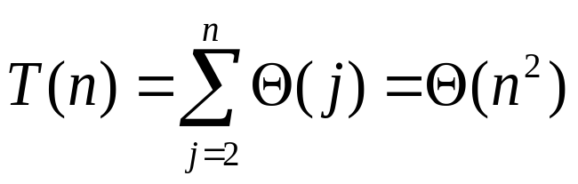
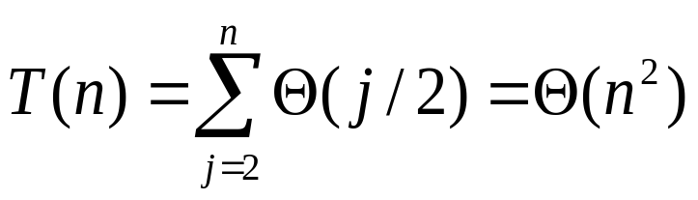
Insertion Sort Running Time
Theta Notation, see next week.
Best-case:
  , inner loop not executed at all
  Worst-case: Input reverse sorted
  [Arithmetic series]
Average-case: All permutations equally likely
Is Insertion Sort a fast sorting algorithm?
Moderately so, for small n
Not at all, for large n

Slide 69
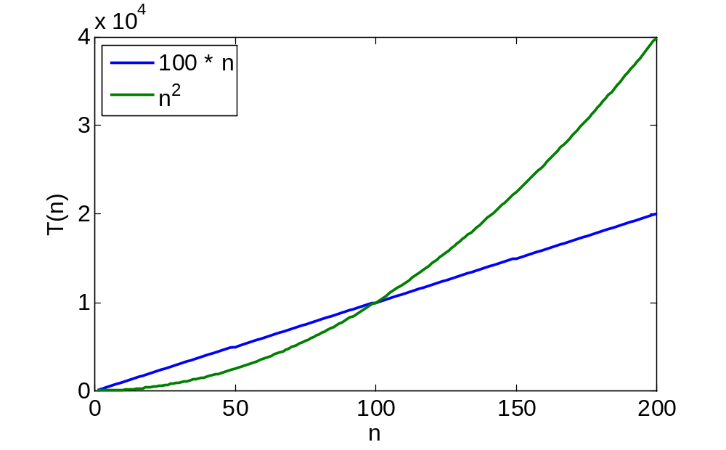
Asymptotic Analysis
Ignore actual and abstract statement costs
Order of growth is the interesting measure:
  Highest-order term is what counts
    As the input size grows larger it is the high order term that dominates

Slide 70
Loop invariants and correctness of insertion sort
Claim: at the start of each iteration of the for loop, the subarray A[1..j-1] consists of the elements originally in A[1..j-1] but in sorted order.
Proof: by induction

Slide 71
Review: Proof By Induction
Claim:S(n) is true for all n >= k
Basis:
  Show formula is true when n = k
Inductive hypothesis:
  Assume formula is true for an arbitrary n
Step:
  Show that formula is then true for n+1

Slide 72
Prove correctness using loop invariants
Initialization (basis): the loop invariant is true prior to the first iteration of the loop
Maintenance:
  Assume that it is true before an iteration of the loop (Inductive hypothesis)
  Show that it remains true before the next iteration (Step)
Termination: show that when the loop terminates, the loop invariant gives us a useful property to show that the algorithm is correct

Slide 73
Prove correctness using loop invariants
InsertionSort(A, n) {
for j = 2 to n {
key = A[j];
i = j - 1;
▷Insert A[j] into the sorted sequence A[1..j-1]
while (i > 0) and (A[i] > key) {
A[i+1] = A[i];
i = i – 1;
}
A[i+1] = key
}
}
Loop invariant: at the start of each iteration of the for loop, the subarray consists of the elements originally in A[1..j-1] but in sorted order.

Slide 74
Initialization
InsertionSort(A, n) {
for j = 2 to n {
key = A[j];
i = j - 1;
▷Insert A[j] into the sorted sequence A[1..j-1]
while (i > 0) and (A[i] > key) {
A[i+1] = A[i];
i = i – 1;
}
A[i+1] = key
}
}
Subarray A[1] is sorted. So loop invariant is true before the loop starts.

Slide 75
Maintenance
InsertionSort(A, n) {
for j = 2 to n {
key = A[j];
i = j - 1;
▷Insert A[j] into the sorted sequence A[1..j-1]
while (i > 0) and (A[i] > key) {
A[i+1] = A[i];
i = i – 1;
}
A[i+1] = key
}
}
Assume loop variant is true prior to iteration j
Loop variant will be true before iteration j+1
1
i
j
sorted
Key

Slide 76
Termination
InsertionSort(A, n) {
for j = 2 to n {
key = A[j];
i = j - 1;
▷Insert A[j] into the sorted sequence A[1..j-1]
while (i > 0) and (A[i] > key) {
A[i+1] = A[i];
i = i – 1;
}
A[i+1] = key
}
}
The algorithm is correct!
Upon termination, A[1..n] contains all the original elements of A in sorted order.
1
n
j=n+1
Sorted

