Slide 1

Analysis of Algorithms 1
(Fall 2016)
Istanbul Technical University
Computer Eng. Dept.
Chapter 2: Getting Started
Course slides from Leiserson’s @MIT
Edmonds@York Un.
Ruan @UTSA
have been used in preparation of these slides.
Last updated: Sept. 27, 2016

Slide 2
Outline
Chapter 2
  Insertion Sort
    Pseudocode Conventions
    Analysis of Insertion Sort
    Loop Invariants and Correctness
  Merge Sort
    Divide and Conquer
    Analysis of Merge Sort
Chapter 3: Growth of Functions
  Asymptotic notation
  Comparison of functions
  Standard notations and common functions

Slide 3
Merge Sort
Insertion sort used an incremental approach to sorting: sort the smallest subarray (1 item), add one more item to the subarray, sort it, add one more item, sort it, etc.
Let us think about how the merge sort works. Basically, it uses a divide-and-conquer approach, based on the concept of recursion.

Slide 4
Merge Sort
Divide-and-conquer:
  Divide the problem into several subproblems.
  Conquer the subproblems by solving them recursively. If the subproblems are small enough, solve them directly.
  Combine the solutions to the subproblems to get the solution for the original problem.

Slide 5
Merge Sort
Divide-and-conquer:
  Divide the n-element sequence to be sorted into two subsequences of n/2 each.
  Conquer by sorting the subsequences recursively by calling merge sort again. If the subsequences are small enough (of length 1), solve them directly. (Arrays of length 1 are already sorted.)
  Combine the two sorted subsequences by merging them to get a sorted sequence.

Slide 6
Merge Sort
    Merge-Sort(A, p, r)
    1 if p < r
    2 then {q ← ⎣(p+r)/2⎦
    3 Merge-Sort(A, p, q)
    4 Merge-Sort(A, q+1, r)
    5 Merge(A, p, q, r)}
A is the (sub)array when the procedure is called.
p, q, and r are indices numbering elements of the array such that p ≤ q ≤ r ; p is the lowest index and r is the highest index.

Slide 7
Merge Sort
Note that the merge sort basically consists of recursive calls to itself. The base case (which stops the recursion) occurs when a subsequence has a size of 1.
The combine step is accomplished by a call to an algorithm called Merge.

Slide 8
Merge
Without going into detail about how Merge-Sort works yet, let us take a look at the Merge part. Merge works by assuming you have two already-sorted sublists and an empty array:
1
4
5
2
3
6

Slide 9
Merge
Let us assume we have a sentinel (infinity, which is guaranteed to be larger than the last item) at the end of each sublist which lets us know when we have hit the end of the sublist.
1
4
7
∞
2
3
9
∞

Slide 10
Merge
p q q+1 r
The two sublists are indexed from p to q (for the first sublist) and from q+1 to r for the second sublist. There are (r – p) + 1 items in the two sublists combined, so we will need an output array of that size.
1
4
7
∞
2
3
9
∞

Slide 11
Merge
Look at the first item in each subarray. Choose the smallest item.
Move the chosen item to the output array.
1
4
7
∞
2
3
9
∞
1

Slide 12
Merge
Look at the first item in each subarray. Choose the smallest item.
Move the chosen item to the output array.
4
7
∞
2
3
9
∞
1
2

Slide 13
Merge
Look at the first item in each subarray. Choose the smallest item.
Move the chosen item to the output array.
4
7
∞
3
9
∞
1
2
3

Slide 14
Merge
Look at the first item in each subarray. Choose the smallest item.
Move the chosen item to the output array.
4
7
∞
9
∞
1
2
3
4

Slide 15
Merge
Look at the first item in each subarray. Choose the smallest item.
Move the chosen item to the output array.
7
∞
9
∞
1
2
3
4
7

Slide 16
Merge
Look at the first item in each subarray. Choose the smallest item.
Move the chosen item to the output array.
∞
9
∞
1
2
3
4
7
9

Slide 17
Merge
We know that we have only n = (r – p) + 1 items. So, we will make only (r – p) + 1 moves.
Here r = 1 and p = 6, and (6 – 1) + 1 = 6, so when we have made our 6th move we are through.
∞
∞
1
2
3
4
7
9

Slide 18
Merge
Assuming that the two sublists are in sorted order when they are passed to the Merge routine, is Merge guaranteed to output a sorted array?
Yes. We can verify that each step of Merge preserves the sorted order that the two sublists already have.

Slide 19
Merge(A, p, q, r)
n₁ ← (q – p) + 1
n₂ ← (r – q)
create arrays L[1..n₁+1] and R[1..n₂+1]
for i ← 1 to n₁ do
5 L[i] ← A[(p + i) -1]
6 for j ← 1 to n₂ do
7 R[j] ← A[q + j]
8 L[n₁ + 1] ← ∞
9 R[n₂ + 1] ← ∞
10 i ← 1
11 j ← 1
12 for k ← p to r do
13 if L[i] <= R[j]
14 then A[k] ← L[i]
15 i ←i + 1
16 else A[k] ← R[j]
17 j ← j + 1

Slide 20
Analysis of Merge
Line 1 computes the length n₁ of the subarray A[p..q].
Line 2 computes the length n₂ of the subarray A[q+1..r].
We create arrays L and R ("left" and "right"), of lengths n₁ + 1 and n₂ + 1, respectively, in line 3.
The for loop of lines 4-5 copies the subarray A[p..q] into L[1.. n₁], and the for loop of lines 6-7 copies the subarray A[q+1..r] into R[1..n2].
Lines 8-9 put the sentinels at the ends of the arrays L and R.
Lines 10-17, illustrated in Figure 2.3, perform the r - p + 1 basic steps by maintaining the following loop invariant.

Slide 21
Analysis of Merge
The loop in lines 12-17 of Merge is the heart of how Merge works. They maintain the loop invariant:
At the start of each iteration of the for loop of lines 12-17, the subarray A[p..k-1] contains the k - p smallest elements of L[1..n₁+1] and R[1..n₂+1], in sorted order.
Moreover, L[i] and R[j] are the smallest elements of their arrays that have not been copied back into A.

Slide 22
Analysis of Merge
To prove that Merge is a correct algorithm, we must show that:
Initialization: the loop invariant holds prior to the first iteration of the for loop in lines 12-17
Maintenance: each iteration of the loop maintains the invariant
Termination: the invariant provides a useful property to show correctness when the loop terminates

Slide 23
Initialization
As we enter the for loop, k is set equal to p.
This means that subarray A[p..k-1] is empty.
Since k - p = 0, the subarray is guaranteed to contain the k - p smallest elements of L and R.
By lines 10 and 11, i = j = 1, so L[i] and R[j] are the smallest elements of their arrays that have not been copied into A.

Slide 24
Maintenance
As we enter the loop, we know that A[p..k-1] contains the k - p smallest elements of L and R.
Assume L[i] <= R[j]. Then:
  L[i] is the smallest element not copied into A.
  Line 14 will copy L[i] into A[k].
  At this point the subarray A[p..k] will contain the k - p + 1 smallest elements.
  Incrementing k (in line 12) and i (in line 15) reestablishes the loop invariant for the next iteration.
Assume L[i] >= R[j]. Then:
  Lines 16-17 maintain the loop invariant.

Slide 25
Termination
The loop invariant states that subarray
“A[p..k-1] contains the k - p smallest elements of L[1..n₁+1] and R[1..n₂+1], in sorted order.”
When we drop out of the loop, k = r + 1.
So r = k – 1, and A[p..k-1] is actually A[p..r], which is the whole array.
The arrays L and R together contain n₁ + n₂ + 2 elements. From lines 1 and 2 we know that n₁ + n₂ = ((q – p) + 1) + ((r – q) = (r – p) + 1, and this is the number of all of the elements in the array. The extra 2 is the two sentinel elements.

Slide 26
Merge Sort
Now let us look at Merge-Sort again:
    Merge-Sort(A, p, r)
    1 if p < r
    2 then {q ← ⎣(p+r)/2⎦
    3 Merge-Sort(A, p, q)
    4 Merge-Sort(A, q+1, r)
    5 Merge(A, p, q, r)}
Line 1 is our base case; we drop out of the recursive sequence of calls when p >= r.

Slide 27
Merge Sort
Given our Merge routine, we can now see how Merge-Sort works.
  Assume a list of length = 2^{m}
  Take an unsorted list as input.
  Split it in half. Now you have two sublists.
  Split those in half, and so on, until you have lists of length 1.
  Merge those into sublists of length 2, then merge those into sublists of length 4, etc. Keep going until you have just one list left.
  That list is now sorted.

Slide 28
Merge Sort
  Merge-Sort(A, p, r)
  1 if p < r
  2 then {q ← ⎣(p+r)/2⎦
  3 Merge-Sort(A, p, q)
  4 Merge-Sort(A, q+1, r)
  5 Merge(A, p, q, r)}
Let us call Merge-Sort with an array of 4 elements: Merge-Sort(A, 1, 4), where p = 1 and r = 4.
Line 1: p < r, so do the then part of the if
Line 2: q ← ⎣(p+r)/2⎦, which is 2
Line 3: we call Merge-Sort(A, 1, 2)
WAIT HERE (let us call our place Z) until we return from this call

Slide 29
Merge Sort
    Merge-Sort(A, p, r)
    1 if p < r
    2 then {q ← ⎣(p+r)/2⎦
    3 Merge-Sort(A, p, q)
    4 Merge-Sort(A, q+1, r)
    5 Merge(A, p, q, r)}
Calling Merge-Sort(A, 1, 2)
Line 1: p < r, so do the then part of the if
Line 2: q ← ⎣(p+r)/2⎦, which is 1
Line 3: we call Merge-Sort(A, 1, 1)
WAIT HERE (let us call our place Y) until we return from this call

Slide 30
Merge Sort
    Merge-Sort(A, p, r)
    1 if p < r
    2 then {q ← ⎣(p+r)/2⎦
    3 Merge-Sort(A, p, q)
    4 Merge-Sort(A, q+1, r)
    5 Merge(A, p, q, r)}
Calling Merge-Sort(A, 1, 1)
Line 1: p = r, so skip the then part of the if
Return from this call to Y

Slide 31
Merge Sort
    Merge-Sort(A, p, r)
    1 if p < r
    2 then {q ← ⎣(p+r)/2⎦
    3 Merge-Sort(A, p, q)
    4 Merge-Sort(A, q+1, r)
    5 Merge(A, p, q, r)}
We called Merge-Sort(A, 1, 2)
We have returned from our call in line 3
Line 4: We call Merge-Sort(A, 2, 2)
WAIT HERE (let us call our place X) until we return from this call

Slide 32
Merge Sort
    Merge-Sort(A, p, r)
    1 if p < r
    2 then {q ← ⎣(p+r)/2⎦
    3 Merge-Sort(A, p, q)
    4 Merge-Sort(A, q+1, r)
    5 Merge(A, p, q, r)}
Calling Merge-Sort(A, 2, 2)
Line 1: p = r, so skip the then part of the if
Return from this call to X

Slide 33
Merge Sort
    Merge-Sort(A, p, r)
    1 if p < r
    2 then {q ← ⎣(p+r)/2⎦
    3 Merge-Sort(A, p, q)
    4 Merge-Sort(A, q+1, r)
    5 Merge(A, p, q, r)}
We called Merge-Sort(A, 2, 2)
We have returned from our call in line 4
Line 5: We call Merge(A, 1, 2, 2)
What does Merge do?

Slide 34
Merge Sort
    Merge-Sort(A, p, r)
    1 if p < r
    2 then {q ← ⎣(p+r)/2⎦
    3 Merge-Sort(A, p, q)
    4 Merge-Sort(A, q+1, r)
    5 Merge(A, p, q, r)}
Step 5: Merge(A, 1, 2, 2) :
creates two temporary arrays of 1 element each
copies A[1] and A[2] into these 2 arrays
merges the elements in these two temporary arrays back into A[1..2] in sorted order
returns from the call to Z

Slide 35
Merge Sort
    Merge-Sort(A, p, r)
    1 if p < r
    2 then {q ← ⎣(p+r)/2⎦
    3 Merge-Sort(A, p, q)
    4 Merge-Sort(A, q+1, r)
    5 Merge(A, p, q, r)}
Return from call to Merge-Sort(A, 1, 2) in Line 3. At this point half of our original array, A[1..2], is in sorted order.
Next we call Merge-Sort(A, 3, 4). It will put A[3..4] into sorted order.
Line 5 will merge A[1..2] and A[3..4] into A[1..4] in sorted order.

Slide 36
Merge Sort
sorted sequence
1 2 2 3 4 5 6 6
Merge
2 4 5 6
1 2 3 6
Merge
Merge
2 5
4 6
1 3
2 6
Merge
Merge
Merge
Merge
5
2
4
6
1
3
2
6
initial sequence

Slide 37
Analysis of Divide-and-Conquer Algorithms
The Merge-Sort algorithm contains a recursive call to itself. When an algorithm contains a recursive call to itself, its running time often can be described by a recurrence equation, or recurrence.
The recurrence equation describes the running time on a problem of size n in terms of the running time on smaller inputs.
We can use mathematical tools to solve the recurrence and provide bounds on the performance of the algorithm.

Slide 38
Analysis of Divide-and-Conquer Algorithms
A recurrence of a divide-and-conquer algorithm is based on its 3 parts: divide, conquer, and combine.
Let T(n) be the running time on a problem of size n.
If the problem is small enough, say n <= c, we can solve it in a straightforward manner, which takes constant time, which we write as Θ(1).
If the problem is bigger, we solve it by dividing the problem to get a subproblems, each of which is 1/b the size of the original. For Merge-Sort, both a and b are 2.

Slide 39
Analysis of Divide-and-Conquer Algorithms
Assume it takes D(n) time to divide the problem into subproblems.
Assume it takes C(n) time to combine the solutions to the subproblem into the solution for the original problem.
We get the recurrence:
{
Θ(1) , if n ≤ c
aT(n/b) + D(n) + C(n), otherwise
T(n) =

Slide 40
Analysis of Merge Sort
Base case: n = 1. Merge sort on an array of size 1 takes constant time, Θ(1).
Divide: The Divide step of Merge-Sort just calculates the middle of the subarray. This takes constant time. So D(n) = Θ(1).
Conquer: We make 2 calls to Merge-Sort. Each call handles ½ of the subarray that we pass as a parameter to the call. The total time required is 2T(n/2).
Combine: Running Merge on an n-element subarray takes Θ(n), so C(n) = Θ(n).

Slide 41
Analysis of Merge Sort
Here is what we get
By inspection, we can see that we can ignore the Θ(1) factor, as it is irrelevant compared to Θ(n). We can rewrite this recurrence as:
{
Θ(1) , if n = 1
2T(n/2) + Θ(1) + Θ(n), if n > 1
T(n) =
{
c , if n = 1
2T(n/2) + cn, if n > 1
T(n) =

Slide 42
Analysis of Merge Sort
How much time will it take for the Divide step?
Let us assume that n is some power of 2.
Then for an array of size n, it will take us log₂n steps to recursively subdivide the array into subarrays of size 1.
Example: 8 = 2³

Slide 43
Analysis of Merge Sort
Example: 8 = 2³
Step 0:
Step 1:
Step 2:
Step 3:

Slide 44
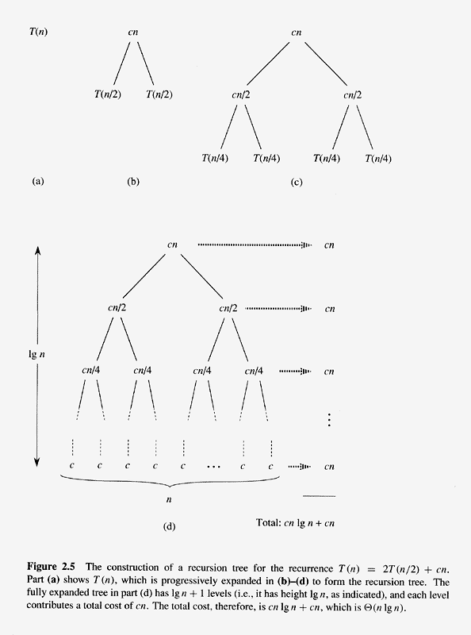
Copyright © The McGraw-Hill Companies, Inc. Permission required for reproduction or display.

Slide 45
Analysis of Merge Sort
So, it took us log₂n steps to divide the array all the way down into subarrays of size 1.
As a result, we will have log₂n + 1 (sub)arrays to deal with. In our example, where n = 8 and log₂n = 3, we will have to deal with arrays of size 1, 2, 4, and 8.
Every time we Merge the arrays, it takes us n steps, since we have to put each array item into its proper position within each array.

Slide 46
Analysis of Merge Sort
Consequently, we will have log₂n + 1 recursive calls of the Merge-Sort function, and each time we call Merge-Sort the Merge function will cost us n steps, times a constant value.
The total cost, then, can be expressed as:
cn(log₂n + 1)
Multiplying this out gives:
cn(log₂n) + cn
Ignoring the low-order term and the constant c gives:
Θ(n•log₂n)

Slide 47
Chapter 3: Growth of Functions
  Asymptotic notation
  Comparison of functions
  Standard notations and common functions

Slide 48
Asymptotic Notation
What does asymptotic mean?
Asymptotic describes behavior of function in the limit - for sufficiently large values of its parameter

Slide 49
Asymptotic Notation
The order of growth of the running time of an algorithm is defined as the highest-order term (usually the leading term) of an expression that describes the running time of the algorithm
We ignore the leading term’s constant coefficient, as well as all of the lower order terms in the expression
Example: The order of growth of an algorithm whose running time is described by the expression an²+ bn + c is simply n²

Slide 50
Big O
Let us say that we have some function that represents the sum total of all the running-time costs of an algorithm; call it f(n)
For merge sort, the actual running time is:
f(n) = cn(log₂n) + cn
We want to describe the running time of merge sort in terms of another function, g(n), so that we can say f(n) = O(g(n)), like this:
cn(log₂n) + cn = O(nlog₂n)

Slide 51
Big O: Definition
For a given function g(n), O(g(n)) is the set of
functions
O(g(n)) = { f(n): there exist positive constants c and n₀ such that
0 ≤ f(n) ≤ c•g(n) for all n ≥ n₀ }
c is the multiplicative constant
n₀ is the threshold

Slide 52
Big O
  f(n) ∈ O(g(n))
c∙g(n)
f(n)
Running Time (t)
n₀
Input Size (n)

Slide 53
Big O
Big O is an upper bound on a function, to within a constant factor.
O(g(n)) is a set of functions
Commonly used notation
f(n) = O(g(n))
Correct notation
f(n) ∈ O(g(n))

Slide 54
Big O
Question:
  How do you demonstrate that f(n) ∈ O(g(n))?
Answer:
  Show that you can find values for c and n₀ such that 0 ≤ f(n) ≤ c g(n) for all n ≥ n₀

Slide 55
Big O
Example: Show that 7n – 2 is O(n)
Find a real constant c > 0 and an integer constant n₀ ≥ 1 such that 7n – 2 ≤ cn for every integer n ≥ n₀.
Choose c = 7 and n₀ = 1.
It is easy to see that 7n – 2 ≤ 7n for every integer n ≥ 1.
∴ 7n – 2 is O(n)

Slide 56
Big O
Example: Show that 20n³ + 10n log n + 5 is O(n³)
Find a real constant c > 0 and an integer constant n₀ ≥ 1 such that 20n³ + 10n log n + 5 ≤ cn³ for every integer n ≥ n₀.
How do we find c and n₀?
Note that 10n³ > 10 n log n, and that 5n³ > 5.
So, 15n³ > 10n log n + 5
And 20n³ + 15n³ > 20n³ + 10n log n + 5
Therefore, 35n³ > 20n³ + 10n log n + 5

Slide 57
Big O
So we choose c = 35 and n₀ = 1
An algorithm that takes 20n³ + 10n log n + 5 steps to run cannot possibly take any more than 35n³ steps, for every integer n ≥ 1
Therefore 20n³ + 10n log n + 5 is O(n³)

Slide 58
Big O
Example: Show that ½ n² – 3n is O(n²)
Find a real constant c > 0 and an integer constant n₀ ≥ 1 such that ½ n² – 3n ≤ cn² for every integer n ≥ n₀
Choose c = ½ and n₀ = 1
Now ½ n² – 3n ≤ ½ n² for every integer n ≥ 1

Slide 59
Big O
Example: Show that an(log₂n) + bn is O(nlog n)
Find a real constant c > 0 and an integer constant n₀ ≥ 1 such that
  an(log₂n) + bn ≤ cnlog n
for every integer n ≥ n₀.
Choose c = a+b and n₀ = 2 (why 2?)
Now an(log₂n) + bn ≤ cnlog n for every integer n ≥ 2.

Slide 60
Big O
Example: Show that an(log₂n) + bn is O(nlog n)
Find a real constant c > 0 and an integer constant n₀ ≥ 1 such that
  an(log₂n) + bn ≤ cnlog n
for every integer n ≥ n₀.
Choose c = a+b and n₀ = 2 (why 2?)
log₂1 = 0, a 1(log₂1) + b1 ≤ c1log 1
0+b ≤ 0 => NOT TRUE!

Slide 61
Big O
Question:
  Is n = O(n²) ?
Answer:
  Yes. Remember that f(n) ∈ O(g(n)) if there exist positive constants c and n₀ such that
{0 ≤ f(n) ≤ c•g(n) for all n ≥ n₀ }
If we set c = 1 and n₀ = 1, then it is obvious
that c•n ≤ n² for all n ≥ n₀.

Slide 62
Big O
What does this mean about Big-O?
When we write f(n) = O(g(n)) we mean that some constant times g(n) is an asymptotic upper bound on f(n); we are not claiming that this is a tight upper bound.

Slide 63
Big O
Big-O notation describes an upper bound
Assume we use Big-O notation to bound the worst case running time of an algorithm
Now we have a bound on the running time of the algorithm on every input

Slide 64
Big O
Is it correct to say “the running time of insertion sort is O(n²)”?
Technically, the running time of insertion sort depends on the characteristics of its input.
  If we have n items in our list, but they are already in sorted order, then the running time of insertion sort on this particular input is O(n).

Slide 65
Big O
So what do we mean when we say that the running time of insertion sort is O(n²)?
What we normally mean is:
the worst case running time of insertion sort is O(n²)
That is, if we say that “the running time of insertion sort is O(n²)”, we guarantee that under no circumstances will insertion sort perform worse than O(n²).

Slide 66
Big Theta: Definition
For a given function g(n), Θ(g(n)) is the set of functions:
  Θ(g(n)) = {f(n): there exist positive constants c₁, c₂, and n₀ such that
  0 ≤ c₁ g(n) ≤ f(n) ≤ c₂ g(n)
  for all n ≥ n₀ }

Slide 67
Big Theta
What does this mean?
When we use Big-Theta notation, we are saying that function f(n) can be “sandwiched” between some small constant times g(n) and some larger constant times g(n).
In other words, f(n) is equal to g(n) to within a constant factor.

Slide 68
Big Theta
  f(n) ∈ Θ(g(n))
c₂∙g(n)
f(n)
Running Time (t)
c₁∙g(n)
n₀
Input Size (n)

Slide 69
Big Theta
If f(n) = Θ(g(n)), we can say that g(n) is an asymptotically tight bound for f(n).
Basically, we are guaranteeing that f(n) never performs any better than c₁ g(n), but also never performs any worse than c₂ g(n).
We can see this visually by noting that, after n₀, the curve for f(n) never goes below c₁ g(n) and never goes above c₂ g(n).

Slide 70
Big Theta
Let us look at the performance of the merge sort.
We said that the performance of merge sort was cn(log₂n) + cn
Does this depend upon the characteristics of the input for merge sort? That is, does it make a difference if the list is already sorted, or reverse sorted, or in random order?
No. Unlike insertion sort, merge sort behaves exactly the same way for any type of input.

Slide 71
Big Theta
The running time of merge sort is:
cn(log₂n) + cn
So, using asymptotic notation, we can discard the “+ cn” part of this equation, giving:
cn(log₂n)
And we can disregard the constant multiplier, c, which gives us the running time of merge sort:
Θ(n(log₂n))

Slide 72
Big Theta
Why would we prefer to express the running time of merge sort as Θ(n(log₂n)) instead of O(n(log₂n))?
Because Big-Theta more precise than Big-O
If we say that the running time of merge sort is O(n(log₂n)), we are merely making a claim about merge sort’s asymptotic upper bound, whereas if we say that the running time of merge sort is Θ(n(log₂n)), we are making a claim about merge sort’s asymptotic upper and lower bounds

Slide 73
Big Theta
Would it be incorrect to say that the running time of merge sort is O(n(log₂n))?
No, not at all.
It is just that we are not giving all of the information that we have about the running time of merge sort.
But sometimes all we need to know is the worst-case behavior of an algorithm. If that is so, then Big-O notation is fine.

Slide 74
Big Theta
One final note: the definition of Θ(g(n)) technically requires that every member f(n) ∈ Θ(g(n)) be asymptotically nonnegative – that is, f(n) must be nonnegative whenever n is sufficiently large.
We assume that every function used within Θ notation (and the other notations used in your textbook’s Chapter 3) is asymptotically nonnegative

Slide 75
Big Omega: Definition
For a given function g(n), Ω(g(n)) is the set of functions:
  Ω(g(n)) = { f(n): there exist positive constants c and n₀ such that 0 ≤ c g(n) ≤ f(n)
  for all n ≥ n₀ }

Slide 76
Big Omega
  f(n) ∈ Ω(g(n))
f(n)
Running Time (t)
c∙g(n)
n₀
Input Size (n)

Slide 77
Big Omega
We know that Big-O notation provides an asymptotic upper bound on a function.
Big-Omega notation provides an asymptotic lower bound on a function.
Basically, if we say that f(n) = Ω(g(n)) then we are guaranteeing that, beyond n₀, f(n) never performs any better than c g(n).

Slide 78
Big Omega
We usually use Big-Omega when we are talking about the best case performance of an algorithm.
For example, the best case running time of insertion sort (on an already sorted list) is Ω(n).
But this also means that insertion sort never performs any better than Ω(n) on any type of input.
So the running time of insertion sort is Ω(n).

Slide 79
Big Omega
Could we say that the running time of insertion sort is Ω(n²)?
No. We know that if its input is already sorted, the curve for merge sort will dip below n² and approach the curve for n.
Could we say that the worst case running time of insertion sort is Ω(n²)?
Yes.

Slide 80
Big Omega
It is interesting to note that, for any two functions f(n) and g(n), f(n) = Θ(g(n)) if and only if f(n) = O(g(n)) and f(n) = Ω(g(n)).

Slide 81
Little o: Definition
For a given function g(n), o(g(n)) is the set of functions:
o(g(n))= {f(n): for any positive constant c,
there exists a constant n₀ such that 0 ≤ f(n) < c g(n)
for all n ≥ n₀ }

Slide 82
Little o
Note the < instead of ≤ in the definition of Little-o:
0 ≤ f(n) < c g(n) for all n ≥ n₀
Contrast this to the definition used for Big-O:
0 ≤ f(n) ≤ c g(n) for all n ≥ n₀
Little-o notation denotes an upper bound that is not asymptotically tight. We might call this a loose upper bound.
Examples: 2n ∈ o(n²) but 2n² ∉ o(n²)

Slide 83
Little o: Definition
Given that f(n) = o(g(n)), we know that g grows strictly faster than f. This means that you can multiply g by a positive constant c and beyond n₀, g will always exceed f.
No graph to demonstrate little-o, but here is an example:
n² = o(n³) but
n² ≠ o(n²).
Why? Because if c = 1, then f(n) = c g(n), and the definition insists that f(n) be less than c g(n).

Slide 84
Little omega: Definition
For a given function g(n), ω(g(n)) is the set of functions:
ω(g(n))= {f(n): for any positive constant c,
there exists a constant n₀
such that 0 ≤ c g(n) < f(n)
for all n ≥ n₀ }

Slide 85

Little omega: Definition
Note the < instead of ≤ in the definition:
  0 ≤ c g(n) < f(n)
Contrast this to the definition used for Big-Ω:
  0 ≤ c g(n) ≤ f(n)
Little-omega notation denotes a lower bound that is not asymptotically tight. We might call this a loose lower bound.
Examples:
  n ∉ ω(n²) n ∈ ω( ) n ∈ ω(lg n)

Slide 86
Little omega
No graph to demonstrate little-omega, but here is an example:
n³ is ω(n²) but
n³ ≠ ω(n³).
Why? Because if c = 1, then f(n) = c g(n), and the definition insists that c g(n) be strictly less than f(n).

Slide 87
Comparison of Notations
f(n) = o(g(n)) ≈ a < b
f(n) = O(g(n)) ≈ a ≤ b
f(n) = Θ(g(n)) ≈ a = b
f(n) = Ω(g(n)) ≈ a ≥ b
f(n) = ω(g(n)) ≈ a > b

Slide 88
Asymptotic Notation
c₂∙g(n)
c∙g(n)
f(n)
f(n)
Running Time (t)
Running Time (t)
c₁∙g(n)
n₀
n₀
Input Size (n)
Input Size (n)
Big O
Big Theta
f(n)
Running Time (t)
c∙g(n)
n₀
Big Omega
Input Size (n)

Slide 89
Asymptotic Notation in Equations and Inequalities
When asymptotic notation stands alone on right-hand side of equation, ‘=’ is used to mean ‘∊’.
In general, we interpret asymptotic notation as standing for some anonymous function we do not care to name.
Example: 2n² + 3n + 1 = 2n² + Θ(n) means that 2n² + 3n + 1 = 2n² + f(n) for some f(n) ∊ Θ(n). (In this case, f(n) = 3n + 1, which is in Θ(n).)

Slide 90
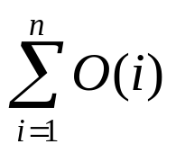
Asymptotic Notation in Equations and Inequalities
This use of asymptotic notation eliminates inessential detail in an equation (e.g., we do not have to specify lower-order terms; they are understood to be included in anonymous function).
The number of anonymous functions in an expression is the number of times asymptotic notation appears
  Example: is one anonymous function
  not the same as O(1)+O(2)+…+O(n), which has n hidden constants

Slide 91
Asymptotic Notation in Equations and Inequalities
Appearance of asymptotic notation on left-hand side of equation means, no matter how the anonymous functions are chosen on the left-hand side, there is a way to choose the anonymous functions on the right-hand side to make the equation valid.
Example: 2n² + Θ(n) = Θ(n²) means that for any function f(n)∈ Θ(n) there is some function
g(n) ∈ Θ(n²) such that 2n² + f(n) = g(n) for all n.

Slide 92
Comparison of Functions
Transitivity:
  f(n) = Θ(g(n)) and g(n) = Θ(h(n)) imply f(n) = Θ(h(n))
  f(n) = O(g(n)) and g(n) = O(h(n)) imply f(n) = O(h(n))
  f(n) = Ω(g(n)) and g(n) = Ω(h(n)) imply f(n) = Ω(h(n))
  f(n) = o(g(n)) and g(n) = o(h(n)) imply f(n) = o(h(n))
  f(n) = ω(g(n)) and g(n) = ω(h(n)) imply f(n) = ω(h(n))

Slide 93
Comparison of Functions
Reflexivity:
  f(n) = Θ(f(n))
  f(n) = O(f(n))
  f(n) = Ω(f(n))

Slide 94
Comparison of Functions
Symmetry:
  f(n) = Θ(g(n)) iff g(n) = Θ(f(n))

Slide 95
Comparison of Functions
Transpose symmetry:
  f(n) = O(g(n)) iff g(n) = Ω(f(n))
  f(n) = o(g(n)) iff g(n) = ω(f(n))

Slide 96
Comparison of Functions
Analogies:
f(n) = o(g(n)) ≈ a < b
f(n) = O(g(n)) ≈ a ≤ b
f(n) = Θ(g(n)) ≈ a = b
f(n) = Ω(g(n)) ≈ a ≥ b
f(n) = ω(g(n)) ≈ a > b

Slide 97
Comparison of Functions
Asymptotic relationships:
f(n) is asymptotically smaller than g(n) if
f(n) = o(g(n))
f(n) is asymptotically larger than g(n) if
f(n) = ω(g(n))

Slide 98
Comparison of Functions
Asymptotic relationships:
Not all functions are asymptotically comparable.
That is, it may be the case that neither f(n) = o(g(n)) nor f(n) = ω(g(n)) is true.

Slide 99
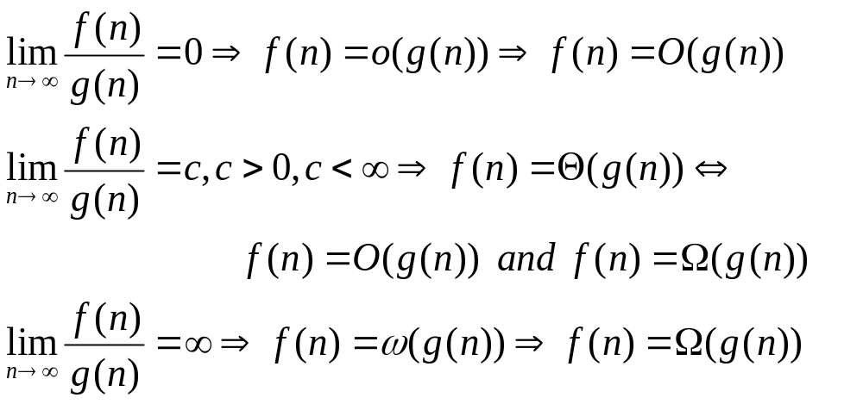
Using limit of ratio to show order of growth of a function

Slide 100
Standard Notation
Pages 51 – 56 contain review material from your previous math courses
Please read this section of your textbook and refresh your memory of these mathematical concepts
The remaining slides in this section are for your aid in reviewing the material

Slide 101
Monotonicity
A function f(n) is monotonically increasing if m ≤ n implies f(m) ≤ f(n).
A function f(n) is monotonically decreasing if m ≤ n implies f(m) ≥ f(n).
A function f(n) is strictly increasing if m < n implies f(m) < f(n).
A function f(n) is strictly decreasing if m < n implies f(m) > f(n).

Slide 102
Floor and Ceiling
For any real number x, the floor of x is the greatest integer less than or equal to x.
The floor function f(x) = ⎣x⎦ is monotonically increasing.
For any real number x, the ceiling of x is the least integer greater than or equal to x.
The ceiling function f(x) = ⎡x⎤ is monotonically increasing.

Slide 103
Modulo Arithmetic
For any integer a and any positive integer n, the value of a modulo n ( or a mod n) is the remainder we have after dividing a by n.
a mod n = a - ⎣a/n⎦ n
if (a mod n ) = (b mod n), then a ≡ b mod n (read as “a is equivalent to b mod n”)

Slide 104
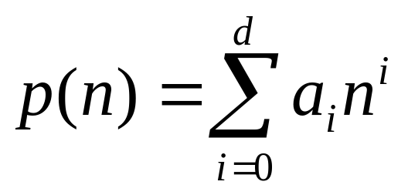
Polynomials
Given a nonnegative integer d, a polynomial in n of degree d is a function p(n) of the form
where the constants a₀, a₁, ..., a_{d} are the coefficients of the polynomial and a_{d} ≠ 0.

Slide 105
Polynomials
A polynomial is asymptotically positive if and only if a_{d} > 0.
If a polynomial p(n) of degree d is asymptotically positive, then p(n) = Θ(n^{d}).
For any real constant a ≥ 0, nª is monotonically increasing.
For any real constant a ≤ 0, nª is monotonically decreasing.
A function is polynomially bounded if f(n) = O(n^{k}) for some constant k.

Slide 106
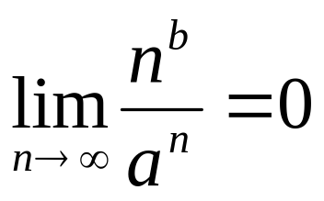
Exponentials
For all n and a ≥ 1, the function a^{n} is monotonically increasing in n.
For all real constants a and b such that a > 1,
This means that n^{b} = o(a^{n}), which means that any exponential function with a base strictly greater than 1 grows faster than any polynomial function.

Slide 107
Logarithms
lg n = log₂ n (binary logarithm)
ln n = log_{e} n (natural logarithm)
lg^{k} n = (lg n)^{k} (exponentiation)
lg lg n = lg (lg n) (composition)
lg n + k means (lg n) + k, not log (n + k)
If b > 1 and we hold b constant, then, for n > 0, the function log_{b}n is strictly increasing.
Changing the base of a logarithm from one constant to another only changes the value of the logarithm by a constant factor.

Slide 108
Logarithms
A function is polylogarithmically bounded if f(n) = O(lg^{k} n) for some constant k.
lg^{b} n = o(nª) for any constant a > 0
This means that any positive polynomial function grows faster than any polylogarithmic function.

Slide 109
Factorials
N factorial is defined for integers ≥ 0 as:
A weak upper bound on n! is n! ≤ n^{n}
  n! = o(n^{n})
  n! = ω(2^{n})
  lg(n!) = Θ(n lg n)
n! = {
1 if n = 0
n • (n – 1)! if n > 0

Slide 110
Fibonacci Numbers
The Fibonacci numbers are defined by the recurrence:
F₀ = 0
F₁ = 1
F_{i} = F_{i-1} + F_{i-2} ≥ 2
Fibonacci numbers grow exponentially

