Slide 1

Analysis of Algorithms 1
(Fall 2016)
Istanbul Technical University
Computer Eng. Dept.
Chapter 4: Recurrences
Course slides from
Susan Bridges @MS State
have been used in preparation of these slides.
Last updated: Oct 4, 2016

Slide 2
Purpose
Understand what a recurrence equation is and why we need to solve it.
Understand methods to solve a recurrence equation.

Slide 3
Outline
Recurrence Equation: What and why
Methods to Solve Recurrences:
  Substitution (constructive induction)
  Iteration of the recurrence
    Recurrence Trees
  Master Theorem

Slide 4
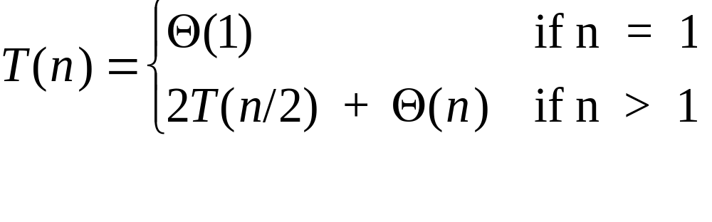
Recurrences
Definition – a recurrence is an equation or inequality that describes a function in terms of its value on smaller inputs
Example – recurrence for Merge-Sort

Slide 5
Why Recurrences?
The complexity of many interesting algorithms is easily expressed as a recurrence – especially divide and conquer algorithms
The form of the algorithm often yields the form of the recurrence
The complexity of recursive algorithms is readily expressed as a recurrence.

Slide 6
Why solve recurrences?
To make it easier to compare the complexity of two algorithms
To make it easier to compare the complexity of the algorithm to standard reference functions.

Slide 7
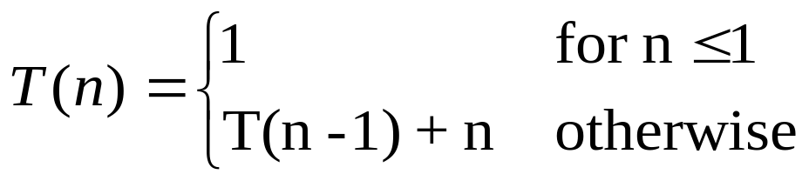
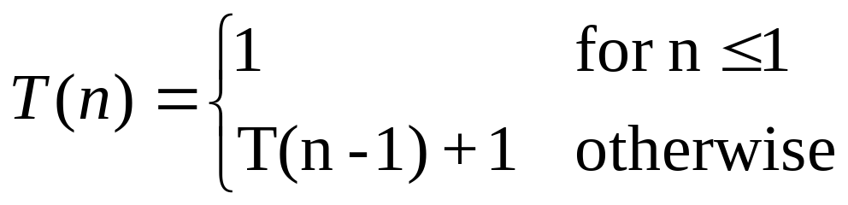
Example Recurrences for Algorithms
Insertion sort
Linear search of a list

Slide 8
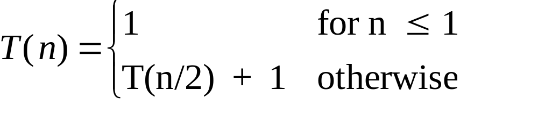
Recurrences for Algorithms, continued
Binary search

Slide 9
Casual About Some Details
Boundary conditions
  These are usually constant for small n
  We sometimes use these to fill in the details of a “rough guess” solution
Floors and ceilings
  Usually makes no difference in solution
  Usually assume n is an “appropriate” integer (i.e. a power of 2) and assume that the function behaves the same way if floors and ceilings were taken into consideration

Slide 10
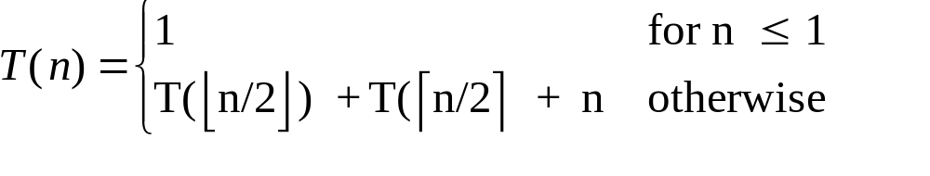
Merge Sort Assumptions
Actual recurrence is:
But we typically assume that n = 2^{k} where k is an integer and use the simpler recurrence.

Slide 11
Methods for Solving Recurrences
Substitution (constructive induction)
Iteration of the recurrence
Master Theorem

Slide 12
Substitution Method
(Constructive Induction)
Use mathematical induction to derive an answer
Steps
  1. Guess the form of the solution
  2. Use mathematical induction to find constants or show that they can be found and to prove that the answer is correct

Slide 13
Substitution
Goal
  Derive a function of n (or other variables used to express the size of the problem) that is not a recurrence so we can establish an upper and/or lower bound on the recurrence
  May get an exact solution or may just get upper or lower bounds on the solution

Slide 14
Constructive Induction
Suppose T includes a parameter n and n is a natural number (positive integer)
Instead of proving directly that T holds for all values of n, prove
  T holds for a base case b (often n = 1)
  For every n > b, if T holds for n-1, then T holds for n.
    Assume T holds for n-1
    Prove that T holds for n follows from this assumption

Slide 15
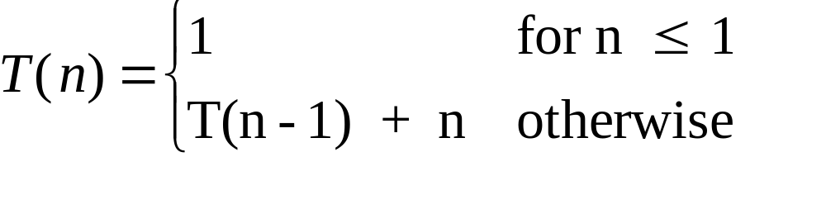
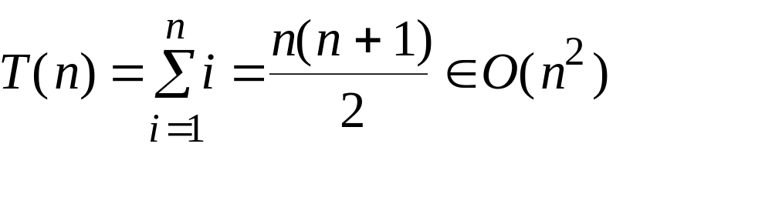
Example 1
Given
Prove T(n) ∈ O(n²)
  Note that this is the recurrence for insertion sort and we have already shown that this is O(n²) using other methods

Slide 16
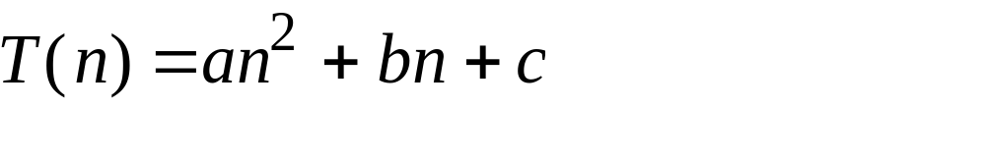
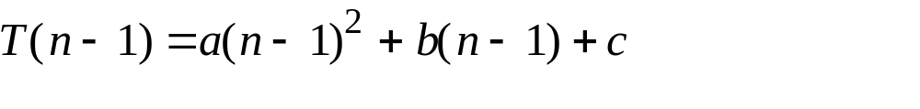
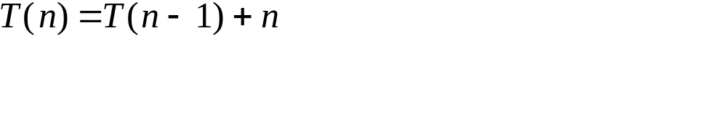
Proof for Example 1
Guess that the solution for T(n) is a quadratic equation
Base case T(1) = a + b + c. We need to find values for a, b, and c first.
Assume this solution holds for n-1
Now consider the case for n. Begin with the recurrence for T(n)

Slide 17
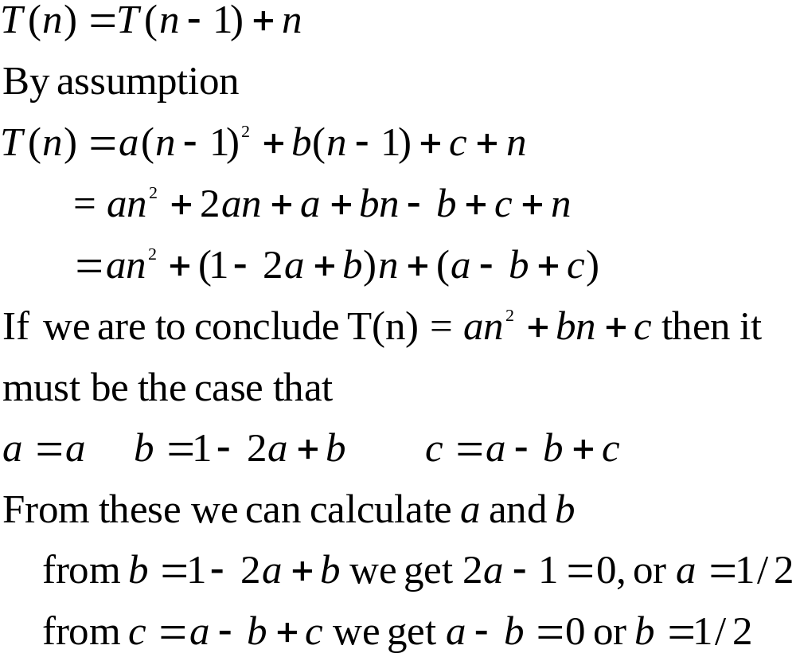

Slide 18
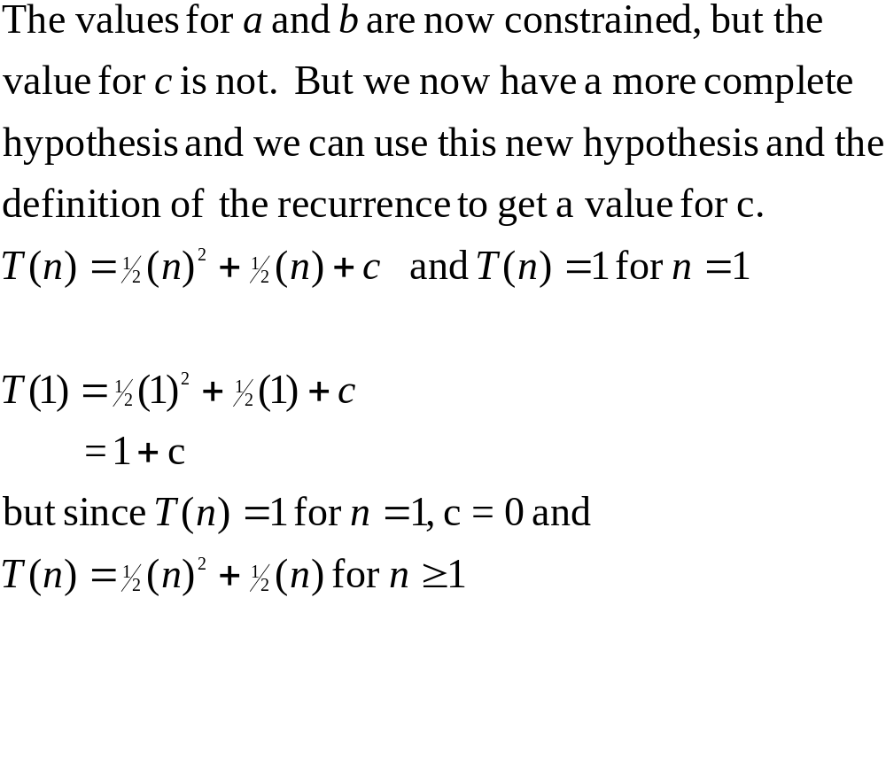

Slide 19
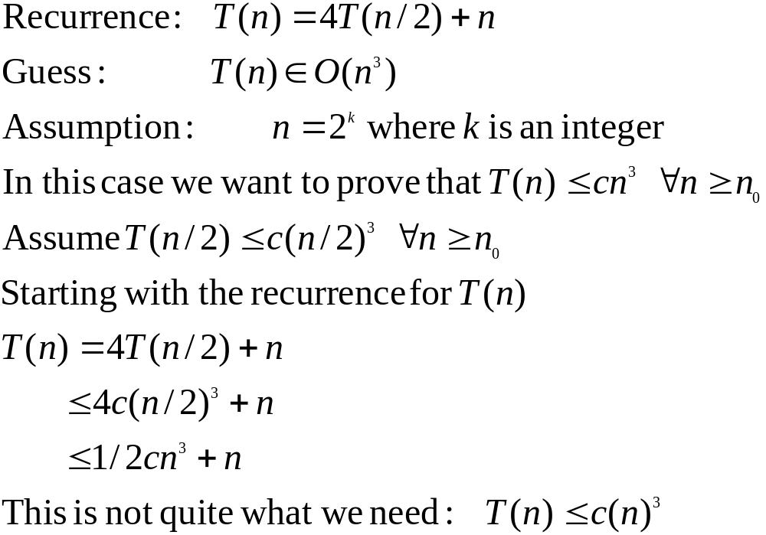
Example 2– Establishing an Upper Bound

Slide 20
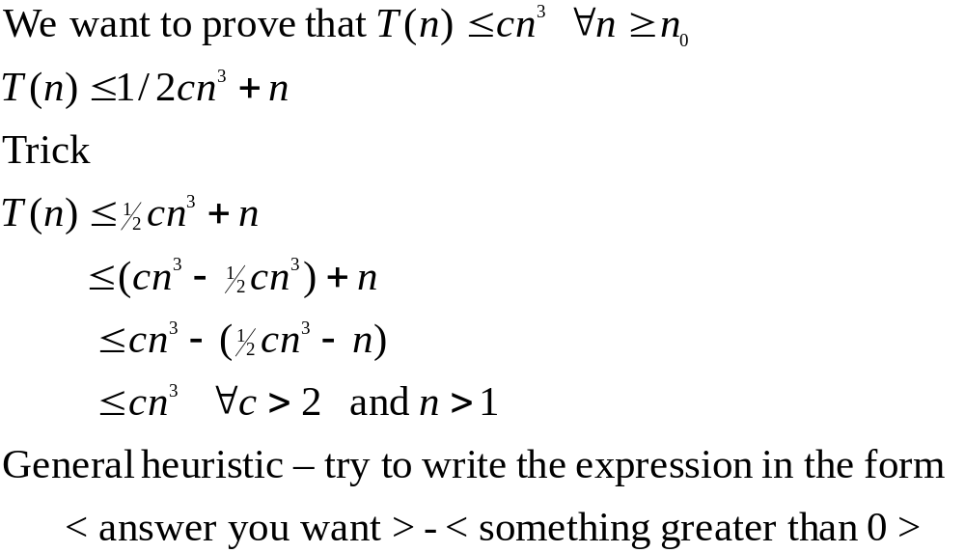

Slide 21
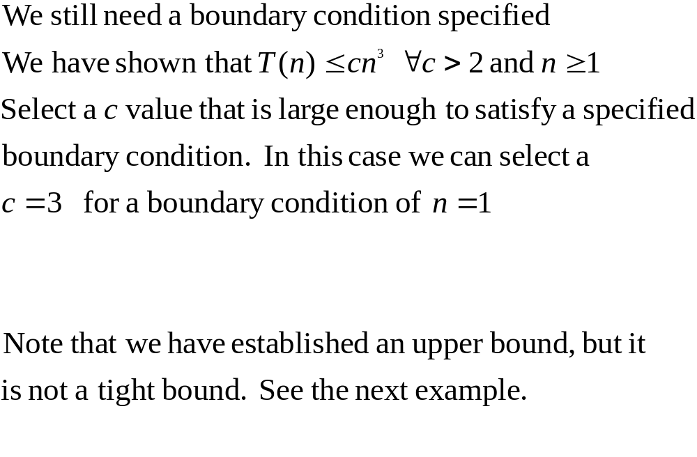

Slide 22
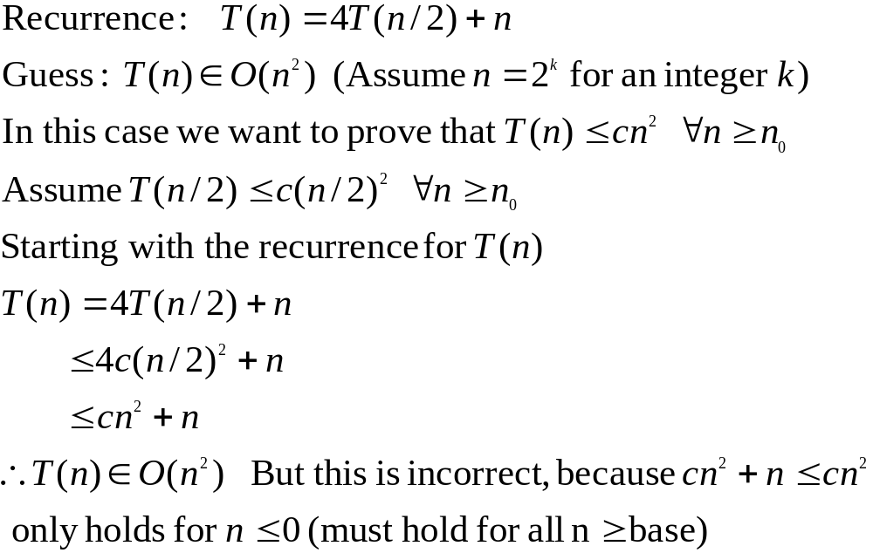
Ex. 3–Fallacious Argument

Slide 23
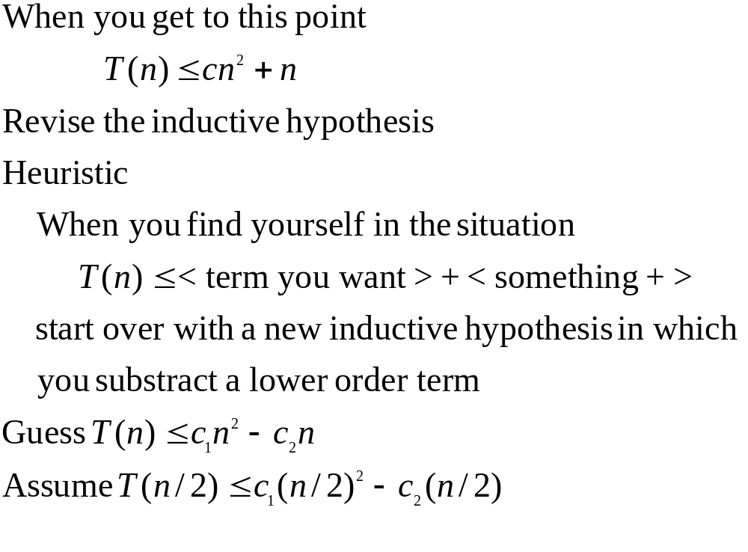
Ex. 3–Try again

Slide 24
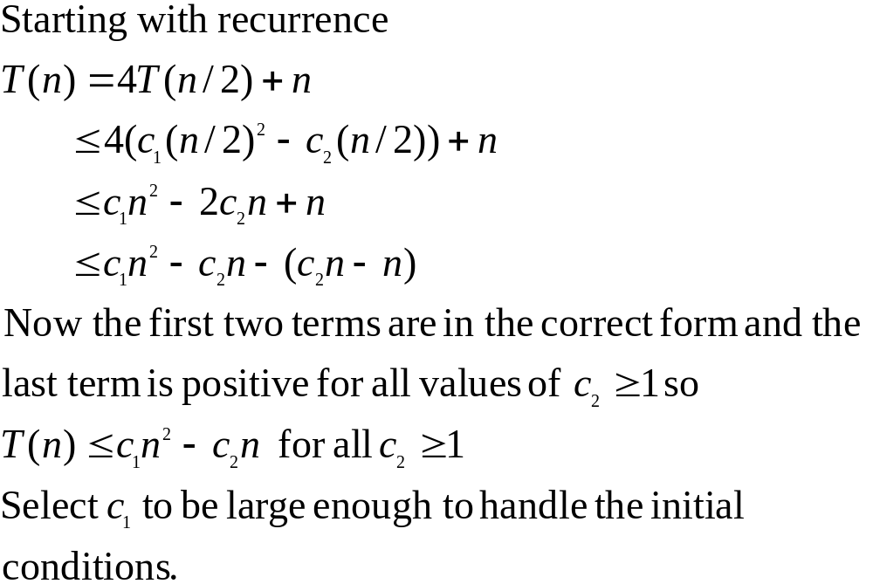
Ex. 3–Try again cont.

Slide 25
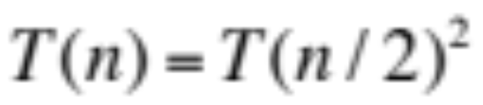
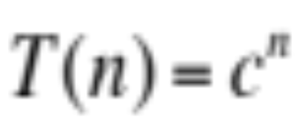
Boundary Conditions
Boundary conditions are not usually important because we do not need an actual c value (if polynomially bounded)
But sometimes it makes a big difference
  Exponential solutions
  Suppose we are searching for a solution to:
  and we find the partial solution

Slide 26
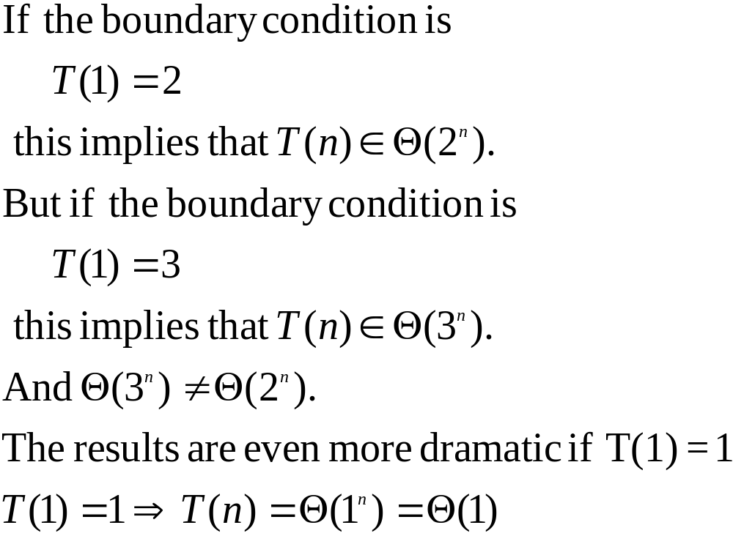
Boundary Conditions cont.

Slide 27
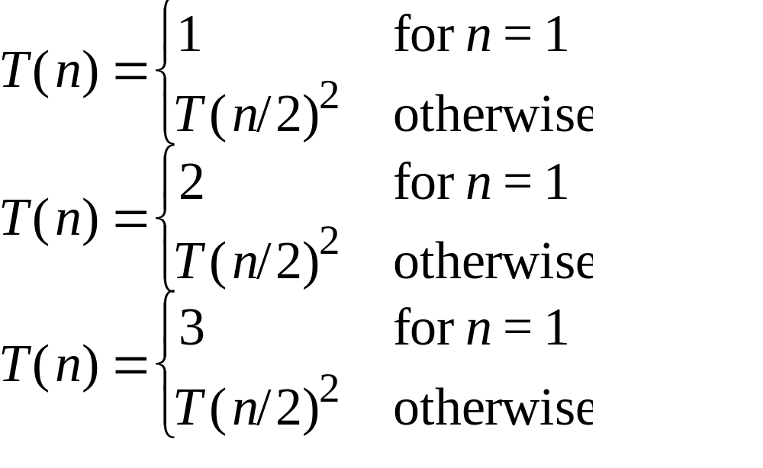
Boundary Conditions
The solutions to the recurrences below have very different upper bounds

Slide 28
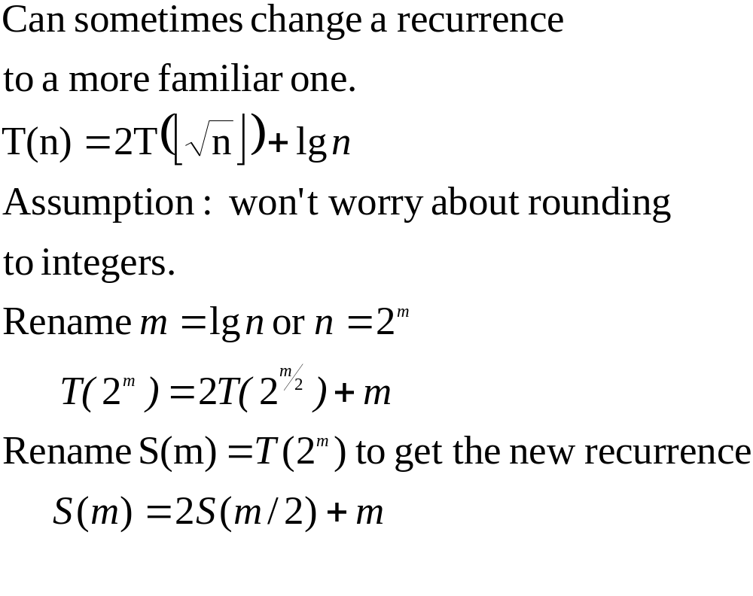
Changing Variables

Slide 29
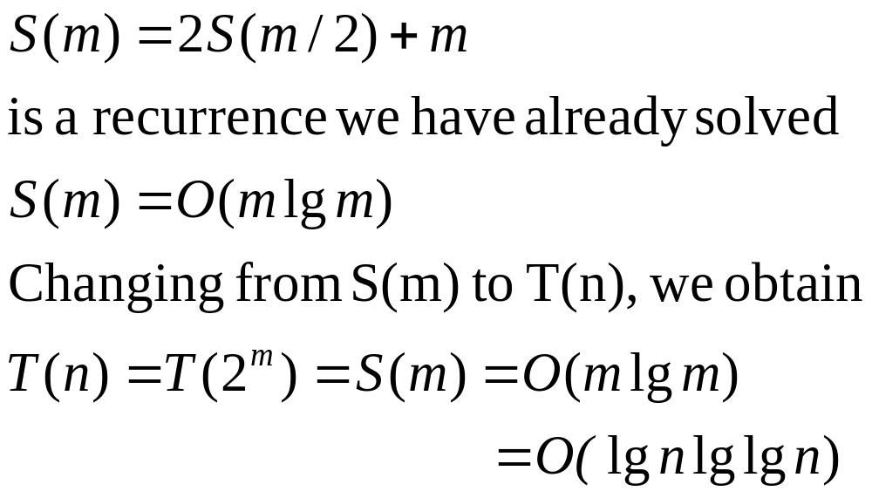
Changing Variables continued

Slide 30
Iterating the Recurrence
The math can be messy with this method
Can sometimes use this method to get an estimate that we can use for the substitution method

Slide 31
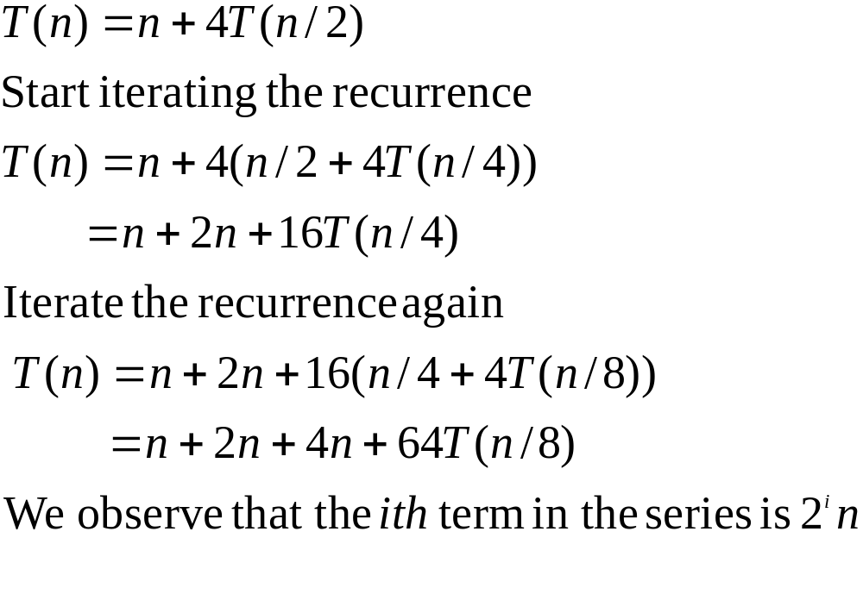
Example 4

Slide 32
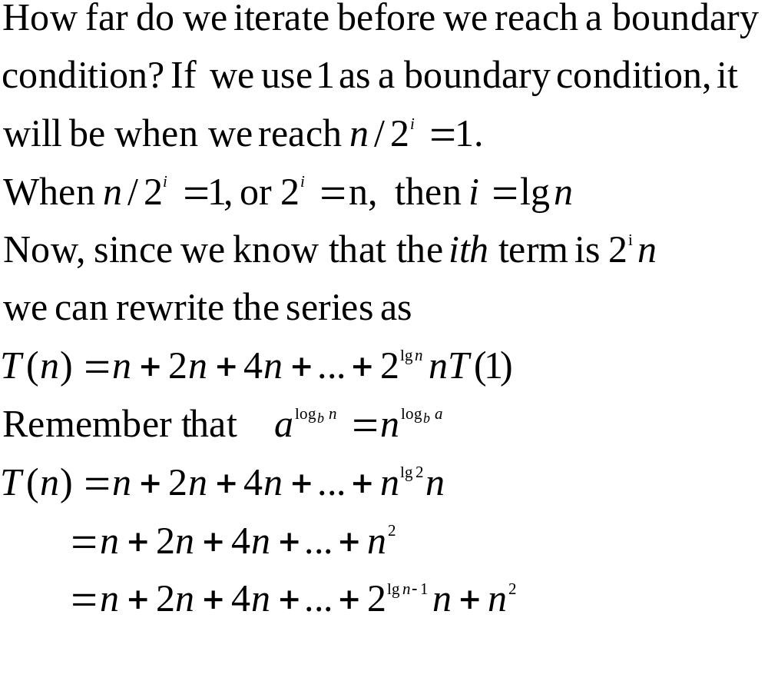

Slide 33
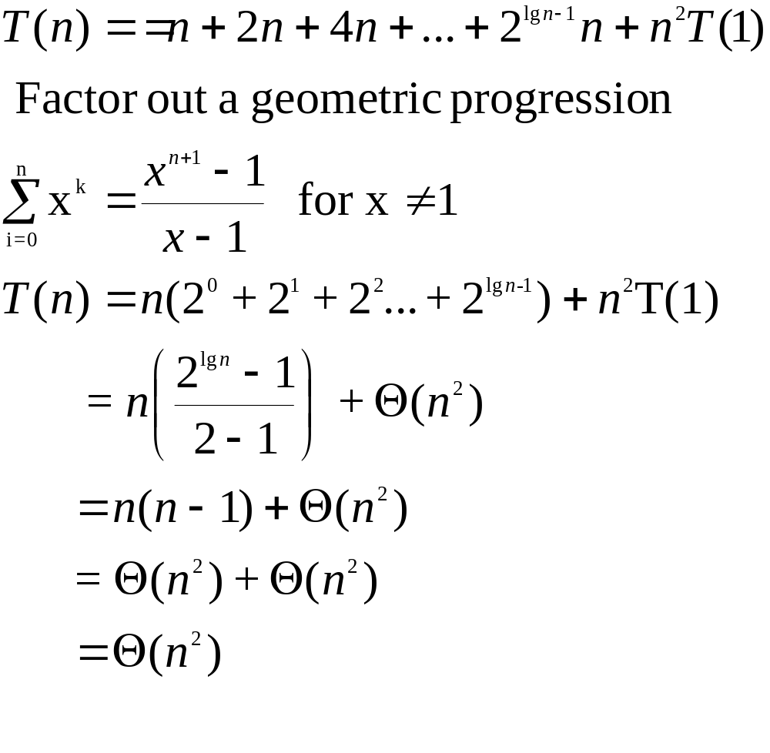

Slide 34
Example 5
Eq. to be solved: T(n) = 4 T(n-1) + 1
T(n) = 4 T(n-1) + 1
4¹ T(n-1) = 4 T(n-2) + 1
4² T(n-2) = 4 T(n-3) + 1
4³ T(n-3) = 4 T(n-4) + 1
4 T(3) = 4 T(2) + 1
T(2) = 4 T(1) + 1
n - 1

Slide 35
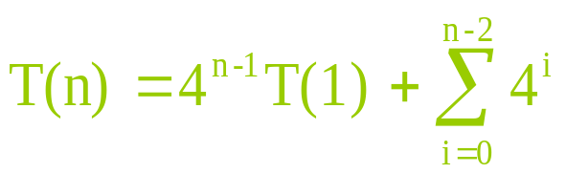
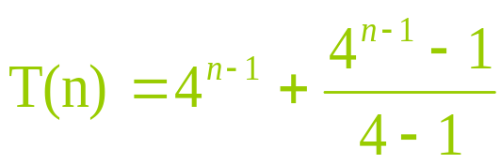
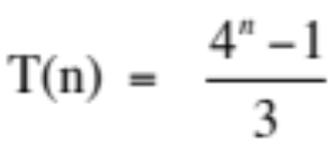
T(n) = 4 T(n-1) + 1
4¹ T(n-1) = 4¹ 4 T(n-2) + 4¹ 1
4² T(n-2) = 4² 4 T(n-3) + 4² 1
4³ T(n-3) = 4³ 4 T(n-4) + 4³ 1
4^{n-3} T(3) = 4^{n-3} 4 T(2) + 4^{n-3} 1
4^{n-2} T(2) = 4^{n-2} 4 T(1) + 4^{n-2} 1

Slide 36

Recurrence Trees
Allow you to visualize the process of iterating the recurrence
Allows you make a good guess for the substitution method
Or to organize the bookkeeping for iterating the recurrence
Example

Slide 37
n²
n²
n²
T(n/2) T(n/2)
(n/2)² (n/2)²
(n/2)² (n/2)²
T(n/4) T(n/4) T(n/4) T(n/4)
(n/4)² (n/4)² (n/4)² (n/4)²

Slide 38
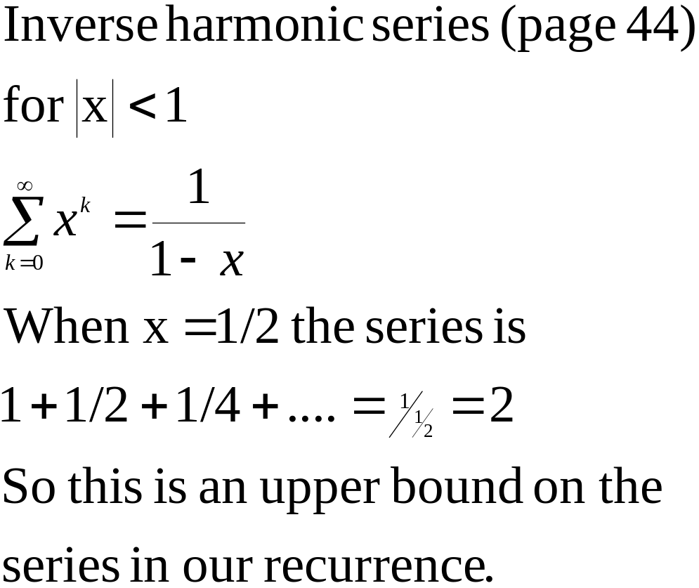
Counting things

Slide 39
Recurrence Tree Example
n²
(n/2)² (n/2)²
lg n
(n/4)² (n/4)² (n/4)² (n/4)²
Total: Θ(n²)

Slide 40
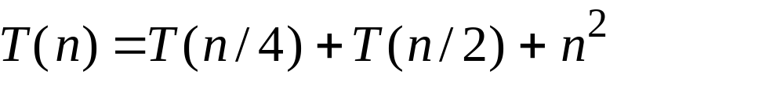
Another Example

Slide 41
n²
n²
n²
5/16 n²
25/256 n²=(5/16)²n²
T(n/4) T(n/2)
(n/4)² (n/2)²
T(n/16) T(n/8) T(n/8) T(n/4)
Since the values decrease geometrically, the total is at most a constant factor more than the largest term and hence the solution is Θ(n²)

Slide 42
Master Method
Solving a class of recurrences having the form of
T(n)=aT(n/b)+f(n)
where a ≥ 1 and b > 1, and
f(n) is asymptotically positive.
Notes:
F(n) >0 for n >=n0

Slide 43
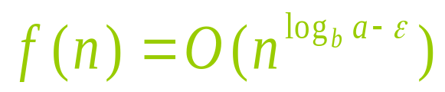

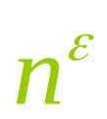
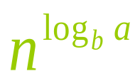
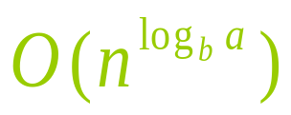
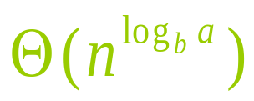
Master Theorem (case 1)
for some constant
  f(n) grows polynomially (by factor )
  slower than
leaf level work dominates
  Summation of recursion-tree levels
  Cost of all the leaves
  The total cost
Notes:
F(n) is polynomially smaller than n to the power of logbaseb a

Slide 44
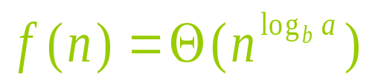
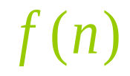
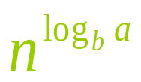
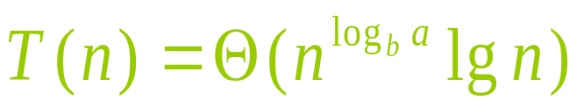
Master Theorem (case 2)
if
  and are asymptotically the same
work is distributed equally throughout the tree
  (level cost) X (number of levels)

Slide 45
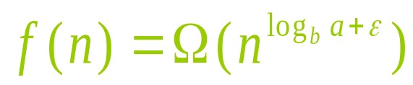



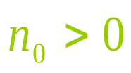

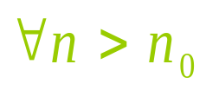

Master Theorem (case 3)
for some constant
  Inverse of the first case
  f(n) grows polynomially faster than
  Also need a regularity condition
  and such that
root work dominates
Notes:
F(n) grows bigger than n to the logbaseb of a
Cost decrease geometrically as we go lower in the tree. Therefore f(n) dominates

Slide 46
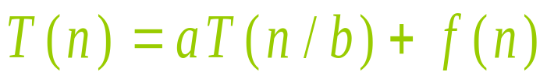
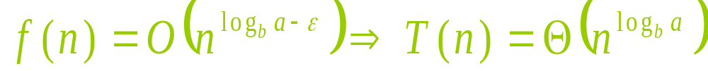
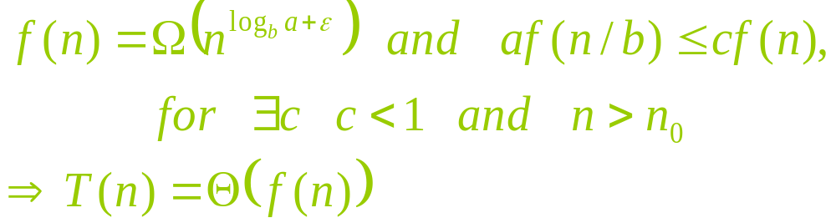
Master Theorem (all cases)
Having a recurrence in the form of
1
2
3

Slide 47
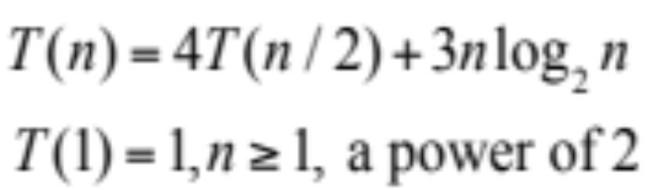
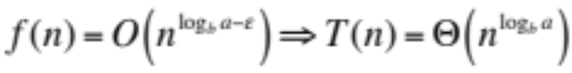
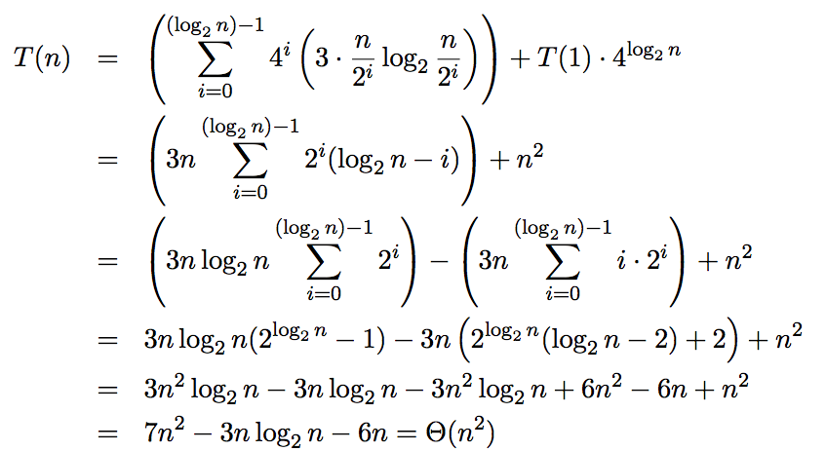
Master Theorem Case 1
Source: http://www.cs.wustl.edu/~sg/CSE241_SP06/recurrence-exs.pdf

Slide 48


Master Theorem Case 2
Source: http://www.cs.wustl.edu/~sg/CSE241_SP06/recurrence-exs.pdf
Notes:
Case where recurrence does not apply
T(n) = 2T(n/2) + nlogn → f(n) = nlogn,
n logbase2 of 2 is n.
Nlogn is aympototically larger than n, but it is not polynomially larger. Therefore recurrence falls into the gap between case 2 and case3.

Slide 49



Master Theorem Case 3
Source: http://www.cs.wustl.edu/~sg/CSE241_SP06/recurrence-exs.pdf

Slide 50
Summary
Recurrence Equation: What and why
Methods to Solve Recurrences:
  Substitution (constructive induction)
  Iteration of the recurrence
    Recurrence Trees
  Master Theorem

