Slide 1
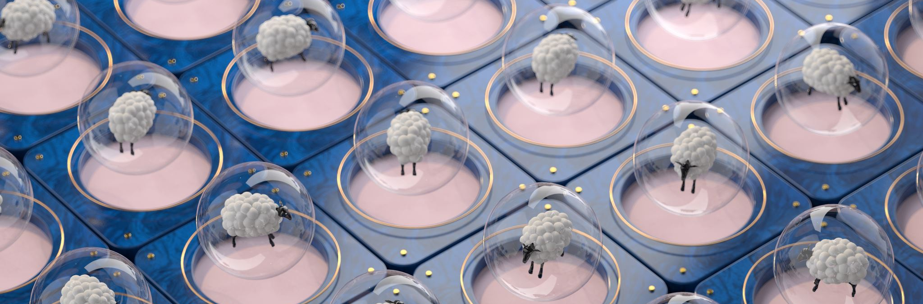
3D interactive animal farm
Group 26
Notes:
Hello, we are group 26

Slide 2
Table of Contents
Introduction
Features & Interactions
Inspirations
Task Allocation
Possible Challenges & Counters
Notes:
We will open with an Introduction about what we are going to make, and move to the features and the interaction that we are going to focus. And Briefly mention the expected outcome from other people’s examples, and what inspired us.

Slide 3
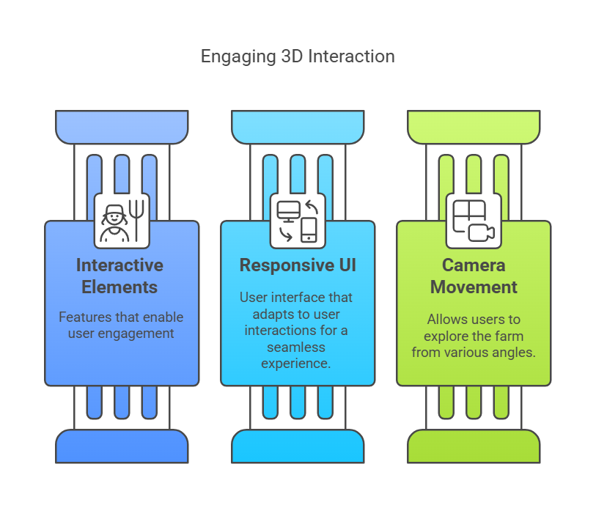
Introduction

Slide 4
Features & Interactions
Features
Place or remove animals/building(Click & Drag)
Camera control
Customisable farm-object environment
Dynamic environment
Interactions
Click – Select and place animals/buildings
Drag – Change placement direction
Camera Movement – Explore the farm from different angles

Slide 5
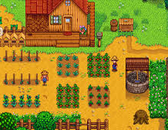
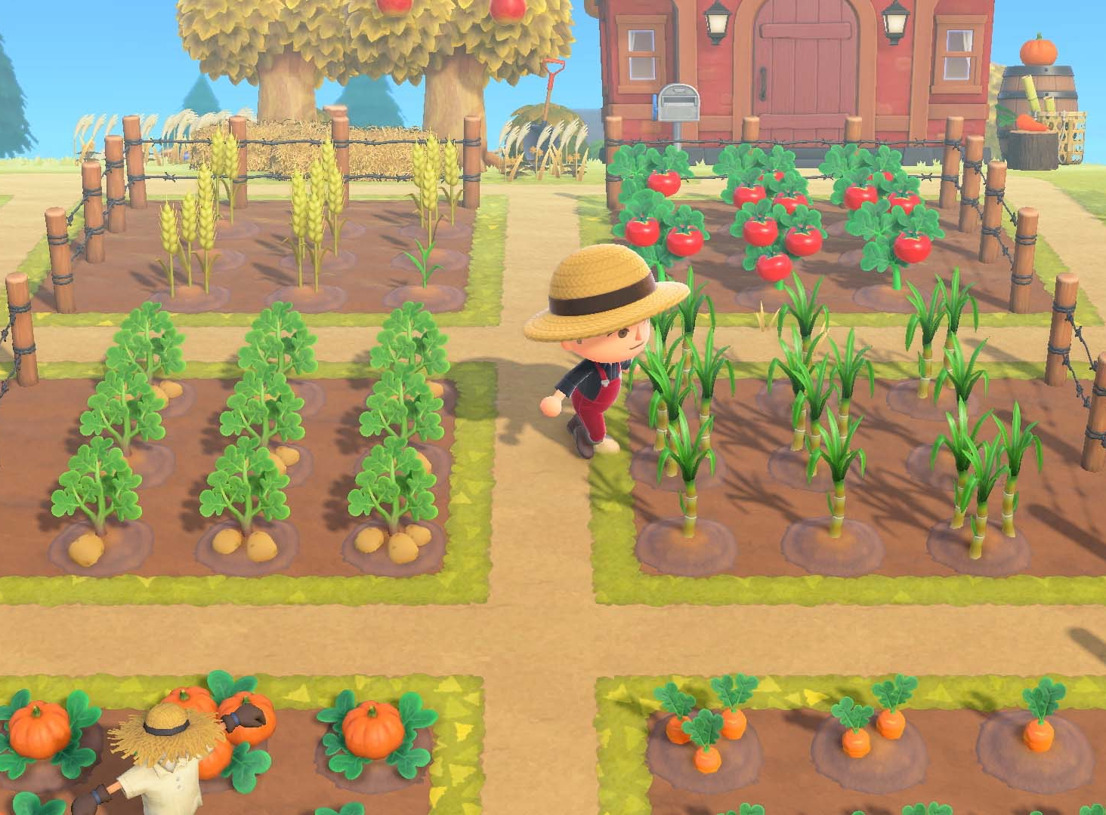
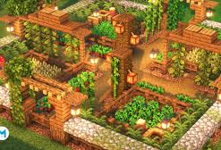
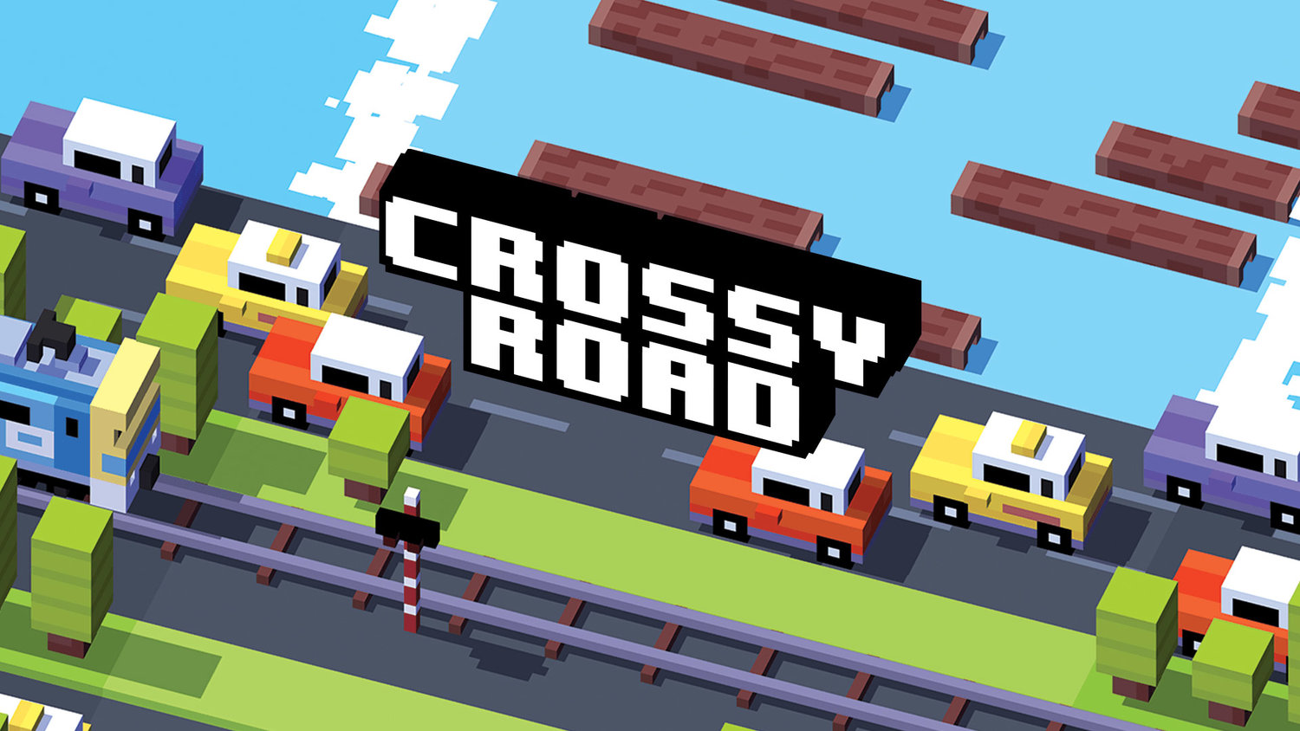
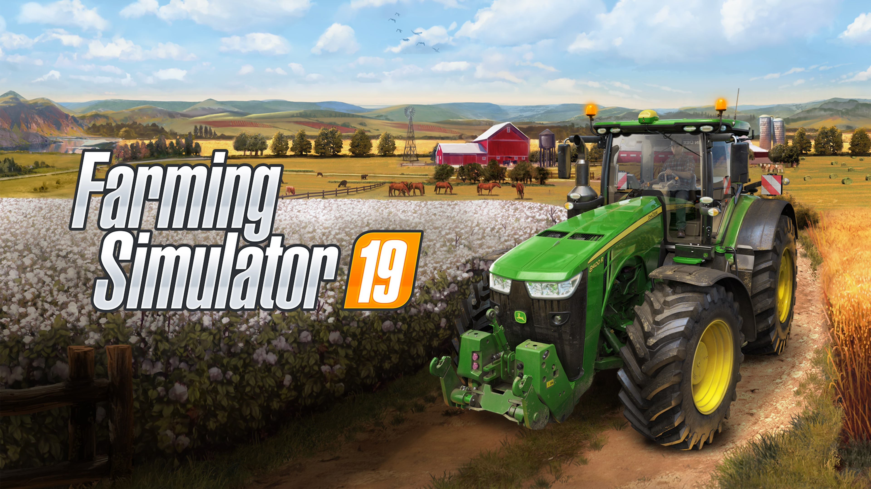
Inspiration
Notes:
Minecraft
Farming simulator
Crossy Road : Animal design
stardew valley

Slide 6
Task Allocation
Feature | Juyoung Chang | Joshua Kim | Jungwook Van
Objects Placement | ✅
Import model | ✅ | ✅ | ✅
Dynamic Environment & Effects |  | ✅
User Interaction & UI |  |  | ✅
Camera Controls | ✅ | ✅ | ✅

Slide 7
Possible Challenges & Counters
Feature | Challenges | Counters
Objects Placement | Need a way to snap objects to the ground & prevent collisions/overlapping. | Use ray-casting to detect collisions Implement grid snapping for objects if necessary.
Dynamic Environment | Performance issue due to many particles | Remove weather particle where the user cannot see in their view
UI & User Experience | UI elements must be clear and accessible. | Provide visual feedback (e.g., highlight selected object) Implement a simple tutorial/guide for first-time users
Camera Controls | If the camera is too restrictive or loose camera makes farm viewing difficult | Consider fixed camera angles(isometric view) if full 3d control is unnecessary Mouse drag to rotate, scroll to zoom

Slide 8
Git-Branching Strategy
Main Branches
main:
Contains stable, production-ready code.
Only code that has been thoroughly tested and reviewed is merged here.
Used for deployment (e.g., GitHub Pages).
dev:
Central branch for ongoing development.
All feature branches are merged into dev after testing.
Serves as the integration point before merging into main.
Workflow:
Main
Main Branch
Contains stable, production-ready code.
Only merge tested and approved features here.
dev
Feature
dev Branch
Central branch for integrating feature branches.
Regularly pull updates from into feature branches.
main
↑
|
dev
↑
|--- feature/object-placement
|--- feature/camera-controls
|--- feature/ui-design

Slide 9

TIMELINE
Project
Setting
Planning
Modelling
Core Features
Integration
Testing
Submission
Legend:
Not Started: Task not yet begun
In Progress: Task currently being worked on
In Progress: Task currently being worked on
Completed: Task finished

Slide 10
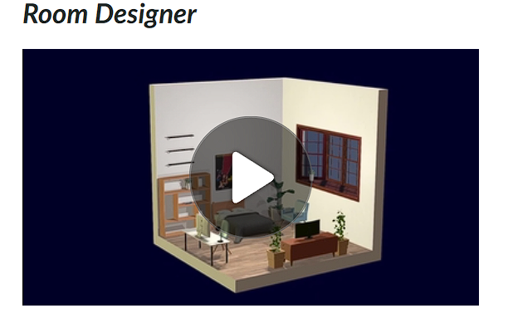
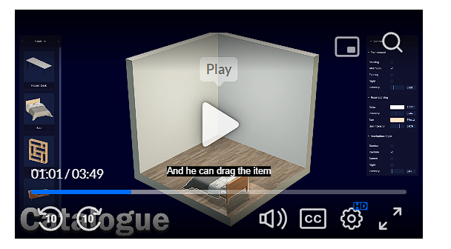
Assignment Final Example
Room Designer (Canvas)
User select from the list of items,

Slide 11
Index Js
SceneManager.js
Farm.js
GrassManager.js
AnimalManager.js
UIManager.js

