Slide 1
Presentation on System Architecture Diagram

Slide 2
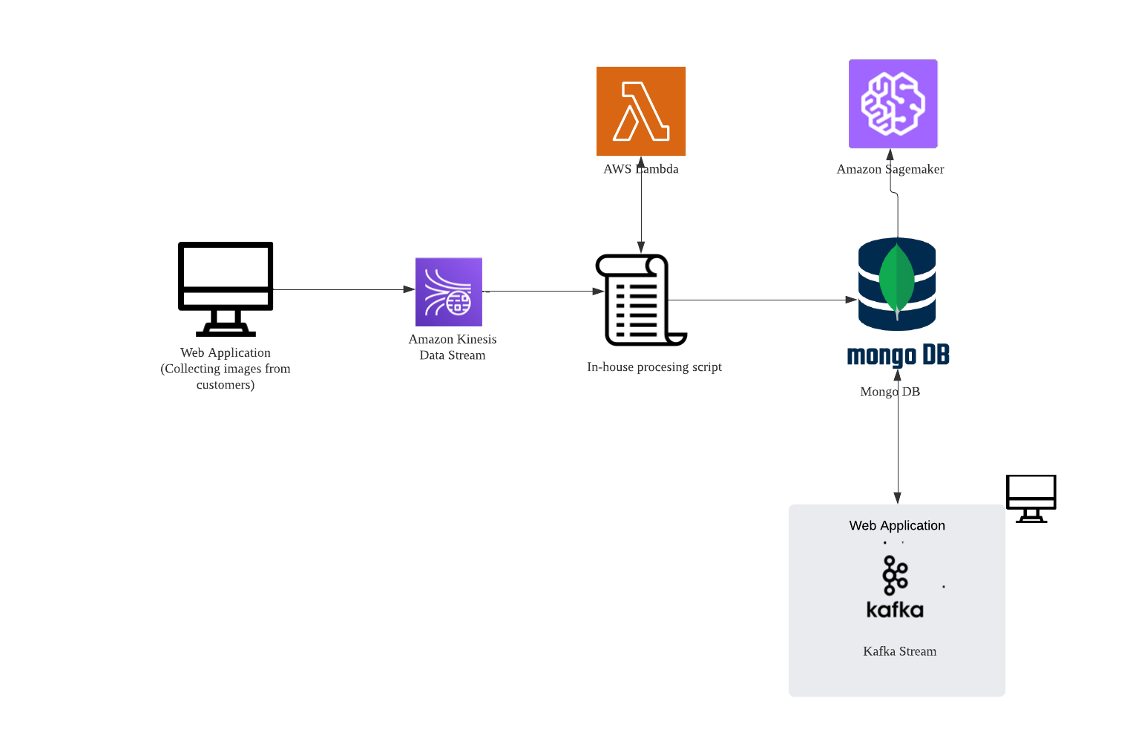
Amazon Kinesis Data Stream helps to stream large scale data in real-time from the web application

Slide 3
The company’s own processing script is used to process the image data and the script function is triggered using AWS Lambda

Slide 4
The processed images is stored in Mongo DB (noSQL database). Hence, appropriate to store images and can store massive amount of data.
Can adjust default settings in MongoDB to ensure the data is not lost.

Slide 5
Data can be pulled from MongoDB for analytics and machine learning using Amazon Sagemaker.

Slide 6
Assumption: Data source to provide data to the Kafka stream for processing is Mongo DB and then the processed data from Kafka is saved back into Mongo DB

Slide 7
PROS AND CONS
Pros
Large, massive data can be handled without the system to break down (that’s what I infer from my research)
Caters to real-time processing
Used cloud – don’t have to manage infrastructure by ourselves except the part where the company has their own web application.
Cons
There might be a more optimal and cheaper solution
Need to be careful about configurations (e.g. I came across that it is possible to lose data from Mongo DB if one sticks with default settings)
Amazon Sagemaker may not be the best application to provide analytical insights if you are looking for convenience [There is still a need to write code by ourself]

