Slide 1
C# Development with OOP
Salih DEMİROĞ
Full Stack Developer, Trainer & Consultant
salihdemirog@gmail.com
v-sademi@microsoft.com

Slide 2
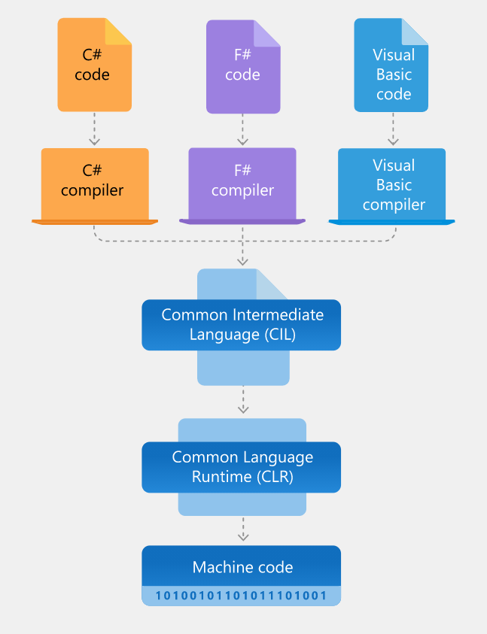
.Net Framework Architecture

Slide 3
Types and Variables in C#

Slide 4
Value and Referance Types
Variable | Size | Description | Class/Struct
byte | 8 bit | 0 ila 255 | System.Byte
short | 16 bit | -32,768 ila 32,767 | System.Sbyte
int | 32 bit | -+2 147 483 647 | System.Int32
long | 64 bit | -+9 223 372 036 854 775 807 | System.Int64
float | 32 bit | 1.5E-45 ila 3.4E+38 | System.Single
double | 64 bit | 5E-324 ila 1.7E+308 | System.Double
decimal | 128 bit | 1E-28 ila 7.9E+28 | System.Decimal
char | 16 bit | Tek haneli unicode karakter alır | System.Char
string | Sbt dğl | Yaklaşık 2 milyar unicode karakter | System.String
bool | 16 bit | true yada false değerini alır | System.Boolean
DateTime | 32 bit | 9999 yılına kadar olan tarih ve saat bilgisi | System.DateTime

Slide 5
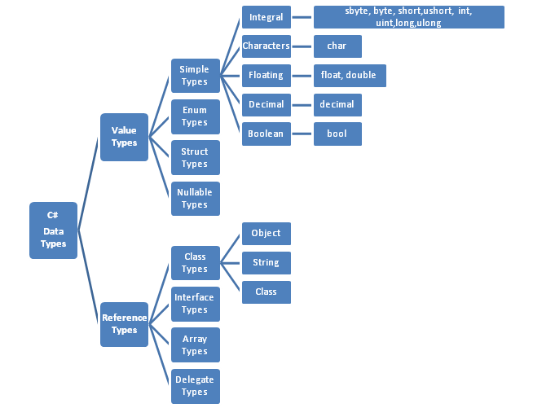
Value and Reference Types

Slide 6
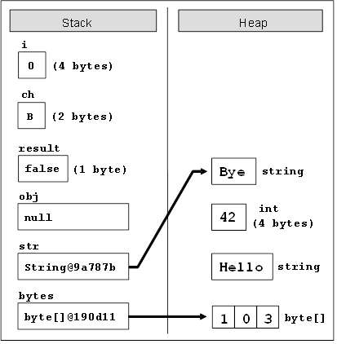
Value and Reference Types

Slide 7
Type, Type, Type
Type Conversion
İmplicit Conversion (bilinçsiz, kapalı, örtük)
Explicit Conversion (bilinçli, açık, belirtik)
checked, unchecked
Boxing & UnBoxing
Literal Type Characters
Nullable Types
object, var, dynamic

Slide 8
Control Statements

Slide 9
Control Statements
Conditional Statements (if)
Selection Statements (switch)
Iteration Statements (while, do while, for, foreach)
Jump Statements (return, break, continue, go to)

Slide 10
Arrays

Slide 11
Collection Objects

Slide 12
Collection Objects
Arraylist
Hashtable
SortedList
Stack
Queque

Slide 13
Generic Class

Slide 14
Generic Classes
List
Dictionary
SortedList
Stack
Queque
Linked List

Slide 15
Object Oriented Programing

Slide 16
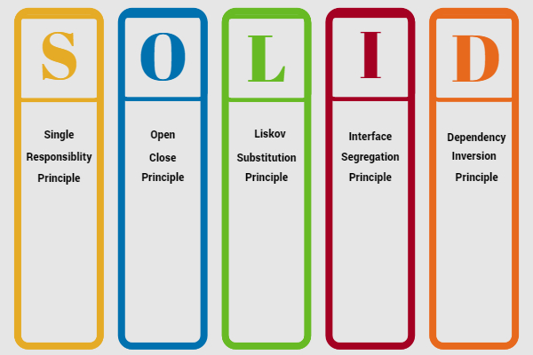
SOLID

Slide 17
What is class in OOP?
A class is a construct that enables you to create your own custom types by grouping together variables of other types, methods and events. A class is like a blueprint. It defines the data and behavior of a type. If the class is not declared as static, client code can use it by creating objects or instances which are assigned to a variable.

Slide 18
Class Members
Methods
optional
params
ref & out
Recursive Functions
Tuple
Property & Indexer
Constructor & Destructor

Slide 19
Static Members
Static Class
Static Constructor
Static Methods
Static Properties
Static Fields

Slide 20
The Basic Principles of OOP

Slide 21
Abstraction (Soyutlama)
An abstraction is a type that describes a contract but does not provide a full implementation of the contract. Abstractions are usually implemented as abstract classes or interfaces, and they come with a well-defined set of reference documentation describing the required semantics of the types implementing the contract.

Slide 22
Encapsulation (Sarmalama)
Encapsulation in oriented programming language is a concept which enforce protecting variables, functions from outside of class, in order to better manage that piece of code and having least impact or no impact on other parts of program due to change in protected code

Slide 23
Polymorphism (Çok Şekillilik)
Polymorphism is often referred to as the third pillar of object-oriented programming, after encapsulation and inheritance. Polymorphism is a Greek word that means "many-shaped"and it has two distinct aspects:
At run time, objects of a derived class may be treated as objects of a base class in places such as method parameters and collections or arrays.
Base classes may define and implement virtual methods, and derived classes can override them, which means they provide their own definition and implementation.

Slide 24
Advanced OOP

Slide 25
Inheritance (Kalıtım)
Inheritance, together with encapsulation and polymorphism, is one of the three primary characteristics (or pillars) of object-oriented programming. Inheritance enables you to create new classes that reuse, extend, and modify the behavior that is defined in other classes. The class whose members are inherited is called the base class, and the class that inherits those members is called the derived class. A derived class can have only one direct base class

Slide 26
Advanced OOP
Inheritance
this, base keyword
sealed keyword
const and readonly keyword
Access Modifiers
Interface & Abstract
absract, virtual, override keyword
Extension Methods
Enums

Slide 27
Advanced OOP
Struct & Class
Reflection
Attribute
Delegate & Events
Lamba Expression

Slide 28
Generic Objects

Slide 29
Generic Objects
Generic Classes
Generic Methods
Generic Structs
Generic Interfaces
Generic Delegates
Generic Constraints (where clauses)

Slide 30
Summary Salih DEMİROĞ salihdemirog@gmail.com http//www.yazilimdevi.com

