Slide 1
Better Features
Before Bigger Models
Reinforcement learning and generative methods
for tabular feature engineering
Salih Eren Yuzbasioglu
CMPE 255 / Individual paper review
Notes:
Hi, I'm Salih Eren Yuzbasioglu. In this presentation, I will discuss a 2025 survey titled A Survey on Data-Centric AI: Tabular Learning from Reinforcement Learning and Generative AI Perspective, by Wangyang Ying and colleagues.
The main question is simple: before making a machine-learning model more complicated, can we improve the features that it receives?
The paper focuses on tabular data, meaning datasets organized into rows and columns. It reviews reinforcement learning and generative approaches for deciding which features to keep and which new features to create.
This is a survey, so I will explain the families of methods and their tradeoffs. I am not presenting a new algorithm or claiming that I reproduced the experiments of the papers it references.
Ying et al. (2025), arXiv:2502.08828v2. https://arxiv.org/abs/2502.08828v2
Paper: A Survey on Data-Centric AI: Tabular Learning from Reinforcement Learning and Generative AI Perspective. arXiv survey; conference acceptance is not asserted.

Slide 2
The input representation matters
Example task: predict customer churn
Original feature | Question to ask
Customer identifier | Does it help with unseen customers?
Total spending | Does account age change its meaning?
Recent visits | Was this measured before prediction?
Candidate feature: spending per month
Paper: Introduction, p. 1. Customer example is illustrative.
02
Notes:
The introduction motivates a data-centric perspective. We can work on the model, but we can also work on the representation of the information that goes into it.
For an example, imagine predicting whether a customer will leave a subscription service. We might have total spending, account age, recent visits, and a customer identifier.
Some columns may be redundant or unhelpful for future customers. Others might become more useful when combined. Total spending divided by account age could describe spending per month. That may be easier for a model to use than the two raw values alone.
This is my explanatory example, not a dataset used in a new experiment in this survey. It illustrates why feature engineering matters. We are changing the representation, and we still need to validate whether that change actually helps.
SOURCE: Ying et al. (2025), arXiv:2502.08828v2. https://arxiv.org/abs/2502.08828v2

Slide 3
Feature selection and generation
 | Selection | Generation
Goal | Keep useful existing columns | Construct useful new columns
Example | Remove a redundant column | Spending ÷ account age
Main concern | Discarding useful interactions | Invalid or costly transformations
Both approaches need validation on unseen data.
Paper: Section 2 and Figure 1, p. 2. Examples are explanatory.
03
Notes:
Figure 1 gives us a map of the paper. The first distinction is between feature selection and feature generation. Each of those is then divided into reinforcement-learning and generative approaches.
Feature selection means choosing from columns that already exist. Feature generation means constructing additional features by transforming or combining existing information.
In the customer example, removing an unhelpful identifier is selection. Creating spending per month is generation. We could also generate several candidate features and then select only the useful ones.
The formula in Section 2 illustrates transformations such as ratios and differences. The important idea is the change in representation, rather than the mathematical notation itself.
There are practical limits. Dividing by account age needs a rule for new accounts with zero age. A feature can be mathematically valid but still be meaningless for the application. These details explain why automated feature engineering still benefits from domain knowledge.
SOURCE: Ying et al. (2025), arXiv:2502.08828v2. https://arxiv.org/abs/2502.08828v2

Slide 4
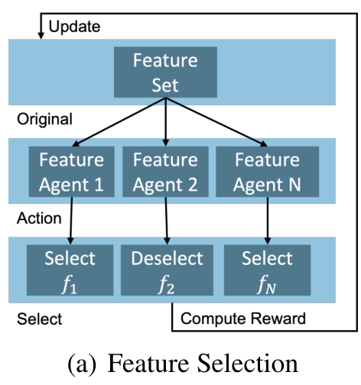
Reinforcement learning for selection
State
The current feature set and its representation
Action
Keep or remove candidate features
Reward
Task performance, with optional cost penalties
Ying et al., Figure 2(a), p. 3. Cropped reproduction, CC BY 4.0.
04
Notes:
Now we reach reinforcement learning. In this setting, the agent is not playing a game. It is making decisions about features.
We can understand the process using state, action, and reward. The state describes the current feature situation. The action changes which features are selected. The reward gives feedback about how useful the resulting selection is.
For example, the system might evaluate a candidate feature subset using validation performance. An application could also penalize unnecessary complexity or expensive features. That is an illustrative design choice, not a claim that every reviewed method uses the same reward.
Section 3.1 organizes methods into multi-agent, single-agent, and hybrid approaches. In some multi-agent methods, agents are associated with individual features. Other approaches group similar features or use one agent to organize the decisions.
Look at Figure 2(a): the feature set leads to decisions about selection, then reward feedback updates the process. The benefit is learning where to search. The challenge is that evaluating many subsets can require substantial computation.
SOURCE: Ying et al. (2025), arXiv:2502.08828v2. https://arxiv.org/abs/2502.08828v2
Figure credit: Wangyang Ying et al. (2025), Figure 2(a). Cropped. https://creativecommons.org/licenses/by/4.0/

Slide 5
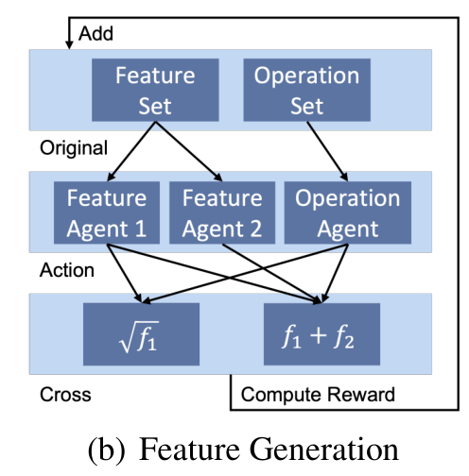
Reinforcement learning for generation
Feature choices
Total spending and account age
Operation choice
Division produces spending per month
Feedback
Evaluate the result and guide later choices
Ying et al., Figure 2(b), p. 3. Cropped reproduction, CC BY 4.0.
05
Notes:
Feature generation adds another type of choice. The system must decide how to transform features, not just whether to keep them.
The paper describes a cascaded framework with three agents: two choose features and one chooses an operator. In our customer example, the choices might be total spending, account age, and division.
Figure 2(b) shows why the operation set matters. After constructing a candidate feature, the system evaluates the updated representation and uses the feedback to guide later decisions.
The section also reviews graph-based exploration and hybrid methods. These can represent relationships between features or reuse information about previous transformations.
The search space grows quickly because a generated feature can become an input to another transformation. That makes constraints useful. For example, a practical system might limit expression depth or reject invalid operations. Those are engineering decisions I would consider when applying the general idea.
SOURCE: Ying et al. (2025), arXiv:2502.08828v2. https://arxiv.org/abs/2502.08828v2
Figure credit: Wangyang Ying et al. (2025), Figure 2(b). Cropped. CC BY 4.0. The spending example is illustrative.

Slide 6
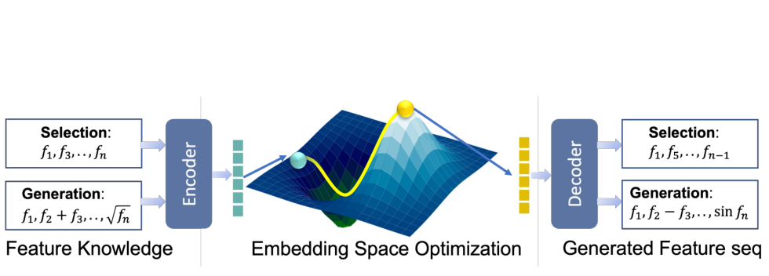
Generative feature selection
Encode experience. Search the learned space. Decode a candidate.
The predicted utility still needs real validation.
Ying et al., Figure 3, p. 4. Cropped reproduction, CC BY 4.0.
06
Notes:
The generative approach changes how the system searches. Instead of considering only separate discrete candidates, it learns a continuous representation of feature-engineering experience.
Figure 3 is the key diagram. First, an encoder maps observed feature selections or transformations into an embedding space. An evaluator estimates how useful a candidate representation might be. A decoder turns a representation back into a concrete feature choice or sequence.
The intuition is that previous attempts contain reusable information. A learned representation might help the system propose better candidates without exploring every possible combination separately.
Section 4.1 reviews an encoder–decoder–evaluator approach that uses reinforcement learning to collect selection experiences. It also discusses sequential generation using a transformer-based variational autoencoder.
An important distinction is that the evaluator predicts utility. It does not prove utility. A candidate that looks promising in the learned space still needs to be checked with the actual downstream task. Otherwise the search might exploit errors in its own evaluator.
SOURCE: Ying et al. (2025), arXiv:2502.08828v2. https://arxiv.org/abs/2502.08828v2
Figure credit: Wangyang Ying et al. (2025), Figure 3. Cropped. https://creativecommons.org/licenses/by/4.0/

Slide 7
Generative transformations and LLMs
Experience can guide new proposals
RL can collect transformation examples for a generative model.
Labels change the available feedback
Unsupervised methods can use graph-based objectives.
LLMs can propose transformations
Each proposal still needs semantic checks and task validation.
Paper: Section 4.2, p. 4.
07
Notes:
Section 4.2 applies related ideas to generating transformations. The paper describes an embedding, optimization, and generation process.
One direction uses reinforcement learning to gather useful examples of transformations, then uses a learned space to propose new ones. Another direction uses graph-based objectives when labels or repeated downstream evaluations are unavailable.
The section also discusses large language models. These can suggest feature transformations and refine suggestions using feedback. But a plausible suggestion is not automatically a useful feature.
For example, an LLM might suggest spending per month because it recognizes the meaning of the column names. We would still have to check the formula, handle missing values, and verify that all required inputs are available at prediction time.
In this paper, generative feature engineering should not be confused with simply generating more rows of training data. The focus is on proposing features and feature-engineering decisions.
SOURCE: Ying et al. (2025), arXiv:2502.08828v2. https://arxiv.org/abs/2502.08828v2

Slide 8
Tradeoffs and limits of the evidence
Approach | Potential benefit | Main concern
Reinforcement learning | Search guided by task feedback | Reward design and search cost
Generative methods | Proposals from learned experience | Evaluator quality and training cost
The survey offers a research map.
It reports no new common benchmark or quantitative ablation study.
Paper: Section 5, p. 5. Qualitative comparison.
08
Notes:
Section 5 compares performance, interpretability, adaptability, and automation.
RL can connect its decisions to feedback from the downstream task, but its search may be expensive and its behavior depends on the reward. Generative methods can organize search through a learned representation, but they depend on the quality of their experience data and learned models.
I would read these as qualitative tradeoffs. They are not universal guarantees that one family is faster, more accurate, or easier to understand.
There is also an evidence limitation: this survey does not present a new common benchmark table comparing every method under identical conditions. It does not report its own numerical ablation study either. So I will not give a percentage improvement that the paper does not establish. The useful contribution here is the organization of the research and the explanation of architectural choices.
SOURCE: Ying et al. (2025), arXiv:2502.08828v2. https://arxiv.org/abs/2502.08828v2

Slide 9
Proposed evaluation and ablations
Measure | Purpose
Task performance | Precision / recall / F1, or regression error
Search and inference cost | Check whether gains justify computation
Feature count and stability | Track complexity and variability across runs
Ablations
Learned vs. random search at the same budget
With vs. without a complexity penalty or generative stage
Keep the final test set outside all feature search and tuning.
Presenter analysis. These are proposed experiments, not reported results.
09
Notes:
To evaluate these ideas in practice, I would compare several feature pipelines while holding the downstream model and data splits fixed.
The comparison would include the original features, a simple feature-selection baseline, a few domain-informed transformations, and the advanced method. I would also compare learned search with random search using the same evaluation budget.
For classification, the metrics should match the application. In an imbalanced churn problem, accuracy alone could hide poor performance on customers who actually leave. Precision, recall, F1, and precision–recall analysis could give a clearer picture. For regression, measures such as mean absolute error or root mean squared error would be appropriate depending on the objective.
I would also record search time, training time, feature count, inference cost, and variability across runs.
An ablation means removing or changing one component to see what it contributes. For example, remove the feature-count penalty, or remove the generative stage from a combined system. Does the added component justify its cost?
These are proposed experiments. I have not run them for this review, and they are not results from the survey. The final test data must stay out of feature search and tuning, and learned transformations must be fitted within the training data of each validation split.
SOURCE: Ying et al. (2025), arXiv:2502.08828v2. https://arxiv.org/abs/2502.08828v2

Slide 10
Practical lessons
A simple baseline sets the standard
Advanced search should earn its cost through reproducible gains.
Every feature needs a traceable definition
Record source columns, formulas and handling of unusual values.
Automated proposals still need judgment
Check meaning, availability at prediction time and generalization.
Paper: Sections 6–9, pp. 5–7. Final interpretation is presenter analysis.
10
Notes:
The later sections discuss practical strategies and open challenges. The recommendations include starting simple, incorporating domain knowledge, validating new features, and considering computational constraints.
For me, the most useful implementation lesson is to keep every transformation traceable. If a generated feature helps, I want to know its source columns, formula, and behavior on missing or unusual values. I also want to know whether its required inputs will exist when the system is deployed.
Section 7 discusses choosing between RL and generative methods, including hybrid approaches. I would treat that guidance as a starting point for experiments, rather than a strict rule that a particular dataset always requires one family.
Section 8 identifies challenges around automation, interpretability, privacy, efficiency, and combining multiple data types. These remind us that improving a validation score is only one part of building a useful system.
For traditional-method context, I also consulted the broader 2025 survey by Dongjie Wang and colleagues, titled Towards Data-Centric AI. It covers conventional feature selection and generation alongside advanced approaches. The two surveys share authors, so I do not treat them as independent proof of the same performance claims.
My conclusion is that feature engineering itself can become a learning problem. RL explores decisions using feedback, while generative methods learn representations that help propose new decisions. They can also work together.
The practical question is whether those proposals produce reproducible improvements over simpler alternatives at an acceptable cost. That is what I would test before choosing an advanced pipeline. Thank you.
SOURCE: Ying et al. (2025), arXiv:2502.08828v2. https://arxiv.org/abs/2502.08828v2

Slide 11
References
Main survey
Ying et al. (2025)
A Survey on Data-Centric AI: Tabular Learning from
Reinforcement Learning and Generative AI Perspective
https://arxiv.org/abs/2502.08828v2
Supporting survey
Wang et al. (2025)
Towards Data-Centric AI: A Comprehensive Survey of Traditional,
Reinforcement, and Generative Approaches for Tabular Data Transformation
https://arxiv.org/abs/2501.10555
Figures: Ying et al., CC BY 4.0. Overlapping authorship between the surveys.
11
Notes:
Main source: Ying et al. (2025), arXiv:2502.08828v2. https://arxiv.org/abs/2502.08828v2
Supporting source: https://arxiv.org/abs/2501.10555
Figures 2(a), 2(b), 3: cropped reproductions under https://creativecommons.org/licenses/by/4.0/
Both sources are cited as arXiv surveys. They share authors and are not independent experimental corroboration.

