Slide 1
Online Retail II
Sales Trends & RFM Customer Segmentation
YBS405 Big Data Management · Piri Reis University
Ahmet Salih Ağaç (20230305058)

Slide 2
Problem & Research Questions
How can a large online-retail transaction log be turned into decisions on stock, marketing and customers?
• RQ1 – How does revenue develop over time? Is there seasonality?
• RQ2 – Which products and countries drive revenue?
• RQ3 – When (day / hour) are orders placed?
• RQ4 – How big is the cancellation problem?
• RQ5 – Who are the most valuable customers (RFM) and how well are they retained (cohorts)?
YBS405 Big Data Management · Online Retail II
2

Slide 3
Dataset: UCI Online Retail II
• Source: UCI Machine Learning Repository (Chen, 2019) – public & citable
• UK online gift-ware retailer, many wholesale customers
• Period: 01.12.2009 – 09.12.2011 · 1,067,371 raw rows · 2 Excel sheets (45 MB)
• 8 attributes: Invoice, StockCode, Description, Quantity, InvoiceDate, Price, Customer ID, Country
• Tools: Python · pandas · matplotlib · seaborn · Jupyter · Parquet · GitHub
YBS405 Big Data Management · Online Retail II
3

Slide 4
Data Cleaning Pipeline
Raw data (2 sheets merged)
1,067,371
Why?
• Cancellations ('C' invoices) kept separately for their own analysis
• Postage, bank charges and adjustments are not products
• 22.8% of rows have no Customer ID → used for sales but not for customer analysis
• Excel → Parquet cache: 2 min → < 1 s load
Exact duplicate rows removed
1,033,036
Cancellation invoices separated
1,013,932
Non-positive quantity removed
1,010,539
Non-positive price removed
1,007,913
Non-product stock codes removed
1,003,417
of which with Customer ID (used for customer analysis)
776,579
YBS405 Big Data Management · Online Retail II
4

Slide 5
At a Glance
£19.6M
39,516
5,852
4,731
Total revenue
Orders
Identified customers
Products
43
£301
86%
17.3%
Countries
Median order value
Revenue from UK
Invoices cancelled
YBS405 Big Data Management · Online Retail II
5

Slide 6
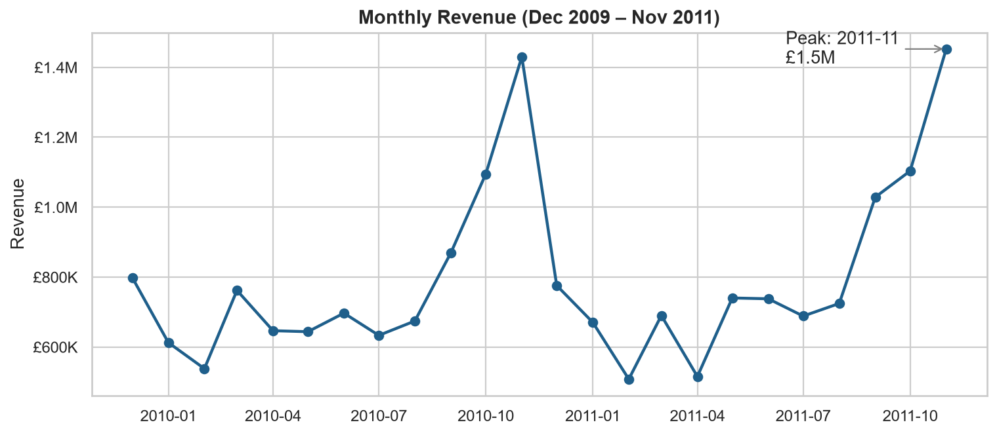
RQ1 · Revenue Is Strongly Seasonal
Key takeaways
• Peak in 2011-11: £1.5M
• Sep–Nov = 37% of revenue
• 2011 vs 2010 (Jan–Nov): +3.0%
• Wholesalers stock up for Christmas
YBS405 Big Data Management · Online Retail II
6

Slide 7
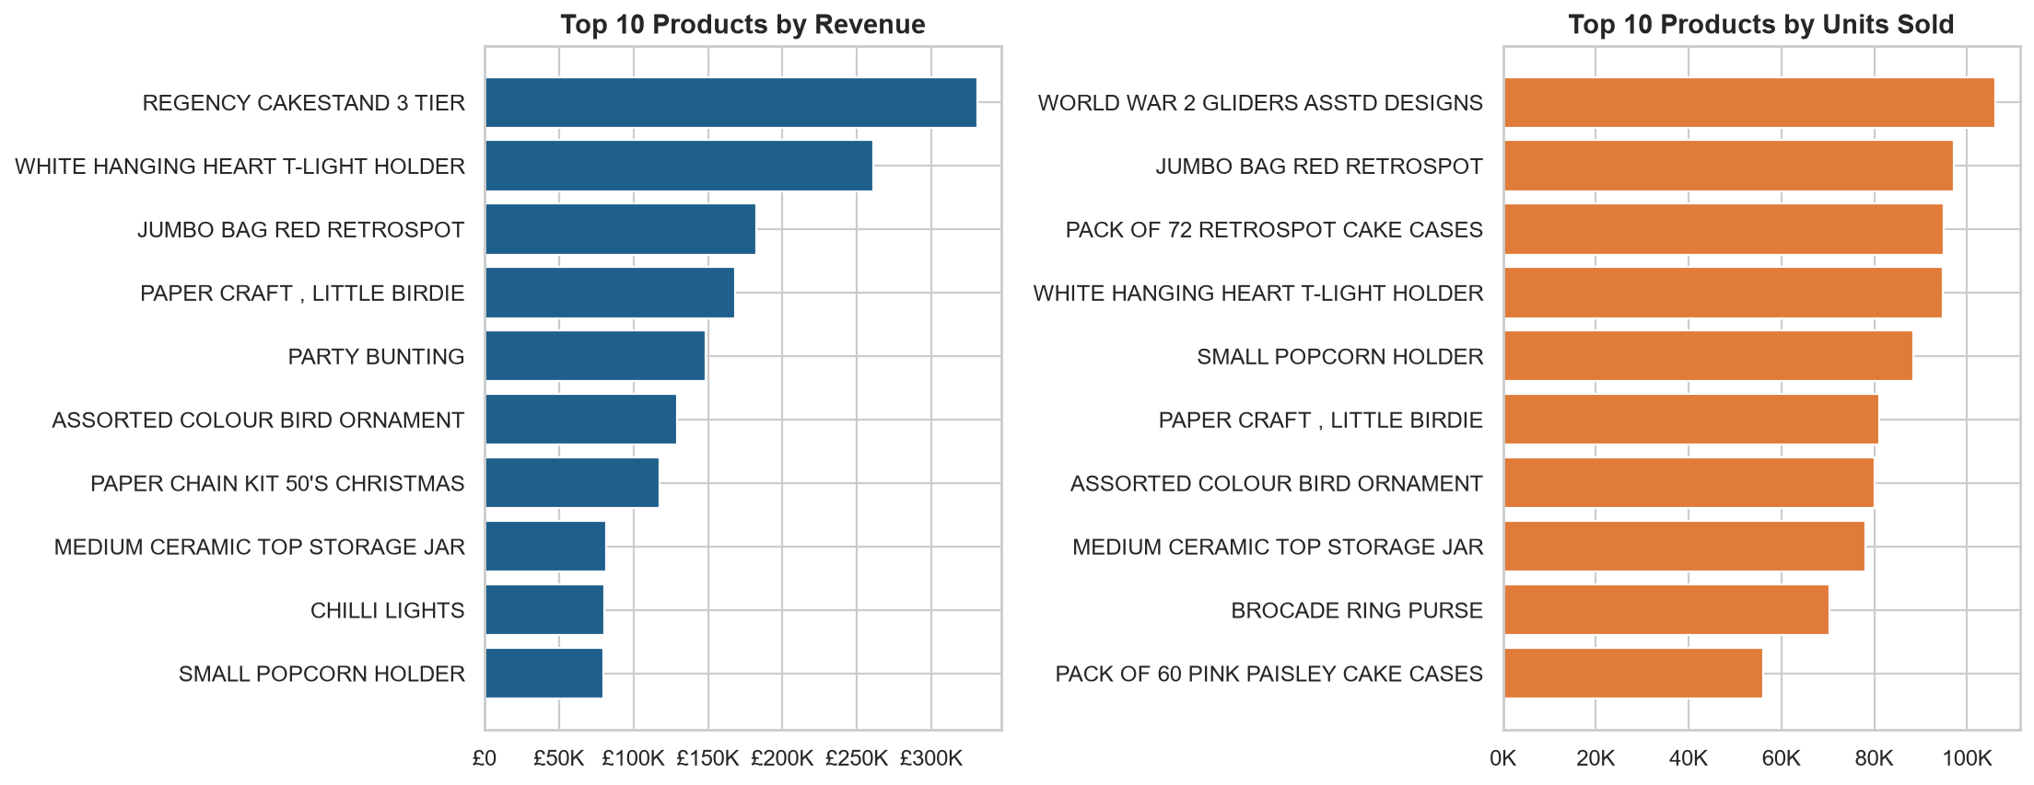
RQ2 · Top Products
Key takeaways
• #1 by revenue: Regency Cakestand 3 Tier
• Top 100 of 4,731 products = 29% of revenue
• Cheap small items lead units; decorative items lead revenue
YBS405 Big Data Management · Online Retail II
7

Slide 8
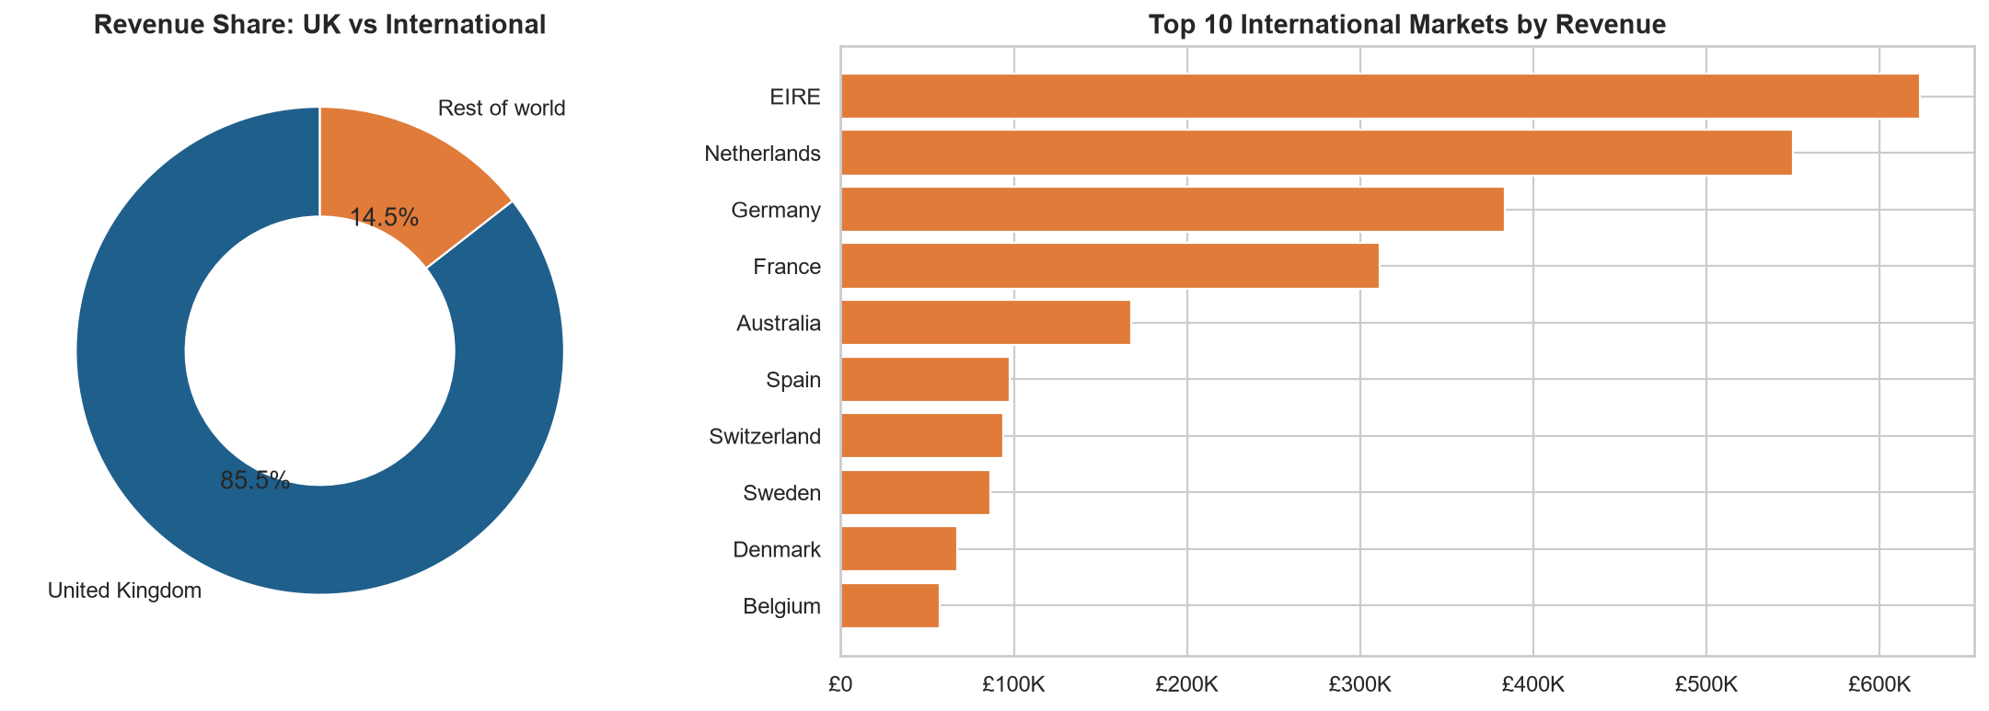
RQ2 · Countries
Key takeaways
• UK = 86% of revenue
• Top foreign markets: EIRE, Netherlands, Germany
• Europe = growth opportunity
YBS405 Big Data Management · Online Retail II
8

Slide 9
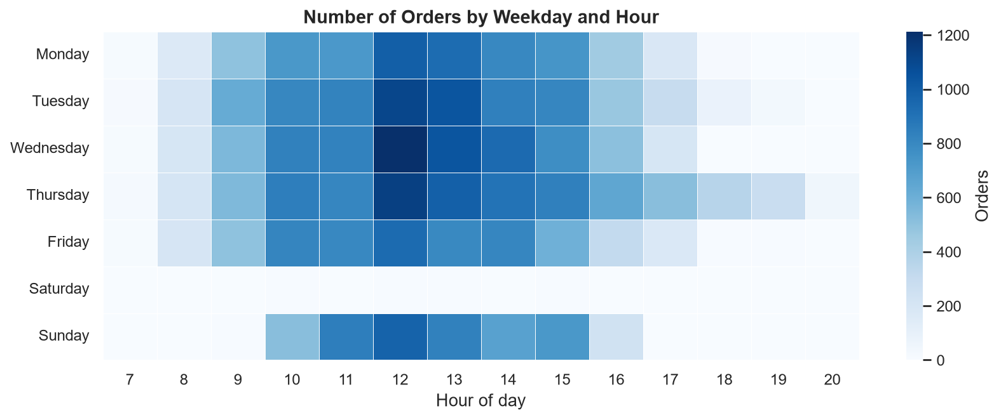
RQ3 · When Do Customers Order?
Key takeaways
• Busiest day: Thursday
• Peak hour: 12:00
• Saturday: only 30 orders in 2 years
• B2B pattern → plan campaigns for weekday mornings
YBS405 Big Data Management · Online Retail II
9

Slide 10
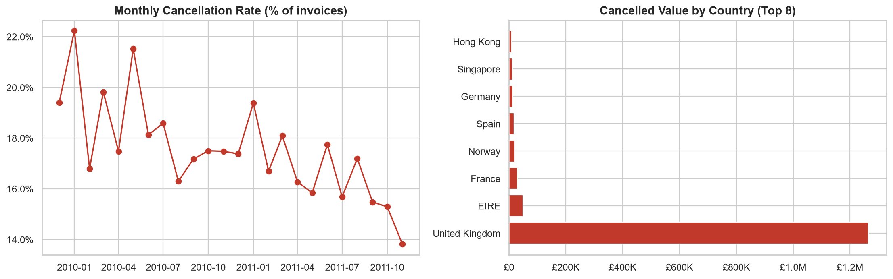
RQ4 · Cancellations
Key takeaways
• 8,292 cancelled invoices (17.3%)
• Cancelled value: £1.5M
• Rate decreasing during 2011
YBS405 Big Data Management · Online Retail II
10

Slide 11
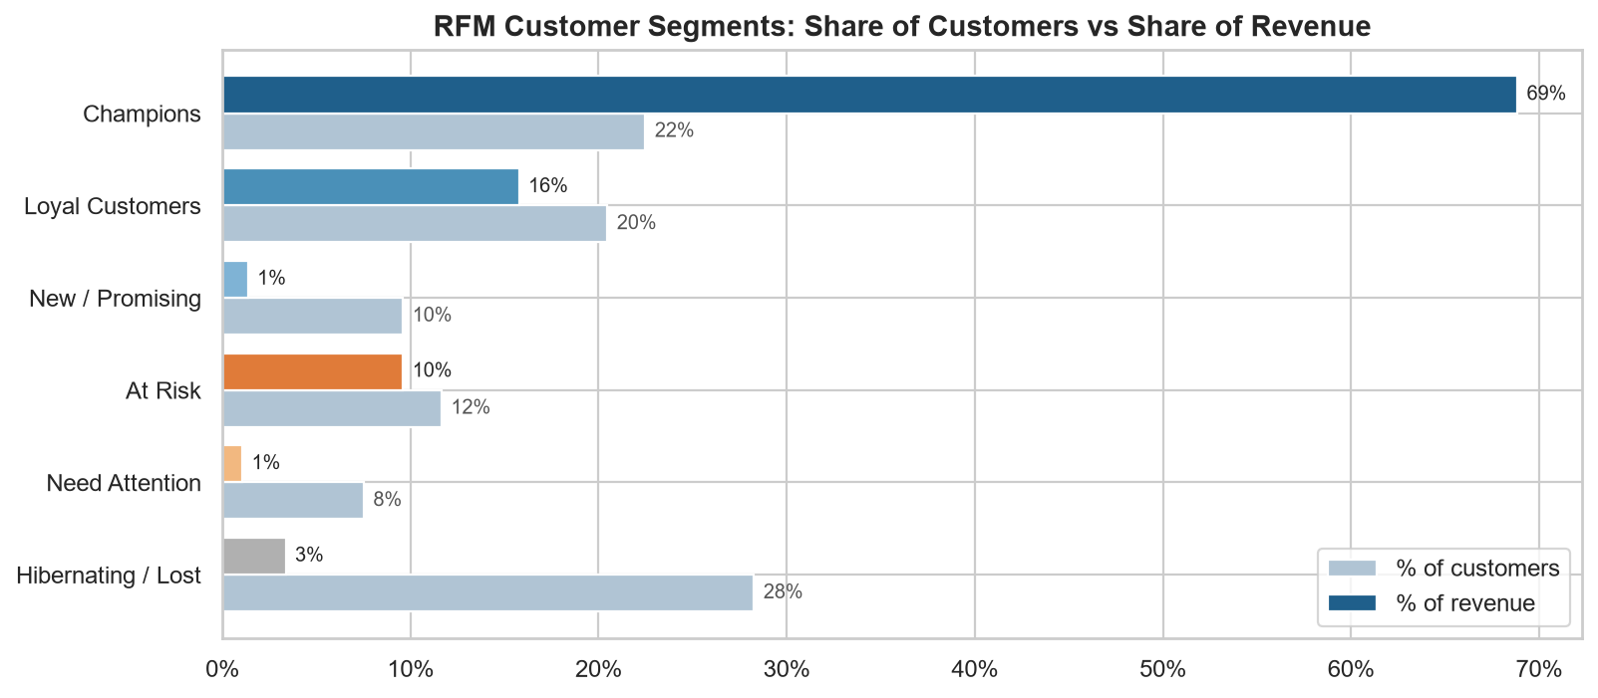
RQ5 · RFM Customer Segments
Key takeaways
• Top 20% of customers = 77% of revenue
• Champions: 22% of customers → 69% of revenue
• At Risk: 682 valuable customers going silent
• 28% bought only once
YBS405 Big Data Management · Online Retail II
11

Slide 12
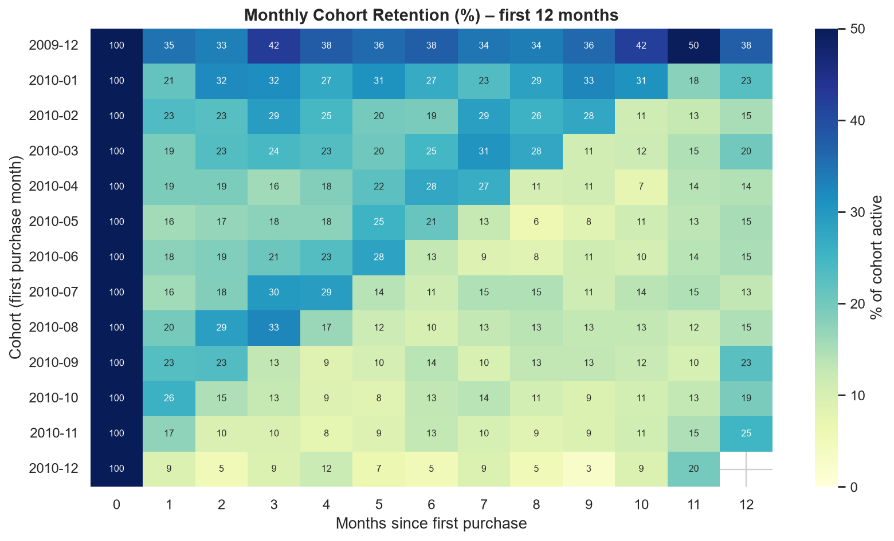
RQ5 · Customer Retention (Cohorts)
Key takeaways
• Only ~19% of new customers return in month 1
• Retention settles at 10–20%
• Dec 2009 cohort contains pre-existing customers
• Customers come back next Christmas (months 10–12)
YBS405 Big Data Management · Online Retail II
12

Slide 13
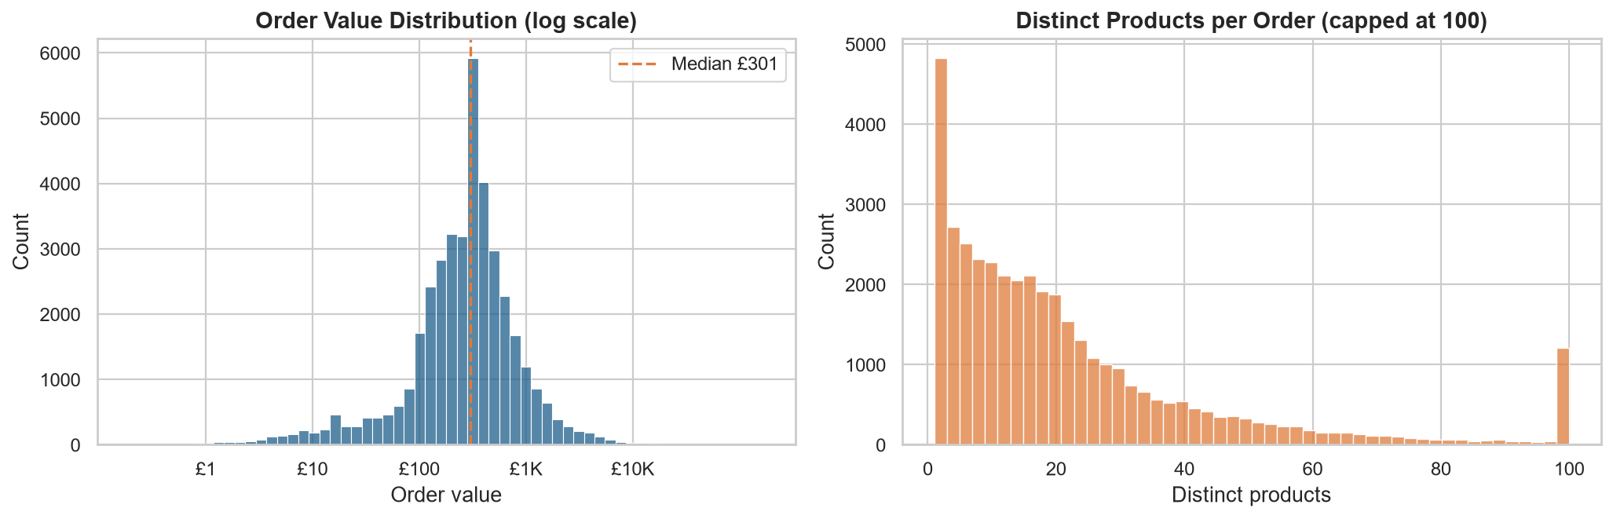
Order Value & Basket Size
Key takeaways
• Median order £301, mean £497
• Median 15 distinct products per order
• 8.6% of orders > £1,000 → wholesalers
YBS405 Big Data Management · Online Retail II
13

Slide 14
Conclusions & Recommendations
What we found
What the retailer should do
• Stable but highly seasonal business (Q4 peak)
• Revenue concentrated: UK market & top 20% customers
• B2B ordering pattern (weekdays, midday)
• High cancellation rate, slowly improving
• Weak new-customer retention
• Start Q4 stock & campaigns in August
• Loyalty / key-account programme for Champions
• Win-back campaign for 'At Risk' customers
• First-month follow-up offers for new customers
• Analyse root causes of cancellations
• Grow in Ireland, Netherlands, Germany, France
YBS405 Big Data Management · Online Retail II
14

Slide 15
Limitations & Project Links
• Single retailer, 2009–2011 → limited generalisability
• No profit/cost or product category data
• Customer analysis only for rows with a Customer ID (77%)
• GitHub: https://github.com/salihgac/ybs405-online-retail-analysis
• Notebook: notebooks/analysis.ipynb · Code: src/ · Figures: figures/
YBS405 Big Data Management · Online Retail II
15

Slide 16
Thank you! Questions?
Dataset: Chen, D. (2019). Online Retail II. UCI Machine Learning Repository. doi:10.24432/C5CG6D

