Slide 1
01
Executive Compare
DyeFlow
RS
Project input and KPI comparison
Baylase RP System | 13 May 2026
Baylase RP System
Standard washing
Tanatex | After Washing
Tanatex | After Washing
●
COST/KG
☁
CO₂/KG
◊
WATER/KG
●
COST/KG
☁
CO₂/KG
◊
WATER/KG
€0.354
364
48.0
€0.419
439
54.0
g/kg
L/kg
g/kg
L/kg
VS
Fabric
500
Fabric
500
Flote
8
Flote
8
Machine
600A
Machine
600A
Heating
Natural Gas
Heating
Natural Gas
DyeFlow
RS
Smart Process. Lower Cost. Better Future.
Page 1

Slide 2
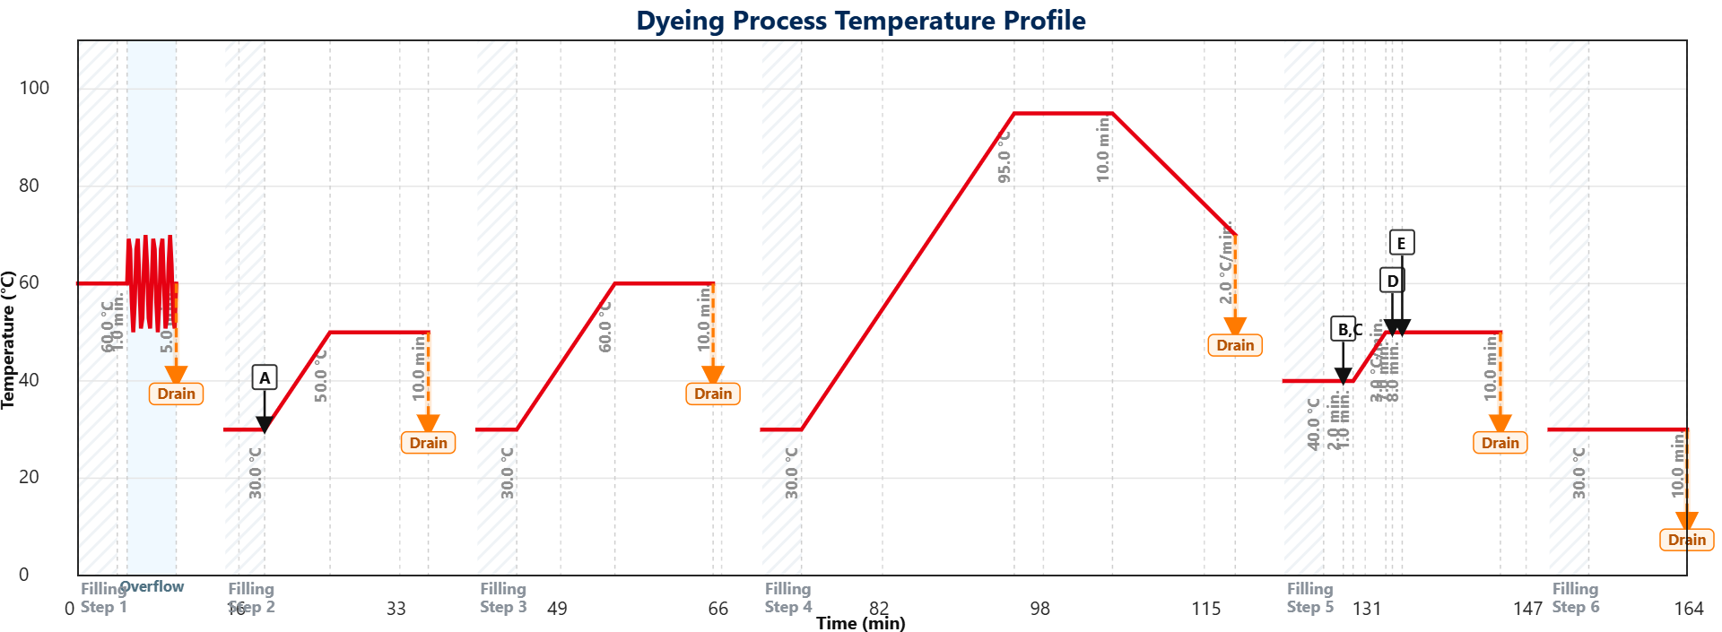
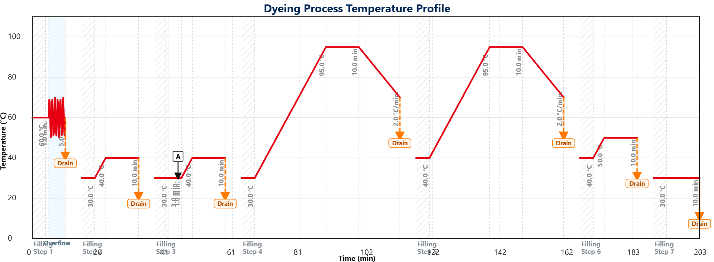
02
Process Graph Compare
DyeFlow
RS
Two process graphs side by side with chemical legends
Baylase RP System | 13 May 2026
CHEMICALS – PROJECT 1
CHEMICALS – PROJECT 2
A
Acetic Acid
B
Acetic Acid
C
Baylase Assist RP
A
Acetic Acid
D
pH Check
E
Baylasse RP
DyeFlow
RS
Smart Process. Lower Cost. Better Future.
Page 2

Slide 3
03
Cost Delta Dashboard
DyeFlow
RS
Batch and kg-based cost comparison
Baylase RP System | 13 May 2026
TOTAL COST/KG
HEATING/KG
ELECTRICITY/KG
P1 0.354
P2 0.419
P1 0.221
P2 0.265
P1 0.018
P2 0.023
+18.4%
Better: P1
+19.9%
Better: P1
+27.8%
Better: P1
WATER/KG
LABOUR/KG
CHEMICAL/KG
P1 0.048
P2 0.054
P1 0.019
P2 0.023
P1 0.000
P2 0.000
+12.5%
Better: P1
+21.1%
Better: P1
0.0%
Equal
Executive Decision
Project 1 shows the better total cost per kg in this comparison. Use the delta cards above to identify which utility or cost driver creates the difference.
DyeFlow
RS
Smart Process. Lower Cost. Better Future.
Page 3

Slide 4
04
Carbon Intelligence Compare
DyeFlow
RS
Batch and kg-based environmental comparison
Baylase RP System | 13 May 2026
TOTAL CO₂/KG
ELECTRICITY CO₂/KG
HEATING CO₂/KG
P1 364
P2 439
P1 45.3
P2 57.2
P1 318
P2 382
+20.8%
Better: P1
+26.2%
Better: P1
+20.0%
Better: P1
ENERGY/KG
WATER/KG
TIME
P1 0.108
P2 0.136
P1 48.0
P2 54.0
P1 169
P2 208
+25.9%
Better: P1
+12.5%
Better: P1
+23.2%
Better: P1
Sustainability Insight
Project 1 shows the better CO₂ intensity per kg. The comparison separates electricity, heating, energy and water impacts for management review.
DyeFlow
RS
Smart Process. Lower Cost. Better Future.
Page 4

