Slide 1
01
Executive Summary
DyeFlow
RS
DyeFlow RS
Baylase RP System | 13 May 2026
●
TOTAL COST
◷
TOTAL TIME
⚡
ENERGY
PROJECT INFORMATION
MACHINE INFORMATION
€177
169
0.11
Process
After Washing
Machine
600A
0.354 €/kg
min
kWh/kg
Fabric
500 kg
Capacity
600 kg
◊
WATER
☁
CO₂ EMISSION
⚗
CHEMICAL COST
Flote
8
Drain Time
5 min
48.0
182
€0.0
Heating
Natural Gas
L/kg
kg/batch | 364 g/kg
0.000 €/kg
Pump Power
24 kW
Currency
EUR
Reel Power
2.2 kW
Carry Over
2 %
Fabric Status
Dry
Total Power
28.2 kW
⚙ INSIGHT
This process has a total cost of €0.354 per kg with 364 g CO₂ emission and 48.0 L water usage per kg.
DyeFlow
RS
Smart Process. Lower Cost. Better Future.
Page 1

Slide 2
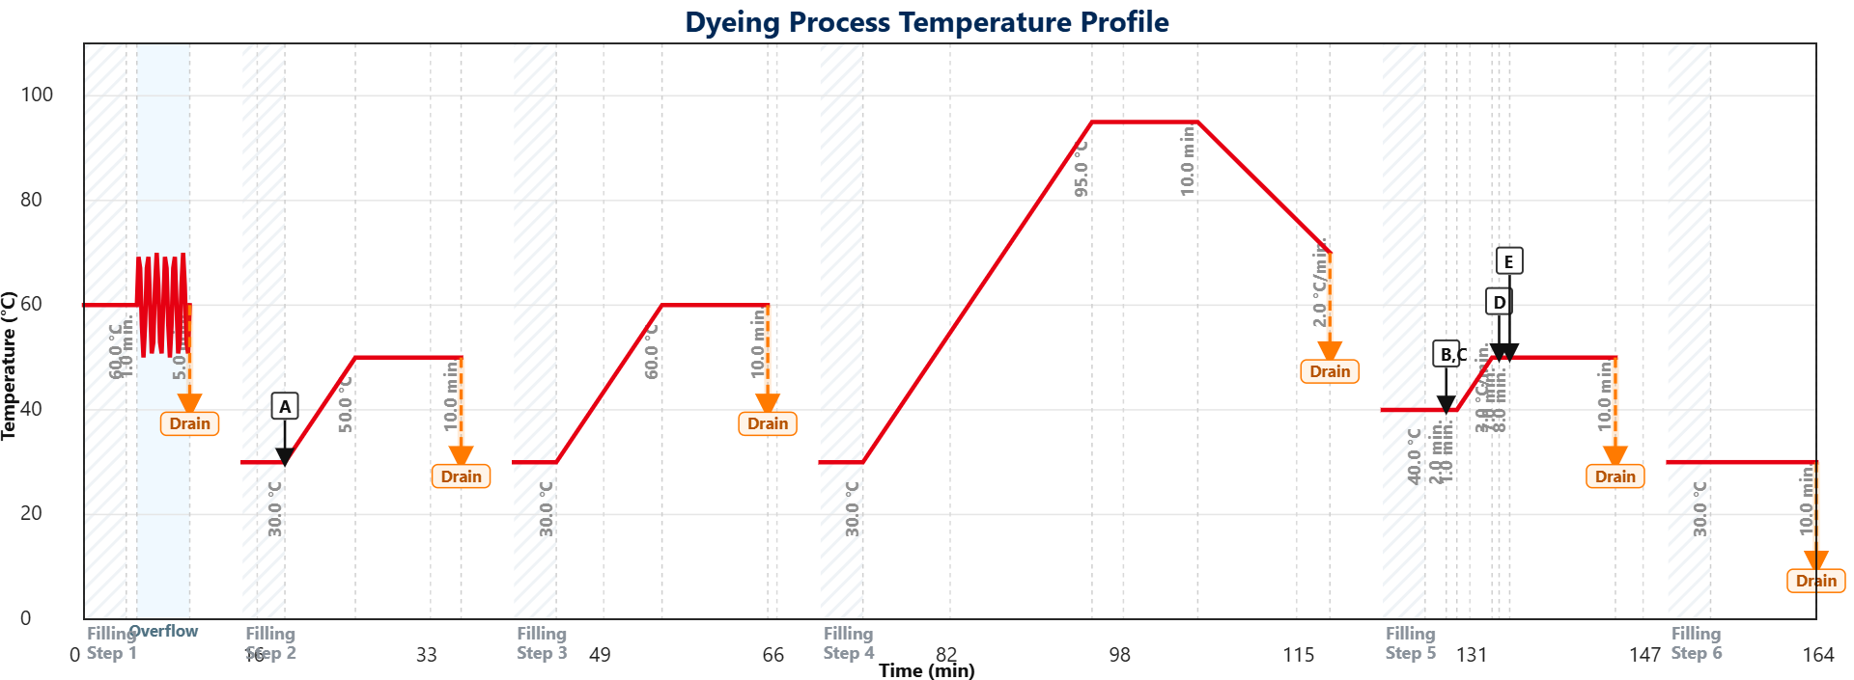
02
Process Timeline
DyeFlow
RS
Temperature & Chemical Dosing Profile
Baylase RP System | 13 May 2026
◊
1. FILLING
♨
2. HEATING
⟳
3. PROCESS
↘
4. COOLING
↓
5. DRAIN
✤
6. EXTRACTION
CHEMICAL LEGEND
A
Acetic Acid
B
Acetic Acid
C
Baylase Assist RP
D
pH Check
E
Baylasse RP
Total Cost €177
Time 169 min
Water 48.0 L/kg
CO₂ 364 g/kg
Energy 0.11 kWh/kg
DyeFlow
RS
Smart Process. Lower Cost. Better Future.
Page 2

Slide 3
03
Chemical Operations
DyeFlow
RS
Step by Step Chemical Dosing Summary
Baylase RP System | 13 May 2026
STEP
CHEMICAL
DOSAGE
UNIT
PRICE
COST IMPACT
A
Acetic Acid
1.60
g/l
0.00
€0.00
B
Acetic Acid
0.00
g/l
0.00
€0.00
C
Baylase Assist RP
1.00
g/l
0.00
€0.00
D
pH Check
0.00
g/l
0.00
€0.00
E
Baylasse RP
0.00
g/l
0.00
€0.00
⚗ TOTAL CHEMICAL COST
€0.00 / batch
0.000 €/kg
DyeFlow
RS
Smart Process. Lower Cost. Better Future.
Page 3

Slide 4
04
Cost & Utilities Dashboard
DyeFlow
RS
Batch & Per Kg Analysis
Baylase RP System | 13 May 2026
TOTAL COST / BATCH €177
TOTAL COST / KG €0.354
ENERGY / KG 0.11 kWh
WATER / KG 48.0 L
Batch Basis (Per Batch)
Key Takeaway
Heating
€110
Cost Structure
Heating is the major cost driver. Optimizing this component will deliver the highest savings potential.
Electricity
€9.18
Chemical
€0.00
Heating 62.4%
Water
€24.0
Electricity 5.2%
Chemical 0.0%
Waste
€24.0
Water 13.6%
Waste 13.6%
Labour
€9.38
Labour 5.3%
TOTAL €177
Per Kg Basis
Heating €0.221
Electricity €0.018
Chemical €0.000
Water €0.048
Waste €0.048
Labour €0.019
DyeFlow
RS
Smart Process. Lower Cost. Better Future.
Page 4

Slide 5
05
Sustainability & Carbon Footprint
DyeFlow
RS
Environmental Impact Overview
Baylase RP System | 13 May 2026
⚡
ELECTRICITY CO₂
♨
HEATING CO₂
☁
TOTAL CO₂
◊
WATER
22.7
159
182
24000
kg / batch
kg / batch
kg / batch | 364 g/kg
L / batch | 48.0 L/kg
Impact Distribution (Per Batch)
Electricity CO₂
12.5%
Heating CO₂
87.5%
Key Insight
This process generates 364 g CO₂ per kg and consumes 0.11 kWh energy and 48.0 L water per kg.
DyeFlow
RS
Smart Process. Lower Cost. Better Future.
Page 5

