Slide 1


Slide 2

Apple introducing new
i-Phone 10s PRO

Slide 3
Launching with
Latest Processor Snap Dragon 1103, 4.5GHZ
128 GB Internal Memory
32 GB RAM
3G/4G/5G, WIFI LTE
Nvidia Tegra 2GB GPU
6.5’’ Super-AMOLED Display

Slide 4

35 MP Dual Camera
Ultra HD, FHD, HD capturing
360 Panoramic
Noise reduction

Slide 5

VR Gaming Experience
Nvidia Tegra, 2.2 GHZ GPU
32 GB DDR4 RAM

Slide 6
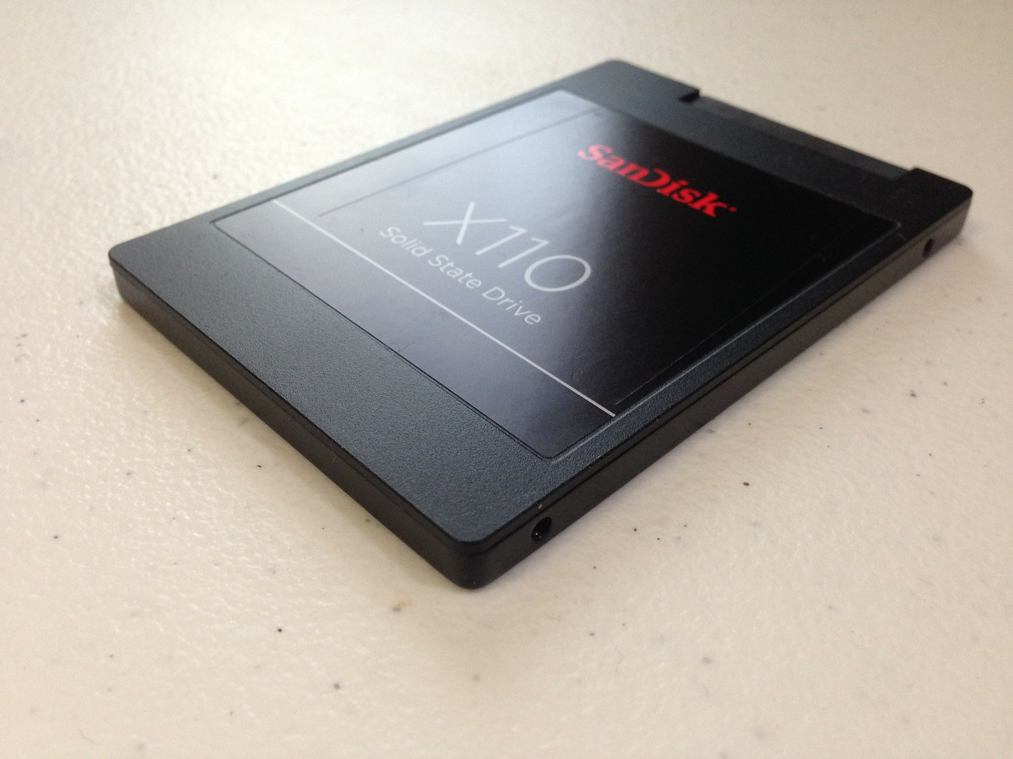
128 GB Storage Capacity
128 GB SSD
210-300 MB/S Read/Write Speed
5 year warrenty

Slide 7

All your favorite apps included
Image Editor
Text Editor, Word Processing
Printer support
Digital Painting

Slide 8

Stay Long
6000 mAh Li-I Battery
Turbo charging
3 day call backup
Power saving mode

Slide 9
6.5’ Ultra HD Display
1920 x 1028 Resolution
Multi-touch support
Latest Super-AMOLED technology
On-screen finger print scanner

Slide 10
Running on Latest ios olive 2.0 OS
Split-screen support
Dual workspace
Multi user
More SECURED

Slide 11

All at $455 only
Everything
Available at
$455

Slide 12
All at $455 only
Thank
YOU

Slide 13


All at $455 only

