Slide 1
Recommendation SYSTEMS for Soccer Transfers by Salih Kilicli

Slide 2
PROBLEM STATEMENT
Given a team and a player who is about to leave the team, how can we find the best replacement with given restrictions:
Age
Salary
Transfer\Loan Cost
Time constraint (transfer seasons)
etc.

Slide 3
The need
Soccer clubs spend millions to transfer the most skilled players
(transfer fees have increased exponentially within the last decade)
Only teams with large amounts of revenue can afford players with high transfer fees and salaries
COVID-19 and the resulting recession have drastically affected team revenues (games are postponed but salaries are still paid)
Players are protected under strict FIFA rules and teams cannot layoff their players unless they pay the full amount of the contract

Slide 4
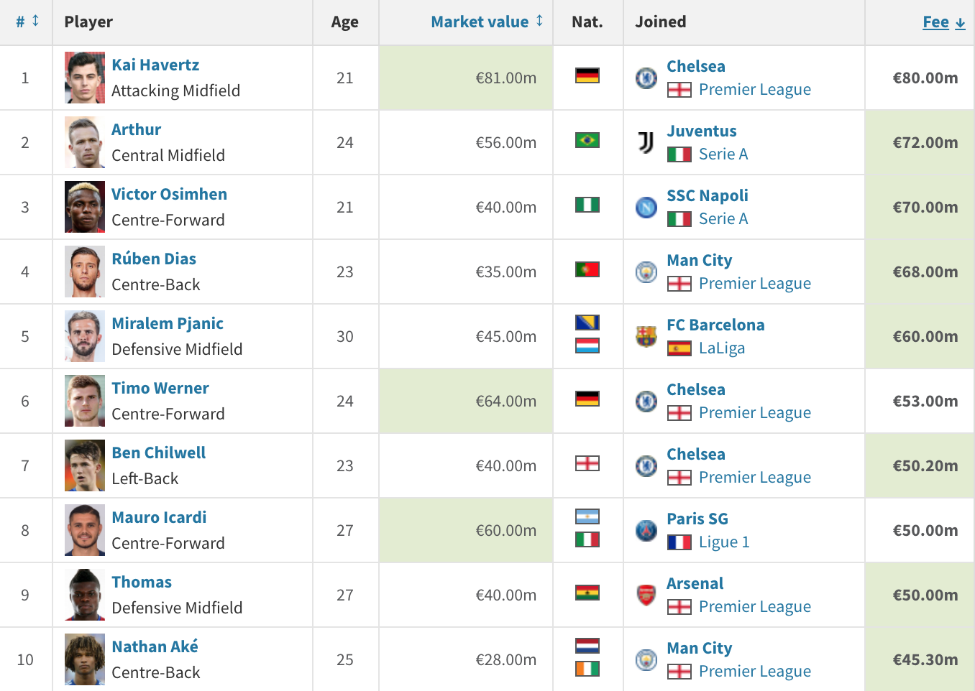
Current season - most expensive 10 transfers
Total : € 598.5 M
~ $ 708.68 M

Slide 5
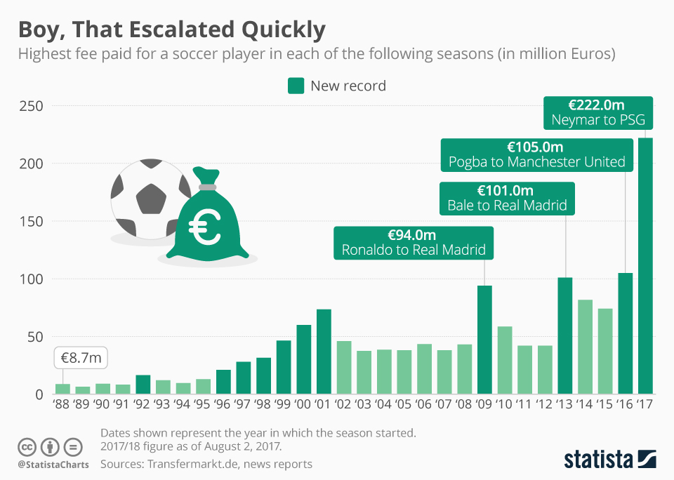
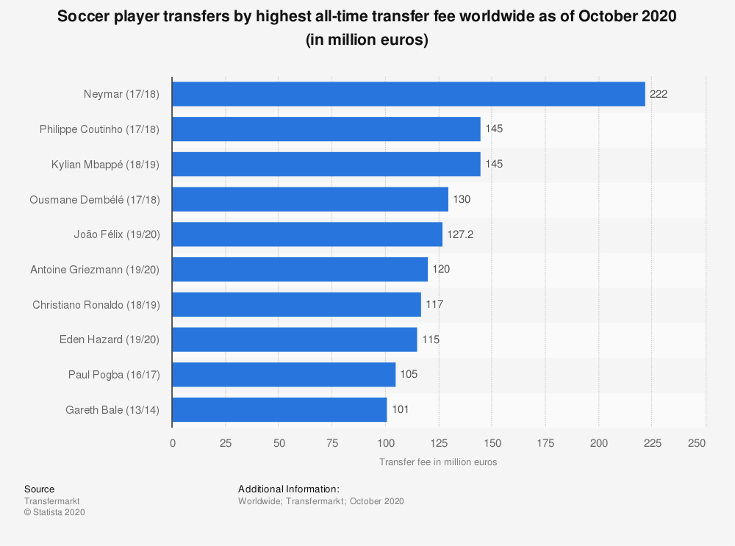
Change in the record transfer fees

Slide 6
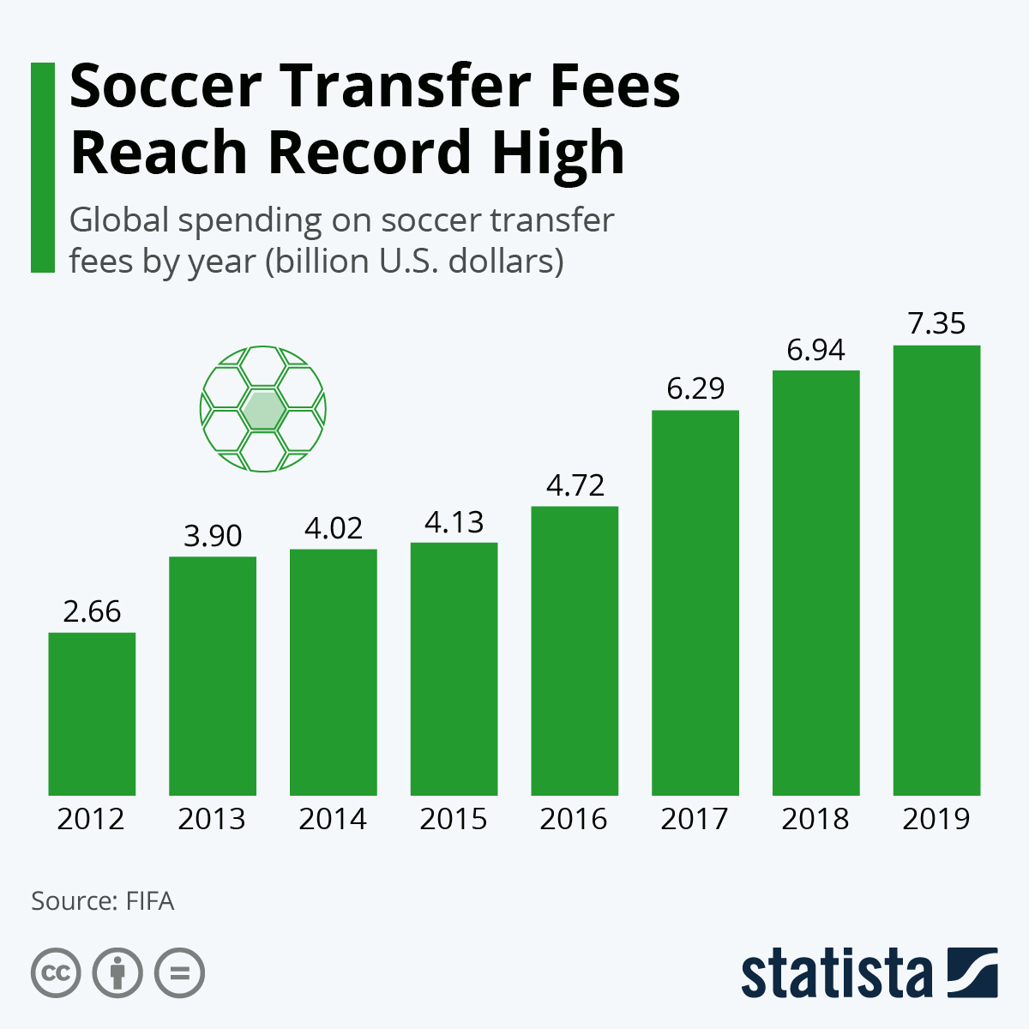
Change in the total money spent on transfers

Slide 7
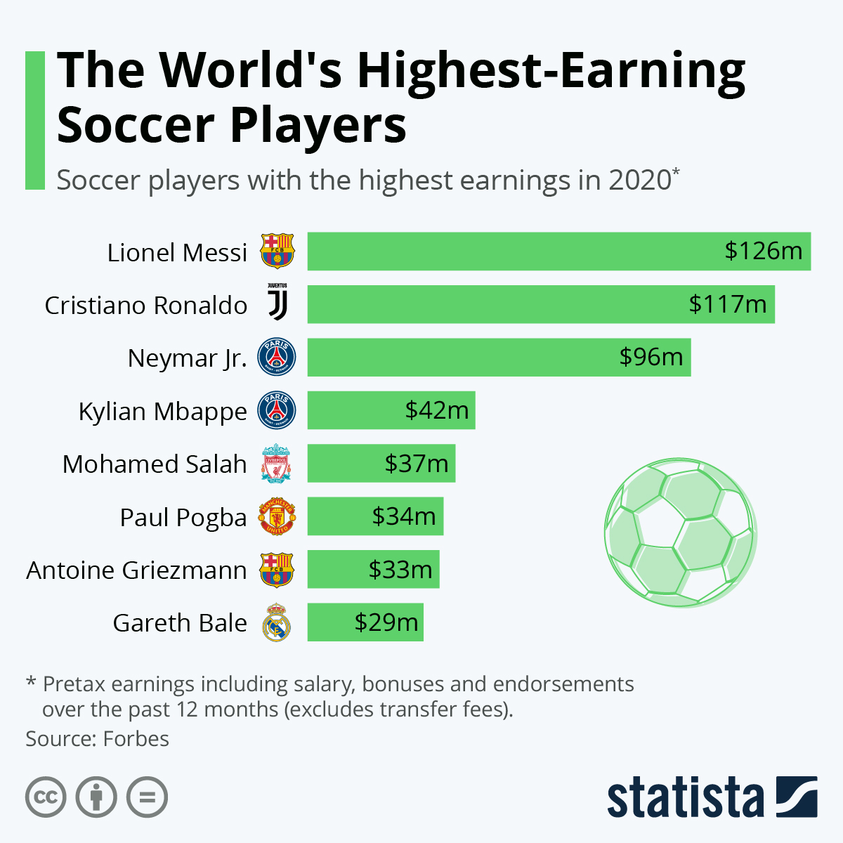

Slide 8
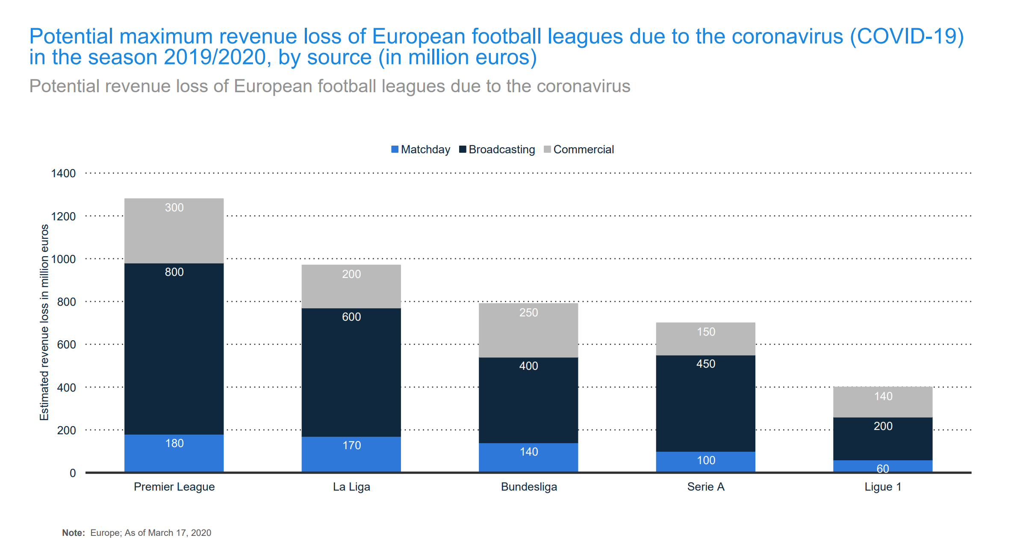

Slide 9
Example
So, now let’s imagine Chelsea FC got an offer too good to refuse for N’Golo Kante in the Winter 2021 transfer season.
The club is trying to find a good replacement for N’Golo Kante, but they have limited time and resources as the end of the transfer season approaches.
Moreover, there are a lot of uncertainty due to COVID19, and revenues are plummeting.
Some of the options in hand:
Contact scouts to watch players that can replace Kanté
Contact management agencies to find players with similar skillset

Slide 10
MAIN PITFALLS
Scouting is often time consuming, and currently impractical
Agent fees have skyrocketed within the last decades

Slide 11
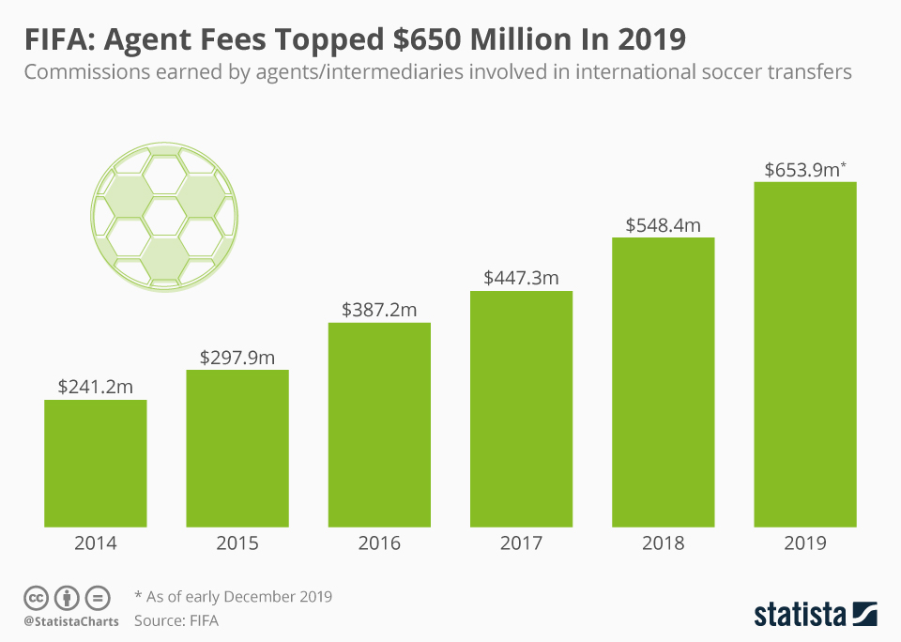
Recent exponential growth in Agent fees

Slide 12
Proposal
Utilize Artificial Intelligence and Machine Learning algorithms to reduce the time and capital constraints
Recommendation systems can be used to help soccer clubs, or scout teams to reduce the eligible options and find an optimal replacement

Slide 13
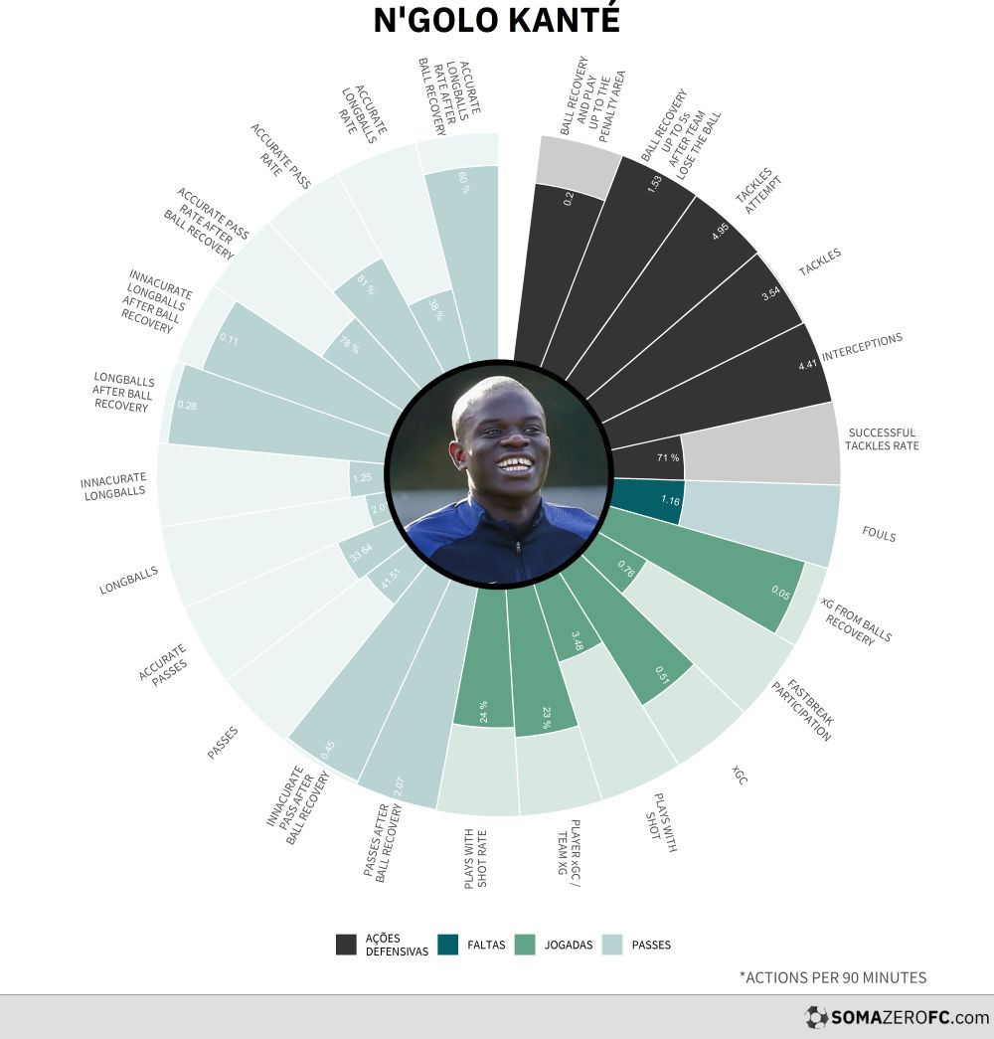
Example visualizations

Slide 14
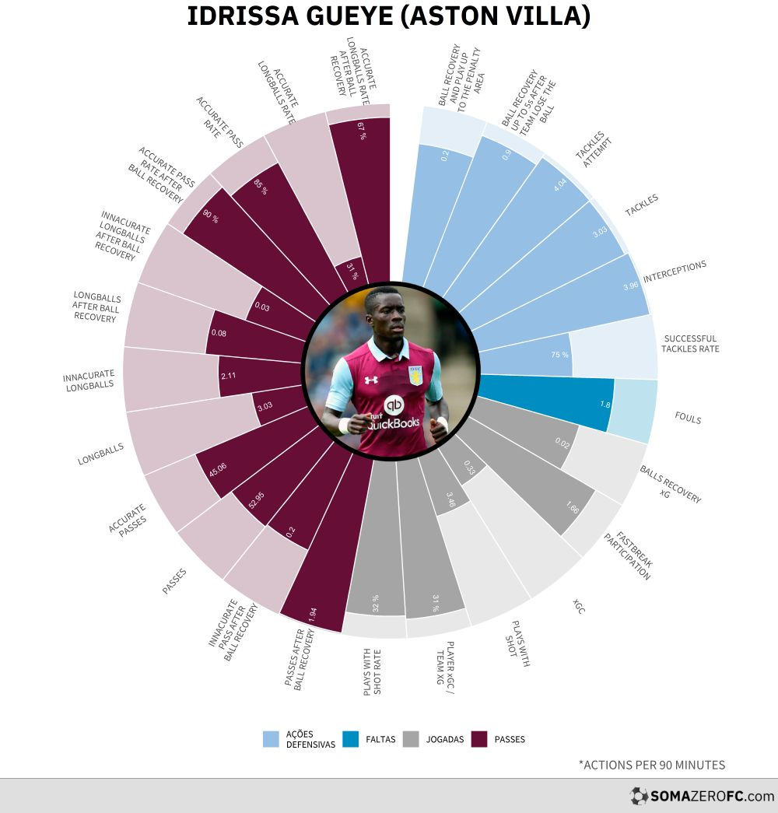
Possible replacement 1

Slide 15
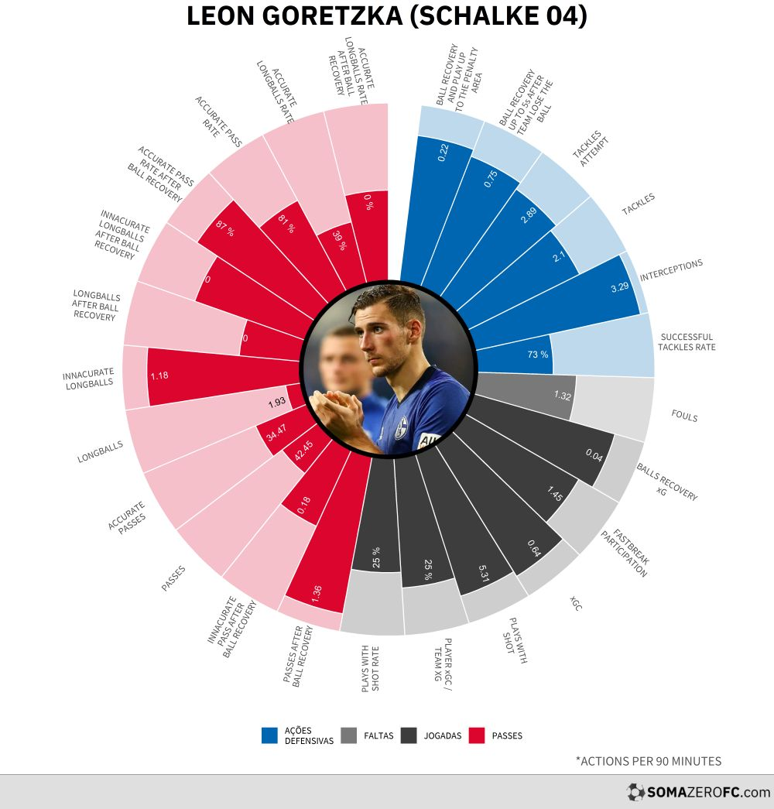
Possible replacement 2

Slide 16
Ultimate Goal
Create a website using Heroku app and one of the state-of-the-art data visualization dashboards such as Dash, Streamlit, etc.
Rank similar players depending on given constraints, such as:
Age
Salary
Transfer/Loan Cost
Etc.
Example player skills comparison: Messi vs Ronaldo (by Salih)

Slide 17
Thank you for listening!
References
1) https://www.statista.com/
2) https://www.somazerofc.com/
3) https://www.instagram.com/somazerofc/
4) https://www.transfermarkt.com/statistik/saisontransfers

