Slide 1

GYRO
A Dapp for Public Transportation

Slide 2
PROBLEM STATEMENT
Despite being extremely prevalent, the availability and accessibility of public transport remains chaotic and a problem.
Even the tracking of these vehicles is disorganized hence posing safety risks and maintenance issues.

Slide 3
OUR SOLUTION
GYRO, A Decentralized application or a Dapp, provides you an efficient and streamlined interface to access the public transportation. Our dapp basically organizes the whole management of these public transportation vehicles like buses, auto, e-rickshaws etc.

Slide 4

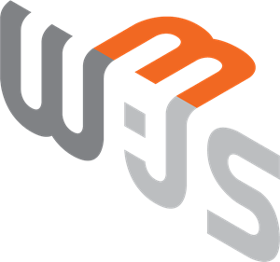


TECH STACK

