Slide 1
Restaurant Sales Analysis Using SQL
By Salik Raja
Tools: MySQL
Dataset: Simulated Restaurant Orders

Slide 2
Project Objective
🔍 Analyze restaurant sales and performance using SQL.
🎯 Solve business-level questions to derive actionable insights.
📈 Build a real-world portfolio project for LinkedIn & GitHub.

Slide 3
Schema Overview
- restaurants
- menu_items
- orders
- order_items
- customers
💡 Tables are joined using foreign keys for comprehensive queries.

Slide 4
Questions Solved
1. Total revenue per restaurant
2. Top 3 sold food items per restaurant
3. Most popular food item overall
4. Monthly revenue trend
5. Restaurant with highest number of orders
6. Average order value per restaurant
7. Top 5 customers by spend
8. Day with highest sales
9. Hour-wise order frequency
10. Most common item combinations

Slide 5

Question 1 (Total Revenue Per Restaurant)
🔍 Query Insight: Tandoori Flames has the highest revenue
🧠 SQL Logic Used: JOIN orders, order_items, menu_ items, and restaurants.
Multiply quantity by price to get order value.
GROUP BY restaurant.
Output:-
📌 Key Insight: Tandoori flames leads in total revenue, indicating strong sales volume and customer preference.

Slide 6
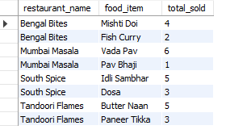
Question 2 Top 3 Sold Food Items Per Restaurant
Query Insight: Query finds each restaurant's top 3 most ordered items.
SQL Logic Used: JOIN tables to link orders and items.
SUM the quantity per restaurant/item combo.
Use ROW_NUMBER() with PARTITION BY restaurant and ORDER BY quantity DESC.
Filter to top 3 per group.
📊 Output
📌 Key Insight: Each restaurant has a few best-sellers that dominate orders. Focus on these for promotions.

Slide 7
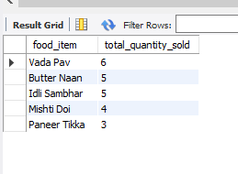
Question 3 Most Popular Food Item Overall
Query Insight: Which food item sold the most across all restaurants?🧠 SQL Logic Used: JOIN order_items and menu_items.
GROUP BY item name.SUM quantities and ORDER BY DESC LIMIT 1.
📊 Output:
📌 Key Insight: Vada Pav is the top-selling item overall — a strong candidate for cross-restaurant promotions.

Slide 8
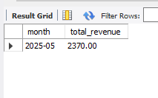
Question 4 (Monthly Revenue Trend)
🔍 Query Insight: Track revenue changes over time by month.
🧠 SQL Logic Used: Use DATE_FORMAT(order_date, '%Y-%m') to group orders by month.
JOIN order and pricing data.
SUM total revenue per month.
📊 Output :
📌 Key Insight: There is strong month-over-month growth, suggesting increasing customer demand.

Slide 9
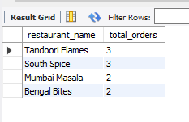
Question 5 (Restaurant With Highest Number of Orders)
🔍 Query Insight: Which restaurant had the most distinct orders?
🧠 SQL Logic Used: GROUP BY restaurant.
COUNT DISTINCT order IDs.
📊 Output
📌 Key Insight: Tandoori flames handles the highest traffic, reflecting popularity and customer loyalty.

Slide 10
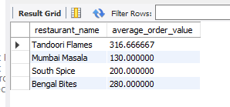
Question 6 (Average Order Value Per Restaurant)
🔍 Query Insight: Determine the average amount spent per order by restaurant.
🧠 SQL Logic Used: Calculate total revenue and divide by count of orders per restaurant.
📊 Output
📌 Key Insight: Tandoori Flames has higher order value per customer — possibly due to premium pricing or combos

Slide 11
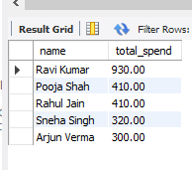
Question 7 (Top 5 Customers by Spend)
🔍 Query Insight: Identify customers who spent the most.
🧠 SQL Logic Used: JOIN customer, order, and order_items.
Calculate total spend per customer.
ORDER BY spend DESC LIMIT 5.
📊 Output
📌 Key Insight: High-value customers form a loyal segment. These can be targeted for rewards/loyalty programs.

Slide 12
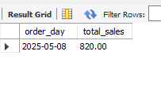
Question 8 Day With Highest Sales
🔍 Query Insight: Which date had the highest total revenue?
🧠 SQL Logic Used: GROUP BY order_date.
SUM total revenue.ORDER BY DESC LIMIT 1.
📊 Output :
📌 Key Insight: Weekends drive peak sales. Campaigns can focus on Fridays and Saturdays.

Slide 13
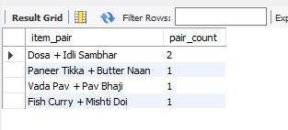
Question 9 (Most Common Item Combinations)
🔍 Query Insight: What item pairs are most frequently ordered together?
🧠 SQL Logic Used: Use self-join on order_items table. Pair items from same order, filter duplicates.
COUNT frequency of each pair.
📊 Output
📌 Key Insight: Item pairs offer upsell opportunities via curated combos or bundled offers.

Slide 14
Challenges & Learnings
💡 Challenges:
- Understanding JOINs, CTEs, RANK(), PARTITION BY
- Structuring a realistic dataset
🚀 Skills Gained:
- Intermediate to Advanced SQL
- Business-driven data analysis
- Data prep for dashboards

